Slide 1
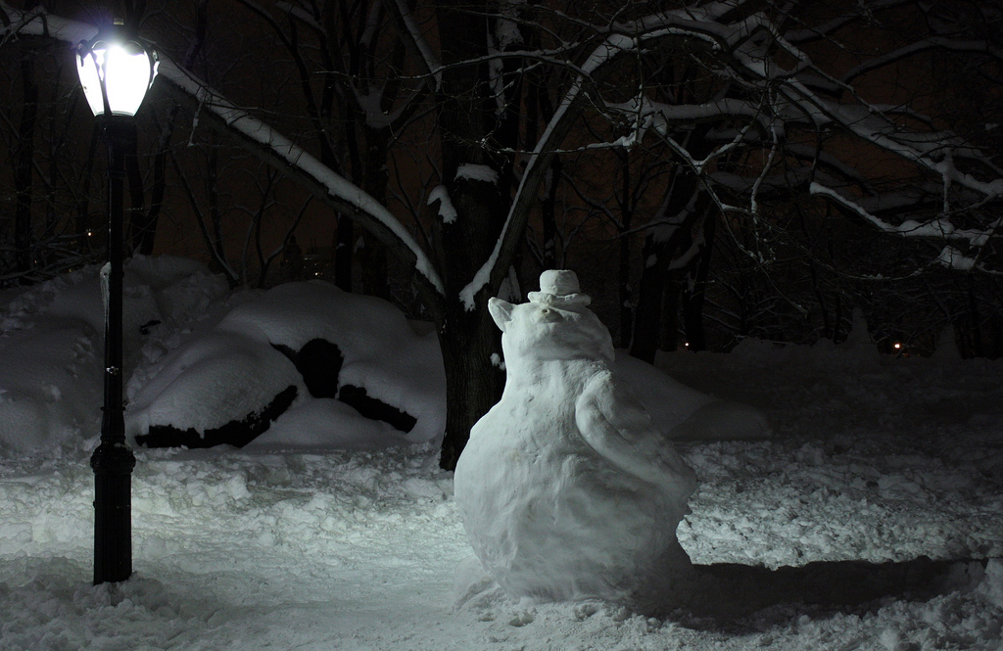

Describe a Setting
Write 5 sentences about:
What you can feel under your feet
What you can see
What you can hear
What the weather is like
Your footprints
Challenge:
Imagine the penguin comes to life. Describe the moment when it realises it can move. Describe it moving gently and carefully at first. Describe what it decides to do.
Photo courtesy of Francesco @flickr.com) - granted under creative commons licence - attribution

