Slide 2
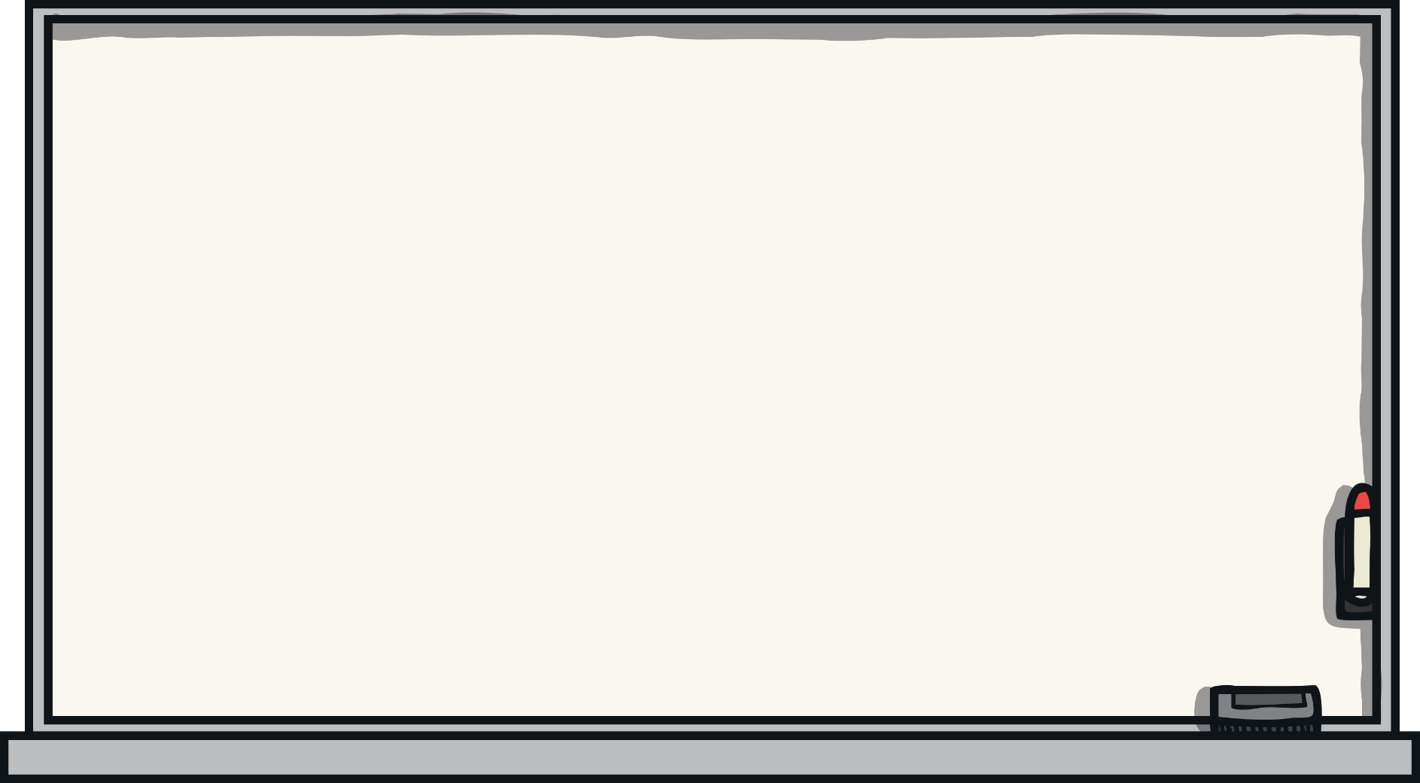
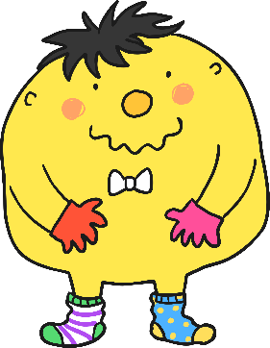
Help Mr Whoops
Can you help Mr Whoops to fix these sentences? Spot his mistakes and write the sentences correctly on your whiteboard.
Watch out for mistakes with his:
spelling;
grammar;
punctuation.
Next

Slide 3
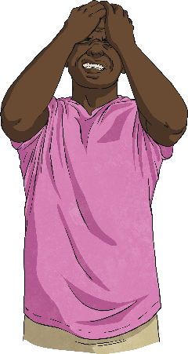
Fix the Sentence
1
Help Mr Whoops to fix this sentence:
i am dissapointed becoz Iv’e forgoted too bring my librery book two sckhool
Can you correct all of his mistakes?
Answer

Slide 4
Fix the Sentence
1
The sentence should read:
I am disappointed because I’ve forgotten to bring my library book to school.
Did you manage to correct all of the mistakes?
Next

Slide 5
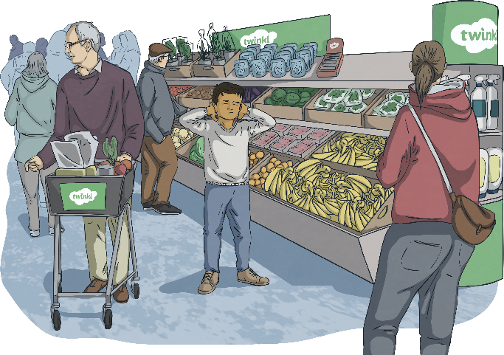
Fix the Sentence
2
Help Mr Whoops to fix this sentence:
is you surten that yo’uve spend enuff time at teh intermarket!
Can you correct all of his mistakes?
Answer

Slide 6
Fix the Sentence
2
The sentence should read:
Are you certain that you’ve spent enough time at the supermarket?
Which mistake was the trickiest to spot?
Next

Slide 7
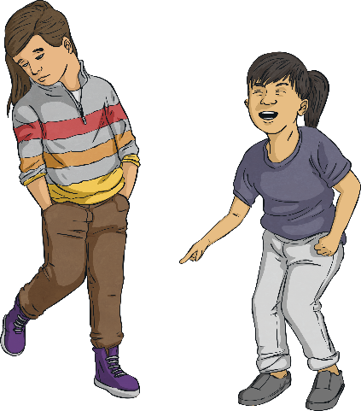
Fix the Sentence
3
Help Mr Whoops to fix this sentence:
Yung chidlren are usualy imature and can
disbehave alot “siad my freind.”
Can you correct all of his mistakes?
Answer

Slide 8
Fix the Sentence
3
The sentence should read:
“Young children are usually immature and can misbehave a lot,” said my friend.
Which mistake was the hardest to correct?
Next

Slide 9
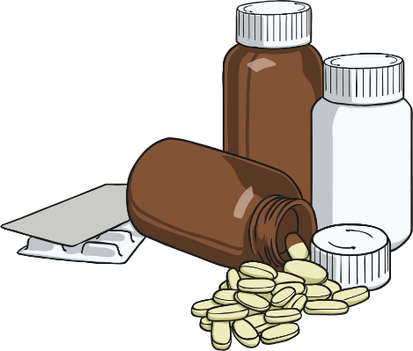
Fix the Sentence
4
Help Mr Whoops to fix this sentence:
it is importent two read the informasion on the
babies’ medisun bottle carefulally so dat she gets bester.
Can you correct all of his mistakes?
Answer

Slide 10
Fix the Sentence
4
The sentence should read:
It is important to read the information on the
baby’s medicine bottle carefully so that she
gets better.
Did any of the mistakes trip you up?
Next

Slide 11
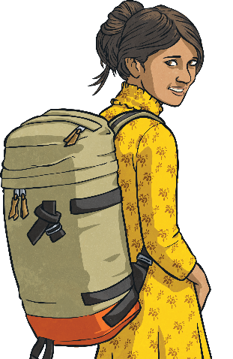
Fix the Sentence
5
Help Mr Whoops to fix this sentence:
“i did’nt tutch him’s backpack. i has an backpack off mi own! protested” sam
Can you correct all of his mistakes?
Answer

Slide 12
Fix the Sentence
5
The sentence should read:
“I didn’t touch his backpack. I have a backpack
of my own!” protested Sam.
Which mistake was the hardest to correct?
Finish

