Slide 1
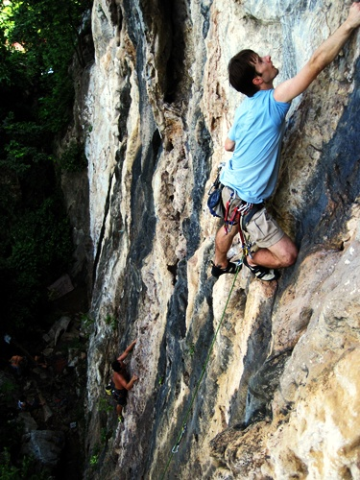

Predict what Happens Next…
Mike and his friend Joe are experienced rock climbers enjoying what they do best. However as the sky begins to cloud over quickly, spots of rain fall.
What happens next?
What dangers are there around Mike?
What problem could happen to Mike?
How could it be fixed?
How do Mike and Joey finish the story?
Photo courtesy of Phan yien @flickr.com) - granted under creative commons licence - attribution

