Slide 1
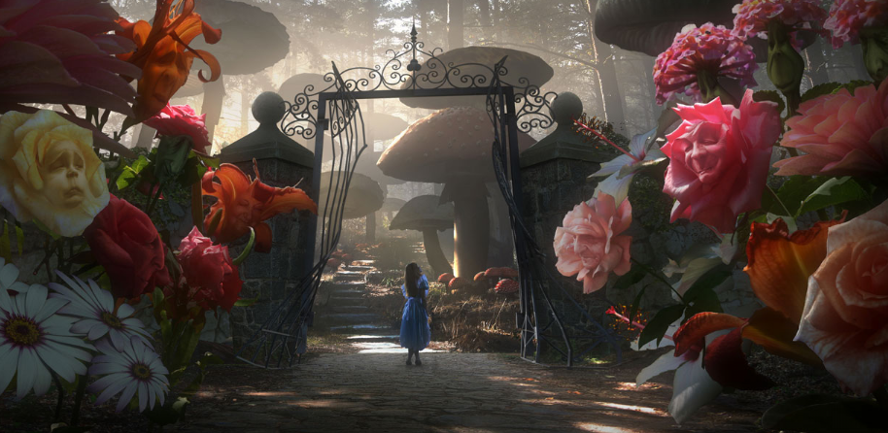

Imagine a Setting
This is a scene from ‘Alice in Wonderland’.
The surroundings seem so big, making Alice appear even smaller.
Imagine you were trapped in your school after you had been shrunk.
Describe your journey from the door across the classroom.
What dangers would you have to be careful of as a tiny person?
Challenge: Use a thesaurus to look up ‘big’ and ‘small’.
Photo courtesy of Cea. @flickr.com) - granted under creative commons licence - attribution

