Slide 1
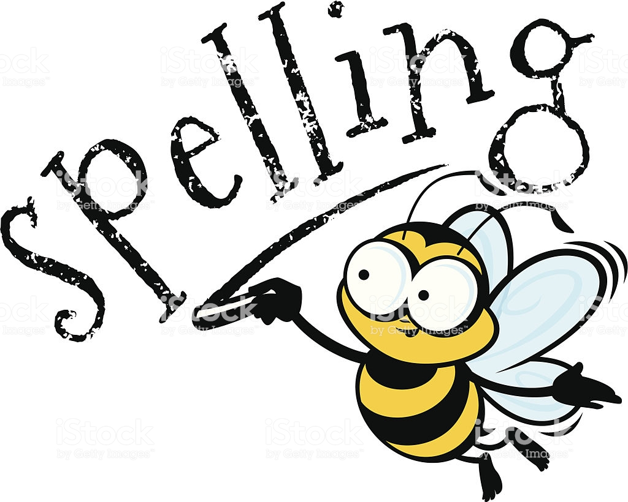
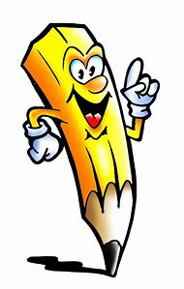
Spellings
Week 4
humorous
mountainous
obvious
outrageous
poisonous
serious
tremendous

