Slide 2



Diving into Mastery Guidance for Educators
Each activity sheet is split into three sections, diving, deeper and deepest, which are represented by the following icons:
These carefully designed activities take your children through a learning journey, initially ensuring they are fluent with the key concept being taught; then applying this to a range of reasoning and problem-solving activities.
These sheets might not necessarily be used in a linear way. Some children might begin at the ‘Deeper’ section and in fact, others may ‘dive straight in’ to the ‘Deepest’ section if they have already mastered the skill and are applying this to show their depth of understanding.
Diving
Deeper
Deepest

Slide 3
Aim
Measure and calculate the perimeter of a rectilinear figure (including squares) in centimetres and metres.

Slide 4
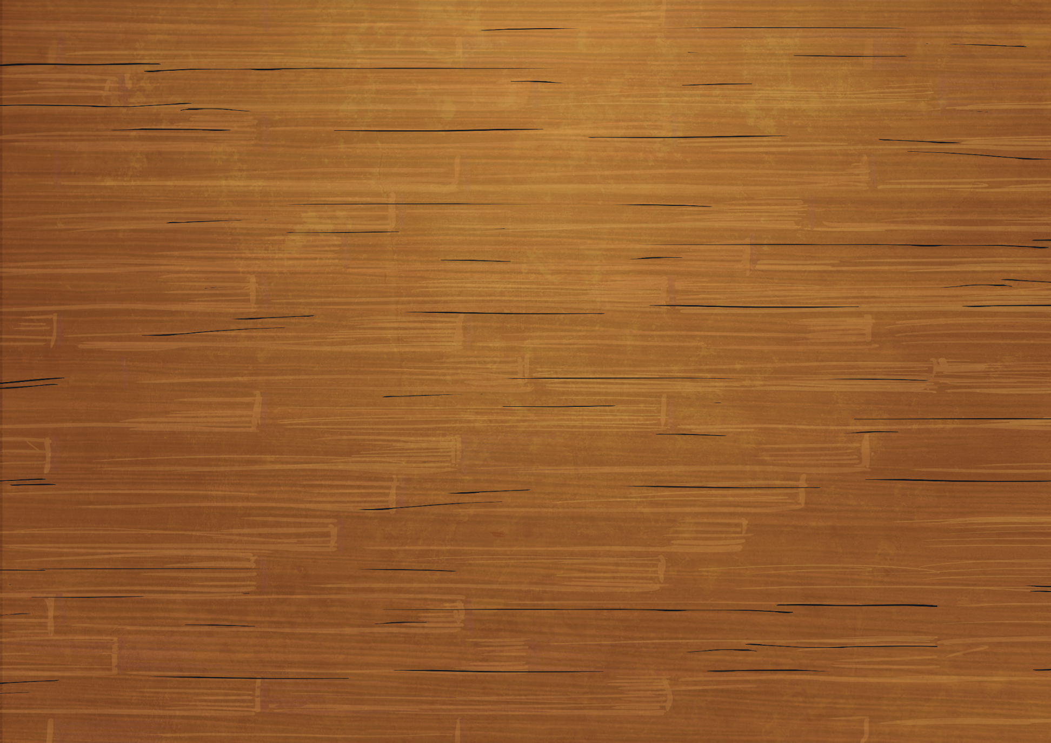
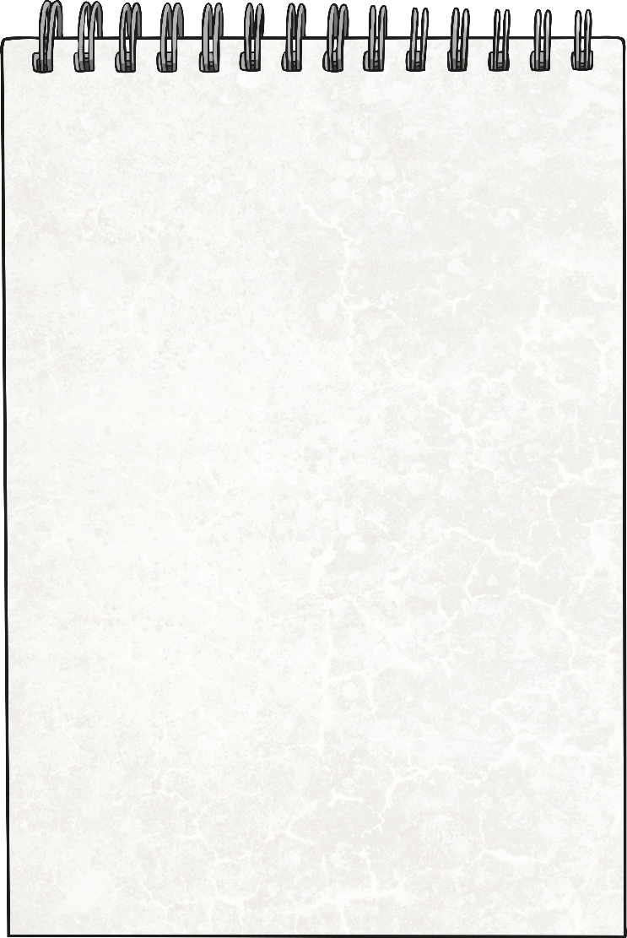

Perimeter of Rectilinear Shapes
Diving
Find the missing side lengths and calculate the perimeter of this rectilinear shape.
2m
Perimeter = 22m
Perimeter =
2m
5m
4m
2m
7m

Slide 5
Perimeter of Rectilinear Shapes
Diving
Draw two different rectilinear shapes that have a perimeter of 28cm.
8cm
3cm
6cm
2cm
2cm
There are lots of different possible answers.
Did you draw a different answer?
3cm
2cm
6cm
7cm
5cm
3cm
9cm

Slide 6


Perimeter of Rectilinear Shapes
Deeper
 |  | 1 | 0
 |  | 1 | 0
 |  |  | 8
 |  |  | 2
 | + |  | 1
 |  |  |  | c | m
 |  | 1
9
10cm
1cm
8cm
10cm
0
Milo has forgotten to find the missing side length.
4
1
3
9cm
Milo has worked out
the perimeter of this rectilinear shape. Can you explain his mistake and find the correct answer?
The correct perimeter with all the sides added up is 40cm.
2cm

Slide 7


Perimeter of Rectilinear Shapes
Deepest
There are many possible answers to this question.
Here are two possible solutions:
Can you draw a rectilinear shape, made up of two rectangles, that has a perimeter of 24cm? Find two possible solutions.
2cm
4cm
6cm
5cm
8cm
7cm
Did you find a different answer?
2cm
1cm
2cm
2cm
4cm
5cm

Slide 8


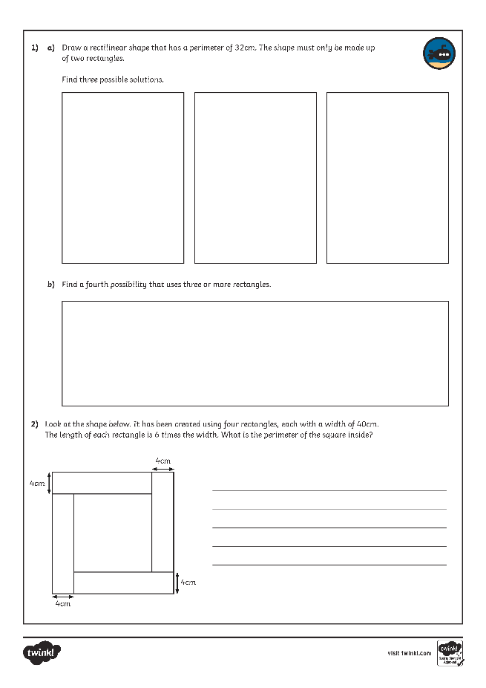
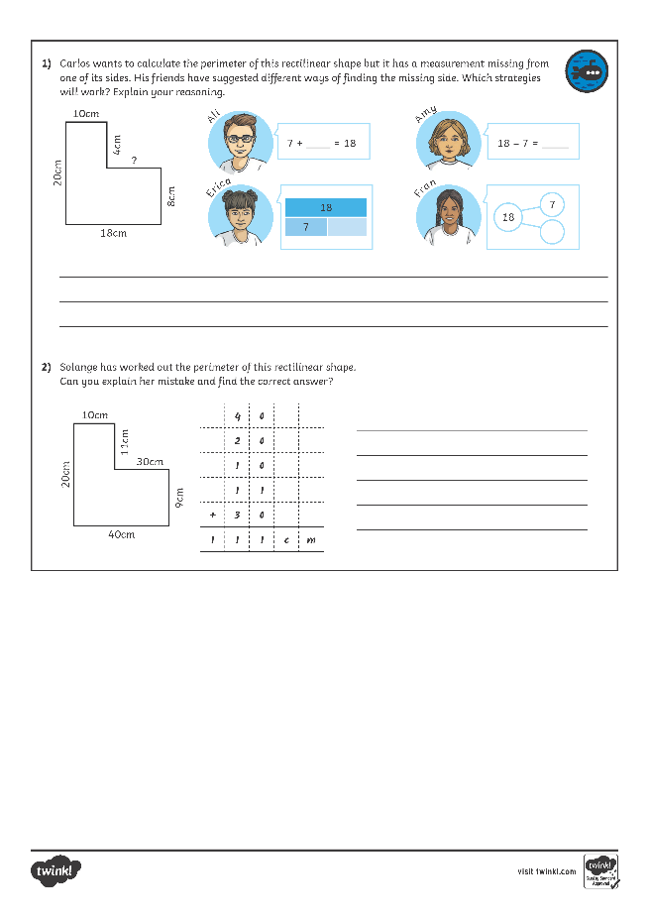
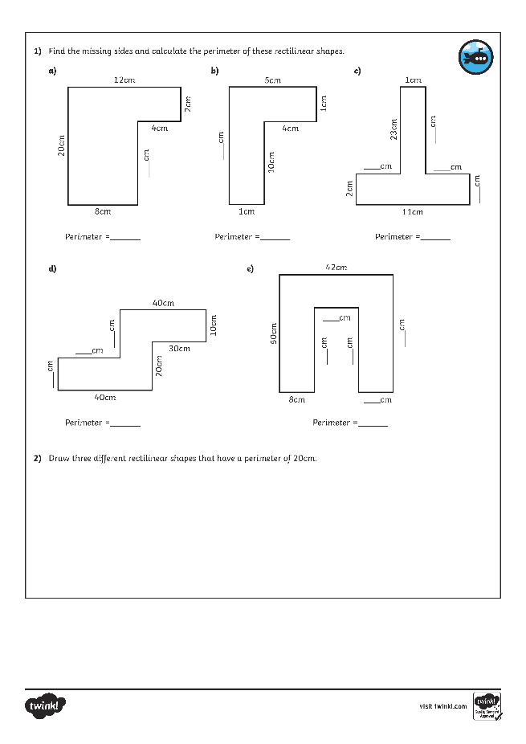
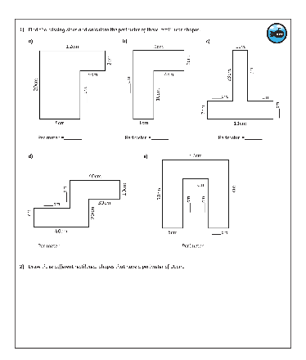
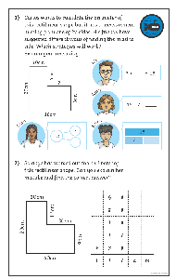
Perimeter of Rectilinear Shapes
Dive in by completing your own activity!

Slide 9
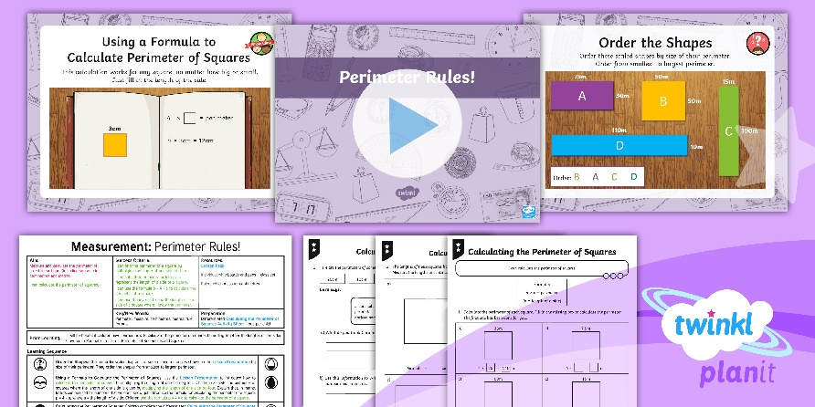
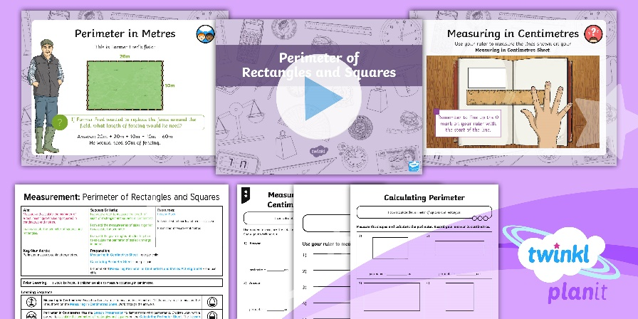

Need Planning to Complement this Resource?
National Curriculum Aim
Measure and calculate the perimeter of a rectilinear
figure in centimetres and metres.
For more planning resources to support this aim, click here.
Twinkl PlanIt is our award-winning scheme of work
with over 4000 resources.

