Slide 1
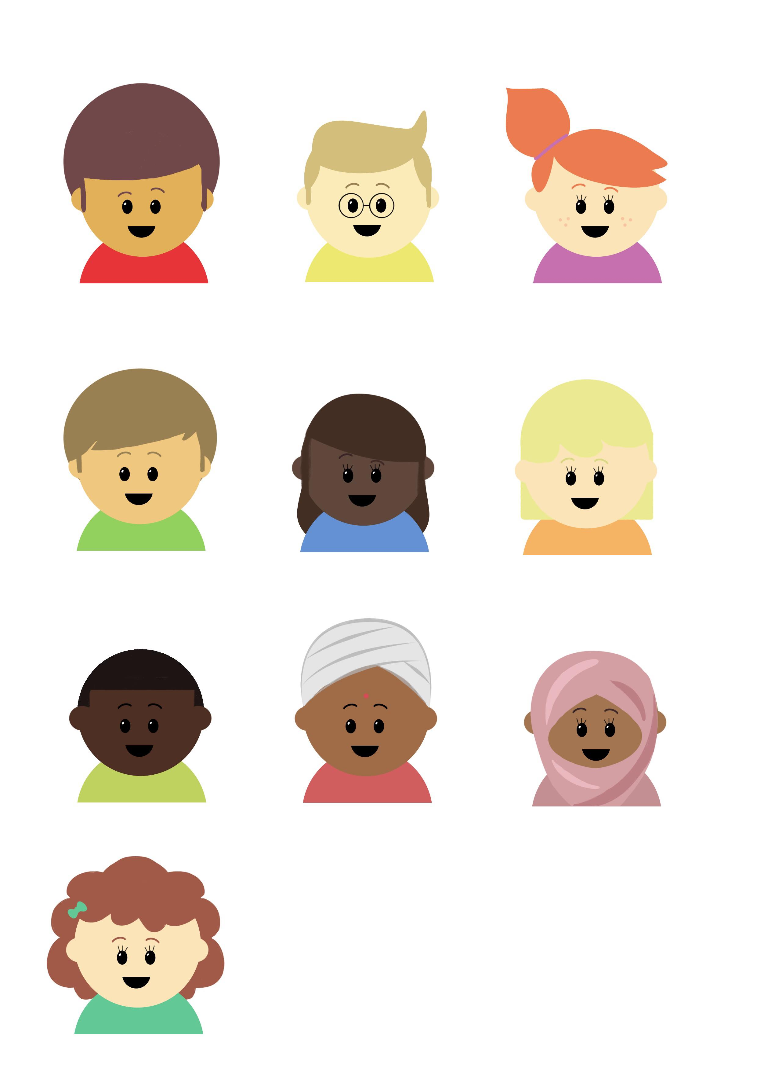

Progression in Mastery
Year 4 Compare Decimals
Are you ready for the challenge of comparing decimal numbers?
©Deepening Understanding LTD 2020

Slide 2
Let’s do this!
What numbers do these charts represent?
What if each counter was moved 1 place to the left?
10 | 20 | 30 | 40 | 50 | 60 | 70 | 80 | 90
1 | 2 | 3 | 4 | 5 | 6 | 7 | 8 | 9
0.1 | 0.2 | 0.3 | 0.4 | 0.5 | 0.6 | 0.7 | 0.8 | 0.9
0.01 | 0.02 | 0.03 | 0.04 | 0.05 | 0.06 | 0.07 | 0.08 | 0.09
0.01 | 0.02 | 0.03 | 0.04 | 0.05 | 0.06 | 0.07 | 0.08 | 0.09
0.1 | 0.2 | 0.3 | 0.4 | 0.5 | 0.6 | 0.7 | 0.8 | 0.9
1 | 2 | 3 | 4 | 5 | 6 | 7 | 8 | 9
10 | 20 | 30 | 40 | 50 | 60 | 70 | 80 | 90
©Deepening Understanding LTD 2020

Slide 3
Let’s revisit what we should know
This decimal number is written in numerals as 26.54
It is written in words as twenty-six point five four.
This is because there are 2 tens, 6 ones, a decimal point, 5 tenths and 4 hundredths.
tens | ones | tenths | hundredths
2 | 6 | 5 | 4
©Deepening Understanding LTD 2020
Notes:
Ensure your pupils understand that ‘point eight two’ is a different number to ‘eighty-two’

Slide 4
Let’s revisit what we should know
We use these symbols to compare numbers.
greater than
equal to
less than
The widest part of the symbol always points towards the larger number.
©Deepening Understanding LTD 2020

Slide 5
Let’s learn
We look at the place and value of each digit when comparing decimals.
13.54 has 1 ten, 3 ones, 5 tenths and 4 hundredths.
13.04 has 1 ten, 3 ones, 0 tenths and 4 hundredths.
tens | ones | tenths | hundredths
1 | 3 | 5 | 4
tens | ones | tenths | hundredths
1 | 3 | 0 | 4
©Deepening Understanding LTD 2020

Slide 6
Let’s learn
tens | ones | tenths | hundredths
1 | 3 | 5 | 4
tens | ones | tenths | hundredths
1 | 3 | 0 | 4
The decimals have the same number of tens and ones.
13.54 has 5 more tenths than 13.04. Therefore, it is greater.
We all say it!
I say it!
You say it!
©Deepening Understanding LTD 2020

Slide 7
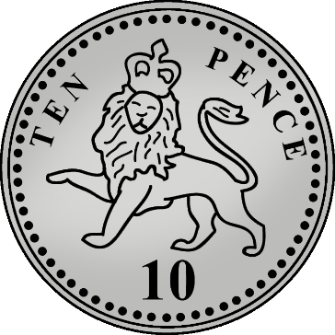
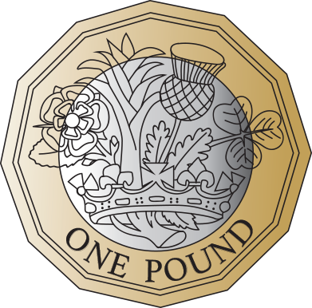
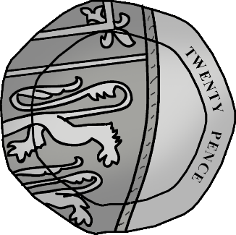
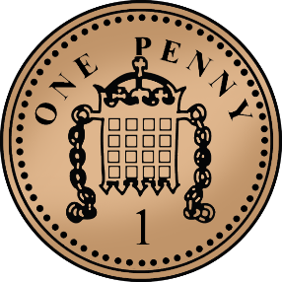
Let’s talk
Jane and Alfie are comparing the amount of money they have.
Who is correct?
I have the most money because my coins have a higher value.
I have the most money because I have more coins.
©Deepening Understanding LTD 2020

Slide 8
Let’s learn
When we compare decimal numbers, the number of digits is not relevant but the value of the digits is.
22.41 has 2 tens, 2 ones, 4 tenths and 1 hundredth.
23.2 has 2 tens, 3 ones and 2 tenths.
tens | ones | tenths | hundredths
10
10
1
1
0.1
0.1
0.1
0.1
0.01
tens | ones | tenths | hundredths
10
10
1
1
1
0.1
0.1
©Deepening Understanding LTD 2020

Slide 9
Let’s learn
tens | ones | tenths | hundredths
10
10
1
1
0.1
0.1
0.1
0.1
0.01
tens | ones | tenths | hundredths
10
10
1
1
1
0.1
0.1
The decimals have the same number of ______.
_ _._ _ has __ more ______ than _ _._. Therefore, it is ______.
We all say it!
I say it!
You say it!
©Deepening Understanding LTD 2020

Slide 10
Let’s talk
Which of these representations is the largest number?
How do you know?
tens | ones | tenths | hundredths
10
10
10
0.1
0.1
0.1
0.1
0.01
0.01
0.01
0.01
0.1
tens | ones | tenths | hundredths
10
10
1
1
0.1
0.1
0.1
0.01
0.01
0.01
0.01
©Deepening Understanding LTD 2020

Slide 11
Let’s develop our learning
Use the stem sentence to compare these decimal numbers.
16.14
10.14
26.14
16.04
16.01
_ _._ _ has __ more ______ than _ _._ _. Therefore, it is ______.
We all say it!
I say it!
You say it!
©Deepening Understanding LTD 2020

Slide 12
Let’s develop our learning
Use the greater than and less than symbols to compare these pairs of decimals.
10.93
11.09
23.87
28.37
21.2
21.02
45.26
45.62
©Deepening Understanding LTD 2020

Slide 13
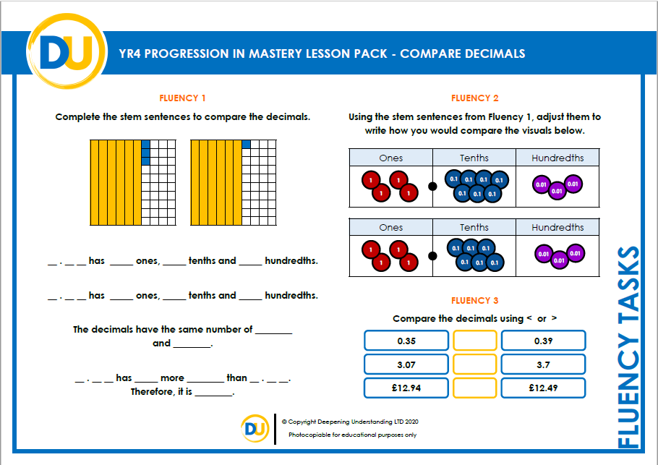
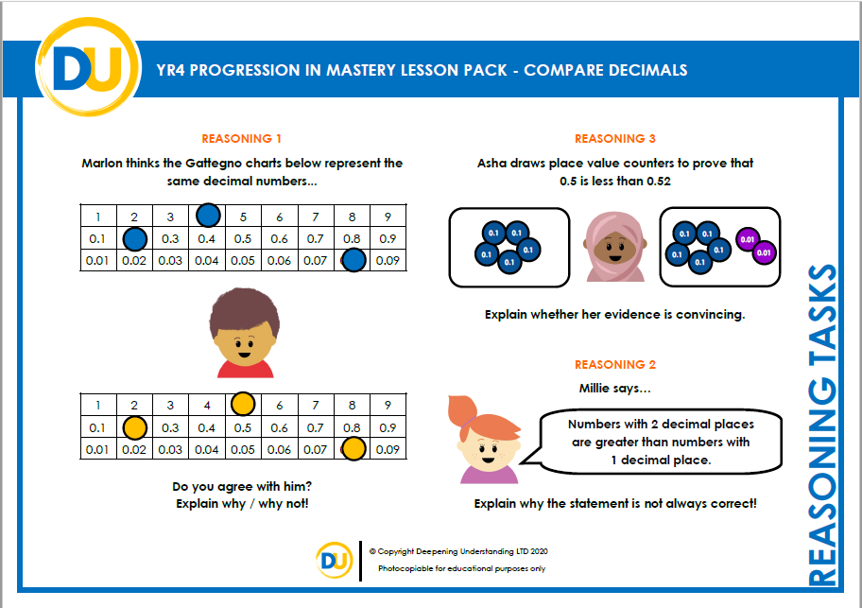
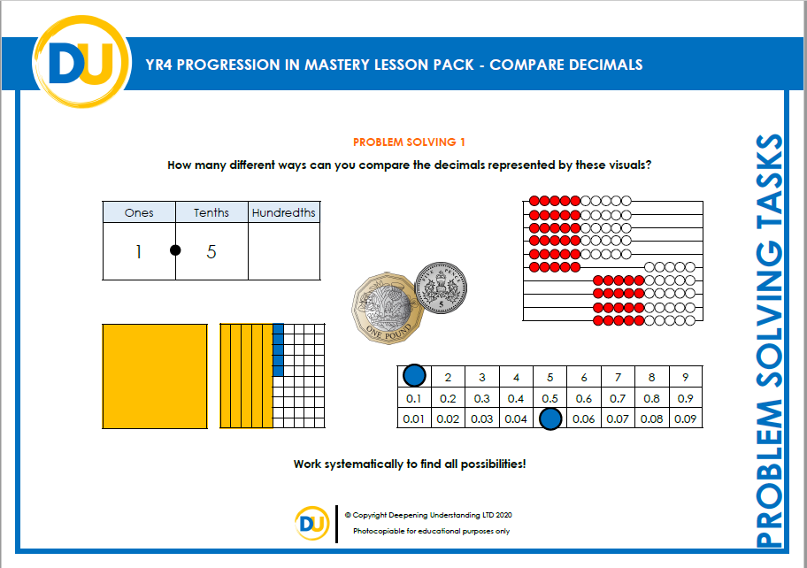
Independent Task
Let’s showcase our learning
©Deepening Understanding LTD 2020

Slide 14
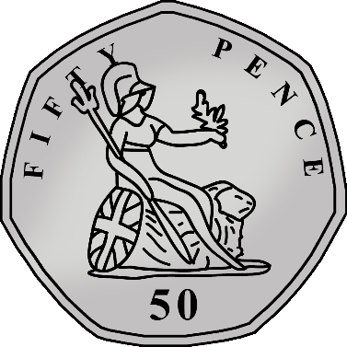

Exit task – Dong Nao Jin
Jane has seven coins in her purse.
She has at least one £1, 50p, 10p and 1p coin.
She has more than £2.50 but less than £3.75.
What coins could she have?
©Deepening Understanding LTD 2020

