Slide 2
Feedback: “Should pupils wear masks
in school?”
“It is important to keep the spread of the virus to a minimum. It also enhances the rate of protection not only for ourselves but others too.”
Sutton Coldfield Grammar School for Girls
“People shouldn’t wear masks in school because we are already in school bubbles.”
St Wilfrid’s Church of England Academy
“I think it should be optional because there are pros and cons from both perspectives.”
Thetford College
Yes
No
42.4%
57.6%
Thank you to everyone who expressed their thoughts on the fact we covered this topic too!
“Good question, going to be a close one…”
St Wilfrid’s Church of England Academy
“It was nice to be able to have our thoughts taken into account about the current situation.”
Sutton Coldfield Grammar School
“I think this topic was very interesting and also related to the current situation!
Northwood College for Girls
Notes:
Full Quote (or see next slide): “It’s brilliant to hear the views from schools about organ donation. Each country which has been successful in increasing transplantation has done so in a range of ways, including law changes, but especially by helping educate the public about organ donation. The change in law is a part of this work but not all of it – getting the facts and talking about organ donation with your family are so important. Organ donation, whether living kidney donation or after death is the ultimate gift – it transforms lives.
The comments about people not being that bothered are very similar to those we’ve heard from adults, many of whom will go on to say that they are therefore content for a donation to take place. The opt-out law means that someone is deemed to be a donor unless they have chosen to opt out during their life; they still have a choice (to opt out), but the balance now changes in favour of organ donation, with lots of safeguards. We absolutely agree that it’s vital to talk about organ donation – this is so that your family would know what you would have wanted in the very unlikely situation that you might become an organ donor. It’s important to note that families will still be involved in any discussion about organ donation.
The changes will affect you when you turn 18, but you don't have to wait! You can record your organ donation decision now. Make sure you talk to your family or loved ones about what you decide, as they will always be involved if organ donation is ever a possibility.”
Images
https://www.kidneycareuk.org/about-us/we-are-kidney-care-uk/

Slide 3

Feedback: “Should students wear masks in schools?”
It’s very impressive that almost half of you voted in favour of masks in school! Many of us in the NHS struggle to wear masks all day, despite the obvious benefit to our older sicker patients. But a large portion of infection is in younger healthy people. So should we expect you to wear masks to prevent deaths beyond the school gates? Is this necessary if we follow the rules of social bubbles and self-isolation? Only if this would significantly reduce transmission to older, more vulnerable people.
Yes
42.4%
No
57.6%
The evidence for this strategy is limited so far, but this might be because it’s very hard to put into practice and prove its worth. This leaves us uncertain about how to reduce infections, even if the ‘why’ is clear.
So whilst we wait a more scientific strategy, or a vaccine, the NHS thanks for your co-operation. We will beat this together!
Alex Bunn, GP at HMP Wandsworth and Associate Clinical Director at Oxleas NHS Trust
Notes:
Images

Slide 4













Starter: What’s social media for?
Pair task (3-5 mins)
Which social media platforms do you use? What do you use them for? Discuss with your partner or mind-map your ideas.
Learning new
things?
Catching up with
friends?
Sharing pictures or videos?
Sharing your views?
Arguing or debating issues?
Following influencers or celebrities?
Finding people with similar interests?
Challenge:
What do you think most people use social media for?
Notes:
Images
icons8
iStock
References

Slide 5
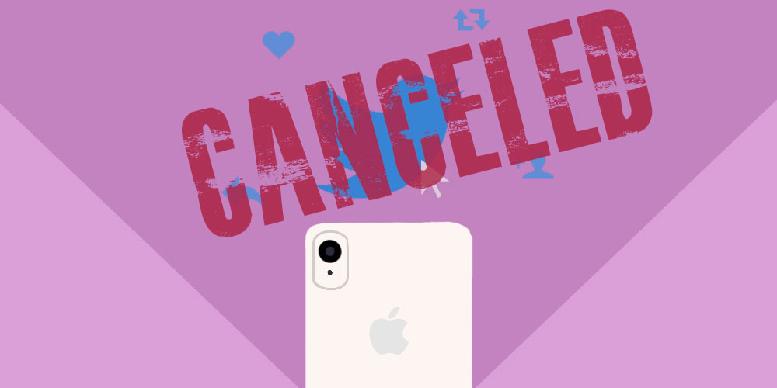
Is “cancel culture” unfair?
Teacher’s note:
This lesson contains sensitive themes. We recommend reviewing the resources prior to teaching.
Notes:
Images
https://www.mindmate.org.uk/cancel-culture-stop-cancelling-us/
References

Slide 6






What is “cancel culture?”
Starter:
What’s social media for?
Should they be cancelled?
Why are we talking about this?
Gone too far?
Agree or disagree?
Vote!
Notes:
Images
iStock

Slide 7

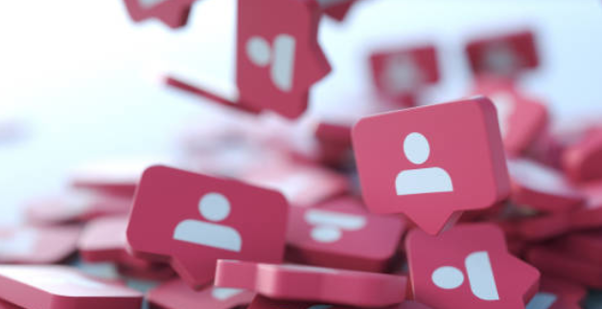
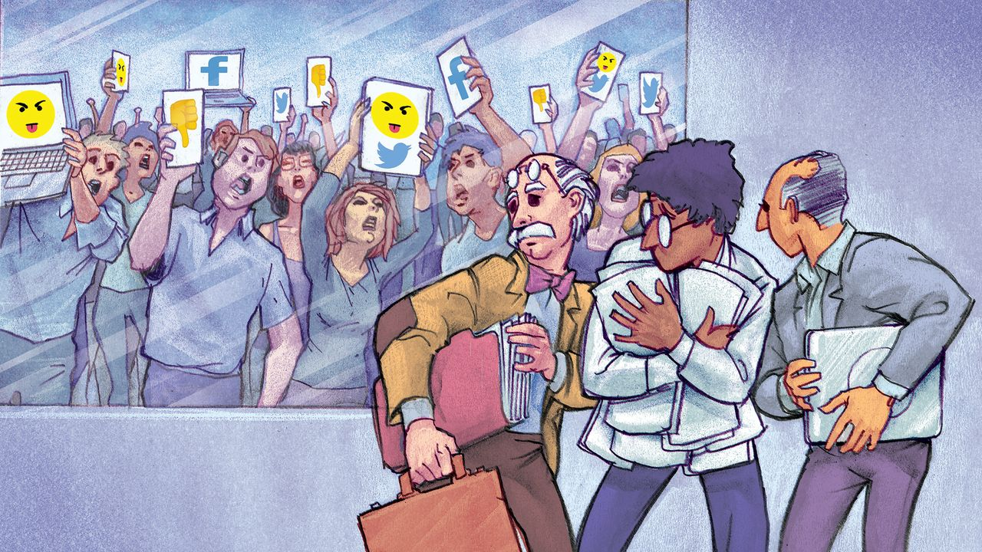
What is “cancel culture?”
Partner talk (2-3 mins)
What would you do if someone that you followed or subscribed to online said something unkind, or something that you did not agree with?
It is up to you who’s content that you follow and give attention to. If somebody says or does something, either online or in real life, you might decide to stop giving them attention. This has been nicknamed “cancelling.”
While cancelling someone who you don’t want to support anymore is ok, “cancel culture” refers to something a bit different- it’s a call to have the offender banned, fired and their reputation destroyed. In short, it’s the call for them, as people, to be “cancelled” by everybody.
Notes:
References:
https://www.merriam-webster.com/words-at-play/cancel-culture-words-were-watching#:~:text=To%20cancel%20someone%20(usually%20a,or%20promoting%20a%20writer's%20works.
Images:
https://www.mindmate.org.uk/cancel-culture-stop-cancelling-us/
iStock

Slide 8


What is “cancel culture?”
Starter:
What’s social media for?
Should they be cancelled?
Why are we talking about this?
Gone too far?
Agree or disagree?
Vote!
Notes:
Images
iStock

Slide 9
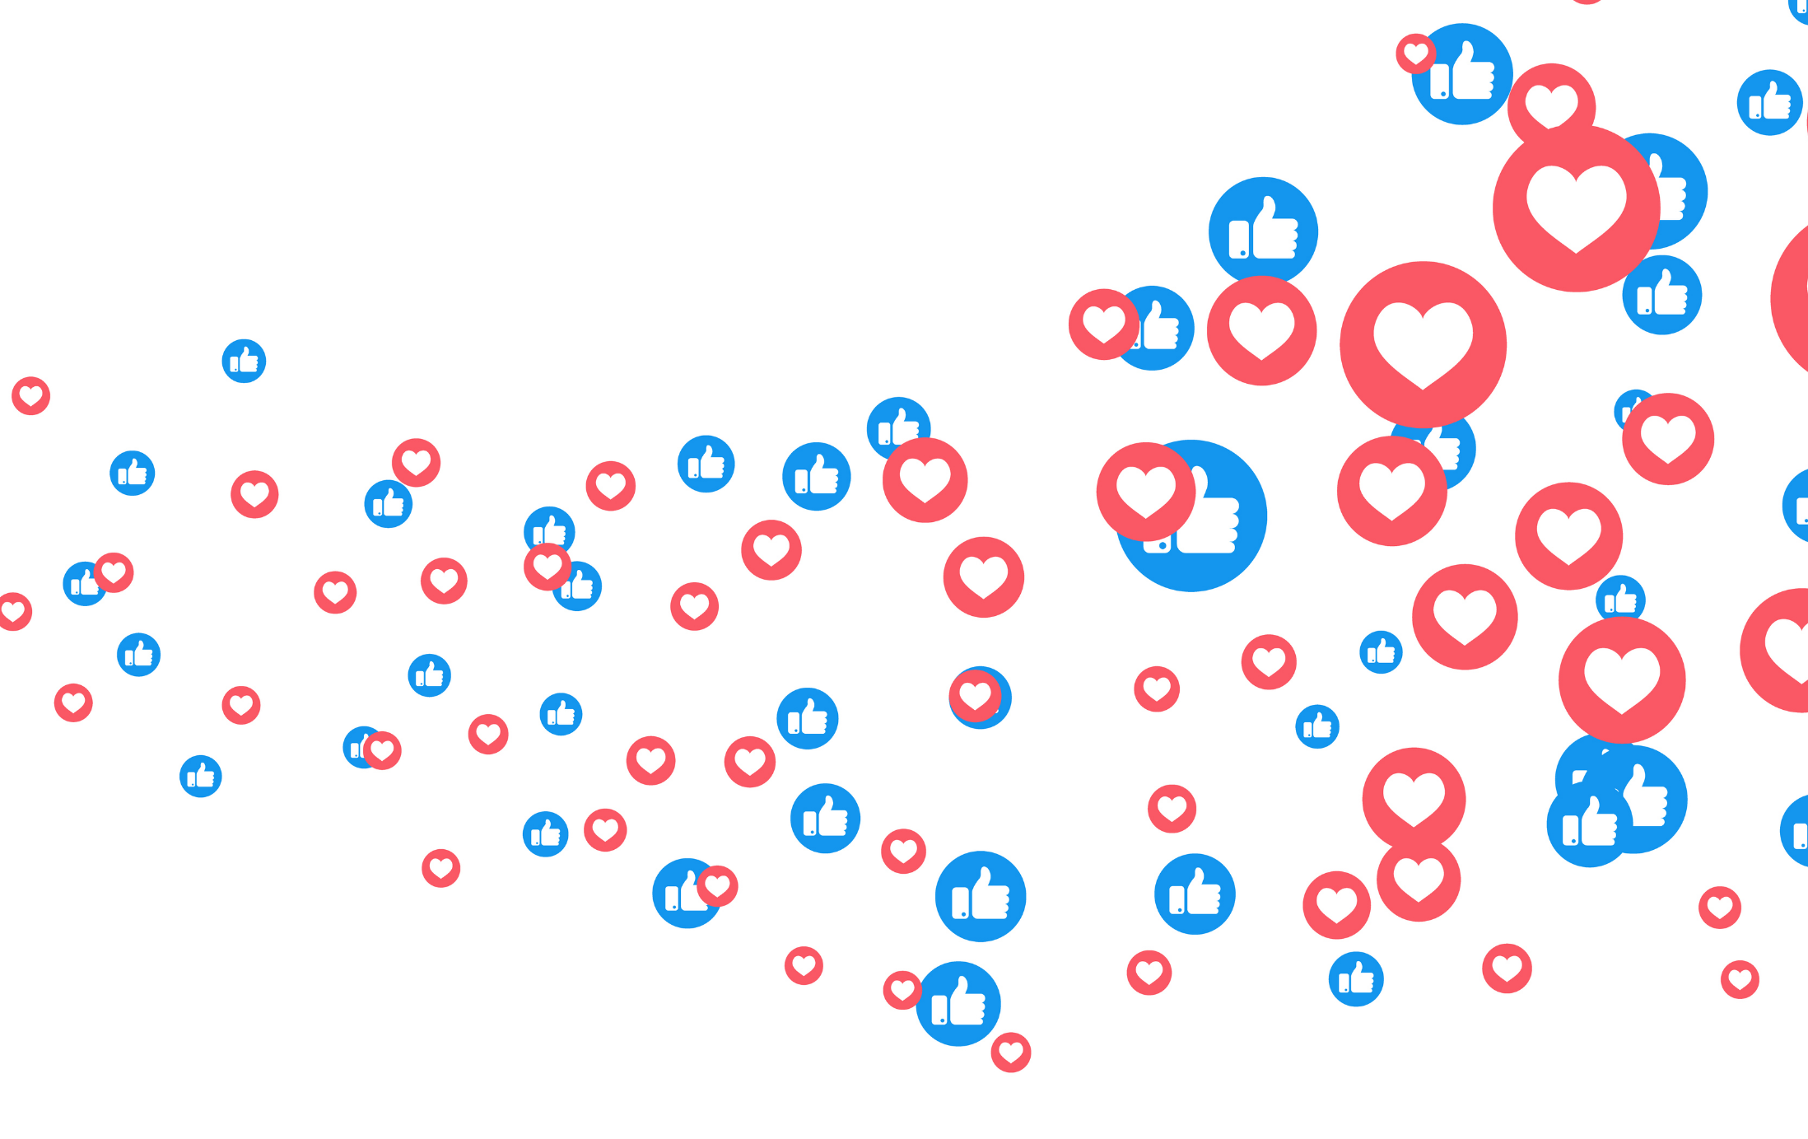
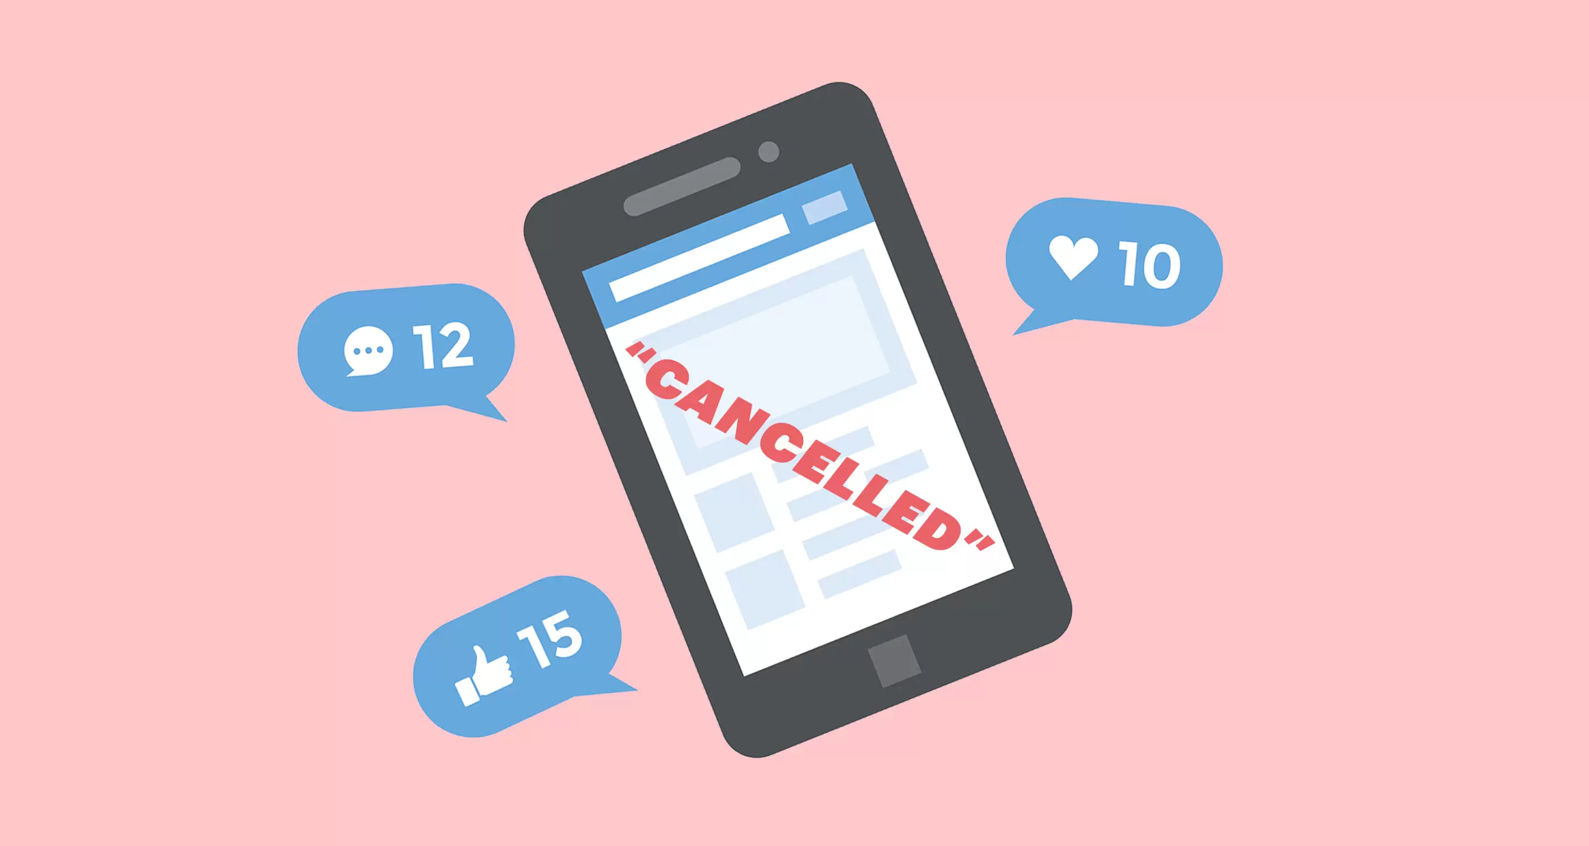
Why are we talking about this?
With more than 3.8 billion people on social media around the world, it’s not surprising that the internet is the starting place for many “cancellations” of people.
But is “cancelling” the right way to go about things? Or has “cancel culture” turned into something much more dangerous? This is what you will be discussing today.
Partner talk (2-3 mins)
What are your first thoughts about this topic? Do you think that “cancel culture” is a good thing or a bad thing?
Notes:
Images
iStock
https://www.mindmate.org.uk/cancel-culture-stop-cancelling-us/
References:
1) https://wearesocial.com/blog/2020/01/digital-2020-3-8-billion-people-use-social-media#:~:text=More%20than%204.5%20billion%20people,the%20middle%20of%20this%20year.

Slide 10
What is “cancel culture?”
Starter:
What’s social media for?
Should they be cancelled?
Why are we talking about this?
Gone too far?
Agree or disagree?
Vote!
Notes:
Images
iStock

Slide 11
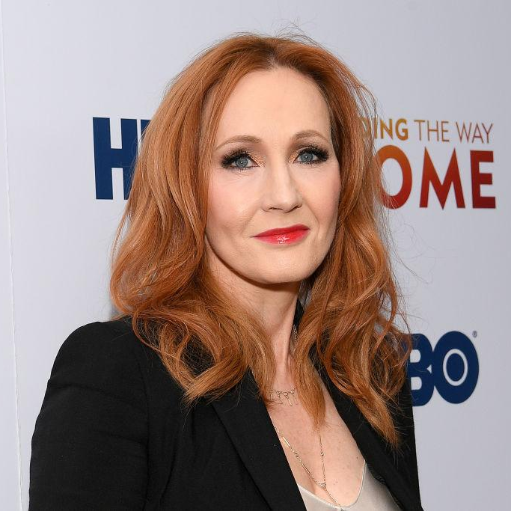
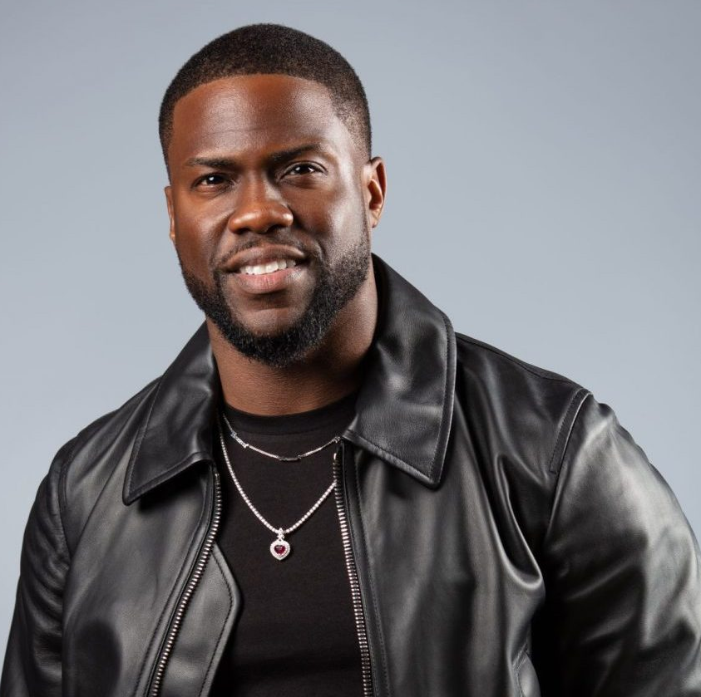
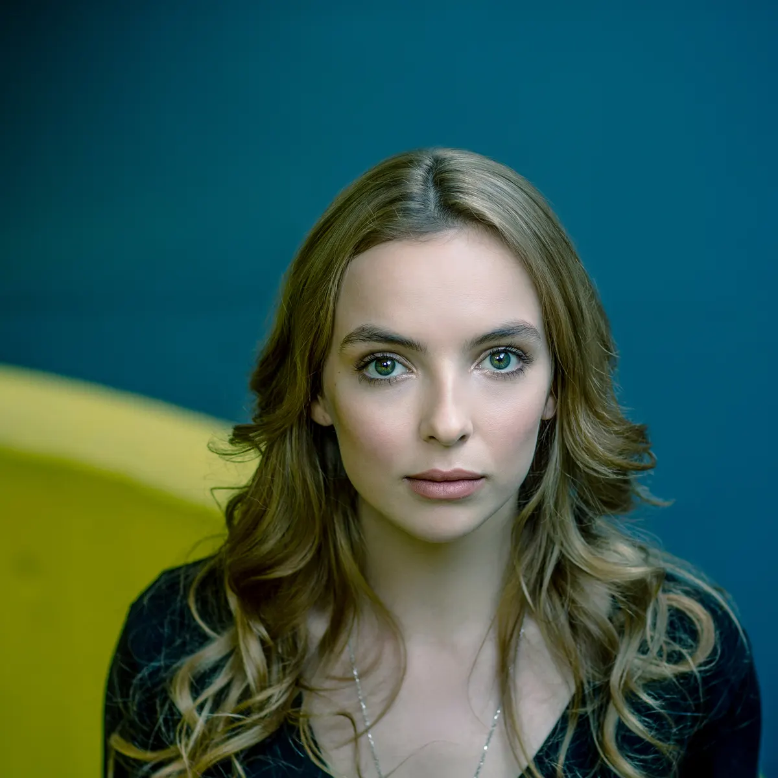
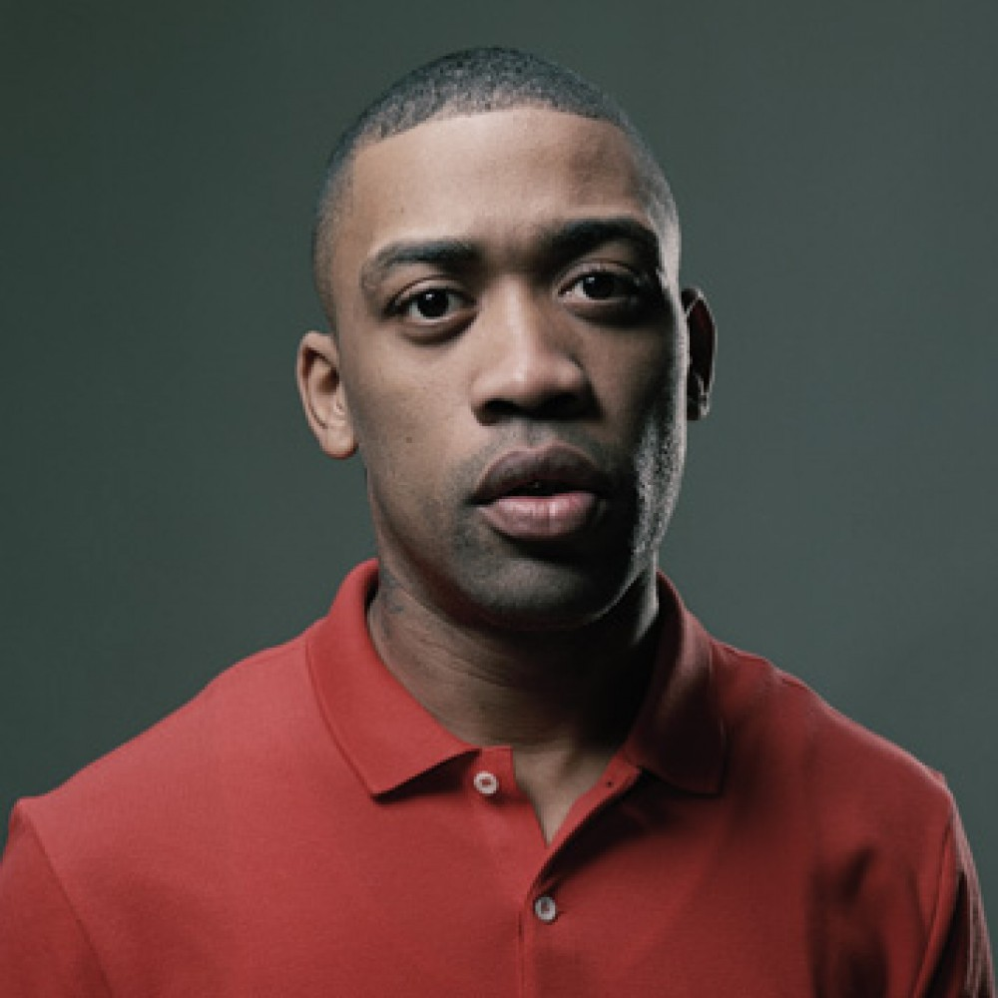


Should they be cancelled?
Class task (10-15 mins)
On the next few slides you are going to hear about a few different celebrities who some people want to “cancel.” For each one, read the information given and decide whether you think that they should be cancelled or not.
Yes – cancel them!
Should they be cancelled?
No they shouldn’t!
Challenge:
If you think that a celebrity should not be cancelled, what do you think should happen? Explain your answer to your class, or write it down.
Notes:
Images
https://www.scotsman.com/arts-and-culture/books/jk-rowling-twitter-why-harry-potter-author-has-been-accused-transphobia-social-media-platforms-2877977
https://www.blackenterprise.com/need-motivation-kevin-hart-is-the-life-coach-youve-been-waiting-for/
https://www.theguardian.com/tv-and-radio/2018/dec/20/the-chic-assassin-jodie-comer-on-playing-killing-eves-villanelle
https://bigdada.com/artist/wiley

Slide 12
Should they be cancelled?
JK Rowling is the author of the Harry Potter books, which were later made into famous films, games and even a theme park. She has more than 14 million followers on Twitter.
In 2020, many people said that she should be “cancelled” after she sent some tweets that some people thought were offensive to transgender people.
As a result, some people have stopped buying Harry Potter books to protest against her tweets.
Transgender:
Somebody who feels that they are not the same gender to the one that they were born as. For example, someone who was born as a male but feels that they are female.
Yes – cancel her!
Should she be cancelled?
No she
shouldn’t!
Notes:
Images:
https://www.scotsman.com/arts-and-culture/books/jk-rowling-twitter-why-harry-potter-author-has-been-accused-transphobia-social-media-platforms-2877977
References:
https://www.scotsman.com/arts-and-culture/books/jk-rowling-twitter-why-harry-potter-author-has-been-accused-transphobia-social-media-platforms-2877977
https://dictionary.cambridge.org/dictionary/english/transgender

Slide 13
Should they be cancelled?
Kevin Hart is a famous comedian and actor. He was going to be presenting the 2019 Academy Awards last year, but had to quit because of some tweets he’d sent in the past.
People said that he should be “cancelled” after they found that he had made homophobic comments on Twitter and in his shows between 2009 and 2011.
When asked about the jokes in 2015, he said that he wouldn’t make the same jokes today, and in 2018 he said he wouldn’t apologise. However, just a few weeks later, he apologised on Twitter for hurting people and said he would not host the Academy Awards.
Homophobic:
Showing a fear or a dislike of gay people.
Yes – cancel him!
Should he be cancelled?
No he shouldn’t!
Notes:
References:
https://dictionary.cambridge.org/dictionary/english/homophobic
https://www.billboard.com/articles/events/oscars/8492982/kevin-hart-oscar-hosting-controversy-timeline

Slide 14
Should they be cancelled?
Jodie Comer is well known actress who doesn’t like to share too much on social media. She has supported lots of charities, including Black Lives Matter (BLM).
However, there were rumours that she was in a relationship with someone who might be a Donald Trump supporter. Because of this, some people said she couldn’t be a supporter of BLM.
Many people online said she should be cancelled, and she was even trending on Twitter. She didn’t reply to any of the comments, so no one knows if they were true or not.
Yes – cancel her!
Should she be cancelled?
No she
shouldn’t!
Notes:
Images:
1) https://www.theguardian.com/tv-and-radio/2018/dec/20/the-chic-assassin-jodie-comer-on-playing-killing-eves-villanelle
References
https://www.telegraph.co.uk/tv/0/twitters-cancellation-jodie-comer-fair-salem-witch-trials

Slide 15
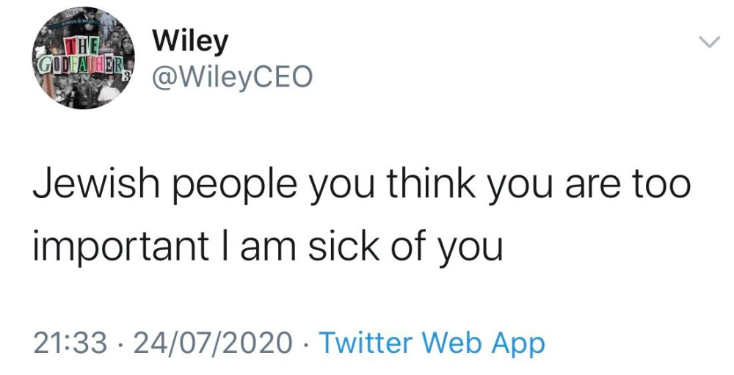
Should they be cancelled?
Earlier this year, rapper Wiley was dropped by his management company after he posted anti-Semitic (against Jewish people) posts on his Instagram and Twitter accounts.
Millions of people complained and refused to use Twitter until his tweets were deleted, and Twitter later banned Wiley completely. Some people have also said he should give back his MBE Music Award.
He did later apologise, saying : "My comments should not have been directed to all Jews or Jewish people. I want to apologise for generalising, and I want to apologise for comments that were looked at as anti-Semitic."
Yes – cancel him!
Should he be cancelled?
No he shouldn’t!
Notes:
Images:
https://bigdada.com/artist/wiley
References:
1) https://www.bbc.co.uk/news/technology-53581771

Slide 16
What is “cancel culture?”
Starter:
What’s social media for?
Should they be cancelled?
Why are we talking about this?
Gone too far?
Agree or disagree?
Vote!
Notes:
Images
iStock

Slide 17




Gone too far?
Discuss (5-10 mins)
Now that you know what “cancelling” is, and why people choose to do it, it’s time to think about what happens after someone is “cancelled”. On the next few slides, you are going to hear about two people who were “cancelled” and how this affected their lives. For each one, decide whether you think that the way that they were treated is fair or unfair. Use your fingers to show your thoughts!
They deserved worse.
The punishment fit the crime.
I can’t decide.
It was a bit harsh.
It went way too far.
1
2
3
4
5
Challenge:
How long do you think a person should be ‘cancelled’/punished for?
Not in the classroom?
Mind-map the ways you think it might affect their lives.
Notes:
Images
iStock

Slide 18
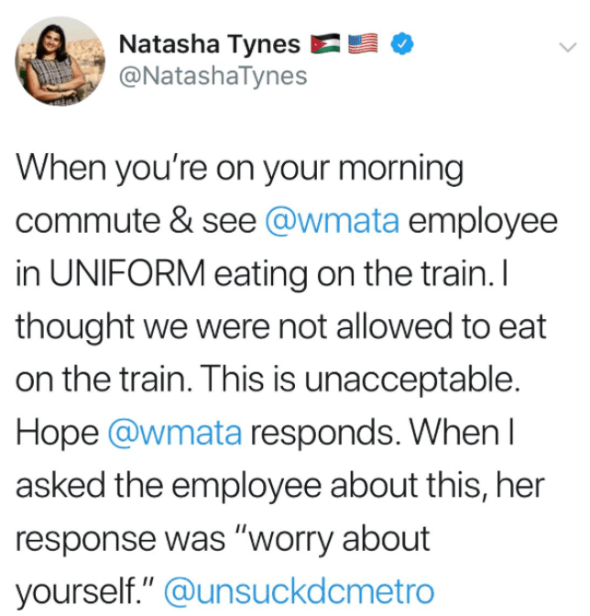
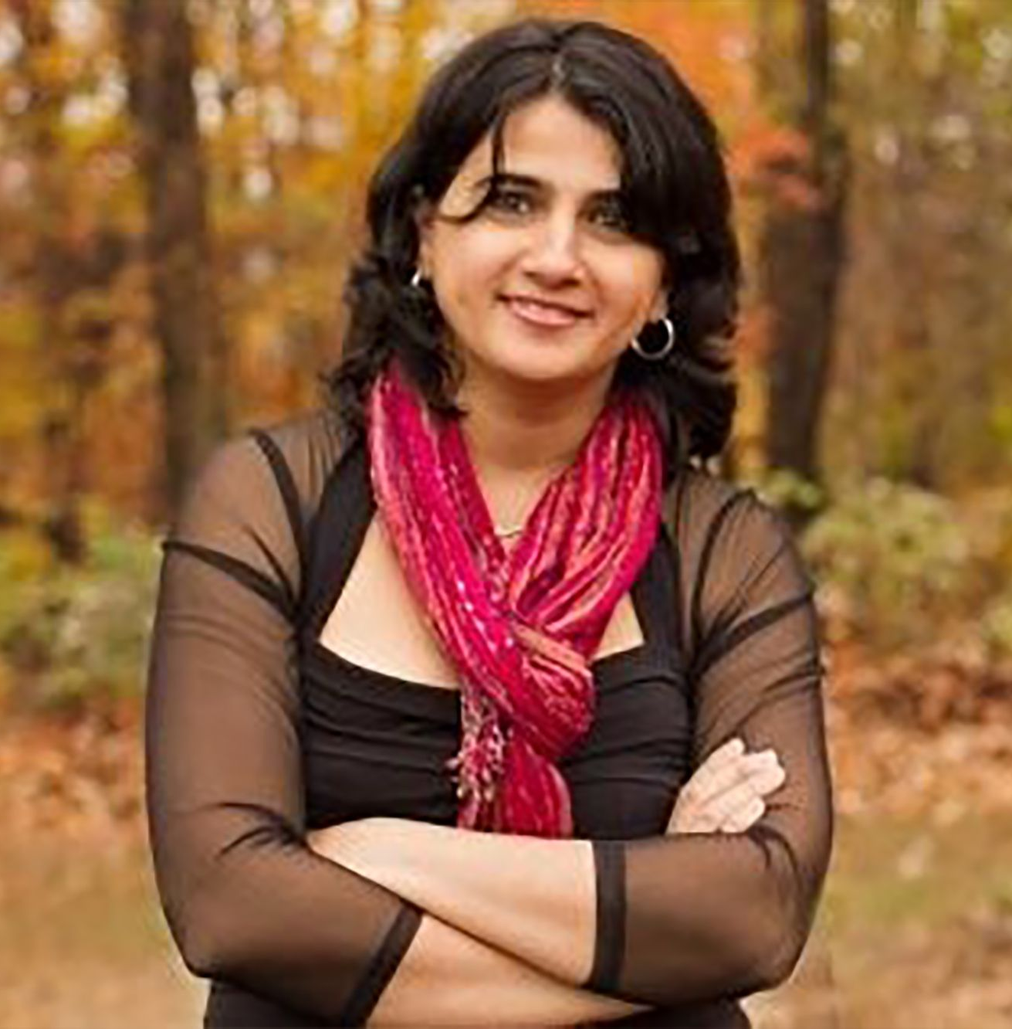
Gone too far?
In 2019, Jordanian-American Author Natasha Tynes sent this tweet about an employee eating on the metro. As the employee was a black women, many felt her complaint was "anti-black".
As a result, her book deal was cancelled by her publishers. She suffered a “nervous breakdown,” and people on the internet even threatened to kill her. She even returned to Jordan twice out of fear for her safety.
They deserved worse.
The punishment fit the crime.
I can’t decide.
It was a bit harsh.
It went way too far.
1
2
3
4
5
Notes:
Images:
https://www.bbc.co.uk/news/world-us-canada-48257825
https://www.buzzfeednews.com/article/tasneemnashrulla/dc-metro-writer-tweet-eating-train-book-sue-publisher
References:
1) https://www.bbc.co.uk/news/world-us-canada-48257825

Slide 19
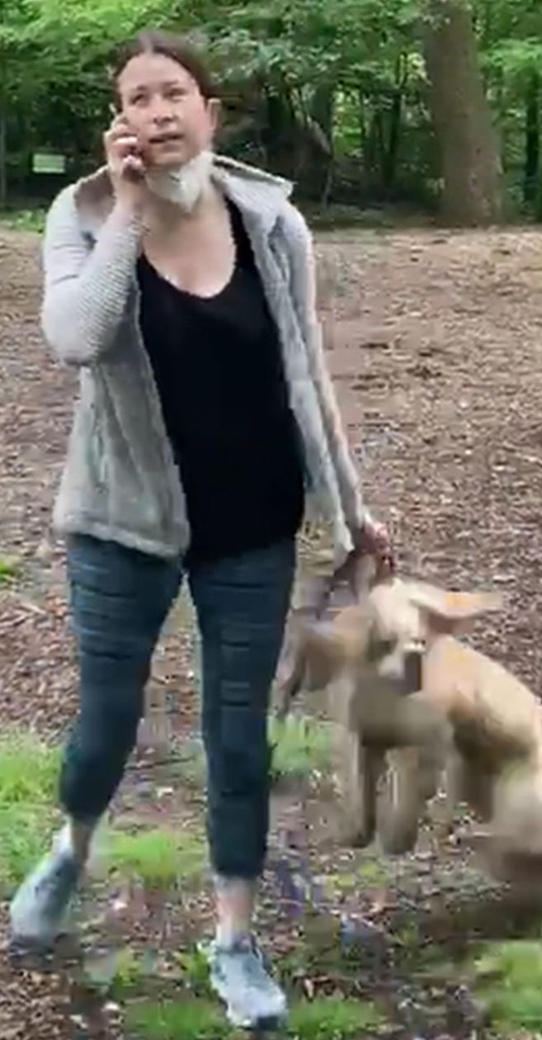
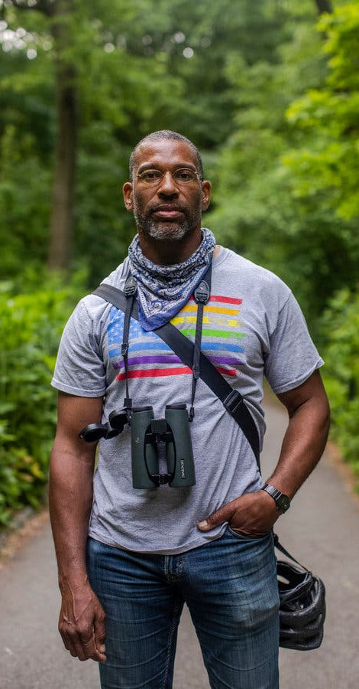
Gone too far?
In May, Christian Cooper filmed a women calling the police and saying an “African American man” was threatening her life after he asked her to put her dog on her lead.
The video went viral and she was fired from her job, her dog was taken from her and she got into trouble with the police. She said her “life is being destroyed”.
They deserved worse.
The punishment fit the crime.
I can’t decide.
It was a bit harsh.
It went way too far.
1
2
3
4
5

Slide 20
What is “cancel culture?”
Starter:
What’s social media for?
Should they be cancelled?
Why are we talking about this?
Gone too far?
Agree or disagree?
Vote!
Notes:
Images
iStock

Slide 21





Agree or disagree?
Agree or disagree (7-15 mins)
On the next few slides you are going to see some different opinion on cancel culture. For each opinion, use your feet to show whether you agree or disagree with the statement. Be ready to explain why!
I disagree!
I agree!
Not in the classroom?
For each argument, write a sentence explaining why you agree or disagree with each person.
Notes:
Images
iStock

Slide 22
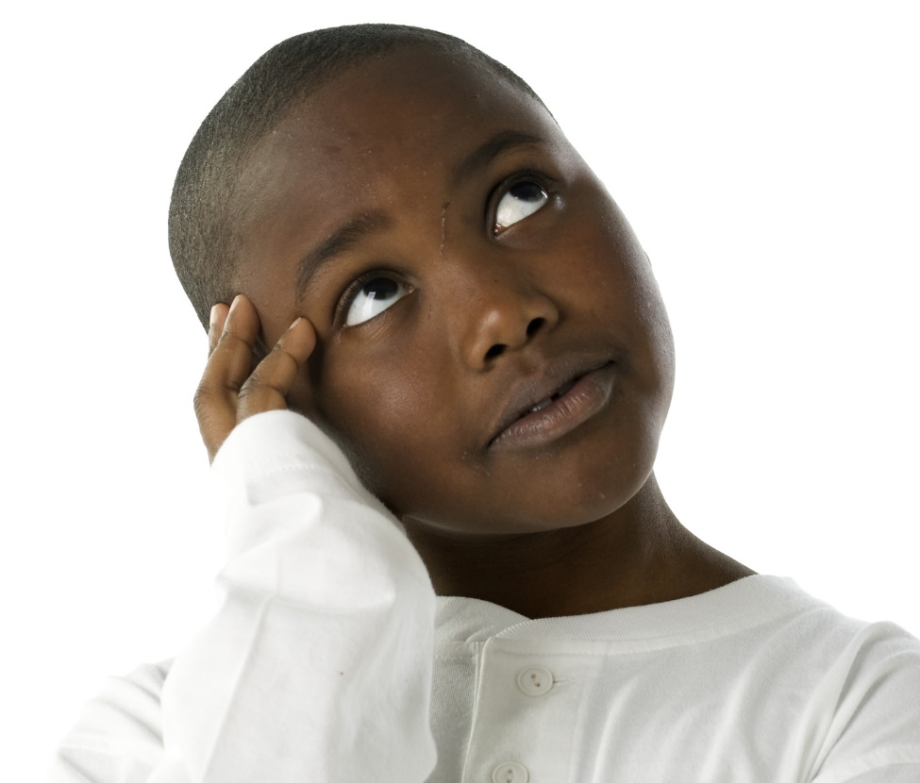
Agree or disagree?
Celebrities are supposed to be our role models- they should be setting the highest example, not saying unkind or wrong things to the public.
I disagree!
I agree!
Do you agree or disagree?
Notes:
Images
iStock

Slide 23
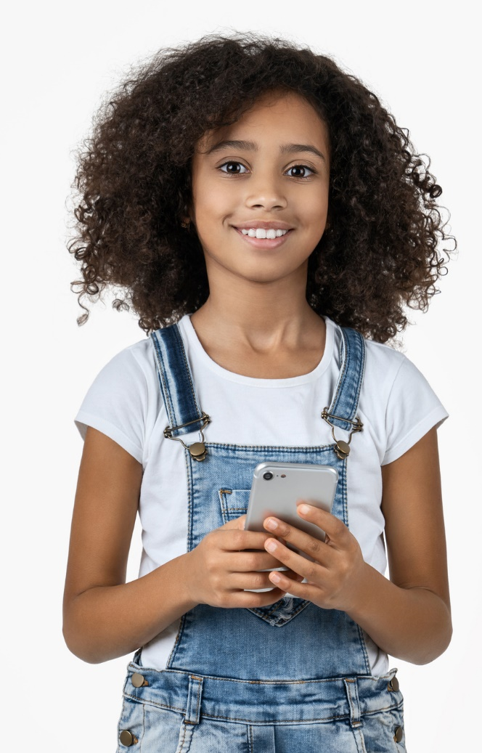
Agree or disagree?
If we cancelled everyone who ever made a mistake, we’d have no one left.
I disagree!
I agree!
Do you agree or disagree?
Notes:
Images
iStock

Slide 24
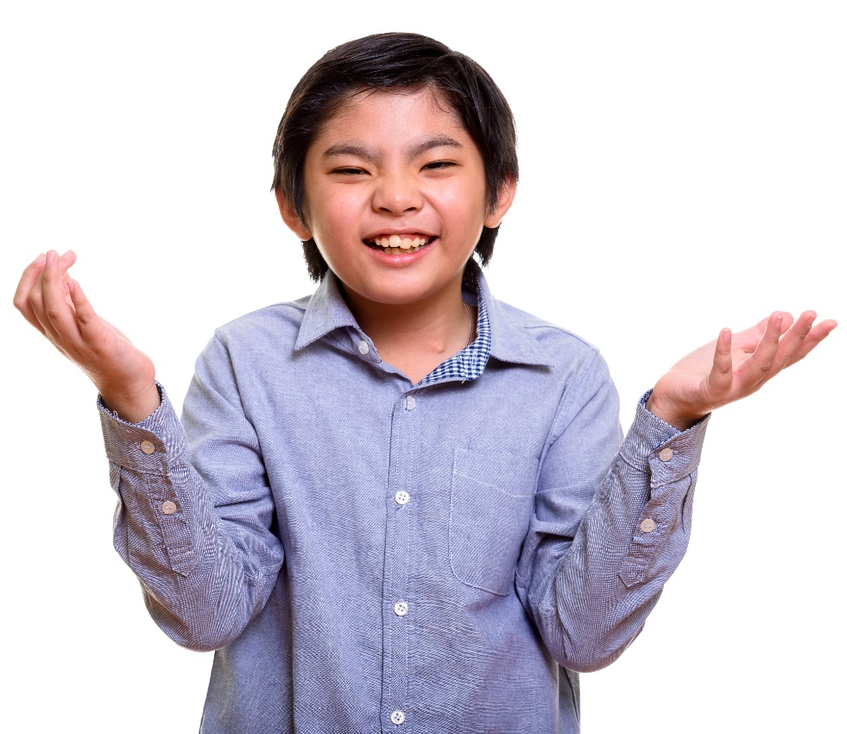
Agree or disagree?
It’s fine to have different opinions, but you shouldn’t put them on the internet where everyone can see it, because you don’t know who you might offend.
I disagree!
I agree!
Do you agree or disagree?
Notes:
Images
iStock

Slide 25
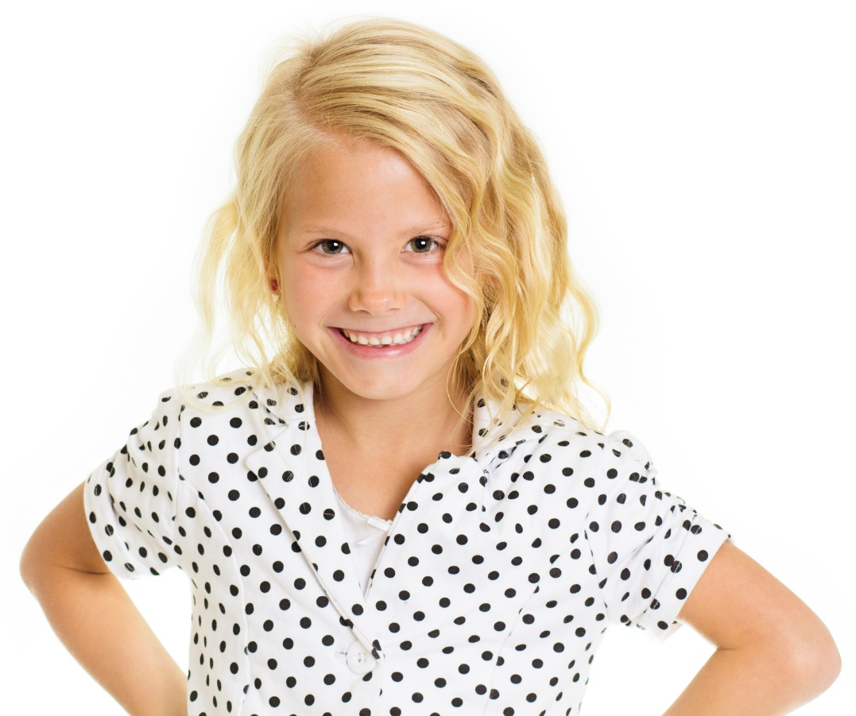
Agree or disagree?
Our differences are the best thing about our society. By cancelling people we don’t agree with, we’re forcing everyone to think the same thing.
I disagree!
I agree!
Do you agree or disagree?
Notes:
Images
iStock

Slide 26
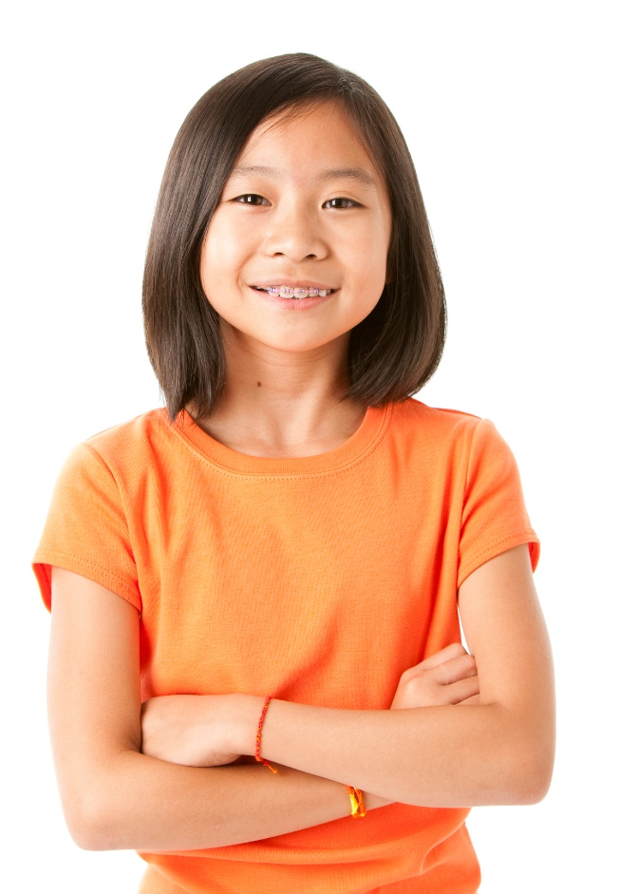
Agree or disagree?
Cancelling celebrities is ok- they should know better – but when normal people go viral and get cancelled, that’s not fair. They don’t have the money or the experience that celebs have.
I disagree!
I agree!
Do you agree or disagree?
Notes:
Images
iStock

Slide 27
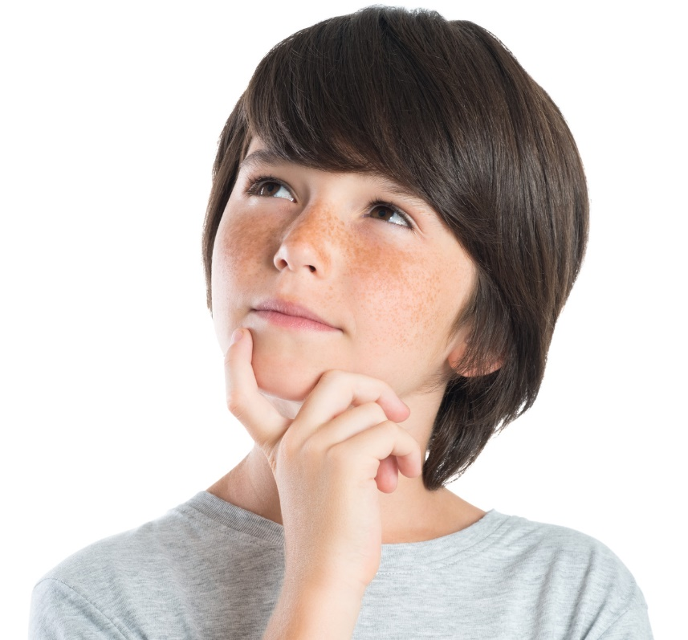
Agree or disagree?
Cancelling people is fine, but telling everyone else that they have to cancel someone just because you have isn’t ok. Everyone should make their own decision.
I disagree!
I agree!
Do you agree or disagree?
Notes:
Images
iStock

Slide 28
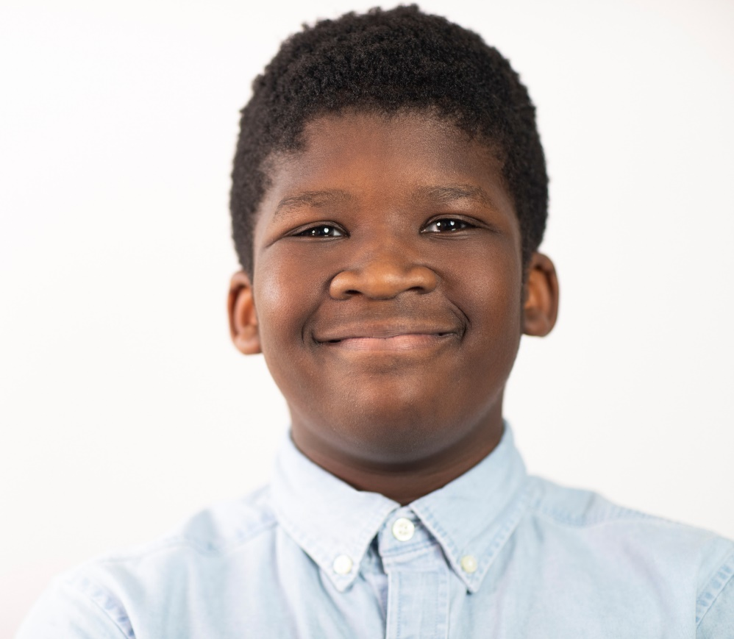
Agree or disagree?
Cancel culture shows everyone that we’re not going to stand for homophobic, racist or any other kind of abusive language. It’s the best way to make people listen.
I disagree!
I agree!
Do you agree or disagree?
Notes:
Images
iStock

Slide 29
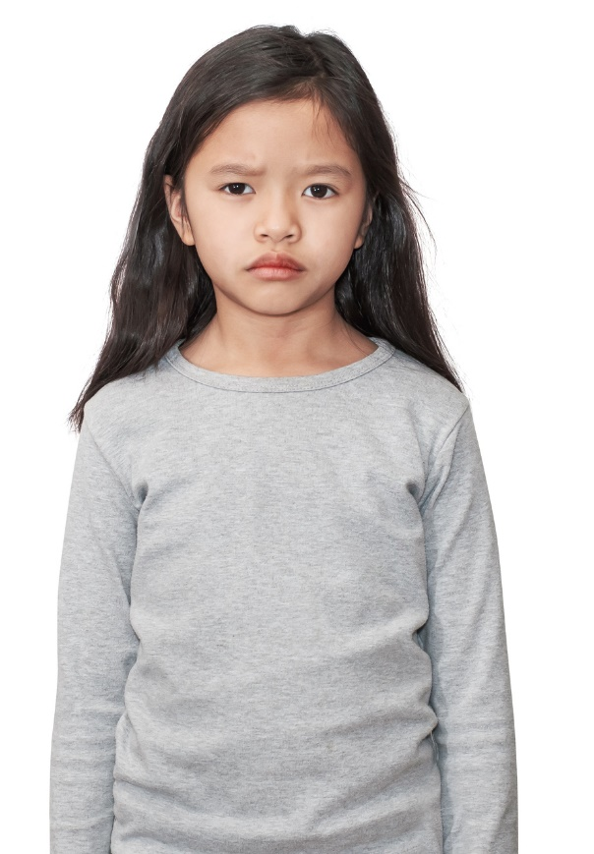
Agree or disagree?
Cancel culture needs to be cancelled. We need a culture where, when you make mistakes, people understand and teach you to be better.
I disagree!
I agree!
Do you agree or disagree?
Notes:
Images
iStock

Slide 30
What is “cancel culture?”
Starter:
What’s social media for?
Should they be cancelled?
Why are we talking about this?
Gone too far?
Agree or disagree?
Vote!
Notes:
Images
iStock

Slide 31
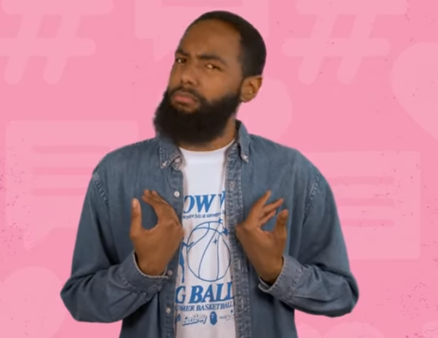
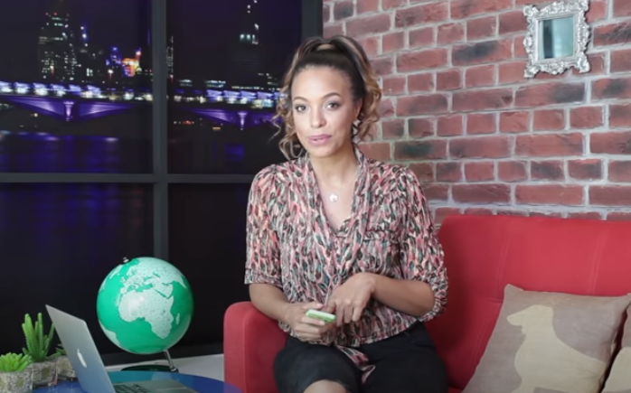
Learn more: How much screen time is too much?
0:00-5:16
With everything going on with COVID, and all the different apps and games that are out right now, it can be easy to spend all day in front of a screen… but is this bad for us? Take a look at this video to find out more information.
0:00-
4:52
Career Spotlight:
This week, we’re shining a light on how social media can affect you when you try to get a job later on. Click the image to hear about your digital footprint and how this can both help, or stop, you from getting a job.
https://safeshare.tv/x/ss5f6c5dfb9ff51
https://safeshare.tv/x/ss5f6c5bffe6fd5
Notes:
Alternative video links:
Digital Footprint: https://www.youtube.com/watch?v=OBg2YYV3Bts
Screen time: https://www.youtube.com/watch?v=fVALeerZpd4

Slide 32
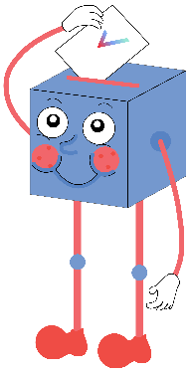
Is “cancel culture” unfair?
Everyone is entitled to have different views, and we cannot just “cancel” someone because we don’t agree with what they say.
People with homophobic, racist and unkind views need to be taught why these are wrong. Cancelling doesn’t teach them, it just makes them angrier.
Many people take “cancelling” too far and want that person to be “de-platformed” and have their life ruined, often for a mistake or a misunderstanding. That’s not fair.
Part of being a celebrity is knowing that people look up to you and scrutinise what you say, so if you end up being cancelled, it’s your own fault.
There’s no room in our society for role models with homophobic, racist or just unkind views. We’re trying to build a kind community and they don’t help.
“Cancelling” someone just means choosing not to support them anymore. We’re all allowed to do that.
Notes:
References

Slide 33


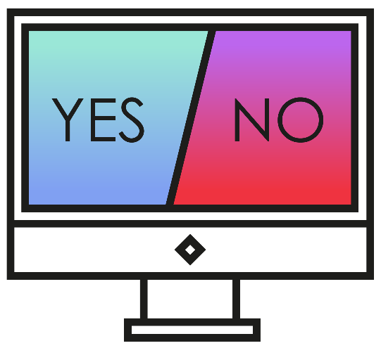
Vote!
In the classroom?
Log your class’s votes now at: www.votesforschools.com/login/teacher
At home?
Follow this link to vote: https://www.surveymonkey.co.uk/r/vfs-primary-ks2-cancel-culture
Not sure how?
Click the ballot box to see a video on how to log your votes!
Having trouble?
Copy and paste the link into your internet browser!
If you have any issues, feedback or comments, email amy@votesforschools.com.
Notes:
SurveyMonkey Link: https://www.surveymonkey.co.uk/r/vfs-secondary-volunteering
SafeShare How-To Video Link: https://safeshare.tv/x/N0-AjP3cFjg
YouTube How-To Link: https://www.youtube.com/watch?v=N0-AjP3cFjg&feature=youtu.be

