Slide 2
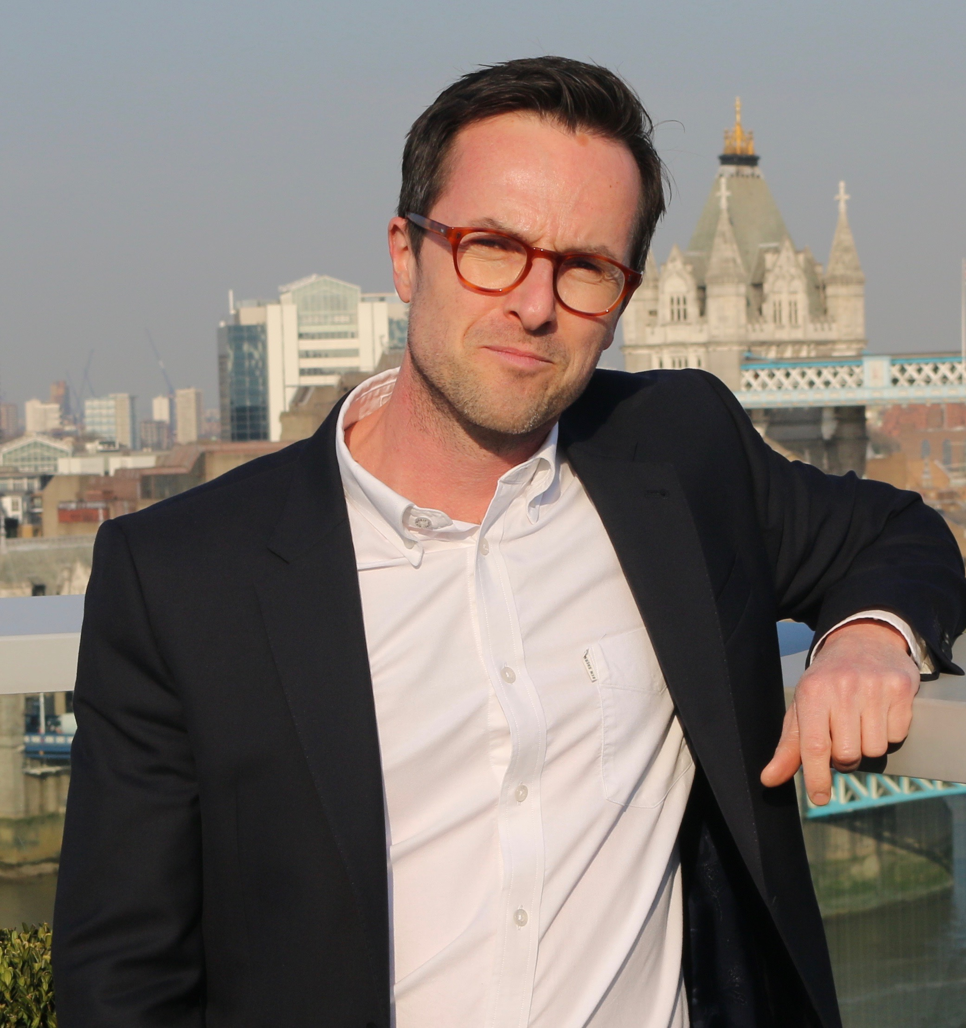
Feedback: “Should everyone volunteer in their community?”
“I think it is great that people are helping the community. It is a very nice thing to do.”
Northwood College for Girls
No
“People should be able to choose the things that they do with their time.”
Skippers Hill Primary School
34.6%
“I would like to volunteer to help get rid of all the leaves on the ground now.”
Engayne Primary School
“Not everyone would have time to volunteer/would be able to volunteer for some things.”
Sutton Coldfield Grammar School
Yes
65.4%
“We're really grateful to all the students who took part in this discussion. There's a clear view that volunteering is a good thing and could help bring communities together; but it needs to remain attractive and interesting to encourage people to choose to do it. These findings will form part of Talk/together, the UK's biggest-ever public consultation on how to build a closer and more connected society.”
Steve Ballinger, Director of Communications for British Future (full quote in notes)
Notes:
Full Quote: “We're really grateful to VotesforSchools and to all the students who took part in this discussion. The results are very interesting, offering both encouragement and challenge: there's a clear view that volunteering is a good thing and could help bring communities together; but it needs to remain attractive and interesting, to encourage people to choose to do it. These findings will form part of Talk/together, the UK's biggest-ever public consultation on how to build a closer and more connected society and we'll incorporate them into a final report early next year that will help shape our future campaigns.”
Images
Courtesy of Steve

Slide 3











Starter: Who are you?
Your friends?
Your past?
Your family?
Your religion?
Your school?
Individual task (2-3 mins)
Think about who you are: your personality, the way you look/dress, the things you like – what do you think influenced these parts of you? On your own, mind-map who or what made you who you are today.
Your hobbies?
Music?
What you watch/read?
Where you grew up?
Online influences?
Notes:
Images:
1) icons8

Slide 4
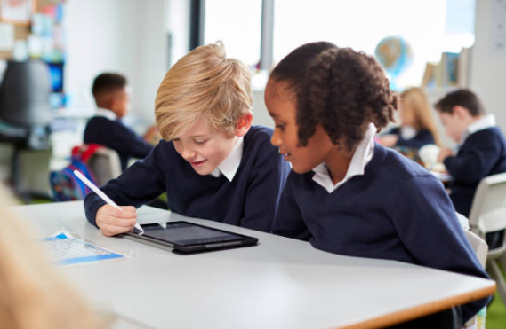
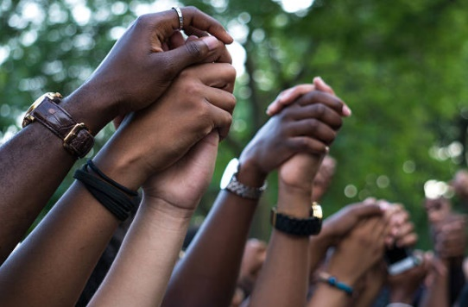

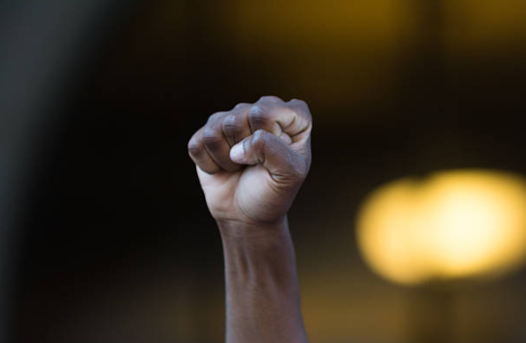
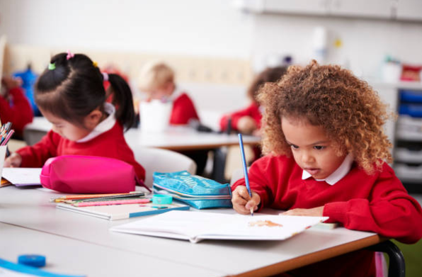
Does the curriculum represent you?
Notes:
Images
https://www.blackhistorymonth.org.uk/
iStock
References

Slide 5







Starter: Who are you?
Why are we talking about this?
What is representation?
What is the curriculum?
Is it representative?
Could we do better?
Vote!
Notes:
Images
Noun Project

Slide 6


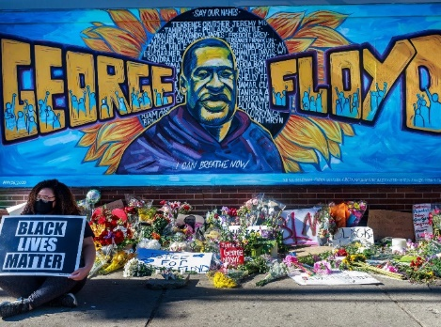
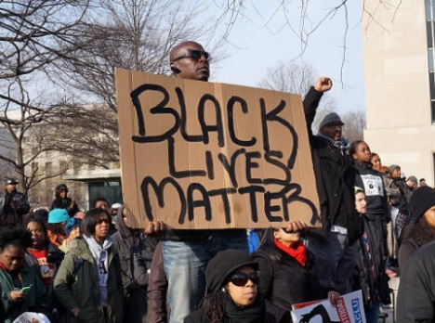
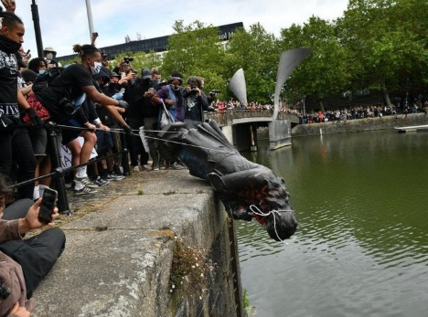
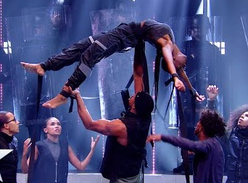
Why are we talking about this?
It’s Black History Month here in the UK! Every year, in October, people all over the UK get together to learn, celebrate and talk about black history.
This year, the conversation feels more important than ever, as there have been many events, protests and discussions about racism, both here in the UK and across the world.
Discuss (2-3 mins)
Click to see four pictures from 2020. Which of them do you remember?
The death of George Floyd
Worldwide protests
The removal of statues
Diversity’s BLM dance
Notes:
Images
https://edition.cnn.com/style/article/george-floyd-mural-social-justice-art/index.html
https://www.youtube.com/watch?v=kzFNKFitHjw
https://www.expressandstar.com/news/uk-news/2020/06/07/why-was-the-statue-of-edward-colston-so-controversial/
Istock
https://www.blackhistorymonth.org.uk/
References
https://dictionary.cambridge.org/dictionary/english/volunteer?q=volunteering

Slide 7
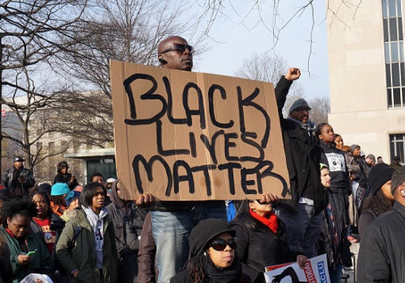
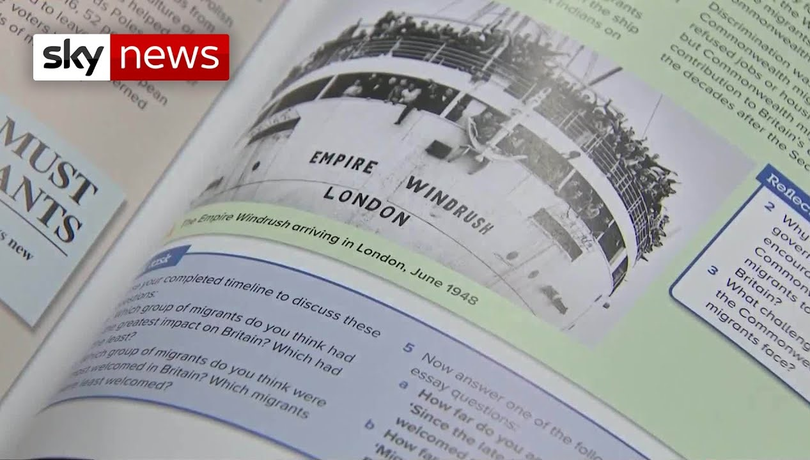
Why are we talking about this?
Though Black Lives Matter has been around since 2013, this year we’ve seen a bigger push to look at what can be done to tackle racism and celebrate Black history and culture, both in the UK and around the world.
One conversation that has been talked about a lot is whether there is enough representation in the curriculum that is taught in schools, or whether the curriculum should change.
0:00-1:56
Watch (2-3 mins)
Click the image to hear about the changes that are being suggested and why. Do you agree?
Today we’ll be thinking about what representation means and whether you feel that your curriculum represents you, your history and your identity.
https://safeshare.tv/x/j-5-DWYcAT0
Notes:
Alternative video link: https://www.youtube.com/watch?v=j-5-DWYcAT0 (stop at 1:56)
Images
iStock
https://www.youtube.com/watch?v=j-5-DWYcAT0
References
https://www.blackhistorymonth.org.uk/
https://metro.co.uk/2020/06/04/what-systemic-racism-mean-12806367/

Slide 8
Starter: Who are you?
Why are we talking about this?
What is representation?
What is the curriculum?
Is it representative?
Could we do better?
Vote!
Notes:
Images
Noun Project

Slide 9









What is representation?
Representation means that we see all different types of people in what we read, listen to and learn about. This could be through:
The people you see on TV and in films
The people you read about in books
The characters you see in games
In adverts and on leaflets
The people you learn about in school
People in powerful jobs, such as politics
Pair task (2 mins)
On your own or with a partner, can you think of three characters in films, TV, books or games that you feel ‘represent’ you? It could be…
Someone who looks like you?
Someone who acts like you?
Someone who has a similar story to you?
Reflection (2-3 mins)
How easy or hard was it for you to think of these examples? Why do you think that is?
Notes:
Images:
1) icons8

Slide 10
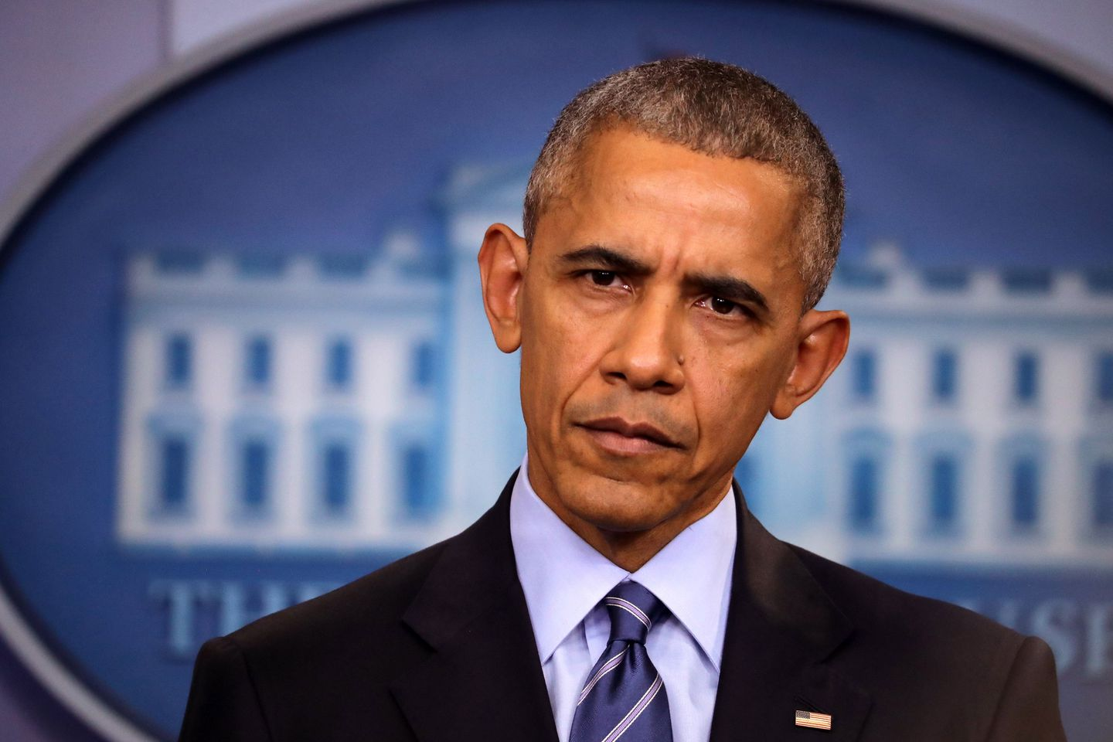
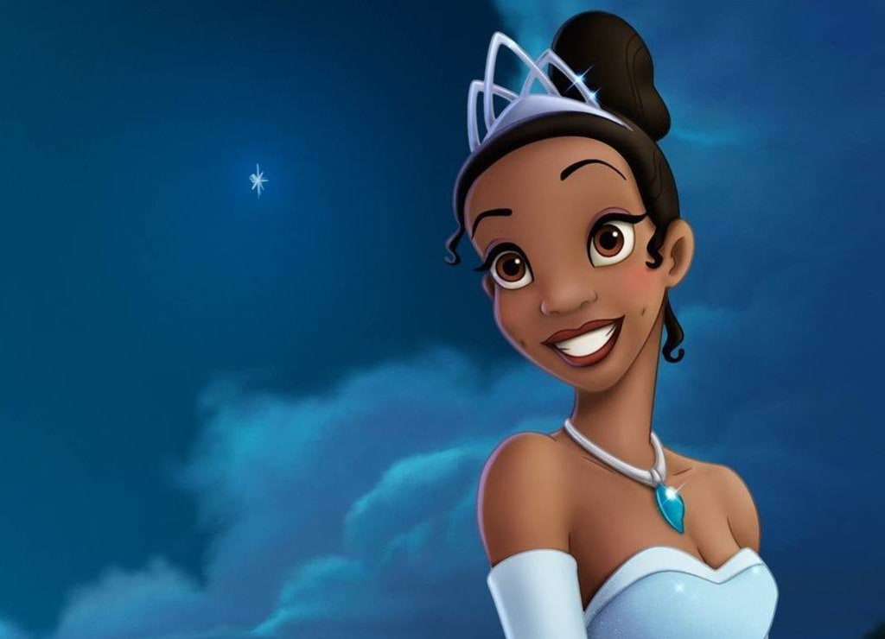
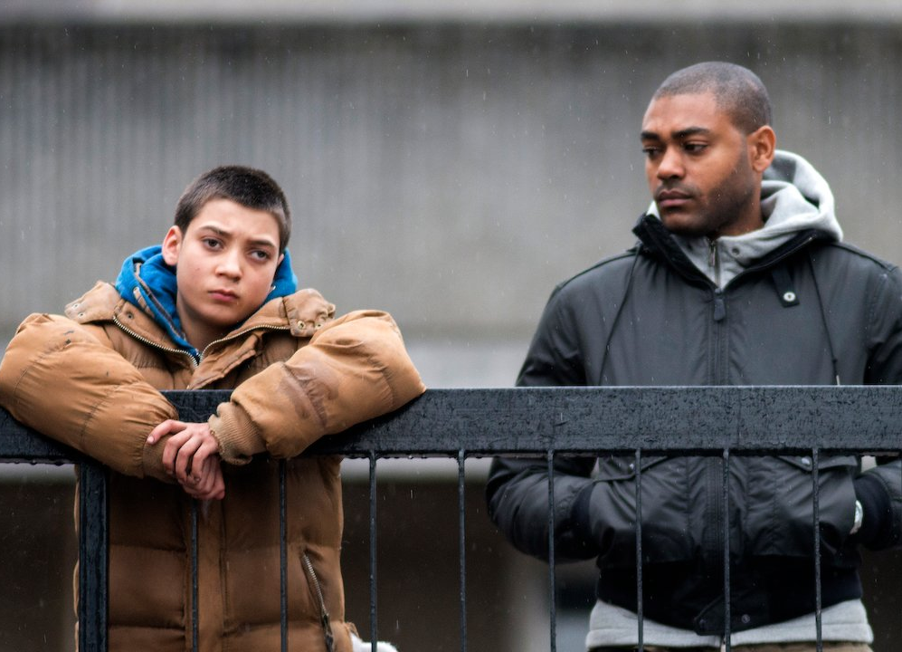
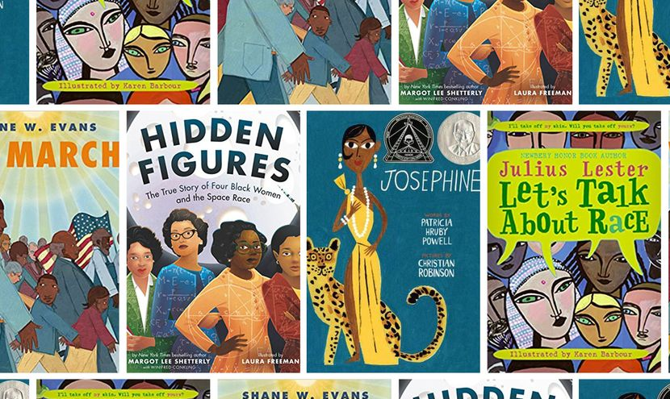
What is representation?
Pair task (2-3 mins)
Now that you have thought about where you are represented, discuss with your class why you think it is important to be represented, and how you might feel if you were not represented. If you get stuck, click to hear some other children’s opinions.
Seeing Barack Obama as the first Black President made me want to become a world leader too!
I can remember seeing the Disney film The Princess and the Frog - I’d never seen a Black princess before.
Lots of times on TV programmes I see Black people in gangs or getting into trouble, and I worry that this will happen to me too.
I kind of wish books didn’t have pictures in them, because I like to think all of the characters look like me but usually they don’t.
Challenge (3-5 mins)
These examples focus on Black representation. Can you think of any other groups who might not be equally represented in the media?
Notes:
Images:
https://vocal.media/viva/why-tiana-is-the-best-disney-princess
https://www.bostonglobe.com/opinion/2016/12/28/obama-lame-duck-stunt-israel/sapBpDy9CRIuRHV0ZgCn7M/story.html
https://www.netflix.com/gb/title/70236561
References:
https://time.com/black-panther/
https://www.washingtonpost.com/news/post-nation/wp/2017/05/05/why-its-so-powerful-to-see-yourself-represented-in-pop-culture/

Slide 11
Starter: Who are you?
Why are we talking about this?
What is representation?
What is the curriculum?
Is it representative?
Could we do better?
Vote!
Notes:
Images
Noun Project

Slide 12
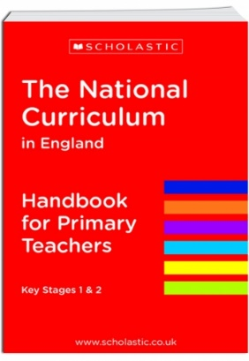
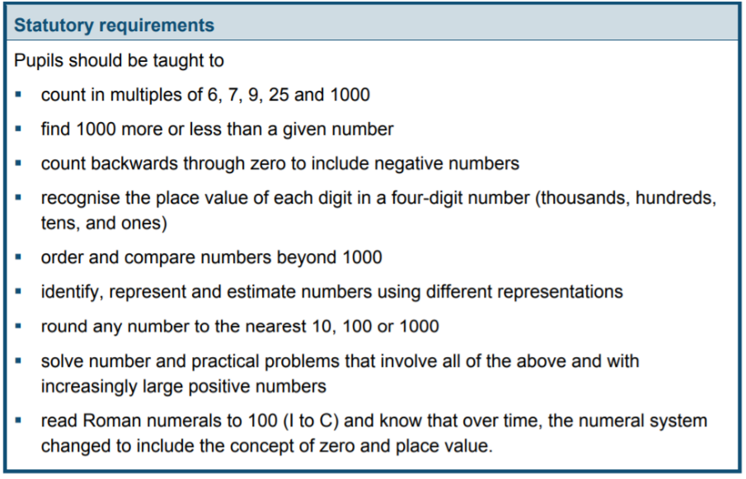
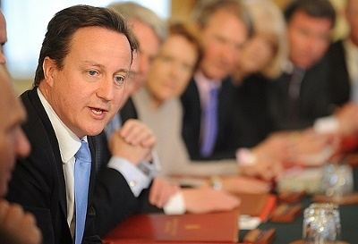
What is the National Curriculum?
Discuss (1-3 mins)
Have you ever wondered who decides what you learn at school? Share your ideas before finding out!
Everything that you learn at school comes from a book called The National Curriculum.
The National Curriculum is a book for teachers, which tells them what their class should know by the end of each year.
It was updated by the Government in 2014, and has over 200 pages of instructions for teachers, to make sure that every child in England has the same education.
Challenge:
This page shows some of the things that you learn in maths in Year 3. Do you recognise any?
Notes:
Images:
https://assets.publishing.service.gov.uk/government/uploads/system/uploads/attachment_data/file/425601/PRIMARY_national_curriculum.pdf
References:
1) https://assets.publishing.service.gov.uk/government/uploads/system/uploads/attachment_data/file/425601/PRIMARY_national_curriculum.pdf

Slide 13
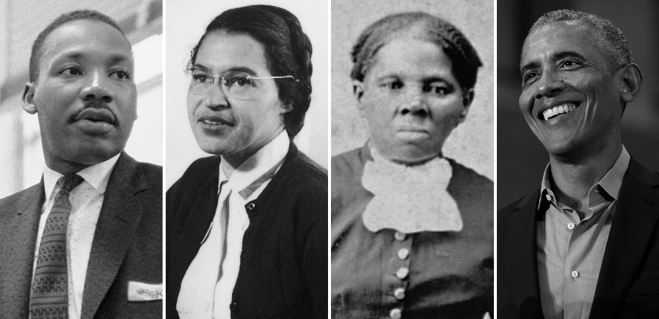
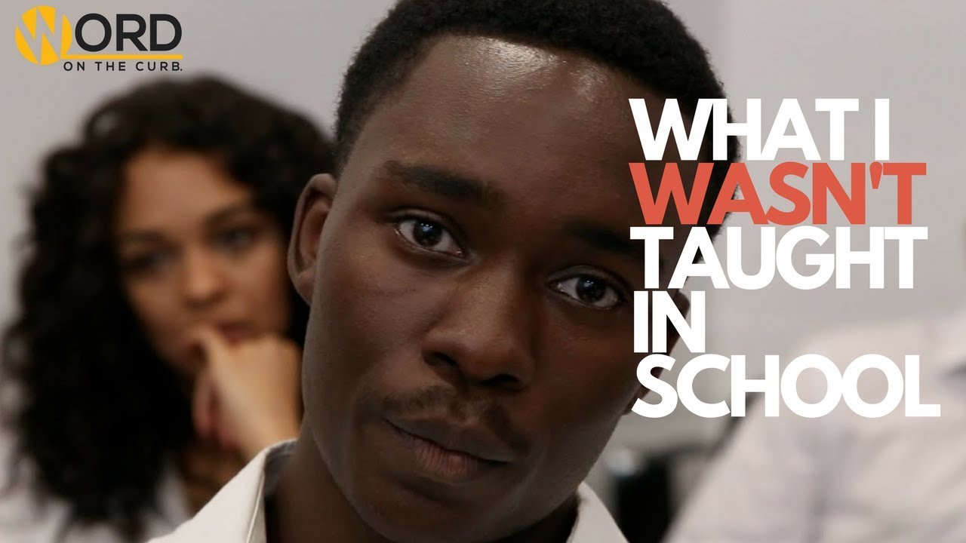
What is the National Curriculum?
When the Government updated the curriculum in 2014, they wanted to focus on British history and British art/culture. However, many people have said that there isn’t enough representation of Black British history or of people from other countries.
They say that not enough Black history is taught in schools, and that pupils only really learn about a few people and their fight against slavery, and not about all the achievements Black people have made in Britain and around the world.
0:00-1:35
Watch and discuss (2-3 mins)
Listen to this poem by Samuel King about what he didn’t learn about in school during Black History Month. Do you agree that more Black history should be taught in school? Why/why not?
https://safeshare.tv/x/ss5f75b38d50368
Notes:
Alternative video link: https://www.youtube.com/watch?v=TNfH41-LI4w (0:39-2:14)
Images:
https://time.com/5771045/black-history-month-evolution/
References:
1) https://time.com/5771045/black-history-month-evolution/

Slide 14
Starter: Who are you?
Why are we talking about this?
What is representation?
What is the curriculum?
Is it representative?
Could we do better?
Vote!
Notes:
Images
Noun Project

Slide 15



Is it representative?
Is it representative? (10 mins)
On the next few slides you will see some different topics, lessons and events that are often taught in Primary schools. For each one, use your thumbs to show whether you think that this helps represent everyone or not and be ready to explain why you feel this way.
Not representative
Partly representative
Everyone is represented

Slide 16
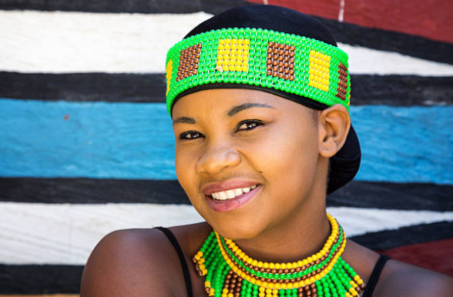



Is it representative?
At the start of every year, we hold a school “culture day” where we all bring in things from home like food, clothes or music, and we teach each other about ourselves and our culture.
Not representative
Partly representative
Everyone is represented
Notes:
Images:
1) iStock

Slide 17
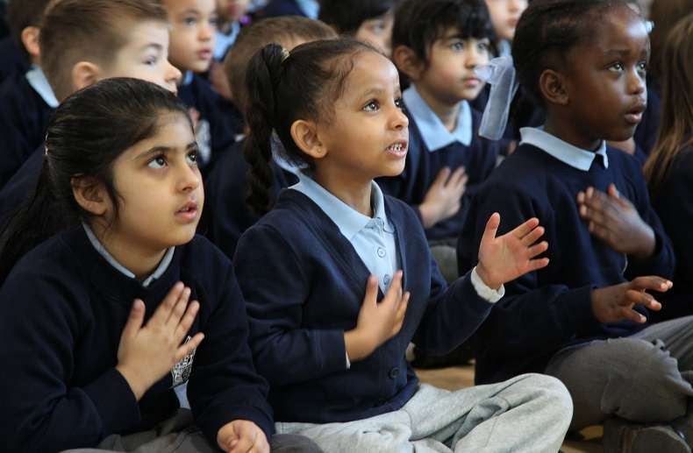
Is it representative?
During Black History Month we always have an assembly about important black people like Martin Luther King and Rosa Parks. We don’t really learn about Black people in other months though.
Not representative
Partly representative
Everyone is represented
Notes:
Images:
https://www.tes.com/news/why-schools-should-bring-back-singing-assembly
iStock

Slide 18
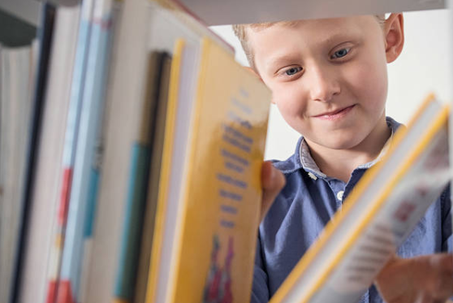
Is it representative?
Our school library has so many different books, about people of every skin colour and from every country. We even have dual language books for people who want to read in their own language.
Not representative
Partly representative
Everyone is represented
Notes:
Images:
1) iStock

Slide 19
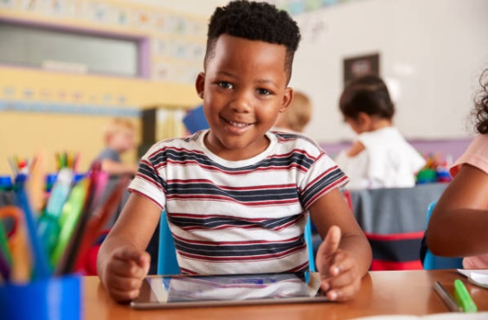
Is it representative?
This year in history we’ve learned about the Stone Age, the Ancient Egyptians and The Tudors. I’m not sure what skin colour these people had because it’s not something we talked about in class.
Not representative
Partly representative
Everyone is represented
Notes:
Images:
1) iStock

Slide 20
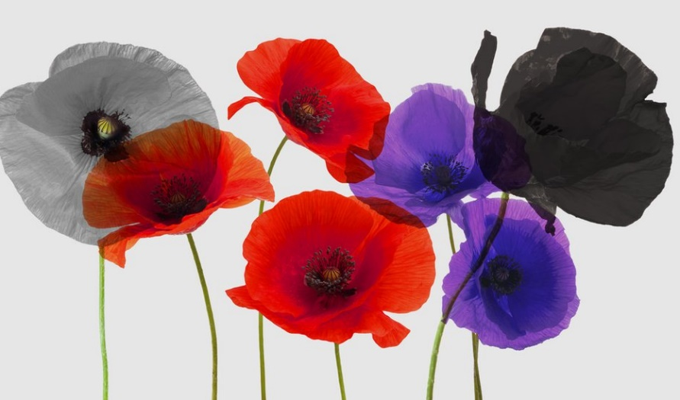
Is it representative?
When we were learning about World War II last year, we made poppies in all different colours to remind ourselves of all the different soldiers that served in the war.
Not representative
Partly representative
Everyone is represented
Notes:
Images:
1) https://www.bbc.co.uk/newsround/45975344

Slide 21
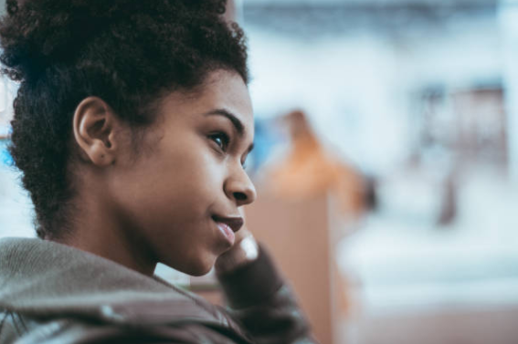
Is it representative?
In RE we learn about all the different religions around the world. I like it because there are lots of different religions in my school, but I don’t understand how England changed from a very strict Christian country to a country with lots of religions.
Not representative
Partly representative
Everyone is represented
Notes:
Images:
1) iStock

Slide 22
Starter: Who are you?
Why are we talking about this?
What is representation?
What is the curriculum?
Is it representative?
Could we do better?
Vote!
Notes:
Images
Noun Project

Slide 23







Ext: Could we do better?
Marks out of 10? (2 mins)
Now that you know what representation means and what the curriculum is for, it’s time to rate your school! Using your fingers, give your school a mark out of 10 for how well you think they represent you. Be ready to explain your reasons.
“I think that… because…”
“We could do better by…”
“The best thing about us is…”
“I sometimes feel like…”
“We’re very good at… because…”
Notes:
Images
1) Icons8

Slide 24



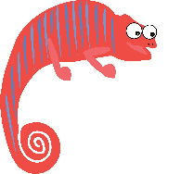

Ext: Could we do better?
When it comes to making a change in the way things are done in schools, there are three main groups of people who can make a difference:
The Government decide what is taught in schools.
Headteachers and teachers decide how schools should be run.
Pupils decide how they act and behave around each other.
You’re in charge! (10-15 mins)
Your teacher will organise you into groups of 3. Your task is to think about what each of these groups already do to make the curriculum representative. Once you’ve done that, think about what they could do to make it even better. There are some ideas on the next slide to help you.
Not in the classroom?
Try to think of one change each group could make. Then, explain your ideas on a video, and send it to your teacher!

Slide 25









Ext: Could we do better?
1
The Government
2
Schools
3
Pupils
Make sure the curriculum is representative of everyone.
Get representative books in the library.
Share more about themselves and their history.
Hire teachers from different backgrounds.
Hold celebration days so we can learn about each other.
Don’t be unkind to people who are different.
Ask teachers what they think and take their ideas on board.
Ask pupils who or what they would like to learn more about in lessons.
Set up a book club where they read representative books.
Challenge:
Which of these suggestions do you agree with and which do you disagree with? Why?

Slide 26


Quick idea
Get involved!
As always, Black History Month have a wide range of exciting and insightful events planned throughout October. Why not check out what’s on offer by clicking the image?
Please Note: As with any events at the moment, please ensure that if you do attend – whether in person or virtually – you do so safely & respectfully.
Big idea
Start your own discussion group
Conversations are key to moving forward and making the changes you want to see. With this in mind, why not start a discussion group with your classmates to talk about what your school could do more to promote Black history and culture? Even if they already do a great job, talking about it always helpful!
Notes:
Images
https://www.blackhistorymonth.org.uk
iStock
References
https://www.blackhistorymonth.org.uk/

Slide 27
Starter: Who are you?
Why are we talking about this?
What is representation?
What is the curriculum?
Is it representative?
Could we do better?
Vote!
Notes:
Images
icons8.com

Slide 28
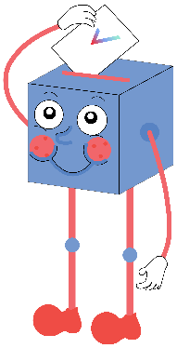
Does the curriculum represent you?
I feel like my culture, background and identity are represented in my school curriculum.
While I feel represented, I think many of my friends or classmates aren’t.
I feel my school works hard to portray our multiculturalism within our curriculum.
I think enough is being done to represent myself and the people around me.
I feel like my culture, background and identity are not represented in my school curriculum.
I think I’m partly represented, but I am conscious that influential people in my life aren’t.
I feel our multiculturalism isn’t portrayed within our curriculum.
I think more could be done to represent myself and the people around me.
Notes:
References

Slide 29



Vote!
In the classroom?
Log your class’s votes now at: www.votesforschools.com/login/teacher
At home?
Follow this link to vote: https://www.surveymonkey.co.uk/r/vfs-primary-ks2-BHM
Not sure how?
Click the ballot box to see a video on how to log your votes!
Having trouble?
Copy and paste the link into your internet browser!
If you have any issues, feedback or comments, email amy@votesforschools.com.
Notes:
SurveyMonkey Link: https://www.surveymonkey.co.uk/r/vfs-primary-ks2-BHM
SafeShare How-To Video Link: https://safeshare.tv/x/N0-AjP3cFjg
YouTube How-To Link: https://www.youtube.com/watch?v=N0-AjP3cFjg&feature=youtu.be

