Slide 2

Feedback: “Is "cancel culture" unfair?
“I never really thought cancel culture was so big, but this lesson really helped me understand what is going on in the world, and that it actually has a huge impact on people.”
Northwood College for Girls
“I am a bit in the middle with my opinion. I think that people should be punished for the things that they say and it shows that we don't like people who say them things, but it is a bit harsh.”
Pinfold Primary School
“Sometimes it’s ok but you don’t want to over do it like taking everything away from whoever you want to cancel.”
Engayne Primary School
Yes
“We all have the right to unfollow people as we do it everyday.”
Skippers Hill Manor School
No
57.8%
42.2%
Young people: lead the way! This is a current, important and complex issue…about freedom of speech in the age of social media. [Social media should] encourage learning, sharing of ideas, creativity and help us feel safe - but within limits. Those limits are about protecting against harm and fear from those who would wish to intimidate and discriminate.
Edward Waller, Co-Director of Realising Rights
Notes:
Full Quote: “We are pleased to see that you have been discussing 'cancel culture'. It is interesting to see that opinion is divided on this and this reflects a dilemma that is well worth exploring further. In fact it is crucial we all explore our thinking on this more. Young people: lead the way! This is a current, important and complex issue, but not at all new. It is about freedom of speech in the age of social media. A key requirement of a democracy is that it provide for freedom of speech which encourages learning, sharing of ideas, creativity and helps us feel safe - but within limits. Those limits are about protecting against harm and fear from those who would wish to intimidate, discriminate or organise to overthrow that democracy. Human Rights advocates like ourselves argue that human rights principles provide the best limits as they are universal principles which address the needs of all human beings on this planet as well as the planet itself. As Thomas Paine argued in his famous writing The Rights Of Man in 1791, during the French Revolution: “Whatever is my right as a man is also the right of another; and it becomes my duty to guarantee as well as to possess.” Wise words then and now? The challenge is to learn what our human rights are so we know what to respect , uphold and defend for ourselves and others. We need human rights education for all. What do you think?
At Realising Rights our aim is to make Human Rights real for everyone by understanding what rights are and how they can make a difference.”
Image supplied by Edward Waller.
Images
Courtesy of Steve

Slide 3








Starter: Have you noticed?
Pair task (3-5 mins)
Take a look at the statements below. Which of them have you noticed in your local area and how do you feel about them?
Working from home?
Ask a friend or family member what they’ve noticed!
Masks littered on the ground
Bins full of food or parcel packaging.
People travelling in cars alone
Empty buses, trains or trams
News articles about climate change
Environmental protests or gatherings
Challenge:
Based on this activity, what do you think this week’s lesson might be about?
Notes:
Images:
1) nounproject

Slide 4
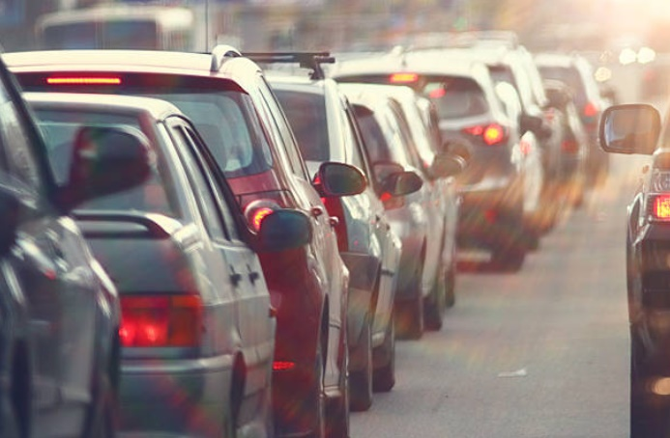
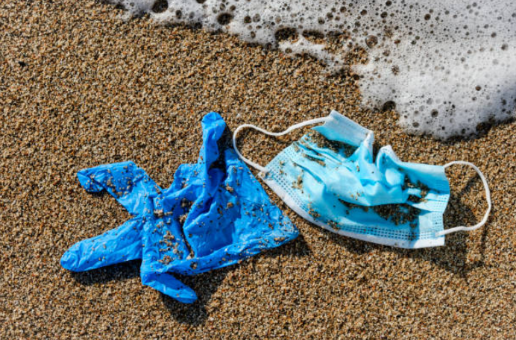
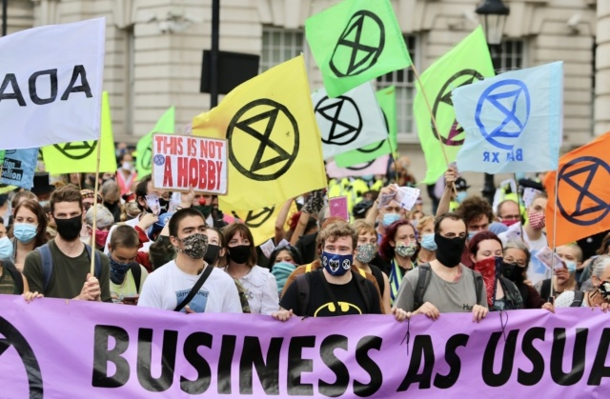
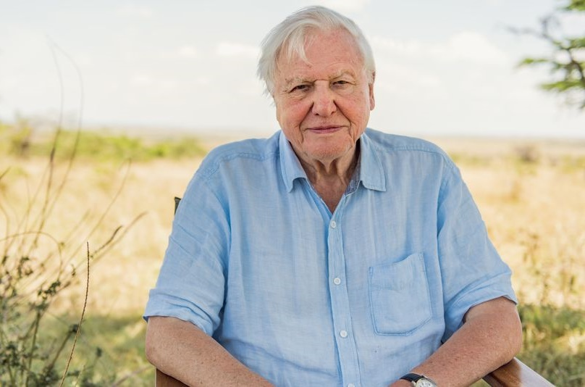
Have we forgotten about the environment this year?
Notes:
Images
iStock
https://mashable.com/article/sir-david-attenborough-instagram/?europe=true
References

Slide 5



Starter: Have you noticed?
Why are we talking about this?
Have we forgotten?
The good news or the bad news?
Playing your part
Ext: Go viral!
Vote!
Notes:
Images
iStock

Slide 6

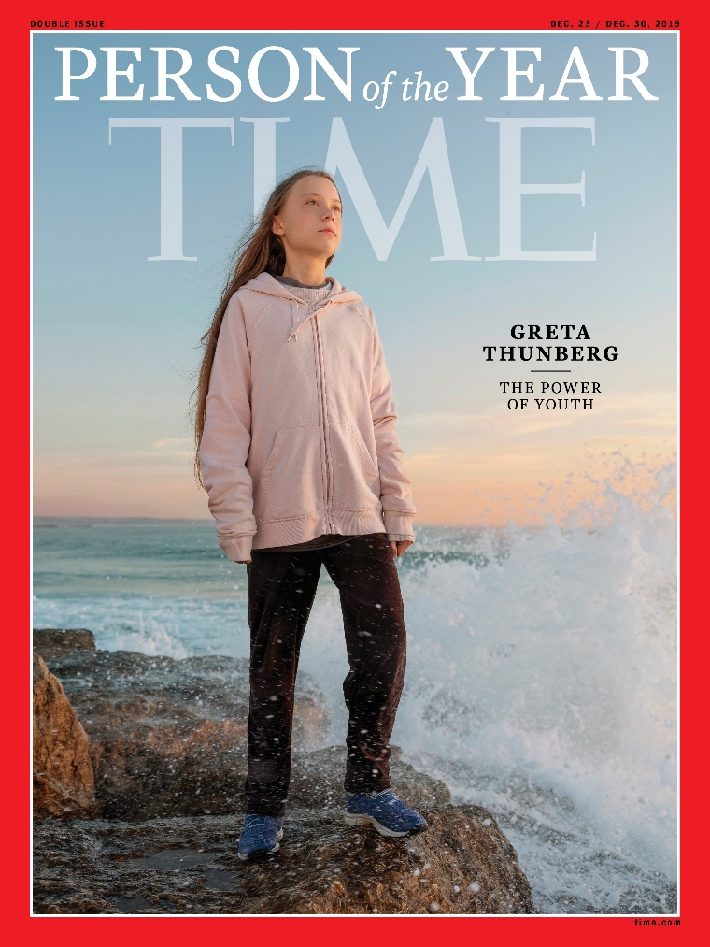


Why are we talking about this?
Remember me? (1min)
Do you recognise who Time’s person of the year was? You’ll find out on this slide!
The Coronavirus pandemic has changed the world in lots of ways. While the past few months have been really difficult there have been some great examples of people coming together to help each other too.
But one topic we’ve not heard about quite so much is the environment – last year, Greta Thunberg was named “Person of the Year” for trying so hard to reverse climate change, but has COVID-19 made us forget all about this issue? Or is it still at the front of your mind?
Challenge:
Have you seen or heard any environmental news this year? If so, share it with your class.
Notes:
Images
iStock
https://time.com/person-of-the-year-2019-greta-thunberg/
References
https://www.bbc.com/future/article/20200422-how-has-coronavirus-helped-the-environment

Slide 7
Starter: Have you noticed?
Why are we talking about this?
Have we forgotten?
The good news or the bad news?
Playing your part
Ext: Go viral!
Vote!
Notes:
Images
iStock

Slide 8





Have we forgotten?
True or false (7-10mins)
As you’ve probably noticed, things are looking very different to how they did a year ago… but how different are they? Read through the facts on the next slide and use your thumbs to show whether you think that they are true or false. Then, click to see if you’re right!
I think that this is true!
I think that this is false!
Challenge:
If you think that a “fact” in false, make a prediction for what you think the truth is and see if you get it right!

Slide 9

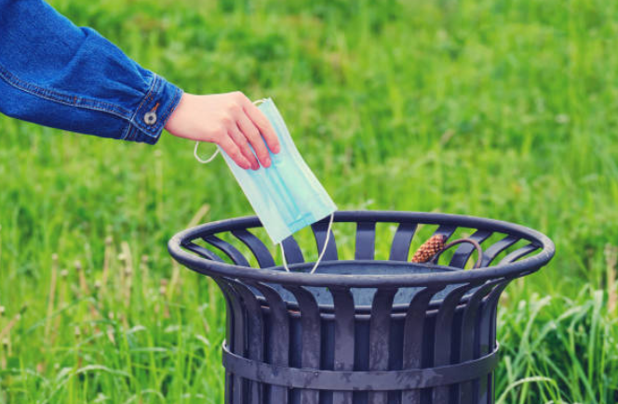
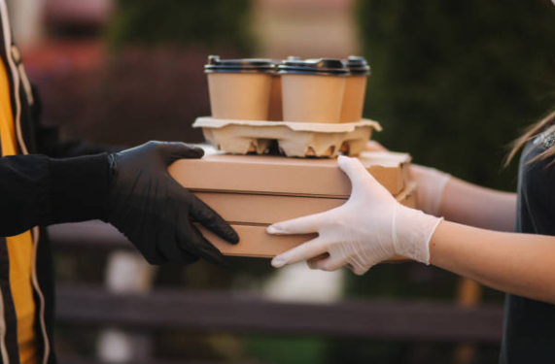

Have we forgotten?
We are throwing away 129 billion face masks every month globally during the pandemic¹.
This is true! A charity called Surfers against Sewage has said it’s seen an “explosion” of abandoned masks and gloves on the beaches and in rivers around the UK.
The amount people spent on food delivery services rose by 30% between April 2019-2020².
This is false - they actually only rose by 15%, but critics say that food delivery services use lots of single use containers and packaging which are often not recyclable.
Is it true or false?
I think that this is true!
I think that this is false!
Notes:
Images:
iStock
References:
https://www.greenmatters.com/p/face-masks-gloves-litter-coronavirus
https://www.bbc.co.uk/newsround/54015196
https://www.talkingretail.com/news/industry-news/food-delivery-surges-popularity-lockdown-15-06-2020/

Slide 10
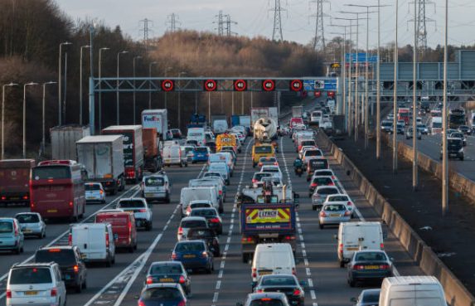
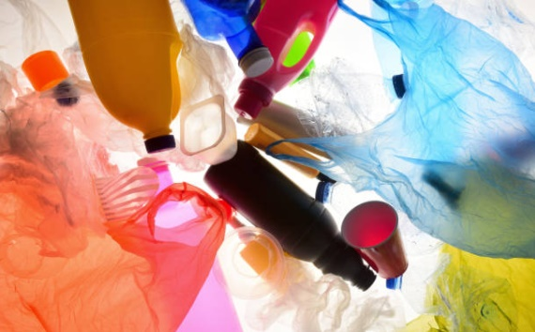
Have we forgotten?
In May, it was reported that traffic in the UK was at its highest levels since the 1970s.
This is false- traffic was actually less traffic in May than there has been in over 50 years, which helped reduce carbon emissions! There were less planes and trains too!
The amount of single-use plastic we use has increased since the Coronavirus pandemic.
This is true – from single-use cups and menus to gloves and bottles of soaps, experts expect us to use 40% more plastic over the next 10 years.
Is it true or false?
I think that this is true!
I think that this is false!
Notes:
Images:
iStock
References:
1) Traffic – 1970s levels: https://www.bbc.co.uk/news/uk-52461913
2) Plastic: https://science.sciencemag.org/content/369/6509/1314

Slide 11
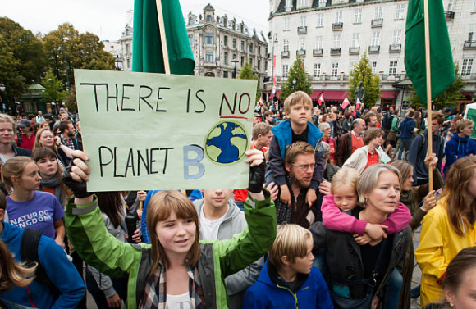

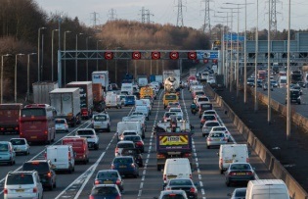

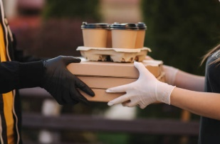
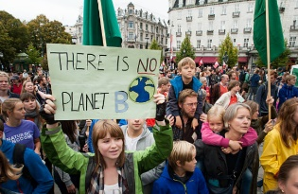
Have we forgotten?
There haven’t been any environment protests since the start of lockdown.
This is false, but protests have been done differently. For much of lockdown, they happened online, but recently Extinction Rebellion held their first in-person protest.
Is it true or false?
I think that this is true!
I think that this is false!
Reflect (2-5mins)
Did any of these facts surprise you, or did you already know or expect them?
Notes:
Images:
iStock
References:
https://theconversation.com/environmental-activism-goes-digital-in-lockdown-but-could-it-change-the-movement-for-good-137203
https://www.bbc.co.uk/newsround/53983439

Slide 12
Starter: Have you noticed?
Why are we talking about this?
Have we forgotten?
The good news or the bad news?
Playing your part
Ext: Go viral!
Vote!
Notes:
Images
iStock

Slide 13

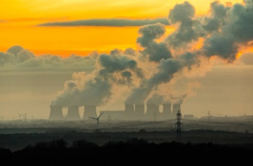
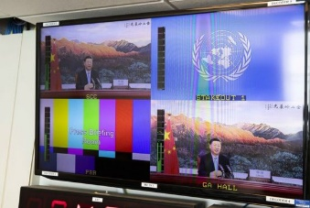
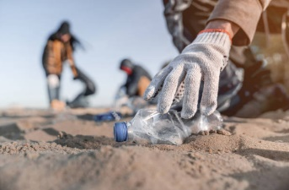
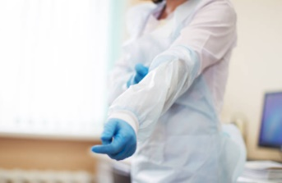
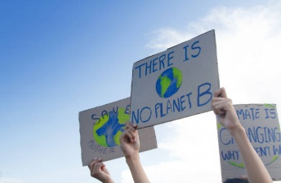



The good news or the bad news?
Now that you’ve seen how Coronavirus has affected our behaviour around the environment, it’s time to look at some news from around the world.
The good news or the bad news? (5-10mins)
Look at the news headlines on the next few slides. For each one, read the information and use your feet to say whether this shows whether it’s good news for the environment or whether it’s bad news.
This is bad news!
It’s both good and bad!
This is good news!
Notes:
Images:
1) iStock

Slide 14
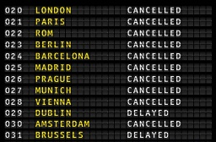
The good news or the bad news?
As the world went into lockdown, the amount of air pollution we were producing dropped by 7% - the biggest “carbon crash” on record! This was partly due to flights being cancelled, factories closing and us travelling less.
Is this good, bad or neutral news?
This is bad news!
It’s both good and bad!
This is good news!
Notes:
Images:
iStock
References:
https://time.com/5864374/coronavirus-carbon-emissions/
https://www.independent.co.uk/news/coronavirus-pollution-environment-lockdown-carbon-emissions-charts-a9510636.html

Slide 15
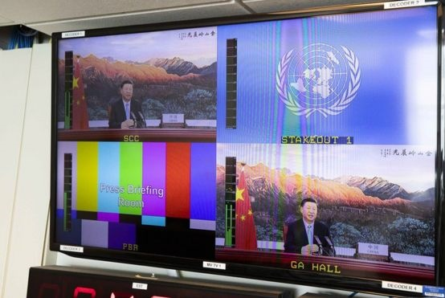
The good news or the bad news?
Experts think that up to 28% of the world’s air pollution is made by China, but last month, President Xi Jinping of China announced that the country will be “carbon neutral” by 2030!
Is this good, bad or neutral news?
This is bad news!
It’s both good and bad!
This is good news!
Notes:
Images:
iStock
References:
https://www.bbc.co.uk/news/science-environment-54256826

Slide 16

The good news or the bad news?
Here in the UK, littering has increased massively during the pandemic! However, there have also been more volunteers picking up rubbish, so it doesn’t go into our rivers and seas.
Is this good, bad or neutral news?
This is bad news!
It’s both good and bad!
This is good news!
Notes:
Images:
1) iStock
References:
https://www.weforum.org/agenda/2020/07/plastic-waste-management-covid19-ppe/
https://www.theguardian.com/environment/2020/jul/21/it-was-so-gross-i-nearly-cried-meet-the-uks-litter-picking-army-fighting-our-rising-tide-of-filth
https://www.youtube.com/watch?v=Goc622f4Wcs

Slide 17
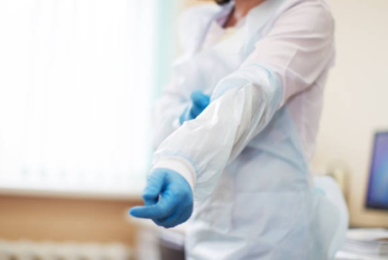
The good news or the bad news?
COVID-19 has meant we’re using more plastic than ever before, but social distancing has meant a lot less people can work at rubbish and waste centres, making recycling and getting rid of our waste much more difficult!
Is this good, bad or neutral news?
This is bad news!
It’s both good and bad!
This is good news!
Notes:
Images:
iStock
References:
https://www.weforum.org/agenda/2020/07/plastic-waste-management-covid19-ppe/
https://www.theguardian.com/environment/2020/jul/21/it-was-so-gross-i-nearly-cried-meet-the-uks-litter-picking-army-fighting-our-rising-tide-of-filth
https://www.youtube.com/watch?v=Goc622f4Wcs

Slide 18

The good news or the bad news?
There were a lot less in-person protests during lockdown, but Extinction Rebellion have been back recently – blocking the roads outside newspaper factories instead of protesting online.
Is this good, bad or neutral news?
This is bad news!
It’s both good and bad!
This is good news!
Notes:
Images
https://theconversation.com/environmental-activism-goes-digital-in-lockdown-but-could-it-change-the-movement-for-good-137203
iStock
https://www.theguardian.com/environment/2020/apr/02/we-must-use-this-time-well-climate-experts-hopeful-after-cop26-delay-coronavirus
References
https://theconversation.com/environmental-activism-goes-digital-in-lockdown-but-could-it-change-the-movement-for-good-137203
https://www.theguardian.com/environment/2020/sep/11/extinction-rebellion-how-successful-were-the-latest-protests
https://www.theguardian.com/environment/2020/apr/02/we-must-use-this-time-well-climate-experts-hopeful-after-cop26-delay-coronavirus

Slide 19
Starter: Have you noticed?
Why are we talking about this?
Have we forgotten?
The good news or the bad news?
Playing your part
Ext: Go viral!
Vote!
Notes:
Images
iStock

Slide 20
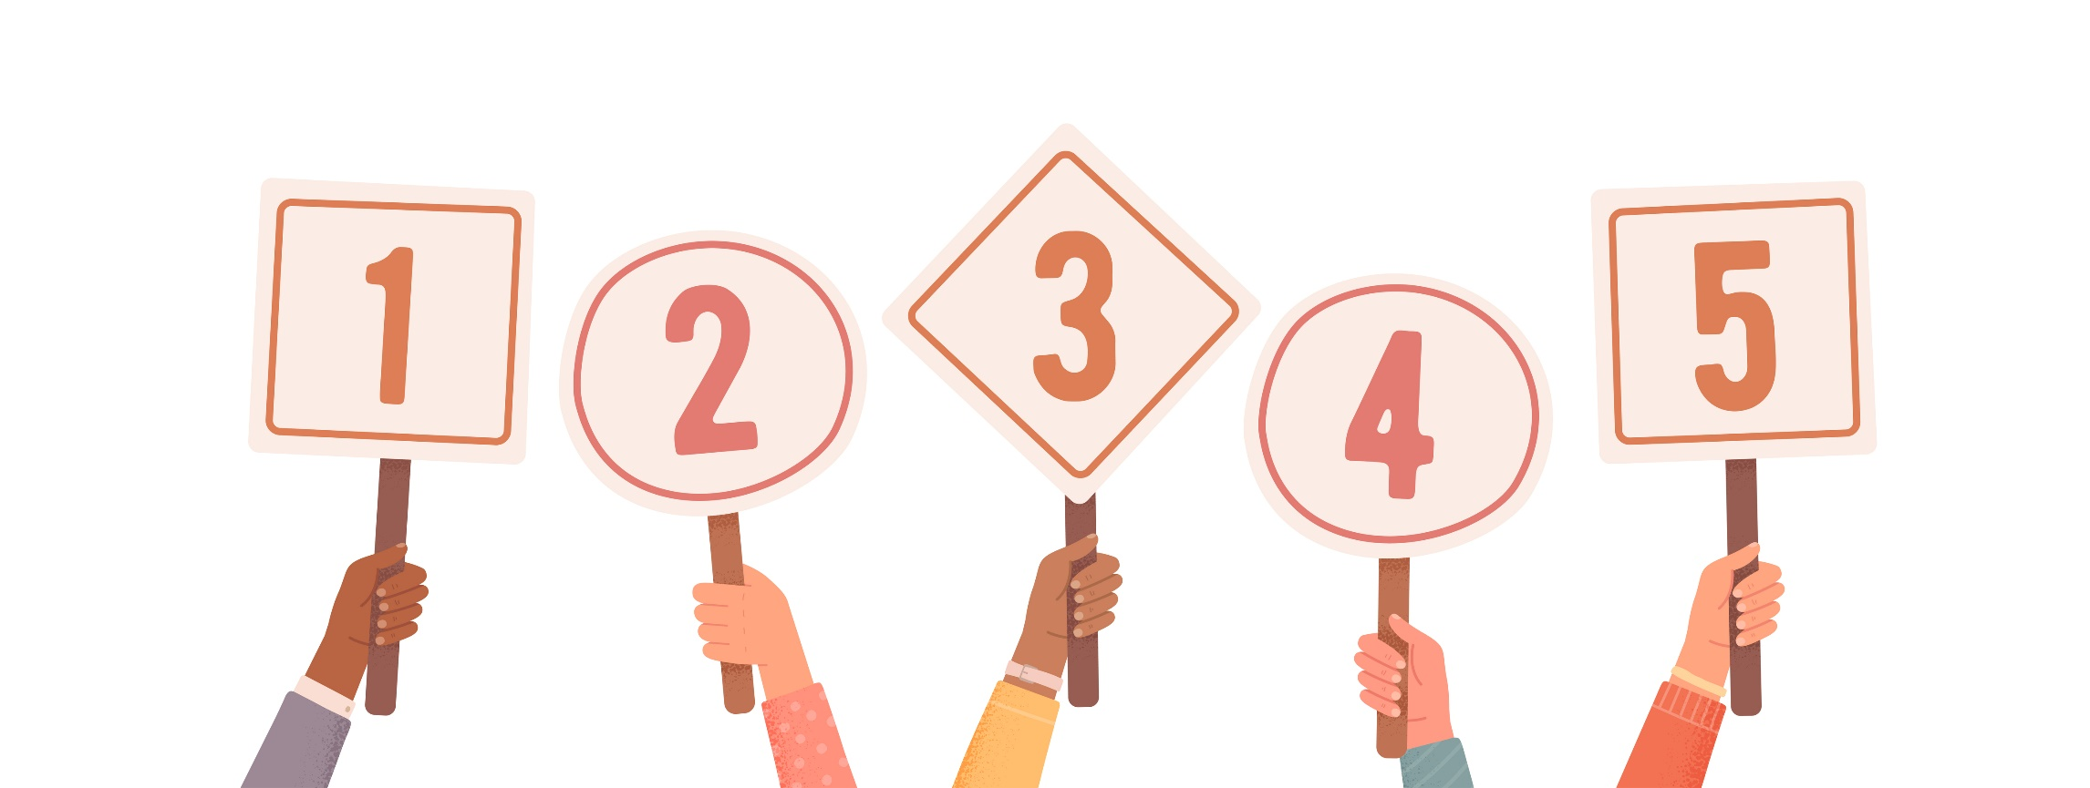
Playing your part
Marks out of 5! (5-10mins)
On the next few slides you are going to see some different things that we could all do to help protect the environment. For each one, give yourself a score out of 5 using the scoreboard below. Count up your scores at the end!
I’ve never done this…
I’ve don’t usually do this…
I sometimes do this, but not always…
I usually do this, but not always
I’ve always do this…
Notes:
Images:
1) iStock

Slide 21
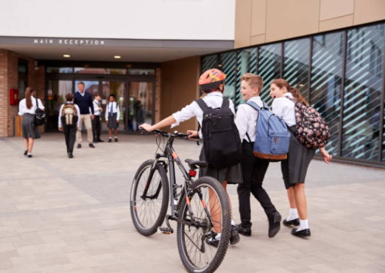
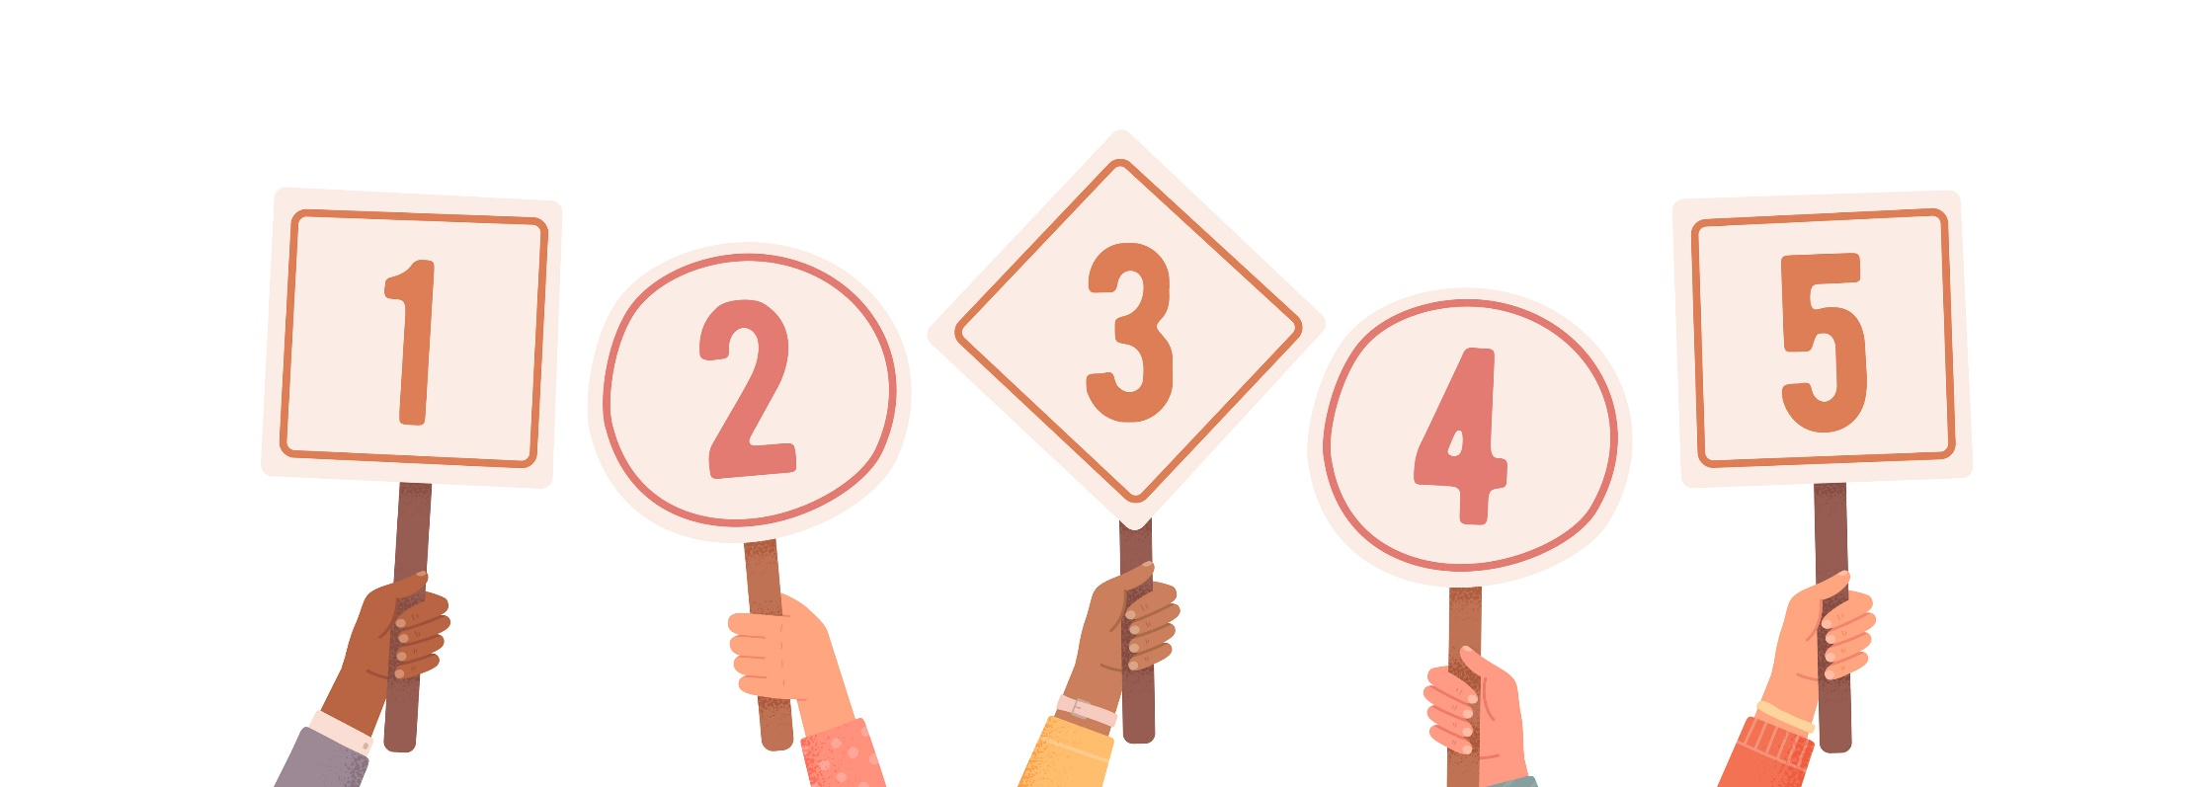
Playing your part
It might be harder to get a bus to school at the moment, as not as many people can get on. But you can help the environment by walking or cycling to school a few times a week!
I’ve never done this…
I’ve don’t usually do this…
I sometimes do this, but not always…
I usually do this, but not always
I’ve always do this…
Notes:
Images:
iStock

Slide 22
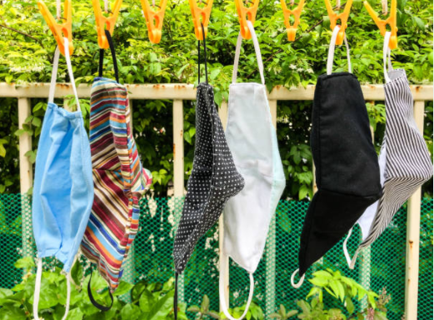
Playing your part
Using reusable masks like these is much better for the environment as they can be washed and used many times, and not just thrown in the bin after one use.
I’ve never done this…
I’ve don’t usually do this…
I sometimes do this, but not always…
I usually do this, but not always
I’ve always do this…
Notes:
Images:
1) iStock

Slide 23
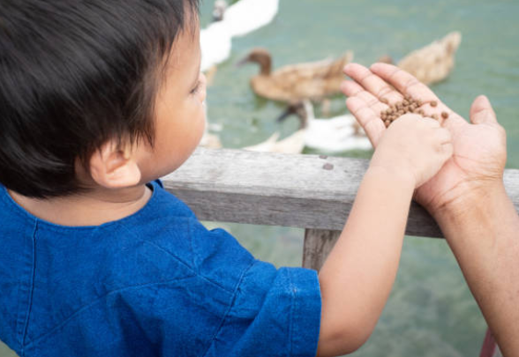
Playing your part
We all know that climate change is affecting wild animals, but there’s lots you can do to help tackle this, like making your garden a safe space for animals and supporting your local parks and wild spaces.
I’ve never done this…
I’ve don’t usually do this…
I sometimes do this, but not always…
I usually do this, but not always
I’ve always do this…
Notes:
Images:
iStock

Slide 24
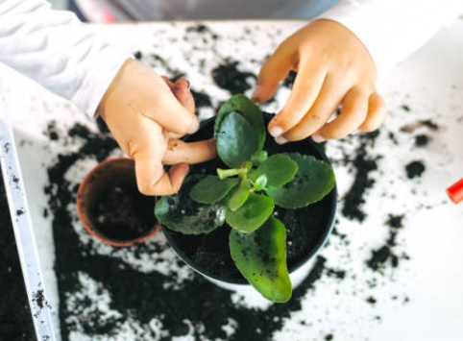
Playing your part
More car journeys means more pollution. You can help tackle this by growing your own plants. It doesn’t matter if they’re indoors or outdoors- more plants means more fresh air around you!
I’ve never done this…
I’ve don’t usually do this…
I sometimes do this, but not always…
I usually do this, but not always
I’ve always do this…
Notes:
Images:
1) iStock

Slide 25
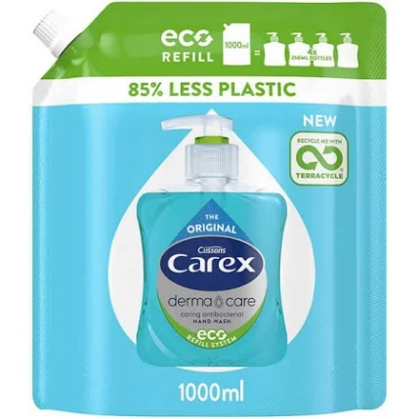
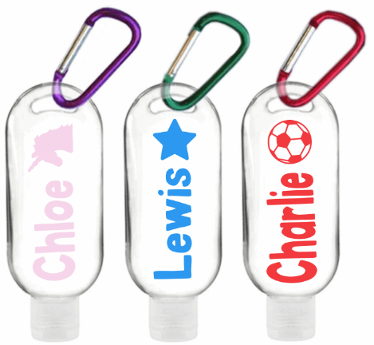
Playing your part
We’re using lots of soap and sanitiser right now, which can means lots of plastic waste going into the bin. One way you can reduce this is by using refillable bottles and bags, like these!
I’ve never done this…
I’ve don’t usually do this…
I sometimes do this, but not always…
I usually do this, but not always
I’ve always do this…
Notes:
Images:
iStock
https://ukmedicaldirect.com/products/carex-dermacare-original-antibacterial-hand-wash-refill-1000ml?variant=33375788859524&utm_medium=cpc&utm_source=google&utm_campaign=Google%20Shopping&gclid=CjwKCAjwiOv7BRBREiwAXHbv3CBFa3FBmtTPUvLXcm7igWCr2iYwnk3wH3N12_XhBP0HcqdbZ9XanBoCvkEQAvD_BwE
https://racheljdesigns.net/products/pre-order-batch-2-refillable-personalised-50ml-hand-sanitiser-bottles-with-clips

Slide 26
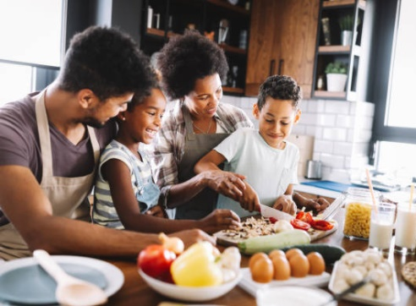
Playing your part
Being at home more also means we all have more time to think about what we want for dinner – and vegetarian meals are much better for the environment than meat. You could try learning some new vegetarian recipes!
I’ve never done this…
I’ve don’t usually do this…
I sometimes do this, but not always…
I usually do this, but not always
I’ve always do this…
Notes:
Images:
1) iStock

Slide 27
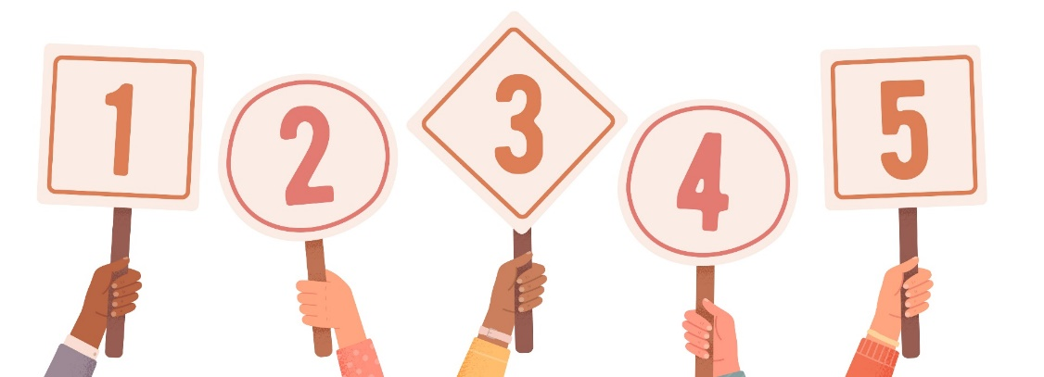
Playing your part
Count up your scores! (2-3mins)
Now that you’ve given yourself a score on how kind you’re being to the environment, count up your scores and click to see how well you did!
5-9
Improvement needed!
10-14
Not good, not bad…
Oops! It looks like you’ve forgotten about the environment. What will you do to change this?
You’re not terrible, but there’s definitely room for improvement here – what changes can you make?
15-19
You’re doing well!
20-25
Environmental Hero!
Impressive – this is a good place to be! A few changes and you’ll be a hero!
Wow! The environment needs more heroes like you! Well done!
Challenge:
What other ways can you think of to be kind to the environment?
Notes:
Images:
1) iStock

Slide 28
Starter: Have you noticed?
Why are we talking about this?
Have we forgotten?
The good news or the bad news?
Playing your part
Ext: Go viral!
Vote!
Notes:
Images
iStock

Slide 29

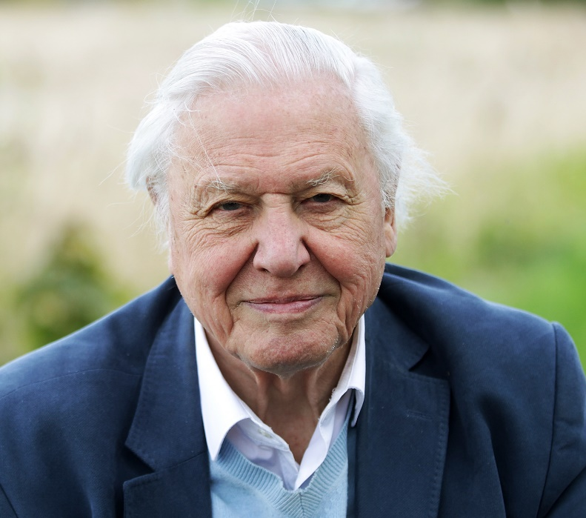



Ext: Go viral!
Last month, Sir David Attenborough joined the social media platform Instagram. It took just four hours for David to break the Guinness World Record for the fastest time to reach 1 million followers, and he now has more than 5 million.
0:00-1:14
Watch (1-2mins)
Click the image to watch Sir David’s first Instagram post. Then, see if you can answer the questions below:
Does David make you want to do more to help the environment? Why/why not?
Do you think joining Instagram will help David spread his message to more people?
Why do you think so many people want to follow David?
https://safeshare.tv/x/X-q01qtHY3s
Notes:
Alternative video link: https://www.youtube.com/watch?v=X-q01qtHY3s
Images
Icons8
References:
1) https://www.theverge.com/2020/9/29/21493467/david-attenborough-instagram-guinness-world-record

Slide 30

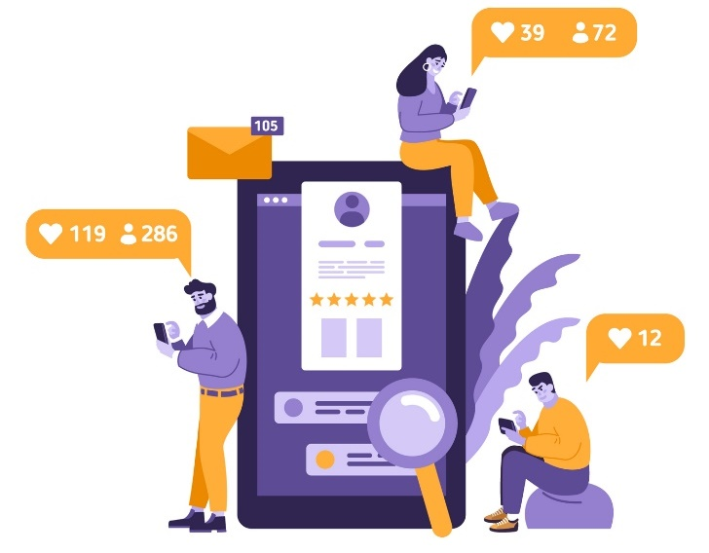
Ext: Go viral!
Go viral (10+ mins)
There are many different techniques that Sir David Attenborough uses to persuade us to listen to him and want to help the environment. Your task is to learn about them, and then, in pairs, to create your own video to persuade even more people to help the environment. Use the next few slides to help you!
Alternative activity:
Don’t want to make a video? No problem! Why not write a script of what you think Sir David should say on his next Instagram video?
When you’re done, we’d love to see your videos! Ask an adult to email them to amy@votesforschools.com for a chance to be featured in our lesson in a few week’s time!
Notes:
Images:
1) iStock

Slide 31








Ext: Go viral!
One thing you can do to persuade people is to ask rhetorical questions. These are questions that don’t really need an answer - they’re used to be dramatic or to make a point, not really to ask a question. Here are some examples:
Do you enjoy living on planet earth? ...Then you should need to start listening.
Are you bored of talking about climate change? Perhaps you should do something about it then.
Did you know that throwing rubbish on the floor is hurting animals all over the world?
Have you ever thought about what our world would be like without wildlife?
Make your own!
In your pairs, can you think of your own rhetorical question to start your viral video?
Not in class?
You can still do this activity without a partner.

Slide 32
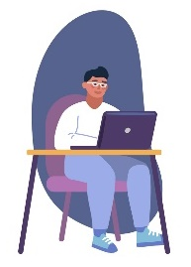

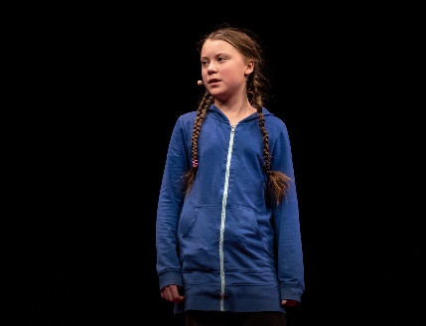

Ext: Go viral!
It’s not only questions that make people listen to you – they need to hear the facts on what is happening and why they should help! Putting facts and figures in your speech will help persuade people that you are the expert and should be listened to!
0:00-1:33
Watch (2-5mins)
Click the image to watch part of Greta Thunberg’s
famous TED talk video. How many different facts
does she tell the audience?
Your turn!
What facts and figures do you know about the environment that you can add to your speech? Think about what you already know, and what you’ve learned about today.
Can’t remember any facts?
Why not go back through this lesson and remind yourself of some?
Notes:
Alternative video link: https://www.youtube.com/watch?v=EAmmUIEsN9A
Images:
1) iStock

Slide 33




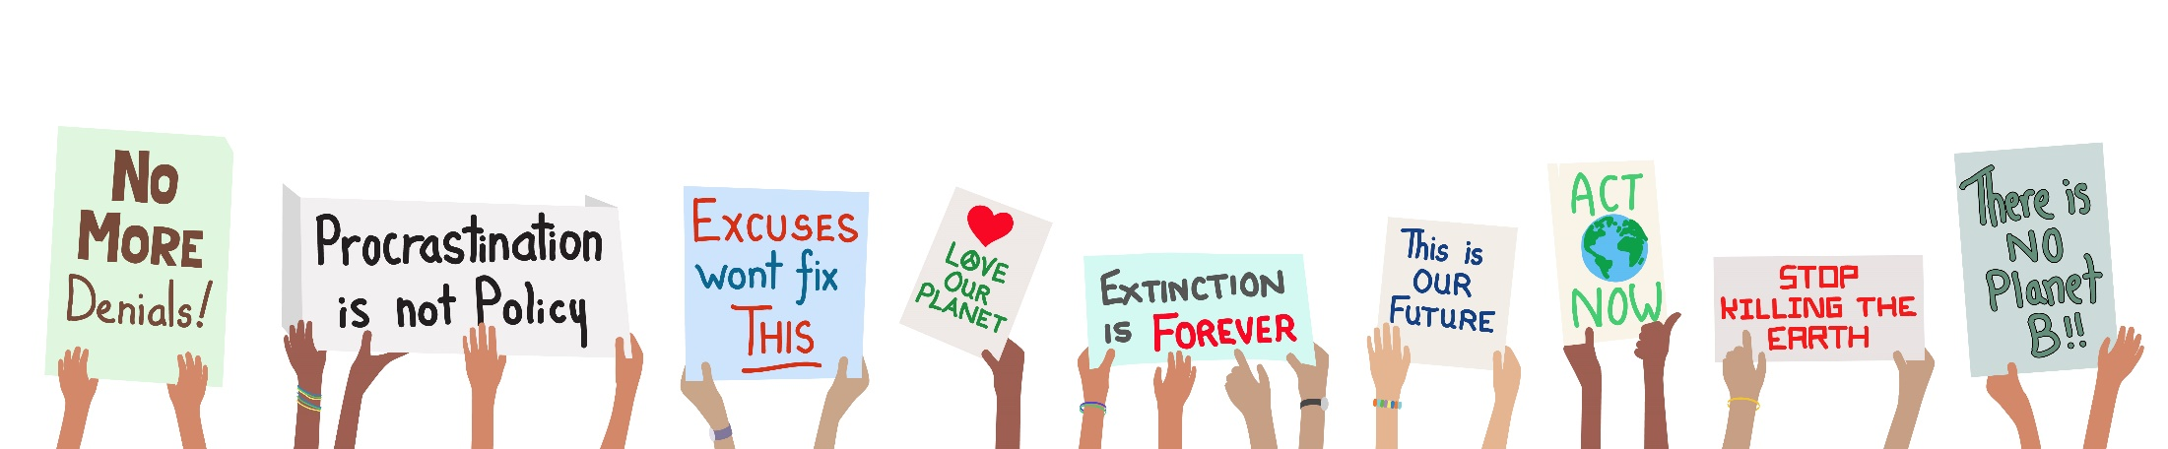
Ext: Go viral!
Another trick for persuading people is to use emotive language to make people emotional about the topic. For example…
0:00-1:14
This is a crisis – and one which will ruin our beautiful planet if we don’t take action.
Desperate animals are dying in the wild because of what humans are doing.
Watch (1-2mins)
Watch Sir David again, but this time listen out for any emotive language he uses. What words or phrases do you hear?
Every filthy cloud of pollution adds to our terrifying situation.
Try it yourself!
Now you know what emotive language is, how can you add it to your viral video script?
Notes:
Alternative video link: https://www.youtube.com/watch?v=X-q01qtHY3s

Slide 34
Starter: Have you noticed?
Why are we talking about this?
Have we forgotten?
The good news or the bad news?
Playing your part
Ext: Go viral!
Vote!
Notes:
Images
iStock

Slide 35
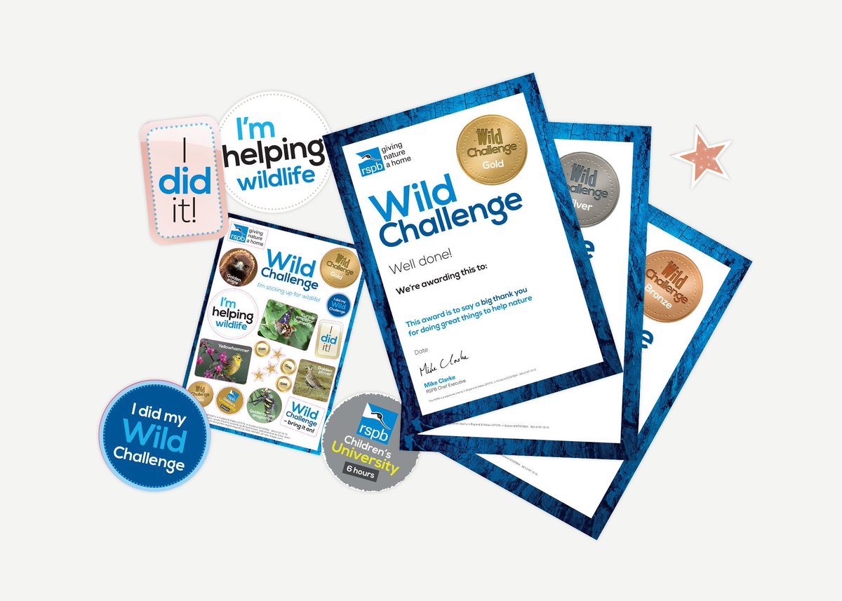
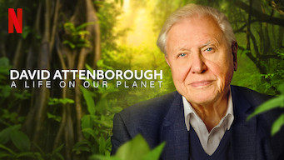
Learn more: Get Wild!
You can help to “give nature a home” by taking part in RSPB’s Get Wild Challenge with your class or family – the challenge asks you to get outdoors and help the environment, and there’s even awards to win! Click the image to sign your class up!
0:00-
2:00
Career Spotlight:
Sir David Attenborough’s latest documentary is all about his life working with animals. Tune into Netflix to hear how he became a TV presenter, and find out what you can do to help the environment.
https://safeshare.tv/x/64R2MYUt394
Notes:
Alternative video links:
https://www.youtube.com/watch?v=64R2MYUt394
Images:
Taken from videos, referenced above
References:
1) https://www.rspb.org.uk/fun-and-learning/for-families/family-wild-challenge/what-is-wild-challenge/

Slide 36
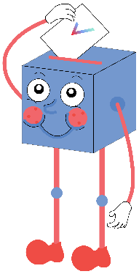
Have we forgotten about the environment this year?
The focus has been quite strongly on coronavirus and other forms of social activism, which means climate activism has taken a backseat.
Single-use plastic has become more necessary to avoid the spread of Coronavirus.
I have definitely noticed more littler, particularly disposable masks.
This year has been incredibly distracting, and I’m not as vocal about climate change as I was last year.
Lockdown meant that people were forced to stop using as much transport, which had positive benefits to climate change.
There are still protests going on, such as Extinction Rebellion and online protests.
Influential figures such as Sir David Attenborough and the Royal family are reminding us about why it’s important to look after our planet.
I have not forgotten and am still making an effort to help the environment.
Notes:
References

Slide 37



Vote!
In the classroom?
Log your class’s votes now at: www.votesforschools.com/login/teacher
At home?
Follow this link to vote: https://www.surveymonkey.co.uk/r/vfs-primary-environment
Not sure how?
Click the ballot box to see a video on how to log your votes!
Having trouble?
Copy and paste the link into your internet browser!
If you have any issues, feedback or comments, email amy@votesforschools.com.
Notes:
SurveyMonkey Link: https://www.surveymonkey.co.uk/r/vfs-primary-environment
SafeShare How-To Video Link: https://safeshare.tv/x/N0-AjP3cFjg
YouTube How-To Link: https://www.youtube.com/watch?v=N0-AjP3cFjg&feature=youtu.be

