Slide 2




Feedback: “Have we forgotten about the environment this year?
Yes
“I don't think that we have forgotten about the environment this year, but I just think that it wasn't the main focus due to coronavirus and people's safety.”
Skippers Hill Manor School
“Everyone is wasting fabric masks and not recycling rubbish!”
Broadford Primary School
46.1%
No
53.9%
“I think that our country and world has completely forgotten about the environment because there are masks on the floor everywhere and more plastic is being used because of the making of masks.”
North Harringay Primary School
“I think the environment is the most beautiful thing in the world. I have learnt so much about climate change this year and yet so many people have forgotten about the situation. Greta Thunberg and David Attenborough are the most inspirational people on earth , and they are fighting for it.”
Northwood College for Girls
Notes:
Images
Icons8

Slide 3

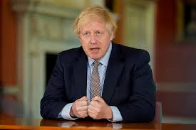
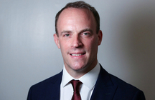
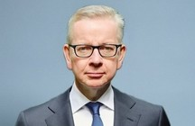
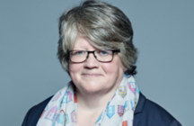
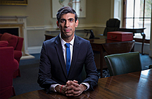
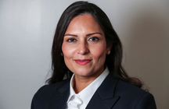
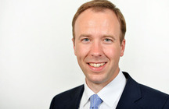

Starter: Who am I?
Who am I? (3-4 mins)
Take a look at the people shown on this slide. How many of them do you recognise? Do you know any of their names? Click to find out if you’re right!
Boris Johnson
Dominic Raab
Michael Gove
Thérèse Coffey
Rishi Sunak
Priti Patel
Matt Hancock
Robert Buckland
Challenge (1 min)
Do you know what all of these people have in common?
Notes:
Images and references:
https://www.gov.uk/government/ministers
https://www.gov.uk/government/speeches/pm-address-to-the-nation-on-coronavirus-10-may-2020

Slide 4
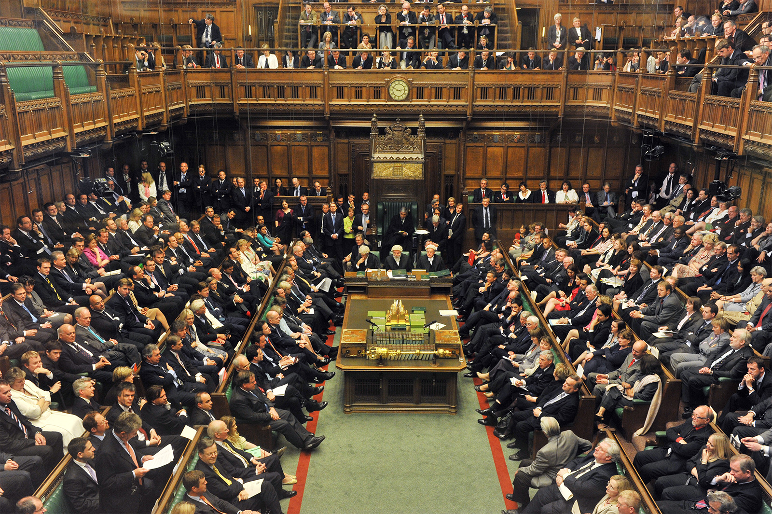
Would you want to be a politician right now?
Having trouble watching videos in our lessons?
We’re here to help! Email amy@votesforschools.com for any technical support, or with any queries about your VotesforSchools lessons.
Notes:
Images
iStock
References

Slide 5






Starter: Who am I?
Why are we talking about this?
How does it all work?
A day in the life…
A Parliamentary Debate…
Vote!
Notes:
Images
iStock
https://www.alexburghart.org.uk/news/uk-parliament-week-2020-be-celebrated-across-brentwood-and-ongar-sign-now
https://www.gov.uk/government/speeches/pm-address-to-the-nation-on-coronavirus-10-may-2020

Slide 6

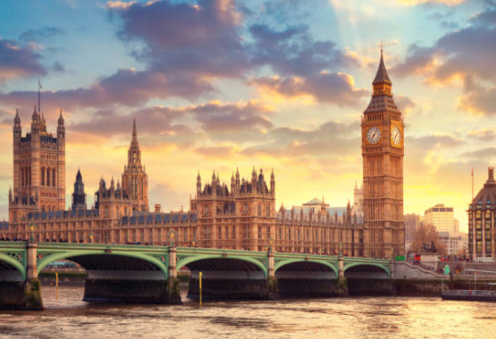
Why are we talking about this?
This week is Parliament Week here in the UK – a week where young people are encouraged to get involved and have their voice heard.
Lots of things that affect our lives, such as schools, hospitals and the environment, are discussed in Parliament by the politicians here in the UK, who help make decisions for our country.
But what exactly is a politician? What do they do, how do they do it and, most importantly, would you like to do it? This is what you‘ll be finding out today…
Notes:
Images:
Istock
https://www.britannica.com/topic/House-of-Commons-British-government

Slide 7
Starter: Who am I?
Why are we talking about this?
How does it all work?
A day in the life…
A Parliamentary Debate…
Vote!
Notes:
Images
iStock
https://www.alexburghart.org.uk/news/uk-parliament-week-2020-be-celebrated-across-brentwood-and-ongar-sign-now
https://www.gov.uk/government/speeches/pm-address-to-the-nation-on-coronavirus-10-may-2020

Slide 8








How does it all work?
For some people, talking about politics can feel boring, confusing or even scary. Usually, this is because they’re not quite sure what politics is, or what all the different words mean!
Parliament
Member of Parliament
Government
Are you Quiz ready? (8-15 mins)
On the next few slides, you are going to find out exactly how the UK “works”, and why parliament and politicians are so important. Pay attention though - you’ll be quizzed at the end on all of these key words!
House of
Lords
Election
House of Commons
Short on time?
Skip to slide 13 to watch a quick video explaining how the UK government works.
Notes:
Images:
1) Nounproject

Slide 9
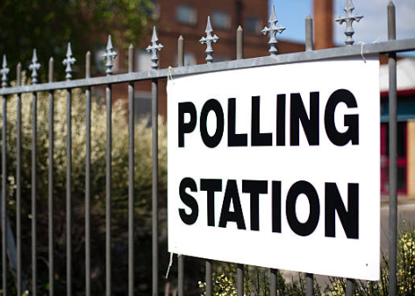






How does it all work?
When you are 18, you will be allowed to vote in an election. An election is when you vote for a Member of Parliament (MP) who you want to represent your local area in parliament.
Confused?
It’s a bit like when you vote for your school councillor!
Most MPs are part of a political party. A political party is a big club of people that have similar views to each other.
Question (1-2 mins)
Which of these political parties have you heard of before?
Parliament
Member of Parliament
Election
House of
Lords
Government
House of Commons
Notes:
Images:
https://www.conservatives.com/
iStock
Nounproject
https://sco.wikipedia.org/wiki/File:Logo_Labour_Party.svg
https://en.wikipedia.org/wiki/Green_Party_of_England_and_Wales
https://en.wikipedia.org/wiki/Liberal_Democrats_(UK)
https://www.glassdoor.co.uk/Overview/Working-at-Scottish-National-Party-EI_IE764744.11,34.htm

Slide 10
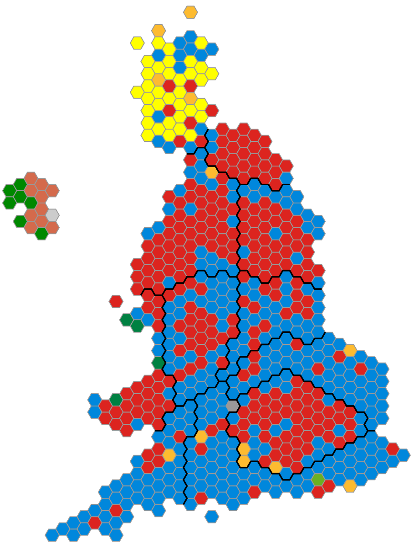
How does it all work?
This map shows all the different constituencies (local areas) in the UK. When each area has chosen their MP, we look at what party those MPs belong to. The party with the most chosen MPs becomes the Government.
Question (1-2 mins)
Take a look at this map from the last election. Which party had the most local areas? (Hint: they’re now our government!)
Parliament
Member of Parliament
Election
House of
Lords
Government
House of Commons
Notes:
Images:
Noun Project
https://constitution-unit.com/2018/07/31/beating-the-boundaries-the-stalled-debate-on-how-to-draw-up-the-uks-parliamentary-constituencies/
Parties referenced on slide 9.

Slide 11
How does it all work?
So, the party who has the most MPs becomes the Government, and they are “in charge” of the UK – which means it’s their job to make decisions and laws to help all the people that live here.
But if your local area’s MP isn’t part of the winning party, they’re still important too. It’s their job to help the Government to make these decisions, and to tell the Government when they disagree with them. They do all of this in the House of Commons.
This picture shows all the chosen MPs sitting inside of the House of Commons.
Parliament
Member of Parliament
Election
House of
Lords
Government
House of Commons
Notes:
Images:
iStock
Nounproject

Slide 12
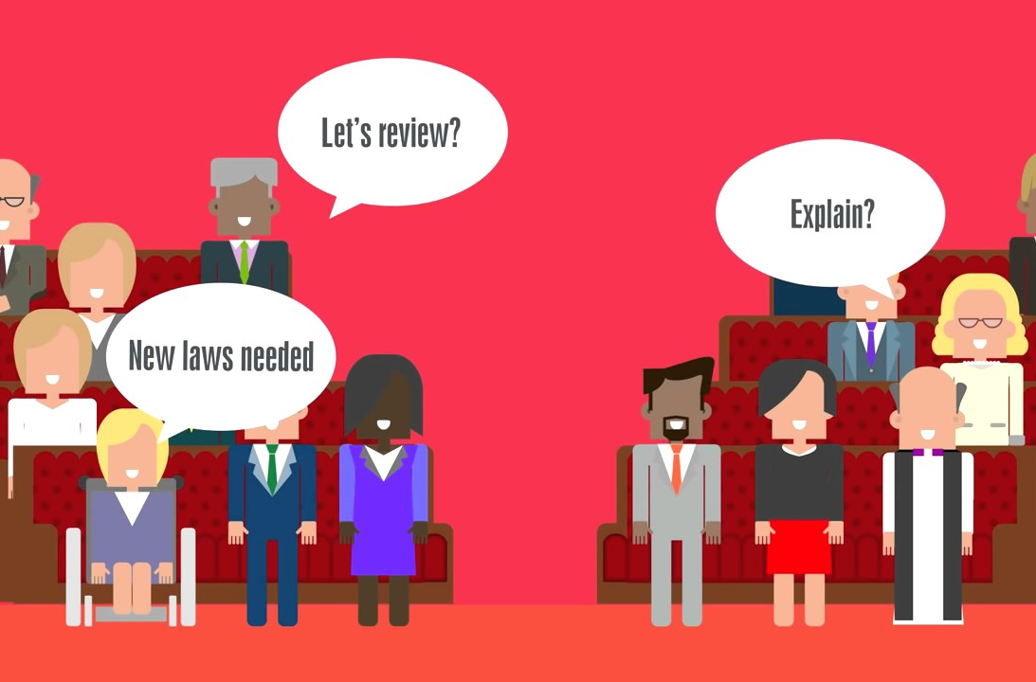
How does it all work?
0:00-2:25
Once the Government and all the MPs have decided that they want to change something, they ask the House of Lords to check it before it becomes a law. The House of Lords is made up of people who have been chosen to help the Government because they have special skills or knowledge.
Watch (2-3 mins)
If you’re short on time, or if you just need a quick reminder, click to watch a short video explaining how the UK works in under three minutes!
Parliament
Member of Parliament
Election
House of
Lords
Government
House of Commons
Notes:
Alternative video link: https://www.youtube.com/watch?v=ex_xxMptomI
Images:
From video
Nounproject

Slide 13
How does it all work?
Quiz (2-5 mins)
Now that you’ve learned how the UK works, it’s time to test your knowledge. In pairs, can you match each key word to its definition? Click to reveal the answers!
Member of Parliament
A place where MPs meet to talk about the country and make new laws to help people.
Election
A group of “experts” who are chosen by the prime minister and queen to help parliament to make laws.
Government
All the MPs who have been chosen to represent their local area are called parliament.
Parliament
A day where everyone 18+ can vote for the MP they want to represent them in parliament.
House of Commons
The party with the most MPs becomes the government, who are “in charge” of the country.
House of
Lords
A person chosen to represent their local area in parliament.
Notes:
Images:
1) Nounproject

Slide 14
Starter: Who am I?
Why are we talking about this?
How does it all work?
A day in the life…
A Parliamentary Debate…
Vote!
Notes:
Images
iStock
https://www.alexburghart.org.uk/news/uk-parliament-week-2020-be-celebrated-across-brentwood-and-ongar-sign-now
https://www.gov.uk/government/speeches/pm-address-to-the-nation-on-coronavirus-10-may-2020

Slide 15




A Day in the Life…
Now that you know what a politician is, and why their job is important, it’s time to think about what it’s like to be a politician, and whether it’s a job that you would like.
Is it the job for you? (5-10 mins)
Over the next few slides you are going to find out more about what a Member of Parliament (MP) does at work everyday! For each part of the job that you hear about, use your thumbs to show whether it’s something that you think you would enjoy doing, or whether it’s something that you’d rather avoid!
I’d like to do this!
No, thank you!
Challenge:
Do you know who your local MP is? If you’re not sure, click here and enter your postcode to find out!

Slide 16
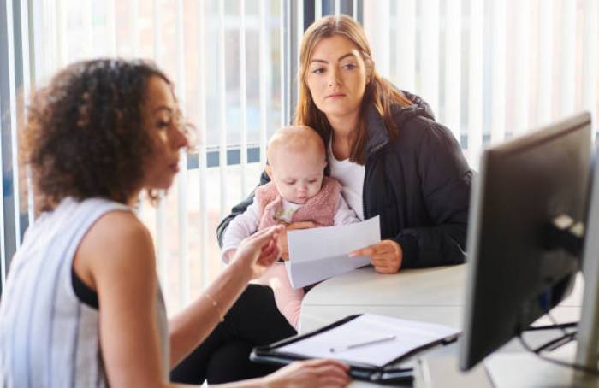
A Day in the Life…
One of your main jobs as MP will be to talk to the people who live in your area and to find out how you can help them.
People who live in your area will come to you for advice about lots of different things, like asking for a new library in the area or complaining about the bin collection in the area.
Would you enjoy this part of the job?
I’d like to do this.
No, thank you!
Notes:
Images:
1) IStock

Slide 17

A Day in the Life…
To help the people in your area, you will often need to speak to other MPs for advice and help.
For example, if people in your local area were complaining about a new office building which would take up half of the local park, you may decide to speak to other ministers and ask for the office to be smaller, or built somewhere else.
Would you enjoy this part of the job?
I’d like to do this.
No, thank you!
Notes:
Images:
1) iStock
References:
https://www.parliament.uk/get-involved/contact-an-mp-or-lord/contact-your-mp/#jump2
https://www.yeovil-libdems.org.uk/what_can_your_mp_help_you_with

Slide 18
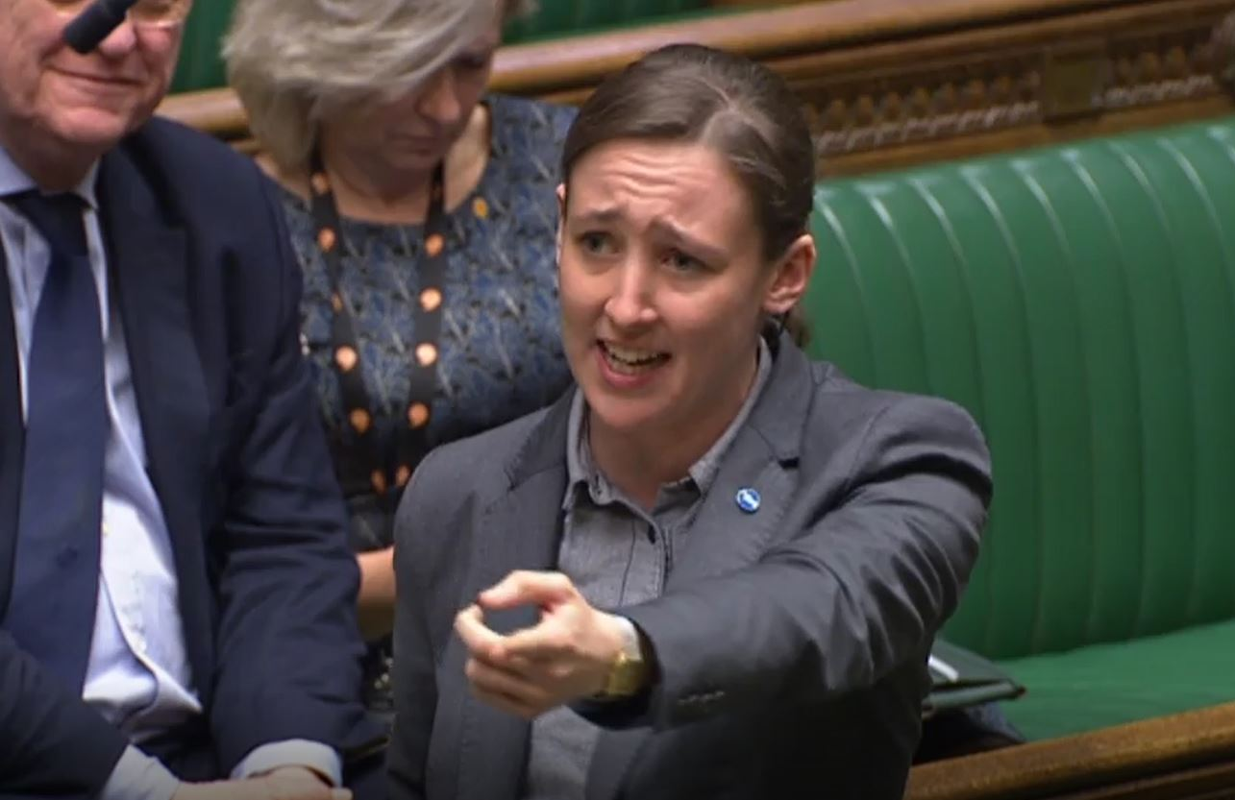
A Day in the Life…
0:00-1:36
If you cannot solve the problem by speaking to others, you might decide to talk about a problem in the House of Commons.
There are lots of different ways that you can do this, such as starting a debate, or just asking a question.
Warning:
Mhairi shares a story that some may find upsetting. Skip if not appropriate.
Watch (2 mins)
Click the image to watch an Mhairi Black, the UK’s youngest MP, talk about someone from their local area in parliament.
Would you enjoy this part of the job?
I’d like to do this.
No, thank you!
https://safeshare.tv/x/lZAmhB55_-k
Notes:
Alternative video link: https://youtu.be/lZAmhB55_-k?t=119 (1:59-3:34)
Images:
1) https://www.thenational.scot/news/17290946.watch-mhairi-black-nails-absurdity-uk-brexit/

Slide 19
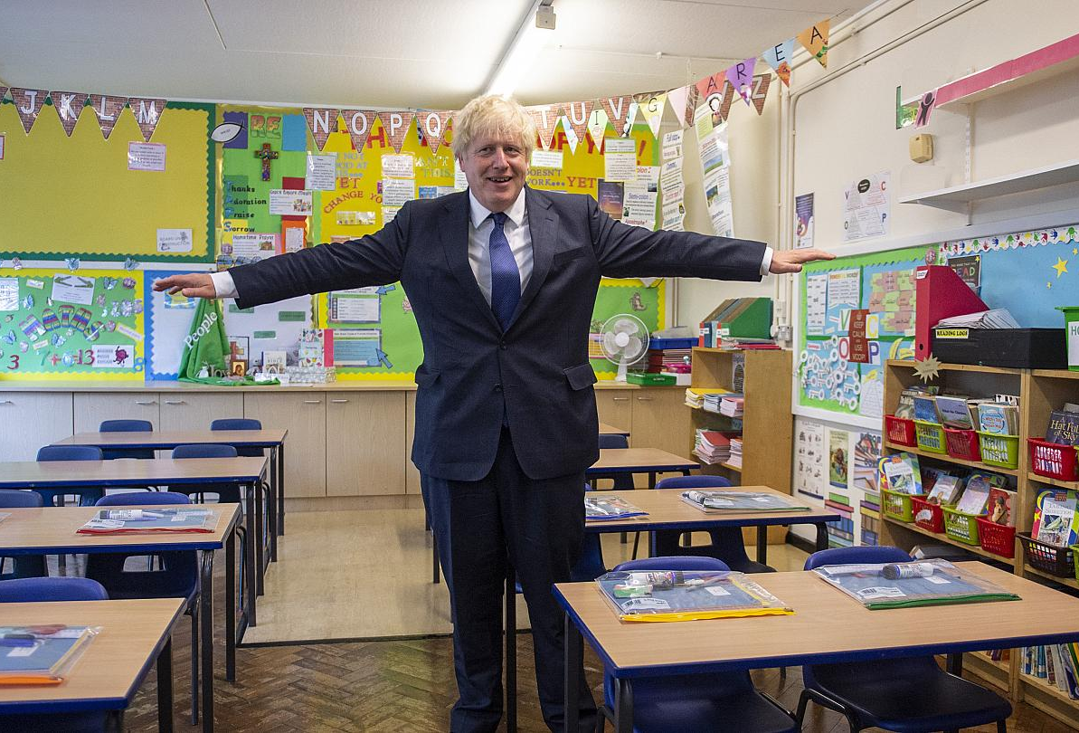
A Day in the Life…
As an MP, it is your job to get to know the schools, businesses and people in your local area.
You’ll need to try and build good relationships with people, answer questions, listen to complaints and persuade people to vote for you. Be warned though - some people might not like your ideas, or be very nice to you!
Would you enjoy this part of the job?
I’d like to do this.
No, thank you!
Notes:
Images:
1) https://www.ft.com/content/3d3a4433-bb4d-4930-9476-2d4173dab9c4

Slide 20
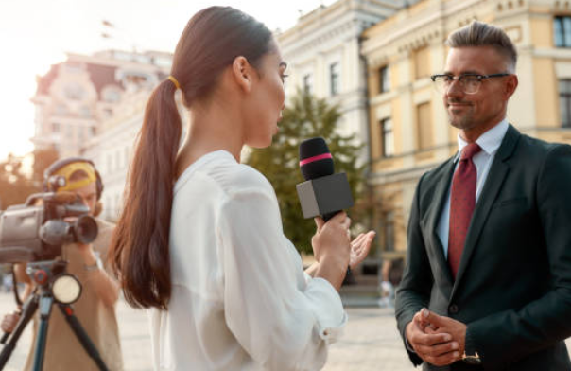
A Day in the Life…
As an MP, you will also be asked to speak on TV, to news reporters, at local events and on radio shows.
Here you might be asked questions about your beliefs, and on what you are doing to help your community. But remember: some of the questions can be very tricky!
Would you enjoy this part of the job?
I’d like to do this.
No, thank you!
Notes:
Images:
1) iStock

Slide 21


A Day in the Life…
Perhaps the most important part of your job as a politician is to help decide which laws should be made for the UK.
If you are chosen as an MP for your local area, you will sometimes be asked to go to Parliament and vote on different laws. For example, recently MPs have discussed:
Should people who are cruel to animals go to prison?
Should we teach more Black History in schools?
Should we give food vouchers to families over the school holidays?
Would you enjoy this part of the job?
I’d like to do this.
No, thank you!
Challenge:
How many of these debates have you heard about in the news recently?
Notes:
References:
https://www.theyworkforyou.com/debates/?id=2020-10-20c.920.1
https://www.theyworkforyou.com/debates/?id=2020-10-21b.1130.0
https://www.theyworkforyou.com/debates/?id=2020-10-23a.1348.0

Slide 22
Starter: Who am I?
Why are we talking about this?
How does it all work?
A day in the life…
A Parliamentary Debate…
Vote!
Notes:
Images
iStock
https://www.alexburghart.org.uk/news/uk-parliament-week-2020-be-celebrated-across-brentwood-and-ongar-sign-now
https://www.gov.uk/government/speeches/pm-address-to-the-nation-on-coronavirus-10-may-2020

Slide 23





A parliamentary debate…
Now that you know what a politician is, and what jobs they do, it’s time for you to see if you’ve got what it takes to be one!
A parliamentary debate… (15-20 mins)
On the next few slides you are going to find out more about a debate the happened in parliament a few weeks ago. As a class, you will listen to all the different opinions (and give your own!) before voting on your question. Don’t worry though - there will be lots of boxes like this one to help you on the way!
Not in the classroom?
Read through the activity and the arguments carefully, thinking about who you agree with and why. At the end, write a paragraph explaining what you think and why.

Slide 24
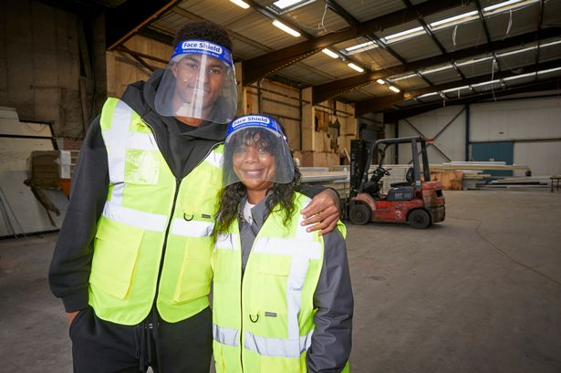
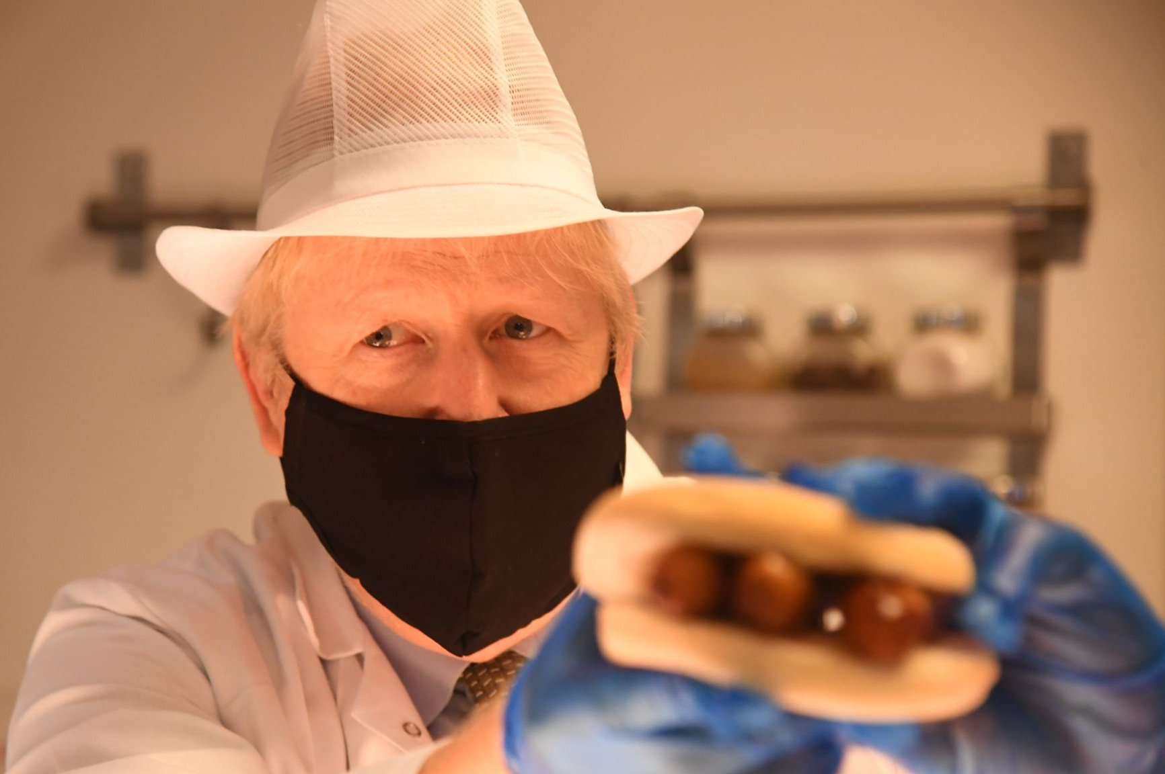
A parliamentary debate…
You might remember hearing about Free School Meals a few months ago, when footballer Marcus Rashford asked the Government to give children from poorer families food vouchers during the summer holidays.
Being at home more means using more food and electricity than usual, and COVID has also meant that many people have lost their jobs and might be finding it difficult to pay their bills and buy the things that they need.
A few weeks ago, MPs met again to talk about whether the Government should keep giving food vouchers during the holidays up until April 2021.
First thoughts (1-2 mins)
Do you think that the government should give meal vouchers to families during the school holidays?
Challenge (1-2mins)
Can you think of a reason why someone might disagree with you?
Notes:
Images:
https://www.mirror.co.uk/news/uk-news/map-shows-parents-can-free-22899493
https://news.sky.com/story/free-school-meals-boris-johnson-admits-he-hasnt-spoken-to-rashford-since-june-12115062

Slide 25


A parliamentary debate…
Today in parliament you will be discussing:
Should the Government give vouchers for free school meals in the school holidays for families who do not have a lot of money?
Hear hear! (4-8 mins)
Imagine that you are an MP in parliament. Your job is to listen to the different opinions (and sometimes to give your own) before voting. Your teacher is going to read you some of the things that were said by other MPs during the debate. If you agree with them, say “Hear! Hear!” to show your support. If you disagree, stay quiet until it’s your turn to give your opinion at the end.
Why hear hear? Click me to watch a short video about the rules of the House of Commons!
Many people have lost their jobs because of Covid-19, so families need supporting.
Now students are back in school, families are spending less, so they don’t need as much help during the holidays.
https://safeshare.tv/x/Xw5jOZOjH60
Notes:
Alternative video link: https://www.youtube.com/watch?v=Xw5jOZOjH60

Slide 26






A parliamentary debate…
The government have given £65 million to local councils to help the families that really need help, which is better than just giving people food vouchers.
‘Holiday hunger’ is a real problem for many children, and the government needs to do something to stop it.
The £65 million funding to local council isn’t enough to cover Free School Meals as well as everything else.
It’s the parent’s responsibility to feed their children, not the government’s.
The government shouldn’t be persuaded by celebrities on the internet!
All year Free School Meals are the best way to make sure that all children are being fed properly.
Over to you! (2-5 mins)
What do you think? Should the Government give food vouchers to families during the holidays? Explain your reasons why, and show your support for your classmates by saying “Hear! Hear!”
Did you know?
If you want to speak in Parliament, you must stand up first.
Notes:
Images
Icons8
References
https://hansard.Parliament.uk/commons/2020-10-21/debates/79C0CA8D-CADF-4562-9317-5A51810BB5DE/FreeSchoolMeals
https://www.yorkshirepost.co.uk/news/politics/why-i-voted-against-free-school-meals-children-over-holidays-leeds-mp-stuart-andrew-3014143
https://www.bbc.co.uk/news/uk-54692880
https://labourlist.org/2020/10/5-terrible-tory-reasons-for-not-extending-free-school-meals-this-week/

Slide 27



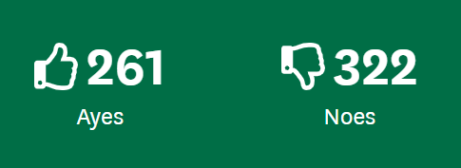
A parliamentary debate…
Should the Government give vouchers for free school meals in the school holidays for families who do not have a lot of money?
Time to vote! (2-3 mins)
Now that you’ve had a chance to share your thoughts, it’s time to vote! Your teacher will read you the question again, then use your feet to vote. If you think that the Government should provide free meals to families during the school holidays go to the right. If you think that they shouldn’t, go to the left.
No!
Yes!
Your teacher will now count up your votes and see what the result is. When you know what your class vote is, click to see whether the Government voted the same way!
Did you know?
In parliament, “yes” votes are called “ayes.”
Final thoughts (2-3 mins)
55% of parliament voted no. Did your class vote the same way?
Reflect (2-3 mins)
How did you find that activity? Would you like to do it in real life?
Notes:
Images and references:
1) https://votes.parliament.uk/Votes/Commons/Division/896#notrecorded

Slide 28
Starter: Who am I?
Why are we talking about this?
How does it all work?
A day in the life…
A Parliamentary Debate…
Vote!
Notes:
Images
iStock
https://www.alexburghart.org.uk/news/uk-parliament-week-2020-be-celebrated-across-brentwood-and-ongar-sign-now
https://www.gov.uk/government/speeches/pm-address-to-the-nation-on-coronavirus-10-may-2020

Slide 29




Learn more: The News, made simple
Politics and the news can be very confusing and we all have times where we struggle to get our heads round what’s going on. That’s where The Ten News comes in – they’re a podcast made especially for kids, by kids! Click the image to check out their website and listen to their news show that’s only 10 minutes long!
0:00-0:55
Career Spotlight:
Your career in politics could start with Parliament Week! Click the image to find out more about the impact it’s had on groups around the UK, including children and young people. Alternatively, click the icon to head straight to the Parliament Week UK website to see how else you can get involved.
https://safeshare.tv/x/uQmcfq-HpnA
Notes:
Images and references:
https://www.thetennews.com/
https://www.ukparliamentweek.org/en/

Slide 30
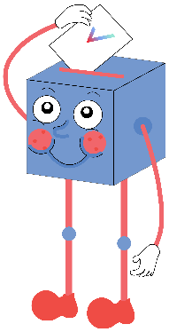
Would you want to be a politician right now?
You can impact laws and change the country for the better.
You get a real say in how the country is being run, and can help lots of people.
I think I could do a really good job at making decisions for the country.
…
It can be really hard to have to make a decision, especially when lots of people disagree with you, and might dislike you for it.
With everything that’s going on, right now would be a terrible time to be a politician.
It’s just not the job for me.
…

Slide 31



Vote!
In the classroom?
Log your class’s votes now at: www.votesforschools.com/login/teacher
At home?
Follow this link to vote: https://www.surveymonkey.co.uk/r/vfs-primary-parliament-week
Not sure how?
Click the ballot box to see a video on how to log your votes!
Having trouble?
Copy and paste the link into your internet browser!
If you have any issues, feedback or comments, email amy@votesforschools.com.
Notes:
SurveyMonkey Link:
SafeShare How-To Video Link: https://safeshare.tv/x/N0-AjP3cFjg
YouTube How-To Link: https://www.youtube.com/watch?v=N0-AjP3cFjg&feature=youtu.be

