Slide 2
Feedback: “Would you want to be a politician right now?”
“Yes because you make necessary decisions to make your country better.”
Engayne Primary School
“I would not like to be a politician right now because you would have to make a lot of decisions about this terrible virus.”
Blackwood Primary School
“Yes because I want to help.”
Broadford Primary School
“Its hard to help when you don’t know the people.”
Homerswood Primary & Nursery School
Yes
No
39.9%
60.1%
“Politicians’ jobs are really important. I would like to be a politician to make the world a better place. I would make rules to help keep people healthy and safe.”
Engayne Primary School
“I am really shy to talk to dozens of people so I don't want to have that job.”
Homerswood Primary and Nursery School

Slide 3






Feedback: “Would you want to be a
politician right now?”
Well done to all the young people who cast their votes in VotesforSchools as part of UK Parliament Week. It’s great to see young people getting involved and expressing their views – that’s exactly what UK Parliament Week is all about. Voting is such an important way to have your say and get your voice heard – keep it up! We wish these future voters and future politicians all the very best on their democratic journeys!
Comment on behalf of the team at UK Parliament Week!
The VoteTopic results were also shared with…
Youth Politics UK
British Youth Council
Leader of the House of Commons
UK Parliament Week
The Children’s Commissioner
Notes:
Images
https://youthpolitics.org.uk/
https://www.byc.org.uk/uk/uk-youth-parliament
https://twitter.com/commonsleader
https://www.ukparliamentweek.org/en/?s=UK+Parliament+week+funding
https://www.childrenscommissioner.gov.uk/

Slide 4















Starter: Where do I fit in?
Environmentalist Activist
Artist Netballer Musician
Where do I fit in? (2-5 mins)
On your own, or with your partner, can you think of 3-5 words you would use to describe yourself? Use the pictures to help you.
Sporty Outdoorsy Gymnast
Challenge:
How does it feel to “fit in” with these groups?
Scientist Bookworm
YouTuber Footballer Girly
Notes:
Images
Icons8

Slide 5

Is it important to fit in at school?
Notes:
Images
iStock
References

Slide 6







Starter: Where do I fit in?
Why are we talking about this?
“Fitting the mould”
Just like everybody else?
Over to you!
Ext: I will…
Vote!
Notes:
Images
Icons8

Slide 7
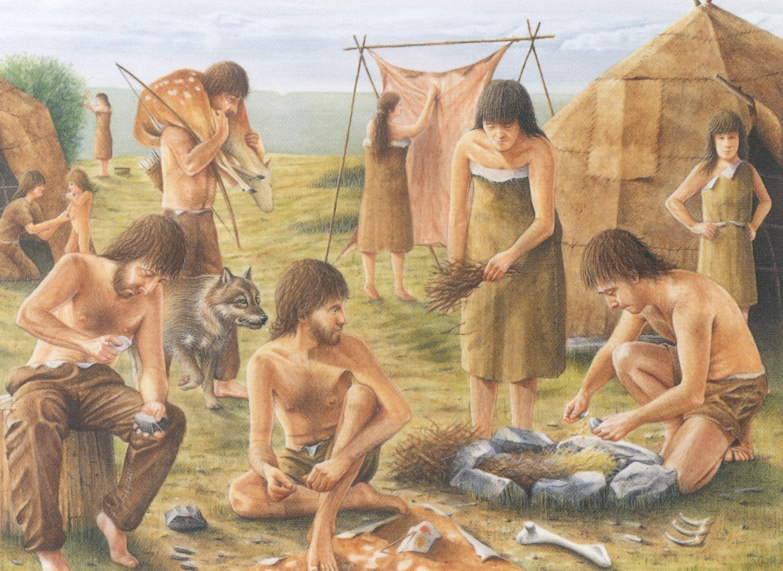

Why are we talking about this?
Even though we know that everybody is different, we still often try to “fit in” with the people around us.
It‘s not our fault either! Our brains are hardwired to try and fit in because of our ancestors, many thousands of years ago.
Hardwired:
To do something automatically
A long time ago, (before electricity, supermarkets and even guns!) people needed to work together to gather food and make shelters to survive. To do this, it was important to be part of a group.
Question (1-2 mins)
Can you think of a reason why our ancestors might’ve needed fit in?
Notes:
Images
https://liveknowledgeworld.wordpress.com/2013/12/10/inventors-of-the-stone-age/
References
https://dictionary.cambridge.org/dictionary/english/hardwired

Slide 8
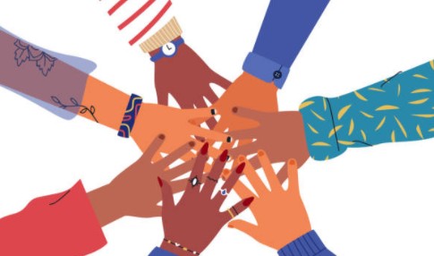
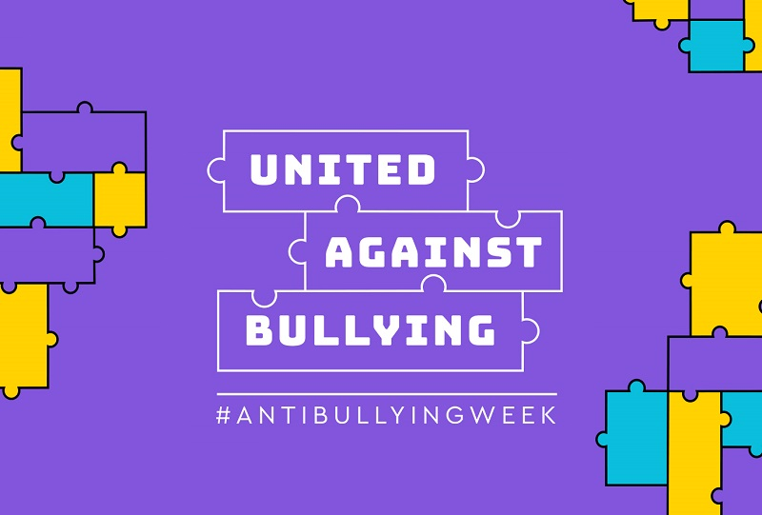
Why are we talking about this?
While we don‘t need to fit in to survive anymore, our brains are still hardwired to make us want to fit in.
This is particularly true in school, where we often feel pressure to fit in because we worry that we won‘t make friends or that we‘ll be bullied.
And because it‘s Anti-Bullying Week, we wanted to take a closer look at this idea, and ask you if you still think it‘s important to fit in at school today.
First thoughts (1-2 mins)
Hold a quick class vote on whether you think it’s important to fit in at school today. Then, see if you change your mind in this lesson!
Notes:
Images
https://www.anti-bullyingalliance.org.uk/anti-bullying-week/anti-bullying-week-2020-united-against-bullying
iStock

Slide 9
Starter: Where do I fit in?
Why are we talking about this?
“Fitting the mould”
Just like everybody else?
Over to you!
Ext: I will…
Vote!
Notes:
Images
Icons8

Slide 10




Just like everybody else?
One big reason many people try to fit in in school is because they worry that they will not make friends, or that they will be bullied if they‘re different from everybody else.
Just like everybody else? (4-8 mins)
Take a look at the statements on the next few slides. If they are true for you, stand on the left side of the room. If they are not true for you, stand on the right.
It‘s true for me!
It‘s not true for me!
Challenge:
Try to pay attention to your classmates’ answers too. Are they the same or different to you?

Slide 11
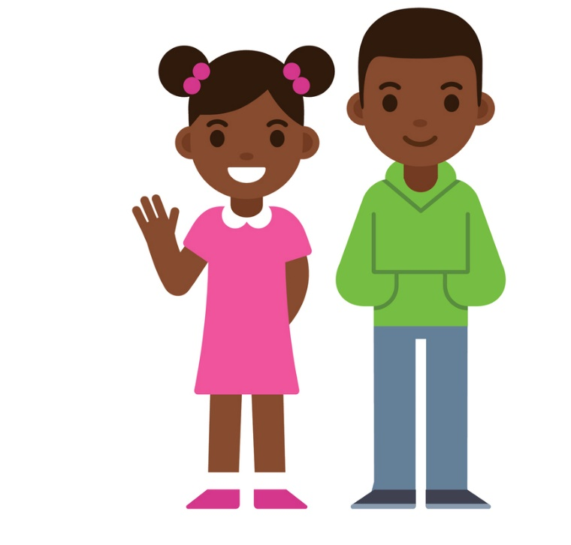
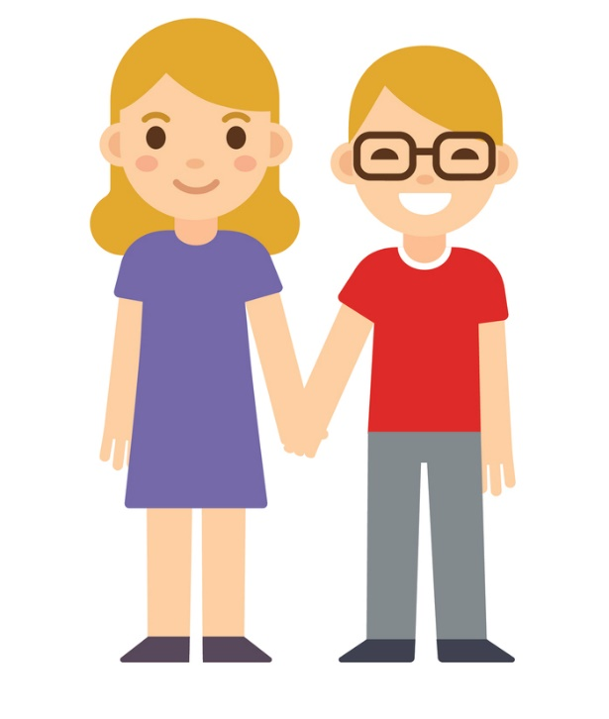
Just like everybody else?
I have a brother or a sister.
It‘s true for me!
It‘s not true for me!
Just like everybody else?
If they this is true for you, stand on the left side of the room. If it’s not true for you, stand on the right.
Notes:
Images
iStock

Slide 12
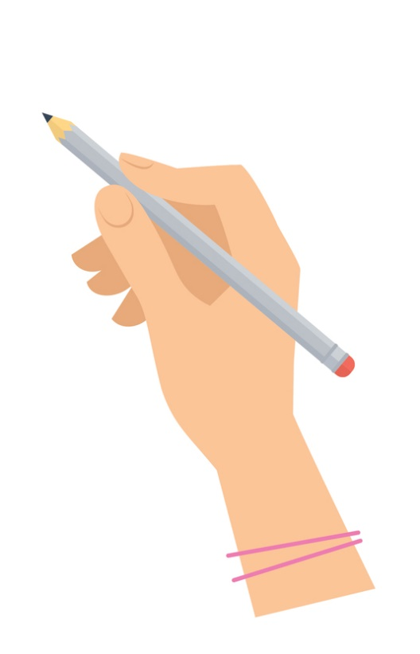
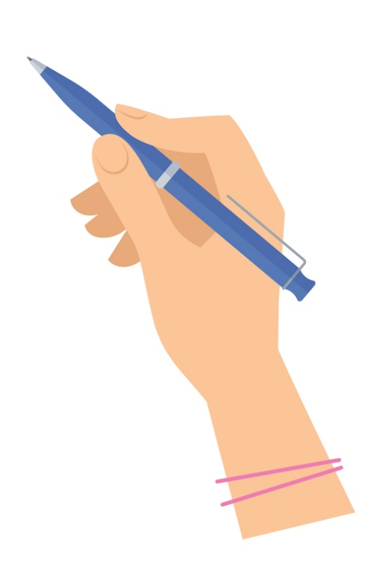
Just like everybody else?
In my spare time, I enjoy drawing.
It‘s true for me!
It‘s not true for me!
Just like everybody else?
If they this is true for you, stand on the left side of the room. If it’s not true for you, stand on the right.
Notes:
Images
iStock

Slide 13
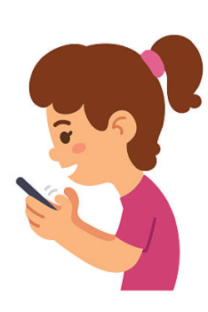
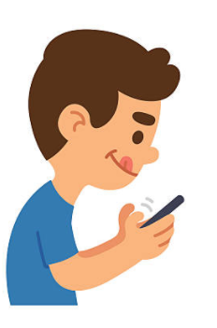
Just like everybody else?
In my spare time, I enjoy gaming.
It‘s true for me!
It‘s not true for me!
Just like everybody else?
If they this is true for you, stand on the left side of the room. If it’s not true for you, stand on the right.
Notes:
Images
iStock

Slide 14

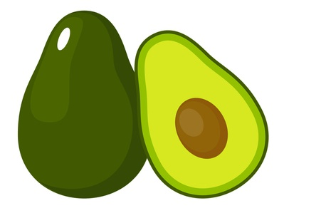
Just like everybody else?
I like eating fruit and vegetables.
It‘s true for me!
It‘s not true for me!
Just like everybody else?
If they this is true for you, stand on the left side of the room. If it’s not true for you, stand on the right.
Notes:
Images
iStock

Slide 15
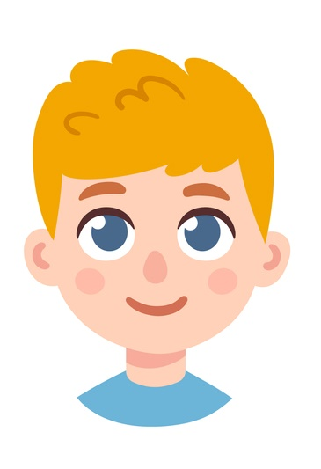
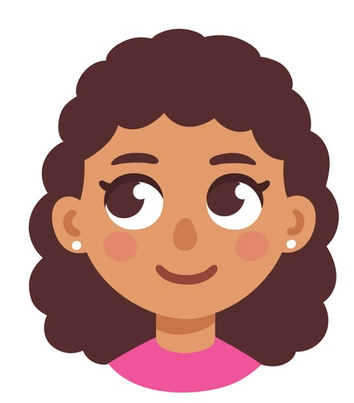
Just like everybody else?
I have long hair.
It‘s true for me!
It‘s not true for me!
Just like everybody else?
If they this is true for you, stand on the left side of the room. If it’s not true for you, stand on the right.
Notes:
Images
iStock

Slide 16




Just like everybody else?
Reflect (1-2 mins)
Now that you’ve seen just a few of your similarities and differences, take a look at the following statements. Put your hand up if you agree with each one.
I agree!
We‘re all very similar.
We‘re all very different.
We all have some similarities and some differences.
Not in the classroom?
Think of a few people that you get on well with. Are you very similar, or very different?
Notes:
Images
iStock

Slide 17
Starter: Where do I fit in?
Why are we talking about this?
“Fitting the mould”
Just like everybody else?
Over to you!
Ext: I will…
Vote!
Notes:
Images
Icons8

Slide 18
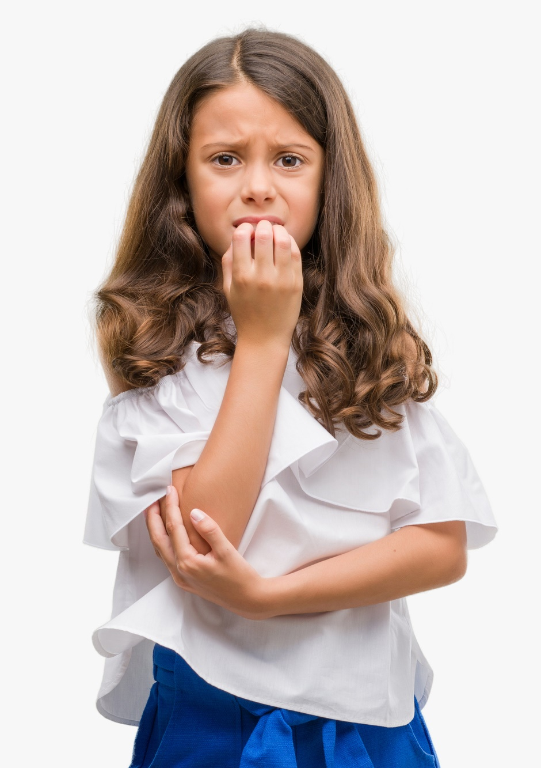
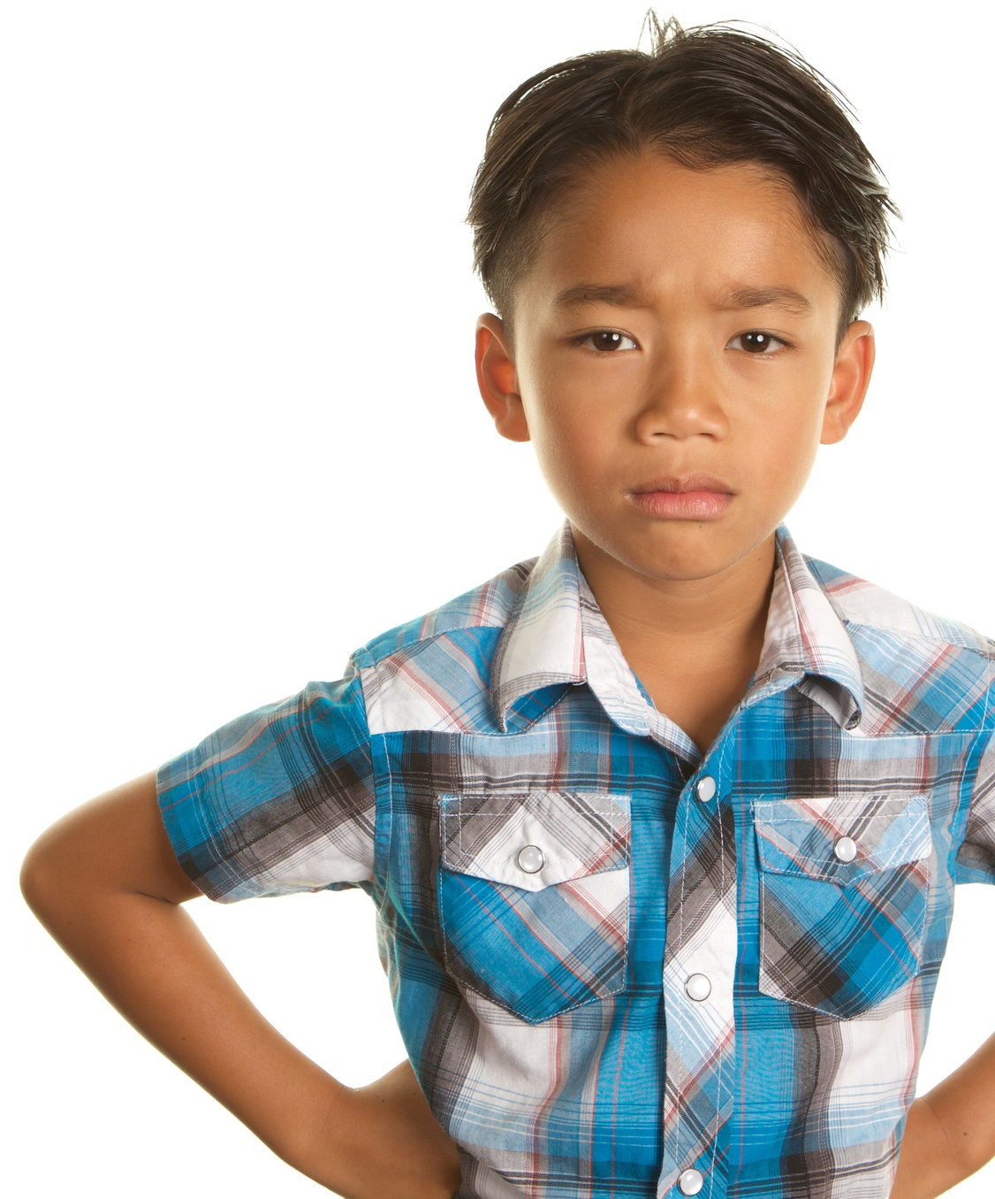
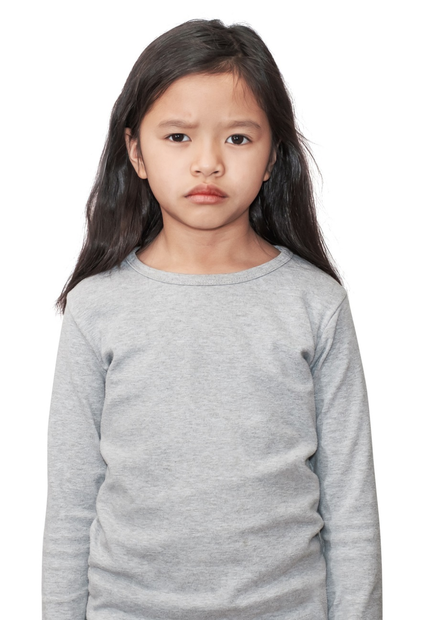
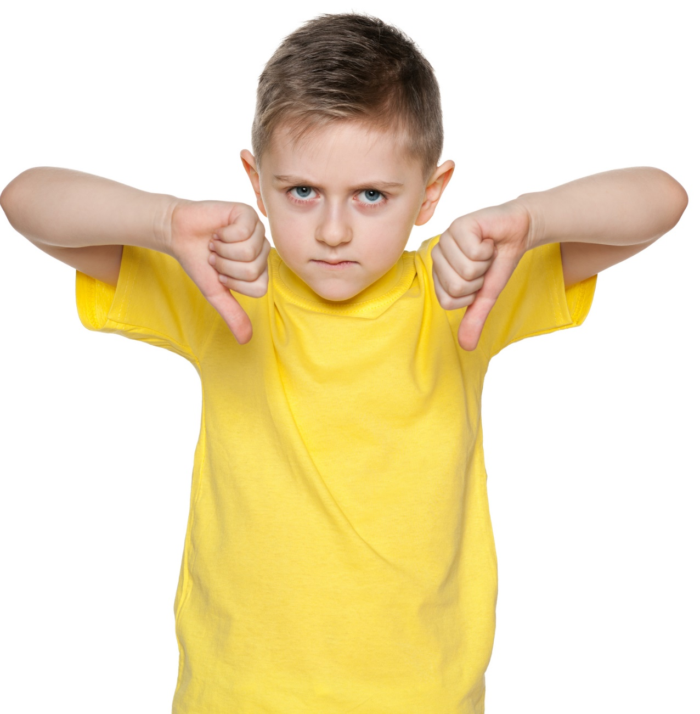
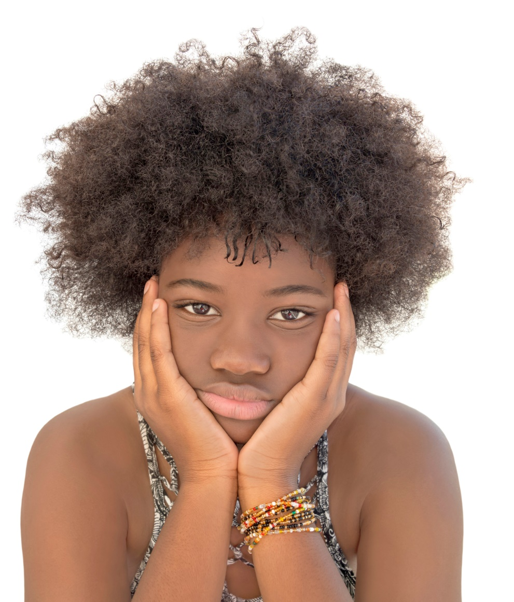
“Fitting the mould”
What would you do? (10-15 mins)
On the next few slides you are going to meet some pupils that need your help! For each one, read the scenario and discuss in your groups (or as a class) and see if you can answer the questions for each one.
Notes:
Images
iStock

Slide 19

“Fitting the mould”
There’s a kid in our class that I don’t really know, who no one really likes. I’m not sure why, she’s just a bit … weird.
Some of the other kids make fun of her sometimes, and I might occasionally laugh along too, but really, I’m starting to think they’re taking it a bit too far. She isn’t my friend or anything, so I probably won’t say anything, but I do feel a bit bad for her.
Read the scenario and discuss:
What is the writer doing to fit in?
Why are they choosing to laugh instead of saying what they think?
What would you do in their situation?
Would you say that this is bullying? Why or why not?
Notes:
Images
iStock

Slide 20

“Fitting the mould”
I really like trying new styles with my hair, and sometimes they can be a bit … different! But I really enjoy it.
Recently, some of my friends have started making fun of me when I come in in the morning, which makes me feel really self-conscious. So I’ve started wearing my hair the same as everyone else. I miss showing off the different things I can do with my hair, but at least I’m not teased anymore.
Read the scenario and discuss:
What did she do to fit in?
Why do you think she chose to fit in instead of standing out?
What would you do in her situation?
Would you say her friends were bullying her? Why or why not?
Notes:
Images
iStock

Slide 21
“Fitting the mould”
I recently started at a new school with my friend, Jada. I’ve made some really cool new friends… but they don’t really like Jada. They say she’s boring and a teacher’s pet. They’re quite funny and sometimes I also make fun of her behind her back… but it’s just a joke!
I still like Jada and I still talk to her and WhatsApp her, just… not when my new friends are around.
Read the scenario and discuss:
What is she doing to fit in?
Why do you think she’s joining in instead of defending her friend?
What would you do in her situation?
Would you call her a bully? Why or why not?
Notes:
Images
iStock

Slide 22
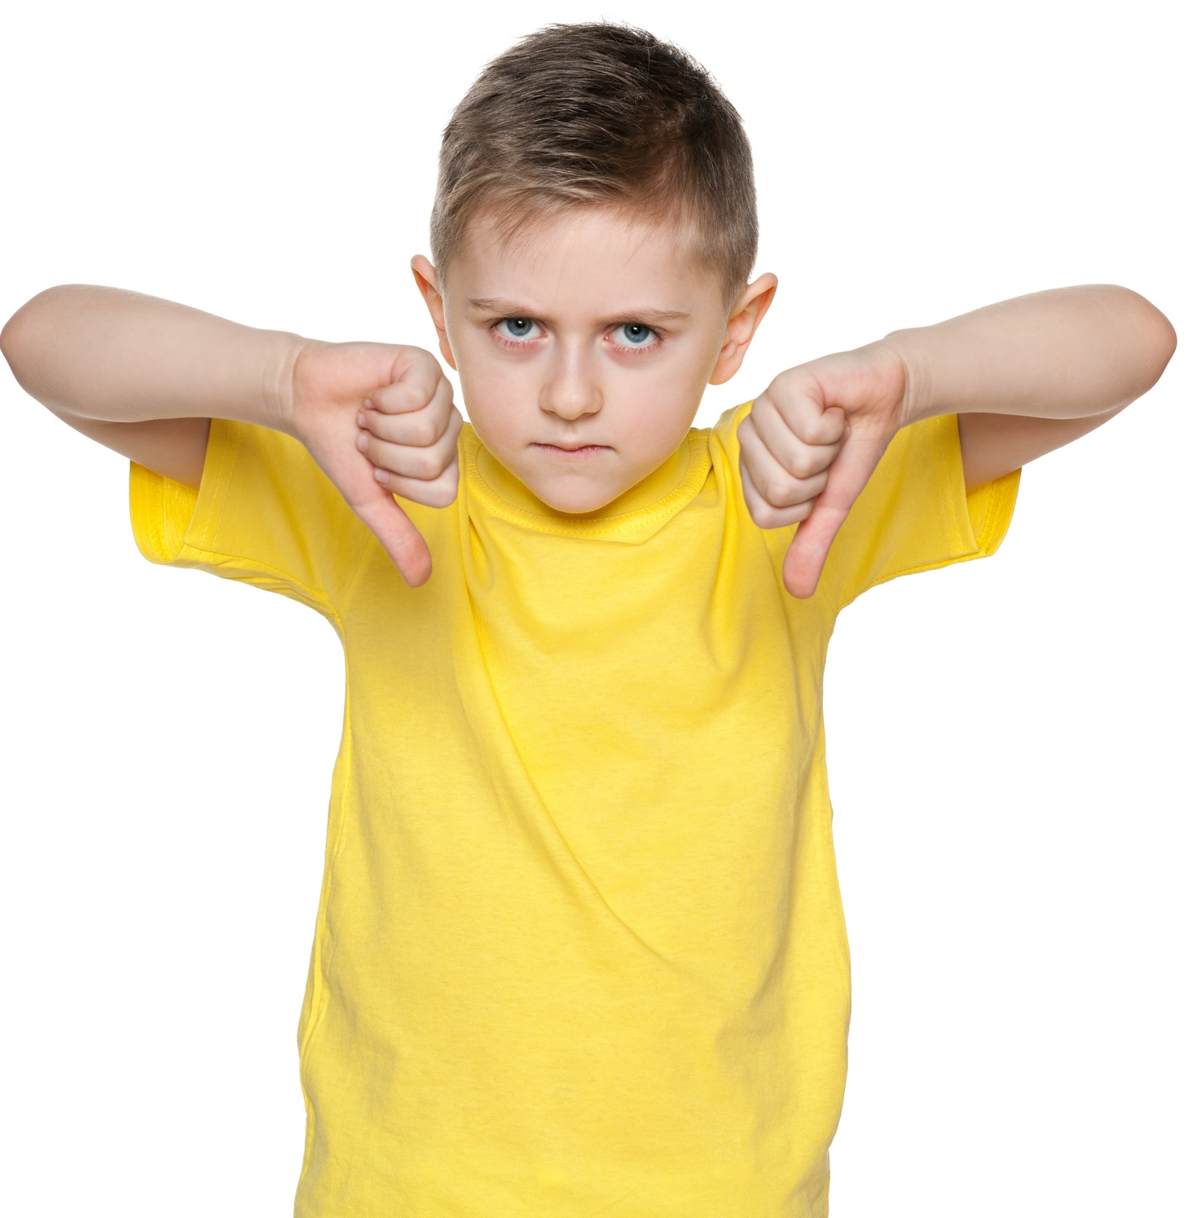
“Fitting the mould”
I’ve always been really into science, and my two best friends are too. We like to make up our experiments and we love Doctor Who.
But a group of boys in our class call us “The Geeks” and say that we can only play with them if we stop being “so nerdy.” I want to make friends with them, so I’m thinking of pretending that I don’t like science anymore, but still liking it when I’m at home.
Read the scenario and discuss:
What is he thinking of doing to fit in?
Should he pretend not to like science at school?
What would you do in his situation?
Would you say the group of boys are bullying them? Why or why not?
Notes:
Images
iStock

Slide 23
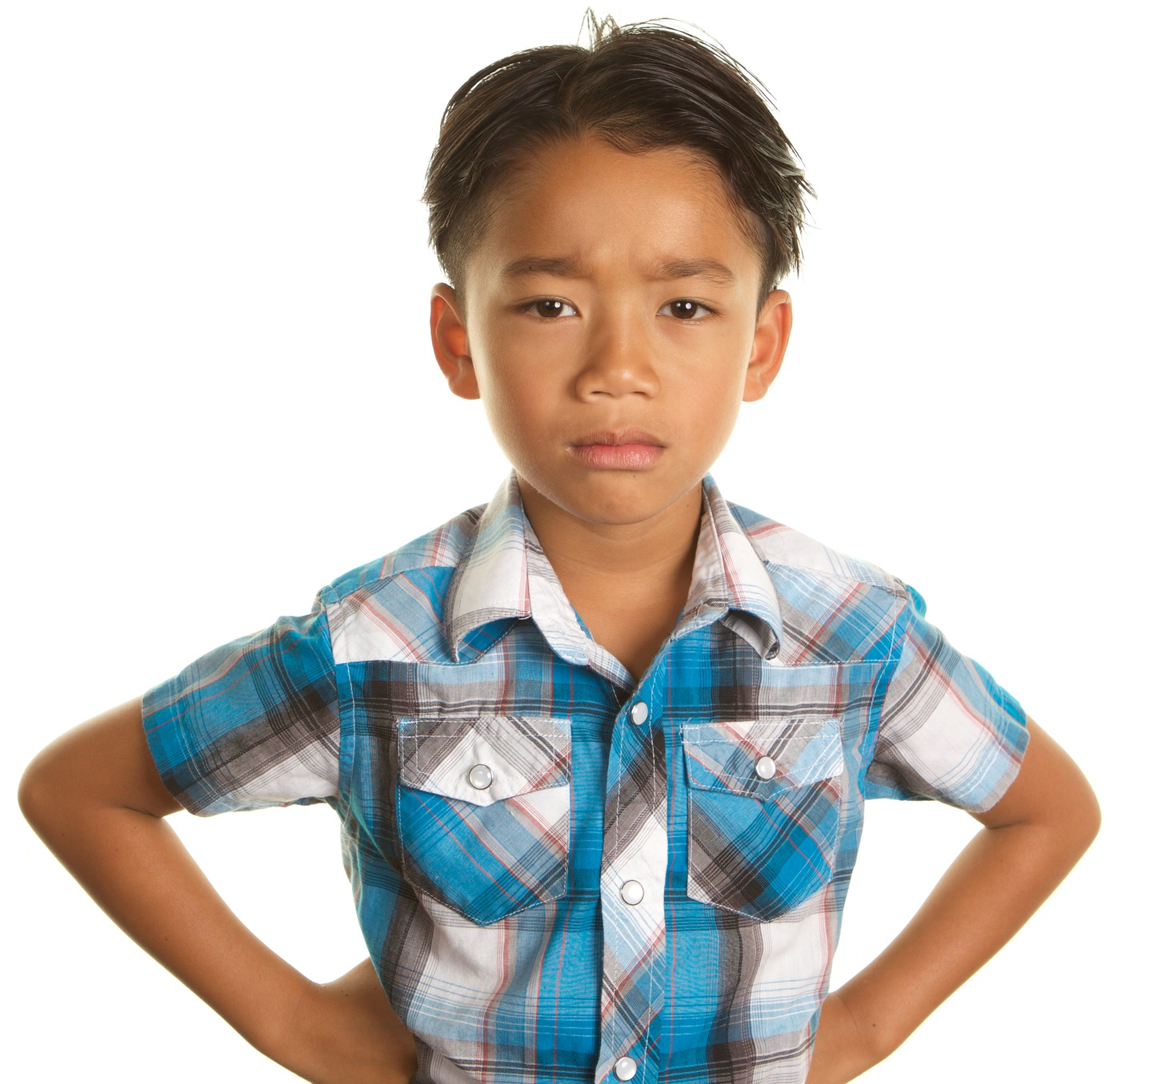
“Fitting the mould”
The other day before school, my friend took a really ugly picture of me. I asked him to delete it, but some other kids thought it was really funny and begged him to send it to them, so he did.
Now at school they’re all laughing at me. I asked my friend why he did it and he says he doesn’t know and he’s sorry, but how can I trust him after he chose them over me?
Read the scenario and discuss:
What did his friend do to fit in?
Why do you think he sent the photo instead of deleting it?
What would you do in their situation?
Would you call his friend a bully? Why or why not?
Notes:
Images
iStock

Slide 24
Starter: Where do I fit in?
Why are we talking about this?
“Fitting the mould”
Just like everybody else?
Over to you!
Ext: I will…
Vote!
Notes:
Images
Icons8

Slide 25






Over to you!
Now you’ve thought about how you fit in, how you’re different, and how peer pressure can tempt you into changing, it’s time to think about where you stand on this week’s question.
Is it important to fit in at school?
I disagree
Vote with your thumbs (5-10 mins)
On the next slide, read through the different opinion and use your thumbs to show if you agree or disagree with each one.
I agree

Slide 26








Over to you!
I agree
Use your thumbs to show if you agree or disagree.
I disagree
“Fitting in with a group just makes school a lot easier.”
“Everyone’s different and we should celebrate that.”
“Sometimes it’s easier to go along with the crowd, even if you know it’s not right.”
“If your friends are expecting you to change who you are, then they’re not really your friends.”
“Being yourself and doing the right thing is much more important than fitting in.”
“There is a lot of pressure to fit in at school, you really can’t avoid it.”

Slide 27
Starter: Where do I fit in?
Why are we talking about this?
“Fitting the mould”
Just like everybody else?
Over to you!
Ext: I will…
Vote!
Notes:
Images
Icons8

Slide 28





I will…
Now that you’ve learned more about yourselves and your peers, and seen how bullying can affect people, it’s time to think about what you can do to stop bullying altogether!
I will… (3-5 mins)
Take a post it note, or a piece of paper and write a pledge to help stop bullying in your school. Use the examples to help you!
I will always be myself!
I will not hide my differences from others.
Pledge:
A promise
I will celebrate my friends’ differences.
I will…
Extra idea:
Why not make a display of your pledges in your classroom?
Notes:
Images
iStock

Slide 29
Starter: Where do I fit in?
Why are we talking about this?
“Fitting the mould”
Just like everybody else?
Over to you!
Ext: I will…
Vote!
Notes:
Images
Icons8

Slide 30


Learn more: Anti-Bullying Week
If you haven’t already, head over the Anti-Bullying Alliance’s website to find all of their resources for 2020’s Anti-Bullying Week, including an assembly, lesson and even a poster that you can put up in your school!
Career Spotlight:
What kind of person do you think it takes to make everyone feel like they fit in? This week, we’d like you to a job advert for an Anti-Bullying Officer for your class! Think about what sort of skills they should have, any experience they need, and what their responsibilities might be. Then, why not apply for the job for your class!
Notes:
Images and references:
https://www.anti-bullyingalliance.org.uk/anti-bullying-week/anti-bullying-week-2020-united-against-bullying
iStock

Slide 31
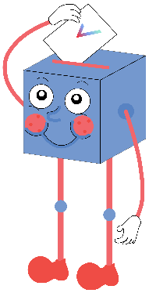

Is it important to fit in at school?
Making friends and joining groups is an important part of school life.
Things are just easier if you fit in than if you stand out.
You’re less likely to be bullied at school if you fit in with everyone else.
…
It’s always important to be yourself, even if that means you don’t always fit in.
Fitting in is boring, standing out is much more fun!
School should be a time where you find out who you are and what you enjoy. You can’t do that if you’re trying to fit in
…
We will be sharing your thoughts on this topic with the Anti-Bullying Alliance, Ditch the Label, the NSPCC, Bullying UK, and some famous faces who have shared their experiences of bullying.

Slide 32



Vote!
In the classroom?
Log your class’s votes now at: www.votesforschools.com/login/teacher
At home?
Follow this link to vote: https://www.surveymonkey.co.uk/r/vfs-primary-fitting-in
Not sure how?
Click the ballot box to see a video on how to log your votes!
Having trouble?
Copy and paste the link into your internet browser!
If you have any issues, feedback or comments, email amy@votesforschools.com.
Notes:
SurveyMonkey Link:
SafeShare How-To Video Link: https://safeshare.tv/x/N0-AjP3cFjg
YouTube How-To Link: https://www.youtube.com/watch?v=N0-AjP3cFjg&feature=youtu.be

