Slide 2




Feedback: “Could you break a record?”
“I think anyone can do anything you set your mind to…if you have the right mindset and are persistent.”
Northwood College for Girls
No
19.4%
“I don’t think I could beat a record because they are hard to beat.”
Rushall Primary School
“I think it is possible for anyone to achieve anything. If you put your mind to it nobody can stop you.”
Skippers Hill Manor School
Yes
80.6%
“Going into a month lock-down you can practice things you have never done before.”
Northwood College for Girls
“No because I am not really into things like the longest fingernails in the world – but my Mum thinks I could break the record with how fast I do my times tables!”
Childwall Church of England School
“I will try to hold the record for the longest fidget spin spun!”
Pinfold Street Primary School
Notes:
Images

Slide 3
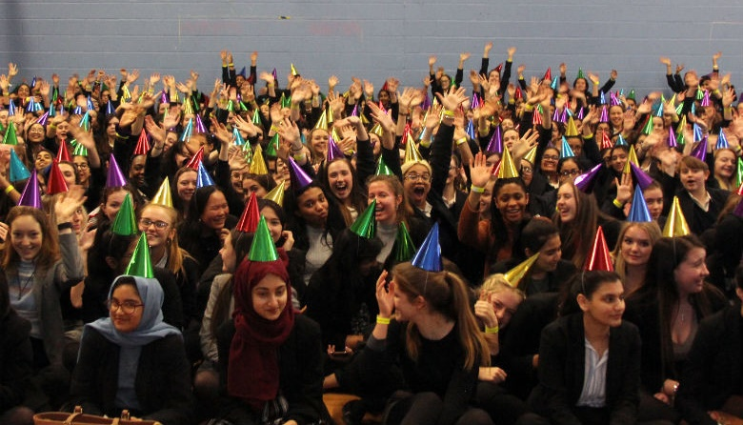





Feedback: “Could you break a record?”
0:00-2:58
For the students at Sutton Coldfield Grammar School for Girls, the question wasn’t could you break a record, it’s have you already broken one! Click the image to find out more about their achievement. Thank you so much for sharing it with us!
The VoteTopic results were also shared with…
The Guinness World Records
This Girl Can
Team GB
Blue Peter
BBC Newsround
https://safeshare.tv/x/_JaJMufgHt4
Notes:
Alternative Video Link: https://www.youtube.com/watch?v=_JaJMufgHt4&feature=youtu.be
Images
https://www.guinnessworldrecords.com/world-records/429867-largest-gathering-of-people-wearing-conical-party-hats
https://en.wikipedia.org/wiki/Guinness_World_Records
https://www.thisgirlcan.co.uk/
https://en.wikipedia.org/wiki/Team_GB
https://www.huffingtonpost.co.uk/entry/blue-peter-viewing-figures-ratings_uk_595ca9bce4b02734df34b54a?guccounter=1&guce_referrer=aHR0cHM6Ly93d3cuZ29vZ2xlLmNvbS8&guce_referrer_sig=AQAAANMBfg4YjbQkEn2W43DrQOBQqNgTYZfkPn2S9OyrUELHS75UxzA874r8M_bmlY7IjVpZkhKcezdAAgIWvw6udAolWI964MlkS4SQoBOZ_OVCGzJG62u6R1V_7prYOodgGoHMv2Mca9MH6wvyMhp1Ztz3eKYkesqymVpE-3mgcEZs
https://www.youtube.com/channel/UCKlqMc-09XZknXO8jsK-15A

Slide 4

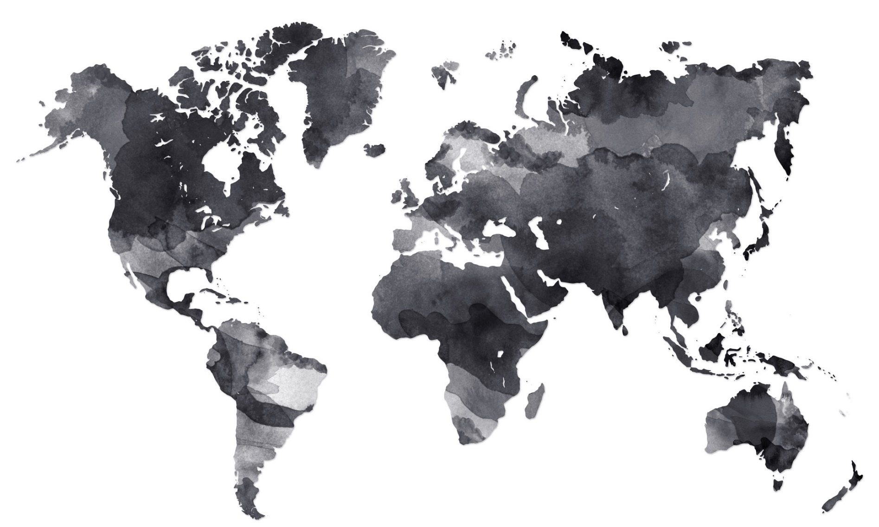


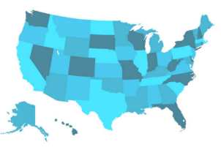

Starter: Can you find US?
Can you find US? (2-5 mins)
Take a look at this map of the world. Can you find the United Kingdom (UK) on it? How about the United States (US)? Click to see if you’re right!
The United States of America (USA)
The United Kingdom (UK)
The United States of America (often called the US) got its name because it is made up of 50 states. The capital city is Washington D.C, but you might have also heard of these states: Florida, California or Texas!
The United States (US) is 4,242 miles away from the United Kingdom. It takes between 6 and 11 hours to fly there!
Notes:
Images:
iStock
References:
https://www.cheapflights.co.uk/flights/USA/London/#:~:text=How%20long%20is%20the%20flight,can%20take%20over%2011%20hours.
https://www.google.com/search?q=distance+from+uk+to+us&oq=distance+from+uk+to+us&aqs=chrome.0.0i457j0l3j0i22i30j69i64l3.2952j0j9&sourceid=chrome&ie=UTF-8

Slide 5
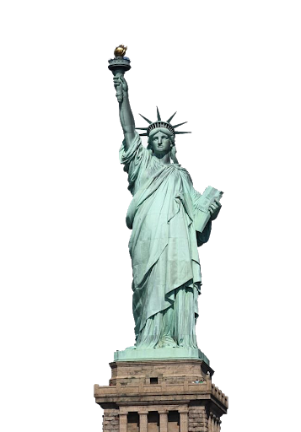

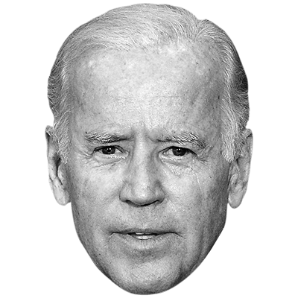


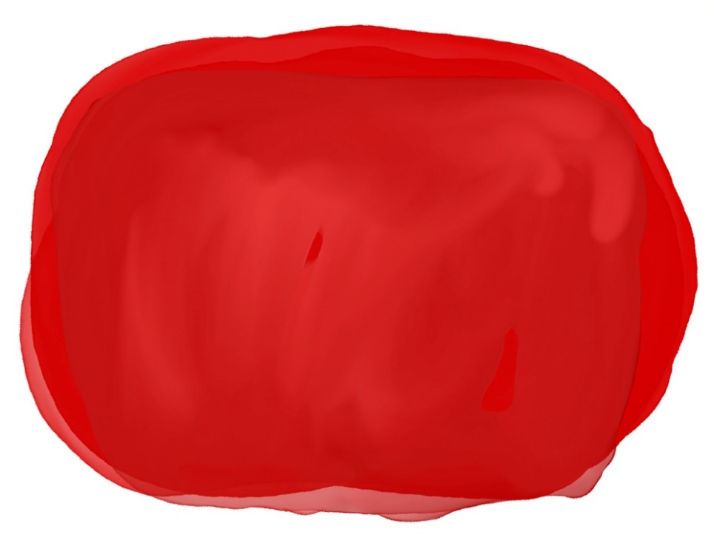
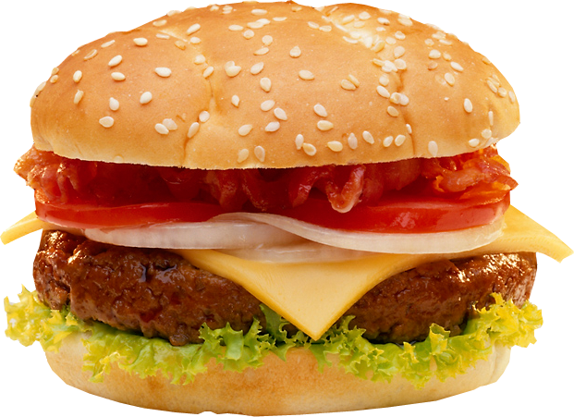


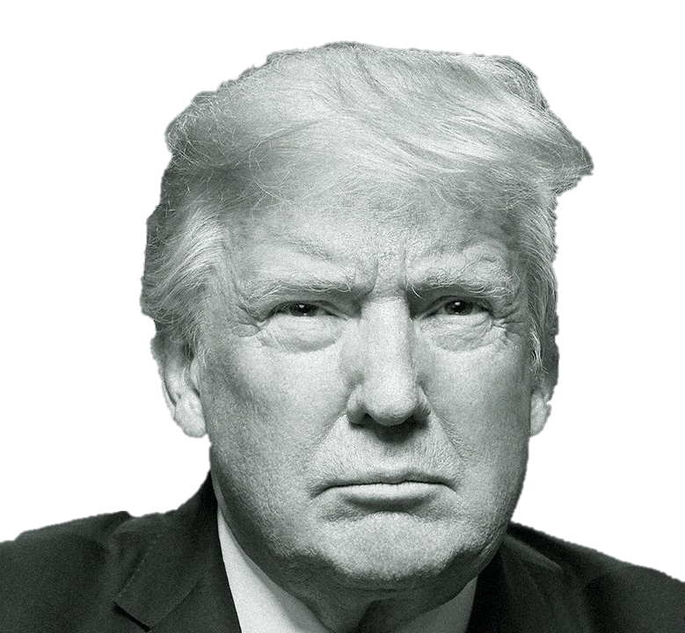


Are we too influenced by the US?
Notes:
Images
iStock
https://www.pinterest.co.uk/pin/406520303859405711/
https://commons.wikimedia.org/wiki/File:Apple_logo_black.svg
http://www.pngmart.com/image/127605
https://fontmeme.com/hard-rock-font/
http://www.pngplay.com/image/20715
https://projects.economist.com/democratic-primaries-2020/candidate/joe-biden/
https://www.economist.com/leaders/2018/08/23/is-donald-trump-above-the-law
http://freepngimages.com/cheeseburger-transparent-background/
References

Slide 6







Starter: Can you find US?
Which do you prefer?
Why are we talking about this?
Why the US?
Is it a bad thing?
Ext: Celebrating the Best of Britain!
Vote!
Notes:
Images
iStock
Icons8 – Colour Hand Drawn

Slide 7



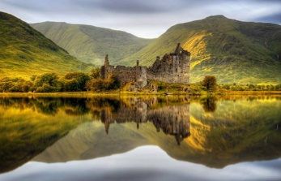
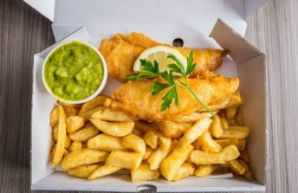

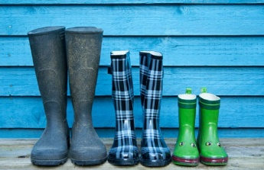



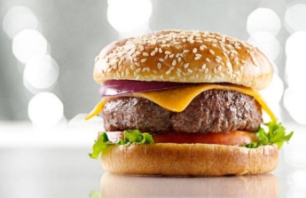
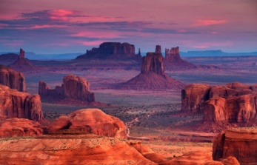

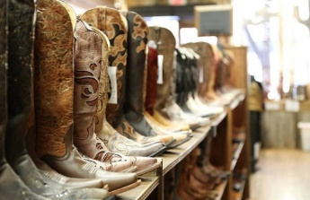

Which do you prefer?
Red or blue? (5-10 mins)
Take a look at the different choices on the next few slides. For each one, decide if you prefer the blue option or the red option. Keep count of how many reds and blues you choose using a tally chart.
I prefer blue!
I prefer red!
Notes:
Images:
iStock
https://www.pinterest.co.uk/pin/797559415239764655/
https://www.stickpng.com/img/icons-logos-emojis/shop-logos/fred-perry-logo
https://www.pinterest.co.uk/pin/854909941753199871/
https://informitv.com/2019/12/15/sky-sidelines-britbox/
https://www.stickpng.com/img/icons-logos-emojis/tech-companies/netflix-logo

Slide 8




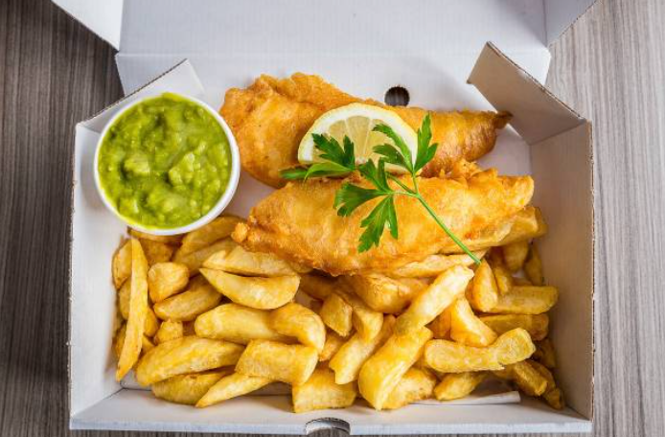

Which do you prefer?
Which of these do you prefer?
I prefer red!
I prefer blue!
Don’t forget!
Add a point to your tally chart for the one that you prefer!
Red | Blue
Notes:
Images:
1) iStock

Slide 9






Which do you prefer?
Which of these do you prefer?
I prefer red!
I prefer blue!
Don’t forget!
Add a point to your tally chart for the one that you prefer!
Red | Blue
Notes:
Images
https://www.bbc.co.uk/cbbc/shows/cbbc
https://www.pinterest.co.uk/pin/854909941753199871/

Slide 10

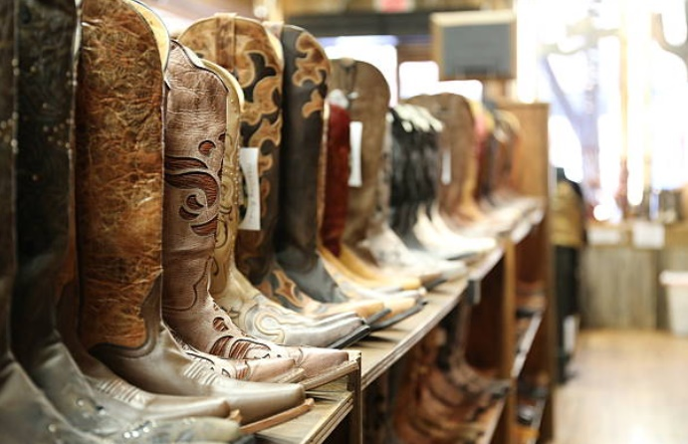


Which do you prefer?
Which of these do you prefer?
I prefer red!
I prefer blue!
Don’t forget!
Add a point to your tally chart for the one that you prefer!
Red | Blue
Notes:
Images:
1) iStock

Slide 11



Which do you prefer?
Which of these do you prefer?
I prefer red!
I prefer blue!
Don’t forget!
Add a point to your tally chart for the one that you prefer!
Red | Blue
Notes:
Images:
https://www.pinterest.co.uk/pin/797559415239764655/
https://www.stickpng.com/img/icons-logos-emojis/shop-logos/fred-perry-logo

Slide 12



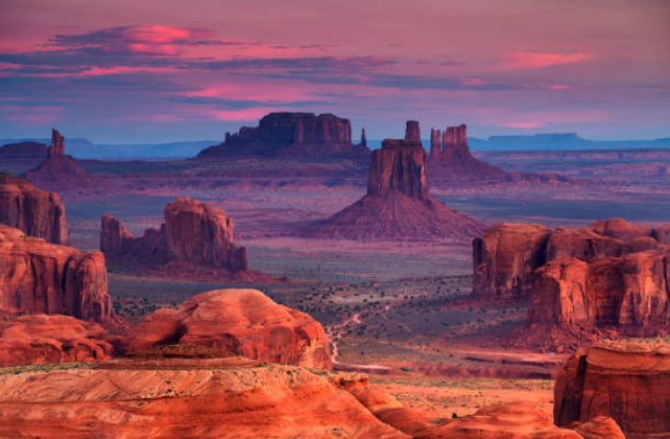

Which do you prefer?
Which of these do you prefer?
I prefer red!
I prefer blue!
Don’t forget!
Add a point to your tally chart for the one that you prefer!
Red | Blue
Notes:
Images:
1) iStock

Slide 13






Which do you prefer?
What did you prefer? (2-3 mins)
Now count up your tally. Did you get more blues or more reds?
Mostly Reds
Half and half
Mostly Blues
You tend to prefer things from the United States!
You like things from the US and from home equally!
You tend to prefer things from the United Kingdom!
Reflect (2-3 mins)
Did you know that these things were from the US and not from the UK? Are there any that surprised you?
Reflect (2-3 mins)
Do you think that it’s important to know where different brands, traditions and cultural practises come from?

Slide 14
Starter: Can you find US?
Which do you prefer?
Why are we talking about this?
Why the US?
Is it a bad thing?
Ext: Celebrating the Best of Britain!
Vote!
Notes:
Images
iStock
Icons8 – Colour Hand Drawn

Slide 15




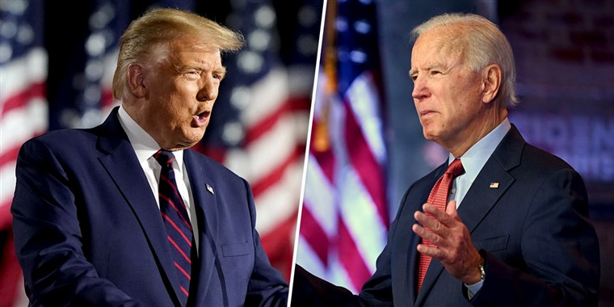


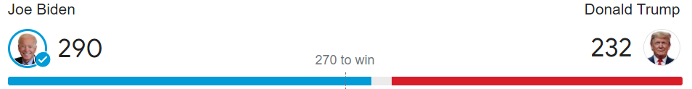
Why are we talking about this?
A few weeks ago it felt like everyone was talking about the USA... But why?
Question! (1 min)
What major event happened in the US recently?
Just like we have here in the UK, the US held an election a few weeks ago. This meant that Americans voted for who they wanted to be the President.
More than 146 million people voted in the election, and (drumroll!) Joe Biden won. This means that he will become the next President of the United States!
Notes:
Images
BBC News
https://www.ap.org/media-center/understanding-the-election - the bottom image was accurate as of 19/11/20!

Slide 16
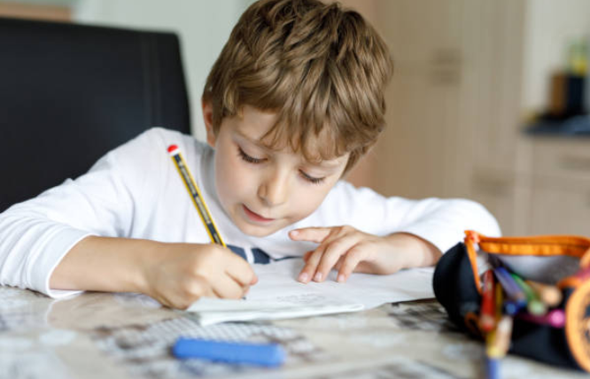

Why are we talking about this?
We’re all influenced by different things, and influences can be both good and bad. For example, you might have a friend that works really hard at their times tables, which could influence you to try harder at yours too.
Influence:
To cause someone to change a behaviour, belief, or opinion.
Question (2 mins)
Can you think of a time that you have been influenced? It could be positive or negative.
As you’ve already seen, there are lots of different brands, sports, celebrations and other things that we have here from the US, but why is this? And is this influence a good thing, or is it going too far? That’s what you’ll be discussing today.
Notes:
Images
iStock

Slide 17
Starter: Can you find US?
Which do you prefer?
Why are we talking about this?
Why the US?
Is it a bad thing?
Ext: Celebrating the Best of Britain!
Vote!
Notes:
Images
iStock
Icons8 – Colour Hand Drawn

Slide 18



Why the US?
By now you know that there are quite a few different ways that we are influenced by the US – but what makes the US so much more influential than other countries?
True or false? (8-10 mins)
Take a look at these “facts” about the US on the next few slides. Use the emojis to show whether you think that they are true or false. Then, click to find out the answer!
It’s false
It’s true
1
Their economy produces around one quarter of the world’s wealth.
It’s true!
The US is the world’s largest economy*, and has been for 149 years! This means that they make lots of different things that sell around the world and make them a lot of money (like iPhones, Google and Amazon!).
Notes:
* By net worth. Definition has been simplified.
Images:
https://emojipedia.org/
icons8
References:
https://www.bbc.co.uk/bitesize/articles/zfcnf4j#:~:text=The%20word%20'economy'%20describes%20how,gold
https://www.businessinsider.com/worlds-most-powerful-countries-2020-ranked-us-news-2020-1?r=US&IR=T
https://www.bbc.co.uk/bitesize/guides/z6frqp3/revision/2

Slide 19
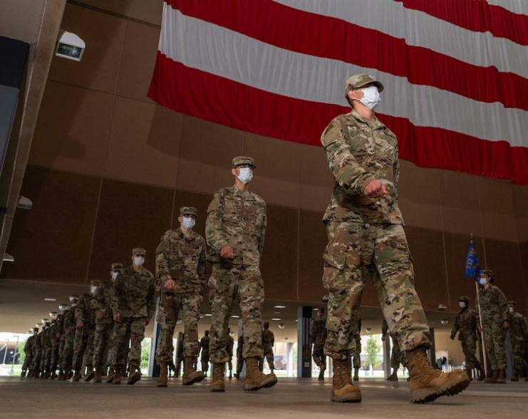

Why the US?
2
The US doesn’t have a very big army - they don’t need one.
It’s false!
The US spend more on their military than any other country and have the largest Air Force & Navy in the world. This means that going to war with them would be quite difficult.
3
Films, music and TV shows from the US are watched all around the world.
It’s true!
Beyoncé, Lady Gaga, Will Smith, Brad Pitt, Disney & Marvel are just some of the many famous singers, actors and film companies that come from the US and are very popular here!
Notes:
Images:
https://www.exp1.com/blog/hollywood-sign-history/
https://www.csmonitor.com/USA/Military/2020/0415/No-quick-exit-US-military-plans-for-new-normal-in-COVID-era
icons8
References:
https://www.bbc.co.uk/bitesize/guides/z6frqp3/revision/2
https://www.statista.com/statistics/264443/the-worlds-largest-armies-based-on-active-force-level/
https://en.wikipedia.org/wiki/United_States_Armed_Forces

Slide 20






Why the US?
Being the Prime Minister of the UK is often described as a more important job that the President of the US.
4
It’s false!
The job of President of the United States is commonly called the “most important job in the world.” As the leader of one of the richest and most powerful countries in the world, the President has to make lots of decisions on things like…
Covid-19
Laws and rules
Healthcare
Taxes and money
Climate change
Foreign Policy
And because the US is so influential, these decisions affect lots of other countries. However, being the Prime Minister here is still pretty important!
Notes:
Images:
Icons8
https://emojipedia.org/

Slide 21
Starter: Can you find US?
Which do you prefer?
Why are we talking about this?
Why the US?
Is it a bad thing?
Ext: Celebrating the Best of Britain!
Vote!
Notes:
Images
iStock
Icons8 – Colour Hand Drawn

Slide 22
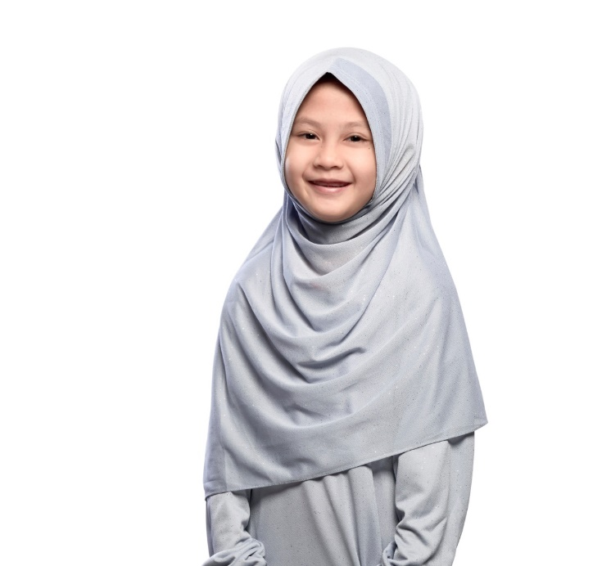
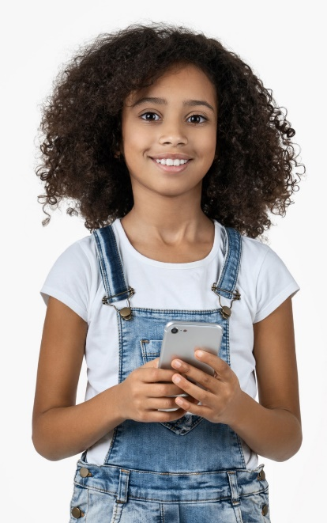


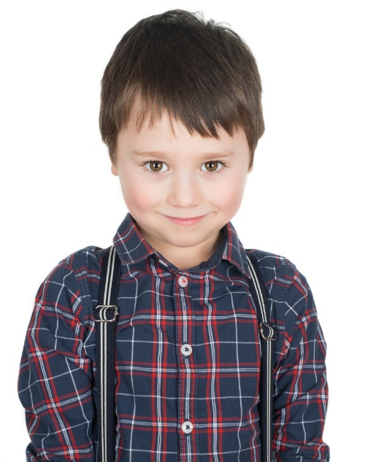
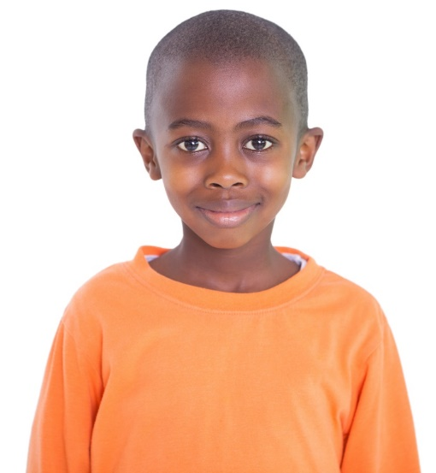
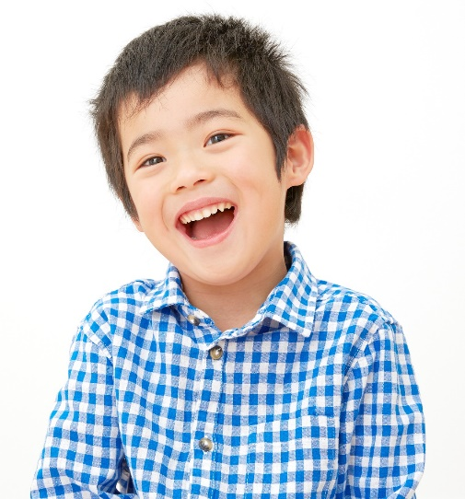
Is it a bad thing?
Is it a bad thing? (8-20 mins)
Over the next few slides, you are going to see some different opinions about how much we’re influenced by the US. For each one, spend 2-3 minutes deciding whether you agree or disagree with the statement. Then, ask one person from your group to explain your reasons to the rest of the class.
Short on time?
Vote with your feet instead to show if you agree or disagree. Be ready to explain why!
Notes:
Images
1) iStock

Slide 23
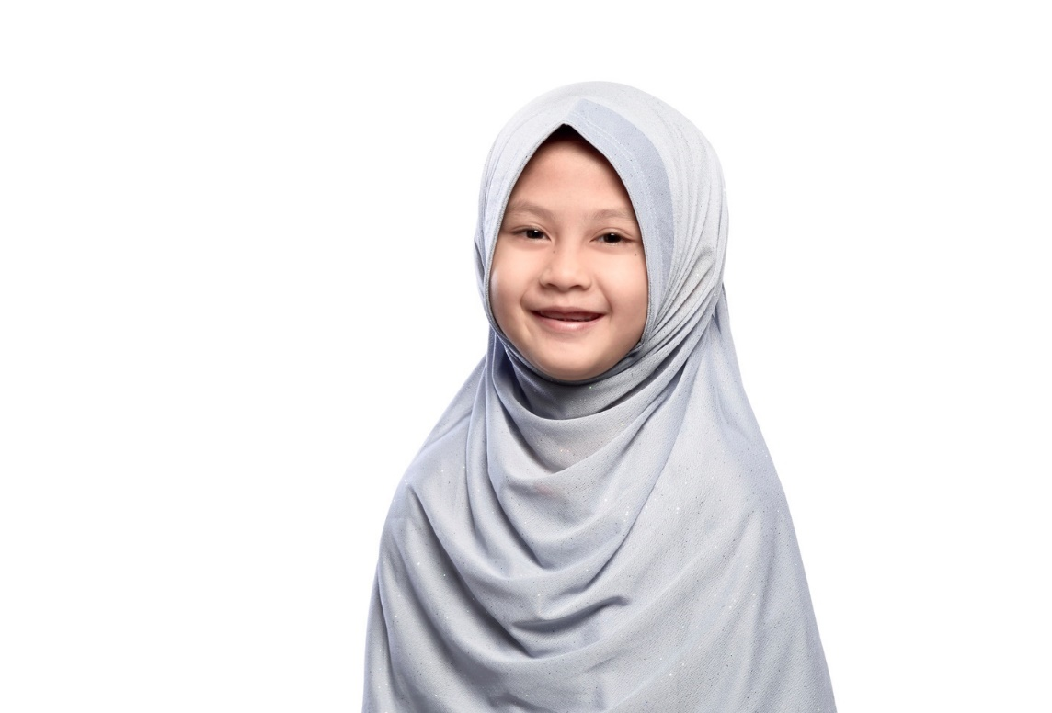
Is it a bad thing?
One of the best things about the UK is that it celebrates different cultures from around the world, including the US. We don’t need to change anything.
In your groups, decide whether you agree or disagree with this statement. Then ask one person to explain your thoughts to the rest of the class. Use the speech bubbles to help you!
Our group thinks that…
We agree/disagree with the statement because…
While we agree that… we still think that…
They haven’t thought about…
Notes:
Images
1) iStock

Slide 24
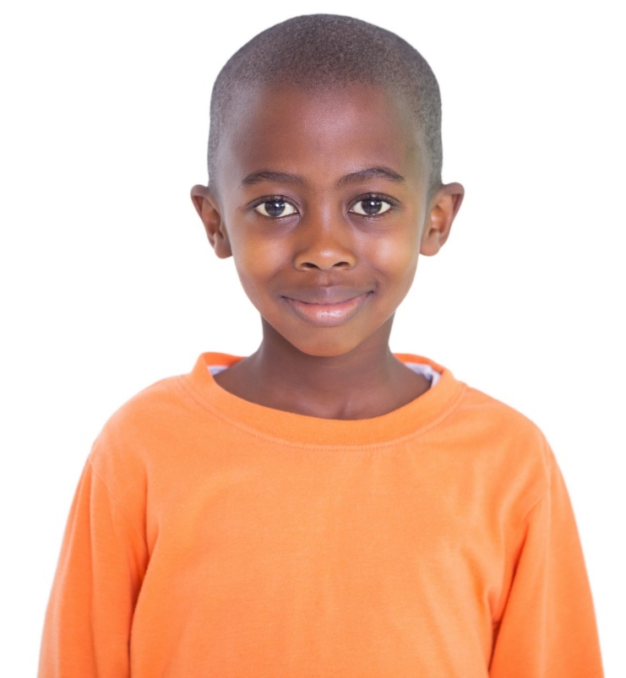
Is it a bad thing?
It’s not a bad thing to learn about other places, but we’re too influenced by the US and not enough by other countries and cultures. We should try to find out more about the rest of the world instead.
In your groups, decide whether you agree or disagree with this statement. Then ask one person to explain your thoughts to the rest of the class. Use the speech bubbles to help you!
Our group thinks that…
We agree/disagree with the statement because…
While we agree that… we still think that…
They haven’t thought about…
Notes:
Images
1) iStock

Slide 25

Is it a bad thing?
Things like the Black Lives Matter protests in the US make us look at our own country and want to be better. This is a good thing!
In your groups, decide whether you agree or disagree with this statement. Then ask one person to explain your thoughts to the rest of the class. Use the speech bubbles to help you!
Our group thinks that…
We agree/disagree with the statement because…
While we agree that… we still think that…
They haven’t thought about…
Notes:
Images
1) iStock

Slide 26

Is it a bad thing?
The US has lots of things that we don’t want to be influenced by, like expensive healthcare and carrying guns. We need to be more careful.
In your groups, decide whether you agree or disagree with this statement. Then ask one person to explain your thoughts to the rest of the class. Use the speech bubbles to help you!
Our group thinks that…
We agree/disagree with the statement because…
While we agree that… we still think that…
They haven’t thought about…
Notes:
Images
1) iStock

Slide 27

Is it a bad thing?
We live in the UK, so we should celebrate UK culture, not keep being influenced by other countries. Otherwise, we’ll forget what being British means!
In your groups, decide whether you agree or disagree with this statement. Then ask one person to explain your thoughts to the rest of the class. Use the speech bubbles to help you!
Our group thinks that…
We agree/disagree with the statement because…
While we agree that… we still think that…
They haven’t thought about…
Notes:
Images
1) iStock

Slide 28

Is it a bad thing?
Many people in the UK come from different countries all over the world, so we should celebrate every culture. This way, everyone will feel at home.
In your groups, decide whether you agree or disagree with this statement. Then ask one person to explain your thoughts to the rest of the class. Use the speech bubbles to help you!
Our group thinks that…
We agree/disagree with the statement because…
While we agree that… we still think that…
They haven’t thought about…
Notes:
Images
1) iStock

Slide 29

Is it a bad thing?
It doesn’t have to be one or the other. We can still celebrate all of our own traditions and be influenced by other cultures.
In your groups, decide whether you agree or disagree with this statement. Then ask one person to explain your thoughts to the rest of the class. Use the speech bubbles to help you!
Our group thinks that…
We agree/disagree with the statement because…
While we agree that… we still think that…
They haven’t thought about…
Notes:
Images
1) iStock

Slide 30
Starter: Can you find US?
Which do you prefer?
Why are we talking about this?
Why the US?
Is it a bad thing?
Ext: Celebrating the Best of Britain!
Vote!
Notes:
Images
iStock
Icons8 – Colour Hand Drawn

Slide 31







Ext: Celebrating the Best of Britain!
My favourite things… (2-5 mins)
Before you start this activity, take a few minutes to think of (or jot down) some of your favourite things about the UK. When you have some ideas, click to see the next step!
Celebrating the Best of Britain! (5+ mins)
Now you’ve thought about your favourite things, it’s time to celebrate them! You can choose any of the ways below, but think carefully about how you can show/explain the reasons why the thing(s) you have chosen are great!
Postcard
News headlines
A picture
A short video
A leaflet
A song
Notes:
Images:
Icons8
iStock
https://www.bbc.co.uk/cbbc/shows/cbbc
https://www.stickpng.com/img/icons-logos-emojis/shop-logos/fred-perry-logo
https://informitv.com/2019/12/15/sky-sidelines-britbox/

Slide 32
Starter: Can you find US?
Which do you prefer?
Why are we talking about this?
Why the US?
Is it a bad thing?
Ext: Celebrating the Best of Britain!
Vote!
Notes:
Images
iStock
Icons8 – Colour Hand Drawn

Slide 33
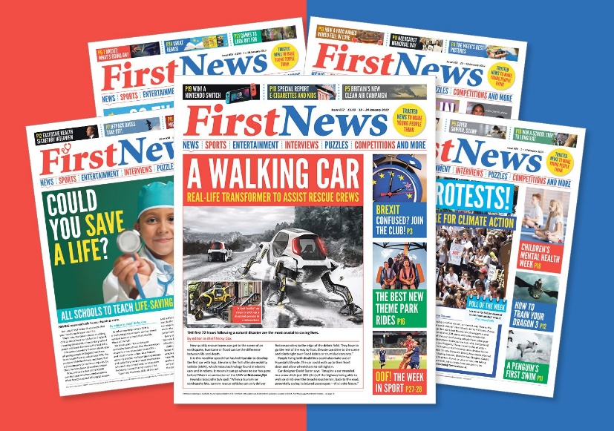

Quick idea
Your News – a different way
You’ve probably already heard of Newsround, but what if reading is your thing? First News is an award winning newspaper written for children! For 3 free issues for your class, just ask your teacher to click the image!
Big idea
World News Club
If you’d like to learn more about different countries in the world, why not start up your own World News Club? You could even create your own school newspaper or film a short news programme each week!
Notes:
Images:
1) https://schools.firstnews.co.uk/products/newspaper/
References:
1) https://schools.firstnews.co.uk/discover-physical-copies/

Slide 34
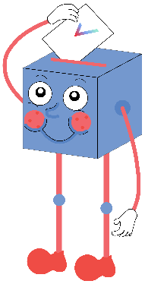

Are we too influenced by the US?
We’re more focused on the issues and arguments in the US than what’s happening in our own country.
We give the US a lot of attention and money, when really it would be better to focus on the UK.
UK culture is starting to be replaced by US culture.
I’m getting bored of hearing about American culture and American people – we should be more focused on what’s happening here.
The US is one of the most powerful countries in the world – so what happens there affects everyone.
We are influenced by all different cultures, not just the US.
We are still an independent nation with our own values and identity – a few TV shows and influencers isn’t going to change that.
I enjoy watching what’s going on it the US, so I don’t think it’s too much.
We will be sharing your thoughts on this topic with BBC America, the US Embassy, Simple Politics, Netflix UK and The Bill & Melinda Gates Foundation.

Slide 35



Vote!
In the classroom?
Log your class’s votes now at: www.votesforschools.com/login/teacher
At home?
Follow this link to vote: https://www.surveymonkey.co.uk/r/vfs-primary-ks2-USA
Not sure how?
Click the ballot box to see a video on how to log your votes!
Having trouble?
Copy and paste the link into your internet browser!
If you have any issues, feedback or comments, email amy@votesforschools.com.
Notes:
SurveyMonkey Link: https://www.surveymonkey.co.uk/r/vfs-primary-ks2-USA
SafeShare How-To Video Link: https://safeshare.tv/x/N0-AjP3cFjg
YouTube How-To Link: https://www.youtube.com/watch?v=N0-AjP3cFjg&feature=youtu.be

