Slide 2



Feedback: “Is it important to fit in at school?”
“I think it’s important to fit in school because if you stand out there is a higher chance of being bullied. However, you can stand out in a good way by being unique and showing everyone more about yourself, and by stopping being friends with people who bring negativity.”
Eastbury Primary School
“Good friends should accept you for who you are.”
Royal Alexandra and Albert
“You’re not a piece of clay. Moulds are unnecessary.”
Skippers Hill Manor Prep School
“If you don’t fit in how will you make friends?”
Park Hall Infant Academy
“Although it's nice to fit in to help make friends, it is more important to be yourself.”
Blackwood Primary School
Yes
No
37.5%
62.5%
“Anyone can fit in while being their own person, It's good to fit in, but not to the point where you're completely changing yourself. Just be yourself!”
Hevingham Primary School

Slide 3
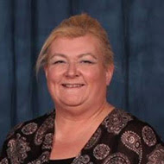





Feedback: “Is it important to fit in at school?”
“At Ditch the Label we want a world in where young people are free to be themselves. However, we know from our own support programmes that this often isn't the case. Our own research finds that physical appearance (what we look like) is still the biggest cause of bullying; in 2020 half of all young people told us they have changed or hidden part of who they are to avoid getting bullied by others.
The results from the question "Is it important to fit in at school?" show how tough this landscape is to navigate…”
Sue Jones, Global Deputy CEO at Ditch the Label (full quote in Notes)
The VoteTopic results were shared with…
StandUp Foundation
Ditch the Label
The NSPCC
The Anti-Bullying Alliance (ABA)
Bullying UK
Notes:
Full Quote: “At Ditch the Label we advocate for a world in which young people are free to be authentically themselves, however, we know from our own support programmes that this often isn't the case. Our own research consistently finds that physical appearance remains the biggest driver of bullying; in 2020 half of all young people told us they have changed or hidden part of who they are to avoid getting abuse from others.
The results from the question "Is it important to fit in at school?" show how tough this landscape is to navigate, especially in the secondary school environment as young people develop vital friendships whilst still exploring who they are. Often teens will begin to curate an online presence which better represents how they self-identify and if this leads to abuse or bullying it can have a significant impact on self-esteem.
Labels can be powerful in how we identify with the world around us and is an integral part of the ongoing fight for true equality; they can also be useful in identifying like-minded people and potential friendships, but if used against us in a negative manner this can be incredibly damaging and potentially lead to feelings of shame. To avoid this and to ensure young people can celebrate who they are, we must listen to, and continue to highlight and centre the voices and lived experiences of young people across education and society to reflect them, their needs and ultimately to make life better for them and our future generations.”
Images
StandUp Foundation: http://www.standupfoundation-uk.org/
Ditch the Label: https://commons.wikimedia.org/wiki/File:Ditch_the_Label_Logo.png
NSPCC: https://www.nspcc.org.uk/about-us/contact-us/press-office/
ABA https://www.ncb.org.uk/about-us/our-specialist-networks/anti-bullying-alliance
Bullying UK: https://www.bullying.co.uk/general-advice/bullying-at-university/

Slide 4

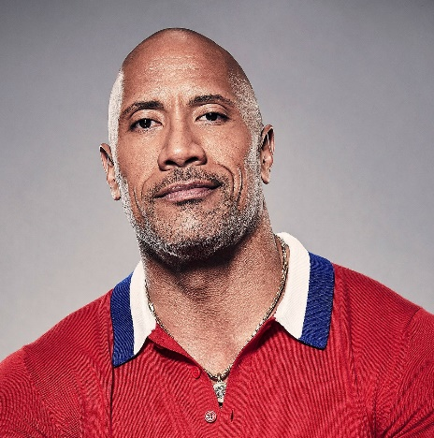
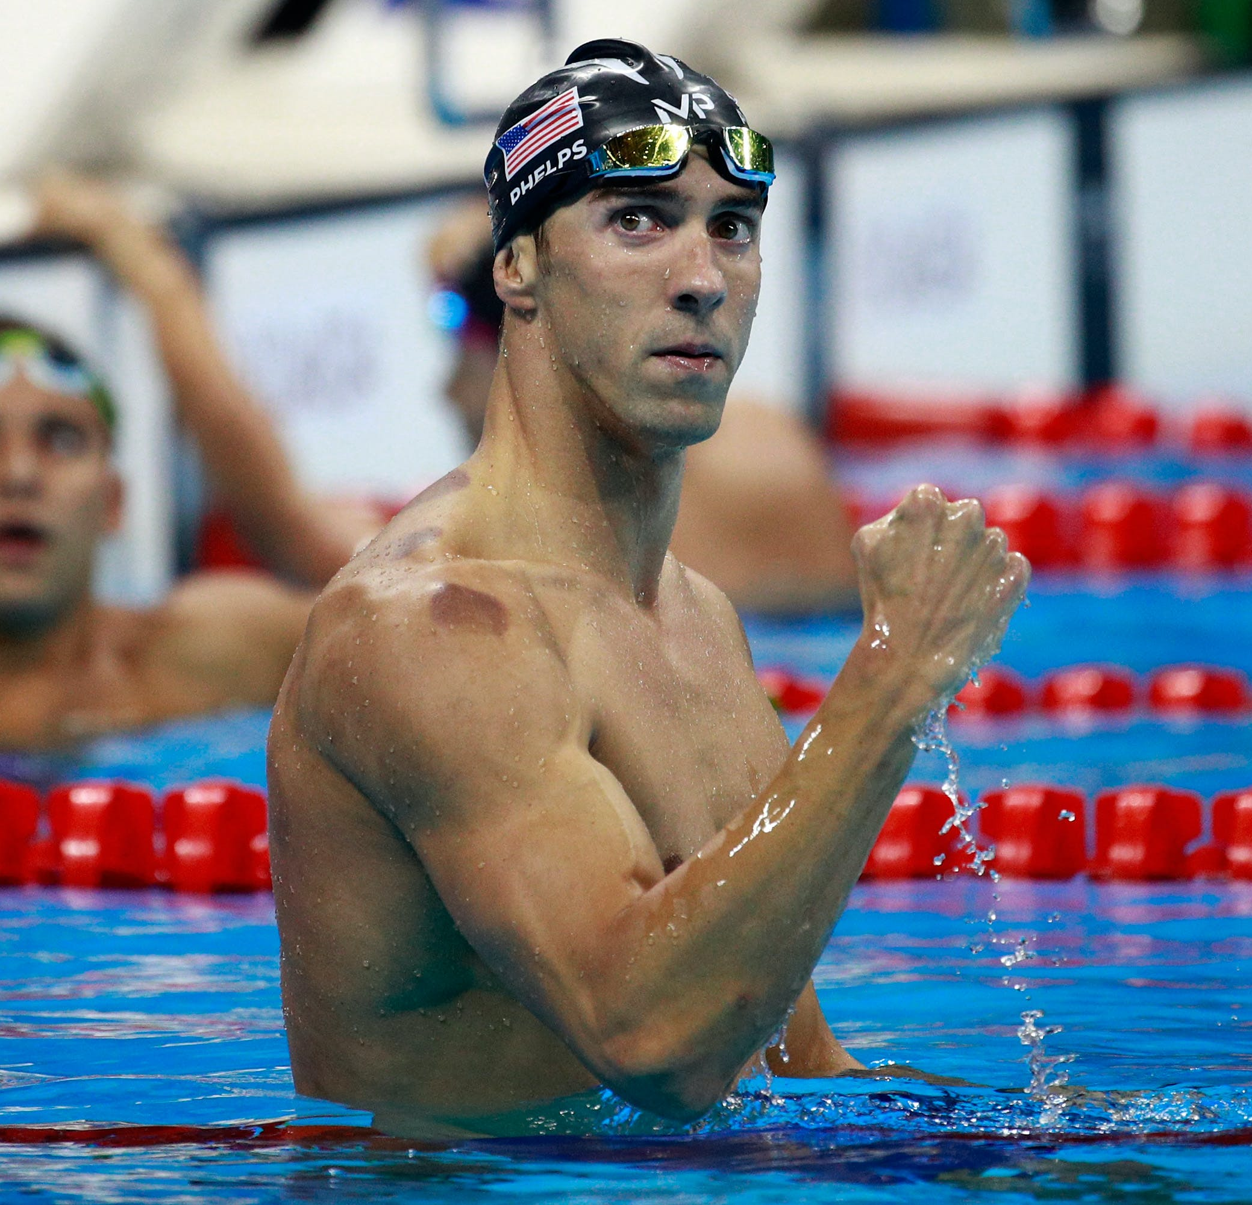
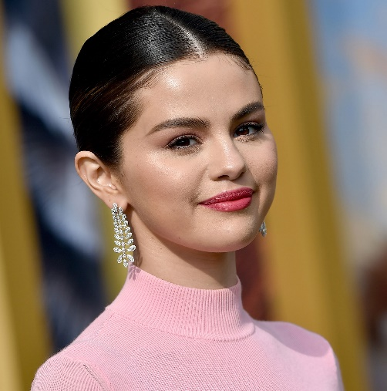
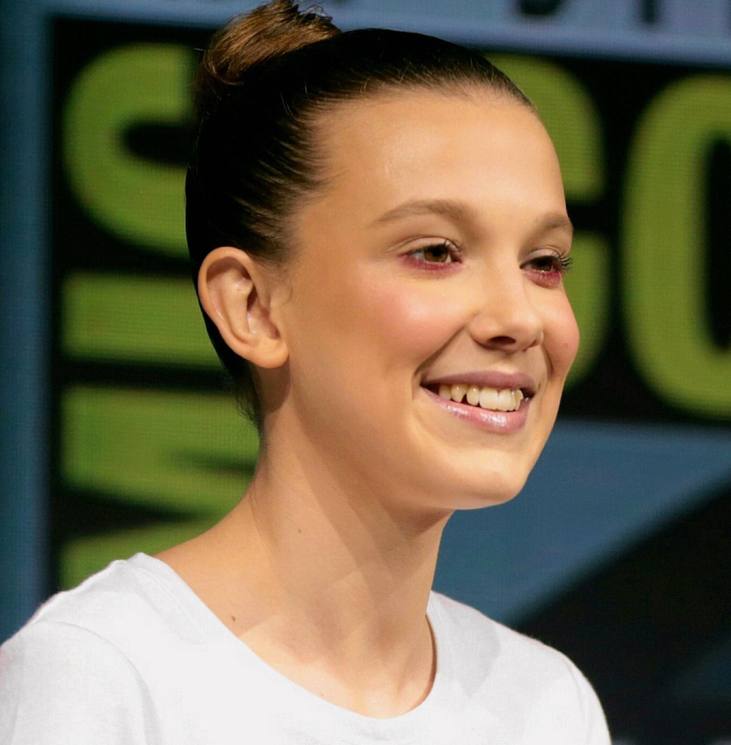
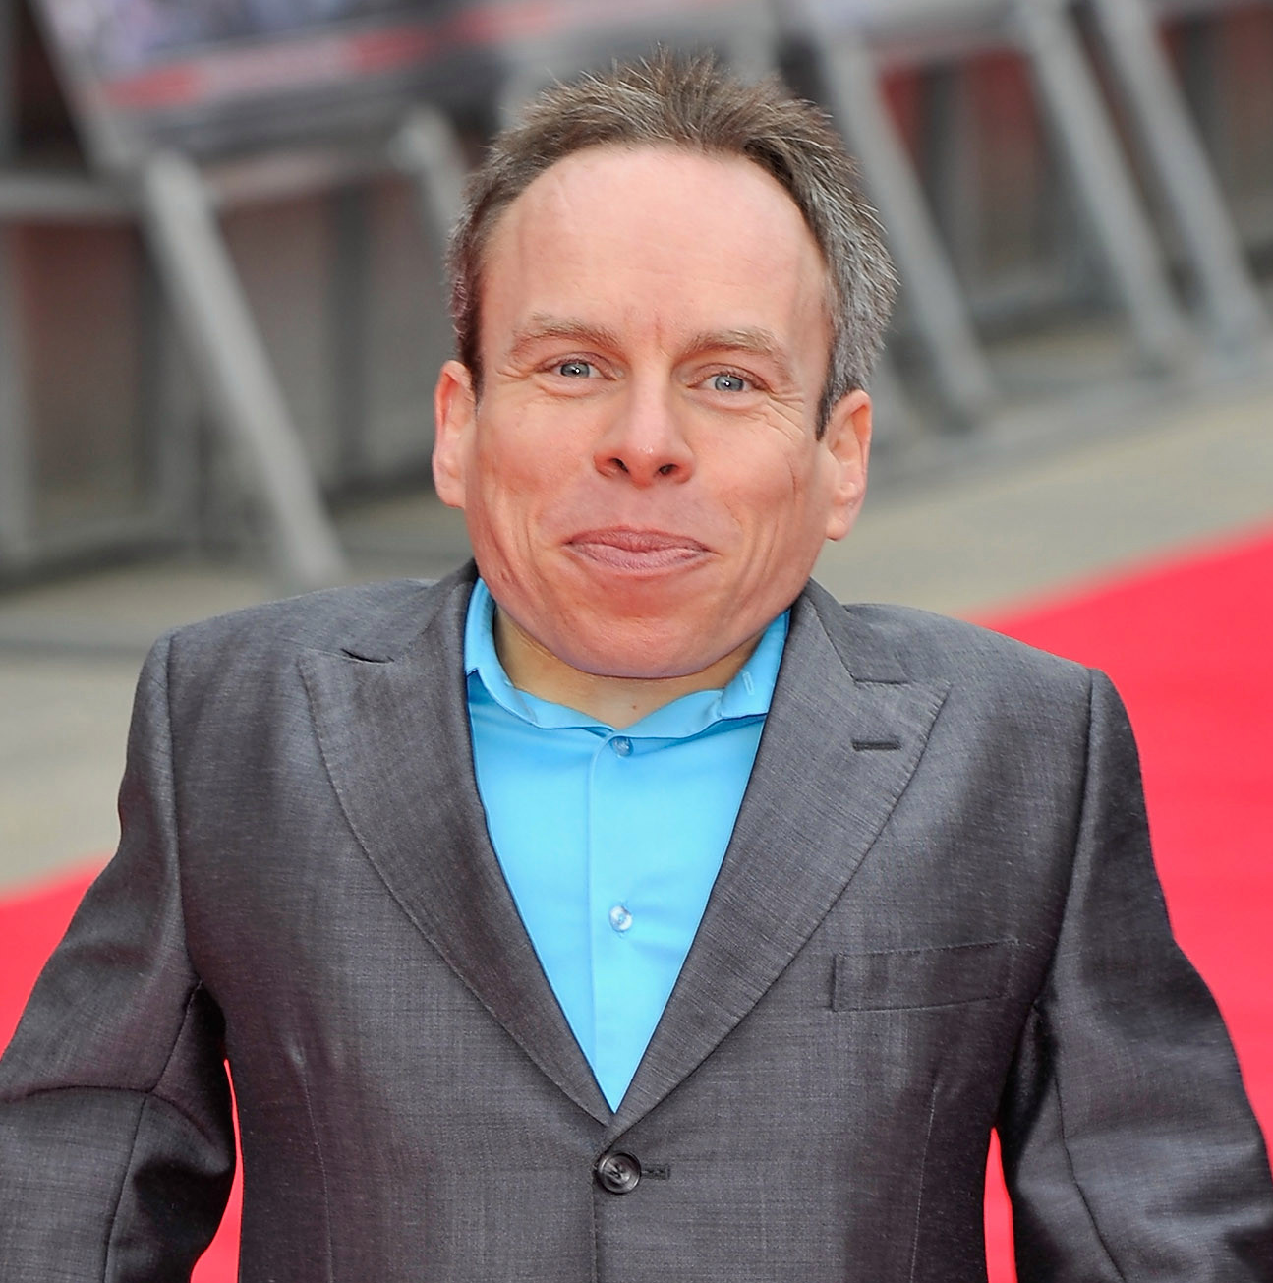


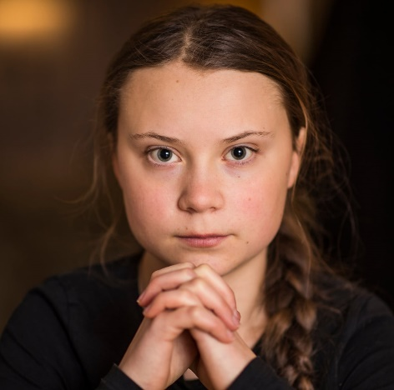

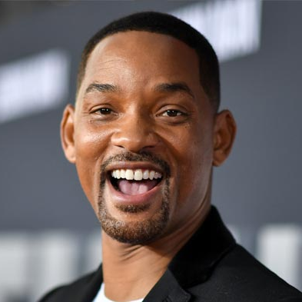


Starter: What do they have in common?
Discuss (1-3 mins)
Discuss with your partner: what do all these people have in common?
You might have said that they’re all famous! But did you know that they also all have a disability?
©VotesforSchools2020
Notes:
Images
Dwayne “The Rock” Johnson: https://www.vanityfair.com/style/2020/09/dwayne-the-rock-johnson-family-coronavirus-diagnosis
Michael Phelps: https://www.biography.com/news/michael-phelp-perfect-body-swimming
Selena Gomez: https://time.com/collection/100-most-influential-people-2020/5888461/selena-gomez/
Millie Bobby Brown: https://en.wikipedia.org/wiki/Millie_Bobby_Brown
Warwick Davis: https://metro.co.uk/2014/02/16/read-warwick-davis-adorable-letter-as-a-13-year-old-to-star-wars-director-george-lucas-4306390/
Alex Brooker: https://www.theguardian.com/tv-and-radio/2020/jul/02/alex-brooker-interview-disability-and-me
Daniel Radcliffe: https://www.insider.com/daniel-radcliffe-facts-2019-7
Greta Thunberg: https://www.theguardian.com/world/2019/mar/11/greta-thunberg-schoolgirl-climate-change-warrior-some-people-can-let-things-go-i-cant
Jamie Oliver: https://www.theguardian.com/food/2020/aug/03/jamie-oliver-fighting-obesity-chef-uk-diet-turkey-twizzlers
Will Smith: https://www.mentalup.co/blog/famous-people-and-celebrities-with-adhd

Slide 5
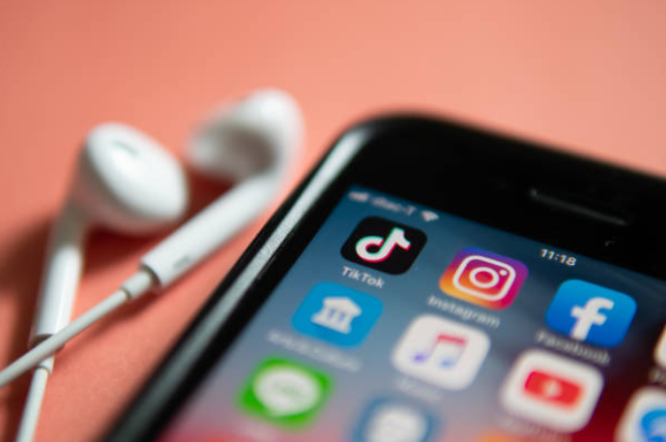
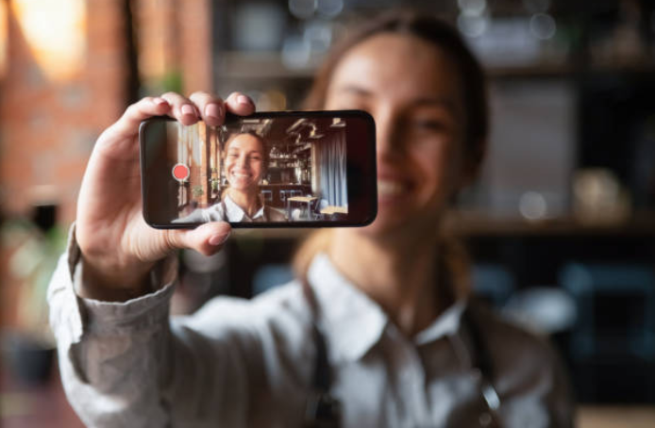

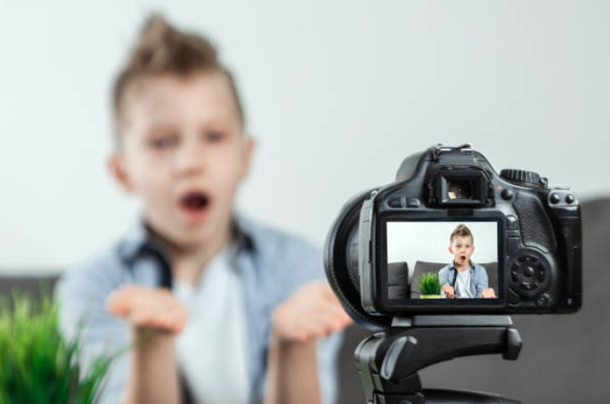
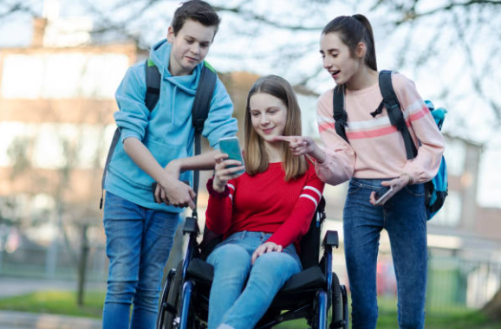
Does social media make it easier to talk about disabilities?
Notes:
Images
iStock
https://idpwd.org/

Slide 6






Starter: What do they have in common?
Why are we talking about this?
Does it
help?
True or false?
What would you do?
Vote!
Notes:
Images
iStock
Icons8 – Colour Hand Drawn

Slide 7






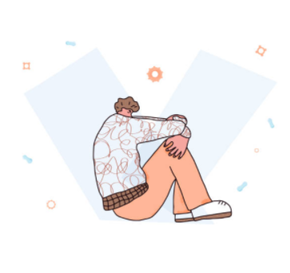
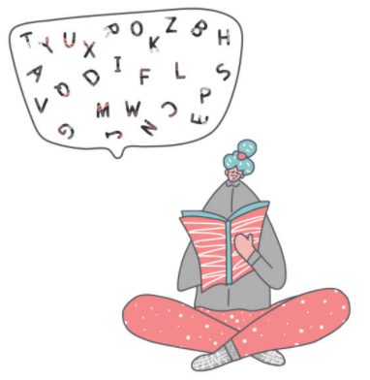
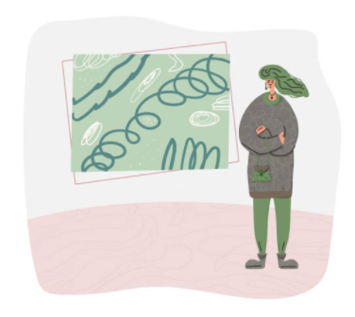
Why are we talking about this?
Thursday 3rd December is International Day of People with Disabilities (IDPWD), a day when people around the world celebrate those who have disabilities.
The theme for IDPWD this year is “Not all disabilities are visible” which focuses on “hidden” or “invisible” disabilities.
“Hidden” or “invisible” disabilities are disabilities that you might not be able to see when you look at somebody. These could be…
Learning disabilities
Mental health disabilities
Physical disabilities
Notes:
Images
https://idpwd.org/
iStock
References
https://idpwd.org/

Slide 8



Why are we talking about this?
Did you know?
There are approximately 67 million people in the UK, and more than 14 million of them are living with a disability.
This means there are lots of people for us to celebrate! However, it also means that it is even more important that we talk about different disabilities and how they affect people in different ways.
Experts think that there could be even more people living with disabilities in the UK and around the world, but that they do not know about them because people are too worried to talk about it.
That’s where celebrities come in: could they help us talk about disabilities more easily? This is what you will be thinking about today! You are going to find out about some famous figures who have shared their stories, and how social media helped them do this.
Notes:
Images
Icons8
References
https://idpwd.org/

Slide 9




Why are we talking about this?
It is believed that 3.81 billion people are on social media worldwide, which means that what celebrities post can reach a lot of people.
Challenge:
Do you know if any of the celebrities you admire have social media?
Although most platforms ask you to be 13+ to use them, it’s likely you’ve accessed some of them before…
The truth is… (1-2 mins)
Put your hand up if you have watched or created a video on one of these social media platforms before.
Notes:
Images
iStock
Icons8

Slide 10
Starter: What do they have in common?
Why are we talking about this?
Does it
help?
True or false?
What would you do?
Vote!
Notes:
Images
iStock
Icons8 – Colour Hand Drawn

Slide 11
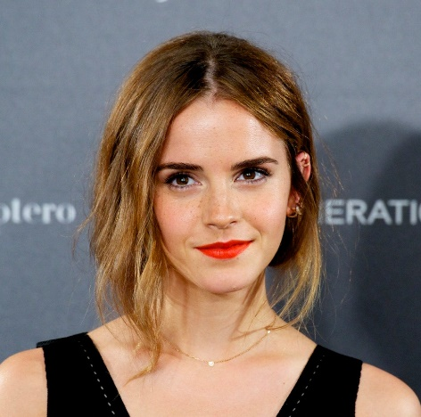
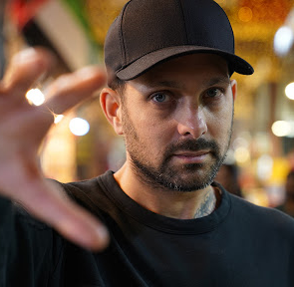


Does it help?
As you read earlier, there are approximately 67 million people in the UK, and more than 14 million of them have a disability. Many of these disabilities are ones that you can’t see just by looking at someone. For example…
Challenge:
Do you recognise any of these people? Where have you seen them before?
All these celebrities have used the internet & social media to talk about their hidden disability because they wanted to help others to understand their experience, and encourage people to talk about their own disability. But does it work?
Does it work? (8-15 mins)
On the next few slides, read about each celebrity as a class and think about whether their story makes it easier or harder to talk about disabilities. Use the hand actions to show your thoughts!
It makes it easier to talk about it.
It makes it harder to talk about it.
Notes:
Images
Celebrities references on following slides
https://emojipedia.org/apple/

Slide 12
Does it help?
Singer Selena Gomez has talked about two disabilities that she has, Lupus and Bipolar Disorder.
Lupus
An autoimmune disease that occurs when your body’s immune system attacks your own tissues and organs. There is no known cure¹.
Bipolar Disorder
A mental health condition that affects your moods².
She said that it’s really important that we can all talk about disabilities. However, she has taken a few breaks from social media because she says it sometimes makes her feel sad and affects her mental health.
Does Selena’s story make it easier or harder to talk about disabilities? Why?
It makes it easier to talk about it.
Challenge:
If you were Selena, would you post about this? Why/why not?
It makes it harder to talk about it.
Notes:
Images
https://www.reddit.com/r/bipolar/comments/fufn21/selena_gomez_just_confirmed_she_was_diagnosed/
https://emojipedia.org/apple/
References
https://www.mayoclinic.org/diseases-conditions/lupus/symptoms-causes/syc-20365789#
https://www.nhs.uk/conditions/bipolar-disorder/
https://www.respectability.org/2019/03/women-disabilities-selena-gomez/
https://www.teenvogue.com/story/selena-gomez-body-shaming-weight-social-media-break

Slide 13
Does it help?
Magician Dynamo (Steven Frayne) has spoken about having Crohn’s Disease.
(0:00-1:52)
Crohn’s Disease
A disease that affects the digestive system and can cause you to have diarrhoea, stomach pain, to feel sick or tired, as well as other symptoms¹.
In 2018, he posted a video online telling people about the side effects of his disability, including a rash and weight gain. He also thanked his fans for their support and has nicknamed them #CrohnsWarriors and #IBSWarriors.
Does Dynamo’s story make it easier or harder to talk about disabilities? Why?
It makes it easier to talk about it.
Watch (1-2 mins)
Just for fun, click the picture of Dynamo to see some of his magic!
It makes it harder to talk about it.
https://safeshare.tv/x/ss5fbe58de77fb6
Notes:
Alternative video link: https://www.youtube.com/watch?v=qXHLFvP8ZPA (2:41-4:33)
Images
https://www.ft.com/content/befd6ddc-7344-11ea-95fe-fcd274e920ca
https://emojipedia.org/apple/
References
1) https://www.crohnscolitisfoundation.org/sites/default/files/legacy/assets/pdfs/living-with-crohns-disease.pdf

Slide 14
Does it help?
Jumanji star Dwayne “The Rock” Johnson has said that he’s struggled with depression lots of times.
Depression
Depression is one of the most common mental health problems¹. People with depression suffer from long lasting feelings of unhappiness, hopelessness, tiredness and worry².
In 2018, he spoke out about his battle with depression, and shared his experiences in both newspapers and online. He claims he told people about his experiences in the hope that it would show others suffering that they’re “not alone”.
Does Dwayne’s story make it easier or harder to talk about disabilities? Why?
It makes it easier to talk about it.
Challenge:
If you had this disability, would you speak out about it? Why/why not?
It makes it harder to talk about it.
Notes:
Images
https://www.refinery29.com/en-gb/2018/04/195361/dwayne-johnson-opens-up-about-depression
https://emojipedia.org/apple/
References
https://www.mentalhealth.org.uk/statistics/mental-health-statistics-most-common-mental-health-problemshttps://www.appliedbehavioranalysisprograms.com/history-autism-treatment/
https://www.nhs.uk/conditions/clinical-depression/https://www.nhs.uk/conditions/generalised-anxiety-disorder/symptoms/
https://www.cnbc.com/2018/04/03/dwayne-the-rock-johnson-reveals-how-he-beat-years-of-depression.html

Slide 15
Does it help?
Activist Greta Thunberg has talked about her Asperger’s Syndrome a lot, both on and offline.
Asperger’s Syndrome
People with Asperger’s Syndrome often have difficulties with social and communication skills. They often have good memory skills but may struggle with abstract concepts¹.
In 2019, she spoke at a UN conference and was later mocked online by some trolls. However, she replied by celebrating how “being different is a superpower” as she says her passion and determination for tackling climate change is partly down to how Asperger's “makes me see things from outside the box³.”
Does Greta’s story make it easier or harder to talk about disabilities? Why?
It makes it easier to talk about it.
Challenge:
What do you notice about Greta’s attitude towards her disability?
It makes it harder to talk about it.
Notes:
Images
https://blog.stcloudstate.edu/foundationsforwriting/2019/09/29/greta-thunberg-responds-to-aspergers-critics-its-a-superpower/
https://emojipedia.org/apple/
References
https://www.autism-society.org/what-is/aspergers-syndrome/
https://www.theguardian.com/environment/2019/sep/02/greta-thunberg-responds-to-aspergers-critics-its-a-superpower
https://www.theguardian.com/commentisfree/2019/apr/23/greta-thunberg-autism

Slide 16
Does it help?
In 2015, the ADHD Foundation said that actress Emma Watson has ADHD and was on medication when she was filming Harry Potter.
Attention Deficiency and Hyperactive Disorder (ADHD)
A condition that affects people’s behaviour, so they might seem restless, have trouble concentrating and may act on impulse. The symptoms usually improve with age.
While lots of people praised Emma and said she was a good role model for young people with ADHD, she hasn’t actually ever talked about having ADHD on social media or to any newspapers, leaving some people to wonder why not.
Does Emma’s story make it easier or harder to talk about disabilities? Why?
It makes it easier to talk about it.
Challenge:
Why do you think Emma hasn’t spoken about her disability?
It makes it harder to talk about it.
Notes:
Images
https://www.vanityfair.com/hollywood/2016/02/emma-watson-break-from-acting
https://www.facebook.com/adhdfoundation/photos/emma-watson-has-appeared-in-15-films-gained-straight-as-at-gcse-a-level-and-has-/1608152719433526/
https://emojipedia.org/apple/
References
https://www.nhs.uk/conditions/attention-deficit-hyperactivity-disorder-adhd/
https://www.facebook.com/adhdfoundation/photos/emma-watson-has-appeared-in-15-films-gained-straight-as-at-gcse-a-level-and-has-/1608152719433526/
https://graziadaily.co.uk/celebrity/news/emma-watson-social-media-private/

Slide 17
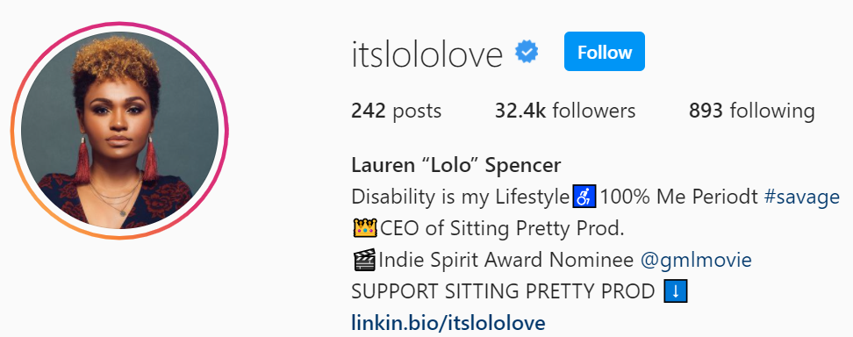
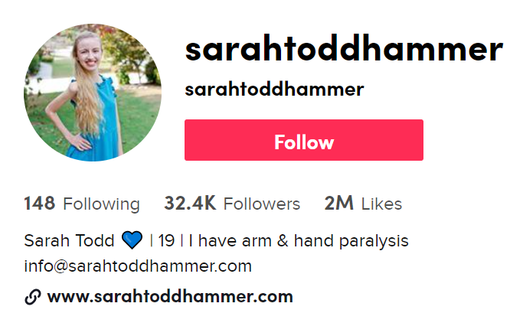
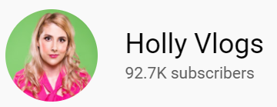
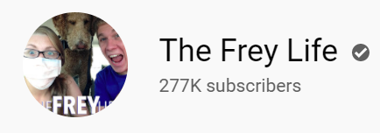
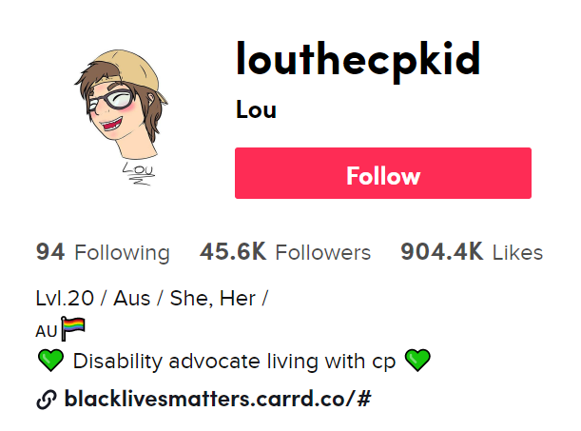
Does it help?
It’s not just celebrities talking online about having a disability either – there are lots of people who share what it’s like to live with a disability too.
Question:
Have you heard of any of these people or channels? Do you follow any yourself?
While there are plenty of people who choose to share their story about living with a disability on the internet, there are many more people who choose not to share, either online or in front of people they don’t know.
What do you think? (1-2 mins)
Why might some people with disabilities not want to share their experience online?
Notes:
References/Images:
https://www.instagram.com/itslololove/?hl=en
https://www.tiktok.com/@louthecpkid?referer_url=https%3A%2F%2Faccessnow.com%2F&referer_video_id=6826970188114562310
https://www.tiktok.com/@sarahtoddhammer
https://www.youtube.com/user/ukcouponing
https://www.youtube.com/user/thefreylife
https://accessnow.com/blog/10-tiktok-accounts-breaking-barriers-for-the-disability-community/

Slide 18
Starter: What do they have in common?
Why are we talking about this?
Does it
help?
True or false?
What would you do?
Vote!
Notes:
Images
iStock
Icons8 – Colour Hand Drawn

Slide 19
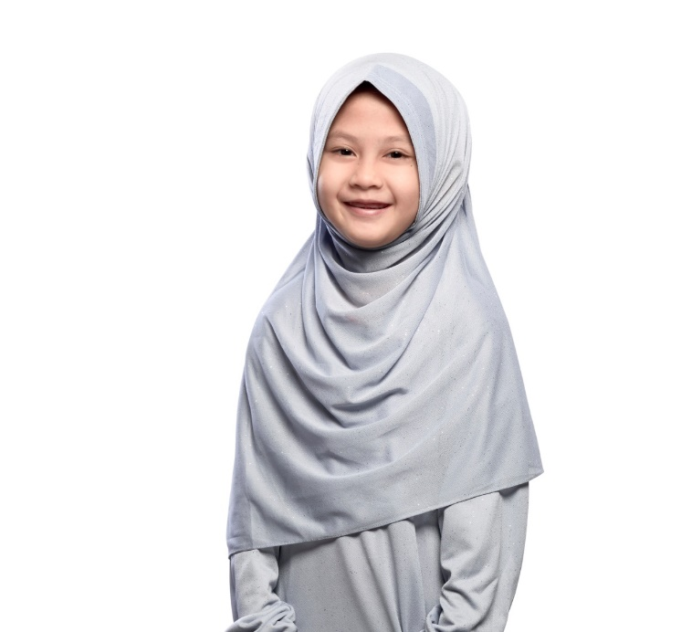
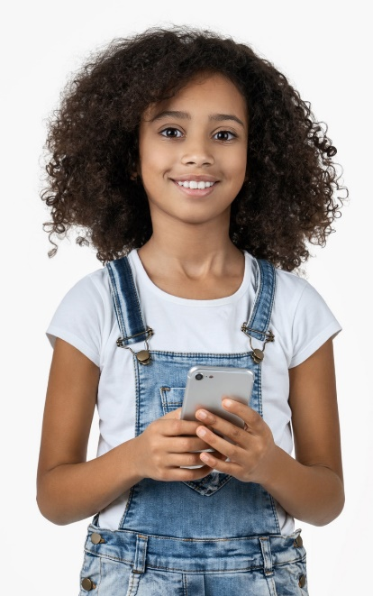



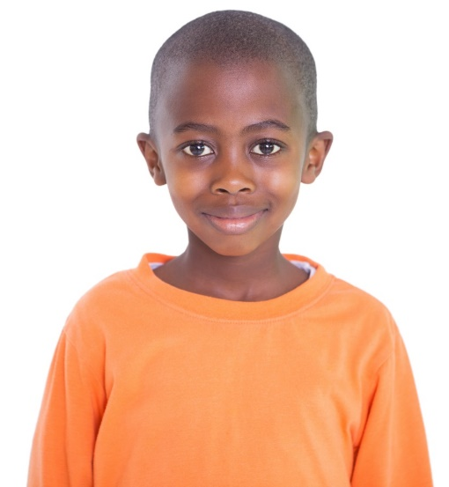



True or false?
Vote with you feet (8-10 mins)
By now you’ve found out lots about the different disabilities that exist, and how some people are using the internet to make disabilities more visible. With this in mind, take a look at the statements on the new few slides and decide if you agree or disagree with each one. Be ready to share your answers!
I disagree!
I agree!
Notes:
Images:
1) iStock

Slide 20
True or false?
Sometimes it’s easier to talk and learn about these things online than it is in person.
Many people use social media to portray themselves as perfect, and hide things like disabilities.
I disagree!
I agree!
Notes:
Images:
1) iStock

Slide 21
True or false?
Online, you can find people who have had similar experiences to you, which can encourage people to share.
The internet is a cruel place, which will make people unwilling to share things like disabilities.
I disagree!
I agree!
Notes:
Images:
1) iStock

Slide 22
True or false?
By sharing their disabilities, celebrities help other people be more honest too.
There’s a lot happening on social media and, personally, I haven’t found there’s enough discussion about disabilities on there.
I disagree!
I agree!
Notes:
Images:
1) iStock

Slide 23
Starter: What do they have in common?
Why are we talking about this?
Does it
help?
True or false?
What would you do?
Vote!
Notes:
Images
iStock
Icons8 – Colour Hand Drawn

Slide 24



What would you do?
Now that you’ve seen how the internet can be both a helpful and unhelpful place to talk about disabilities, it’s time for you to become to the expert!
What would you do? (6-15 mins)
On the next few slides you are going to see some messages from some children who are asking for advice online. With your partner (or as a class) read each one and decide what advice you would give.
Not in the classroom?
Write a reply to each email, advising them on what you think that they should do and why.
Don’t forget about internet safety!
Notes:
*Please Note: All scenarios are fictitious. Any resemblance to real people is purely coincidental.
Images:
iStock

Slide 25
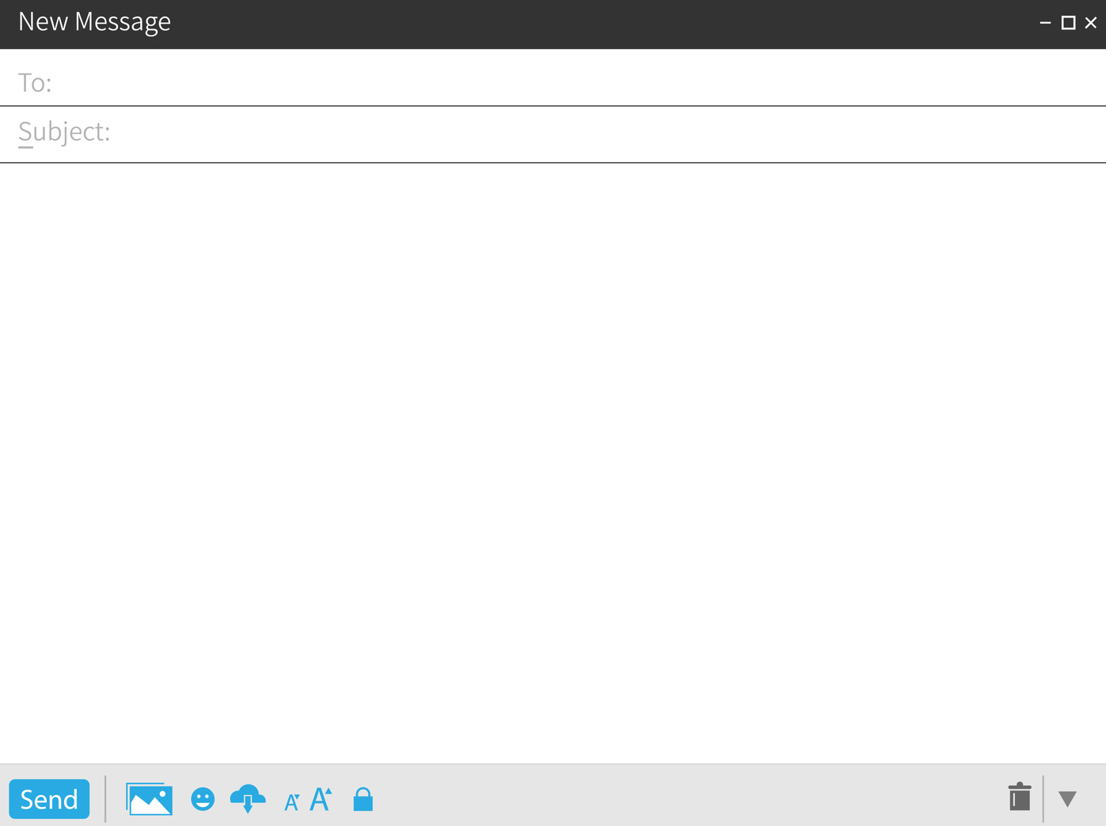
What would you do?
VotesforSchools Advice
Should I do it?
Dear VotesforSchools,
I have epilepsy, but when I tell people about it they usually haven’t heard of it. This means I have to explain what it is to them, which is annoying.
I’d like more people to know about it. As I have about 5,000 followers on TikTok, I was thinking of just making a video to tell people more… I am little worried though. Could something bad happen?
Discuss with your partner: what do you think he should do and why?
Challenge:
What does he need to be careful of if he shares videos online?
Notes:
*Please Note: All scenarios are fictitious. Any resemblance to real people is purely coincidental.
Images:
iStock

Slide 26
What would you do?
VotesforSchools Advice
Was I wrong?
I have a YouTube channel and make videos showing my painting and artwork - it’s quite popular!
Last week I made a different video about me and my life, and I also talked about how it’s sometimes hard to live with my sister, who has a disability.
I was only trying to be honest, but lots of commenters have said that it wasn’t fair to talk about my sister’s life online. Should I take the video down? I didn’t mean any harm.
Discuss with your partner: what do you think she should do and why?
Challenge:
How would you feel if you were the other sister in this scenario?
Notes:
*Please Note: All scenarios are fictitious. Any resemblance to real people is purely coincidental.
Images:
iStock

Slide 27
What would you do?
VotesforSchools Advice
Help!
Hi VfS!
Last week I was told I had ADHD. The doctor tried to explain it to me, but I didn’t really get it so I went online and tried searching for some videos. All the videos were rubbish though!
Most of them were either silly, rude or just not relatable. How else can I find out more about ADHD?
Discuss with your partner: what do you think he should do and why?
Challenge:
What does he need to be careful of, when researching something online?
Notes:
*Please Note: All scenarios are fictitious. Any resemblance to real people is purely coincidental.
Images:
iStock

Slide 28
Starter: What do they have in common?
Why are we talking about this?
Does it
help?
True or false?
What would you do?
Vote!
Notes:
Images
iStock
Icons8 – Colour Hand Drawn

Slide 29


Learn more: Same but different…
Would you like to learn more about the different types of disabilities that people live with? These videos could help! Created by the BBC specifically for KS2 children, these short films give you a chance to find out more about lots of different disabilities, including dyslexia, asthma, Cerebral palsy and Down’s Syndrome.
0:00-4:18
Career Spotlight:
This is Gina. She works for a charity helping people with disabilities find jobs they’ll love.
Click the image to watch a video made especially for you explaining how Gina started working with people with disabilities.
https://safeshare.tv/x/1n_Hr7i70y4#
Notes:
Alternative Video Link – Career Spotlight: https://www.youtube.com/watch?v=1n_Hr7i70y4
Alternative Video Link – Learn More: https://www.bbc.co.uk/teach/class-clips-video/pshe-ks2-same-but-different/zn87vk7
Images:
https://crowcroftpark.net/blog/2020-04-29-16-13-27-bbc-teach
Courtesy of Gina

Slide 30
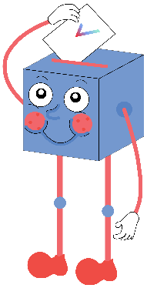

Does social media make it easier to talk about disabilities?
There are more and more people speaking out about disabilities, which makes them more visible.
Sometimes, it’s easier to talk and learn about these things online rather than in person.
Many celebrities are using their platform to share their experience of disabilities, which encourages others to do the same.
…
Lots of people use social media to only present the “good stuff” and hide their imperfections.
The internet can be a cruel place, so many wouldn’t be willing to share their disabilities online.
It’s different for celebrities – real people with disabilities still aren’t that visible, and their stories might get lost in all the posts on social media.
…
We will be sharing your thoughts on this topic with IDPWD, the Royal National Institute for the Blind (RNIB), RNID (formerly Action on Hearing Loss), Diabetes UK, and YoungMinds.

Slide 31



Vote!
In the classroom?
Log your class’s votes now at: www.votesforschools.com/login/teacher
At home?
Follow this link to vote: https://www.surveymonkey.co.uk/r/vfs-primary-ks2-IDPWD
Not sure how?
Click the ballot box to see a video on how to log your votes!
Having trouble?
Copy and paste the link into your internet browser!
If you have any issues, feedback or comments, email amy@votesforschools.com.
Notes:
SurveyMonkey Link: https://www.surveymonkey.co.uk/r/vfs-primary-ks2-IDPWD
SafeShare How-To Video Link: https://safeshare.tv/x/N0-AjP3cFjg
YouTube How-To Link: https://www.youtube.com/watch?v=N0-AjP3cFjg&feature=youtu.be

