Slide 2
Feedback: “Would you pay more for chocolate?”
“I would pay more if others got paid fairly.”
Childwall CofE School
“I like it being cheap so I don't have to save up lots of money to buy chocolate.”
Chipstead Valley Primary School
“Yes I would be happy to pay more for chocolate if it is fairly made because after what I’ve seen and how hard the farmers work to only get 6p, it’s just not fair.”
Linacre Primary School
“I wouldn't pay more for chocolate because you could be spending it on better things like fruit and vegetables.”
Engayne Primary School
Yes
No
“At the start of this lesson I didn't really want to pay more for chocolate but in this lesson I realised how hard farmers work to make chocolate and how little they get. So now I agree that farmers should get more money.”
Broadford Primary School
62.2%
37.8%
“Cocoa farmers have not got the privileges that we have they barely get paid and while we are enjoying eating chocolate the cocoa farmers are harvesting more and more cacao. Also the shops like Asda, Tesco, Sainsbury’s and Morrison's take most of the profit from selling the chocolate so that should change.”
The Godolphin Junior Academy

Slide 3
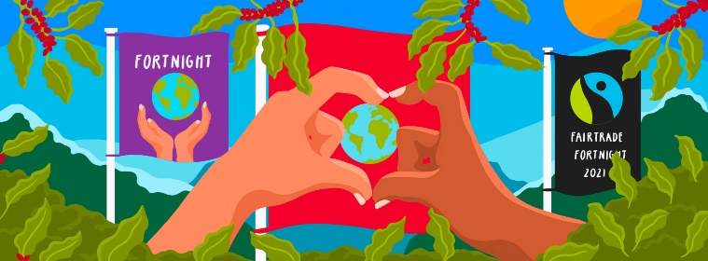
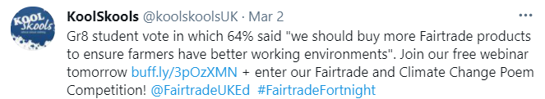






Feedback: “Would you pay more for chocolate?”
0:00-1:13
Click the image to hear from Joanna, who is Education Manager at the Fairtrade Foundation! She was very interested in the results…
Joanna wasn’t the only one who was impressed by your votes and comments… You were also called “inspiring” by Oxfam Education and “gr8” by KoolSkools!
The VoteTopic results were shared with…
The Fairtrade Foundation
Oxfam
Koolskools
Ben & Jerry’s
Eco-Schools
https://safeshare.tv/x/RUJ3ajhnr-c
Notes:
Alternative Video Link: https://youtu.be/RUJ3ajhnr-c
Images
https://www.fairtrade.org.uk/get-involved/current-campaigns/fairtrade-fortnight/
https://twitter.com/koolskoolsUK
https://twitter.com/OxfamEducation
https://en.wikipedia.org/wiki/The_Fairtrade_Foundation
https://www.stickpng.com/img/icons-logos-emojis/shop-logos/oxfam-logo
https://www.koolskools.co.uk/
https://twitter.com/benandjerrysuk
https://twitter.com/ecoschoolsint

Slide 4















Starter: Think of a character…
Think of a character… (2-4 mins)
Take a look at these different jobs. Can you think of a TV character (or a person that you know) that does each of these jobs?
Train Driver
Teacher
Police Officer
Dancer
Nurse
Mechanic
Builder
Notes:
Images
iStock
icons8

Slide 5
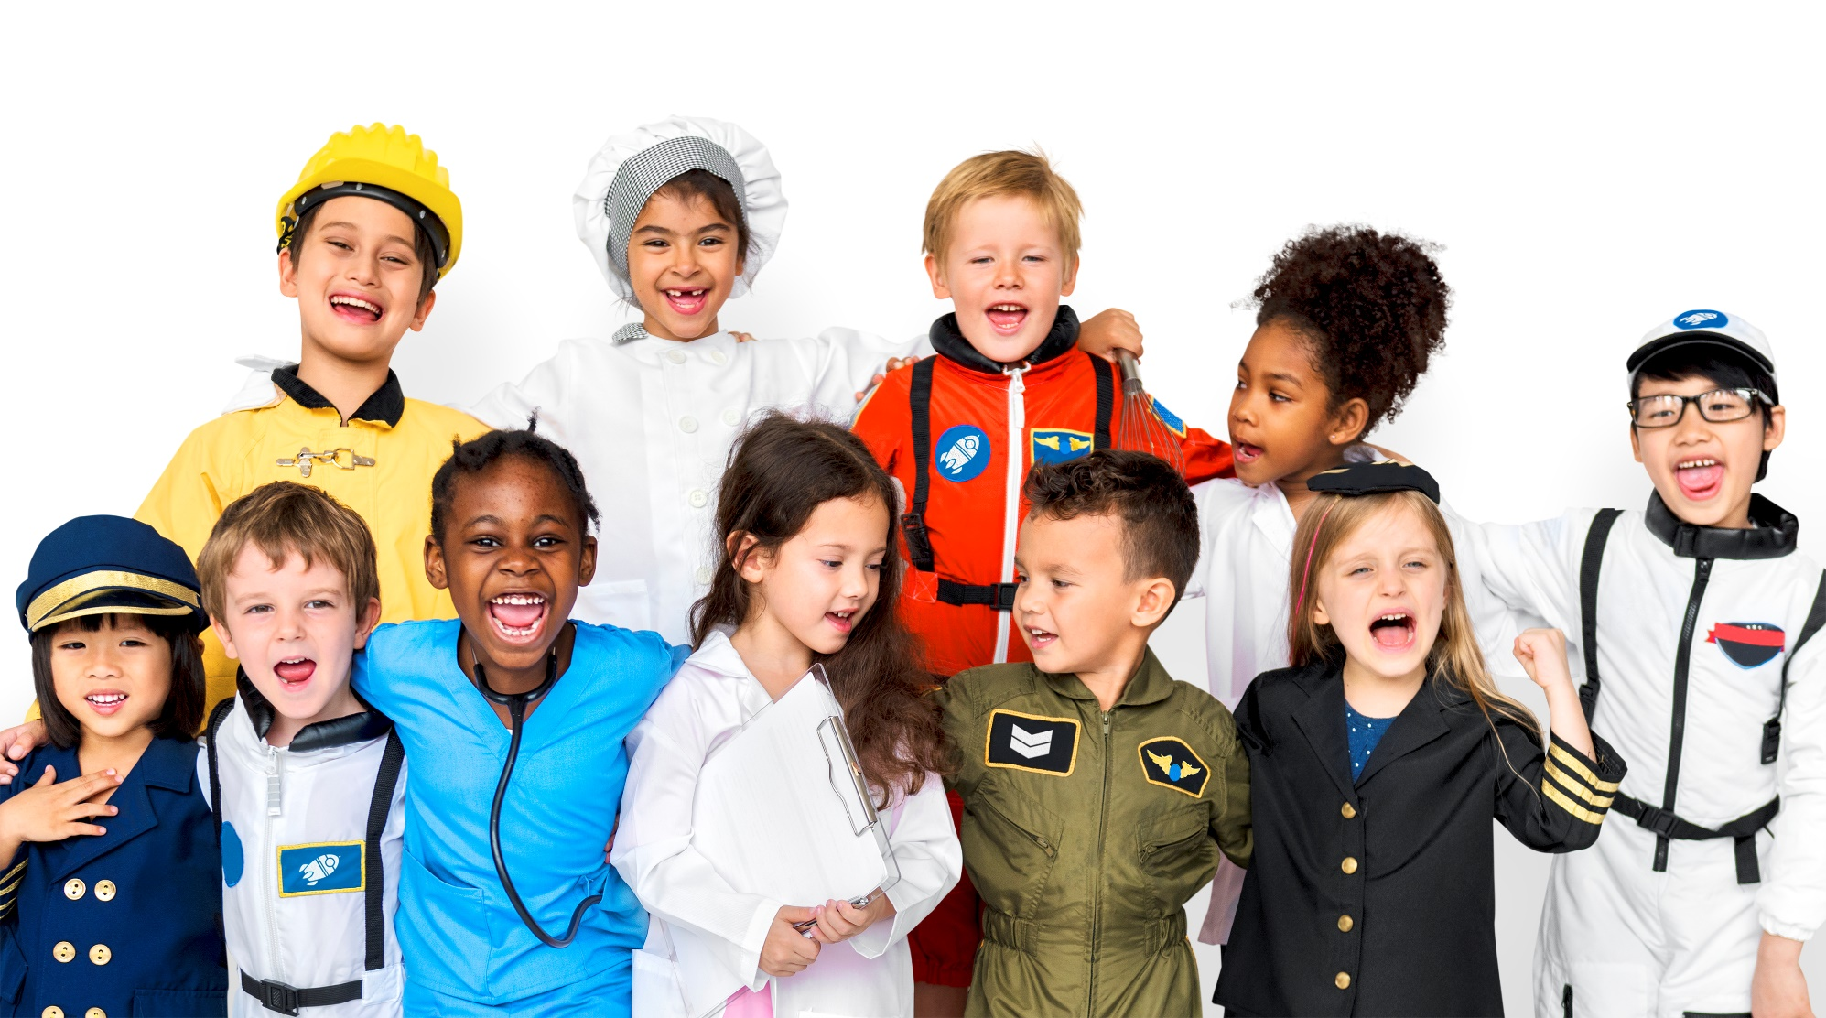
Will gender stereotypes affect your future?
Notes:
Images
iStock

Slide 6


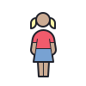





Starter: Think of a character…
Why are we talking about this?
Starting stereotypes early…
Why do role models matter?
What does it all mean?
Will it affect you?
Vote!
Notes:
Images
Icons8

Slide 7

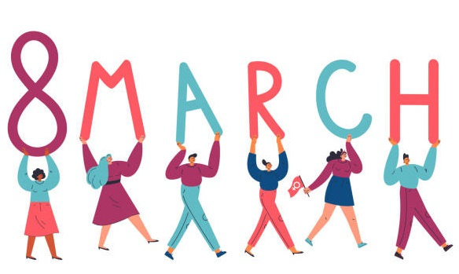

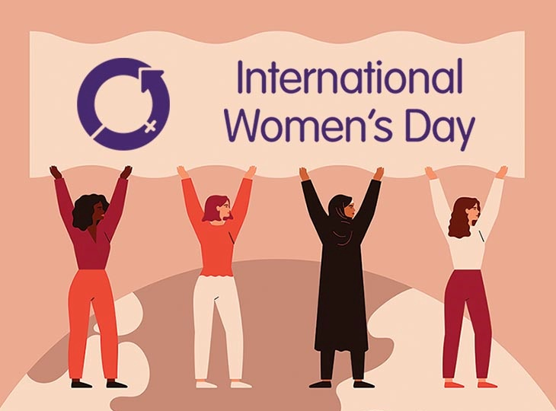
Why are we talking about this?
Monday 8th March is International Women’s Day. All around the world, this is a day to recognise the achievements of women and girls.
You can find out more about the history of International Women’s Day in the assembly!
This year, the theme for International Women’s Day is #ChooseToChallenge, which is asking us all to challenge stereotypes when we see or hear them.
Discuss (2-3 mins)
How do you think you would choose to challenge a view you didn’t agree with?
Notes:
Images:
iStock
https://www.internationalwomensday.com/IWD2021

Slide 8

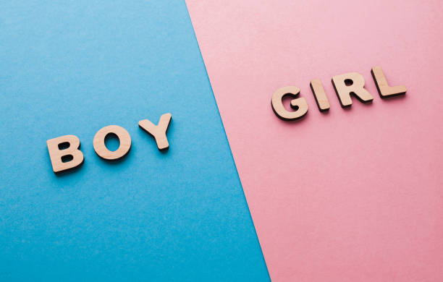





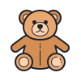
Why are we talking about this?
A stereotype is an idea that people have about what someone or something is like, which is usually incorrect or not accurate.
Gender stereotypes are these incorrect beliefs when they are about boys or girls. For example…
Girls are bad at football.
Men are better at fixing things.
Women are better at cleaning.
Boys shouldn’t play with teddies.
Discuss (2-3 mins)
Which of these stereotypes have you heard before? Can you think of any others?
Notes:
Alternative video link: https://www.youtube.com/watch?v=nWu44AqF0iI
Images:
From Video
iStock
icons8
References:
1) https://dictionary.cambridge.org/dictionary/english/stereotype

Slide 9
Starter: Think of a character…
Why are we talking about this?
Starting stereotypes early…
Why do role models matter?
What does it all mean?
Will it affect you?
Vote!
Notes:
Images
Icons8

Slide 10

Why do role models matter?
Discuss (2-4 mins)
Think back to your Starter activity. What did you notice about the gender each of each of these jobs? Were there any that everyone thought of boys for, or any that everyone thought of girls for?
Train Driver
Teacher
Police Officer
Dancer
Nurse
Mechanic
Builder
It is likely that, for some of these jobs, you only thought of people that were one gender. One reason for this is because of the role models that we see in our lives every day. These could be in books that we read, on the TV, or through the people we meet.
Put it to the test… (2 mins)
Imagine that all of the teachers in your school were women. What might this make you think about people who become teachers?
Notes:
Alternative video link: https://www.youtube.com/watch?v=G3Aweo-74kY
Images:
iStock
icons8

Slide 11

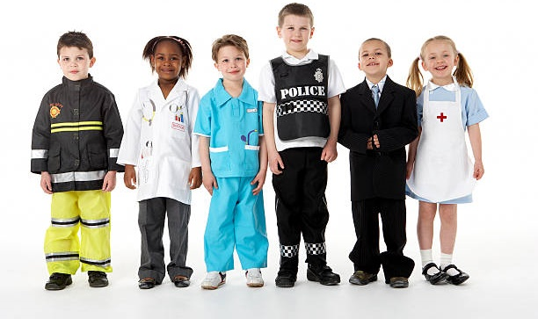

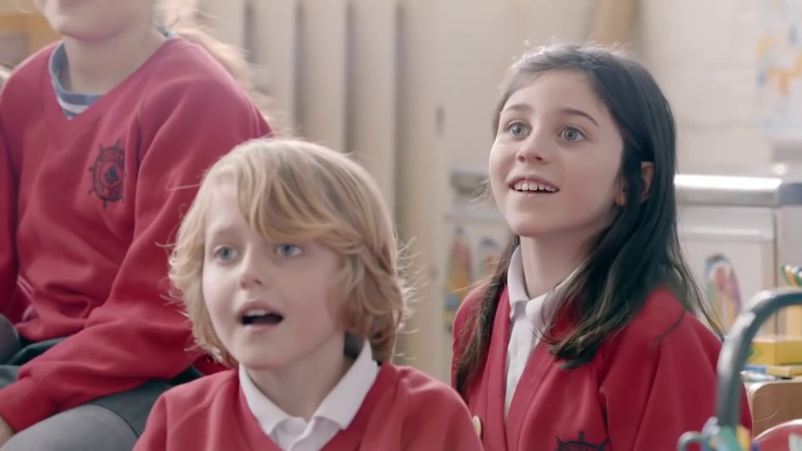
Why do role models matter?
Experts have found that we start to make gender stereotypes when we are in Primary school, and that these stereotypes can affect us in the rest of our lives, including our hobbies and our future jobs.
0:00-2:07
Watch (3-4 mins)
Click the image to watch a video. What does this show you about the role models that these children have seen?
Challenge:
Why do you think they decided to do this experiment?
https://safeshare.tv/x/ss603f7b120a23f
Notes:
Alternative video link: https://www.youtube.com/watch?v=G3Aweo-74kY&t=3s
Images:
From video
iStock
References:
1) https://www.healthychildren.org/English/ages-stages/gradeschool/Pages/Gender-Identity-and-Gender-Confusion-In-Children.aspx#:~:text=Gender%20identity%20typically%20develops%20in,sense%20of%20their%20gender%20identity.

Slide 12
Starter: Think of a character…
Why are we talking about this?
Starting stereotypes early…
Why do role models matter?
What does it all mean?
Will it affect you?
Vote!
Notes:
Images
Icons8

Slide 13
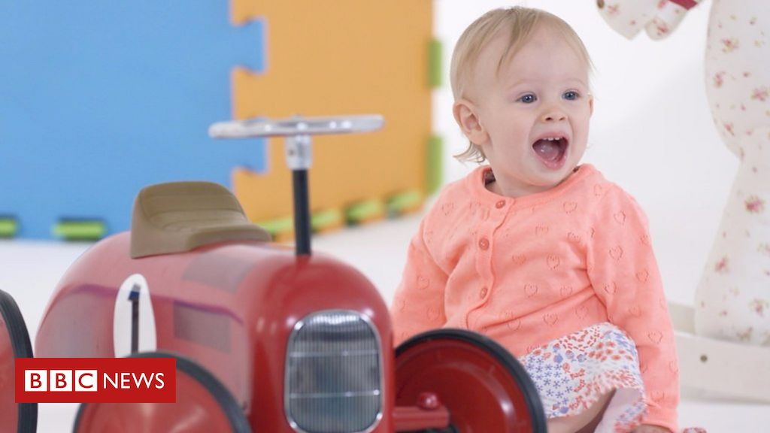







Starting stereotypes early…
0:00-3:25
You found out earlier than we start making gender stereotypes at school, but what about before this?
Watch (3-4 mins)
Click the image to watch an experiment about stereotypes. What stereotypes did you see?
You might not know it, but when you are playing with toys you are learning at the same time!
In fact, experts have found that different toys help you to learn and practise different skills, such as...
Problem solving
Caring for others
Using small and big objects
Creativity and imagination
Building and controlling
https://safeshare.tv/x/ss603e396a10e3e
Notes:
Images:
iStock
Icons8
From video

Slide 14
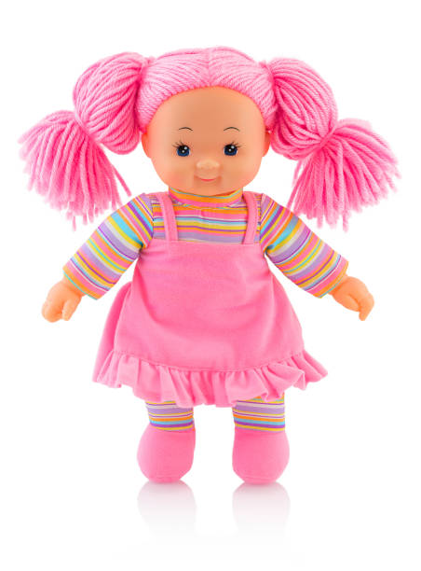
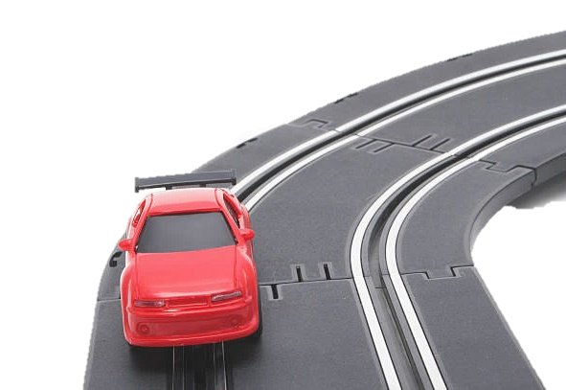
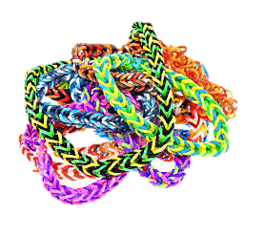
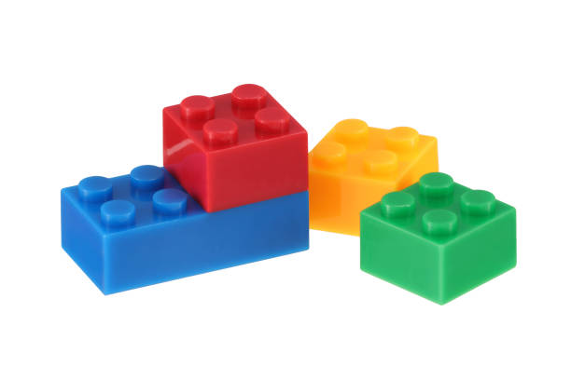

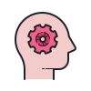
Starting stereotypes early…
Which skills? (4-10 mins)
Click to see some different toys. For each one, choose one of the skills that you think that this toy helps you to learn the most.
Caring for others
Creativity and imagination
Building and controlling
Problem solving
Using small and big objects
Confidence and leadership
Notes:
Images:
iStock
icons8

Slide 15
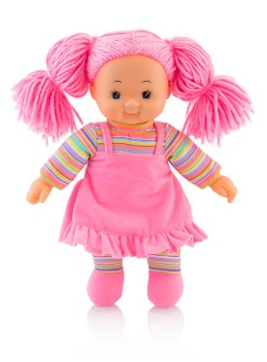

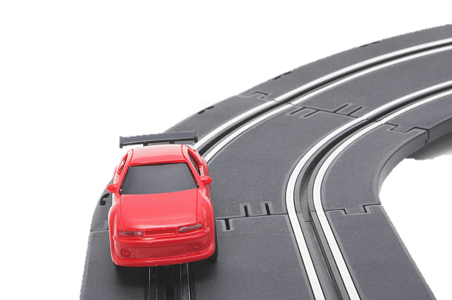





Starting stereotypes early…
Discuss (2-5 mins)
Take a look at these toys again. If you had to stereotype, which would you say are “boys’ toys” and which would you say are “girls’ toys”? Once you’ve decided, click to see some questions to discuss with your partner.
If you only played with “boys’ toys”, which skills would you learn the most and the least?
If you only played with “girls’ toys”, which skills would you learn the most and least?
The more that you play with a certain type of toy, the better your skills will get. As you start to get better at playing with it, your skills will keep on improving too. That’s why it’s important that we play with lots of different toys - to learn as many skills as we can.
Notes:
Images:
1) iStock
References:
1) https://www.theguardian.com/lifeandstyle/2014/apr/22/gendered-toys-stereotypes-boy-girl-segregation-equality

Slide 16
Starter: Think of a character…
Why are we talking about this?
Starting stereotypes early…
Why do role models matter?
What does it all mean?
Will it affect you?
Vote!
Notes:
Images
Icons8

Slide 17
What does it all mean?
Toys and role models might not seem like the most important thing in the world, but they are just two ways that we can see how gender stereotypes can have an effect on us and our lives.
Take a guess! (5-7 mins)
Take a look at these jobs again. This time, can you guess what percentage of people who do these jobs are women?
Train Driver
Teacher
Police Officer
Dancer
Nurse
Mechanic
Builder
Not sure?
Decide whether you think mostly women do this job or not.
Challenge:
Look closely at these numbers. What do you notice, and why do you think that they are this way? Do you think gender stereotypes could have had an effect here?
40%
84%
34%
1%
1%
5%
89%
Notes:
Images
Icons8

Slide 18
Starter: Think of a character…
Why are we talking about this?
Starting stereotypes early…
Why do role models matter?
What does it all mean?
Will it affect you?
Vote!
Notes:
Images
Icons8

Slide 19


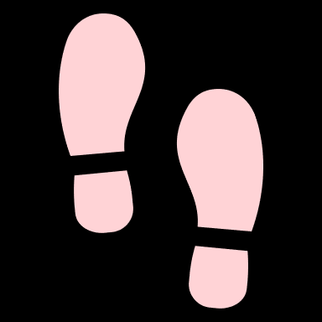




Will it affect you?
As you’ve seen in this lesson, gender stereotyping can start from a very early age, and can affect the choices that we make and the jobs that we take when we are older… But will it be that way for you?
Over to you… (4-8 mins)
On the next few slides, you are going to see some different opinions about gender stereotypes. For each one, move to the left side of the room if you agree. If you disagree, move to the right side of the room. Be ready to explain your reasons!
I agree because…
I disagree because…

Slide 20
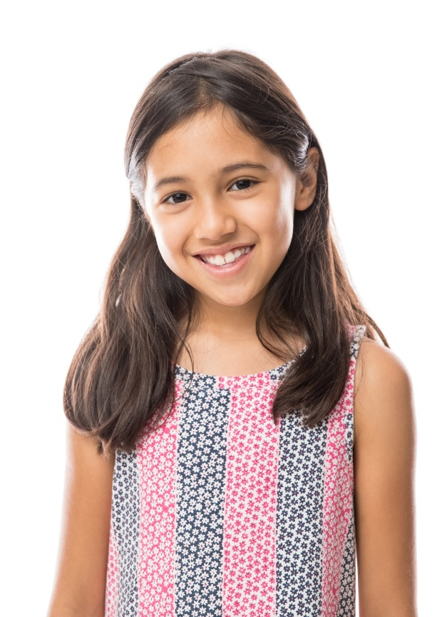
Will it affect you?
There isn’t anything wrong with gender stereotypes – they help to give us a sense of belonging in our society today. I don’t think that this is a bad thing.
I agree because…
I disagree because…
Notes:
Images
iStock

Slide 21
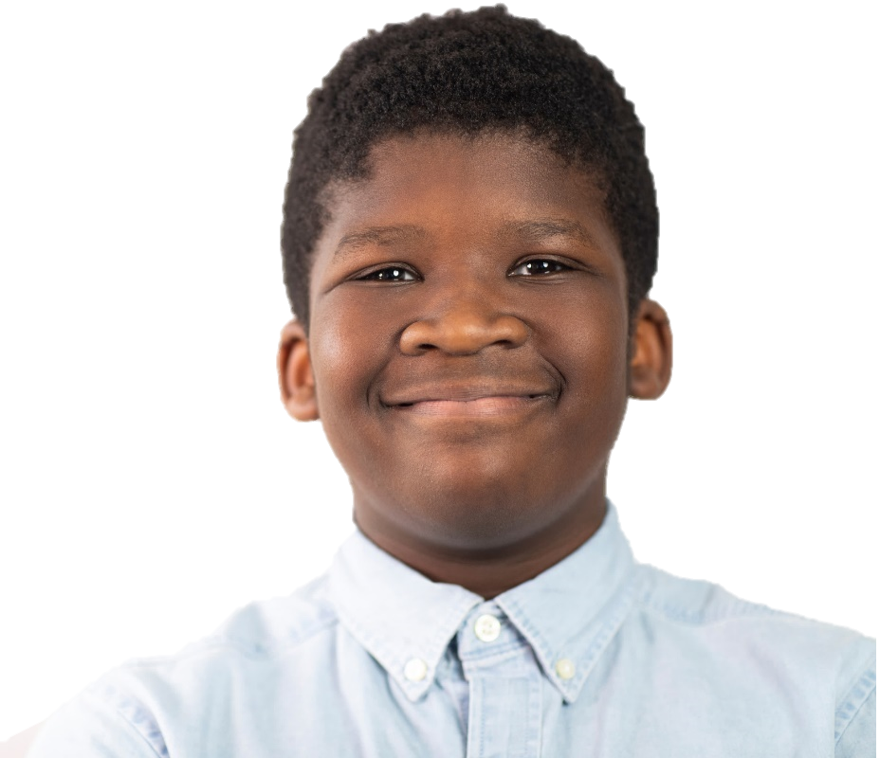
Will it affect you?
Lots of people make gender stereotypes without realising it, so even if we work really hard, other people will still treat us differently based on our gender. This can make it harder for us to achieve the things that we really want.
I agree because…
I disagree because…
Notes:
Images
iStock

Slide 22
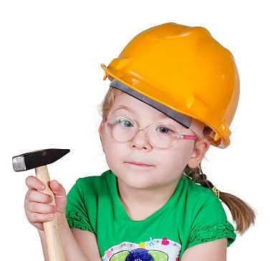
Will it affect you?
Gender stereotypes are changing. Toys aren’t made for just boys or just girls anymore, and we have lots more role models in different jobs compared to how it was before. Things are definitely getting better!
I agree because…
I disagree because…
Notes:
Images
iStock

Slide 23
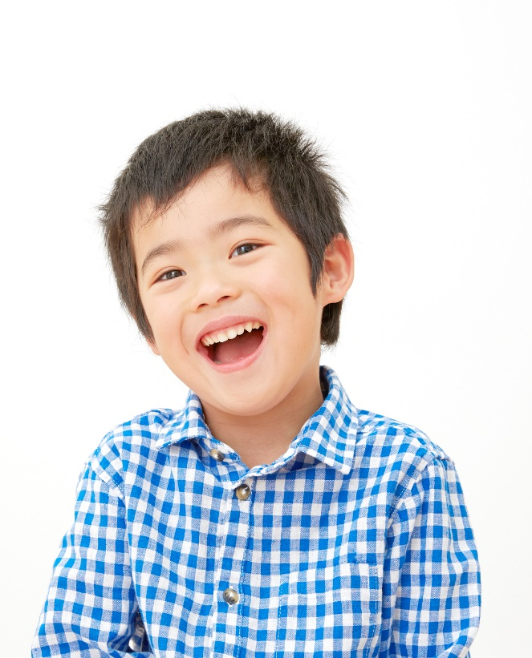
Will it affect you?
Even though things are changing, more needs to be done. I want to live in a world that is fair and equal for everyone, and I don’t want anyone to think that they can’t play with some toys or do some jobs just because of their gender.
I agree because…
I disagree because…
Notes:
Images
iStock

Slide 24
Starter: Think of a character…
Why are we talking about this?
Starting stereotypes early…
Why do role models matter?
What does it all mean?
Will it affect you?
Vote!
Notes:
Images
Icons8

Slide 25
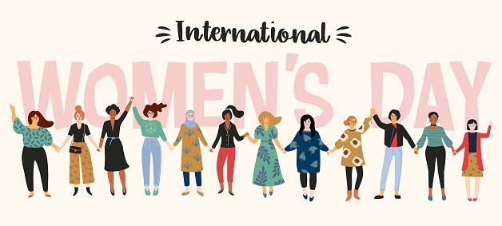
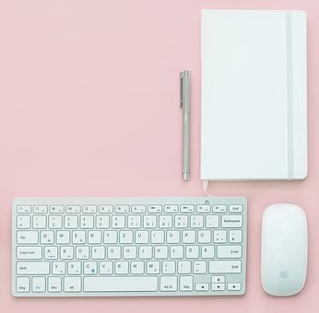
Quick idea
Take your lesson further…
International Women’s Day have made lots of resources for you to use at school and at home – from reading lists to activities, click the image to explore all the different things on offer!
Big idea
Share your thoughts!
Want to share your ideas for change with the rest of the world? Here at VfS, we’re on the lookout for a school, class or pupil to help us write a blog post about this topic, telling the world what changes they would like to see. If you’d like to share your ideas with the world, email primary@votesforschools.com!
Notes:
References:
https://www.internationalwomensday.com/School-Resources
Images:
https://www.internationalwomensday.com/School-Resources
iStock

Slide 26
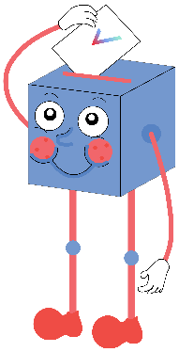

Will gender stereotypes affect your future?
From the moment we are born, people start making gender stereotypes about us, which makes them very hard to avoid.
There are not enough role models in different jobs, which will affect us without us even knowing.
There are many jobs that don’t have a good mixture of people working in them, which shows that gender stereotypes still have a big effect - why would it be different for us?
…
Knowing about gender stereotypes will help us to tackle them, and to make sure that they don’t affect us.
New role models are appearing all the time, doing every job that there is, so we won’t have this problem for long enough to affect us.
Our generation know about gender stereotypes and how they can affect us later in life, so we know how to stop it from happening.
…
We will be sharing your thoughts on this topic with Ditch the Label, This Girl Can, Malala Fund, HeforShe, and Gender Action.

Slide 27



Vote!
In the classroom?
Log your class’s votes now at: www.votesforschools.com/login/teacher
At home?
Follow this link to vote: https://www.surveymonkey.co.uk/r/vfs-primary-ks2-IWD
Not sure how?
Click the ballot box to see a video on how to log your votes!
Having trouble?
Copy and paste the link into your internet browser!
If you have any issues, feedback or comments, email primary@votesforschools.com.
Notes:
SurveyMonkey Link: https://www.surveymonkey.co.uk/r/vfs-primary-ks2-IWD
SafeShare How-To Video Link: https://safeshare.tv/x/N0-AjP3cFjg
YouTube How-To Link: https://www.youtube.com/watch?v=N0-AjP3cFjg&feature=youtu.be

