Slide 2
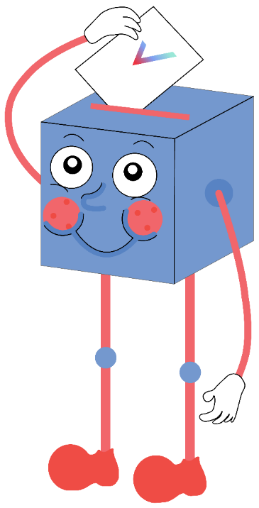
Here’s how you voted!
Would you pay more for chocolate?
No
38%
Yes
62%
Notes:
Images
Icons8

Slide 3

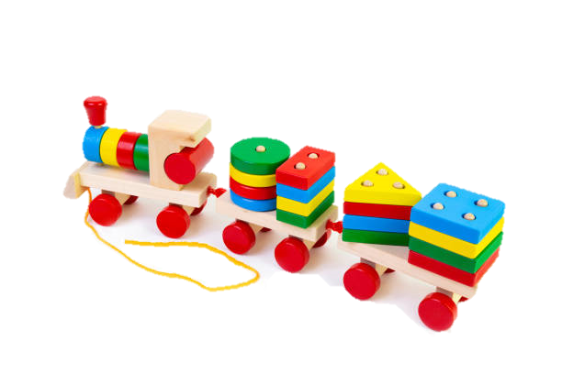
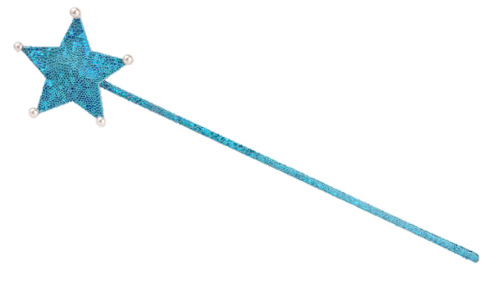
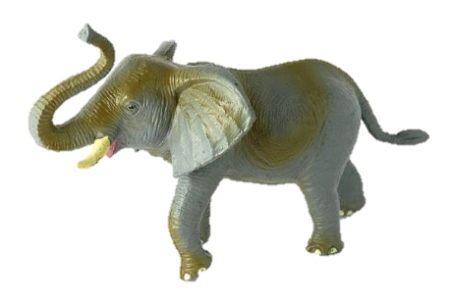
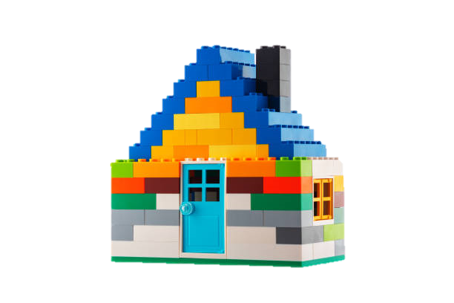
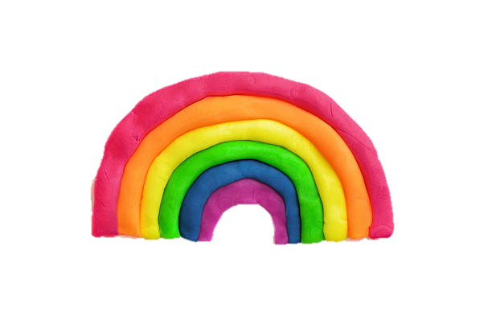
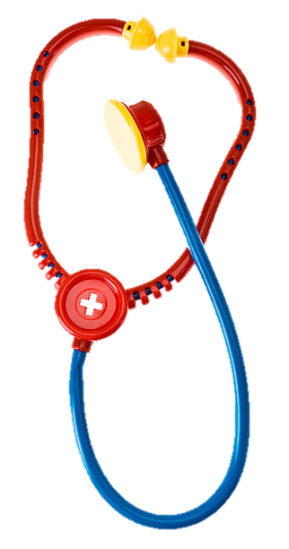
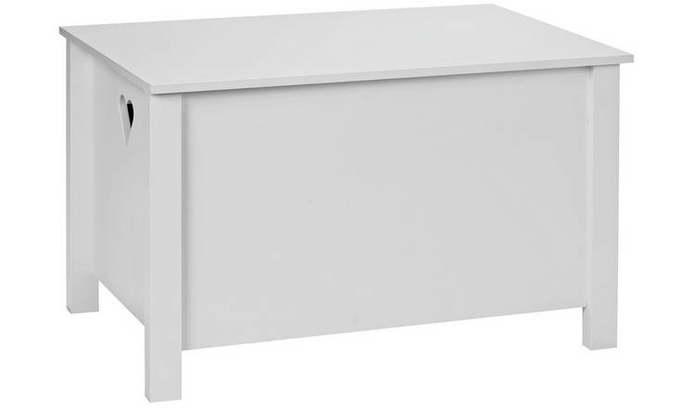
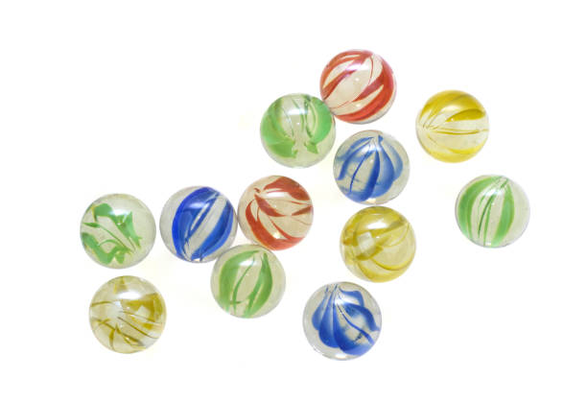
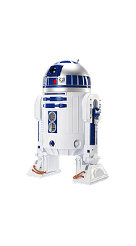
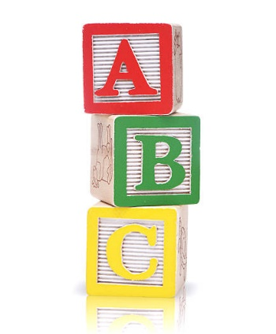
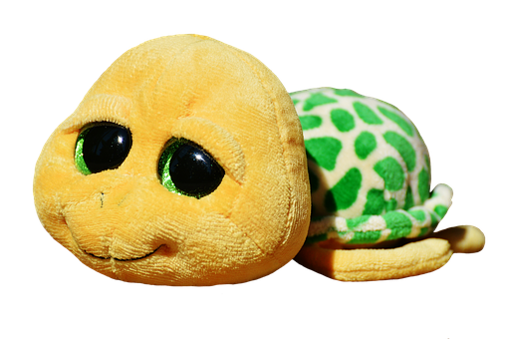
Starter: My favourite things…
Individual task (1-2 mins)
Imagine your toybox at home or in your classroom. What’s in it? Use some of the pictures below to help you! Is there a “theme” to your toybox?
Challenge:
Try drawing your “dream” toolbox!
Notes:
Images
iStock
Pixabay
https://www.argos.co.uk/product/7219791

Slide 4
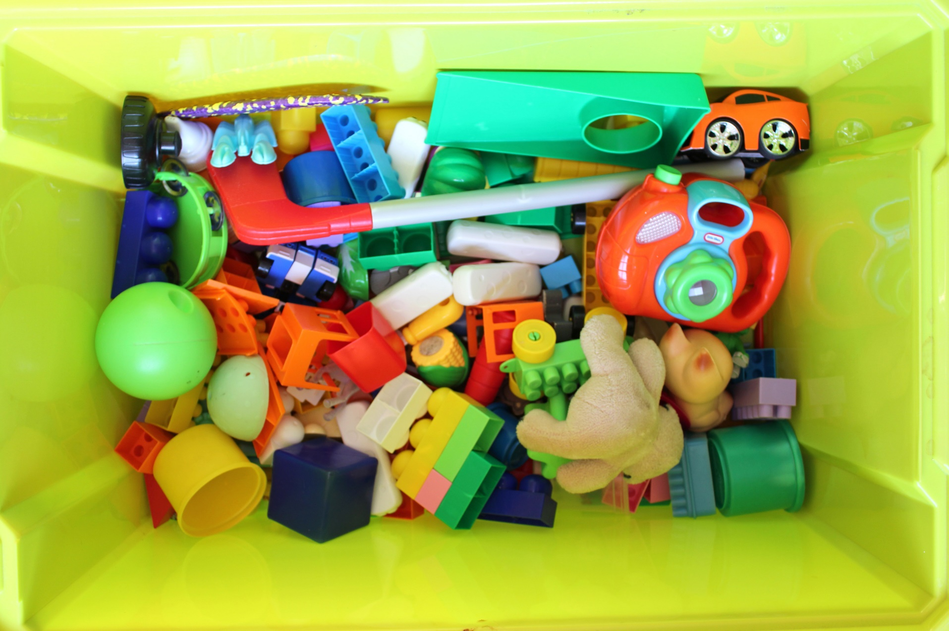

Is it important to play with a variety of toys?
Variety means lots of different toys!
Notes:
Images
iStock

Slide 5






Starter: My favourite things...
Why are we talking about this?
To play or not to play?
Toys are us!
Opinion building blocks
Vote!
Notes:
Images
Icons8

Slide 6


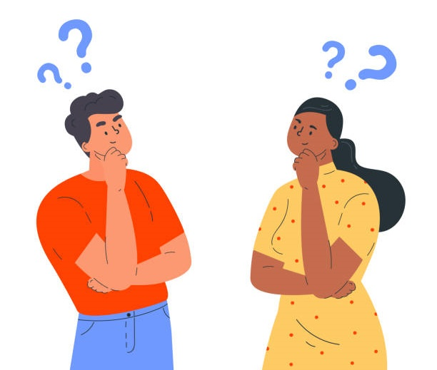
Why are we talking about this?
The 8th March is International Women’s Day, which is celebrated around the world!
Find out more about this in the assembly!
This year, the theme is #ChooseToChallenge, which is all about speaking up when we see something that we think is unfair.
During history, toys have sometimes been described as being “just for boys” or “just for girls”. You are going to think about how we can challenge this view!
Notes:
Images
iStock
References
https://www.internationalwomensday.com/Activity/15586/The-history-of-IWD

Slide 7
Starter: My favourite things...
Why are we talking about this?
To play or not to play?
Toys are us!
Opinion building blocks
Vote!
Notes:
Images
Icons8

Slide 8

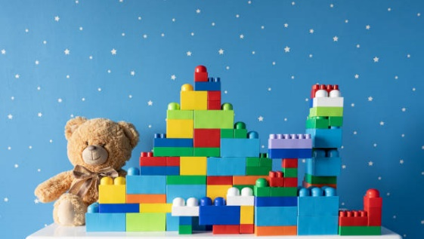

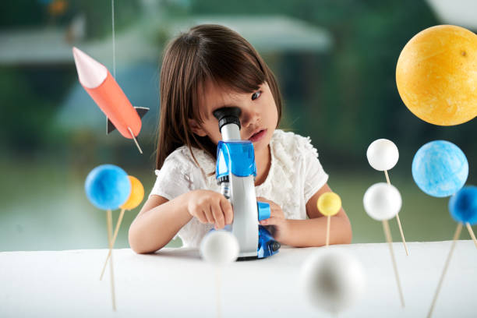



To play or not to play?
One of the choices you probably make almost every day is the types of toys you want to play with!
Sometimes, toys can help us figure out the things we like, the things we don’t like, or the things we want to find out more about.
Class task (5-10 mins)
For each toy on the next few slides, move to the left side of the room if you would like to play with this toy, and move to the right if you wouldn’t!
I would play with this!
Challenge:
Get ready to give your reasons why if your teacher asks you!
I wouldn’t play with this!
Notes:
Images
iStock

Slide 9
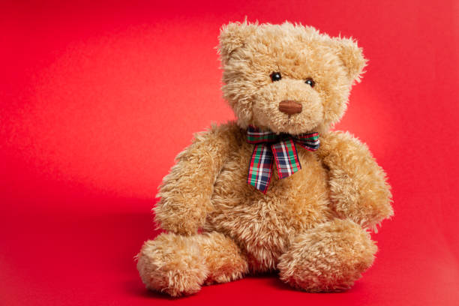
To play or not to play?
Would you play with this toy?
I would play with this!
I wouldn’t play with this!
Notes:
Images
Pixabay

Slide 10

To play or not to play?
Would you play with this toy?
I would play with this!
I wouldn’t play with this!
Notes:
Images
Pixabay

Slide 11
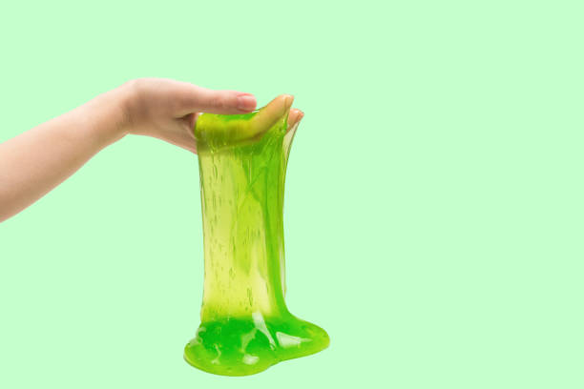
To play or not to play?
Would you play with this toy?
I would play with this!
I wouldn’t play with this!
Notes:
Images
iStock

Slide 12
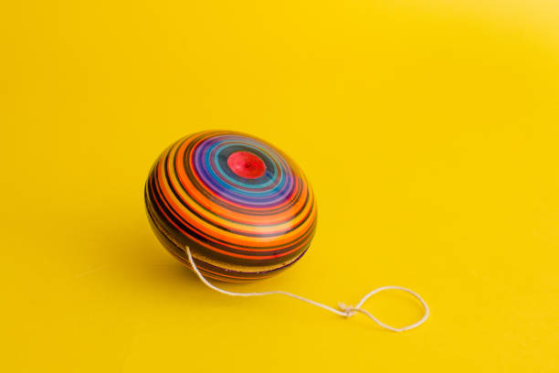
To play or not to play?
Would you play with this toy?
I would play with this!
I wouldn’t play with this!
Notes:
Images
Pixabay

Slide 13
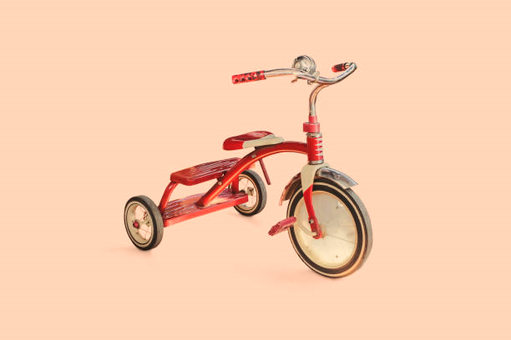
To play or not to play?
Would you play with this toy?
I would play with this!
I wouldn’t play with this!
Notes:
Images
Pixabay

Slide 14




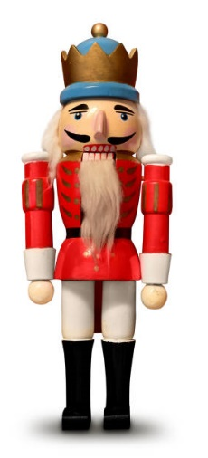
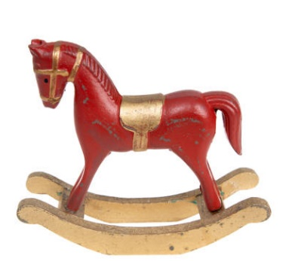
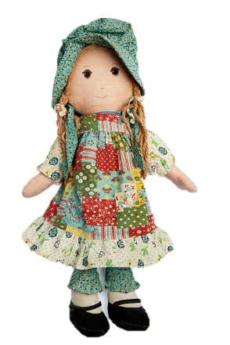
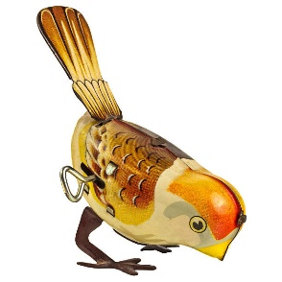
To play or not to play?
It’s quite likely that most of you said yes to playing with all of these toys!
However, throughout history, some toys have been described as “just for girls” or “just for boys”.
Reflect (2-3 mins)
Have you ever heard about a toy being meant for a certain group of children and not others?
You are going to find out a bit more about different types of toys in the next activity.
Notes:
Images
Pixabay

Slide 15
Starter: My favourite things...
Why are we talking about this?
To play or not to play?
Toys are us!
Opinion building blocks
Vote!
Notes:
Images
Icons8

Slide 16
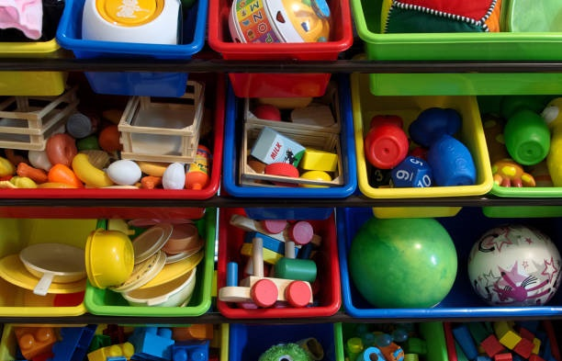
Toys are us!
Pair activity (5-10 mins)
On the next few slides, you are going to see some toys and the skills they can help us with. For each one, talk about the question with your partner (or whoever you are working with!).
Notes:
Images
iStock
References
https://www.visualcapitalist.com/cocoa-a-bittersweet-supply-chain/
https://www.weforum.org/agenda/2020/11/cocoa-chocolate-supply-chain-business-bar-africa-exports

Slide 17
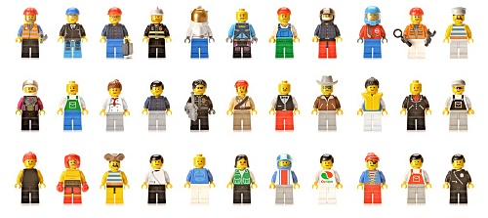
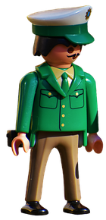
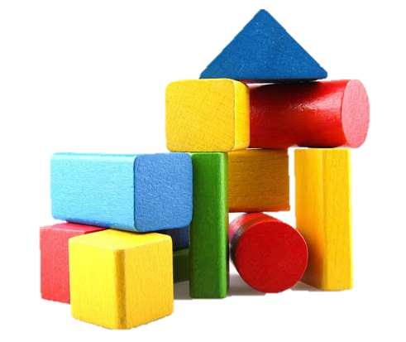
Toys are us!
Lego comes from the country Denmark, and Playmobil is from Germany!
Playing with building toys helps us with our construction skills, using our imaginations, and working in a team. It can even make us better at maths and science!
What do you think?
What would happen if we couldn’t play with these toys? Which skills would we miss out on?
Challenge:
Does this make you want to play with building toys?
Notes:
Images
Pixabay
References
https://www.parentingscience.com/toy-blocks.html

Slide 18
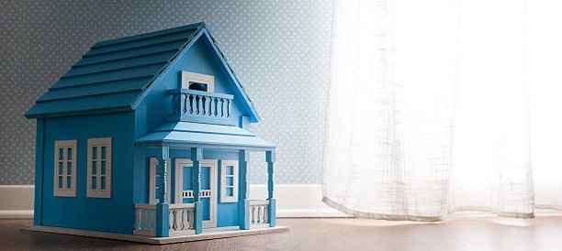
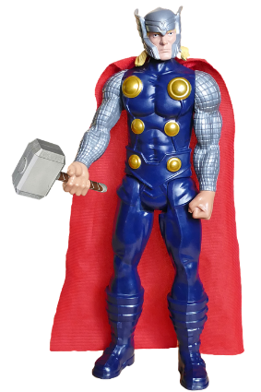
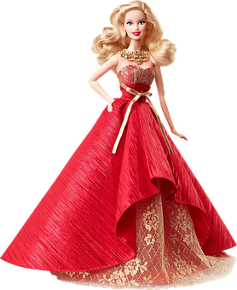
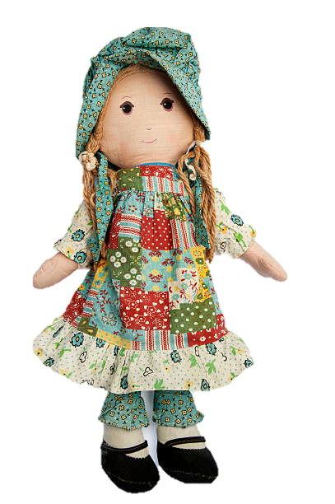
Toys are us!
Dolls are some of the oldest children’s toys ever! History shows that the Ancient Greeks may have played with them.
By playing with dolls, we can learn more about responsibility, understanding people’s feelings, caring for others and even how to talk to our friends, teachers and family!
What do you think?
What would happen if we couldn’t play with these toys? Which skills would we miss out on?
Challenge:
Does this make you want to play with dolls?
Notes:
Images
iStock
Pixabay
References
https://childventures.ca/blog/2014/12/benefits-playing-dolls/#:~:text=Empathy%20%26%20Compassion,grow%20up%20into%20caring%20people.

Slide 19
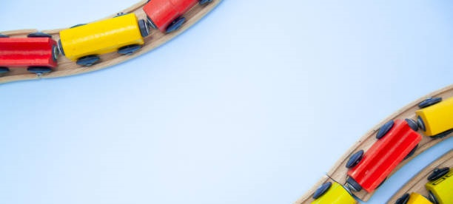
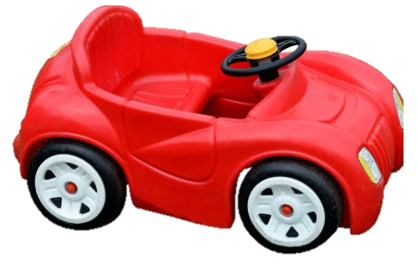
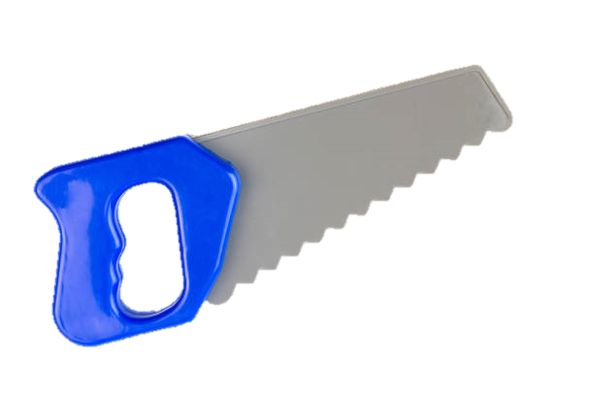
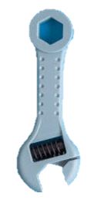
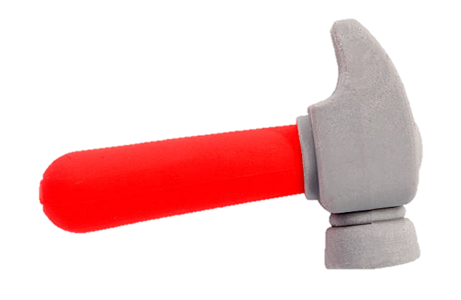
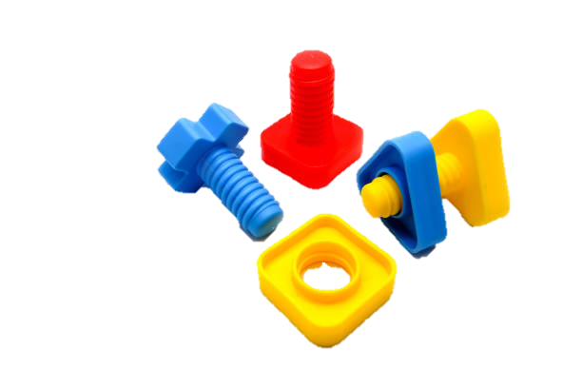
Toys are us!
The first toy vehicle was made by Jack Odell for his daughter to take to school. He made her a tiny steamroller!
Small toy vehicles can help us get better at using our hands and eyes to do more complicated things. Getting in and out of big toy cars can make our balance better and make us stronger! We can also learn a lot about how to fix things that are broken.
What do you think?
What would happen if we couldn’t play with these toys? Which skills would we miss out on?
Challenge:
Does this make you want to play with toy vehicles?
Notes:
Images
iStock
Pixabay
References
https://www.nytimes.com/2007/07/17/world/europe/17odell.html
https://www.waytoplay.toys/blogs/news/developmental-skills-while-playing-with-cars-north-shore-pediatric-therapy

Slide 20
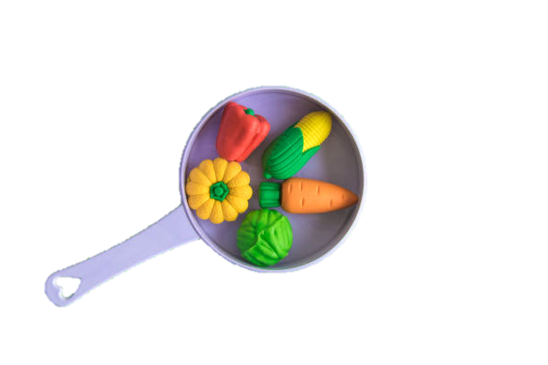
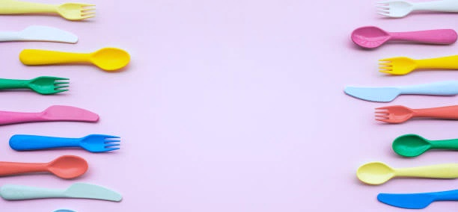
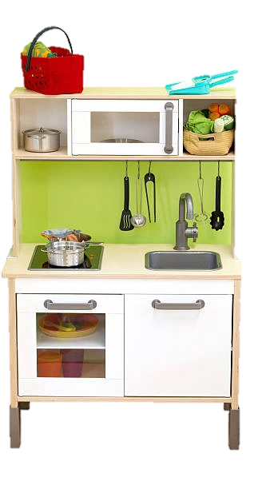
Toys are us!
In America in the 1950s, one toy shop sold tiny packets of food for children to use in their toy kitchens, like Sun-Maid raisins!
Playing in a toy kitchen not only helps us create delicious imaginary food, but also helps us to learn about keeping things organised and tidy. It will also help us feel more confident when we do learn to cook in real life, and make healthy food choices.
What do you think?
What would happen if we couldn’t play with these toys? Which skills would we miss out on?
Challenge:
Does this make you want to play with a toy kitchen?
Notes:
Images
iStock
Pixabay
References
https://www.goodhousekeeping.com/life/g2402/history-of-toy-kitchens/?slide=3
https://www.earlyyearsresources.co.uk/blog/2018/05/play-kitchen-benefits/

Slide 21
Starter: My favourite things...
Why are we talking about this?
To play or not to play?
Toys are us!
Opinion building blocks
Vote!
Notes:
Images
Icons8

Slide 22



Opinion building blocks
If you use your imagination, a toy can be anything you want it to be!
Share your view! (3-5 mins)
Above is an opinion about toys. Your job is to come up with one sentence saying why you agree or disagree, using the building blocks on the next slide to help you!
Notes:
Images:
1) iStock

Slide 23









Opinion building blocks
If you use your imagination, a toy can be anything you want it to be!
Do you agree or disagree? Why?
Tip!
Use the word wall to help you form your sentence.
I agree…
I think…
I disagree…
As…
Because…
Everyone
Children
Adults
Toys
Fun
Play
Notes:
Images:
Icons8

Slide 24
Starter: My favourite things...
Why are we talking about this?
To play or not to play?
Toys are us!
Opinion building blocks
Vote!
Notes:
Images
Icons8

Slide 25
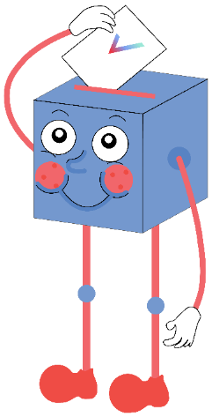
Is it important to play with a variety of toys?
It’s important to play with lots of toys, because then we are building lots of different skills!
You might make new friends by playing with different toys.
By playing with a variety of toys, we can find out more about the world around us.
…
As long as we use our imaginations, anything is possible when it comes to toys!
It’s important you like the same toys as your friends, as then you feel part of a group.
Some people find ones they like and stick to them and that’s fine.
…
For more on International Women’s Day 2021, check out this week’s assembly!

Slide 26



Vote!
In the classroom?
Log your class’s votes now at: www.votesforschools.com/login/teacher
At home?
Follow this link to vote:
https://www.surveymonkey.co.uk/r/vfs-primary-ks1-toys
Not sure how?
Click the ballot box to see a video on how to log your votes!
Having trouble?
Copy and paste the link into your internet browser!
If you have any issues, feedback or comments, email primary@votesforschools.com.
Notes:
SurveyMonkey Link: https://www.surveymonkey.co.uk/r/vfs-primary-ks1-toys
SafeShare How-To Video Link: https://safeshare.tv/x/N0-AjP3cFjg
YouTube How-To Link: https://www.youtube.com/watch?v=N0-AjP3cFjg&feature=youtu.be

