Slide 1
Learning week - celebration
Hello everyone,
We hope you are all well and are taking good care of yourselves. Thank you so much for working so hard and doing so well. Your teachers and everyone in Palfrey Junior School are so proud of you.
So, this week is Learning week and we are celebrating all the fantastic learning and growing you have been doing from home. As a part of this celebration, we would like you to create an acrostic poem about Learning. You will also need to complete a ‘learning tracker’.
So, what is an acrostic poem? An acrostic poem is where you come up with a sentence beginning with each letter in that word. So, this week you will be making an acrostic poem about all your wonderful ‘Learning’.
On the next few slides, you will first find out what an acrostic poem is and how they are written. Then, you will have some thinking questions to help you with ideas to write your acrostic poem about learning. ☺

Slide 2
So, what is an acrostic poem?

Slide 4
Acrostic Features
What did you notice?
Poetic devices may be used.
The first letter of each line spells out the poem’s theme vertically – what’s this one about?
alliteration
simile
I
C
E
C
R
E
A
M
It’s my favourite food
Cold as the inside of a fridge
Every sunny day
Can’t wait
Running to the van
Empty out the money
‘Any sauce on that, love?’
Mmmmmm, yummy!
Lines can be different lengths

Slide 5


Acrostic Examples
What is each poem about?
R
O
A
L
D
D
A
H
L
Revolting rhymes
Oompa-Loompas
Angry farmers
Lazy aunts
Dangerous witches
Dream blower
Adventurous animals
Horrible headteacher
Lickable wallpaper
I
C
E
C
R
E
A
M
It’s my favourite food
Cold as the inside of a fridge
Every sunny day
Can’t wait
Running to the van
Empty out the money
‘Any sauce on that, love?’
Mmmmmm, yummy!

Slide 6
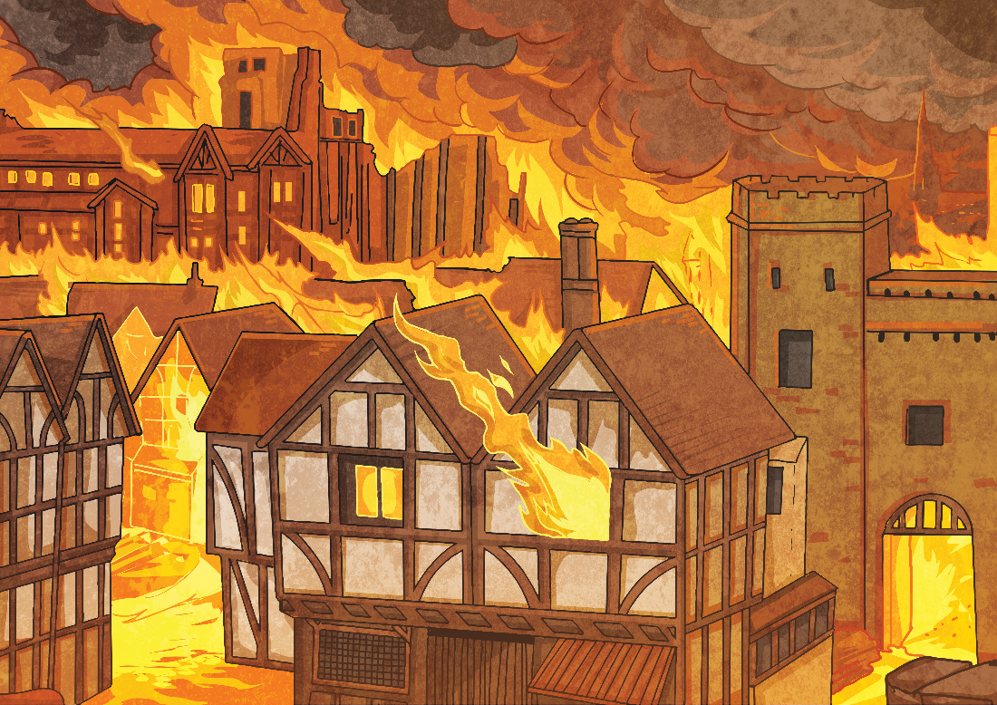
Acrostic Examples
What is the poem about?
Gigantic flames
Remember 1666
Every child knows
Ash floated everywhere
Thousands of homes destroyed
Flames all around
Inside the bakery
Red sky
Everything covered in soot
Over the city
From house to house
Lots of people escaped
On foot, by boat and carriage
Nearly every house
Demolished
On Pudding Lane – Help! Help! But
Not many people died.
G
R
E
A
T
F
I
R
E
O
F
L
O
N
D
O
N

Slide 7



Let’s Try It!
How can we write an acrostic poem?
First, we need to choose a theme. I know, let’s have…
fireworks!
Then, we think of lots of words or phrases associated with that theme…
night
spectacular
smoke
bonfire
pop
bang
fizz
noise
crackle
rocket
stars
explosion
sparkle

Slide 8
Let’s Try It!
How can we write an acrostic poem?
Finally, we use our list of words and phrases to create each line. Don’t worry if you can’t think of them in order – it’s fine to go back and add any missing lines afterwards.
F
I
R
E
W
O
R
K
S
lames flicker in the bonfire
watch the sparks fly up
ockets zoom into the night
verywhere the smell of smoke
aiting for the next explosion
ohh... Ahhh… Wow!
oaring crowds of onlookers
aleidoscope of colours
eems to go on forever

Slide 9
THINKING QUESTIONS – BEFORE WRITING YOUR ACROSTIC ABOUT learning
So, let see… Can you think about what you have been learning? Write down these answers in your pink book and then use these ideas in your poem.
You could answer some of these questions and use the answers in your acrostic sentences…
What is your favourite activity?
Why did you enjoy that activity?
Why is learning fun?
What kind of things do you enjoy learning at home?
Do you miss school?
Why do you miss school?
What have you enjoyed learning in Art and DT?
Did you do fantastic learning in French and Topic? What was it?
What was your favourite literacy and numeracy lesson?
Hey, what about Science? That’s always super fun? What did you enjoy the most and why?

Slide 10
Your Turn!
Thinking about your learning and all the wonderful things you have been learning about, can you create an acrostic poem about learning?
I have done the first letter for you. But, that’s just to show you… you can definitely do your own. Remember, these sentences have to begin with these letters and need to showcase your fantastic learning journey. There is a sheet you can create your own acrostic poem about Learning and turn it in as homework or you can send a photo to school.
Learning is fun.
E
A
R
N
I
N
G

