Slide 1


Slide 2
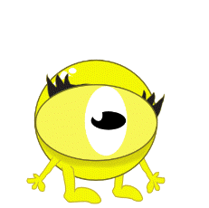
fit

Slide 3

fun

Slide 4


Slide 5
off

Slide 6
huff

Slide 7
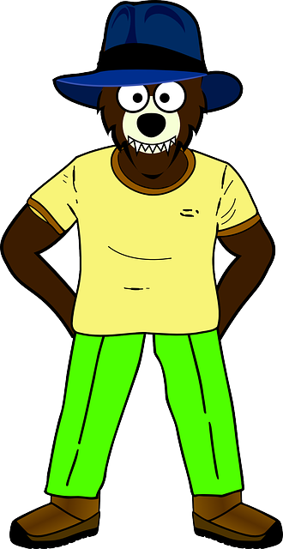
puff

