Slide 1
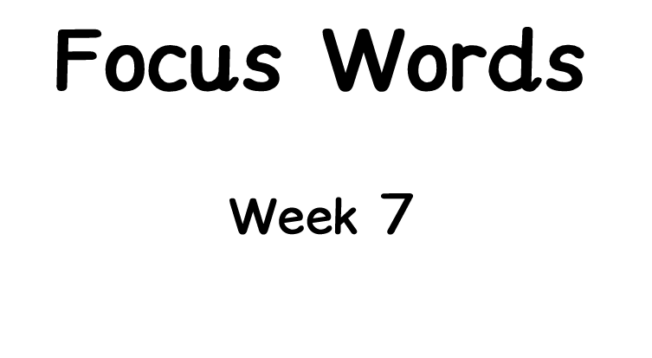



Slide 2


Slide 3


Slide 4


Slide 5



Slide 6


Slide 7
















Switch to Normal View to move the words with the cursor.
Make sentences on the line below.

Slide 8










Recap from last lesson.
Make sentences on the line below.

Slide 9





Recap from a previous lesson.
Make sentences on the line below.

