Slide 1

Pokemon
Scenarios
]
Scarlet & Violet
Made by Junaid
Khaled

Slide 2

Pikachu finds a link online
Pikachu spotted a link on his phone
that said, “If the wheel spins red,
then you get nothing.
But if it spins blue, you get…
£1000 instead!”. What should
he do?

Slide 3
Pick an option:
A: He should click on the link and take the chance to win £1000.
B: He should scroll away from the link and ignore it.

Slide 4
Answer:
Green = Correct Red = Incorrect
A: He should click on the link and take the chance to win £1000.
B: He should scroll away from the link and ignore it.

Slide 5

Squirtle finds a link to a website
Squirtle was scrolling on
his phone, when he saw a link that
said, “FREE £500, JUST CLICK
HERE!”. What should
he do?

Slide 6
Pick an option:
A: He should forget about the link and carry on with what he was doing.
B: He should press HERE and try to get a free £500.

Slide 7
Answer:
Green = Correct Red = Incorrect
A: He should forget about the link and carry on with what he was doing.
B: He should press HERE and try to get a free £500.

Slide 8
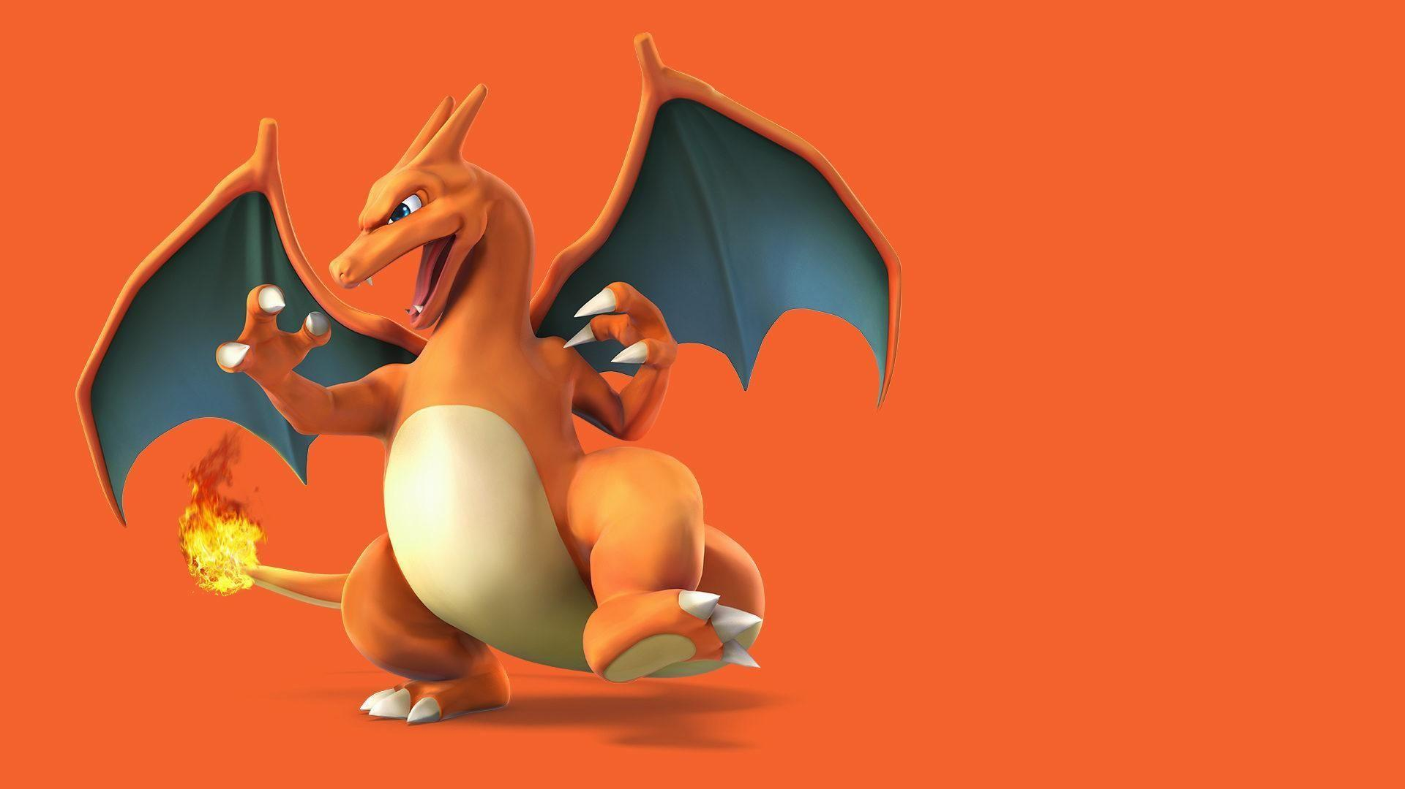
Charizard finds a game
Charizard was looking for
a new game to download, when
he came across a game that he
liked. It said, “Get free Robux
just by playing!” What should he
do?

Slide 9
Pick an option:
A: He should not install the game and look for another one to download.
B: He should install the game and play it to try to get the free Robux.

Slide 10
Answer:
Green = Correct Red = Incorrect
A: He should not install the game and look for another one to download.
B: He should install the game and play it to try to get the free Robux.

Slide 11

Bulbasaur finds a video
Bulbasaur was finding a video to
watch, when she stumbled upon
one that said, “How to get free
Robux!” She watched the video,
but it said for her to give them
her bank details first. What
should she do?

Slide 12
Pick an option:
A: She should give the people her bank details to get the free Robux.
B: She should ignore the video and go watch something else.

Slide 13
Answer:
Blue = Correct Red = Incorrect
A: She should give the people her bank details to get the free Robux.
B: She should ignore the video and go watch something else.

Slide 14




A game by Junaid Khaled
Junaid Khaled Productions
Thank you for playing!

