Slide 1
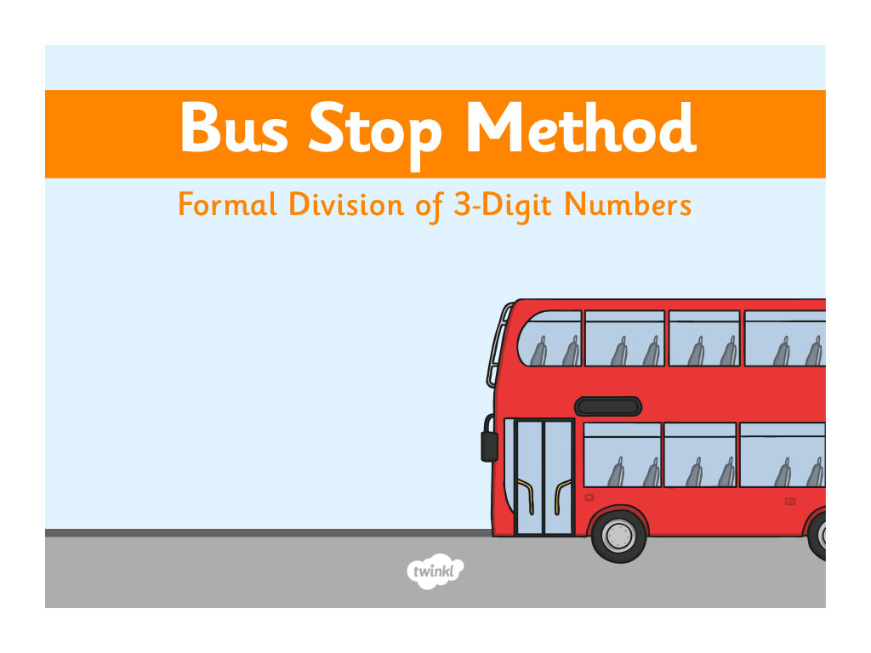

Slide 2
29
145 ÷ 5 =
0
2
9
5
1
1
4
4
5

Slide 3
134
670 ÷ 5 =
1
3
4
5
6
1
7
2
0

Slide 4
181
362 ÷ 2 =
1
8
1
2
3
1
6
2

Slide 5
304
608 ÷ 2 =
3
0
4
2
6
0
8
How many are left over?

Slide 6
214
642 ÷ 3 =
2
1
4
3
6
4
2

Slide 7
128
512 ÷ 4 =
1
2
8
4
5
1
2

Slide 8


