Slide 1


Article 25: “If you live in care or in other situations away from home, you have the right to have these living arrangements looked at regularly to see if they are the most appropriate.”
–
Parents/Carers & Pupils:
This lesson works best in “Full Screen” mode – click the icon at the bottom right of your screen or use the “F5” key to start from the beginning. Use the space bar, mouse or arrow keys to click through!

Slide 2






How to use this lesson…
Use these buttons to get the most out of your lesson.
Find this button in the bottom right of you screen to start your lesson.
Use the arrow keys to go forwards and backwards through your lesson.
To go back to your normal screen, press the esc key on your keyboard.
–
Learning from home?
Here are some ideas of how to get the most out of this lesson at home.
Ask an adult to arrange a video call so you can do some
of the activities with a friend.
Explore the topic with a parent or caregiver: how is their opinion
different to yours?
Teach a younger sibling or relative
about how
VotesforSchools works!
In the classroom?
Look out for these boxes to see how to make the most of the activities!
Parents’ & Carers’ Note:
Please see the Notes section below each slide for any further guidance.
Don’t forget to vote…
You can find the link to do this on the final slide. Get your whole household involved!
Notes:
Images:
https://icons8.com/

Slide 3





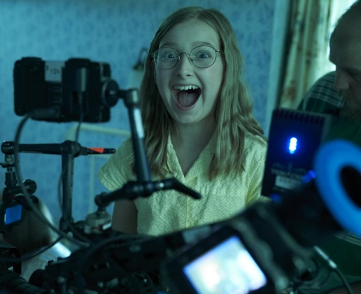
Feedback: “Would you like to be a child actor?”
“I am happy with the things that would happen being a child actor and I would like to do the things that people do on TV.”
Sycamore Academy
“I don't have enough time to be a child actor and play football!”
Chipstead Valley Primary School
“I really like that the cast is so nice, and to have your teachers come around and help you study! I also love that they give you some break time like at school.”
Five Elms Primary School
“I wouldn't want to be a child actor because I think there would be a lot of pressure.”
St Paul’s Church of England Primary School
47.5%
52.5%
“Thank you so much for taking the time to vote, it's interesting to hear what you have to say. It can sometimes be hard to juggle work and school, but personally I think it's worth it. I hope you enjoy the rest of the series!”
Imogen Lamb, who plays Mary-Lou on CBBC’s Malory Towers
Notes:
Parent/Carer Note: This slide shows the feedback to the question pupils answered two weeks ago. Check back in two weeks to see if the comment you make at the end of this lesson is featured!
To record your child’s vote, use the survey link on the last slide or use the hashtag #VotesatHome on social media to browse other children’s responses and share your own.

Slide 4


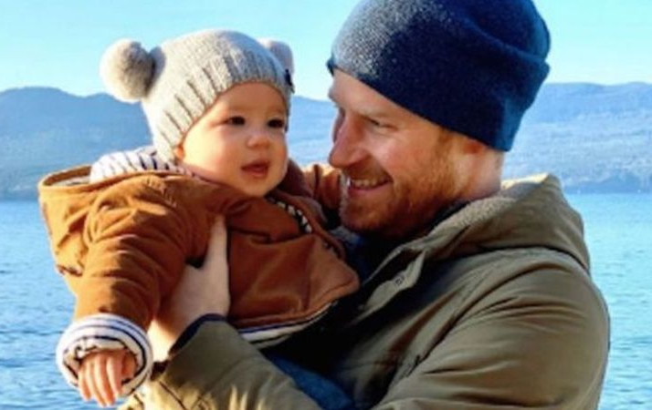




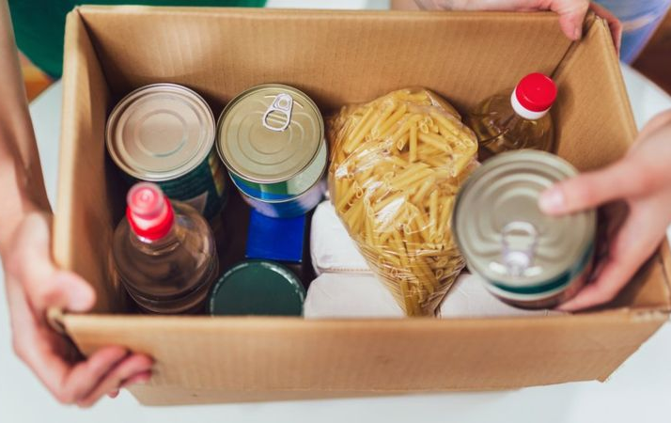
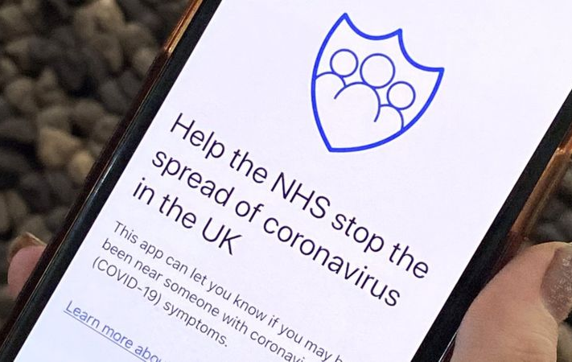
Be informed!
Here’s what’s been in the news this week...
Archie turns one!
Who starts fake Coronavirus news?
Prince Harry and Meghan Markle celebrated their son Archie’s first birthday last week on 6th May!
A reporter at the BBC has been looking into fake stories about the Coronavirus. Click the image to watch a video of her findings.
The number of young people using food banks was double in March this year compared to last year. Experts believe the pandemic is partly to blame.
The NHS are testing an app in the Isle of Wight which they hope will let people know if they have been in contact with the virus.
Food bank use ‘doubles’
COVID-19: An app is coming
Notes:
Parent/Carer Note: Use this slide to learn about headlines around the world. Using the presentation in Slide Show mode, you will be able to click on the highlighted pictures to follow links to websites and videos.
Alternative video link: https://www.bbc.co.uk/newsround/52228461
Images/Stories:
Archie: https://www.bbc.co.uk/newsround/52559539
Fake news: https://www.bbc.co.uk/newsround/52537443
COVID-19: https://www.bbc.co.uk/newsround/52541553
Food banks: https://www.bbc.co.uk/newsround/52462814

Slide 5
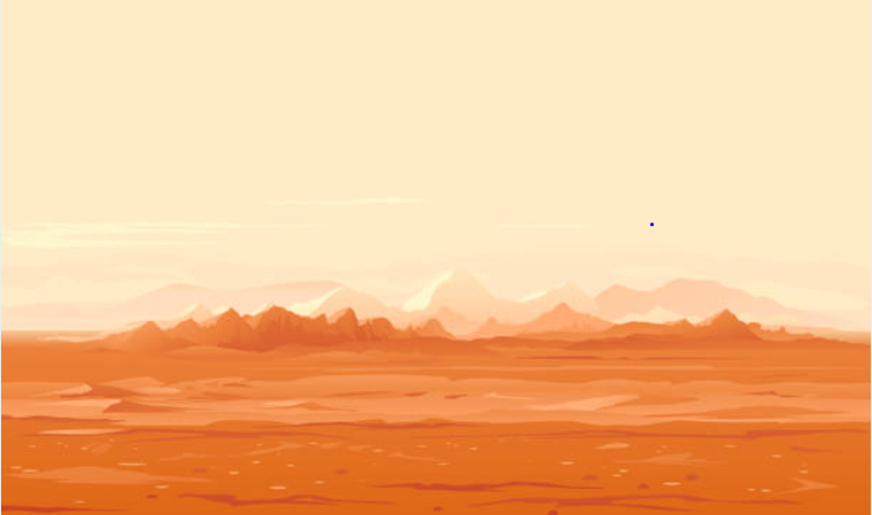









Starter: Guess the question!
Guess the question
(1 min)
Take a look at these emojis. Can you guess what this week’s lesson will be about?
Notes:
Images:
iStock
https://emojipedia.org/

Slide 6
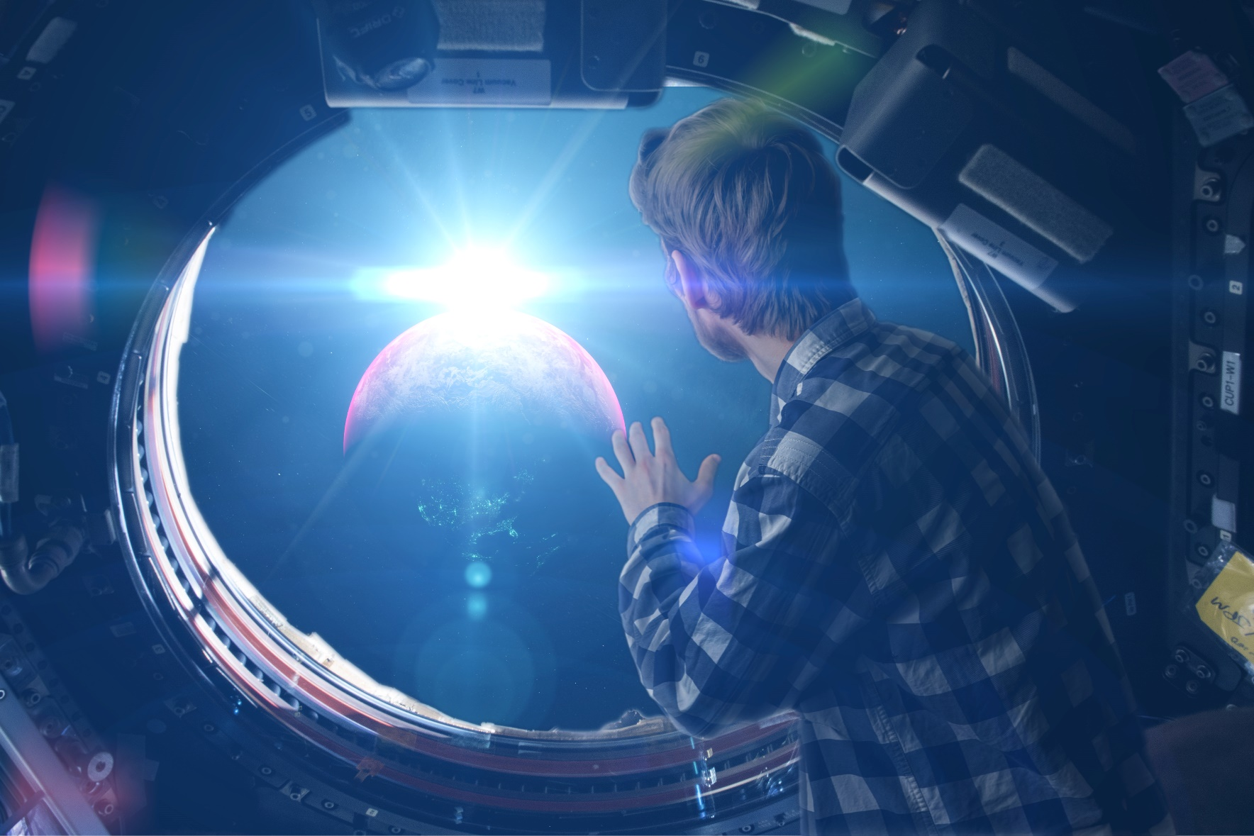
Could you be a first settler on Mars?
First settlers:
The first people to move to Mars to live there.
Notes:
Parent/Carer Note: Each week, your child completes this lesson in school before recording their vote on an online platform. Temporarily, we have created a platform you can use at home. Please see the last slide for details.
Images:
iStock

Slide 7









Starter: Guess the question!
Why are we talking about this?
Why do humans want to go to Mars?
Could we live there?
Should we or shouldn’t we?
Vote!
Ext: Calling all astronauts
Notes:
Images:
iStock

Slide 8
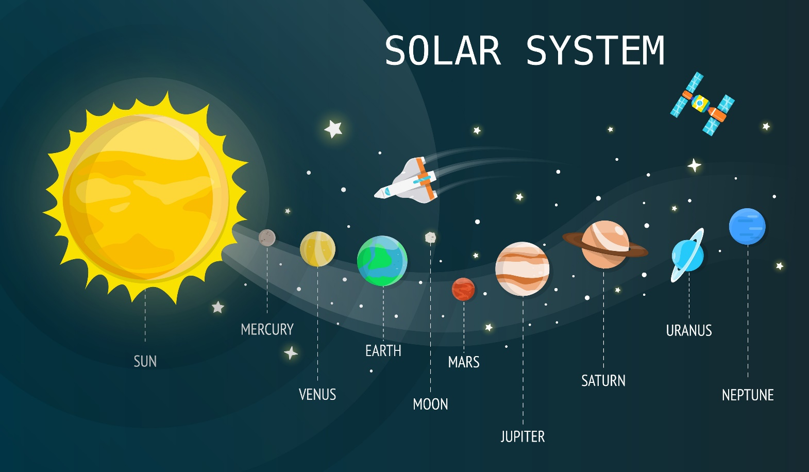
Why are we talking about this?
Find Mars (1 min)
Can you find Earth on this map of the solar system? Can you find Mars
While Mars might look close to earth, it is actually 180,000,000 kilometres away! This means it could take between 150 to 300 days to get there!
Notes:
Parent/Carer Note: This week’s home learning pack contains additional resources to support learning about the solar system.
Images:
1) iStock

Slide 9
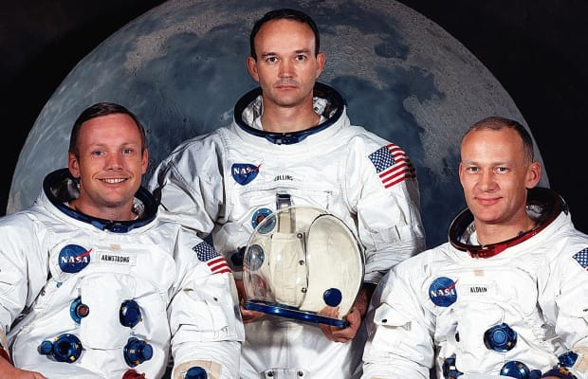
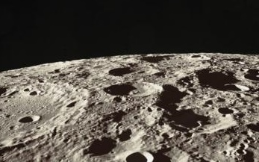
Why are we talking about this?
0:00-2:29
It’s been over 50 years since the Apollo 11 crew were the first humans to ever land on the moon.
Watch (2 mins)
Click the image to watch these three spacemen walk on the moon for the first time!
Since then, 24 more people have visited the moon, and many studies have been carried out on it. They found that the temperature there can be hotter than boiling water, or colder than ice, and there is no water there!
This means that humans could never live on the moon, but what about Mars?
Notes:
Parent/Carer Note: This slide provides context for the lesson this week.
Alternative video link: https://www.youtube.com/watch?v=cwZb2mqId0A
Images:
1) iStock

Slide 10
Starter: Guess the question!
Why are we talking about this?
Why do humans want to go to Mars?
Could we live there?
Should we or shouldn’t we?
Vote!
Ext: Calling all astronauts
Notes:
Images:
iStock

Slide 11








Why do humans want to go to Mars?
You’re the expert!
(5-10 mins)
Imagine you are the head of NASA. Read the information on the next few slides carefully. Based on these arguments, would you send people to Mars? Why/why not?
Did you know?
NASA stands for The National Aeronautics and Space Administration!
Let’s stay here!
I can’t decide!
Let’s go to Mars!
Challenge:
Keep a note of your answer, and see how many times it changes throughout this lesson!
Notes:
Parent/Carer Note: Encourage children to justify their arguments and explain their views.
Images:
https://emojipedia.org/
NASA

Slide 12
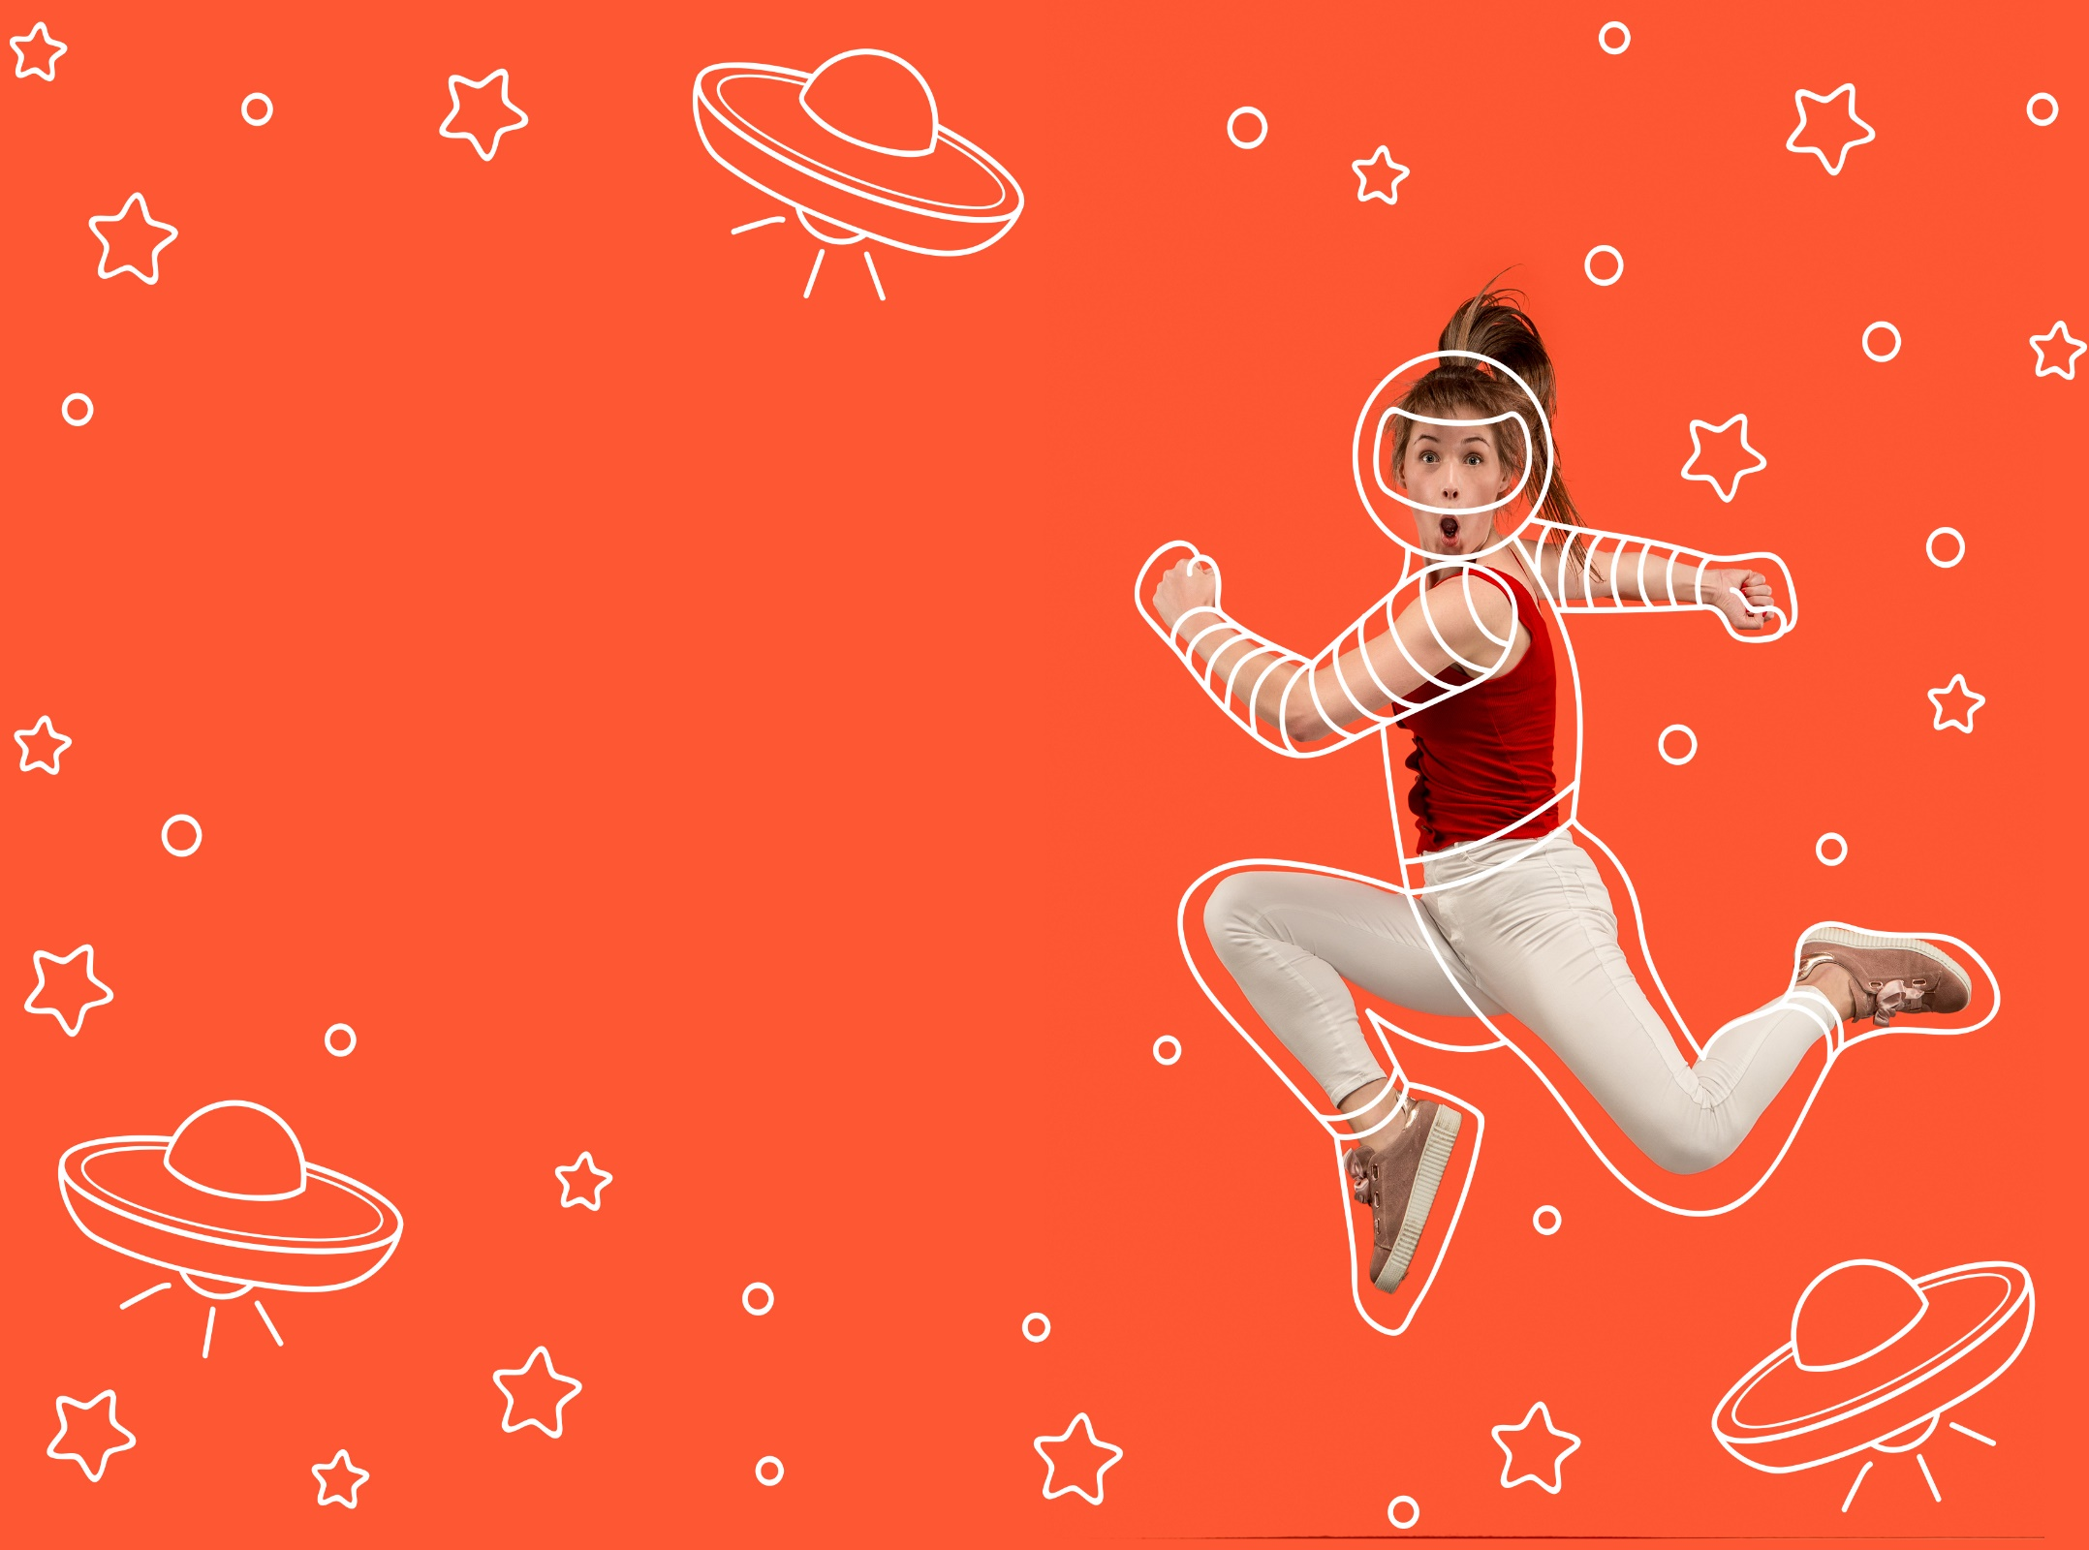
Why do humans want to go to Mars?
Humans are curious! All through history, we’ve explored new towns, cities, countries and even planets. It’s natural that we’d want to go to Mars!
Let’s stay here!
I can’t decide!
Let’s go to Mars!
Notes:
Parent/Carer Note: Encourage children to justify their arguments and explain their views.
References:
https://www.businessinsider.com/5-undeniable-reasons-why-humans-should-go-to-mars-2015-4?r=US&IR=T
Images:
iStock
https://emojipedia.org/

Slide 13
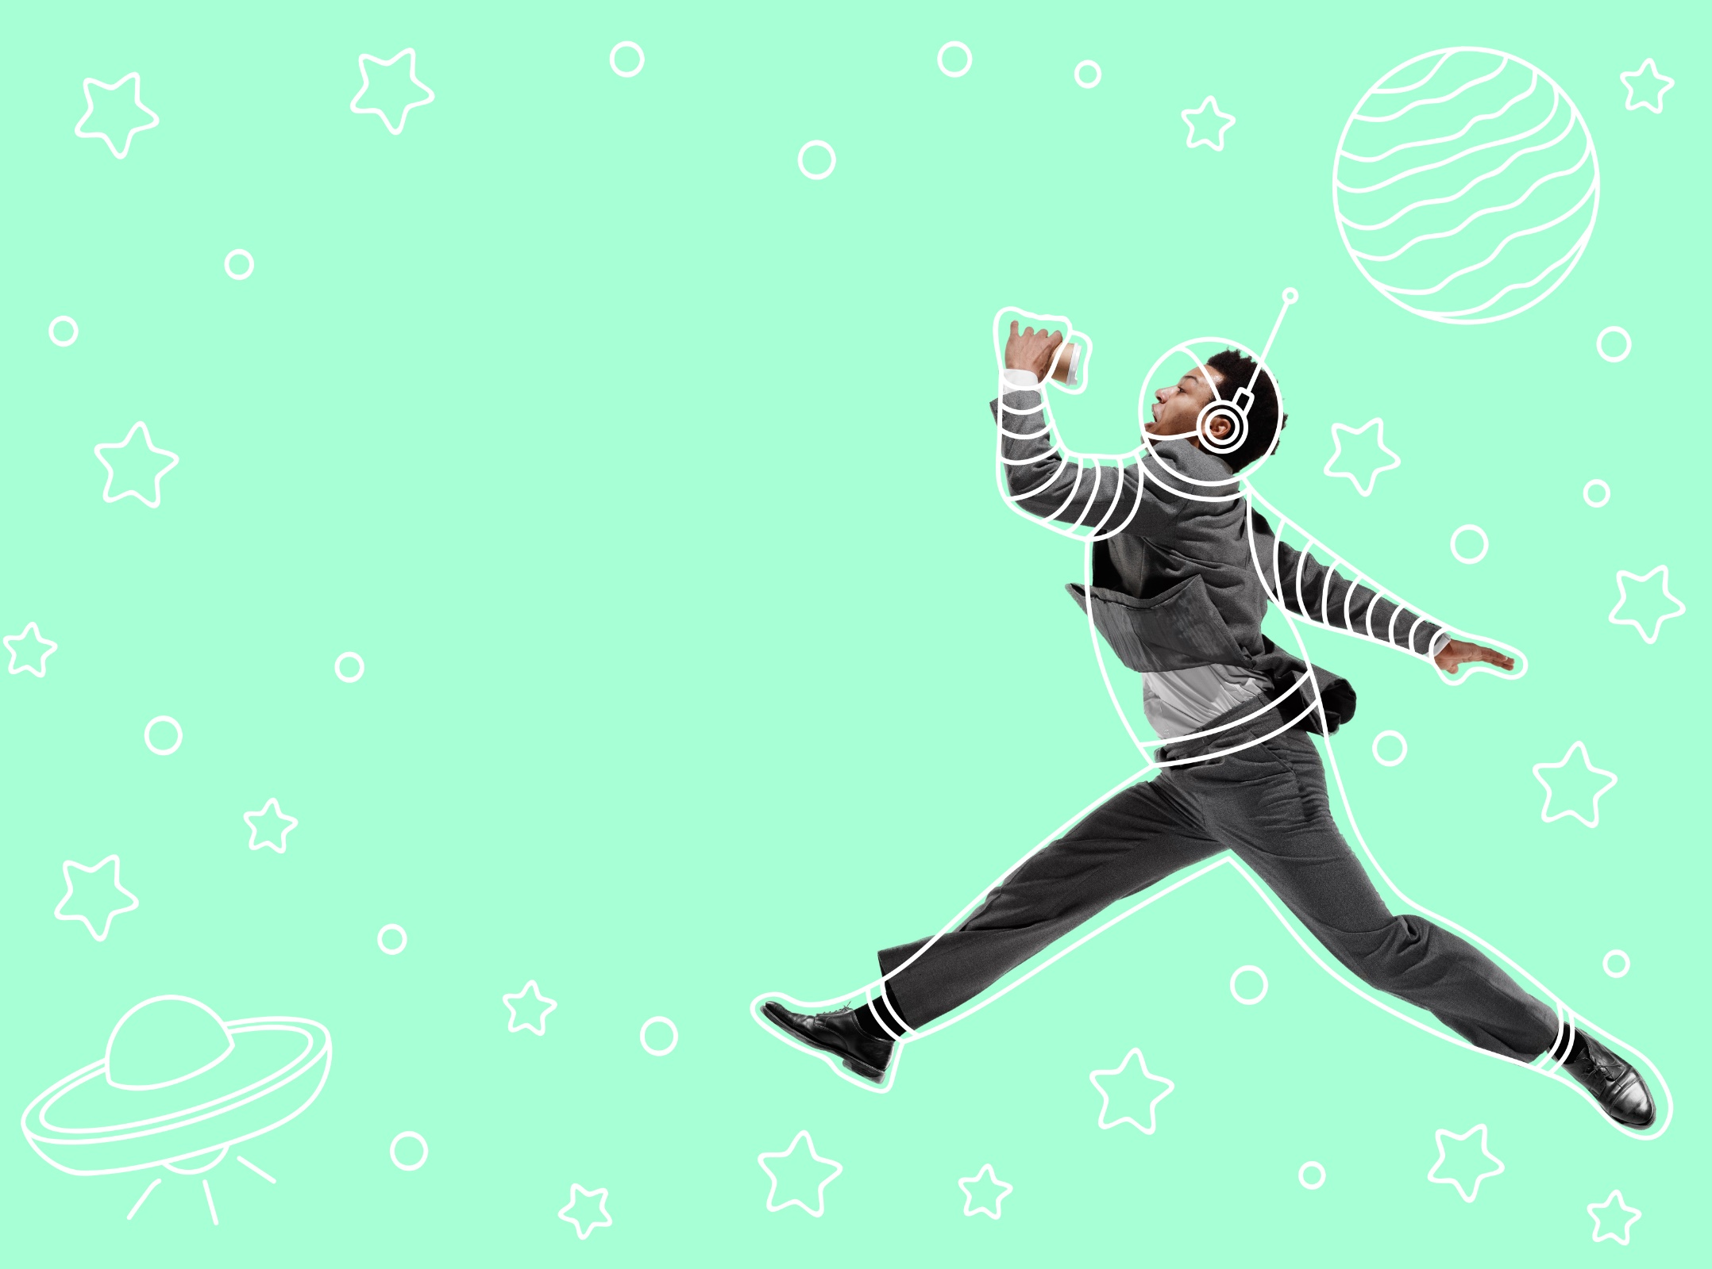
Why do humans want to go to Mars?
If dinosaurs could become extinct on Earth, humans could too. If people live on Mars and Earth we can make sure humans don’t become extinct.
Let’s stay here!
I can’t decide!
Let’s go to Mars!
Notes:
Parent/Carer Note: Encourage children to justify their arguments and explain their views.
References:
https://www.businessinsider.com/5-undeniable-reasons-why-humans-should-go-to-mars-2015-4?r=US&IR=T
Images:
iStock
https://emojipedia.org/

Slide 14

Why do humans want to go to Mars?
Humans could study Mars and find out so much more about our solar system- we might even find aliens!
Let’s stay here!
I can’t decide!
Let’s go to Mars!
Notes:
Parent/Carer Note: Encourage children to justify their arguments and explain their views.
References:
https://www.businessinsider.com/5-undeniable-reasons-why-humans-should-go-to-mars-2015-4?r=US&IR=T
Images:
iStock
https://emojipedia.org/

Slide 15

Why do humans want to go to Mars?
Climate change is spoiling planet Earth. If we start exploring Mars now, we might be able to go and live there if Earth doesn’t survive.
Let’s stay here!
I can’t decide!
Let’s go to Mars!
Notes:
Parent/Carer Note: Encourage children to justify their arguments and explain their views.

Slide 16

Why do humans want to go to Mars?
Scientific discoveries could help us in many ways. For example, a programme that was created to look at photos of Mars is already used to help detect cancer. Just think about all the other things we could learn!
Let’s stay here!
I can’t decide!
Let’s go to Mars!
Notes:
Parent/Carer Note: Encourage children to justify their arguments and explain their views.
References:
https://www.businessinsider.com/5-undeniable-reasons-why-humans-should-go-to-mars-2015-4?r=US&IR=T
Images:
iStock
https://emojipedia.org/

Slide 17
Starter: Guess the question!
Why are we talking about this?
Why do humans want to go to Mars?
Could we live there?
Should we or shouldn’t we?
Vote!
Ext: Calling all astronauts
Notes:
Images:
iStock

Slide 18








Could we live there?
What’s Mars like? (5-15 mins)
On the next few slides you will find out more about Mars and what living on it would be like. Read the information carefully and see if you can answer the quiz after!
Hint:
Look out for these icons to help you answer the quiz!
Challenge:
Try the quiz on a family member or friend!
Notes:
Images:
1) iStock

Slide 19
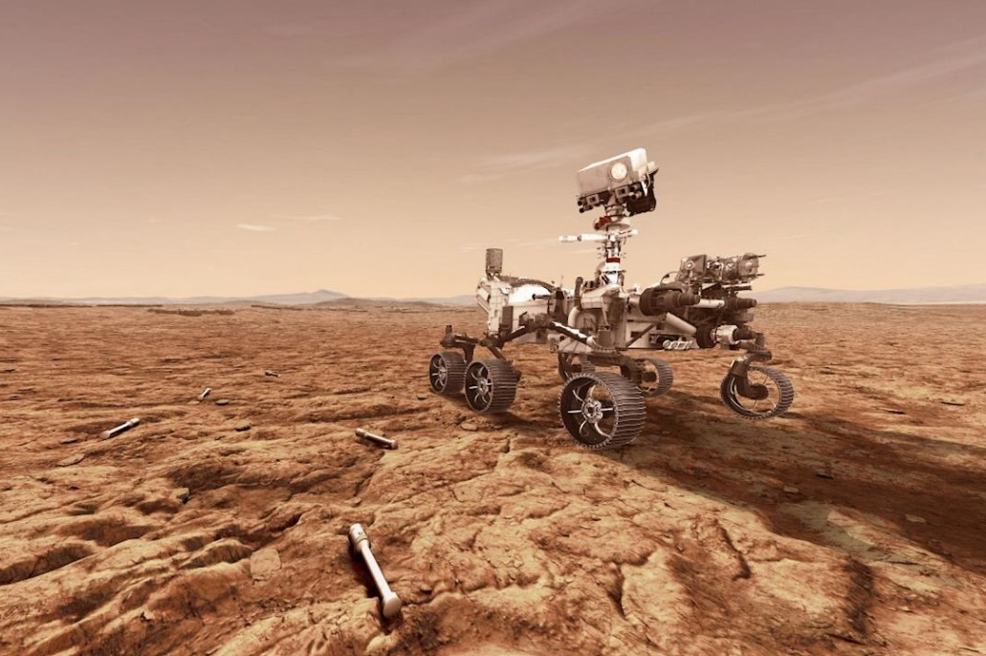

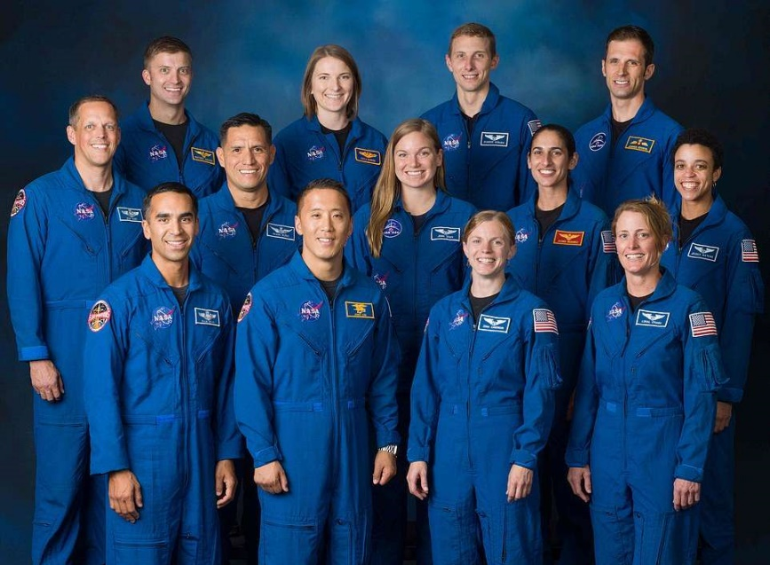

Could we live there?
While many rovers and landers have explored Mars, no human has visited yet. However, some scientists think that we could be visiting there in just a few years!
So far, four rovers have been to Mars. This one is called Perseverance (Percy for short!)
The rovers are collecting information about Mars to find out what humans would need to do to visit or live there.
Many astronauts have already signed up to be the first people to visit Mars. If they go, they have been told that they will probably not come back to Earth again.
Notes:
Images/references:
https://mars.nasa.gov/programmissions/science/goal4/
https://www.nasa.gov/feature/can-plants-grow-with-mars-soil/
https://www.csmonitor.com/Science/2017/0102/NASA-plan-for-housing-astronauts-on-Mars-borrows-from-Eskimos
https://www.lung.org/blog/can-we-breathe-on-mars

Slide 20

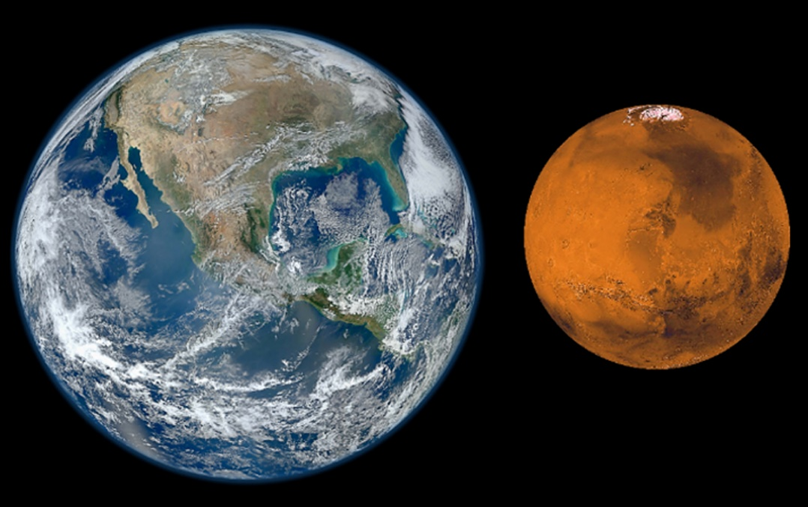

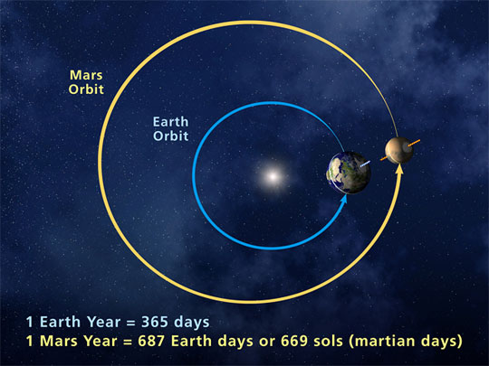

Could we live there?
Mars is a much smaller planet than Earth, and it looks different too!
Here on earth, 70% of the world is made up of water, which is why Earth looks so blue in pictures! However, Mars is dry and dusty, with only 14% water, making it look red.
Just like Earth, Mars travels around the sun. However, it takes Mars much longer, making a year on Mars last 687 days!
Mars is also further away from the sun, making it a colder planet. Here on earth, the average temperature is 14°C, but on Mars it is -46°C. (That’s as cold as the North Pole in Winter!)
Notes:
Images/references:
https://www.universetoday.com/22603/mars-compared-to-earth/
https://suindependent.com/life-earth-mars-going/

Slide 21

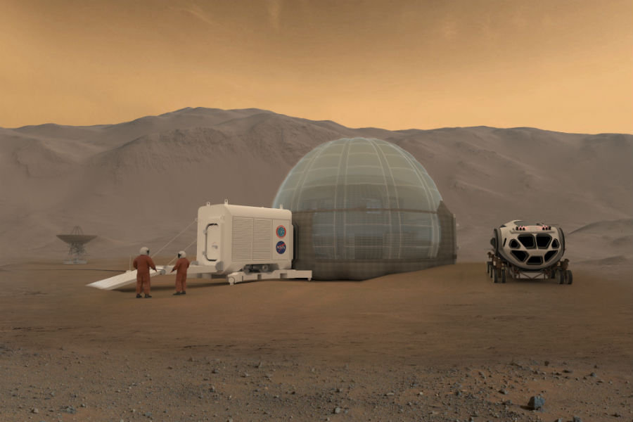

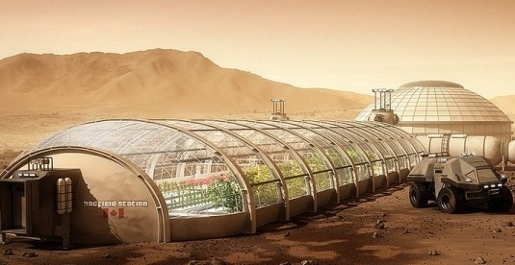

Could we live there?
Humans need oxygen to breathe, but there isn’t enough of it on Mars!
This means that astronauts will need to take tanks of oxygen with them to Mars, and could live in inflatable bubbles until scientists find a way to solve this problem.
Experts also think we might be able to grow plants on Mars. This would help the first settlers to grow foods to eat.
These pictures are what NASA thinks life on Mars might look like for first settlers.
Notes:
Images/references:
https://www.nasa.gov/feature/can-plants-grow-with-mars-soil/
https://www.csmonitor.com/Science/2017/0102/NASA-plan-for-housing-astronauts-on-Mars-borrows-from-Eskimos
https://www.lung.org/blog/can-we-breathe-on-mars
https://www.computerworld.com/article/2490934/when-astronauts-breathe-on-mars--they-ll-thank-mit-professor.html

Slide 22




Could we live there?
–
True or false (5 mins)
Can you answer these true or false questions based on what you just learned? Click to find out the answers.
Parents/Carers & Pupils:
This lesson works best in “Full Screen” mode – click the icon at the bottom right of your screen to complete the quiz. Use the space bar, mouse or arrow keys to click through!
Humans have already been to Mars.
There is more water on Earth than on Mars.
A year on Mars is longer than a year on Earth.
Mars is bigger than Earth.
Humans can breathe on Mars.
The first settler on Mars will come back in a few months.
We could grow our own food on Mars.
First settlers will probably live in inflatable homes on Mars.
Notes:
Images:
1) iStock

Slide 23
Starter: Guess the question!
Why are we talking about this?
Why do humans want to go to Mars?
Could we live there?
Should we or shouldn’t we?
Vote!
Ext: Calling all astronauts
Notes:
Images:
iStock

Slide 24







Should we or shouldn’t we?
Vote with your thumbs (3-10 mins)
On the next few slides you are going to see some different opinions about going to live on Mars. If you agree, put your thumb up. If you disagree put your thumb down.
I agree!
I disagree!
Notes:
Images:
1) iStock

Slide 25

Should we or shouldn’t we?
We already have one planet. We should focus on looking after it, instead of getting a new one!
Vote with your thumbs
If you agree, put your thumb up. If you disagree put your thumb down.
I agree!
I disagree!
Notes:
Images:
1) iStock

Slide 26

Should we or shouldn’t we?
It is incredible that scientists will be able to go to Mars. It shows how much we have learned since the Stone Age.
Vote with your thumbs
If you agree, put your thumb up. If you disagree put your thumb down.
I agree!
I disagree!
Notes:
Images:
1) iStock

Slide 27

Should we or shouldn’t we?
Being able to help make decisions on what Mars will look like, and to build on a new planet would be very cool!
Vote with your thumbs
If you agree, put your thumb up. If you disagree put your thumb down.
I agree!
I disagree!
Notes:
Images:
1) iStock

Slide 28

Should we or shouldn’t we?
Going to Mars means never seeing your family or friends again. I wouldn’t be able to do that!
Vote with your thumbs
If you agree, put your thumb up. If you disagree put your thumb down.
I agree!
I disagree!
Notes:
Images:
1) iStock

Slide 29

Should we or shouldn’t we?
Even if we did get to Mars, living there would be very difficult – there isn’t enough oxygen and the weather is very stormy!
Vote with your thumbs
If you agree, put your thumb up. If you disagree put your thumb down.
I agree!
I disagree!
Notes:
Images:
1) iStock

Slide 30
Starter: Guess the question!
Why are we talking about this?
Why do humans want to go to Mars?
Could we live there?
Should we or shouldn’t we?
Vote!
Ext: Calling all astronauts
Notes:
Images:
iStock

Slide 31
Could you be a first settler on Mars?
Being one of the first humans to stand on Mars, and to help build a world there, would be amazing!
Climate change could mean that humans can’t live on Earth anymore, so we should start looking at other places to live.
If something happened to Earth, humankind could disappear forever. By putting people on both planets, we’ll be helping humans to keep living forever.
…
Going to Mars means never coming back. I wouldn’t want to leave my friends and family behind.
We should be concentrating on trying to improve the environment on Earth, not making it worse by sending spaceships up or running away to a new planet.
At the moment, humans won’t survive on Mars without oxygen or water supplies. Unless this changes, I won’t be going.
…
Notes:
Parent/Carer Note: Use this slide to review the arguments before voting.

Slide 32
Starter: Guess the question!
Why are we talking about this?
Why do humans want to go to Mars?
Could we live there?
Should we or shouldn’t we?
Vote!
Ext: Calling all astronauts
Notes:
Images:
iStock

Slide 33
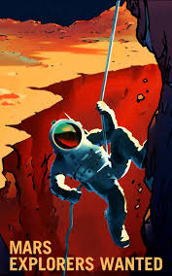


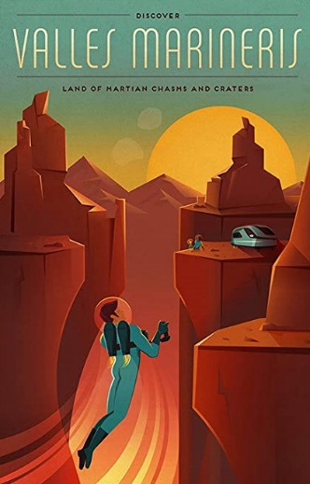


Ext.: Calling all astronauts!
You can’t build a community on Mars without other people, so the next job after designing your perfect work, is finding people to go with you!
Explore
Advertise (5-15 mins)
Create an advertisement that convinces people to join you on your one way journey to Mars. What might you need to say to make someone want to be a first settler?
Inspire
Have you ever wondered…?
Now’s your chance to…
Find
Discover
Notes:
Images:
1) iStock

Slide 34



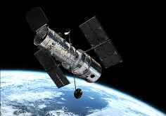

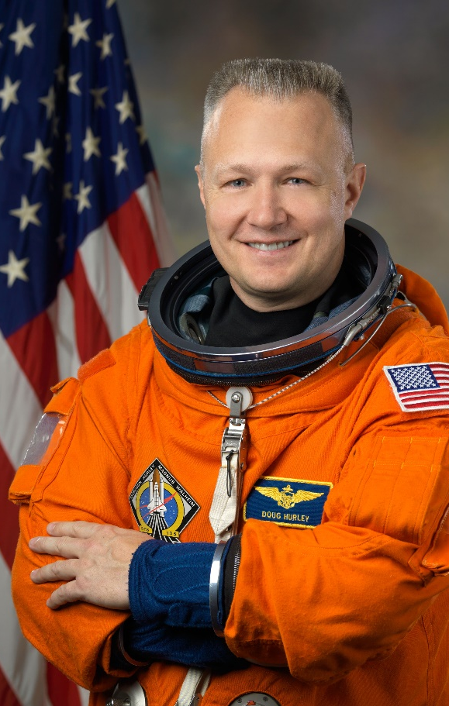
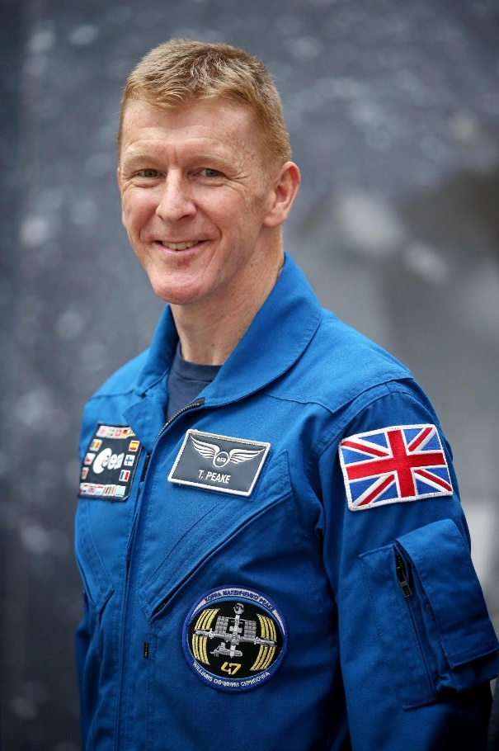
Career Launchpad!
Lean more… what did Hubble see on your birthday?
Hubble is a NASA telescope that explores the universe 24 hours a day, 7 days a week. That means it has observed some fascinating cosmic wonder every day of the year, including on your birthday.
What did Hubble look at on your birthday? Click the link then enter the month and date to find out!
0:00-3:46
0:00-8:11
Career Spotlight:
Sadly, we don’t know any astronauts personally, so we’ve left it to the experts this week instead…
Click the images to hear from NASA & ESA astronauts Doug Hurley and Tim Peake about the qualities you need to succeed in space and the career-defining challenges they faced.
https://safeshare.tv/x/ss5eb16f6cb9769
https://safeshare.tv/x/binIHBHrBcU
Notes:
Parents/Caregivers: Please click each image to watch the respective videos.
Alternative Audio Link – Doug Hurley Career Launchpad: https://www.youtube.com/watch?v=_ojzEqbMZBE
Alternative Audio Link – Tim Peake Career Launchpad: https://www.youtube.com/watch?v=binIHBHrBcU&feature=youtu.be&t=14 (0:14-8:25)
References:
Waterstones: https://www.waterstones.com/book/how-well-live-on-mars/stephen-petranek/9781471138881
NPR: https://www.npr.org/2018/12/21/678641696/stephen-petranek-how-will-humans-live-on-mars
Images:
https://www.youtube.com/watch?v=t9c7aheZxls

Slide 35
You can vote from home at… https://www.surveymonkey.co.uk/r/vfs-primary-mars
To have your voice heard!
If you have any issues, feedback or comments, email amy@votesforschools.com!
Notes:
Teacher’s Note: Please log your class’ vote the usual way!
Parent/Carer Note: The link provided allows your child to record their vote online. Find it here: https://www.surveymonkey.co.uk/r/vfs-primary-child-actors

