Slide 1

Article 32: “… If you work, you have the right to be safe and paid fairly.”

Slide 2




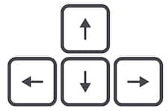

Learning from home?
Here are some ideas of how to get the most out of this lesson at home.
Ask an adult to arrange a video call so you can do some
of the activities with a friend.
Explore the topic with a parent or caregiver: how is their opinion
different to yours?
Teach a younger sibling or relative
about how
VotesforSchools works!
How to use this lesson…
Use these buttons to get the most out of your lesson.
Find this button in the bottom right of you screen to start your lesson.
Use the arrow keys to go forwards and backwards through your lesson.
To go back to your normal screen, press the esc key on your keyboard.
–
In the classroom?
Look out for these boxes to see how to make the most of the activities!
Parents’ & Carers’ Note:
Please see the Notes section below each slide for any further guidance.
Don’t forget to vote…
You can find the link to do this on the final slide. Get your whole household involved!
Notes:
Images:
https://icons8.com/

Slide 3



Feedback: “Do communities become stronger in a crisis?”
For many of you, this would’ve been your first topic at home! Do you remember it?
Keep your eyes peeled for next week’s feedback on “Can you learn more without a classroom?”
“People try to help around their community. Like for the NHS when they were looking for help, lots of people volunteered. This shows that communities become stronger during a crisis.”
Falcons School for Girls
Yes
“By panic buying in the shops people are not looking out for others in their community but simply looking after themselves.”
Woodcote Primary School
80.6%
No
19.4%
“Lots of people in the UK that are in flats are coming out onto their balconies to sing together and play music to support each other.”
Royal Alexander and Albert School
Whether you’re at home or school, make your voice heard by voting! You can find a link on the last slide of this lesson, or try searching for #VotesatHome on social media to see what others are saying!
Notes:
Parent/Carer note: This slide shows the feedback to the question pupils answered two weeks ago. Check back in two weeks to see if the comment you make at the end of this lesson is featured!
To record your child’s vote, use the survey link on the last slide or use the hashtag #VotesatHome on social media to browse other children’s responses and share your own.

Slide 4









Your top tips for home learning!
We also asked you for your top tips while learning at home. Here’s what you said:
“Get a piece of paper ready for every virtual lesson you do so you can keep a log of things and make the information stick in your mind.”
“Don’t stress your self out and make it as much fun as possible.”
“You could map out a school day at home and make a distraction-free room.”
“Before you do your work, tidy the room you are in so you don't get distracted.”
“Reading books, watching documentaries and getting outdoors.”
“Having a to do list has been really helpful, then ticking off as I go along. Believing that you can do it, even without the teacher.”
“PE lessons twice a day around studies is helping me concentrate.”
“Do family classes as they help you with your confidence.”
“Ask parents or brothers and sisters for help.”
Notes:
Parent/Carer Note: You can find more tips in this week’s Home Learning Guide, or why not print this slide for your child to have on their wall/in their learning space?

Slide 5


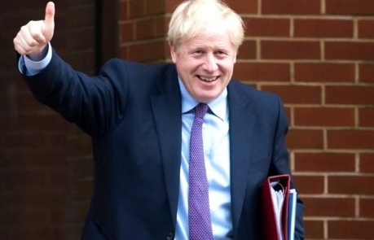
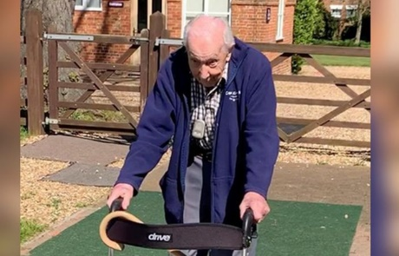




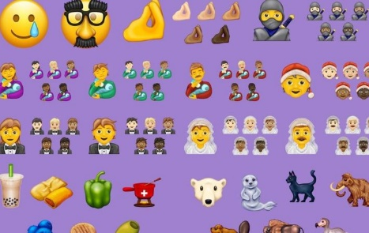
Be informed!
Here’s what’s been in the news this week...
Boris is back!
100 laps for 100th Birthday!
Prime Minister Boris Johnson has left hospital after being treated for COVID-19. He said a big thank you to the NHS.
99-year old Tom Moore has raised more than £12 million for the NHS by walking 100 laps of his garden – and he wants to do 100 more!
The Scouts have put together a list of 100 things you can do to beat boredom indoors. Click here to check them out.
The new emojis for 2020 have been announced, and there’s 117 of them! They’ll appear on your devices later this year.
Scouting out new activities?
Emojis incoming!
Notes:
Parent/Carer note: Use this slide to learn about headlines around the world.
Alternative link: Scouts list: https://www.scouts.org.uk/the-great-indoors/
Images/Stories:
https://www.bbc.co.uk/newsround/52260529
https://www.bbc.co.uk/newsround/52277760
https://www.bbc.co.uk/newsround/52227592
https://www.bbc.co.uk/newsround/51311527

Slide 6

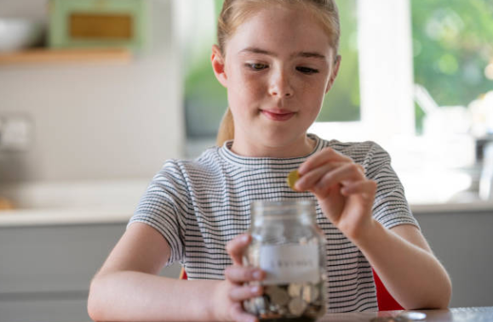


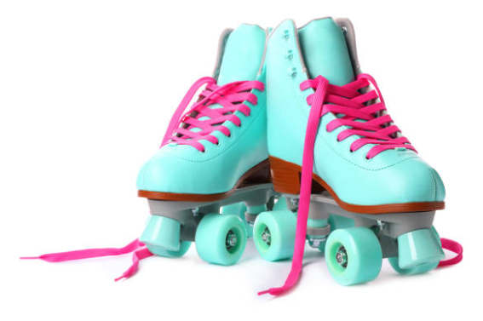

Starter: How long will it take?
Work it out (5 mins)
How many weeks would Ellie need to save up to buy each of these things?
Hint:
Use your times tables to help you!
Ellie earns £4 pocket money every week.
£3
£18
£25
£46
Challenge:
How much quicker could she buy these things if she earned £8 a week? Can you find an easy way to work it out?
Notes:
Parent/Carer Note: Throughout this lesson you will see activity bubbles like this. Each one has a dedicated time limit, allowing you to keep this lesson between 30 and 60 minutes long. Hint: for the challenge, encourage children to double instead of repeating the calculation.
Images:
iStock
https://www.amazon.co.uk/Cat-Hat-Green-Back-Seuss/dp/0007158440

Slide 7

Should young people earn pocket money?
Notes:
Parent/Carer note: Each week, your child completes this lesson in school before recording their vote on an online platform. Temporarily, we have created a platform you can use at home. Please see the last slide for details.
Images:
iStock

Slide 8
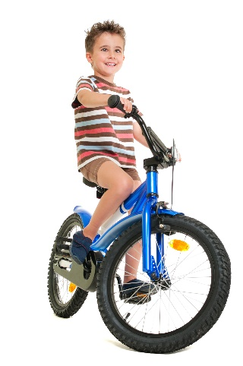



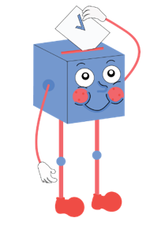
Starter: How long will it take?
Why are we talking about this?
What do you think?
How much should you earn?
Spend or save?
Vote!
Ext: Persuade me!
Notes:
Images:
iStock

Slide 9
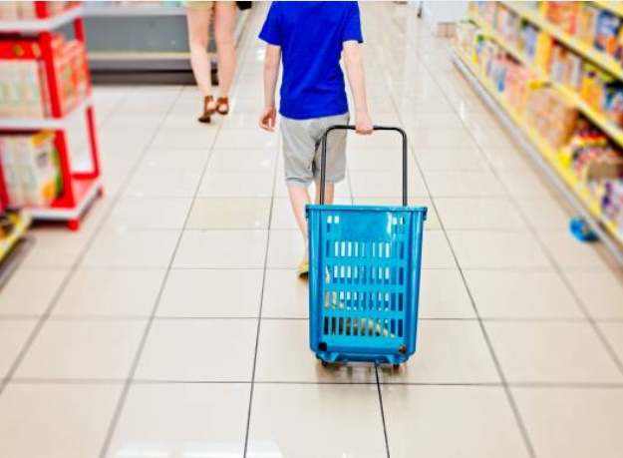
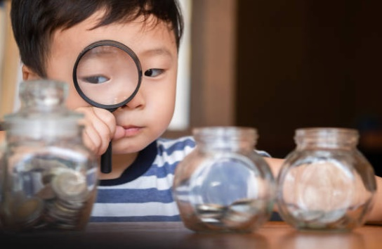
Why are we talking about this?
Whether you’re at home or at school right now, you’re probably being asked to help around the house. But should children be paid to do chores?
One study found that the more pocket money that parents and carers give to young people, the more that they would spend straight away.
However, the researchers also found that children who earned pocket money from a young age were more likely to look after their money and save some of it too!
This week, we’ll be asking you what you think. Remember to log your vote at the end of the lesson!
Notes:
Parent/Carer note: This slide provides context for the lesson this week.
References:
https://www.bbc.co.uk/newsround/22040003
Images:
1) iStock

Slide 10
Starter: How long will it take?
Why are we talking about this?
What do you think?
How much should you earn?
Spend or save?
Vote!
Ext: Persuade me!
Notes:
Images:
iStock

Slide 11


What do you think?
When it comes to pocket money, there are lots of opinions on whether young people should have it. But what do you think?
Challenge:
If you can, play with your class, a family member or a sibling. Do they always agree with you?
I agree!
I disagree!
Stand up, sit down!
(5-15 mins)
Read the arguments on the next few slides. If you agree with the statement, stand up. If you disagree, sit down!
Notes:
Parent/Carer Note: This activity allows children to explore the many different arguments and opinions for pocket money. If possible, involve the whole family and discuss differing opinions, encouraging children to explain their views.
Images:
iStock

Slide 12

What do you think?
Young people should do jobs at home to earn pocket money. They shouldn’t just be given it.
I agree!
I disagree!
Stand up, sit down!
If you agree with the statement, stand up. If you disagree, sit down!
Notes:
Parent/Carer Note: This activity allows children to explore the many different arguments and opinions for pocket money. If possible, involve the whole family and discuss differing opinions, encouraging children to explain their views.
Images:
1) iStock

Slide 13

What do you think?
Not every family can afford pocket money, so it isn’t fair that some children get it and others don’t.
I agree!
I disagree!
Stand up, sit down!
If you agree with the statement, stand up. If you disagree, sit down!
Notes:
Parent/Carer Note: This activity allows children to explore the many different arguments and opinions for pocket money. If possible, involve the whole family and discuss differing opinions, encouraging children to explain their views.
Images:
1) iStock

Slide 14

What do you think?
Earning pocket money teaches young people about money, and about how to save for things they really want.
I agree!
I disagree!
Stand up, sit down!
If you agree with the statement, stand up. If you disagree, sit down!
Notes:
Parent/Carer Note: This activity allows children to explore the many different arguments and opinions for pocket money. If possible, involve the whole family and discuss differing opinions, encouraging children to explain their views.
Images:
1) iStock

Slide 15

What do you think?
Young people shouldn’t be paid to do jobs. They should help their family without getting money for it.
I agree!
I disagree!
Stand up, sit down!
If you agree with the statement, stand up. If you disagree, sit down!
Notes:
Parent/Carer Note: This activity allows children to explore the many different arguments and opinions for pocket money. If possible, involve the whole family and discuss differing opinions, encouraging children to explain their views.
Images:
1) iStock

Slide 16

What do you think?
Young people will only waste the money they are given. It’s better to buy them the things they need than to give them money.
I agree!
I disagree!
Stand up, sit down!
If you agree with the statement, stand up. If you disagree, sit down!
Notes:
Parent/Carer Note: This activity allows children to explore the many different arguments and opinions for pocket money. If possible, involve the whole family and discuss differing opinions, encouraging children to explain their views.
Images:
1) iStock

Slide 17

What do you think?
Parents and carers already buy things for children. They shouldn’t give them money as well.
I agree!
I disagree!
Stand up, sit down!
If you agree with the statement, stand up. If you disagree, sit down!
Notes:
Parent/Carer Note: This activity allows children to explore the many different arguments and opinions for pocket money. If possible, involve the whole family and discuss differing opinions, encouraging children to explain their views.
Images:
1) iStock

Slide 18
Starter: How long will it take?
Why are we talking about this?
What do you think?
How much should you earn?
Spend or save?
Vote!
Ext: Persuade me!
Notes:
Images:
iStock

Slide 19





How much should you earn?
I think that…
Lots of parents do decide to give their child pocket money, but how much is the right amount?
I’m thinking of a number…
(1-2 mins)
Think carefully about the amount of pocket money you would like to have. Write the number down on a piece of paper. Don’t show it to anybody yet!
The perfect amount is…
Young people should get at least…
Same or different? (2-3 mins)
On the count of three, share your answer with your class or the person you are working with. Is their number the same? Why/why not?
I chose this amount because…
I agree/disagree because…
Notes:
Parent/Carer Note: By hearing each other’s different amounts, children have the opportunity to form a balanced view on a suitable amount of pocket money.

Slide 20
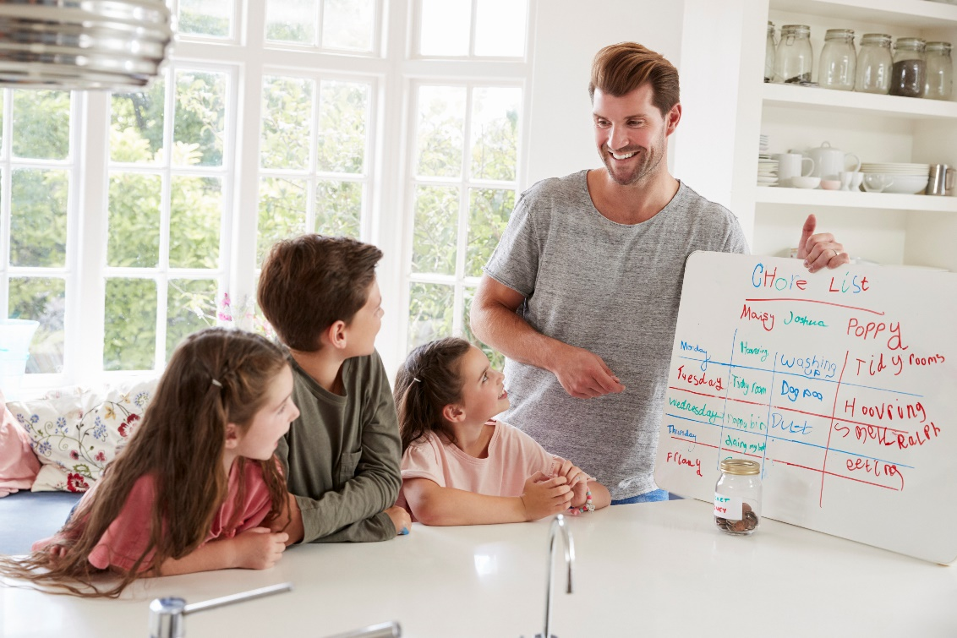
How much should you earn?
If your parent or carer decides to give you pocket money, it is important to decide an amount that you both agree on.
One way that families choose to do this is by creating a list of chores that they would like young people to do, and pay their children for each of these jobs.
Opinion (2 mins)
What do think about this idea? Do you already do it or would you like to? Why or why not?
Challenge:
Try to think of both sides of the argument!
In the classroom?
Discuss your ideas as a group. What positives and negatives can you think of for this method?
Notes:
Parent/Carer Note: Many parents and guardians are using pocket money to incentivise school work and chores at the moment. This activity encourages children to think about the different ways they can help at home.

Slide 21
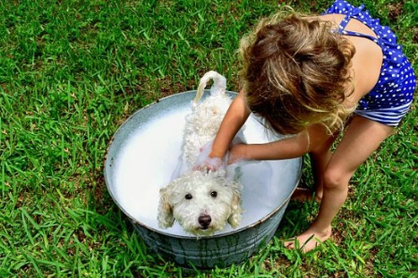



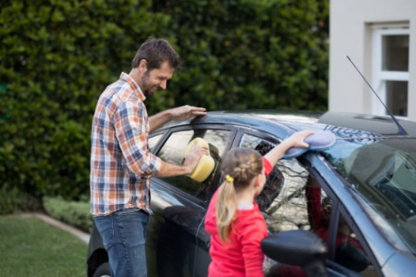
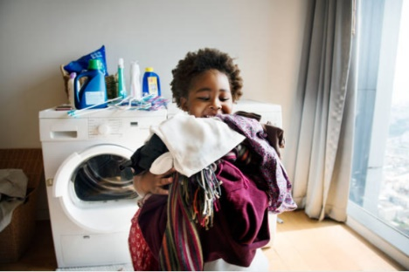
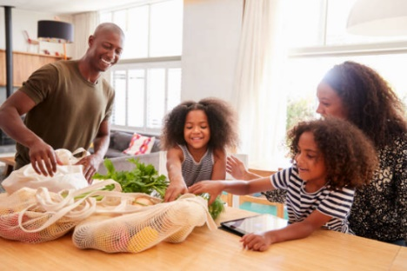
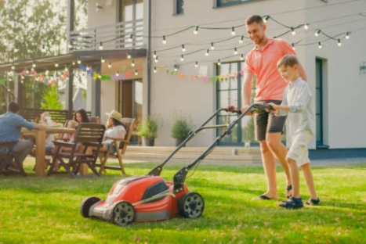
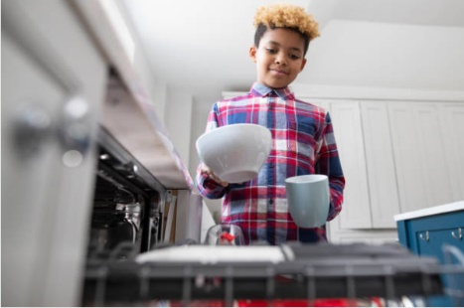
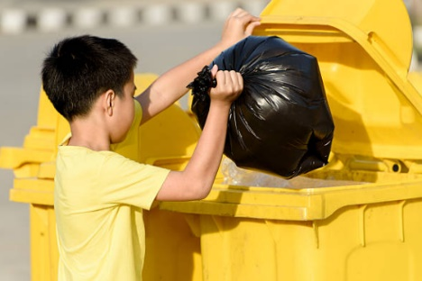
How much should you earn?
Make a list (5-10 mins)
Make a list of all of the jobs that you could do in your house. Then, decide on a price that you think is right for that job. Use the pictures to help you!
Bathing pets
Cleaning
Remember:
Think carefully about your prices. An adult won’t pay if they’re too high, and children won’t want to do them if they’re too low!
Cleaning cars
Washing
Tidying up
Gardening
Washing up
Emptying bins
Notes:
Parent/Carer Note: You may wish to add your own household jobs to this list to suit it to your house.

Slide 22

How much should you earn?
Not all families want to give pocket money to all of their children, so they sometimes choose to earn different things instead.
Our family jobs list:
Help make dinner: 5 minutes screen time
For example, children might earn extra time on their games consoles, or an ice cream at the end of the week.
Put washing away: an extra snack
Help tidy up: choose a family movie
Add to your list
(5-10 mins)
Add a new column to your jobs list. What could you earn instead of money for each job? Click for an example!
Hoover the stairs: chips for dinner
Wash a car: go to the park for an hour
Challenge:
Would you prefer to earn money or treats for doing chores?
Notes:
Parent/Carer Note: We are aware that many families cannot or do not wish to give pocket money. This activity encourages children to think of different ways that can be rewarded for being helpful.

Slide 23
Starter: How long will it take?
Why are we talking about this?
What do you think?
How much should you earn?
Spend or save?
Vote!
Ext: Persuade me!
Notes:
Images:
iStock

Slide 24
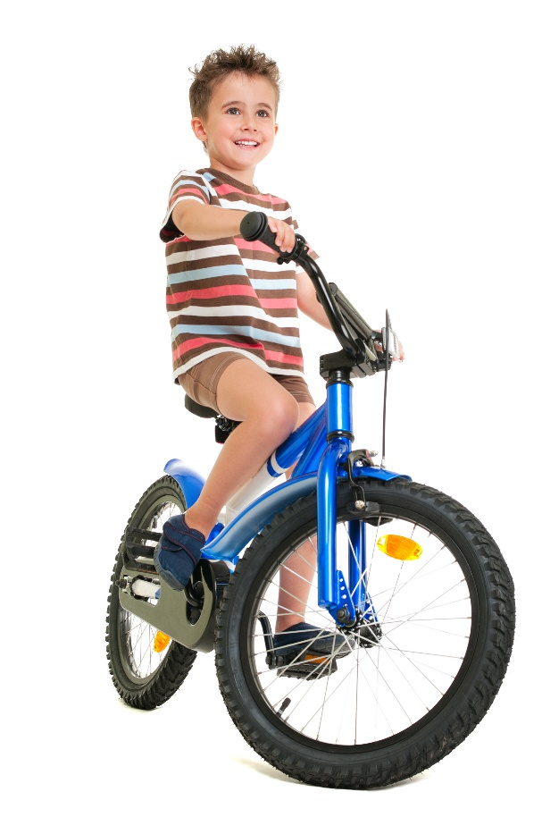



Spend or save?
Spend or save? (5-10 mins)
On the next few slides, can you help these young people decide whether to spend or save their money?
Challenge:
If you have time, make your own scenarios! Try to make them as tricky as you can before testing them on a friend or family member.
Notes:
Parent/Carer Note: Having pocket money has been shown to teach children about budgeting. This activity asks them to think about what they would do in different situations, particularly when considering giving to others. To extend this activity, discuss each scenario with your child, making a balanced argument for each.

Slide 25

Spend or save?
Benas likes to ride his bike over to the park every day. He’s seen some stickers for £2 that will make his bike look amazing!
But it is Benas’ dad’s birthday next week and he’s seen a tie that his dad would like for £5. He’s doesn’t know what he should do.
Spend or save?
Should Benas spend or save his money? Why?
Name:
Benas
Challenge:
How many more weeks will he need to save for a tie?
Weekly pocket money:
£6
Money saved:
£4
Notes:
Parent/Carer Note: Having pocket money has been shown to teach children about budgeting. This activity asks them to think about what they would do in different situations, particularly when considering giving to others. To extend this activity, discuss each scenario with your child, making a balanced argument for each.

Slide 26

Spend or save?
Camilla loves to draw. She’s good at drawing animals, but she finds drawing people really hard. She’s had her pencils for a long time too, and lots are too short to sharpen.
She’s not sure if she should buy a book that will teach her how to draw people better for £6, or whether she should save up for a new pencil set for £15.
Spend or save?
Should Camilla spend or save her money? Why?
Name:
Camilla
Challenge:
How many more weeks will she need to save for a pencil set?
Weekly pocket money:
£3
Money saved:
£9
Notes:
Parent/Carer Note: Having pocket money has been shown to teach children about budgeting. This activity asks them to think about what they would do in different situations, particularly when considering giving to others. To extend this activity, discuss each scenario with your child, making a balanced argument for each.

Slide 27

Spend or save?
Jackson likes gaming. For his birthday he got a PS4, but he only has one controller, so he can’t play with his brother.
He could buy another controller for £45, but his best friend has got a VR headset for £100 and it looks really good. He’s not sure what to do.
Spend or save?
Should Jackson spend or save his money? Why?
Name:
Jackson
Challenge:
How many more weeks will he need to save for a VR set?
Weekly pocket money:
£5
Money saved:
£50
Notes:
Parent/Carer Note: Having pocket money has been shown to teach children about budgeting. This activity asks them to think about what they would do in different situations, particularly when considering giving to others. To extend this activity, discuss each scenario with your child, making a balanced argument for each.

Slide 28

Spend or save?
Aisha uses her laptop to complete her school work at home, but it is slow and often crashes. If Aisha saves £100 her mum said she will help her to buy a new laptop.
Aisha also really likes science, and she’s seen a science experiment kit for £20. She could get the science kit now and have lots of fun, or save for a new laptop.
Spend or save?
Should Aisha spend or save her money? Why?
Name:
Aisha
Challenge:
How many more weeks will she need to save for a laptop?
Weekly pocket money:
£10
Money saved:
£35
Notes:
Parent/Carer Note: Having pocket money has been shown to teach children about budgeting. This activity asks them to think about what they would do in different situations, particularly when considering giving to others. To extend this activity, discuss each scenario with your child, making a balanced argument for each.

Slide 29
Starter: How long will it take?
Why are we talking about this?
What do you think?
How much should you earn?
Spend or save?
Vote!
Ext: Persuade me!
Notes:
Images:
iStock

Slide 30
Should young people earn pocket money?
Earning pocket money teaches young people how to manage money and how to save for things they really want.
Doing jobs or chores to earn pocket money makes children more helpful and responsible.
Being able to save up for something that you really want makes you feel good and understand the value of money.
…
Children should help out with jobs and chores at around the house anyway – they shouldn’t have to be paid to do it.
Some families might not be able to give their children pocket money. We should earn treats instead.
Adults know what’s best for their children and will buy them things they really need. Young people will just waste the money.
…
Notes:
Parent/Carer Note: Use this slide to review the arguments before voting.

Slide 31
Starter: How long will it take?
Why are we talking about this?
What do you think?
How much should you earn?
Spend or save?
Vote!
Ext: Persuade me!
Notes:
Images:
iStock

Slide 32






Ext.: Persuade me!
Would you like pocket money? Or perhaps you’d like to earn treats instead? You might even already get pocket money but want to earn more for your jobs.
Write a speech (5-30 minutes)
Whatever it is that you would like, why not write a speech to persuade your parents or carers? Use these sentence starters to help you.
It important because…
Experts have found that…
Doing this will help me to…
You might think… however…
If you agree, I will…
We’d love to read or hear your speeches!
Ask an adult to tweet them using this hashtag!
Notes:
Parent/Carer Note: This is an Extension activity, suitable for families who wish to take this lesson further and focus on persuasive writing skills.

Slide 33
You can vote from home at… https://www.surveymonkey.co.uk/r/vfs-primary-money
To have your voice heard!
If you have any issues, feedback or comments, email amy@votesforschools.com!
Notes:
Teacher’s Note: Please log your class’ vote the usual way!
Parent/Carer Note: The link provided allows your child to record their vote online. Find it here: https://www.surveymonkey.co.uk/r/X7MXYVB

