Slide 1

Article 29: “Your education should help you use and develop your talents and abilities..."

Slide 2




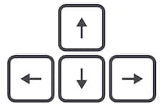

Learning from home?
Here are some ideas of how to get the most out of this lesson at home.
Ask an adult to arrange a video call so you can do some
of the activities with a friend.
Explore the topic with a parent or caregiver: how is their opinion
different to yours?
Teach a younger sibling or relative
about how
VotesforSchools works!
How to use this lesson…
Use these buttons to get the most out of your lesson.
Find this button in the bottom right of you screen to start your lesson.
Use the arrow keys to go forwards and backwards through your lesson.
To go back to your normal screen, press the esc key on your keyboard.
–
In the classroom?
Look out for these boxes to see how to make the most of the activities!
Parents’ & Carers’ Note:
Please see the Notes section below each slide for any further guidance.
Don’t forget to vote…
You can find the link to do this on the final slide. Get your whole household involved!
Notes:
Images:
https://icons8.com/

Slide 3







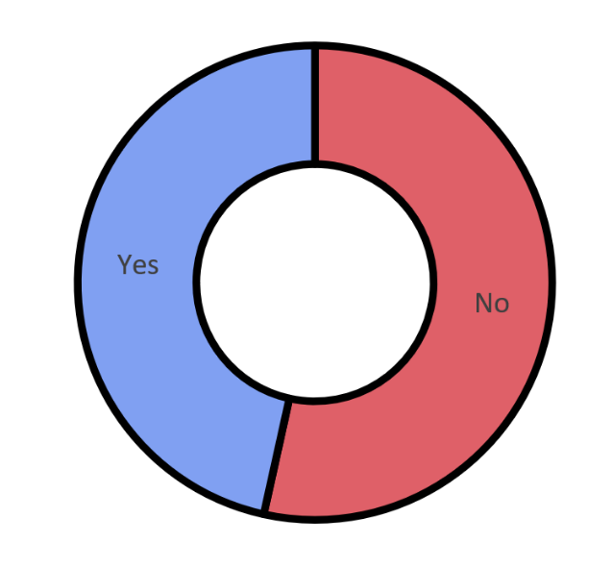






Feedback: “Should petrol & diesel cars be banned?”
“Which is more important: the environment or cars? If we want to save the environment then we need to take it one step at a time, and we can start with banning petrol & diesel cars.”
“I think that …. only diesel cars should be banned because it makes more pollution than petrol.”
55%
“I worry about people being run over because they can't hear the cars.”
45%
“I believe that banning petrol and diesel cars is a step in the right direction towards being carbon neutral, however the alternative (electric cars) aren't always affordable or practical, and we would also need to ensure that the electricity they run on is sustainably sourced.”
In the classroom?
Ask your teacher to record your votes at www.votesforschools.com!
At home?
Follow the link on the last slide to record your vote from home!
Notes:
Parent/Carer note: This slide shows the feedback to the question pupils answered two weeks ago. Check back in two weeks to see if the comment you make at the end of this lesson is featured!

Slide 4









Be informed!
Here’s what’s been in the news this week...
A message from the Doctor…
Australian koalas released into wild
Jodie Whittaker (a.k.a. The Doctor) has sent a message to all humans. Click the image to hear what she had to say!
Four koalas and one joey (a young kangaroo) that were rescued during the bushfires have returned to Australia's Blue Mountains.
After a long wait, Disney+ launched in the UK last week. The service costs £5.99 a month for all your Disney needs while you’re indoors.
Argentina might be on lockdown, but the President said that tooth fairies are key workers and can still go to work!
At home? Watch Disney!
Tooth fairy is a “key worker”
Notes:
Parent/Carer note: Use this slide to learn about headlines around the world.
Images/Stories:
https://www.bbc.co.uk/newsround/52038051
https://www.bbc.co.uk/newsround/52022945
https://www.bbc.co.uk/newsround/52005764
https://www.bbc.co.uk/newsround/52005728

Slide 5







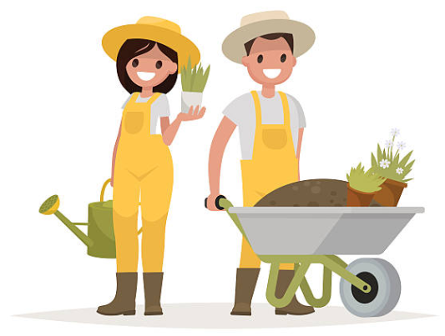
Starter: What have you learned today?
Think about it (2-3 mins)
Make a list of all of the things that you have learned today. How many can you think of?
Compare it (1-2 mins)
Now make a list of all of the things you would’ve learned today if you were in school. Which list has more?
In the classroom?
Make a list of all the things you think you would’ve learned at school instead!
Notes:
Parent/Carer note: Throughout this lesson you will see activity bubbles like this. Each one has a dedicated time limit, allowing you to keep this lesson between 30 and 60 minutes long.
Images:
iStock

Slide 6

Can you learn more without a classroom?
Notes:
Parent/Carer note: Each week, your child completes this lesson in school before recording their vote on an online platform. Temporarily, we have created a platform you can use at home. Please see the last slide for details.
Images:
iStock

Slide 7





Starter: What have you learned today?
Why are we talking about this?
Where do you learn best?
Learning elsewhere
Help! I’m not learning!
Vote!
Ext: An interview with…
Notes:
Images:
iStock

Slide 8

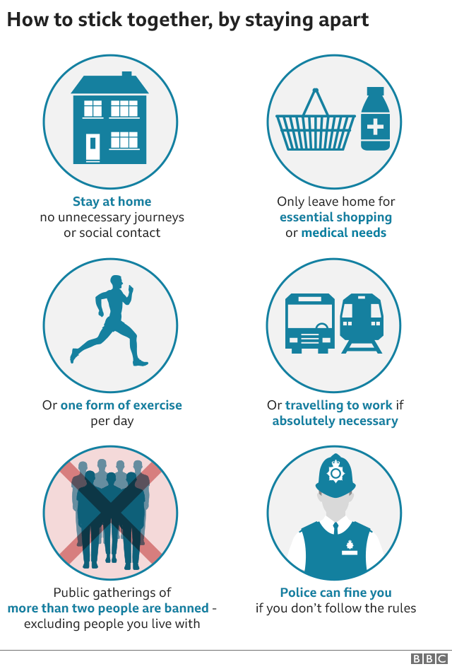
Why are we talking about this?
Last Monday, Prime Minister Boris Johnson told everyone in the UK that they must stay at home for at least 21 days.
0:00-2:12
There are only four reasons that people are allowed to leave their houses. Click the image to see the speech.
To exercise once a day
To help an older person
To buy food and medicine
To travel to work*
He also said that people must stand 2 metres away from each other. If some one does not follow this rule, they can be fined up to £1,000 by the police.
This means that lots of children all around the UK are learning from home…
But where do you learn more?
Notes:
*This is only if they cannot work from home!
Parent/Carer note: For older children, click on the image of Boris Johnson to hear a clip of his speech outlining the current rules for the UK (televised on Monday 23rd March 2020).
Alternative video link: https://www.youtube.com/watch?v=Haaq59UpINI (1:36-3:47)
Images:
https://www.bbc.co.uk/news/uk-52014472

Slide 9
Starter: What have you learned today?
Why are we talking about this?
Where do you learn best?
Learning elsewhere
Help! I’m not learning!
Vote!
Ext: An interview with…
Notes:
Images:
iStock

Slide 10


Where do you learn best?
If you are learning from home right now, you might be finding it really difficult, or you might be preferring it to being in school…
Every person is different. This is why we all like different things, and the same applies to the different ways we prefer to learn too!
Where do you learn best? (3-5 mins)
On the next few slides, finish the sentence using one of the answers that you see. For each one, write down whether you chose a red answer or a blue answer.
In the classroom?
Raise your left hand if you think the blue statement is true for you, raise your right hand if you think red is right!
Notes:
Parent/Carer note: This activity is suitable for children and adults of all ages, and could be a good opportunity to discuss the different preferences in your family.
Images:
iStock

Slide 11



Where do you learn best?
I learn better when…
Or?
I am with my friends!
I am on my own!
Challenge:
Ask someone in your home or class the question. Are your answers the same or different?
Notes:
Parent/Carer note: This activity is suitable for children and adults of all ages, and could be a good opportunity to discuss the different preferences in your family.
Images:
iStock

Slide 12



Where do you learn best?
I learn better when…
Or?
I ask the teacher questions!
I work the answer out by myself!
Challenge:
Ask someone in your home or class the question. Are your answers the same or different?
Notes:
Parent/Carer note: This activity is suitable for children and adults of all ages, and could be a good opportunity to discuss the different preferences in your family.
Images:
iStock

Slide 13


Where do you learn best?
I learn better when…
Or?
It is noisy!
It is silent!
Challenge:
Ask someone in your home or class the question. Are your answers the same or different?
Notes:
Parent/Carer note: This activity is suitable for children and adults of all ages, and could be a good opportunity to discuss the different preferences in your family.
Images:
iStock

Slide 14
Where do you learn best?
Your result! (1 min)
Count up how many blue and red answers you have. What type of learner does this make you? Do you agree with the result? Why/why not?
If you got mostly blues, you might prefer learning in class!
If you got mostly reds, you might prefer learning at home!
Challenge:
Do you always prefer to learn this way, or are there times that you prefer being in class or being alone?
Notes:
Parent/Carer note: This activity is suitable for children and adults of all ages, and could be a good opportunity to discuss the different preferences in your family.
Images:
iStock

Slide 15
Starter: What have you learned today?
Why are we talking about this?
Where do you learn best?
Learning elsewhere
Help! I’m not learning!
Vote!
Ext: An interview with…
Notes:
Images:
iStock

Slide 16




Learning elsewhere
While some learning might be easier in the classroom, lots of learning still takes place elsewhere! For example:
In the garden you could learn…
Geography
Learning about the weather & climate
Science
Growing plants or spotting animals
Physical Education
Exercising and playing games
What can you learn?
(5-10 mins)
Look at the different places on the next few slides. On a piece of paper, write down all the subjects and skills that you could learn in that place.
Challenge:
Can you link every school subject to one place?
In the classroom?
Share your ideas with your group.
Notes:
Parent/Carer note: It would be helpful to work through this activity with your child, being as creative as possible. You could even come up with activities you would like to do at home.
Images:
iStock

Slide 17








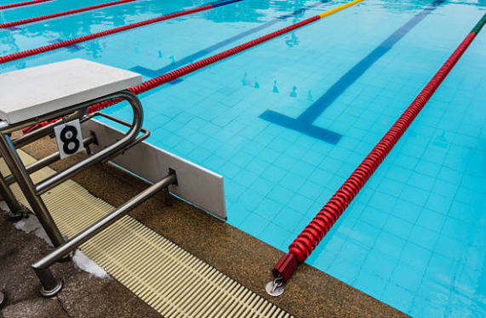



Learning elsewhere
English
How many subjects can you learn in each of these places?
Challenge:
Can you link every school subject to one place?
Maths
Geography
History
Religious Education (RE)
PSHE
Science
Museums
Kitchen
Physical Education (PE)
Modern Languages
Art
Music
Local area
Sports venues
Notes:
Parent/Carer note: It would be helpful to work through this activity with your child, being as creative as possible. You could even come up with activities you would like to do at home.
Images:
iStock

Slide 18









Learning elsewhere
Got skills? (5-10 mins)
Take a look at the different places again. How many of these skills could you learn at each one?
School subjects are important, but there are also many other skills that you need to learn as you grown up.
Setting your own goals & being resilient
Garden
Kitchen
Teamwork
Dealing with stress
Museums
Sports venues
Challenge:
Are these skills learnt better inside or outside the classroom?
Speaking & listening skills
Punctuality (being on time)
Local area
Notes:
Parent/Carer note: This activity is better suited to children 9+. You may wish to skip this slide if your child is finding it difficult.
Images:
iStock

Slide 19
Starter: What have you learned today?
Why are we talking about this?
Where do you learn best?
Learning elsewhere
Help! I’m not learning!
Vote!
Ext: An interview with…
Notes:
Images:
iStock

Slide 20





Help! I’m not learning!
Whether you’re in school or at home, we all find learning difficult sometimes.
This could be because we’re feeling stressed, sad, anxious, distracted or even excited!
All of these feelings are normal, and there are lots of ways to help you manage these feelings and continue to learn.
Can you help? (5-15 mins)
Take a look at some of the problems different children across the country are facing in school or at home. What advice can you give them?
Can’t think of any advice?
Click again to see some advice from VotesforSchools!
Notes:
Parent/Carer note: This activity encourages children to think about the struggles that they may be facing both in school or at home at the moment. Use full screen view to utilise the animations.
Images:
1) iStock

Slide 21

Help! I’m not learning!
I’m learning from home, but I can’t concentrate on my work. Every time I try to work, I get distracted by YouTube or toys in my room. Can you help?
What advice would you give?
If this happens to you, why not write a list of three things you want to get done. Once you’ve finished all three things, have a short break to play with your toys before writing another list!
Challenge:
Write all of your advice down on a piece of paper. Could you make an advice poster for yourself and others?
Notes:
Parent/Carer note: This activity encourages children to think about the struggles that they may be facing both in school or at home at the moment. Use full screen view to utilise the animations.
Images:
1) iStock

Slide 22

Help! I’m not learning!
I’m learning at school but I miss all of my friends. I’m really worried about my mum too, as she is still going to work. Please help!
What advice would you give?
It’s normal to feel worried and sad at the moment, especially when you can’t see your friends or family. It’s important that you let somebody know how you are feeling: why not call or text someone and talk about it?
Challenge:
Write all of your advice down on a piece of paper. Could you make an advice poster for yourself and others?
Notes:
Parent/Carer note: This activity encourages children to think about the struggles that they may be facing both in school or at home at the moment. Use full screen view to utilise the animations.
Images:
1) iStock

Slide 23

Help! I’m not learning!
Me and my sister are both learning from home, but we only have one computer. My Dad says we have to share it, but I can’t do all of my work in time! Help me!
What advice would you give?
This is a tricky situation, but try not to get frustrated! You should tell your teacher about your situation, then try to find ways to keep learning without your computer. You could even work together to get the work done!
Challenge:
Write all of your advice down on a piece of paper. Could you make an advice poster for yourself and others?
Notes:
Parent/Carer note: This activity encourages children to think about the struggles that they may be facing both in school or at home at the moment. Use full screen view to utilise the animations.
Images:
1) iStock

Slide 24

Help! I’m not learning!
I’m learning from home and I don’t know where to start. My teacher has set me lots of work, and I’ve done the lessons that I like, but not the others. Help!
What advice would you give?
Being in charge of your own learning can be overwhelming. The best thing to do is to make yourself a timetable of which subjects you will learn each day. This way, you can spread out your favourites and get everything done.
Challenge:
Write all of your advice down on a piece of paper. Could you make an advice poster for yourself and others?
Notes:
Parent/Carer note: This activity encourages children to think about the struggles that they may be facing both in school or at home at the moment. Use full screen view to utilise the animations.
Images:
1) iStock

Slide 25

Help! I’m not learning!
I’m learning at school and I am in a mixed class with people I don’t know. Lots of younger children need help so I am finding it hard to get my own work done. What should I do?
What advice would you give?
Learning with new people can be unsettling, but it is a great chance to make new friends! If you’re struggling to complete your work while helping others, let your teacher know so that they can help you too.
Challenge:
Write all of your advice down on a piece of paper. Could you make an advice poster for yourself and others?
Notes:
Parent/Carer note: This activity encourages children to think about the struggles that they may be facing both in school or at home at the moment. Use full screen view to utilise the animations.
Images:
1) iStock

Slide 26

Help! I’m not learning!
I’m learning from home but my Mum and Dad have to work all day and can’t help me. I keep getting stuck on questions and don’t know what to do.
What advice would you give?
Challenge:
Write all of your advice down on a piece of paper. Could you make an advice poster for yourself and others?
Learning independently can be hard when you don’t know who to ask for help. If you can, call a classmate and ask if you can do your lessons together. The more friends you can call, the more help you will get!
Notes:
Parent/Carer note: This activity encourages children to think about the struggles that they may be facing both in school or at home at the moment. Use full screen view to utilise the animations.
Images:
1) iStock

Slide 27
Starter: What have you learned today?
Why are we talking about this?
Where do you learn best?
Learning elsewhere
Help! I’m not learning!
Vote!
Ext: An interview with…
Notes:
Images:
iStock

Slide 28
Can you learn more without a classroom?
We can learn new things everywhere!
If I’m at home, my family and friends can help me if I’m finding it difficult.
As well as school subjects, there are lots of skills that can be learned without a classroom.
It’s harder, but I can do it!
…
I find it easier to learn when I’m in a classroom.
In a classroom, a teacher can help you and answer your questions.
When I’m at home, there are a lot more distractions because I have all my toys and gadgets.
It’s too hard, I can’t do it!
…
Notes:
Parent/Carer note: Use this slide to review the arguments before voting.

Slide 29
Starter: What have you learned today?
Why are we talking about this?
Where do you learn best?
Learning elsewhere
Help! I’m not learning!
Vote!
Ext: An interview with…
Notes:
Images:
iStock

Slide 30


Ext.: An interview with…
Teacher’s Note:
Skip if short on time.
School Interview!
Interview! (3-5 mins)
Find someone in your house, like a parent or older brother/sister and interview them about when they were at school!
Where did you go to school?
Did you enjoy school?
What was your favourite subject?
What was your least favourite subject?
Who was your best friend?
Challenge:
Can you add two questions of your own to ask them?
Where and how do you learn best?
Where…?
Why…?
In the classroom?
Interview different classmates or even your teacher!
Who…?
When…?
How…?
What…?
Notes:
Parent/Carer note: If you have time, use this slide to continue the debate and get the whole family involved.
Images:
iStock

Slide 31
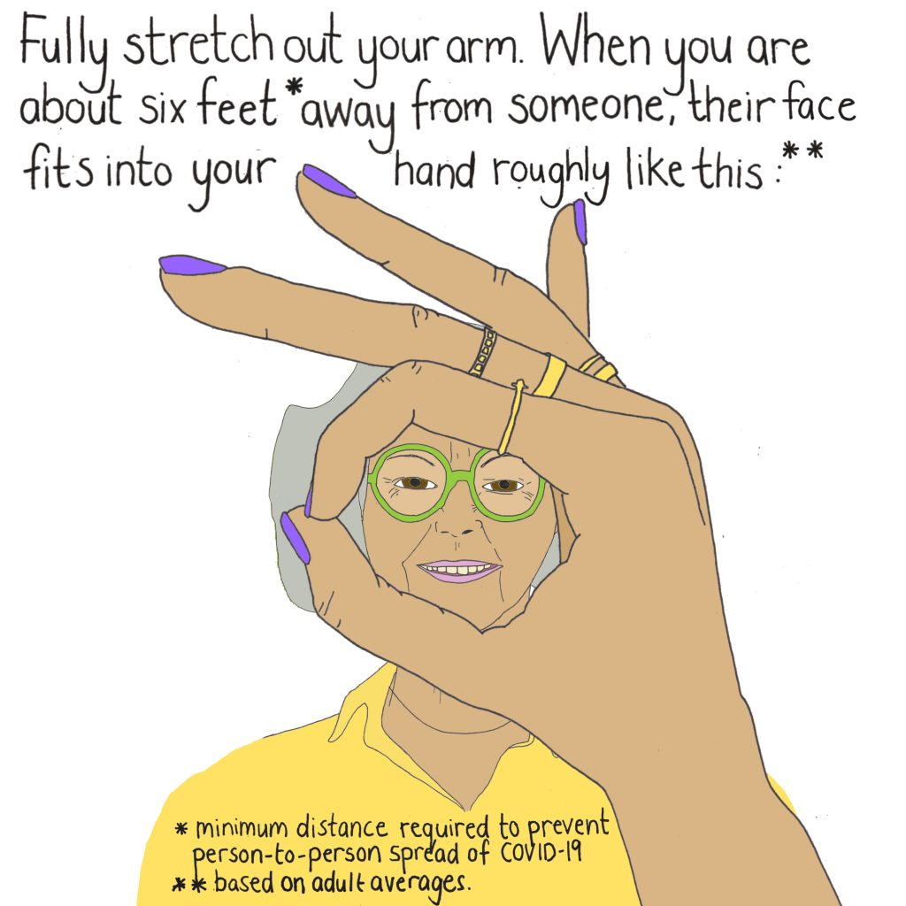
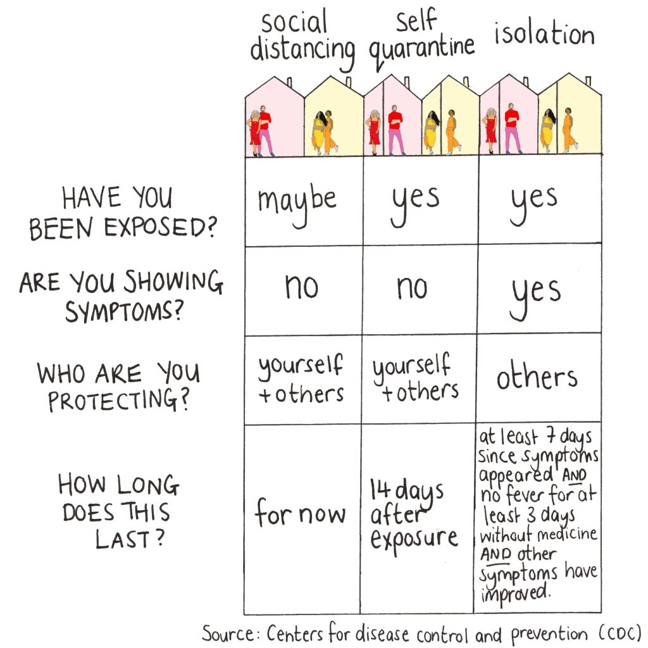


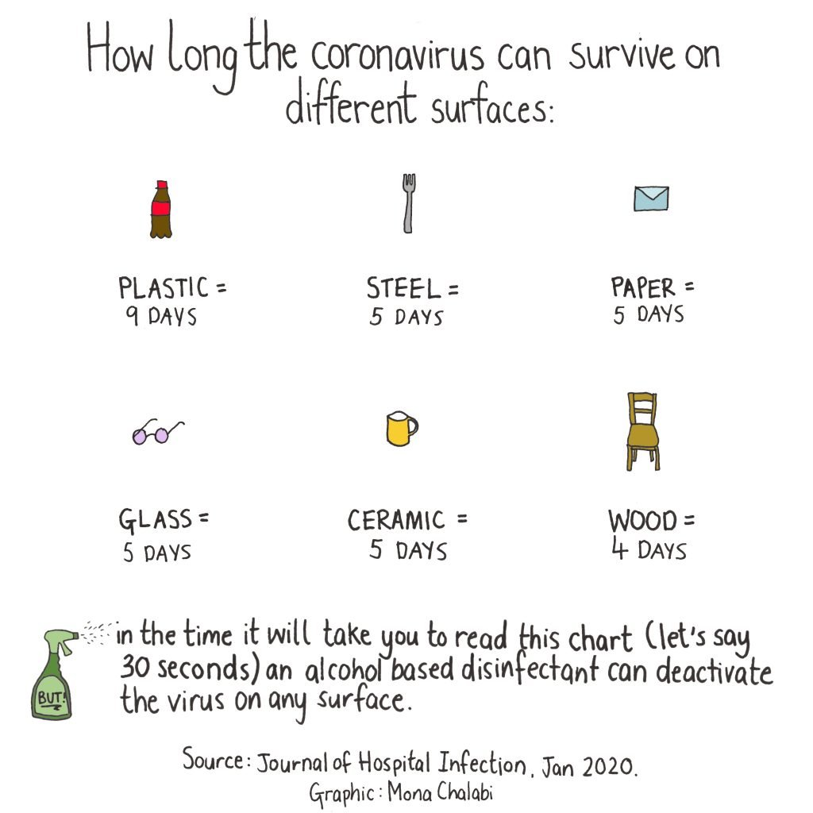


Career Launchpad!
Learn more: Pictures by numbers
Mona Chalabi is a Data Journalist, meaning she makes numbers & statistics into pictures! She has recently been making lots of content about what to do during the Coronavirus outbreak. Why not check out her website¹ to see if you learn something new that you can share with others?
0:00-2:51
Career Spotlight:
This is Kate. She founded VotesforSchools and is our Director of Education.
Click the image to hear more about making the most of the lessons when you are not in the classroom – she includes some advice for parents, caregivers & teachers too!
https://safeshare.tv/x/ehWVpq4iVbU
Notes:
Parents/Caregivers:
Please click the images to visit Mona Chalabi’s website, or click the image of Kate to watch the video. If the video link doesn’t work, please try the alternative below.
Alternative Video Link: https://www.youtube.com/watch?v=dMUY0NID2L0
References:
https://monachalabi.com/
Images:
https://monachalabi.com/projects/data-visualisation/#covid-19
Courtesy of Kate

Slide 32
You can vote from home at… https://www.surveymonkey.co.uk/r/V9LNNDS
To have your voice heard!
If you have any issues, feedback or comments, email amy@votesforschools.com!
Notes:
Teacher’s note: Please log your class’ vote the usual way!
Parent/Carer note: The link provided allows your child to record their vote online.

