Slide 1
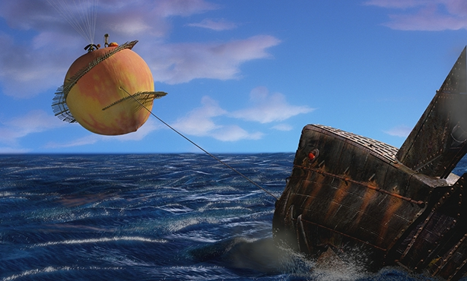
What is happening in this picture?

Slide 2
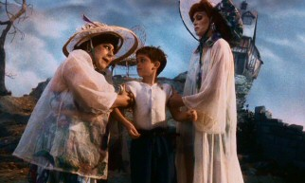
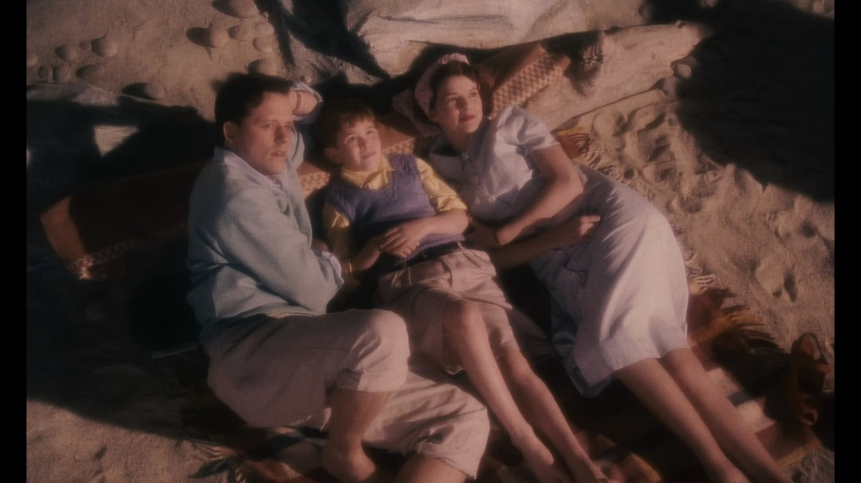
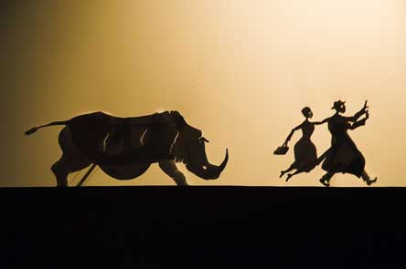
Once upon a time, there was a little boy called James. James’ parents had been killed by an angry rhinoceros so James was forced to go and live with his two, mean aunties who made him do all the housework!

Slide 3
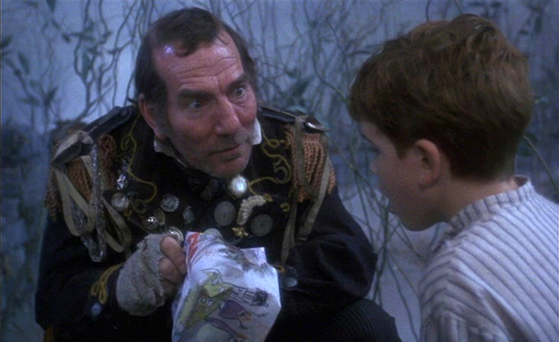
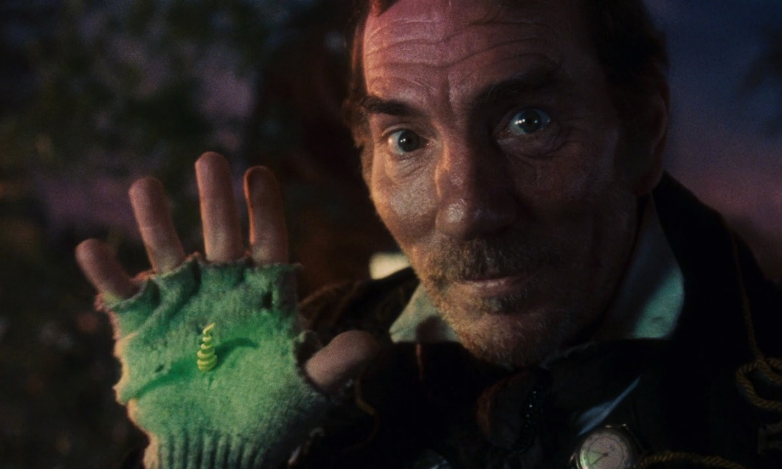
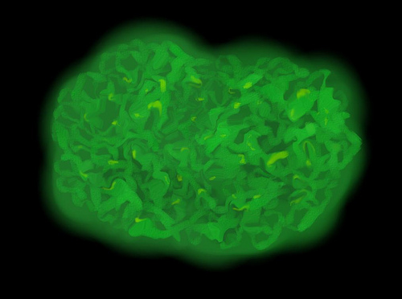
But one day, a man gave James some green bugs and told him they were magic.

Slide 4
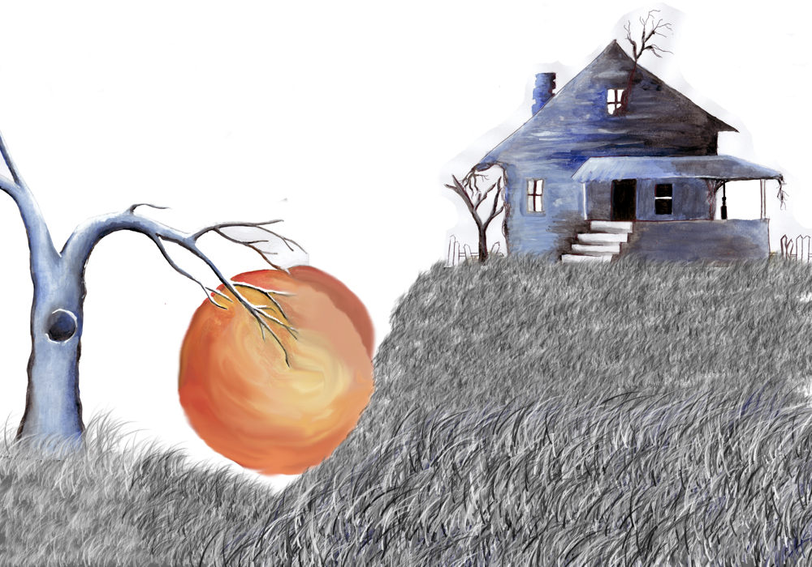
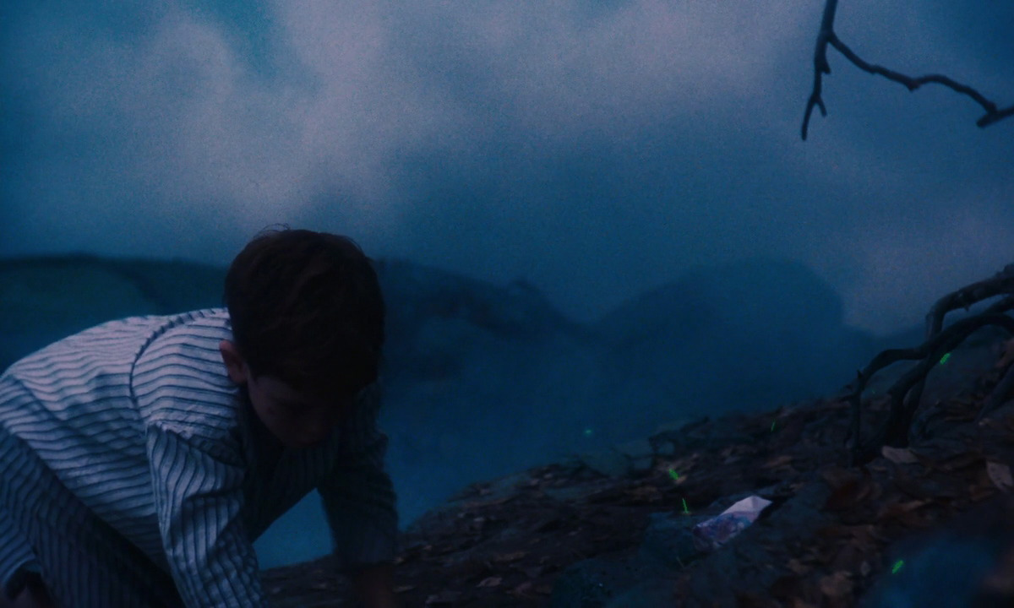
On the way home, James accidentally dropped the bugs into the garden and was very sad.
The next day, he woke up and a giant peach had grown overnight!

Slide 5
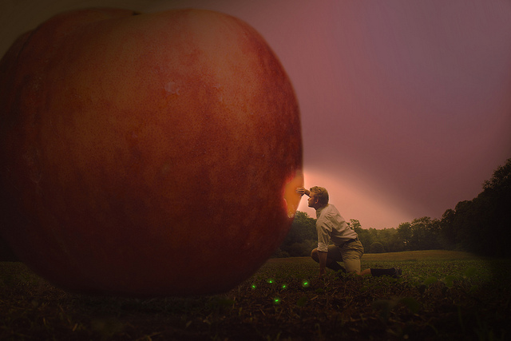
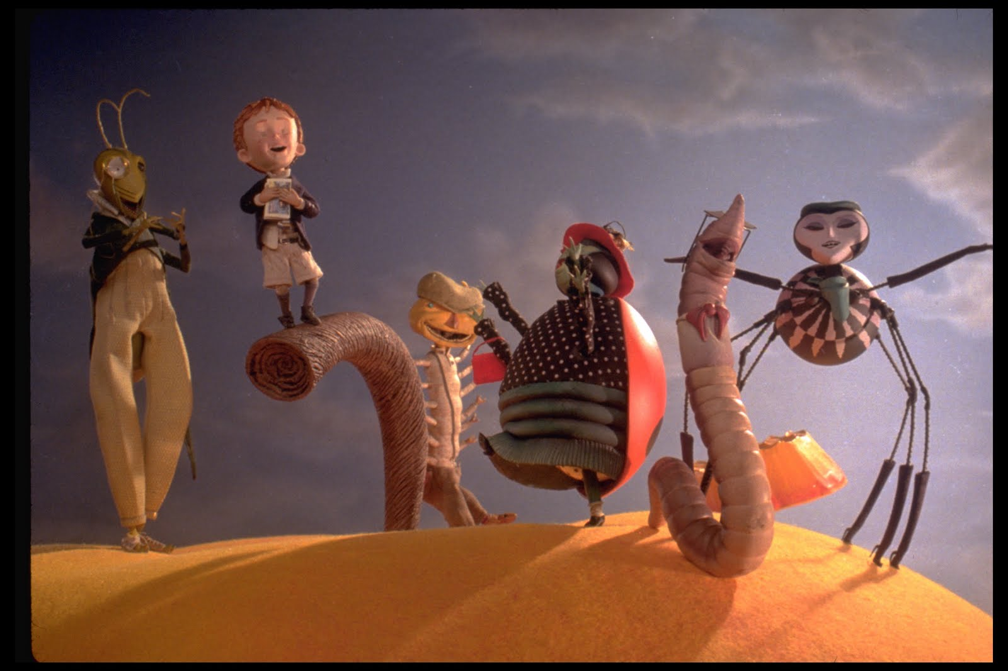
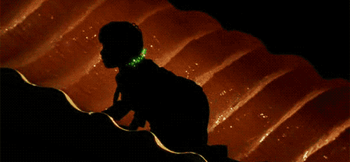
Suddenly, James found a hole in the peach and climbed inside…
He met many a curious creature including a giant green grasshopper, a spider, a lady bird, a glow worm and a centipede with many boots on his many legs!

Slide 6

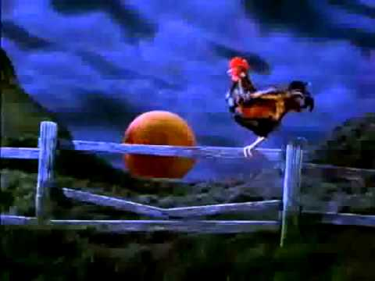
The centipede gnawed the peach stalk and James and his friends rolled towards across England towards the sea.
Afterwards, they sailed across the vast Atlantic Ocean in search of America.

Slide 7
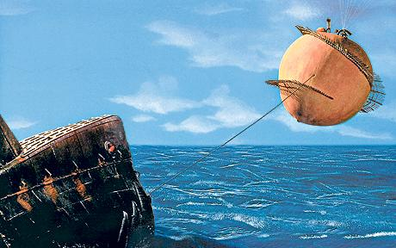
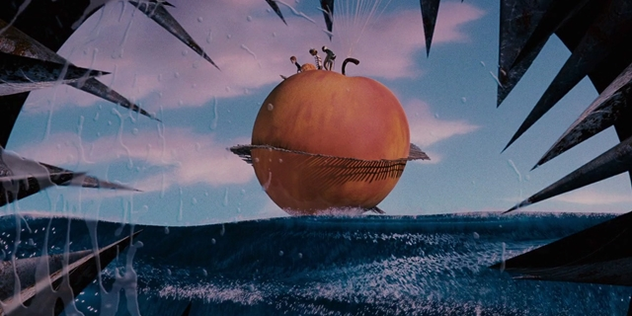
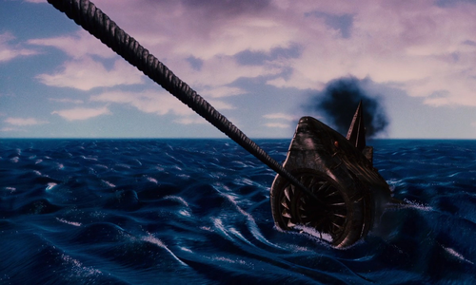
On their journey, they were nearly eaten by a huge, silver mechanical shark!

Slide 8
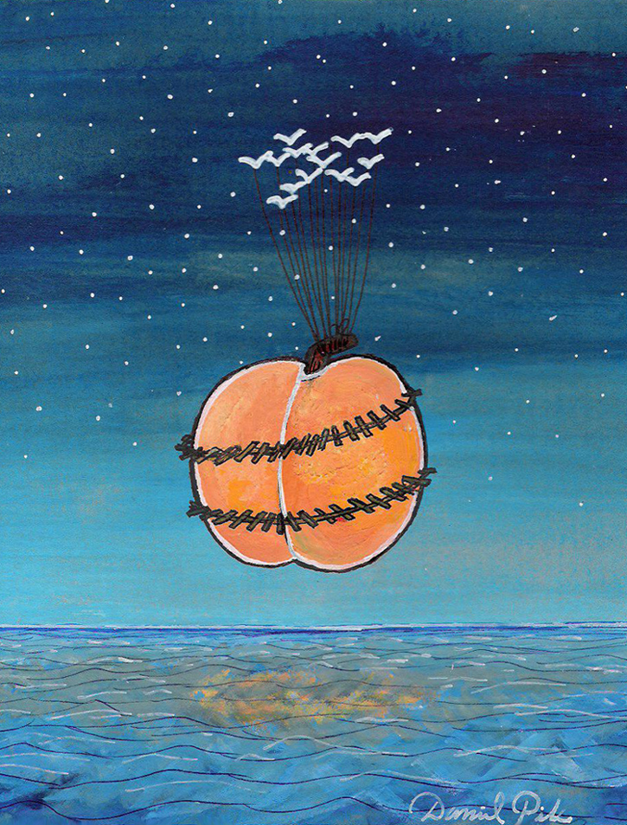
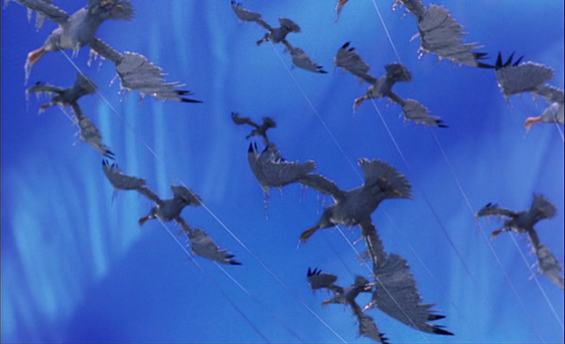
Luckily, they were saved when they lassoed a group of seagulls who flew them to safety.

Slide 9
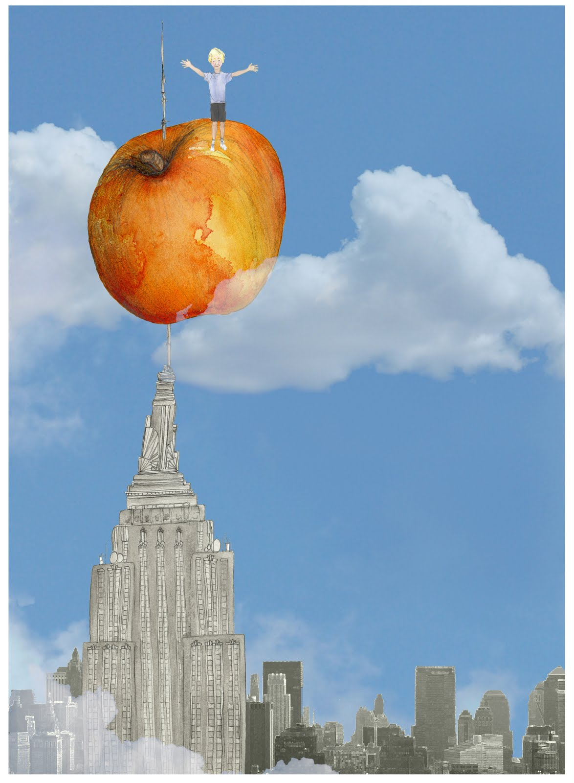
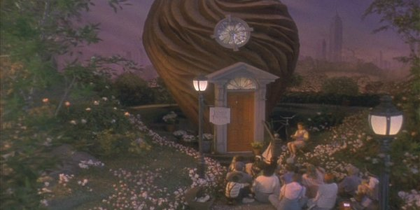
They landed in New York on the top of the Empire State Building.
James and his friends told their story to everyone and lived happily ever after in the peach pit.

