Slide 2
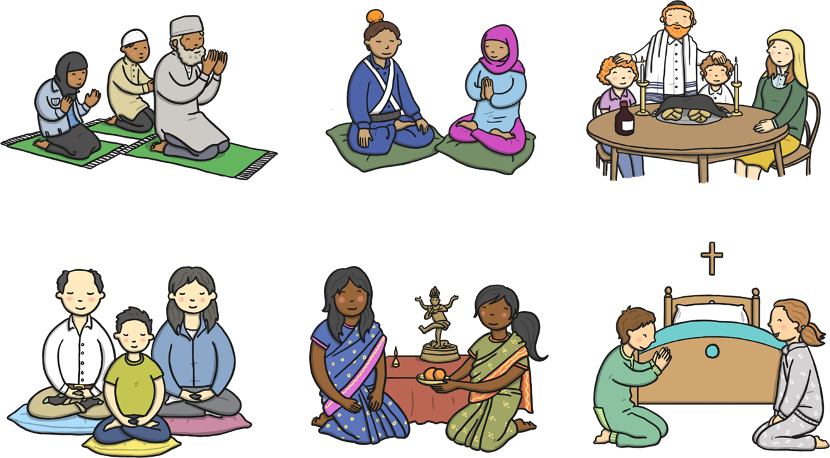
Different Beliefs

Slide 3
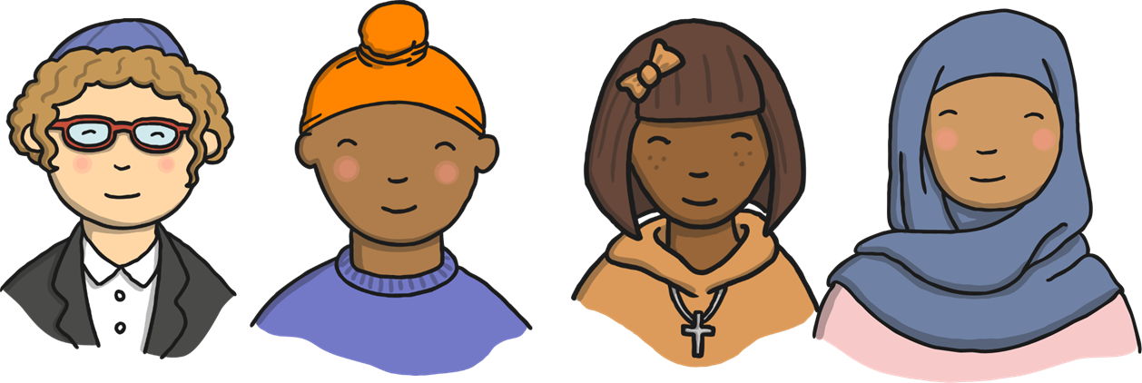
Different Beliefs
People have many different beliefs and gods that they worship.
We wear lots of different clothes and pray in different ways in different places but everyone is special!

Slide 4
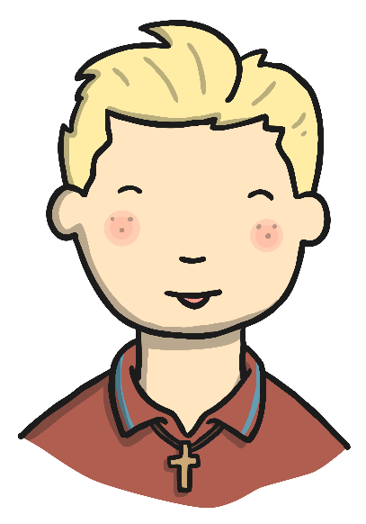
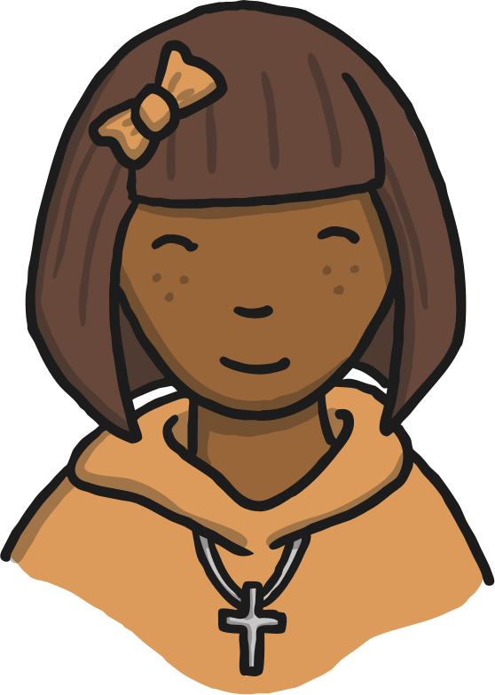
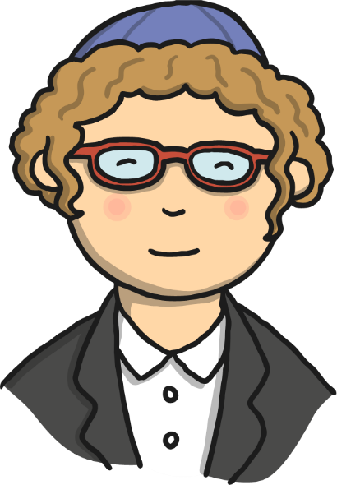
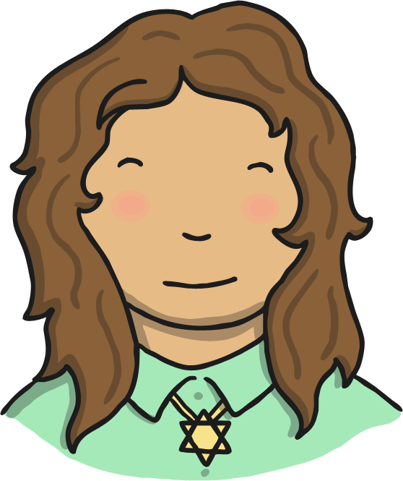
Some Christian children like to wear a cross
and chain.
Some Jewish children like to wear a Magen David (star of David).
Some Jewish boys wear a Kippah.

Slide 5
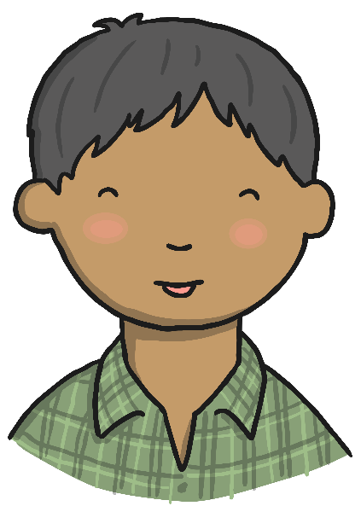
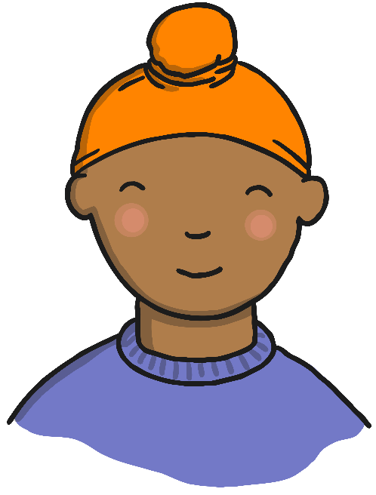
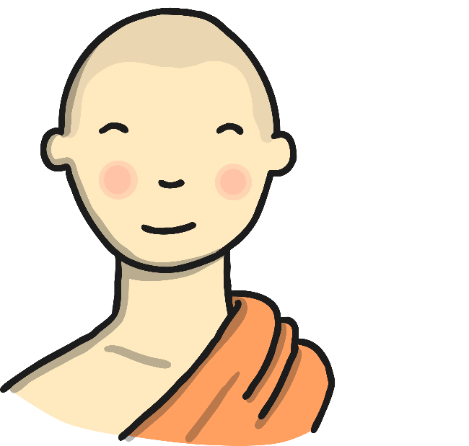
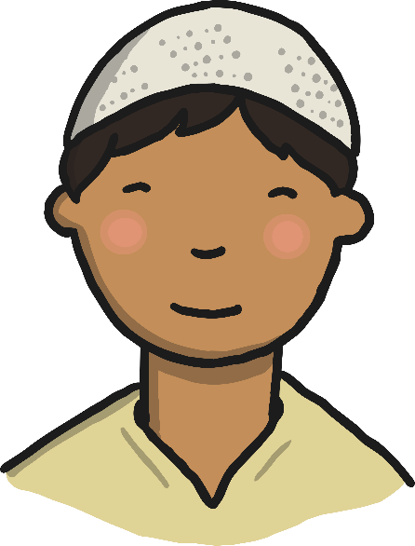
Some Sikh boys like to have their hair short. Some Sikh boys wear a Romala over their hair.
Some Muslim Boys like to wear a Topi on their head.
Some Buddhist boys like to have their head shaven.

Slide 6
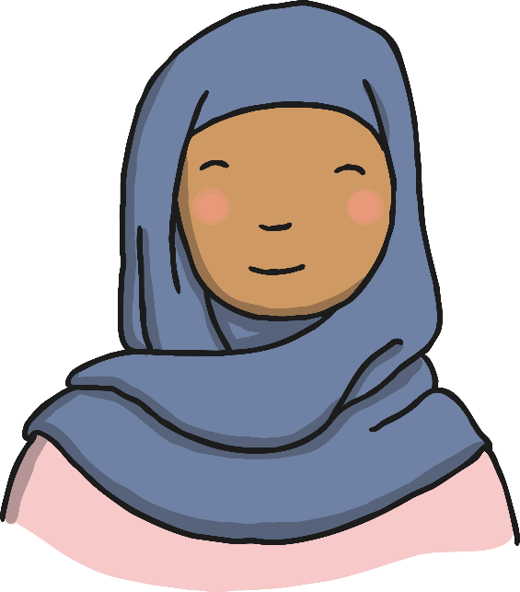

Sometimes you can see things in different religions which are quite similar to others.
A Christian girl may wear a headdress to their first communion which covers their hair.
A Muslim girl may wear a Hijab which covers their hair also.

Slide 7
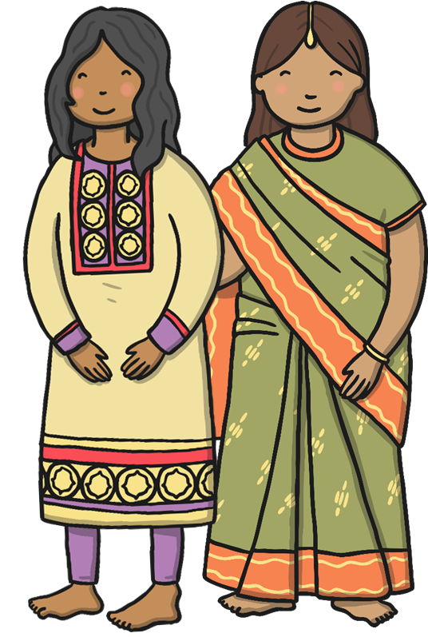
Some Sikh girls wear Shalwar Kameez.
Some Hindu girls wear a Sari.

Slide 8

Christians worship in a church

Slide 9
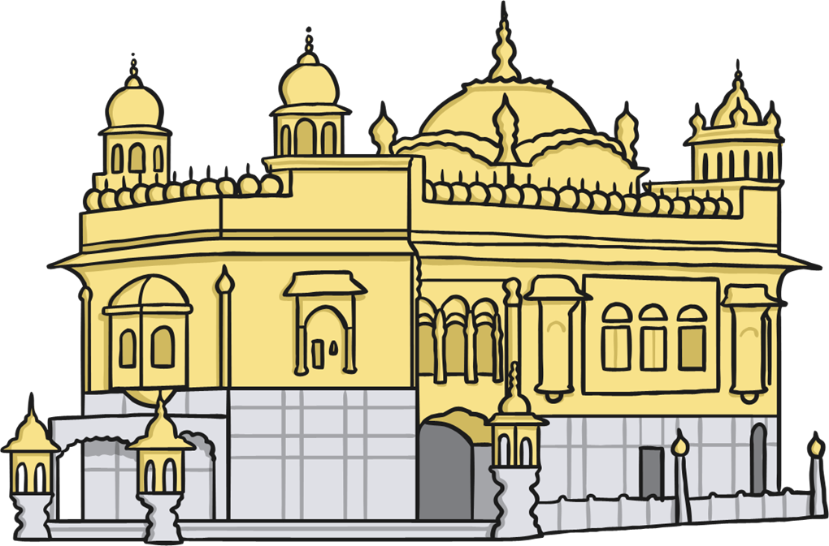
Sikhs worship at a Gurdwara

Slide 10
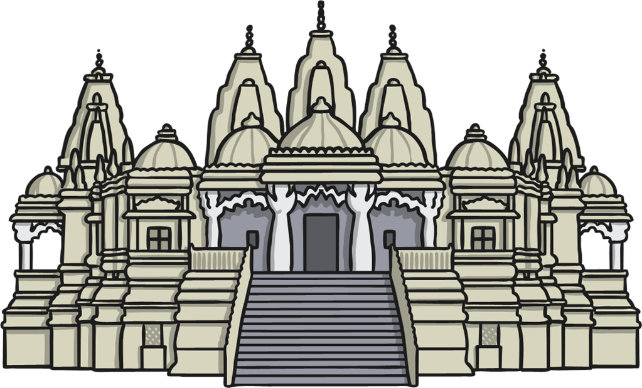
Hindus worship in a Mandir

Slide 11
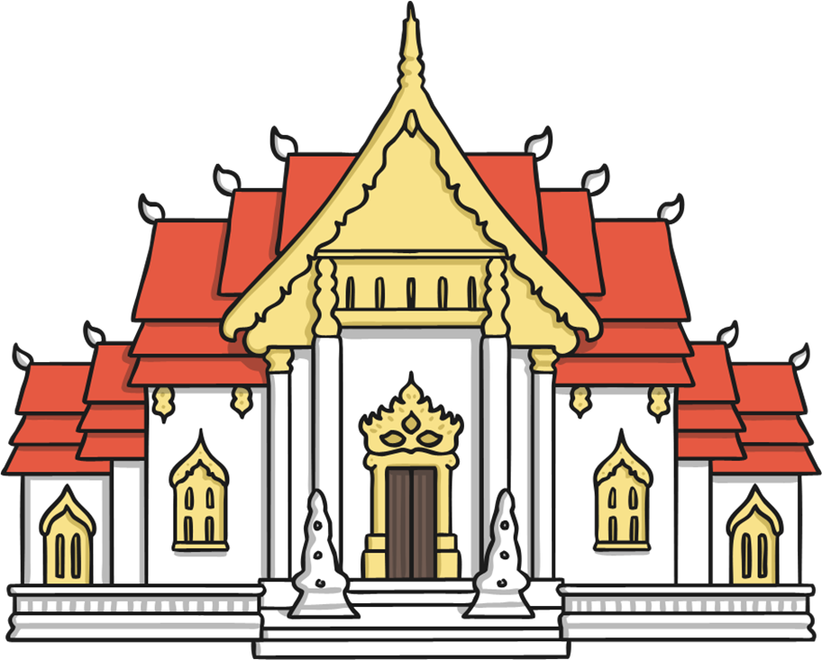
Buddhists worship in a Wat

Slide 12
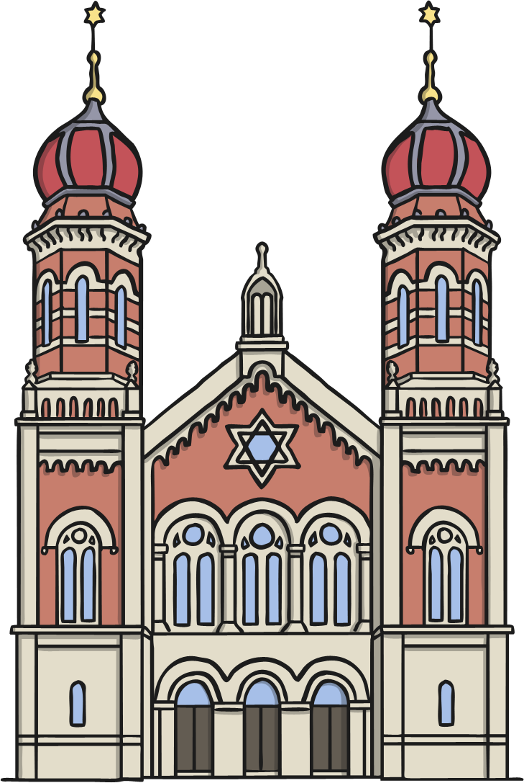
Jews worship in a Synagogue

Slide 13
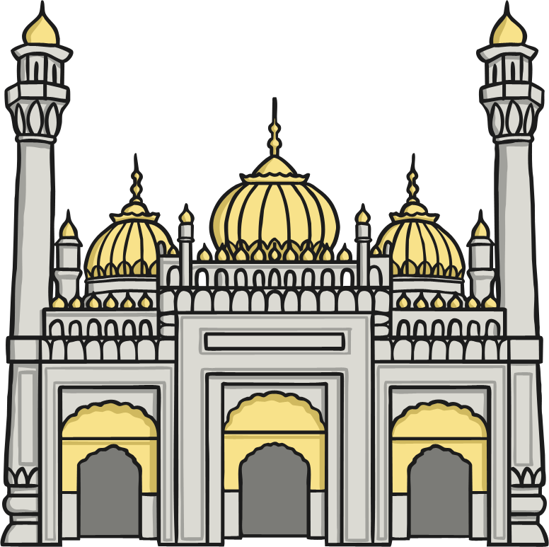
Muslims worship in a Mosque

Slide 14
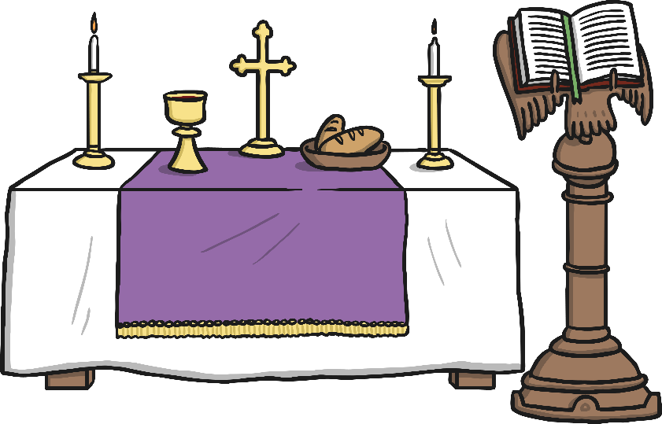
Inside the Church
Table called the Altar
Chalice cup with red wine
Bowl with bread or wafers
Holy Book called the Bible
4
2
3
1

Slide 15
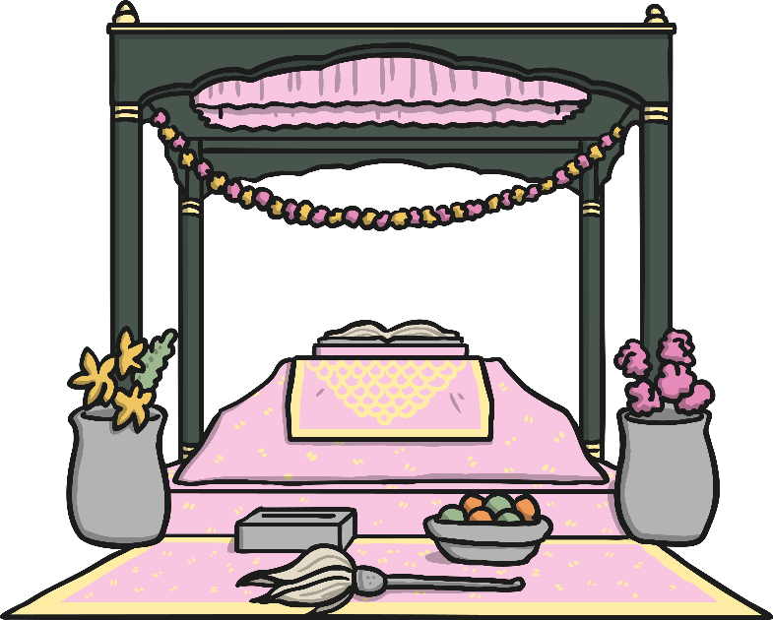

Inside the Gurdwara
Inside the Gurdwara
Silk cloth called a Romala covering the Guru Granth Sahib
Fan called a Chauri
Canopy
Money donation box
Offering of fruit
3
1
4
5
2

Slide 16
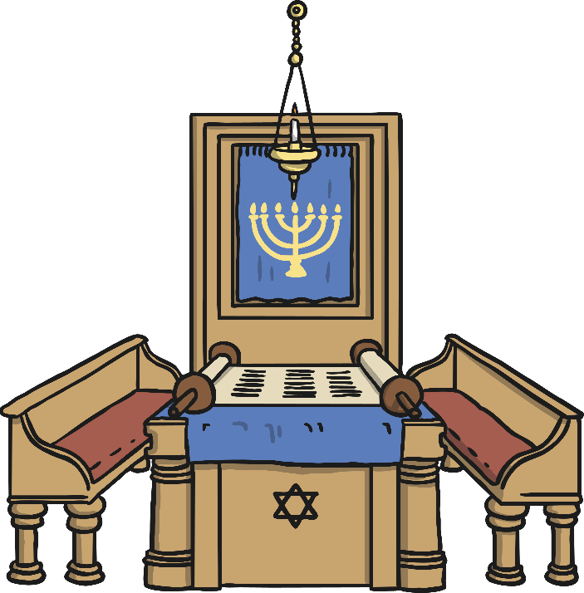
Inside the Synagogue
1
Light called the Ner Tamid
Cupboard called the Ark
Curtain with a candlestick called a Menorah on it.
Jewish Holy Book called the Torah
Torah Scrolls covered by curtain
Magen David
2
5
3
4
6

Slide 17
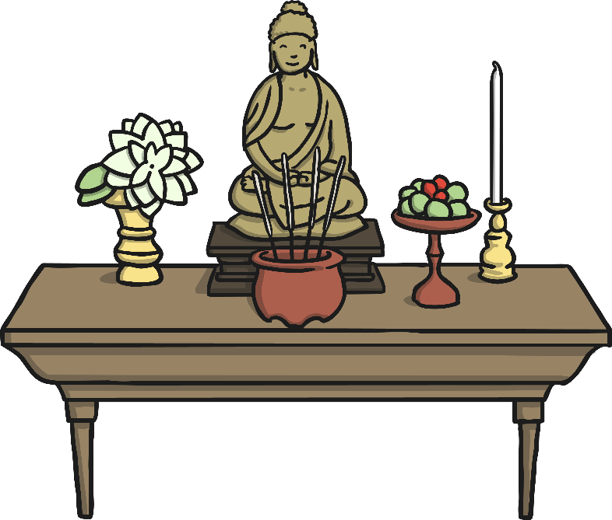
Inside the Wat
1
2
Statue of Buddha
Candles
Vase of flowers
Incense
Offering of fruit
3
5
4

Slide 18
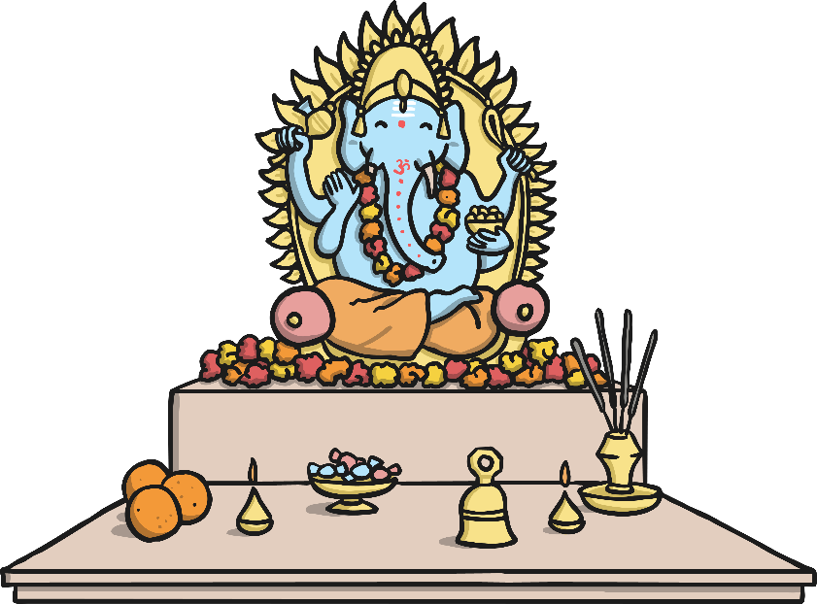
Inside a Mandir
Ganesh, the God for good luck
Bowl of sweets
Orange fruit
Sacred flame
Prayer Bell
Incense
1
4
5
6
3
2

Slide 19
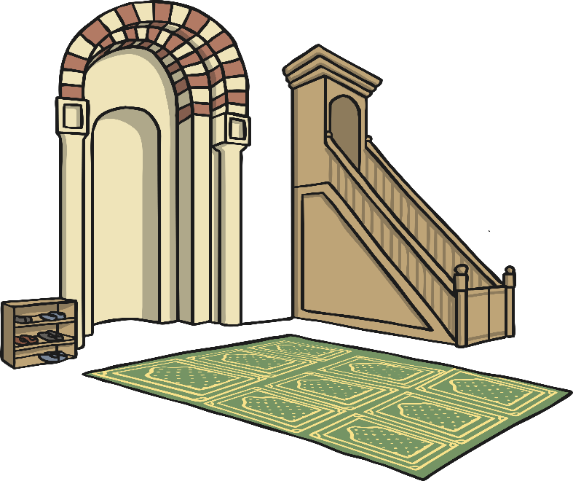
Inside the Mosque
Arch marking the direction of Mecca called a Mihrab
Platform where the Imam gives his talk called a Minbar
Prayer mat facing the Mihrab
Shoe rack
1
2
4
3

Slide 20
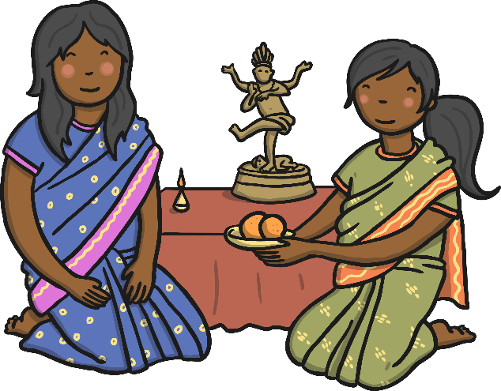
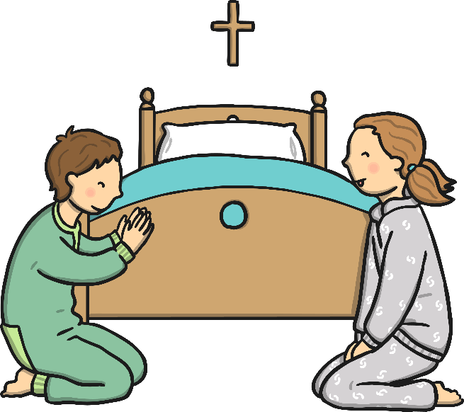
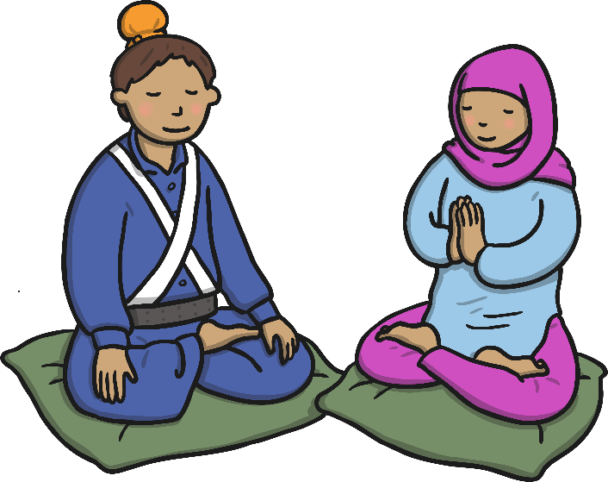
◄ In a Hindu home, a family shrine is set up each morning.
► In a Sikh home, children will say prayers in the mornings and evenings.
▲ In a Christian home, some children will say prayers before they go to bed.

Slide 21
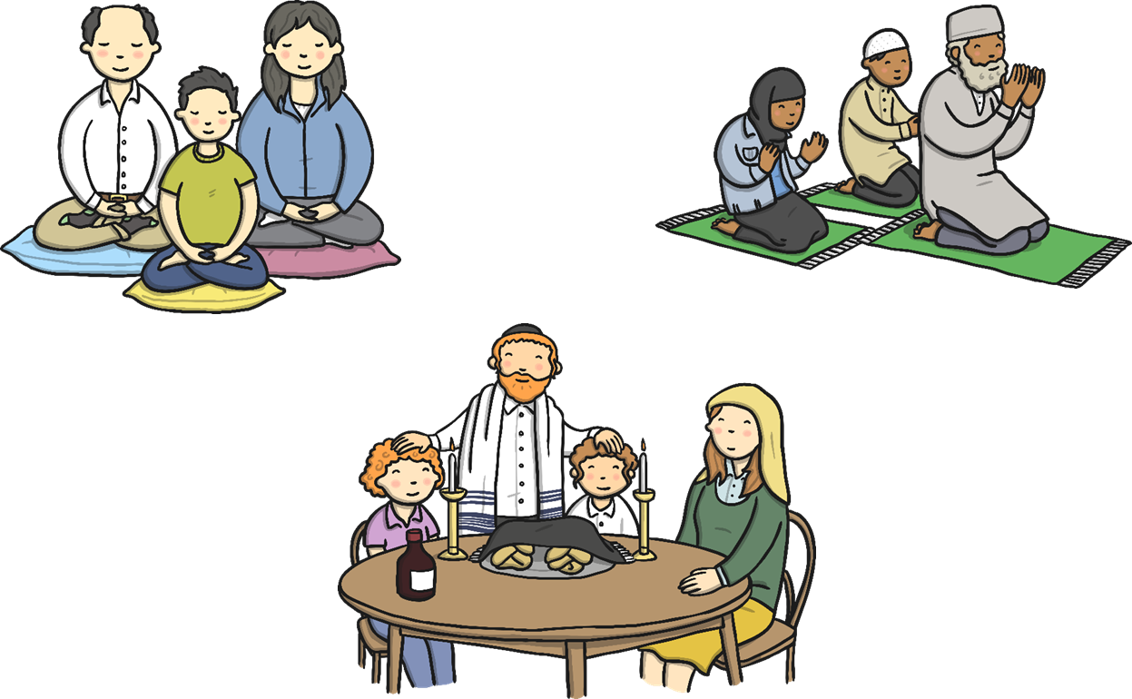
◄ In a Buddhist home, everyone will meditate in silence.
► In a Jewish home, a family meal is eaten every Friday evening and the Father blesses his children.
▲ In a Muslim home, the Father will lead the family prayers every morning and evening.

Slide 22
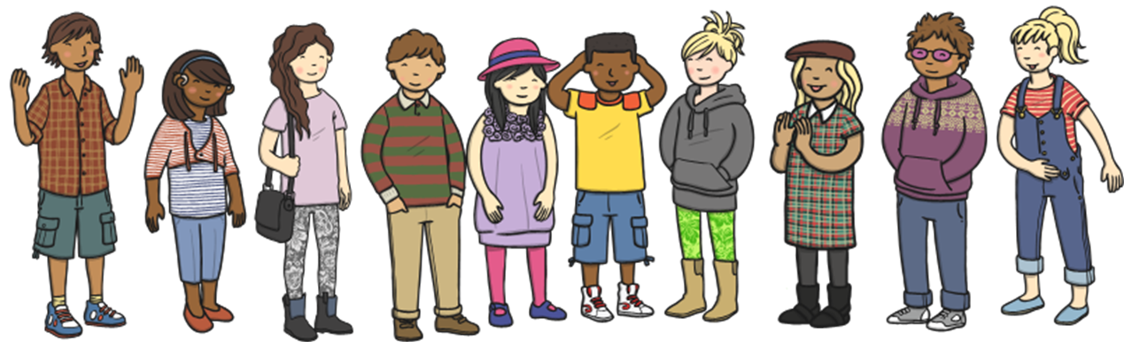
Be lovely to everyone, no matter what they believe in.

