Slide 1

Safer Internet Day 2021
Year 3 and 4

Slide 2
What is fake news?
What is fake news?
Fake news is news or stories on the internet that are not true.
There are two kinds of fake news:
False stories that are deliberately published or sent around, in order to make people believe something untrue or to get lots of people to visit a website. These are deliberate lies that are put online, even though the person writing them knows that they are made up.
Stories that may have some truth to them, but they're not completely accurate. This is because the people writing them - for example, journalists or bloggers - don't check all of the facts before publishing the story, or they might exaggerate some of it.
It is happening a lot at the moment, with many people publishing these stories in order to get as many shares as possible.

Slide 3
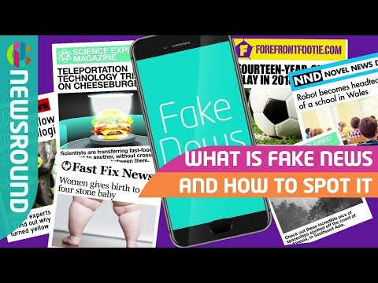
Watch this video about how to spot fake news

Slide 4
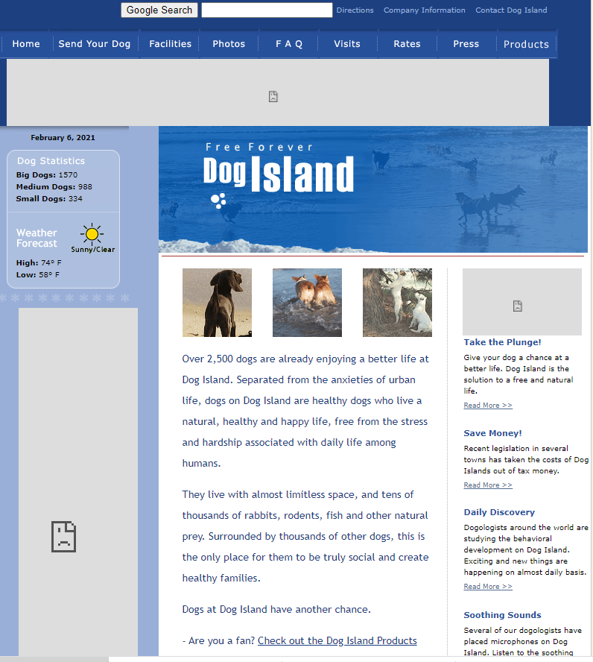
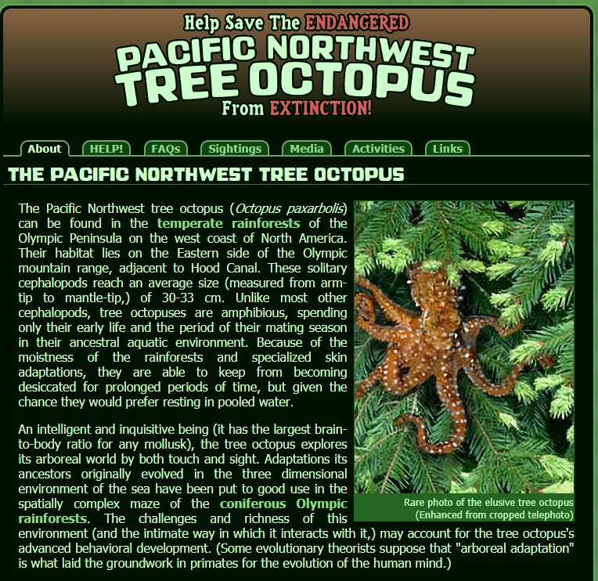
Now let us look at these online articles
http://www.thedogisland.com/
And
https://zapatopi.net/treeoctopus/

Slide 5
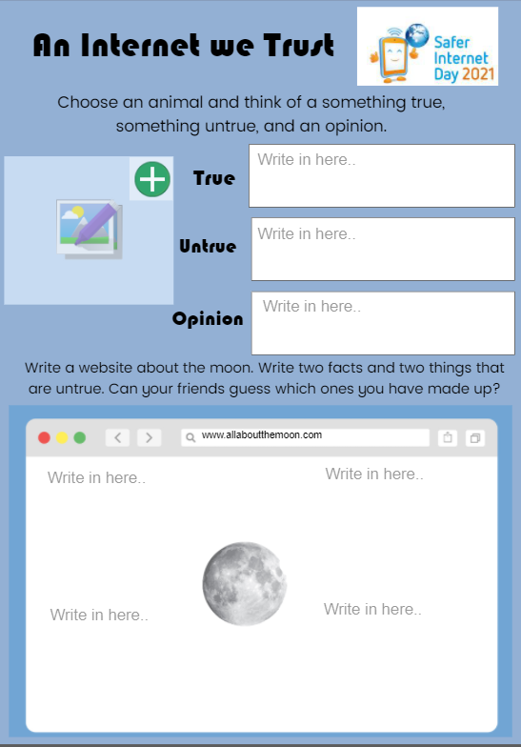
Purple Mash Activity
Now we have seen some REALLY convincing fake articles, can you choose an animal and think of something, true, something untrue and an opinion.
Please be sensible when using the internet to research facts about your chosen animal. Adult supervision may be required.
Then do the same for the moon.
Remember you will need to research facts about the moon. Please use this site:
https://www.sciencekids.co.nz/sciencefacts/space/moon.html

Slide 6
How to spot fake news
If you want to try to make sure that you don't get caught out by fake news, there a few things you can look out for.
Ask yourself:
Has the story been reported anywhere else?
Is it on the radio, TV or in the newspapers?
Have you heard of the organisation that published the story?
Does the website where you found the story look genuine? (meaning it doesn't look like a copycat website that's designed to look like another genuine website)
Does the website address at the very top of the page look real? Is the end of the website something normal like '.co.uk' or '.com', and not something unusual, like 'com.co'?
Does the photo or video look normal?
Does the story sound believable?
If the answer to any of these questions is 'no', you might want to check it out a bit more, before spreading the word.
If you're at all unsure, speak to an adult that you trust about the story to find out a bit more about it.

