Slide 1

Date
LC: Can I explore Muslim beliefs as expressed in poetry?

Slide 2
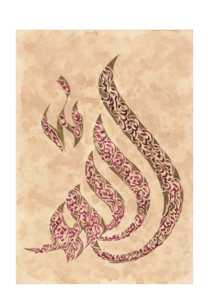
All religions use art to express spiritual ideas.
Here is some Islamic art.
This shows the 99 names of Allah.

Slide 3
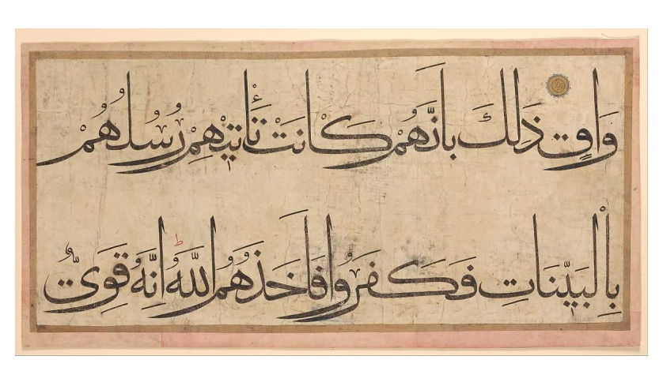
This artistic writing is called calligraphy.

Slide 4
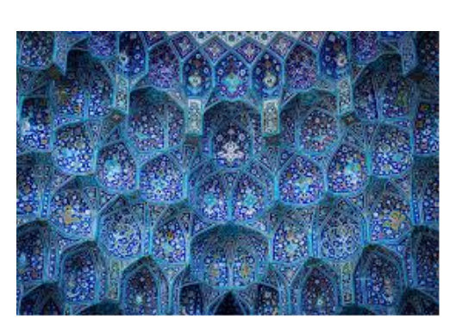
These tessellated tiles are found inside a mosque.

Slide 5
TTYP: Why do Muslim artists choose to use words or patterns and not pictures to express their faith?
Muslims use words or patterns, rather than pictures, to express their faith because _____
(they believe it is wrong/haram to draw pictures of Allah or the prophets)

Slide 6
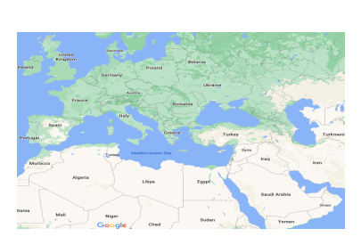
Today we will be looking at how Muslims use poetry to express their beliefs.
In particular we will be looking at a poem by the famous Muslim poet and teacher Al Ghazali.
He lived around 1000 years ago in what is now Iran (back then it was called Persia). This was during what some call the Golden Age of Islam
.

Slide 7
AL Ghazali ‘On God‘ (translated into English)
“He in his essence is one, without any partner.
Single without any similar
Eternal without any opposite.
Separate without any like
He is one, prior with nothing before him
From eternity without any beginning
Abiding in existence without any after him
To eternity without an end
Subsisting without ending
Abiding without termination
Measure does not bind him
Boundaries do not contain him.”

Slide 8
Look at the statements about Islamic teaching on Allah that are either true or false. Explain whether they are true or false, using the poem to explain.
EXTENSION: Think of extra lines that you could add to the poem, using the five pillars of Islam as inspiration

Slide 9
Activity
Read these statements and decide if they are a true or false regarding what Muslims believe about Allah.
In your book explain why they are true or false, using evidence from the poem to support your answer. E.G. ‘This is true because it matches the line _________from the poem.’
True or False Statements?
1) Allah has always existed and was not created.
2) Allah made other gods for humans to worship too.
3) Allah is immortal and cannot die.
4) Allah has a height and weight.
5) Allah is omnipotent (all-powerful)

Slide 10
EXTENSION
When you finish, add your own lines to the poem to describe what else Muslims believe. You may want to use the five pillars of Islam to help you.
Profession of Faith (shahada). The belief that "There is no god but God, and Muhammad is the Messenger of God" is central to Islam.
Prayer (salat). Muslims pray facing Mecca five times a day
Giving to charity (zakat).
Fasting (sawm). During the daylight hours of Ramadan, all healthy adult Muslims are required to abstain from food and drink.
Pilgrimage (hajj). Every Muslim whose health and finances permit it must make at least one visit to the holy city of Mecca, in present-day Saudi Arabia

