Slide 1

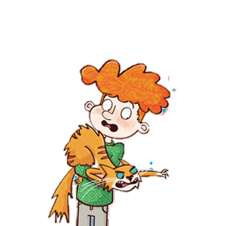
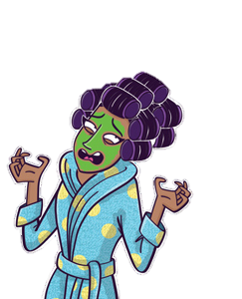
Pre-visit activities

Slide 2

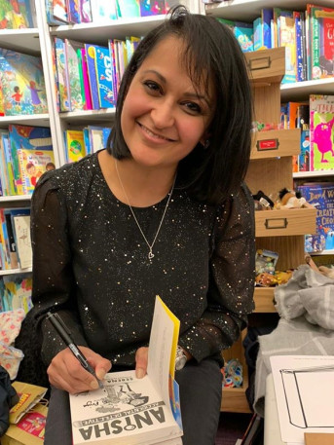
Our author visit
Serena
Patel

Slide 3


This week we will be having a digital visit from a local children’s author called Serena Patel. She is a new children’s writer from Walsall who has already had two books published in 2020 and there will be another one published this July.

Slide 4
She write mystery books about a girl called Anisha Mistry, who loves

Slide 5
Watch the video clip of Serena Patel reading the first chapter of ‘Anisha – Accidental Detective’.
https://www.youtube.com/watch?v=-bvCRuDKBTM

Slide 6
What did you think of the story?
Was it similar to any other stories that you have read?
Were there any differences from other stories that you have read?
Would you like to read more?

Slide 7
What questions would you like to ask
Serena Patel
during our digital visit this week?

Slide 8
Post-visit activities

Slide 9
Our author visit
Serena
Patel

Slide 10
This week, Serena Patel visited us digitally to talk to us an answer questions.
Tell your partner three things that you remember from the visit.
Can you remember what the task she set us was?

Slide 11
Your task is to solve the mystery and write the story of the kidnapping. To do this, you need to first read the list of suspects and clues.
Here is the task:
https://www.youtube.com/watch?v=QVwckiFs3Ek&feature=youtu.be

Slide 12

Suspect 1 – Mindy and Manny
• Uncle Tony’s ten-year-old twins from his first marriage, described by Anisha as “the meanest kids I know”
• Both like wearing all black
• Manny always has his tablet with him
• Mindy always has a notebook and her hairless pet dog with her
• Have told their dad they aren’t happy about the wedding
• Spotted outside the house by a neighbour on their phones
• Claim they have only just returned from boarding school but were seen the day before by Anisha’s cousin

Slide 13
Suspect 2 – Mustaf
• Uncle Tony’s chauffeur
• Very tall and wears a long black coat
• Has never been heard speaking
• Seen looking for something in the boot of the limo – rustling sounds and movement also
heard in the boot.
• Seems to be acting jumpy
• Caught hiding food.

Slide 14
Suspect 3 – Uncle Ricky
• Uncle Tony’s brother and business partner
• Doesn’t always get on with Uncle Tony
• Seen making lots of suspicious phone calls
• Leaves the family pre-wedding party early
• Seen dragging a large wheelie bag around

Slide 15
Suspect 4 – Mr Bogof
• Anisha’s neighbour
• Doesn’t like his street being disturbed by noise or people

Slide 16
Suspect 5 – Tony’s mum and dad
• Don’t approve of the wedding
• Overheard saying they though Aunty Bindi “was like a walking, talking dolly”
• Claim Tony didn’t turn up at their house for his wedding preparations as planned

Slide 17
Suspect 6 – Granny Jas
• Her medicine was mixed into tampered mehndi that was then used on Aunty Bindi ruining
her wedding mehndi
• Being secretive about what’s in her greenhouse – doesn’t want anyone disturbing her work
in there

Slide 18
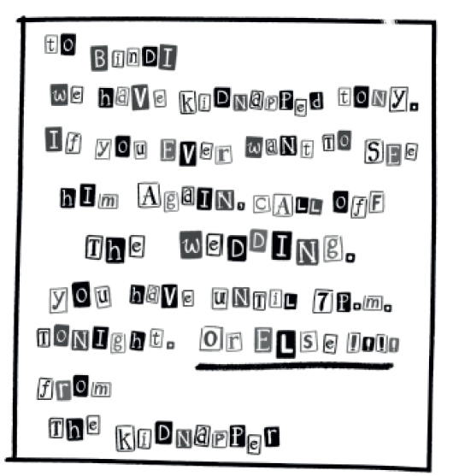
Clue 1 – The Ransom Note

Slide 19
Clue 2 – The Phone Call
Voice: Why has the wedding not been cancelled as we instructed
Anisha: Who is this?
Voice: You don’t need to know that. Just make sure the wedding is cancelled by seven o’clock this evening.
Anisha: Where’s Tony? How do I know you haven’t thrown him over a cliff or hurt him?
Voice: You don’t. CANCEL THE WEDDING OR ELSE.

Slide 20
Clue 3 – Anisha’s bridesmaid lengha top is found ruined

Slide 21
Clue 4 – A black spiral-bound notebook from Uncle Tony’s mobile phone shop is found and is a match for the paper used for the kidnapper’s note

Slide 22
Clue 5 – Manny’s tablet – his search history includes:
• how to be cool in ten short lessons
• trendy hairstyles for boys
• plot your way to becoming a super-villain
• five signs your stepmother is an alien
• the Birmingham South-West Aspire Junior Middle High Academy School website

Slide 23
Clue 6 – A receipt for a padlock found in Mustaf’s car

Slide 24
Using the list of suspects and clues, write down your answers to the following questions:
a. Who do you think kidnapped Uncle Tony?
b. Why do you think they did it?
c. When did they kidnap him?
d. How did they kidnap him?
e. Where did they take him to?
f. What did they want to achieve by kidnapping him?

