Slide 1
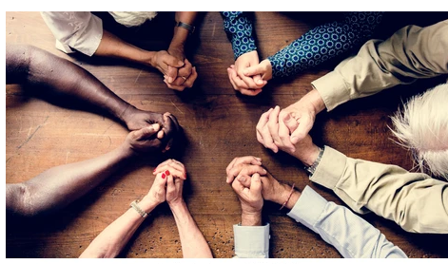
Monday 21st June
LC: Can I create a piece of art to express my spirituality?

Slide 2
TTYP What do we mean by spirituality?
By spirituality, we mean _______
Someone's beliefs and feelings about religion, the soul and things that we cannot see)

Slide 3
On the next few slides we are going to look at some work created by other children who were expressing their spirituality through art.
For each one, decide what you can tell about the artist’s beliefs by looking at their picture.

Slide 4
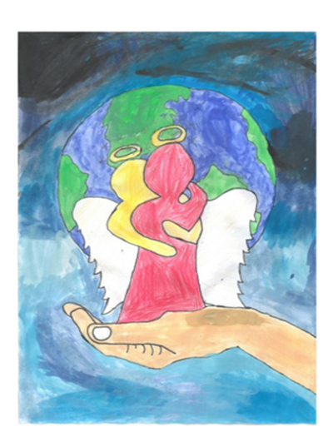
From looking at this picture, I can tell that the artist ___________________

Slide 5
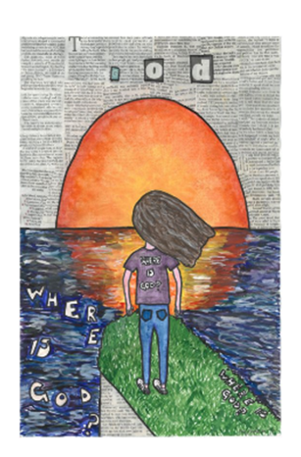
From looking at this picture, I can tell that the artist ___________________

Slide 6
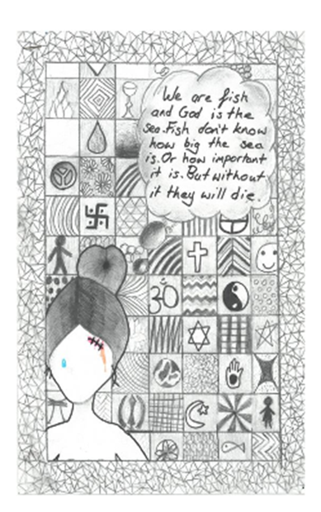
From looking at this picture, I can tell that the artist ___________________

Slide 7
Think in your heads about what is spiritual for you. It doesn’t matter if you don’t follow a religion; you can still include things that are important and reflect the values that you hold (e.g. fairness, happiness, achievement)
My spirituality

Slide 8
Create a picture/collage to express your spirituality. You can include:
.Pictures of religious buildings
.Calligraphy of inspirational quotes or religious sayings
.Pictures of local people and the community
.Patterns
.Pictures from nature.

