Slide 2



Diving into Mastery Guidance for Educators
Each activity sheet is split into three sections, diving, deeper and deepest, which are represented by the following icons:
These carefully designed activities take your children through a learning journey, initially ensuring they are fluent with the key concept being taught; then applying this to a range of reasoning and problem-solving activities.
These sheets might not necessarily be used in a linear way. Some children might begin at the ‘Deeper’ section and in fact, others may ‘dive straight in’ to the ‘Deepest’ section if they have already mastered the skill and are applying this to show their depth of understanding.
Diving
Deeper
Deepest

Slide 3
Aim
Use negative numbers in context and calculate intervals across zero.

Slide 4
Negative Numbers
Diving
Match the answer to these statements to the correct place on the number line.
What is 12 less than 5? | -10 +14 = | What is 17 taken from 7? | Add 9 to -8 = | 2 - 11 =
-7
4
-10
1
-9
-10 -9 -8 -7 -6 -5 -4 -3 -2 -1 0 1 2 3 4 5 6 7 8 9 10

Slide 5
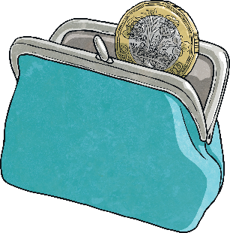
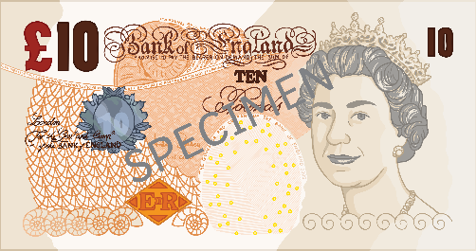

Negative Numbers
Diving
I have -£26 in my bank account. I put £35 into my account. What is my new balance?
My bank account has £9 in it. I spend £19. What is my new bank account balance?
I spend £45 on a new game. The balance in my bank account is now -£12. How much money did I have in my account before I bought the game?
£9
-£10
£33

Slide 6
Negative Numbers
Diving
This table shows how the temperature changed on four different streets around the world. Complete the table to show how the temperatures changed over three months.
Town | October | Temperature change | November | Temperature Change | December
Study Street | 13°C | -10°C |  | -7°C
Reasoning Road | -1°C | +5°C |  | -6°C
Problem-Solving Place | -5.5°C |  | 7.5°C |  | -11.5°C
3°C
-4°C
4°C
-2°C
+12°C
-19°C

Slide 7
Negative Numbers
Deeper
Miriam has found the minimum and maximum average temperatures for four countries around the world. She has calculated the temperature range for each country.
Can you identify her mistakes and correct them?
Country | Average Minimum Temperature | Average Maximum Temperature | Average Temperature Range
Canada | -29°C | 15°C
China | -12°C | 21°C
Sweden | -16.6°C | 17.9°C
44°C
43°C
Correct
33°C
34.5°C
33.5°C

Slide 8



Negative Numbers
Deeper
Country | Average Minimum Temperature | Average Maximum Temperature | Average Temperature Range
Canada | -29°C | 15°C | 44°C
China | -12°C | 21°C | 33°C
Sweden | -16.6°C | 17.9°C | 34.5°C
Using the table, explain whether the following statements are true or false.
If you order the countries by their average minimum temperature, from coldest to warmest, they would be: Canada, Sweden and China.
The difference in temperature between the coldest average minimum temperature and the hottest average maximum temperature is less than 40°C.
True. From the coldest to warmest temperature, the order would be: Canada (-28.7°C), Sweden (-16.6°C) and China (-11.7°C).
False. The difference between -29°C and 21°C is 50°C. This is greater
than 40°C.

Slide 9
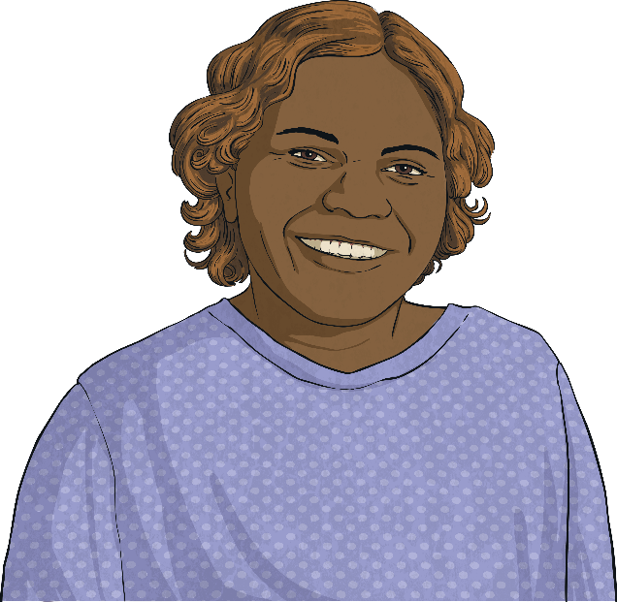
Negative Numbers
Deepest
An explorer was investigating a deep crater.
On day one, she travelled -5.6m down the crater. On day two, she travelled a further -4.8m down the crater. On day three, she travelled 6.8m back up the crater to collect some more supplies. On day four, she travelled another -9.7m back down the crater. On day five, she travelled all the way back up to the top of the crater to return to the surface.
How far did she need to travel on day five to return to the surface?
13.3m

Slide 10
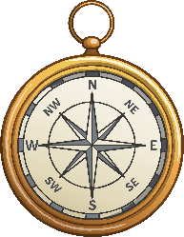
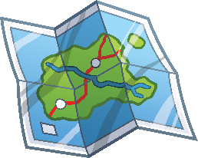
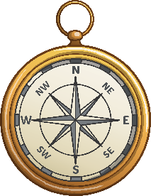

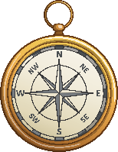



Negative Numbers
Deepest
= a positive or negative number
= a positive or negative number
Investigate the possible values of and if:
+
= 20
Can you use any decimal numbers to make 20?
You may have many different answers. For example:
= -10
= 30 so -10 + 30 = 20
= -5.5
= 25.5 so -5.5 + 25.5 = 20

Slide 11


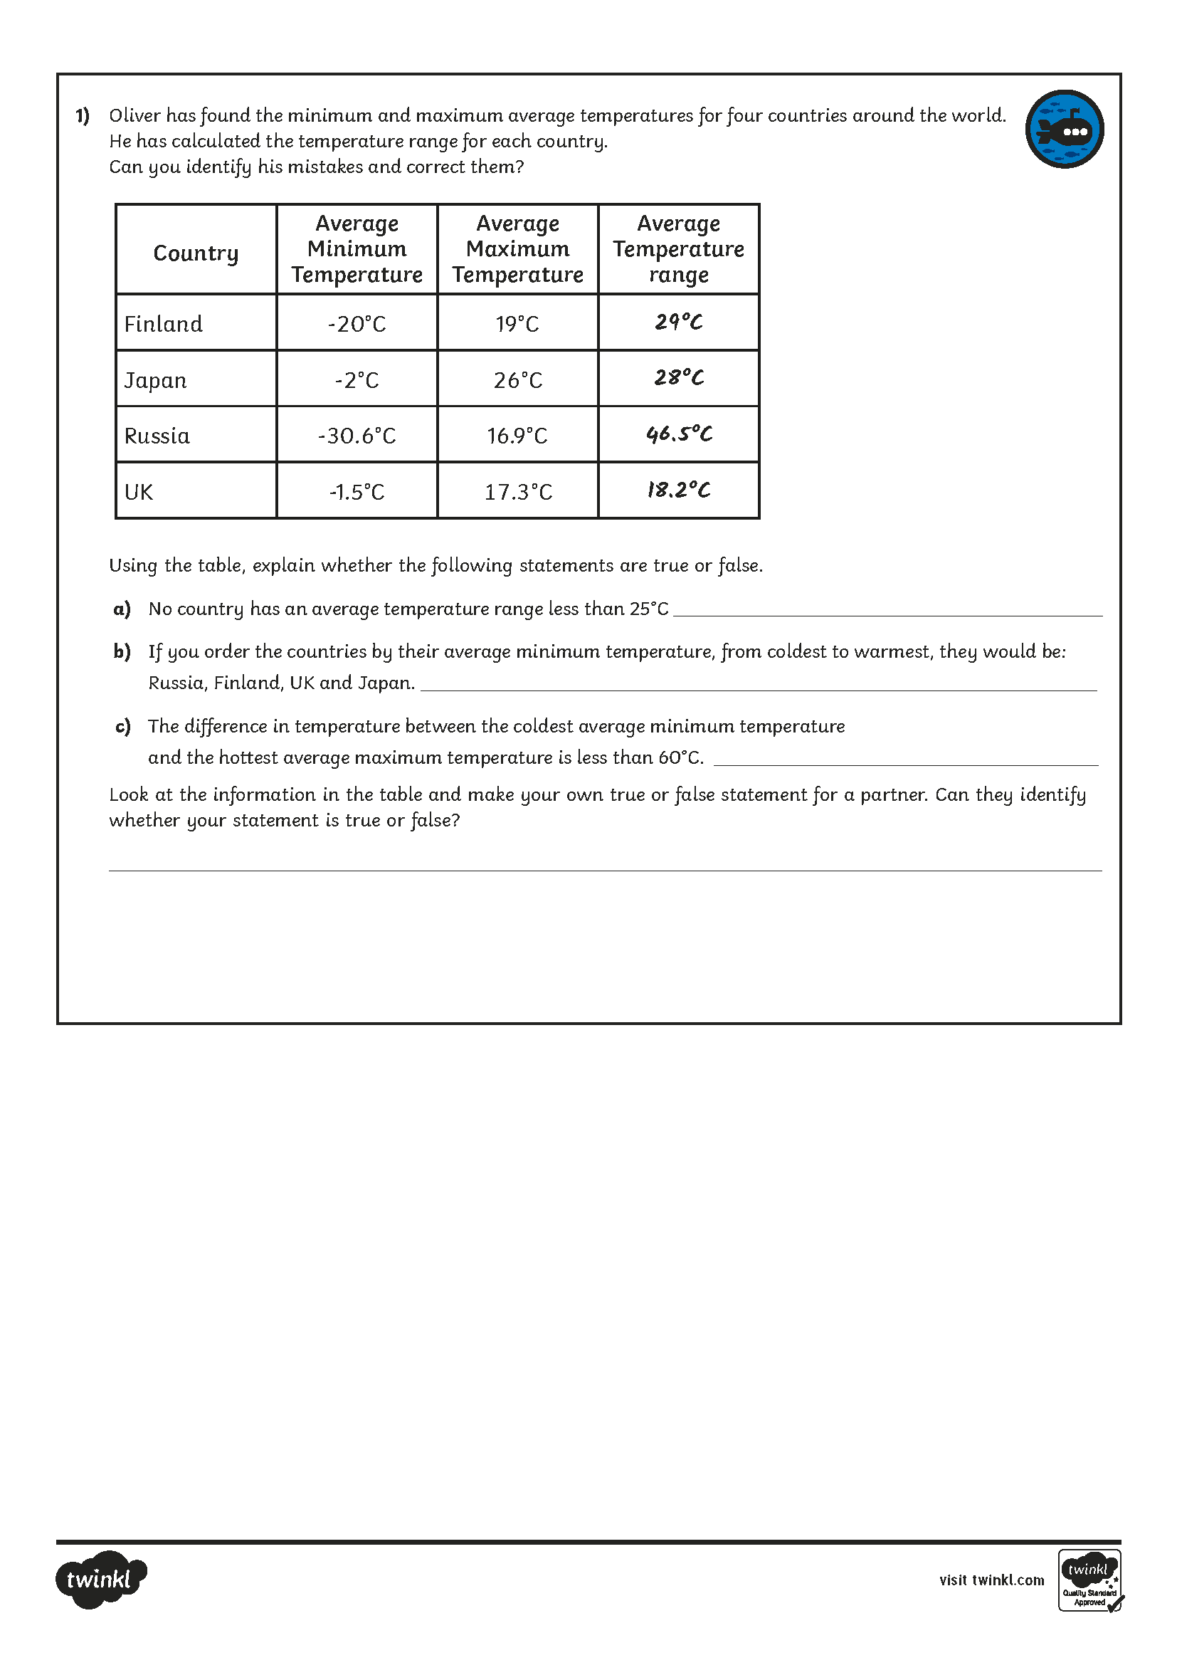
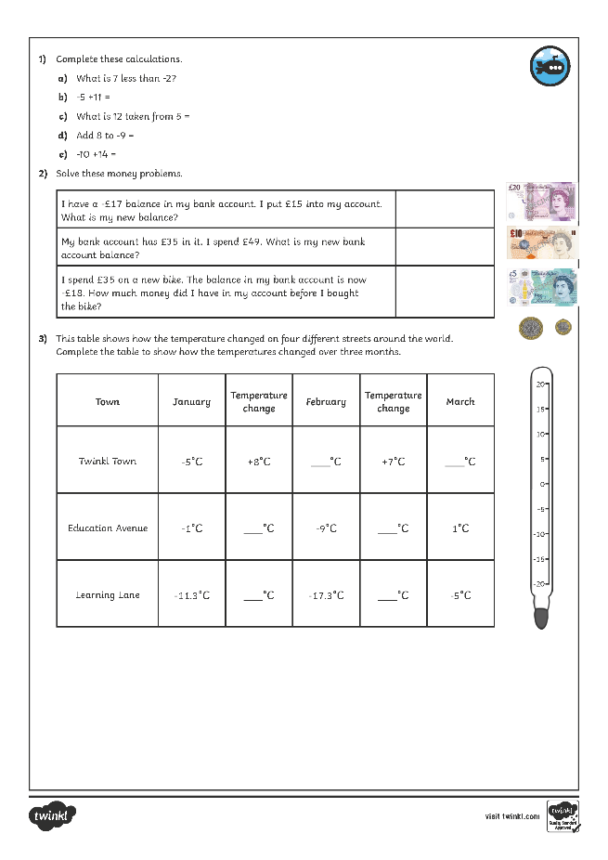
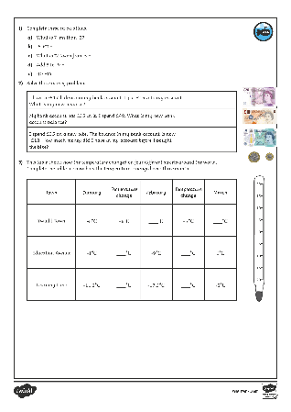
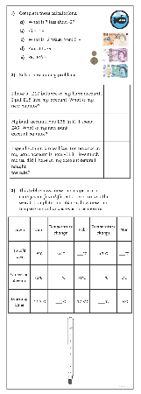
Negative Numbers
Dive in by completing your own activity!

Slide 12
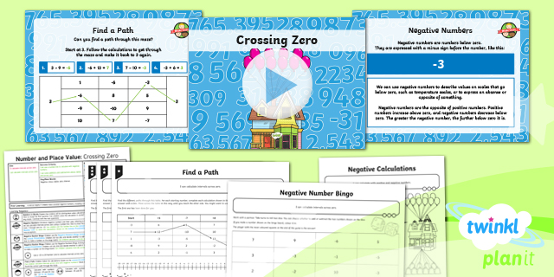
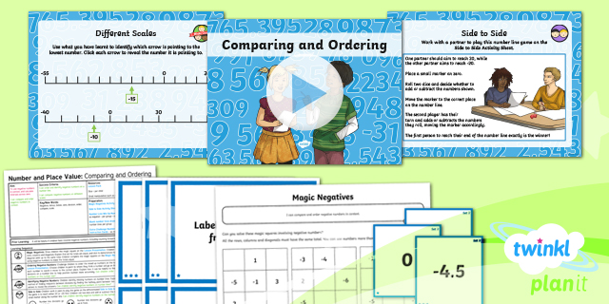

Need Planning to Complement this Resource?
National Curriculum Aim
Use negative numbers in context and calculate intervals
across zero.
For more planning resources to support this aim, click here.
Twinkl PlanIt is our award-winning scheme of work
with over 4000 resources.

