Slide 2



Diving into Mastery Guidance for Educators
Each activity sheet is split into three sections, diving, deeper and deepest, which are represented by the following icons:
These carefully designed activities take your children through a learning journey, initially ensuring they are fluent with the key concept being taught; then applying this to a range of reasoning and problem-solving activities.
These sheets might not necessarily be used in a linear way. Some children might begin at the ‘Deeper’ section and in fact, others may ‘dive straight in’ to the ‘Deepest’ section if they have already mastered the skill and are applying this to show their depth of understanding.
Diving
Deeper
Deepest

Slide 3
Aim
Multiply one-digit numbers with up to two decimal places by whole numbers.

Slide 4
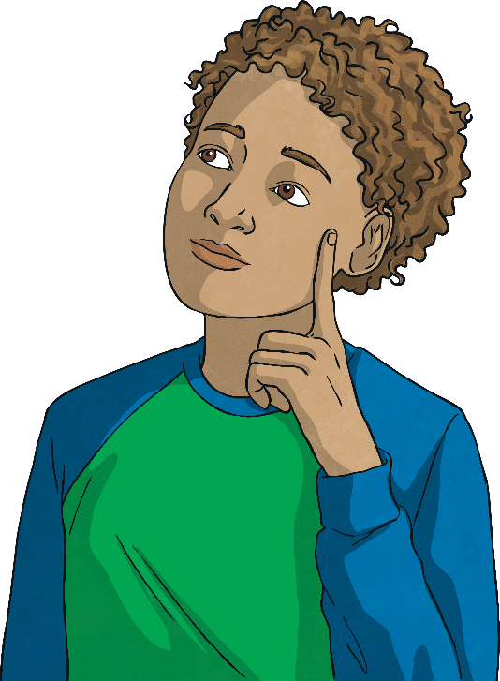

Multiply Decimals by Integers
Diving
Use bar model B to help you give the total value of bar model A.
A
2.67
2.67
2.67
2.67
B
0.89
0.89
0.89
= 2.67
A = 2.67 × 4 = 10.68

Slide 5

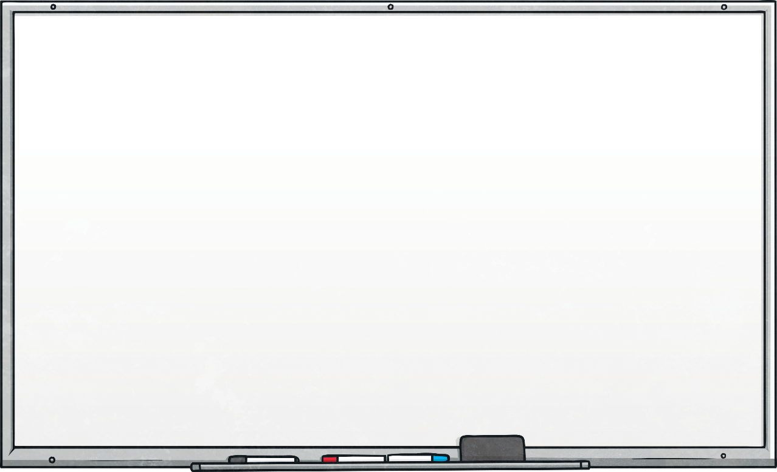
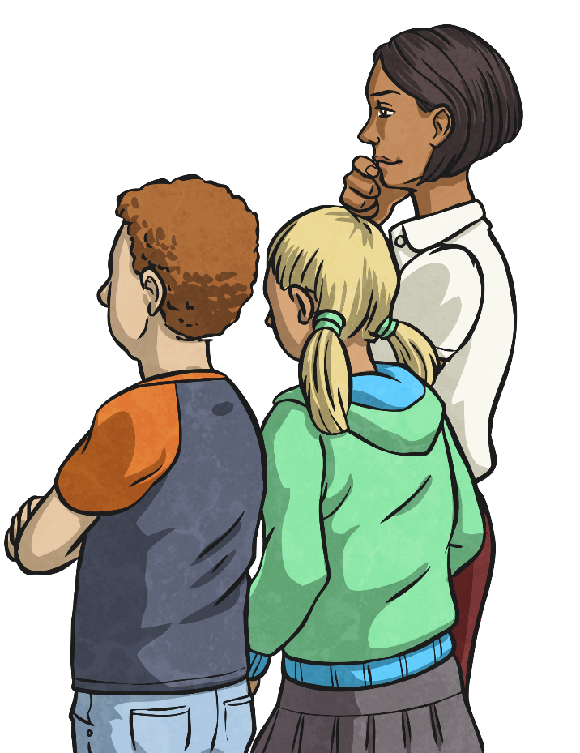
Multiply Decimals by Integers
Diving
Complete this multiplication table with the missing numbers:
× | 2.87 | 3.45
4
6
11.48
13.8
17.22
20.7

Slide 6

Multiply Decimals by Integers
Deeper
Anna is using a place value chart to help her find the answer to this missing digit multiplication question.
Ones | Tenths | Hundredths
1
1
1
1
0.1
0.1
0.01
.
× 2 = 8.64
1
1
1
1
0.1
0.1
0.01
a)
Is Anna correct? If not, what multiplication calculation does Anna’s place value chart represent?
Anna has represented 4.21 × 2 = 8.42
b)
In order to get the correct answer of 8.64, Anna will need to add one tenth counter and one hundredth counter to the place value chart. Is this statement correct? Explain your answer fully.
The statement is not correct as adding just one of each of the counters to the chart will show an answer of 8.53. In order to get the correct answer of 8.64 Anna needs to represent 4.32 in each of the place value rows by adding two tenth counters and two hundredth counters, placing one in each row.

Slide 7

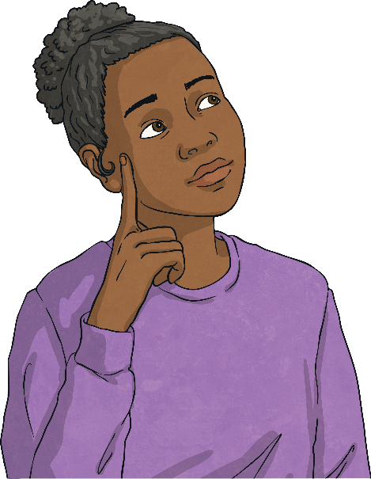
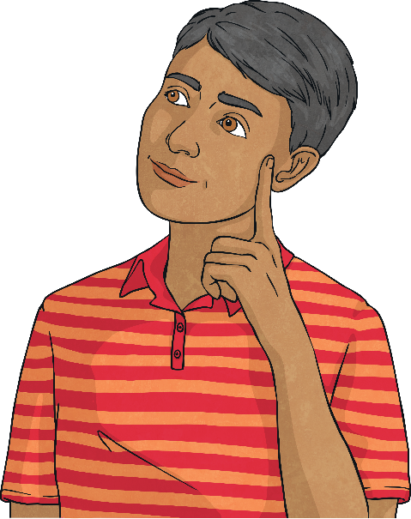
Multiply Decimals by Integers
Deepest
v
Complete this number statement. Do not use a digit more than once. Find five different possibilities.
Different digits from 0-9 may be used here
A digit from 2-9 may be used here
An answer between 6 and 8
.
×
=
Answers will vary.
Possible answers include:
2.56 × 3 = 7.68
3.10 × 2 = 6.2
0.84 × 9 = 7.56
0.98 × 7 = 6.86
0.87 × 7 = 6.09

Slide 8


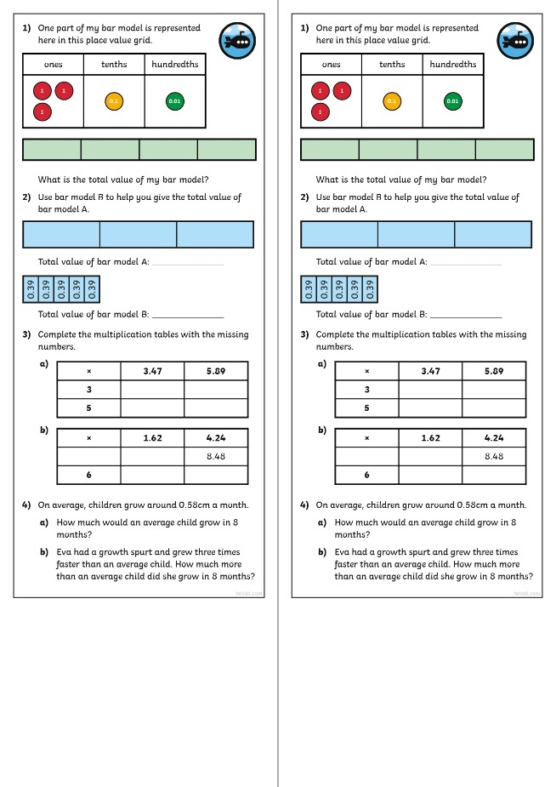
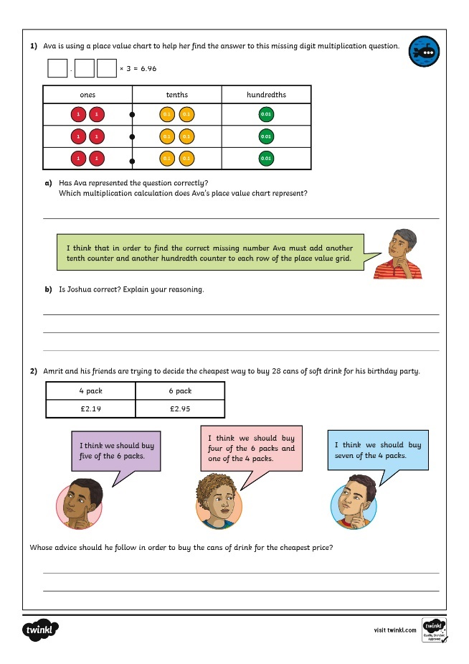
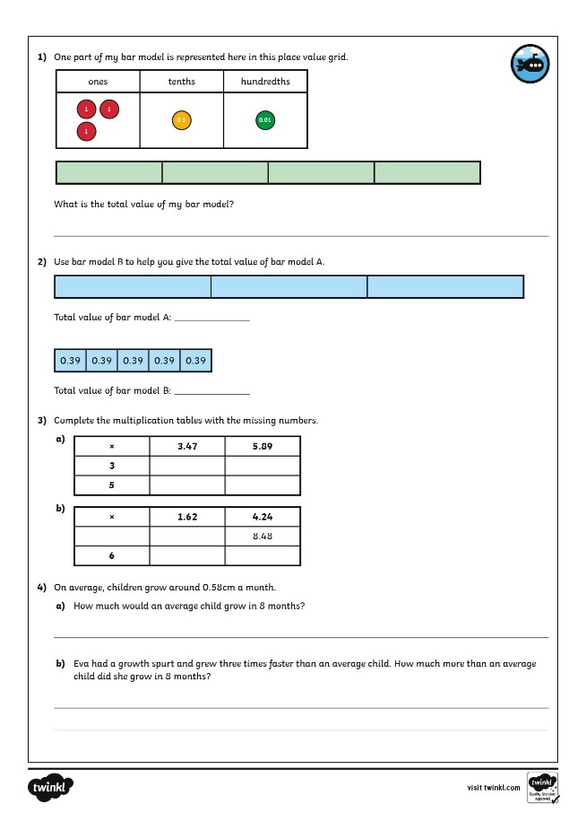
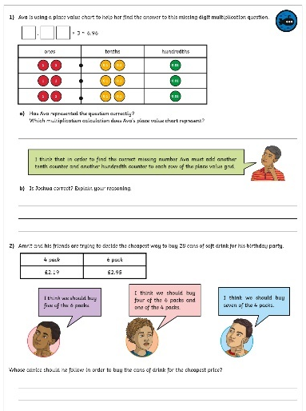
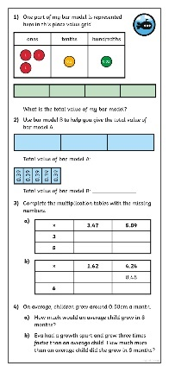
Multiply Decimals by Integers
Dive in by completing your own activity!

Slide 9
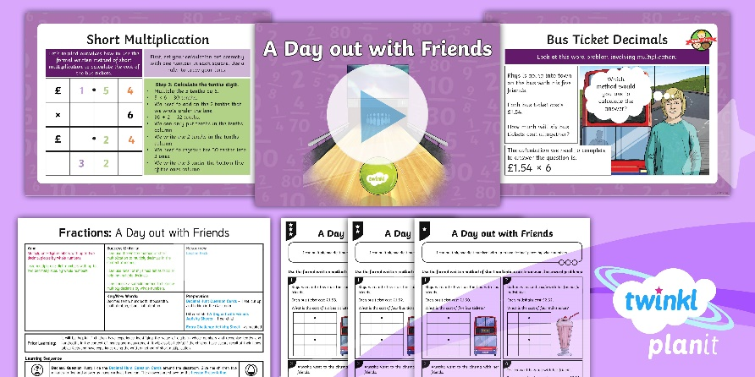
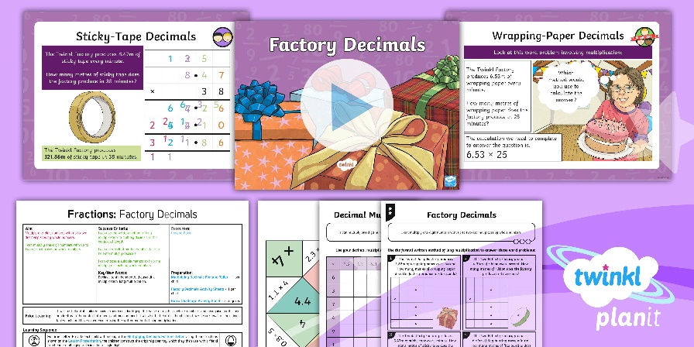

Need Planning to Complement this Resource?
National Curriculum Aim
Multiply one-digit numbers with up to two decimal places by whole numbers.
For more planning resources to support this aim, click here.
Twinkl PlanIt is our award-winning scheme of work
with over 4000 resources.

