Slide 1
Date
LC: Can I understand what is inspiring about Sikh architecture?

Slide 2
What do we mean by spirituality?
. By spirituality, we mean _______
Beliefs and feelings about religion, the soul and things that we cannot see.

Slide 3
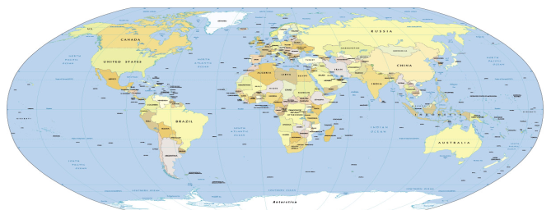
Today we are looking at the most spiritual place for Sikhs, which is …
the Golden Temple.
The Golden Temple is in India
Do you know where it is?

Slide 4
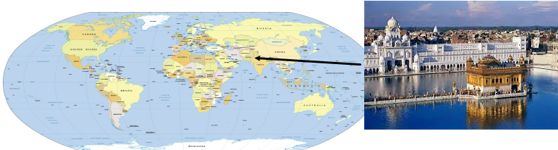
The Golden Temple is in Amritsar, which is the Indian state of Punjab.

Slide 5
This lesson we will be researching facts about The Golden Temple, explaining both what it looks like and why it is special. Use these websites to help you and record you answers in your book.
Where is it? When was it built?
What is it used for? How many people visit it each year? Why is it special for Sikhs?
What does it look like? What is inside it?
Why might non-Sikh people visit it?
https://www.northsouthtravel.com/10-interesting-facts-about-the-golden-temple
https://kids.kiddle.co/Golden_Temple

