Slide 1

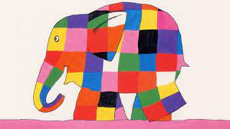
Elmer Day

Slide 2
What is Elmer Day?
Elmer Day is a celebration of reading, of elephants and of accepting yourself and others, just like Elmer the Patchwork Elephant. Today is about celebrating uniqueness and differences.

Slide 3
Elmer
Elmer remains one of the most iconic and widely read children’s book series of all time, selling over 10 million copies worldwide since it was first published by Andersen Press in 1989. Written and illustrated by celebrated children’s author and artist David McKee, the Elmer books have been translated into more than 50 languages and now new books, toys and clothing add to the world of Elmer the Patchwork Elephant.

Slide 4
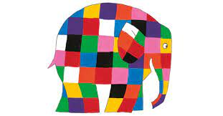

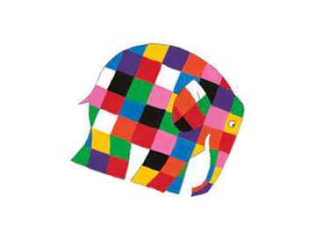
The Story of Elmer
Elmer, he is a multi-coloured elephant who lives happily among a grey herd, and after he tries and fails to hide his true self, he learns that his friends love him for his uniqueness. David McKee wrote Elmer after witnessing an upsetting racist remark aimed at his daughter.

Slide 5
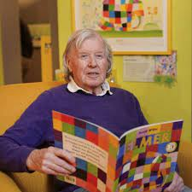
David McKee
David McKee was born in Devon and studied at Plymouth Art College. In the early part of his career, McKee regularly drew and sold humorous drawings to magazines and newspapers such as The Times Educational Supplement, Punch and the Reader’s Digest. David McKee has written and illustrated over 50 picture books for Andersen Press and has penned a number of children’s classics including King Rollo, Mr Benn, Not Now Bernard and Elmer the Patchwork Elephant. David McKee loves to paint and now lives in the South of France but regularly visits London.

Slide 6
The story of Elmer written and performed by David McKee
https://www.youtube.com/watch?v=XtY7KlOX-PE&t=9s

Slide 7
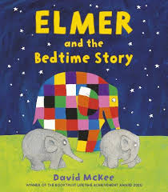
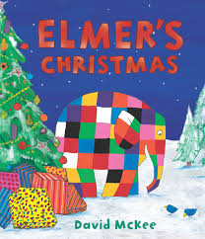
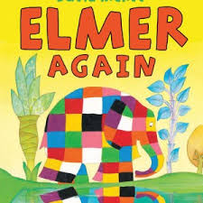
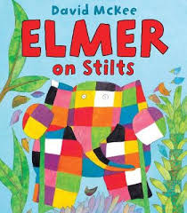
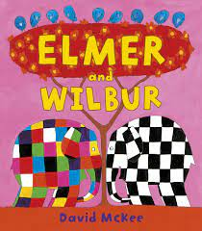
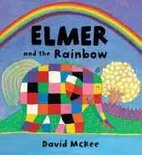
Elmer Stories

Slide 8



Celebrating Differences
What things make us different?
Hair colour
Type of family
Skin colour
Can you think of any other differences?

Slide 9
We Are All Unique
If we all looked the same, we wouldn’t be able to see who was who!
If we all liked the same things we would all fight over what we wanted!
Fortunately we are all different.

Slide 10


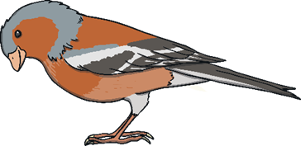
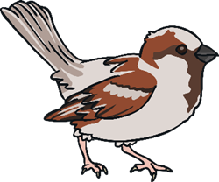
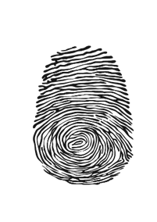

Did You Know?
No two snowflakes are the same. Each has its own individual pattern. Each snowflake is unique.
No two animals are the same. Even if they are both the same type of animal. They’re all unique like us.
Every single person on earth has a unique fingerprint. Each one is special and different.

Slide 11
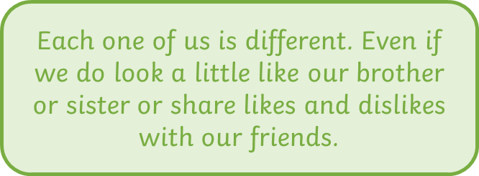
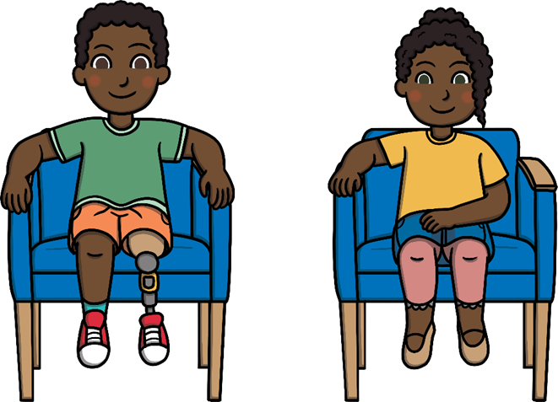
We are all Different

Slide 12
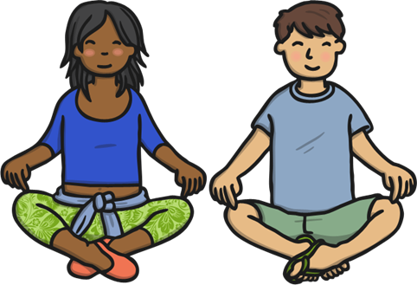
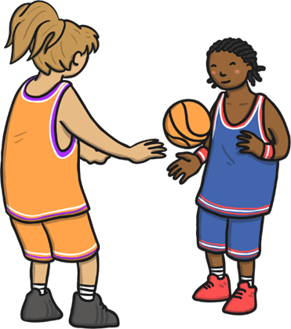
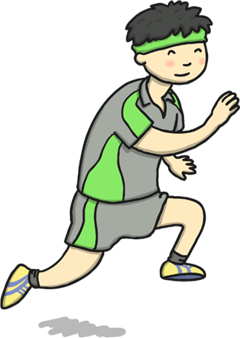
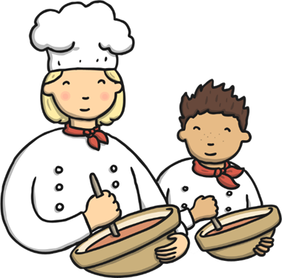
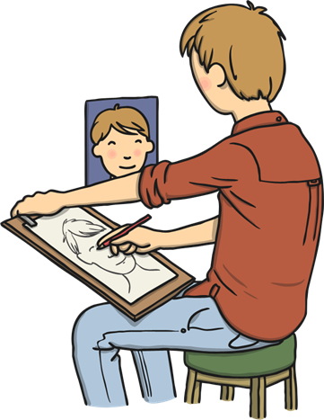
What things make you Special?
What talents do you have?

Slide 13
Inspirational Quotes
‘Be yourself; everyone else is already taken’-Oscar Wilde
‘Why fit in when you were born to stand out?’-Dr. Seuss
‘The things that make me different are the things that make me.’-Winnie The Pooh

Slide 14

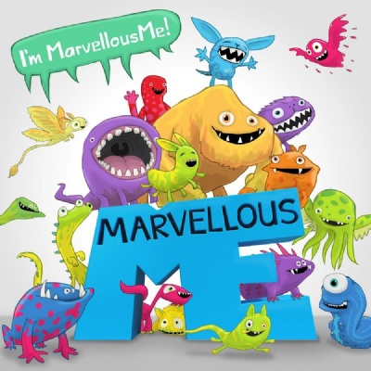
Marvellous Me
Celebrating personal qualities, uniqueness, achievements and talents

