Slide 1
What is a specification and why do we need to write one?
Design and technology - 3D computer aided design
Mr Wicken

Slide 2
Intro quiz ✓
What is a design specification?
What is a manufacturing specification?
Your specifications
Exit quiz

Slide 3
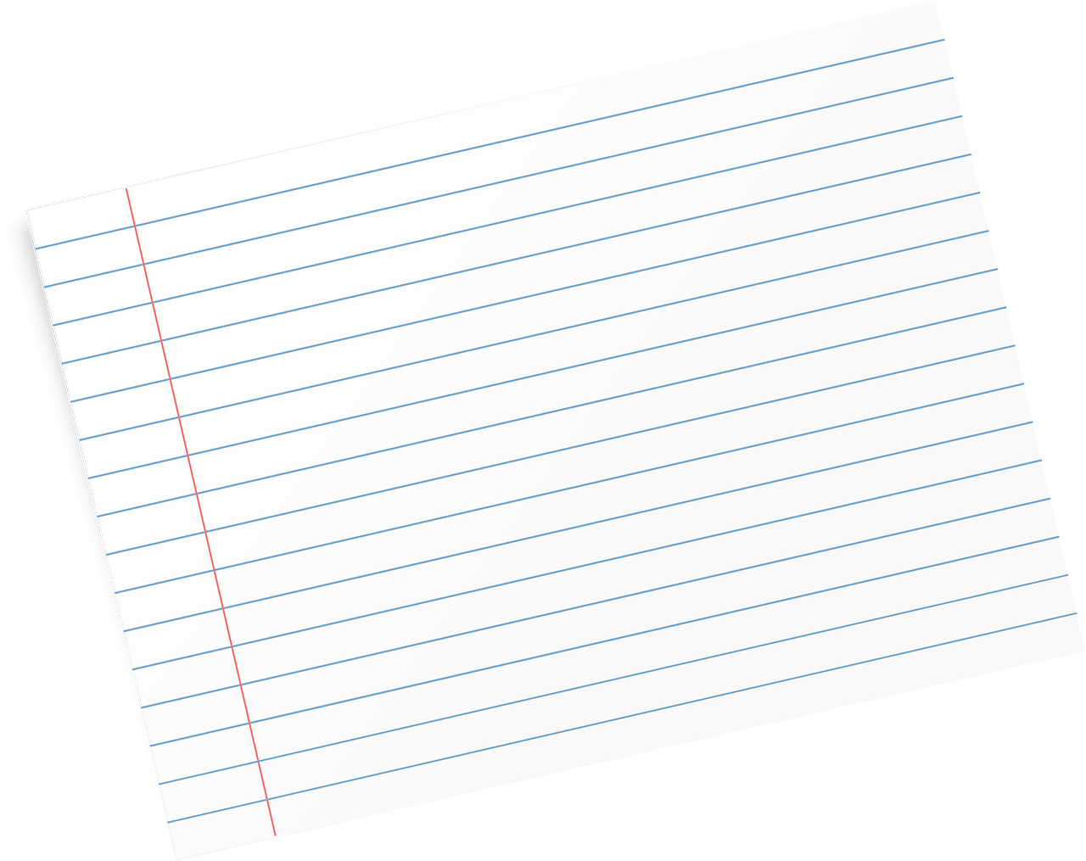
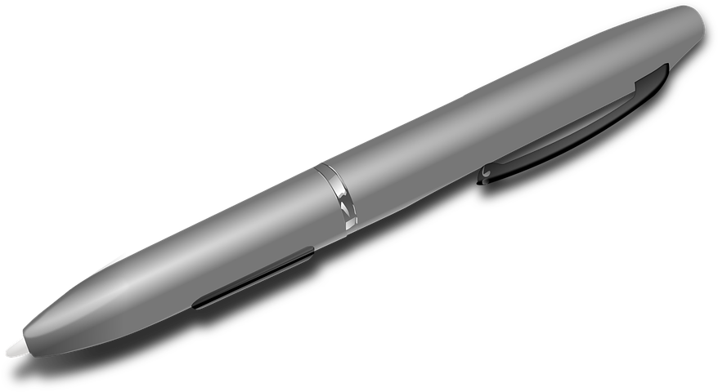
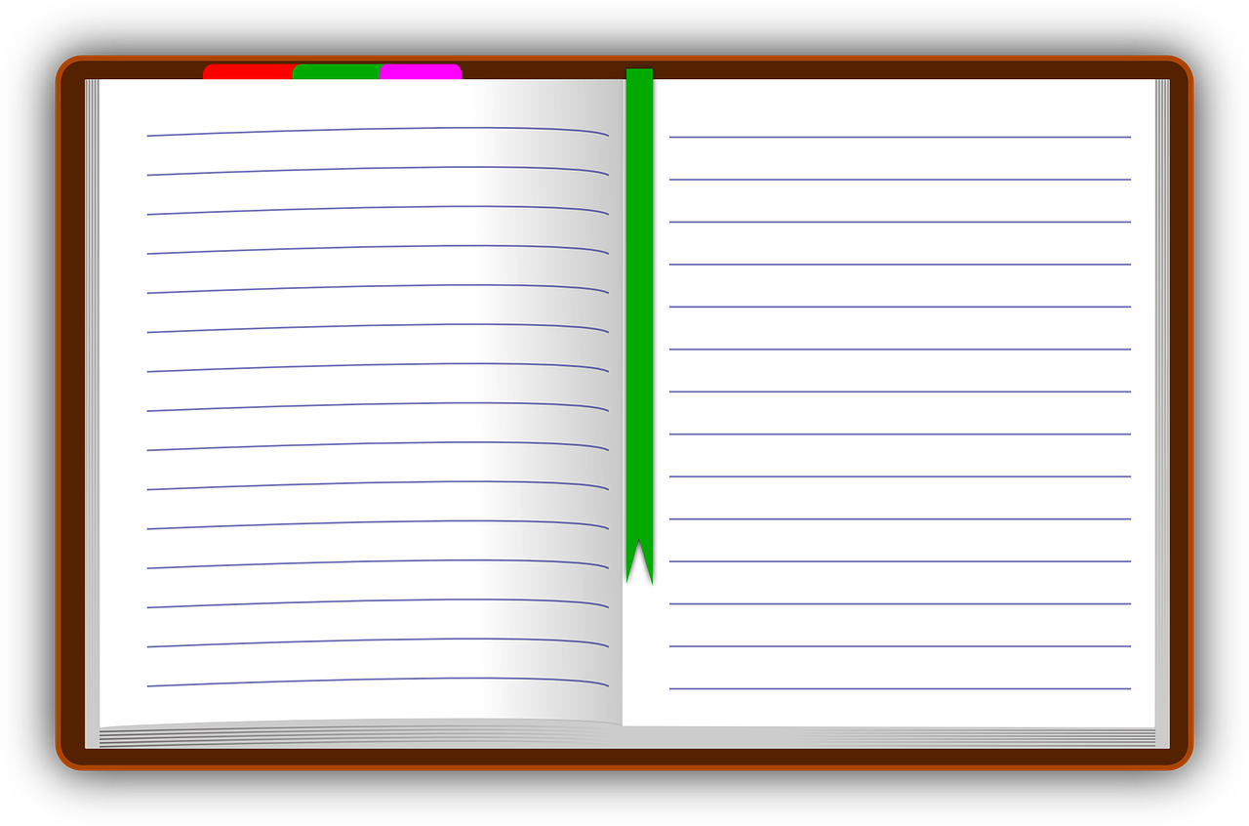
In this lesson, you will need:
Exercise book or paper
Pen
Credit: Pixabay

Slide 4
Keywords
Specification a detailed description of the design and materials used to make something.

Slide 5
What is a design specification?

Slide 6
What is a design specification?
A design specification is a list of key points that your design must meet. The document can be detailed so it can help you to consider some broad areas.
A design specification is best written as a bullet-pointed list, so it can be clearly read and understood. Furthermore, it acts as a ‘tick list’ to evaluate the success of the product when manufactured to check that it meets all the needs identified.

Slide 7
What is a design specification?
There is an acronym that is commonly used to help us structure our design specification. This acronym is ACCESS FM:
Aesthetics - What shape and form should the product be?
Cost - What should the cost of the product be?
Customer - Who is the target market?
Environment - How will the product is environmentally friendly?
Safety - What safety risk must be considered?
Size - What will the size and weight be of the product?
Function - What will the product be used for?
Materials - What materials will be used the make the product?

Slide 8
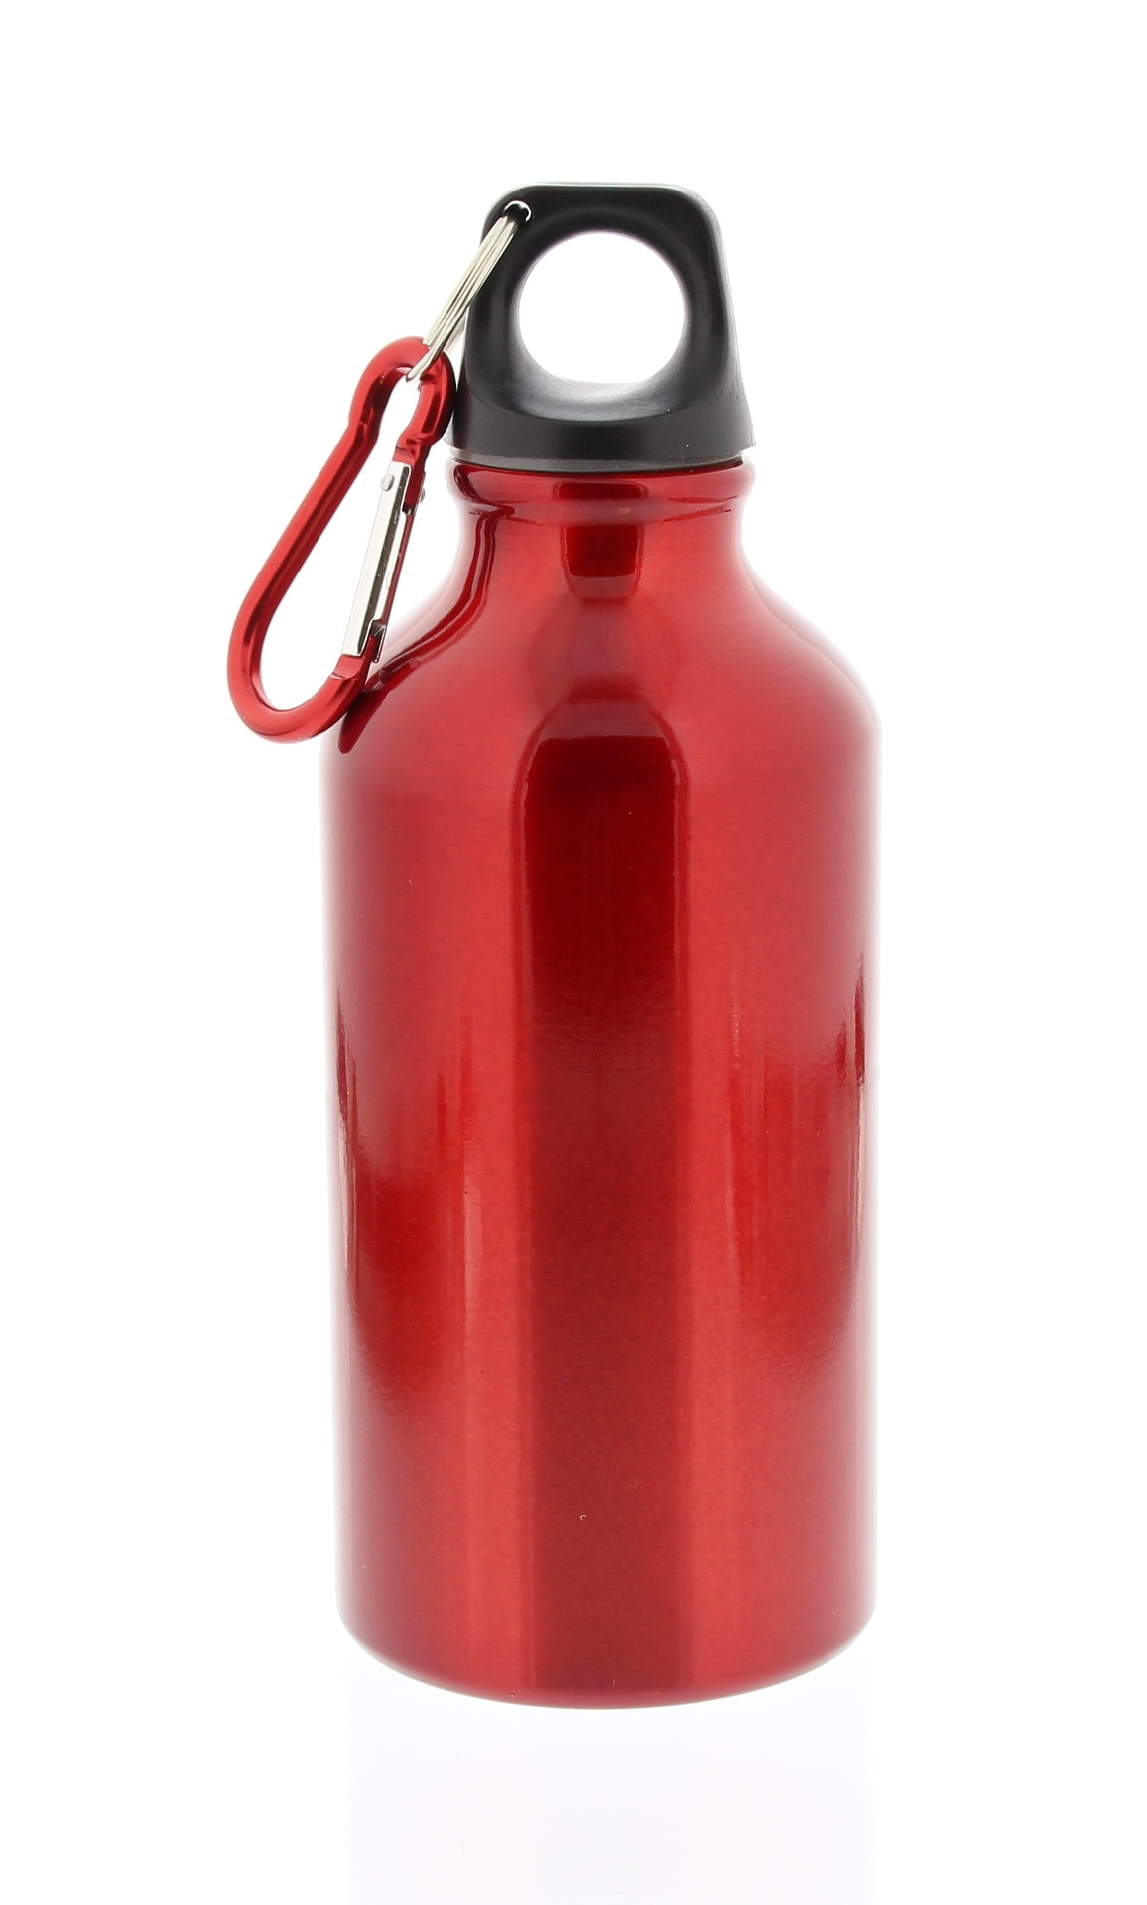
What is a design specification?
Lets complete an example design specification together for the water bottle.
Aesthetics - a shape that can be easily held.
Cost - should not cost any more than £15.
Customer - To be used by children at school.
Environment - the materials should be recyclable.
Safety - must be safe to go in a dishwasher to be cleaned.
Size - needs to hold 500ml of fluid.
Function - to hold a fluid without leaking.
Materials - aluminium will be used as it lightweight.

Slide 9


Pause the video to complete your task
Design specification
Choose a product that you use daily at home. Write the design specification for that product using ACCESS FM. Explain your reasons for each point.
Resume once you’re finished

Slide 10
What is a manufacturing specification?

Slide 11
What is a manufacturing specification?
A manufacturing specification is different to a design specification as this will contain all of the information required to ensure that the product can be manufactured as required.
Another reason for a manufacturing specification is that very often, the person manufacturing the product is different to the person who has designed the product. This way it can ensure all parties involved in the product do not misunderstand the information given.

Slide 12
What is a manufacturing specification?
A manufacturing specification is usually written similar to the design specification but using different points on the construction of the product:
Quantity - how many are going to be made?
Materials - what materials are going to be used the make the product?
Measurements - what are the exact measurements of the product?
Features - what features are to be built into the product?
Testing - how will the product be tested to check quality?

Slide 13
What is a manufacturing specification?
Lets complete an example manufacturing specification together for the water bottle.
Quantity - mass produced. Meaning 1000+.
Materials - body to be aluminium, cap to be plastic.
Measurements - 25cm height x 7cm diameter.
Features - clip to attach bottle to a backpack.
Testing - the bottle will be dropped to check strength.

Slide 14
Pause the video to complete your task
Manufacturing specification
With the same product as you used for the design specification, you now need to write a manufacturing specification. Make sure you put detail in your answers to show your understanding.
Resume once you’re finished

Slide 15
Your specifications

Slide 16
Your specifications
Now we understand the different types of specification, we need to write the specification for our shelter.
It is important to remember all of the work that has been completed already to support the writing of the shelter’s specification
Notes:
Talk about age group, gender, income, etc.

Slide 17
Your specifications
Your specification
Using your exercise books or pieces of paper, you now need to write the specifications for your shelter.
You must write both a design specification as well as a manufacturing specification for your shelter.
Notes:
Talk about age group, gender, income, etc.

Slide 18
Your specifications example - design specification?
Aesthetics - the shape of my shelter will be hexagonal.
Cost - the cost of the shelter will be no more than £500.
Customer - for primary school children and teachers to sit under.
Environment - the materials should be recyclable.
Safety - the shelter will have no sharp edges to avoid injuries.
Size - the shelter will need to be big enough the allow 2 tables under it.
Function - it must protect people from different types of weather.
Materials - aluminium for the supports and canvas for the cover.

Slide 19
Your specifications example - manufacturing specification?
Quantity - a one of build for the primary school.
Materials - body to be aluminium, the canopy will be canvas.
Measurements - 2.5m height x 2m diameter.
Features - lighting to be installed under the canopy.
Testing - water will be poured on the the canopy to check its water resistance.

Slide 20
Pause the video to complete your task
Your specifications
You must write both a design specification as well as a manufacturing specification for your shelter.
Resume once you’re finished

Slide 21

Share your work with Oak National
If you'd like to, please ask your parent or carer to share your work on Twitter tagging @OakNational and #LearnwithOak

