Slide 1
KS2 Science Project
(Assessment, Literacy and Numeracy)
Light and how we see things

Slide 2
https://www.bbc.co.uk/programmes/b00795tw/clips
Follow the link to watch different videos based on our science topic
Light sources
A source of light makes light. The Sun and other stars, fires, torches and lamps all make their own light and so are examples of sources of light.
Some animals, such as fireflies and glow-worms, are light sources. They make their own light to attract mates
Reflection
When light from an object is reflected by a surface, it changes direction. It bounces off the surface at the same angle as it hits it.
Smooth, shiny surfaces such as mirrors and polished metals reflect light well. Dull and dark surfaces such as dark fabrics do not reflect light well.

Slide 3
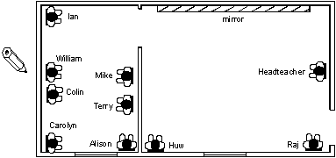
Ian and the Headteacher
How does the Headteacher see Ian?
Ian
mirror
William
Headteacher
Mike
Colin
Terry
Carolyn
Alison
Huw
Raj

Slide 4
Describe how different people in the diagram below see each other
How does … see … ?
Mr P
Miss X
Miss J
Mrs D
Ms L
Miss V
Mr B
Ms N
Miss L
Mr T

Slide 5
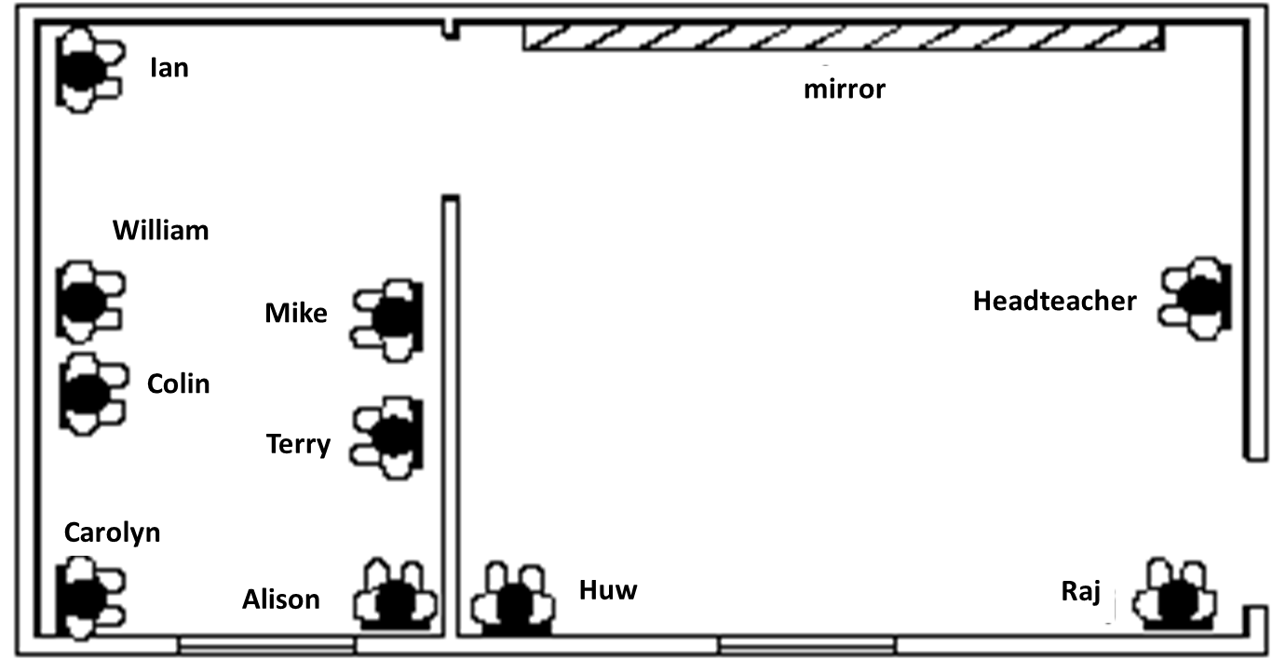
Ian and the Headteacher
How does the Headteacher see Ian?
Explain in as much detail as you can how the Headteacher sees Ian.
You can draw on a copy of the diagram and/or draw your own diagrams.

Slide 6
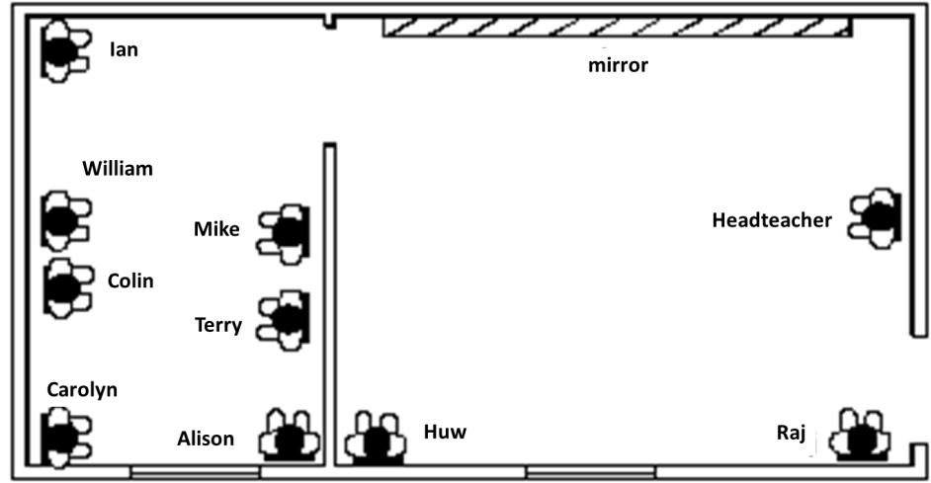
Ian and the Headteacher
Which diagram best shows how the Headteacher sees Ian?
A
B
C
D

Slide 7
Ian and the Headteacher
Which diagram best shows how Ian sees the Headteacher?
A
B
C
D

Slide 8
Ian and the Headteacher
Which diagram(s) would you NOT use when drawing light?
Explain your choice.
A
B
C
D

Slide 9
Huw, Raj and the Headteacher
Ian
mirror
William
Headteacher
Mike
Colin
Terry
Carolyn
Alison
Huw
Raj

Slide 10
Huw, Raj and the Headteacher
On the diagram, draw how the headteacher can see Raj.
Draw how Huw can see the Headteacher (without the mirror).
Draw how Huw can see the Headteacher (through the mirror).
Ian
mirror
William
Headteacher
Mike
Colin
Terry
Carolyn
Alison
Huw
Raj

Slide 11

Huw, Raj and the Headteacher
a. On the diagram, draw how the headteacher can see Raj.
b. Draw how Huw can see the Headteacher (without the mirror).
c. Draw how Huw can see the Headteacher (through the mirror).

Slide 12
Who can the headteacher see?
a. Who can the Headteacher see without using the mirror?
b. Who can the Headteacher see using the mirror?

Slide 13

Person | The Headteacher can see | Huw can see | Carolyn can see
Headteacher
Raj | ✓
Huw | ✓
Ian | ✓
William | ✗
Colin
Carolyn
Alison
Terry
Mike

