Slide 1


Pig Heart Boy
By Malorie Blackman
Week one Lessons

Slide 2
Lesson 1
Tuesday 3rd November
LC: Can I research an author?

Slide 3
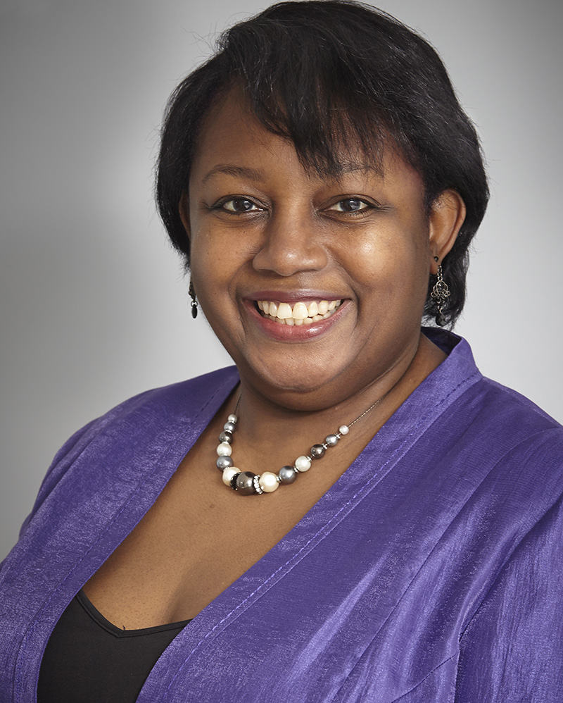
Malorie Blackman
Malorie Blackman is the author of ‘Pig Heart Boy’
Click on her photo to have a look at her website!
Then read her biography and complete the comprehension questions.
Remember to underline the tricky vocabulary in the text, identify the content domain of the question and highlight the evidence in the text to help you to answer correctly.

Slide 4
Lesson 2
Wednesday 4th November
LC: Can I make a prediction about a text?

Slide 5

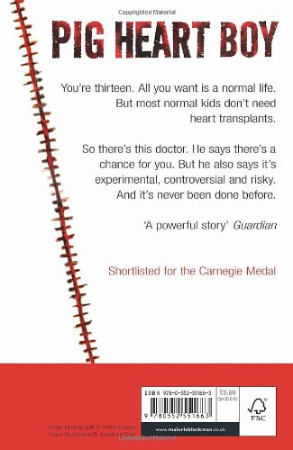
1. What can you guess based on the TITLE?
3. What can you guess based on the BLURB?
4. What can you guess based on the REVIEWS/
COMMENTS?
2. What can you guess based on the IMAGE?

Slide 6
Write your prediction in your book based on the following things:
- The title
- The front cover
- The blurb
Challenge: Back up your prediction with evidence from the text. (use PEPE)
Support: Think through your own idea first, then talk to your partner before writing. Are your predictions similar?

Slide 7
Open your books to page 7 (there is no page number so you will need to work it out).
TTYP: What are consequences?
I think that a consequence is _______.
One example of a consequence is _______.

Slide 8
A consequence is a result or effect, typically one that is unpleasant.
A consequence of going to bed late, is that you are tired.
A consequence of forgetting to bring your lunch, is that you have nothing to eat and are hungry.

Slide 9
Chapter One - Dying
How can silence be ‘roaring’?
What is a surface?
What is chlorine?
Where do you think the narrator is?
What do you think is happening?
Why does the character stop kicking?

Slide 10
Chapter One - Dying
How do you think the character feels in this chapter?
What does the phrase ‘to bow out’ mean?
Who might Alex be?
How does the author create a feeling of disorientation and panic?
Summarise what you’ve learned about the main character from this chapter.
Can you think of another suitable title to summarise this chapter?

Slide 11
Lesson 3
Thursday 5th November
LC: Can I make inferences about a text?

Slide 12
Open your books to page 11 (there is no page number so you will need to work it out).
TTYP: What is a cause?
I think that a cause is _______.
One example of a cause is _______.

Slide 13
A cause is something that gives rise to or creates an action or condition.
A consequence happens as a result of a cause.
Cause: Being late for school.
Consequence: Missing the start of the lesson and not understanding what is happening.

Slide 14
TTYP: If causes happen before consequences, why does this text have them the other way round? What does it tell us about the structure?
If the story is being told out of order, What is the name of the structural device that shows you something that happened in the past in a story?

Slide 15
Chapter Two - Ticking
How is the beginning of this chapter similar to Chapter 1? How is it different?
Do you think the main character liked being underwater? Why?
Find and copy a phrase which means ‘annoy me’.
How does Cam feel watching his friends in the pool.
Find two pieces of evidence to suggest that Marlon is concerned about Cameron.

Slide 16
Answer the inference questions in your book. Remember to refer to evidence from the text in your answer.
Challenge: Create two of your own inference questions based on the chapter after answering the questions given.
Support: Discuss your ideas with an adult if you need to.

Slide 17
Lesson 4
Friday 6th November
LC: Can I discuss a dilemma?

Slide 18
Chapter Three - News
Why is Cam not surprised Mum and Dad are arguing?
Why does Cam tiptoe through the house?
What does it mean to ‘wince’?
Was Dad wrong not to tell anyone about writing to Dr Bryce?
Why does Dad want Cam to have the pig heart?
Why did Cam get involved in the argument between Mum and Dad?
What are you doing if you are ‘eavesdropping’?
What does it mean if you are ‘pipped at the post’?

Slide 19
Chapter Four – Dr Bryce
How does Mum feel knowing Dr. Bryce is coming? How do you know?
If you ‘patronise’ someone, how are you acting?
What does ‘anguished’ mean?
Why do doctors need to develop alternative organs to human?
Find and copy a phrase meaning ‘in a way kind to animals’.
What does ‘saccharine’ mean?
Why did people firebomb Dr. Bryce’s house?
Why does Cam feel like he’s running out of time?
Why does Mum compare the situation to Pandora’s Box?

Slide 20
TTYP: What is the dilemma in the story?
Create a list of pros and cons that Cameron has to consider before making his decision.
We will add to this list as we read on and find new information or viewpoints.

