Slide 1
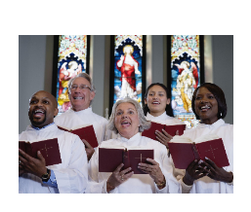
Monday 7th June
LC: Can I explore how Christians use music to express a variety of beliefs?

Slide 2
Listen to the first 20 seconds of each piece of music
https://www.youtube.com/watch?v=-rh8gMvzPw0
(FIRST 20 SECONDS)
https://www.youtube.com/watch?v=_jBLyIQvNf0
How did it make you feel?
Listening to the first piece of music made me feel ___ whereas the second piece made me feel_____.
calm energised bored nervous confused comfortable chilled joyful

Slide 3
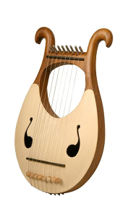
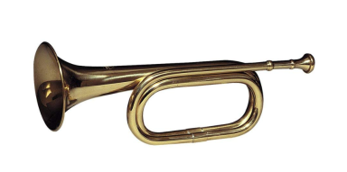
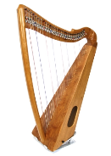
Music is important in both creating and showing feelings.
Christians use it in worship to express a variety of feelings and give teachings.
The Bible also teaches Christians to use music in their worship, "Praise him with the sounding of the trumpet, praise him with the harp and lyre" (Psalm 150)

Slide 4
TTYP: For what different occasions would Christians use music to help them worship God?
Christians use music _______________
(to celebrate, to worship God, to express their feelings, give teachings) (for prayers, weddings, services, Christmas, Easter)

Slide 5
In today’s lesson we are going to listen to parts of five different pieces of Christian music. (There won't be enough time to hear all of every piece).
If you are using a school laptop and you cannot get Youtube to work, go to the end of the slide for your work

Slide 6
For each piece of music, write:
How would you describe the feeling of each piece of music? (calm, joyful, emotional, sad)
When do you think each piece of music would be played? (wedding, funeral, baptism, ordinary service, Christmas, Easter etc)
Does the song give any Christian teachings?

Slide 7

Music 1
Piece one is Psalm 23. Psalms are the oldest type of Christian songs as they come from Judaism and were written in the Hebrew language around 3000 years ago. While the words can be found in the book of Psalms in the Bible, the tune is not in the Bible.
Here, the psalm is sung (or really chanted) in English by a traditional choir
https://www.youtube.com/watch?v=BYJkgLMC56s

Slide 8
How would you describe the feeling of this piece of music?
When do you think each piece of music would be played?
This words of this psalm are very famous and popular so it is sung a lot, although often to a more lively tune.
Does the song give any Christian teachings?
It teaches that God looks after people in the same way that a shepherd look after sheep.

Slide 9
Piece 2 is a very famous Christian hymn (pronouned him) called Amazing Grace, which was written around 300 hundred years ago. Hymns are traditional Christian songs. Unlike psalms, the words are not directly from the Bible but they are inspired by what the Bible teaches.
Listen to the first minute of this
https://www.youtube.com/watch?v=WmMOnbTch5I

Slide 10
How would you describe the feeling of this piece of music?
When do you think each piece of music would be played?
This song is often used at important services such as baptisms or funerals. It is sung at normal services too.
Does the song give any Christian teachings?
This hymn is about grace, the Christian belief that God can forgive your sins (bad actions) and guide you to live a better life if you ask him. For Christians, grace means God loves everyone, even those who do wrong, and wants to help them. (Think of the Prodigal Son story).

Slide 11
Piece 3 is Hark the Herald Angels Sing.
Here it is sung by everyone in a church (the congregation).
https://www.youtube.com/watch?v=wLz4LbhS4_M
You only need to listen to the first minute
Listen to it and see if you can work out when it is normally sung.
Did you spot that this is a Christmas carol? Carols are Christian songs that are to do with the birth of Jesus.
This carol explains how the birth of Jesus is a time of celebration because Christians believe that he came to save the world. In the Bible, angels sing when he is born.

Slide 12
Piece 4 is All things bright and beautiful.
https://www.youtube.com/watch?v=1HyWkC64X08
Listen to the first minute of it.
How would you describe the feeling of this piece of music?
When do you think each piece of music would be played?
This song is often used at Harvest Festival or to remember the environment
Does the song give any Christian teachings?
This hymn describe how God is the creator of all things.

Slide 13
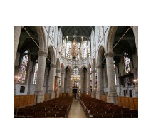
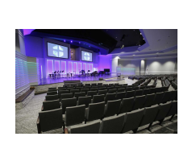
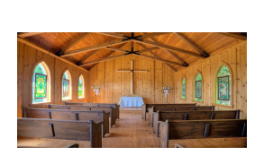
Have a look at the inside of these different churches. What types of music would you expect in each one? What types of instruments would you expect to be playing the music?

Slide 14
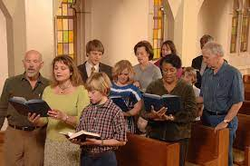
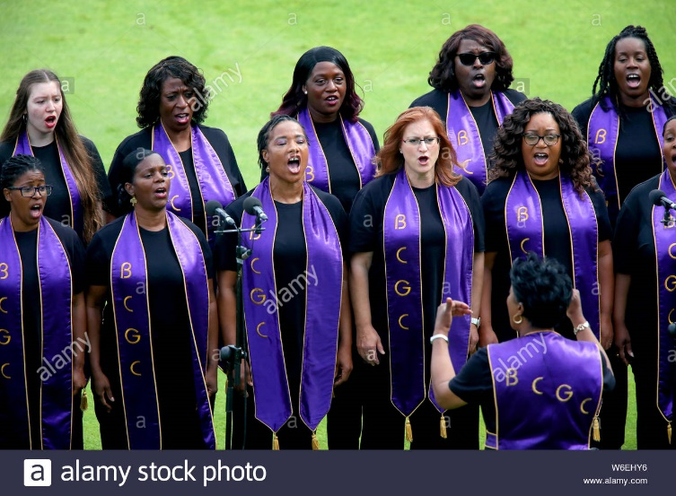
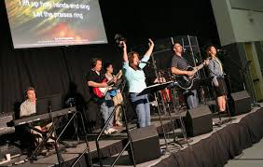
Activity to do if Youtube does not work (1)
Look at these pictures of different Christian music .
How is the music similar?
How is it different?

Slide 15
Activity to do if Youtube does not work (2)
Look at the lyrics for this ancient Christian psalm ( a song from the Bible)
What do they words show about what Christians believe about God?

Slide 16
You, Lord, are my shepherd.
I will never be in need.
² You let me rest in fields
of green grass.
You lead me to streams
of peaceful water,
³ and you refresh my life.
You are true to your name,
and you lead me
along the right paths.
⁴ I may walk through valleys
as dark as death,
but I won’t be afraid.
You are with me,
and your shepherd’s rod^{[a]}
makes me feel safe.
⁵ You treat me to a feast,
while my enemies watch.
You honor me as your guest,
and you fill my cup
until it overflows.
⁶ Your kindness and love
will always be with me
each day of my life,
and I will live forever
in your house, Lord.

