Slide 2
Creation According to the Ancient Maya
The Maya people believed that the Earth was created by Huracán, the wind and sky god.
First, the Earth and the sky were connected, leaving no room for anything to grow. A Ceiba tree was then planted and as it grew, its roots grew down into the underworld and its branches reached up into the upper world. The tree’s trunk grew and left space for plants and animals.
Animals and plants were created before humans. The gods were not happy that the animals could not speak and worship them so they created humans to honour them.

Slide 3
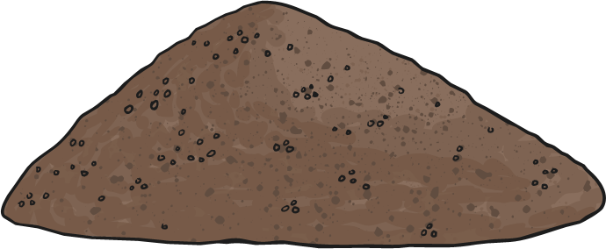
Creation According to the Ancient Maya
The first creation saw the gods create people out of mud.
The mud people were not very productive as they could not think or move very well. The gods were not happy with their creation so they destroyed the mud people with water.

Slide 4
Creation According to the Ancient Maya
The second creation saw the gods create men from wood and women from reeds.
These people were more productive than the mud people and could move well. However, they had no souls and could not honour the gods. They were also immortal; when they died, they would come to life again after three days.
The wood and reed people were destroyed by a flood of boiling hot water.

Slide 5
Creation According to the Ancient Maya
The third creation saw the gods create people from white and yellow maize dough and the blood of the gods.
At first, the gods created four men and four women. These people were thought by the gods to be too wise and a threat to them. Huracán, the sky god, clouded their minds and eyes so they would become less wise.
These people are modern-day humans.

Slide 6
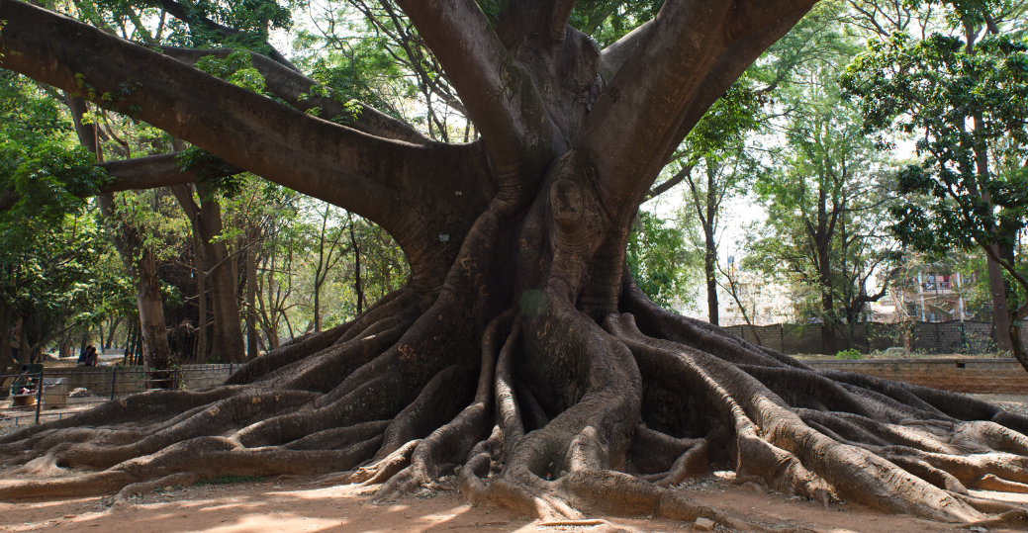
The Universe According to the Ancient Maya
The Maya people believe that there are three separate realms:
The upper world – made up of 13 levels
The middle world – just one level
The underworld – made up of nine levels
All the levels are linked
together by a Ceiba tree.
“DSC_4309” by Morgan Davis is licensed under CC BY 2.0

Slide 7
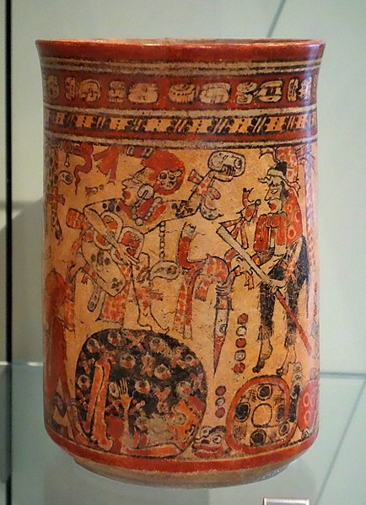
The Underworld
The underworld was called Xibalba, which means 'place of fright’.
It was a great city underneath the surface of the Earth that was reached through a system of caves and tunnels.
The Maya people believed that souls entering Xibalba would have to face a series of tests before they were able to be greeted by the Lords of Xibalba.
The Lords of Xibalba ruled the city.
Hun-Came (meaning ‘One Death’) and Vucub-Came (‘Seven Death’) were the first Maya death gods to rule Xibalba and ten other Lords (demons) worked in pairs to cause forms of human suffering, such as sickness, fear and starvation.
Pot showing gods in the court of Xibalba

Slide 8
Cardinal Directions
Cardinal directions were important to the Maya people.
They believed that there were colours and five elements, linked to the four compass directions and the centre point.
East – red
Associated with birth and the rising of the Sun.
North – white
Associated with cool rains and ancestors that have died.
The Centre – blue or green
Associated with balance and staying in harmony with the world.
South – yellow
The right hand of the Sun.
West – black
Associated with the change of seasons, the sunset and the underworld.
East was shown at the top of the compass, as it was seen as the most important.

Slide 9
The Gods
The ancient Maya people believed in a pantheon (large group) of gods, only a few of which are mentioned by the same name in different sources.
Many of them had overlapping roles and names.
Some had human form, some took the form of an animal and others were a phenomena of nature.

Slide 10
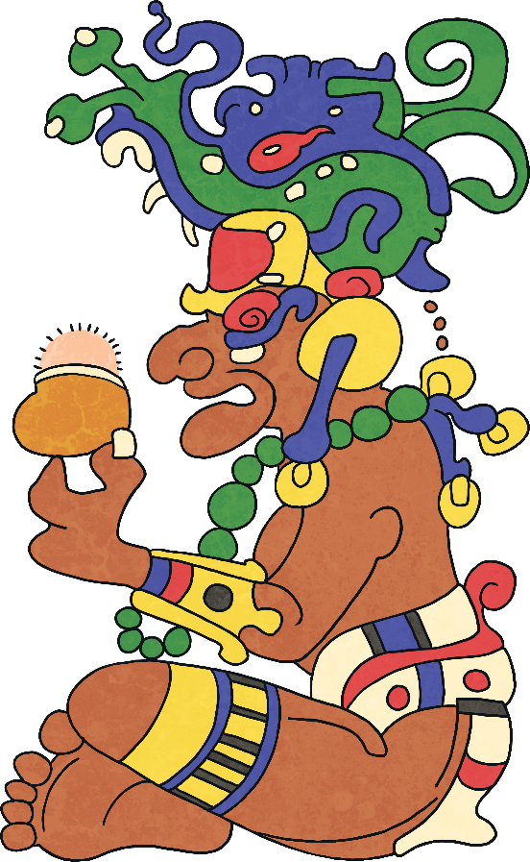
Itzamna
One of the creator gods.
Patron of learning and the inventor of writing.
He taught people literacy, medicine, science, art, sculpture and agriculture.
He also created the calendar.
Portrayed in human form as an old man with no teeth and a large nose.

Slide 11
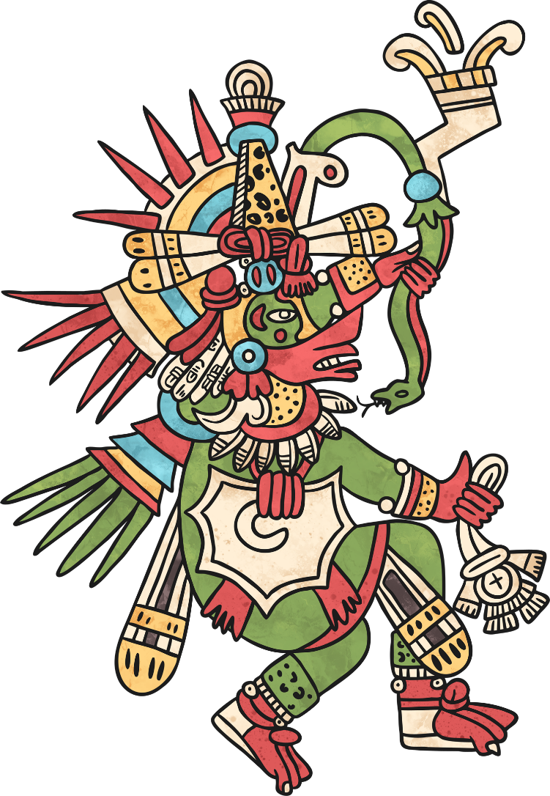
Kukulcan
Supreme god.
God of the four elements with the following items associated with each one:
maize-ear (earth)
fish (water)
lizard (fire)
vulture (air)
One of the creator gods.
God of resurrection and reincarnation.
His name means ‘feathered serpent’.

Slide 12
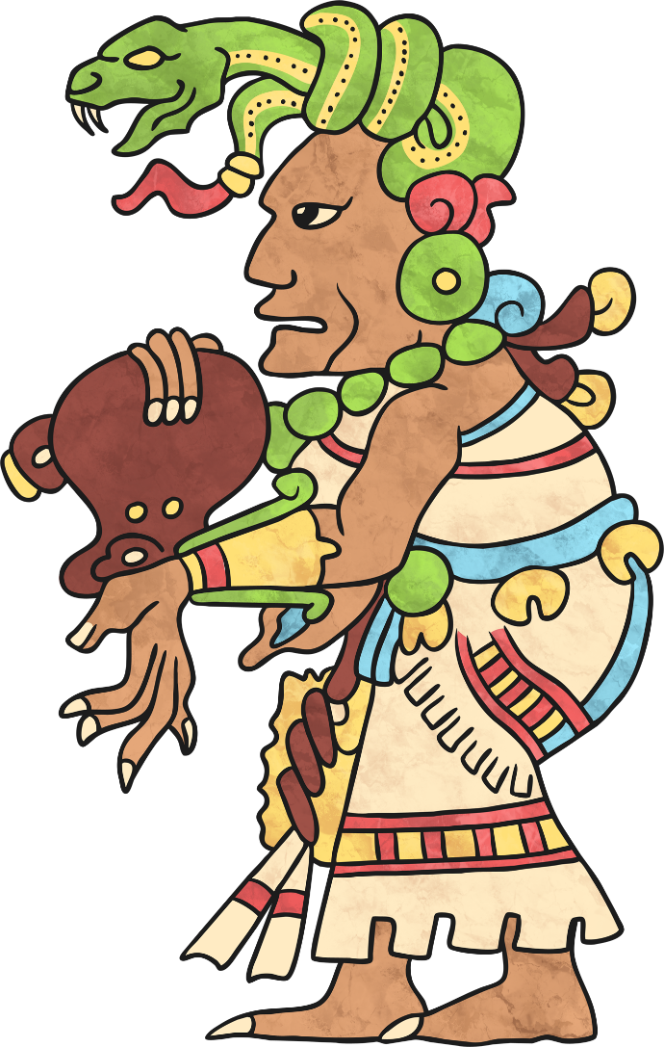
Ix Chel
Wife of Itzamna.
Goddess of childbirth, healing, weaving and the moon.
Portrayed in human form wearing a headdress of snakes entangled in her hair and toes and fingers that looked like jaguar claws.
Capable of causing floods and destruction.
The mother of many other gods.

Slide 13
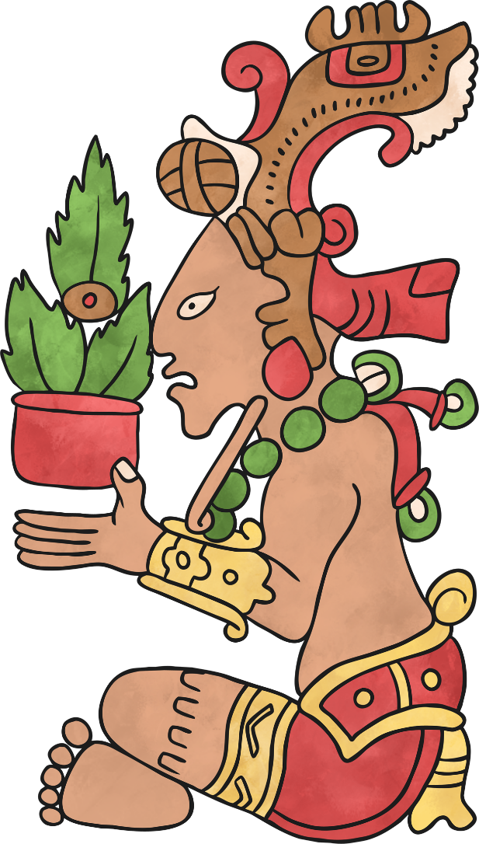
Hun-Hunahpu
Known as many other names, including ‘The Maize God’.
He was an important god because maize made up 80% of the diet of Maya people. They relied on the harvest being successful.
Mayans believe Hun-Hunahpu was killed by the Lord of Xibalba but was resurrected by his sons, the Hero Twins. He is therefore also seen as a figure of revival.

Slide 14
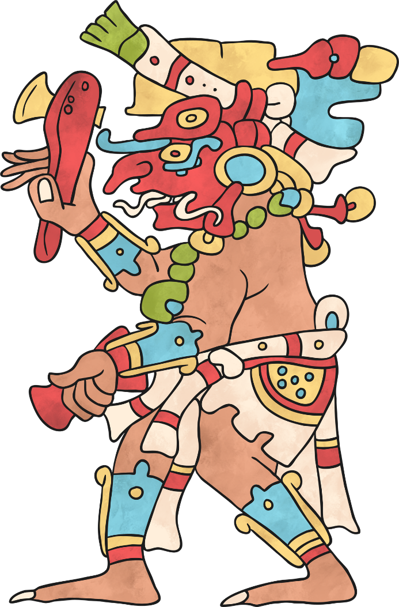
Chac
The supreme god of storms and rain.
Brought the rain needed to make crops grow.
Created storms, thunder and lightning and maintained water sources, such as wells, streams and springs.
Prayers and sacrifices were often offered to him to gain his favour.
Portrayed as a human with a curling snout and reptile fangs.

Slide 15
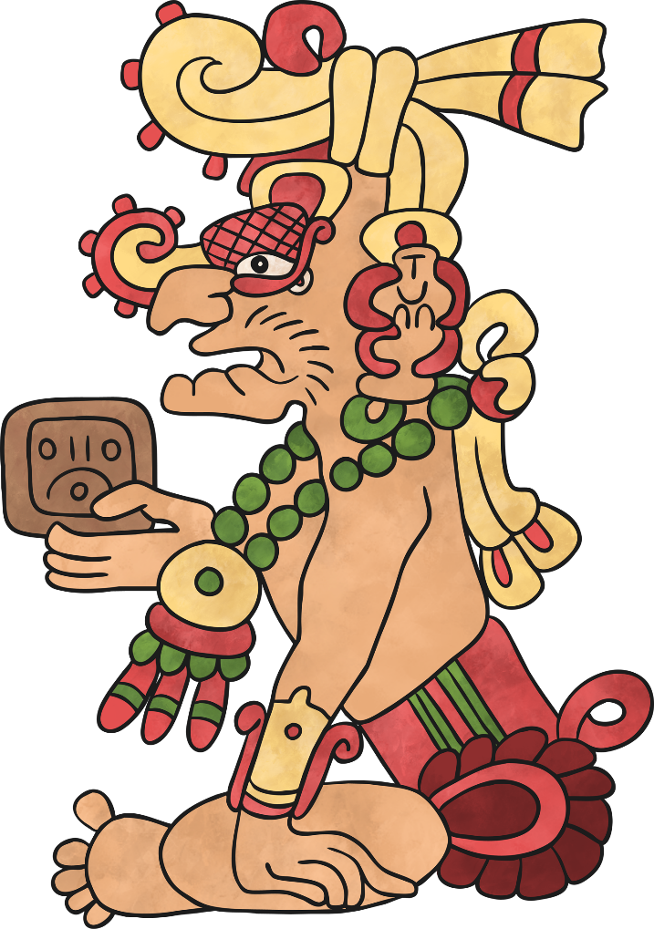
Kinich Ahau
The Sun God, sometimes called ‘The Face of the Sun’.
Also the god of healing and medicine.
He sunk below the Earth and travelled through the underworld at night, changing into the Jaguar God of the Night.

Slide 16
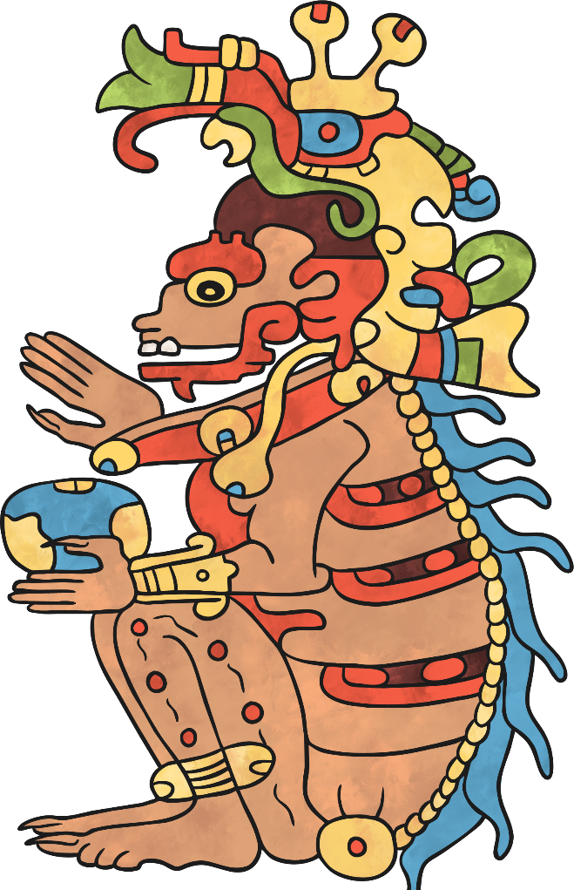
Kisin
God of Death.
Ruled Xibalba and controlled earthquakes.
He is associated with owls as the Maya people linked owls with the caves of Xibalba, the night and killing prey.
Portrayed as a human with a skeletal nose, jaw and spine and a body covered in hideous spots.
His name means ‘Stinking One’.

Slide 17
Religious Rituals
The ancient Maya would perform rituals to gain favour with the gods.
Public festivals related to special dates on the Maya calendar or occasions to plead for a healthy harvest, the health of a ruler, or to win a war.
Before a ritual or festival, people would go without certain food or pierce their tongues, lips, cheeks or ears to offer a sacrifice of human blood.
The festivals were colourful and noisy with processions, banners, drums and trumpets.

Slide 18
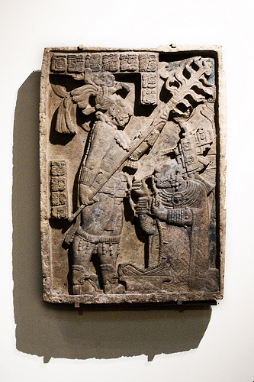
Blood Letting
Stone carvings show rulers and nobles giving blood sacrifices.
They had a lot to lose if they didn't keep the gods happy.
The gods could keep them in power, help defeat their enemies and let them into the Upperworld when they died.
This lintel shows Shield Jaguar, the warrior king of Yaxchilan, standing over his wife, Lady Xook, holding an enormous flaming torch. Lady Xook is pulling a thorn-studded rope through her tongue in an act of blood letting to honour the gods.
“Maya Relief of Royal Blood Letting” by Ann Wuyts is licensed under CC BY 2.0

Slide 19
Human Sacrifice
One of the main purposes for fighting battles was to take captives that could then be sacrificed.
According to a writer in the 1500s, the Maya would paint the body of the victim blue, lay him on a stone platform at the top of a temple, and four men would hold him by his arms and legs.
The executioner would cut between the victim's ribs and rip out his heart with his hand.
The heart would be placed, still beating, on a plate and given to a priest.
The priest would smear blood from the heart on the faces of stone idols.

Slide 20
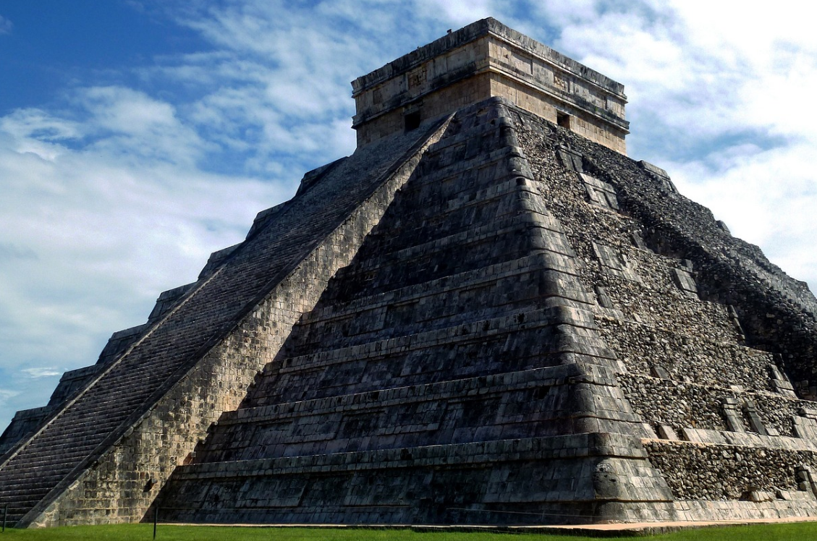
There is plenty of evidence of these practises at Chichen Itza.
Victims could be thrown into the ‘Well of Sacrifice’
(but not all that often).

Slide 21
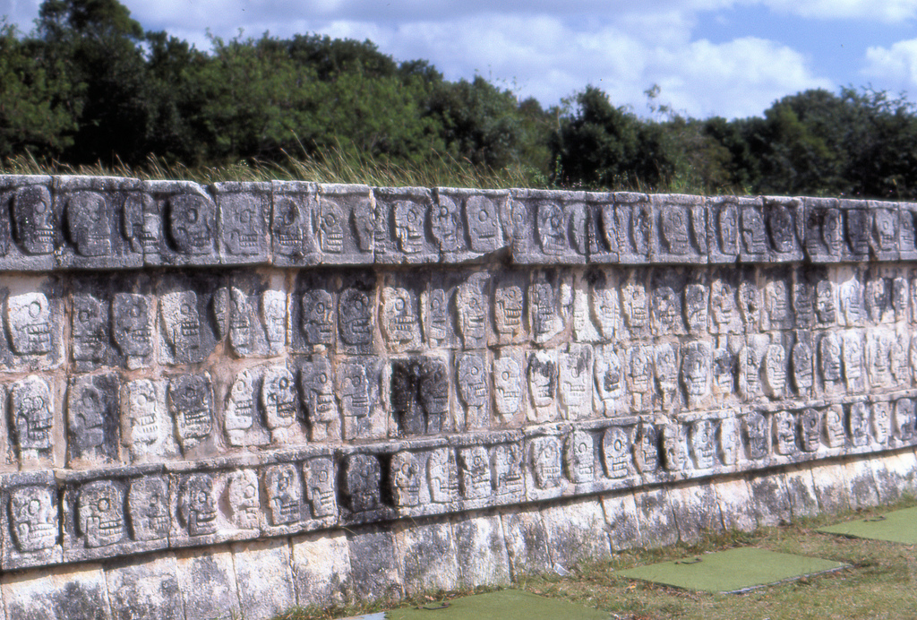
The Wall of Skulls
“Wall of Skulls” by Jim G is licensed under CC BY 2.0

Slide 22
Believe it or not, the victims who went straight to the temple to have their hearts ripped out could be considered the lucky ones!
Wall paintings, ceramic figures, stone carvings and paintings on pottery show some victims being tortured for a long time, before finally being sacrificed.

Slide 23
Something to Think About...
Many cultures and religions believe in an afterlife, somewhere you go after you die. The ancient Maya believed their souls went to a ‘place of fear’. Only the rulers and nobles believed there was a chance of them getting to the Upperworld. Why do you think this was?
How do the beliefs of the ancient Maya compare with different religious beliefs today? Can you find any similarities?
What do you think about their understanding of the world? Why might they have thought this?
Why do you think the ancient Maya had so many different gods?
Where does a lot of the evidence for what we know today come from? How open are these sources to interpretation?
Would you like to be alive in the 1st millennium and living with the ancient Maya? What would be the pros and cons?

Slide 24
Design your own god!
What would this god be responsible for?
What attributes would they have? (e.g. something they carry)
What does your god look like?
What is their name?
What does their name mean?
What sacrifices have to be made to this god?
Extension:
What myth might this god be at the centre of?
What event could be explained by their actions?

