Slide 1
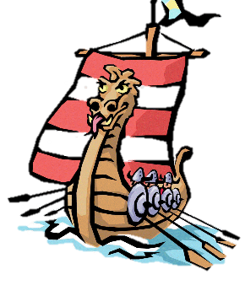
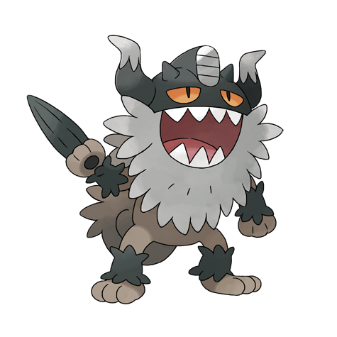
Key Questions
Introduction: What do I already know?
LC 1 | Who were the Anglo-Saxons and did they like the Vikings?
LC 2 | Which region of Britain would you have come under during the Heptarchy?
LC 3 | Why did the Vikings come to Britain and how did they make the journey?
LC 4 | What did the Brits learn from the Vikings?
LC 5 | What was life like for a 11 year old (boy/ girl) Viking?
LC 6 | How did the Vikings live when they came to Britain?
LC 7 | How can you create a Viking long boat from a range of materials?
Fantastic Finish: Children to prepare a Viking day when they show others the crafts and skills that the Vikings had.

Slide 2
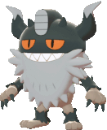
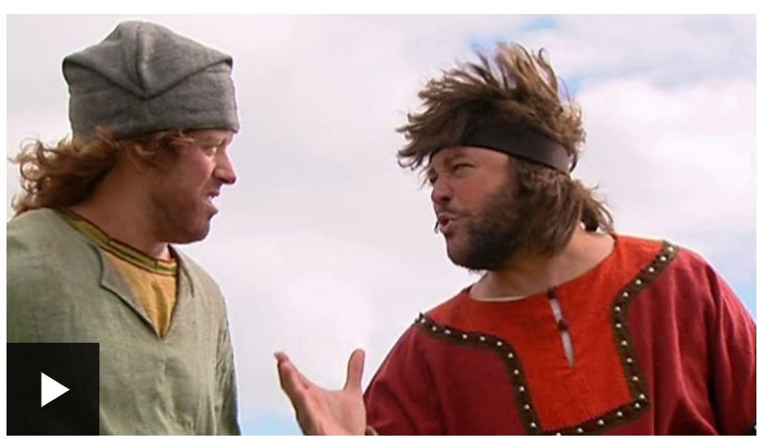
Thursday 26th January
LC: Can I research Lindisfarne?
Self Assessment
What have you learned today? What have you succeeded in doing?
I can
I understand how to
I am able to
I know that
Today you will be learning about the Vikings’ time in Britain to continue our work for LC2: Why did the Vikings come to Britain and how did they make the journey?
https://www.bbc.co.uk/bitesize/clips/zrpnvcw
Watch the video found in the above link. A Viking and a Saxon will take you on a journey to Lindisfarne - or Holy island, as it is also known.
Make notes on the events that occurred there and work through the presentation

Slide 3
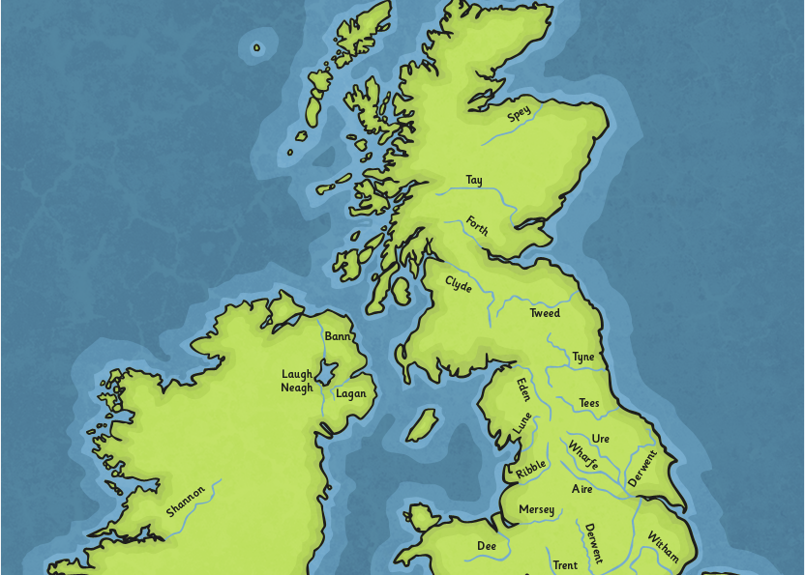
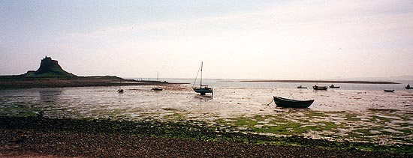

Where Is Lindisfarne?
Lindisfarne is in the north-east of England, near Berwick-upon-Tweed and close to Hadrian’s Wall. It is a tidal island, which means twice in every 24 hours, the tide cuts the island off from the mainland and the only way to reach Lindisfarne is via boat.
There is a paved causeway to walk across when the tide is out.

Slide 4
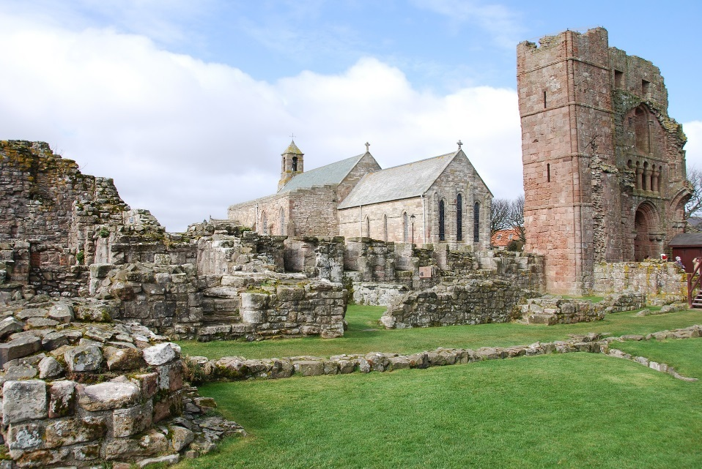


Facts
There are only 160 residents on Lindisfarne, but the island has approximately 650,000 visitors each year.
The Anglo-Saxon name is Lindisfarne, whilst the Holy Island part of the name derives from the Viking raids.
The island is 4.8km east to west and 2.4km north to south.

Slide 5
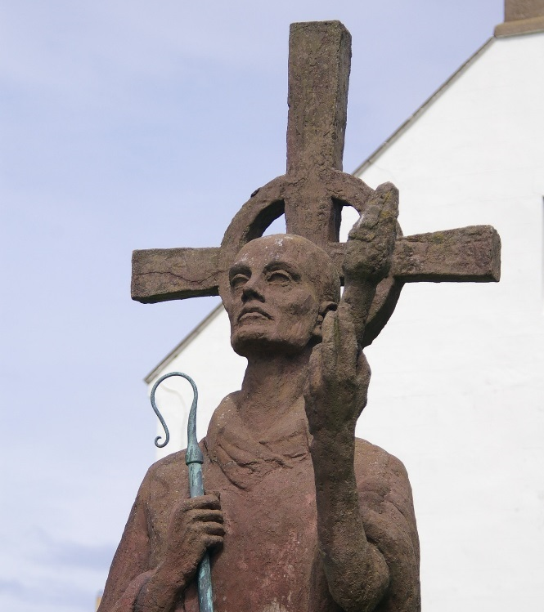

From the Beginning
The Romans living in England did not affect Lindisfarne.
In AD634, the priory was founded by an Irish monk called St. Aidan. He had been sent there by King Oswald, King of Northumbria.
He stayed there until he died in AD651.
A monk is a person who gives up their life for the work of God. Monks live in monasteries and serve the community. They spend their days in prayer, worship and in service to others.

Slide 6
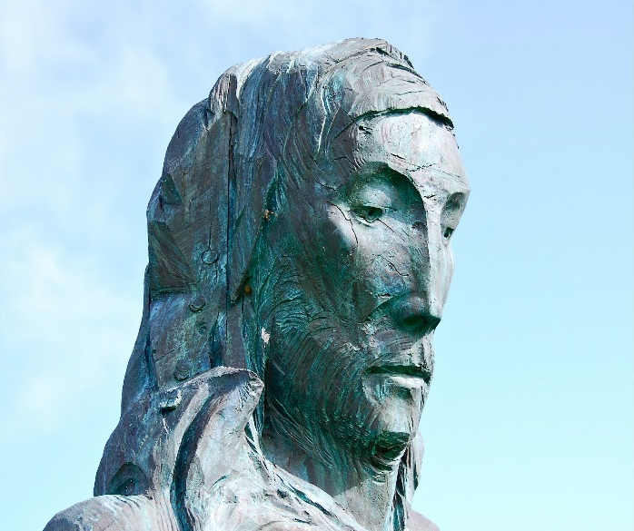
Saint Cuthbert
Northumberland’s patron saint, St. Cuthbert, was an abbot of the monastery, and later the bishop. He was known for his charm and generosity to the poor, and often performed healing miracles and gave people advice about their problems. He became known as ‘The Wonder Worker of Britain’.
There is a long trail called St. Cuthbert’s Way which visitors can walk along.
Mead:
The monks became well-known for brewing an alcoholic drink called mead. To this day, the recipe is still kept a secret by the people who make Lindisfarne Mead.

Slide 7
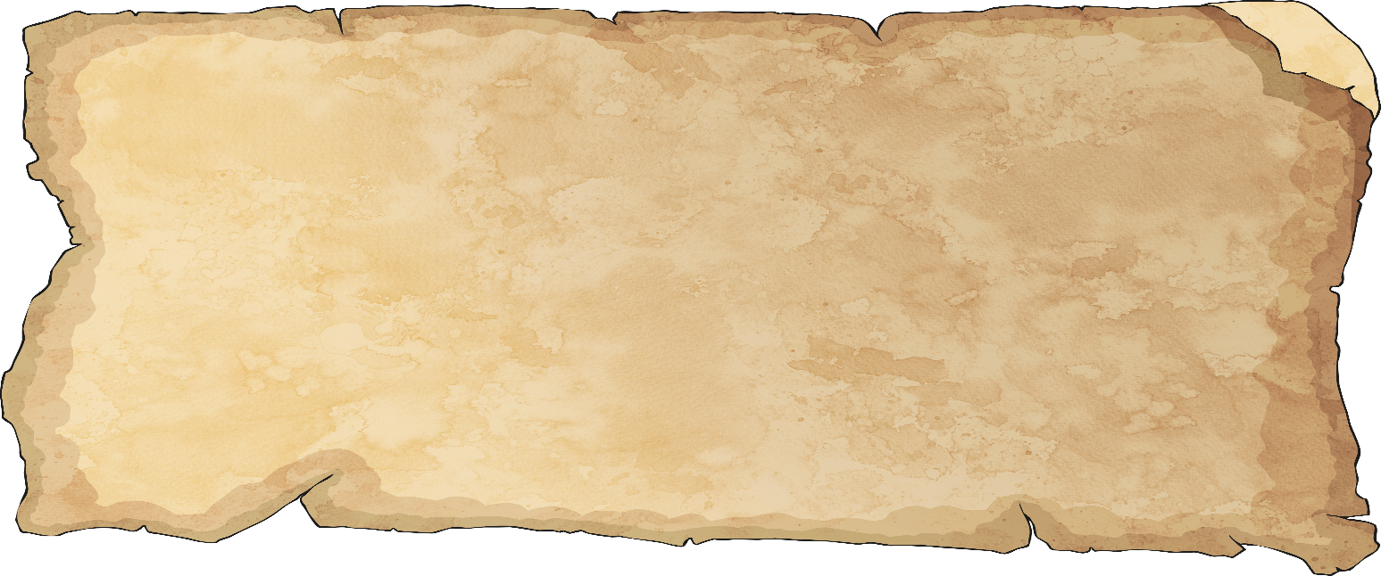
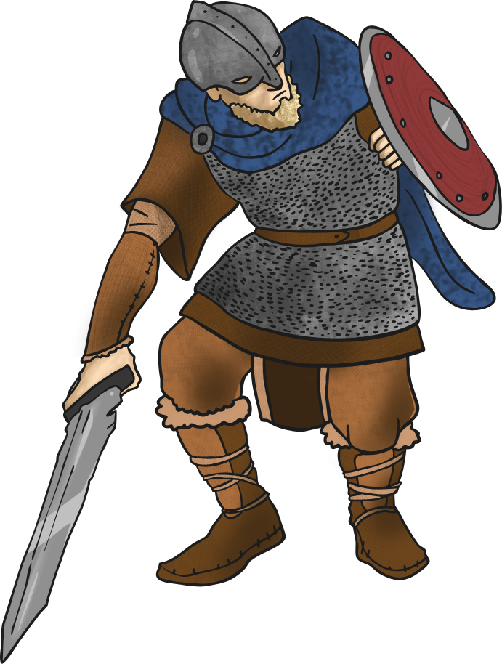
The Viking Raids
Around the time when the Vikings landed on Lindisfarne, the local community of Anglo-Saxons were not behaving in a very Christian way.
The writer Alcuin recorded:
“Either this is the beginning of greater tribulation, or else the sins of the inhabitants have called it upon them. Truly it has not happened by chance, but it is a sign that it was well merited by someone”.
He believed that the Viking landings were a punishment for the local people’s behaviour.

Slide 8
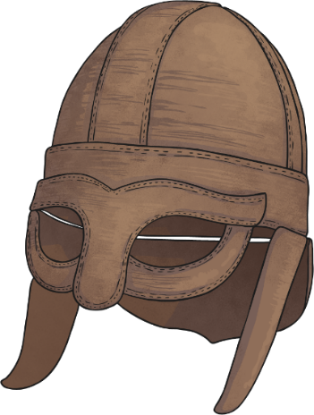
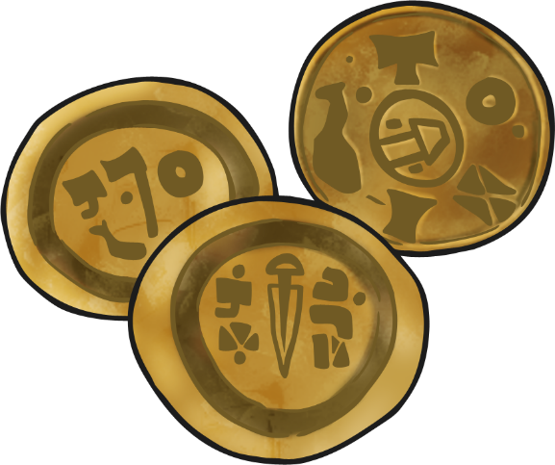
The Vikings Have Landed
On 8th June AD793, the Vikings landed on Lindisfarne. They had sailed across the North Sea from Denmark and Norway. They rampaged through the island and killed monks in the priory. They stole gold and silver, and caused destruction and death.
Vikings are usually described as savages with a love of killing. However, it is likely that they had made pre-attack visits to the island and knew it would have a lot of wealth for them to steal.
Did you know?
The Vikings were more orderly than first thought, and would go back to their own homes with their hoards, and come back to other parts of the UK to continue their raids.

Slide 9
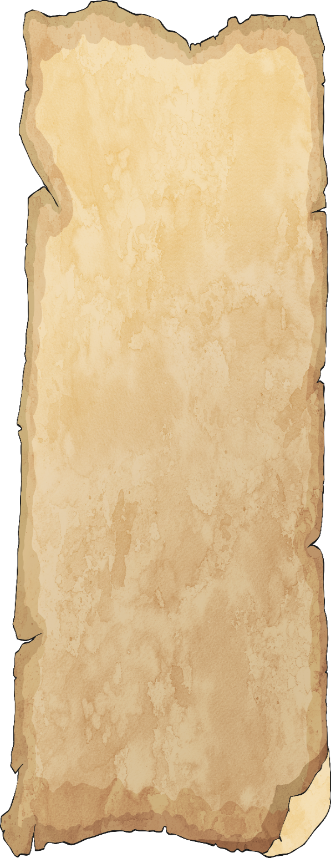
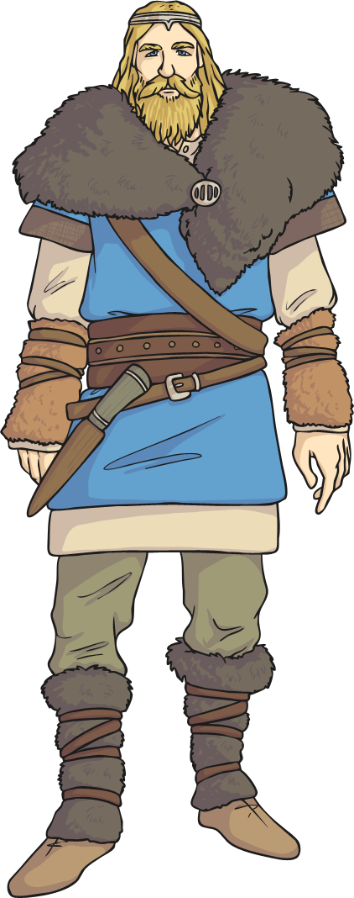
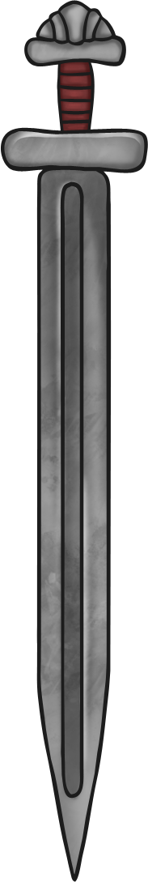
Holy Island
Alcuin reported on the Viking raids at Lindisfarne.
“The heathens poured out the blood of saints around the altar, and trampled on the bodies of saints in the temple of God, like dung in the streets”.
From then on, the island was known as Holy Island.

Slide 10
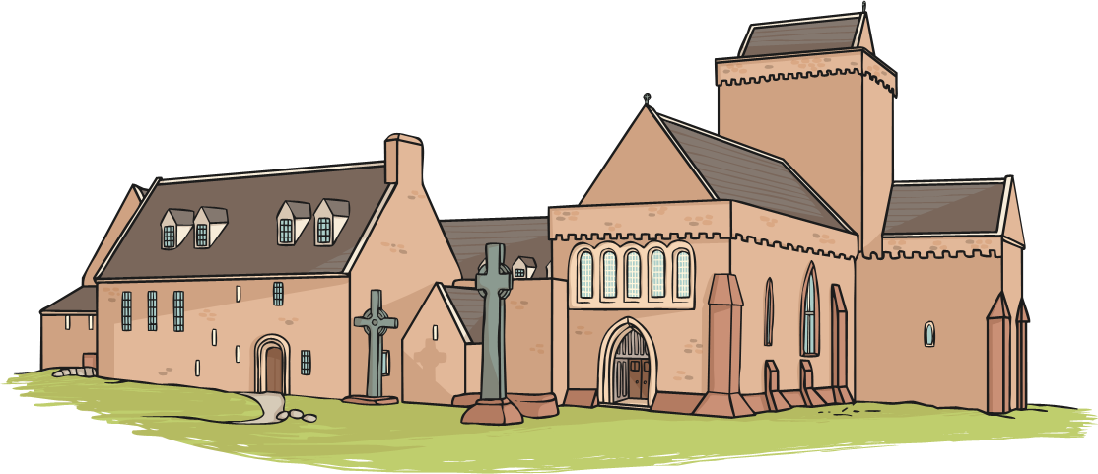
A Priory without Monks
In the years following the raids, the Danes were living in York. Their army moved into Northumberland and caused the collapse of the
Anglo-Saxon kingdoms.
The monks fled from Lindisfarne in 875, taking
St. Cuthbert’s bones with them.

Slide 11



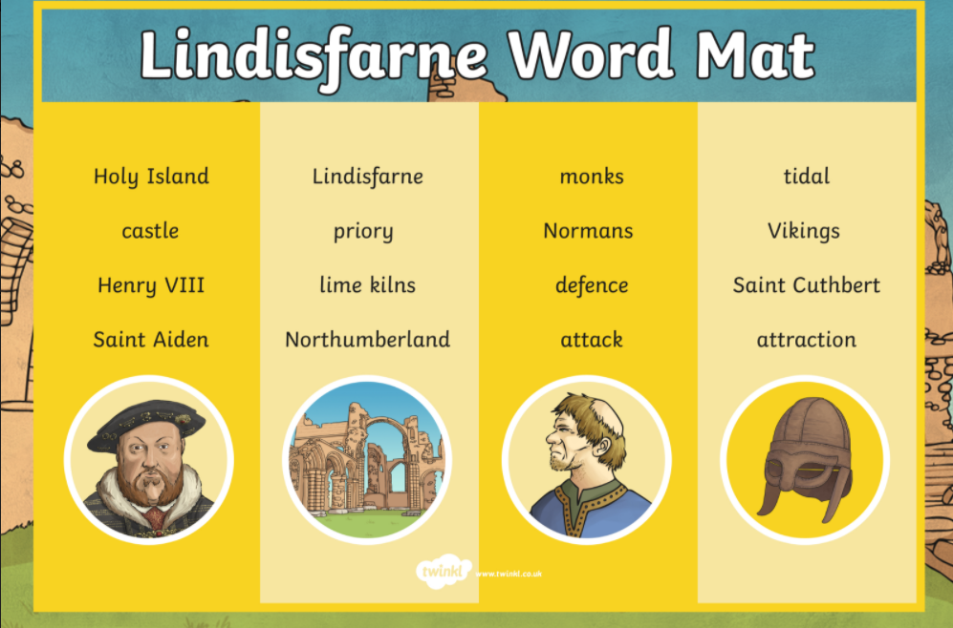
Lindisfarne Activity
Your task is to create a fact file on Lindisfarne - you will use this piece of work in your topic lessons next week. You can use the model fact file to support your writing.
Support: Read through the additional fact file resource which gives you more information about Lindisfarne. There is a word mat which includes key figures, places and names.
Further Learning: Continue to research Lindisfarne independently to learn more about the Viking raid. Create your own fact file in Googledocs or your pink book.

