Slide 1
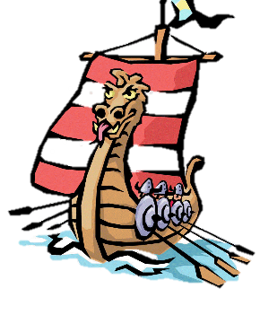
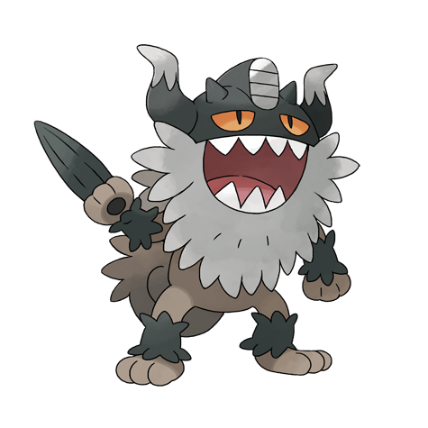
Key Questions
Introduction: What do I already know?
LC 1 | Who were the Anglo-Saxons and did they like the Vikings?
LC 2 | Which region of Britain would you have come under during the Heptarchy?
LC 3 | Why did the Vikings come to Britain and how did they make the journey?
LC 4 | What did the Brits learn from the Vikings?
LC 5 | What was life like for a 11 year old (boy/ girl) Viking?
LC 6 | How did the Vikings live when they came to Britain?
LC 7 | How can you create a Viking long boat from a range of materials?
Fantastic Finish: Children to prepare a Viking day when they show others the crafts and skills that the Vikings had.

Slide 2




Tuesday 24th January
LC: Can I explain the heptarchy?
Self Assessment
What have you learned today? What have you succeeded in doing?
I can
I understand how to
I am able to
I know that
Today you will be learning about the Vikings’ time in Britain to continue our work for LC2: Which region of Britain would you have come under during the heptarchy?
To be successful in today’s lesson, you need to answer the following questions:
Which kingdom would we have lived in?
Who were its rulers?
What towns were there at the time?
Research the kingdom we would have belonged to and answer the key questions in your pink book.
Further learning:
1) Use the link: https://kids.kiddle.co/Mercia and create a informative piece of writing or presentation on our kingdom.
2) https://www.youtube.com/watch?v=hNELyNHgp2o watch the linked animation on the history of the ‘heptarchy’
Support: https://www.bbc.co.uk/bitesize/topics/zxsbcdm/articles/zqrc9j6 use the BBC bitesize resource to help you
Ext: What does hept- mean? Do you know any other words that have this root word? How do they link to heptarchy?

Slide 3
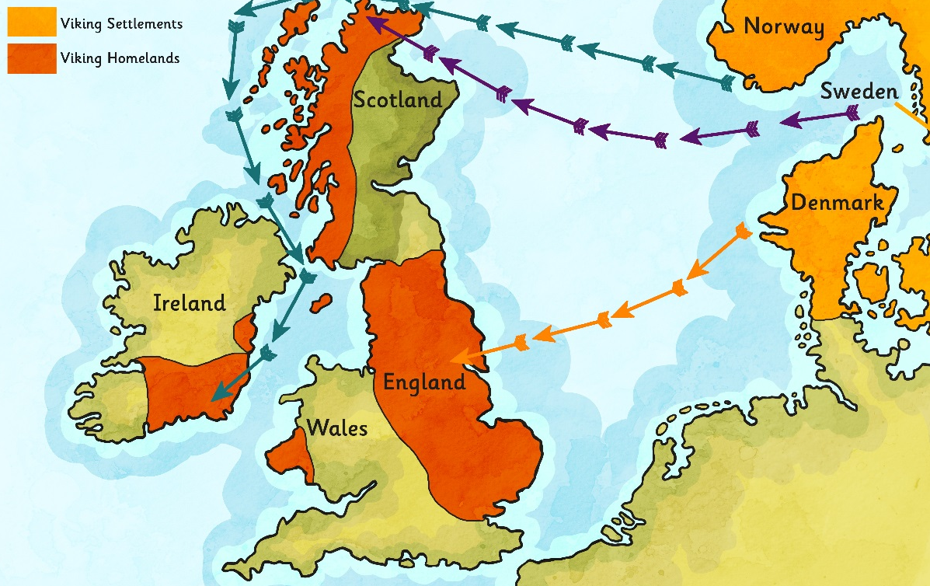
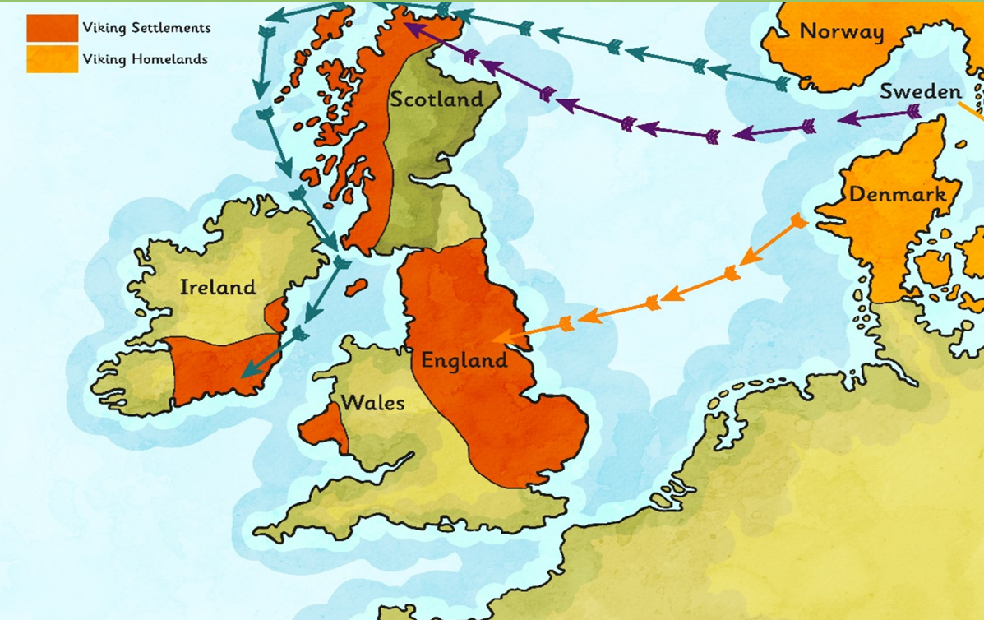
Revision - Where did the Vikings come from?
The Vikings came from the area of the modern Scandinavian countries (Denmark, Norway and Sweden).
They set out in boats called longships to ‘go Viking’ (which means to go travelling around looking for resources and land to claim as their own).
The Vikings first arrived in Britain around AD 787 and in AD 793 they raided and pillaged the monastery at Lindisfarne in Northumbria.
Glossary
Longship – a long, wooden, narrow boat used by the Vikings.
Pillage – to steal goods using violent tactics.
Raid – to suddenly attack a place.

Slide 4
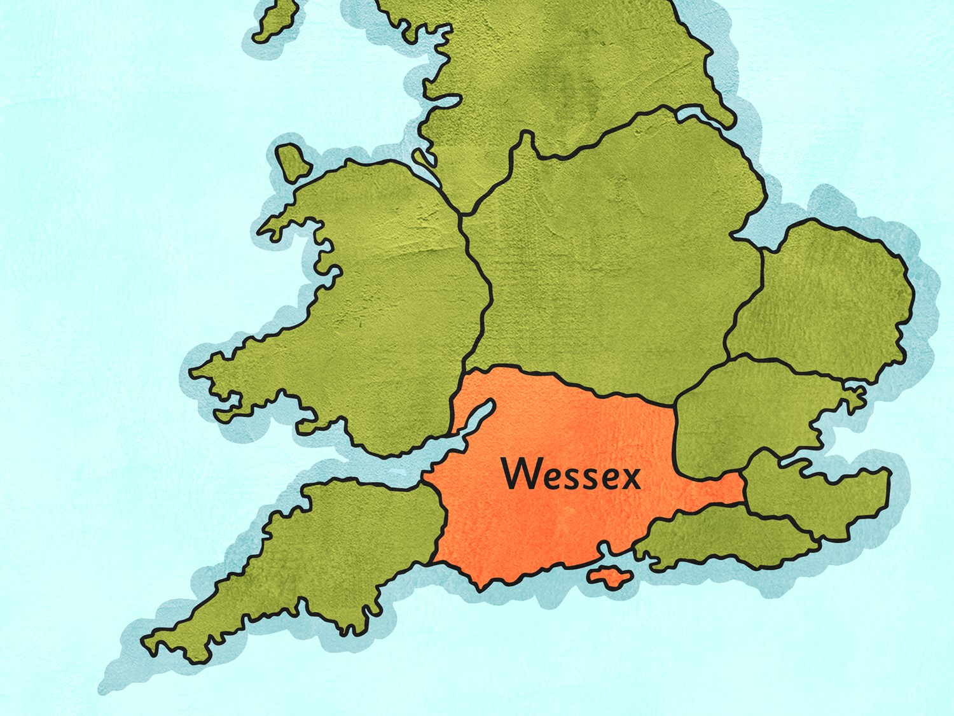
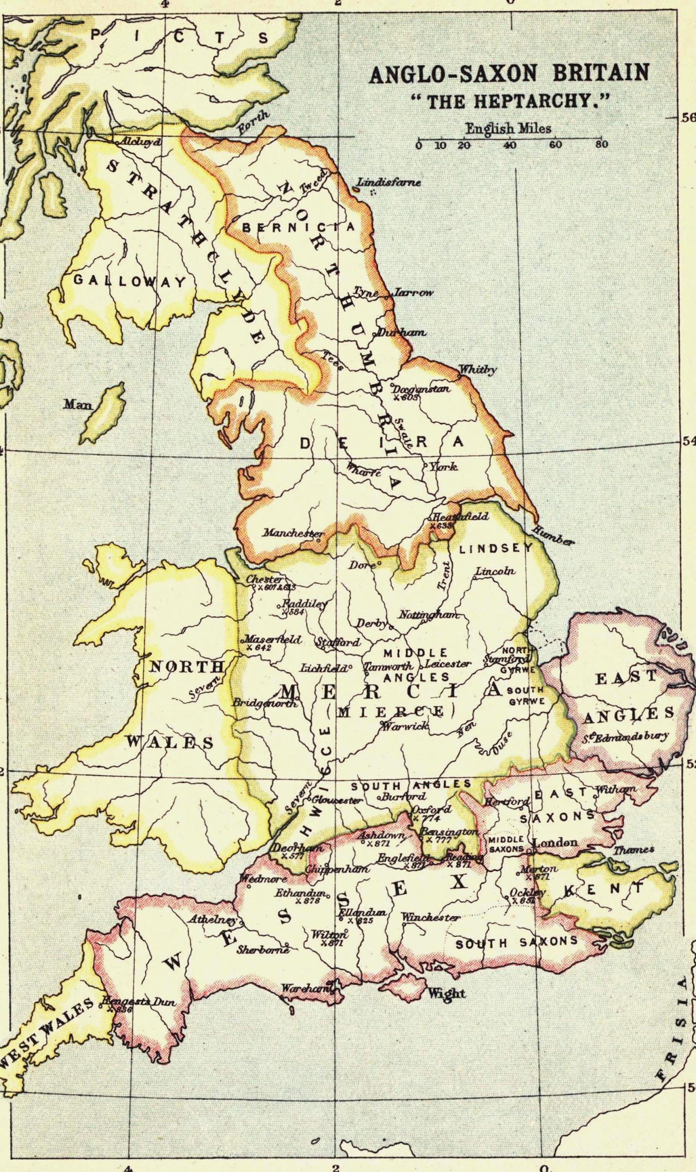
The heptarchy is a collective name applied to seven Anglo-Saxon kingdoms. These were: Northumbria, Mercia, East Anglia, Essex, Kent, Sussex and Wessex. The Anglo-Saxon kingdoms eventually became the Kingdom of England. The term has been in use since the 16th century. It is used to apply both to the seven kingdoms and to the time period in which they existed.
Follow this link to see a larger picture of the map in Anglo-Saxon times:
https://kids.kiddle.co/images/9/9f/Anglo-Saxon_Heptarchy.jpg

Slide 5
Heptarchy Activity
What was a ‘heptarchy’? Use the map and learn the major kingdoms of Britain.
Which kingdom would we have lived in?
Who were its rulers?
What towns were there at the time?
Research the kingdom and answer the key questions in your pink book. You could create a presentation on your kingdom to present this information.

