Slide 1
LC: Can I understand how inspirational Christians followed the teachings of Jesus?

Slide 2
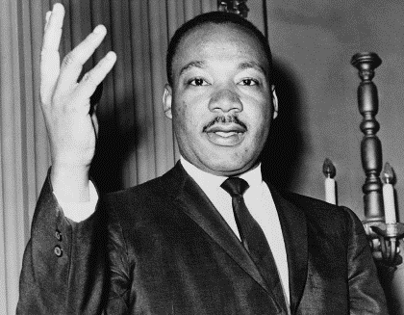
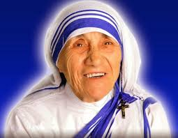
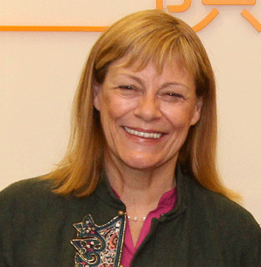
What do you remember about these inspirational Christians?
Martin Luther King campaigned against racism in the USA and helped to change laws that were unfair to non-white people.
Mother Theresa spent her life working with the poor in Calcutta, India. First she worked as a teacher and then she set up care homes for them.
Jackie Pullinger moved from the UK to Hong Kong to work with people in need. She helped drug addicts and gang members to turn their lives around,

Slide 3
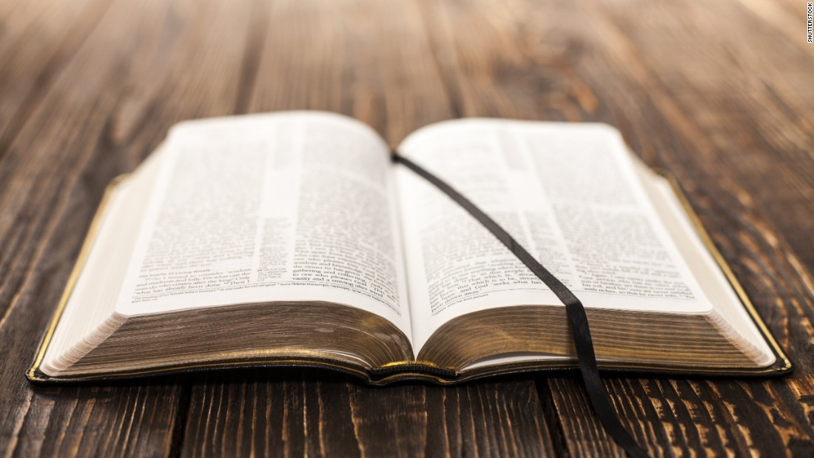
What inspires Christians?
Today we are going to look at how Christians are inspire by the teachings of Jesus.
Christians read what Jesus taught in the Bible. In particular, they read the books called the Gospels, which are like biographies of his life. The four Gospels in the Bible are ones written by Matthew, Mark, Luke and John and each of them tells of the actions and sayings of Jesus.

Slide 4
The Beatitudes
One of the most famous teachings of Jesus is the Beatitudes. It is found in the Gospel of Matthew, chapter 5. Here, Jesus explains what people will be blessed (rewarded) by God.
Blessed are those who know they need God’s help
God’s kingdom belongs to them.
Blessed are those who are sad now.
God will comfort them.
Blessed are those who are humble.
They will be given the land God promised.
Blessed are those who want to do right more than anything else.
God will fully satisfy them.
Blessed are those who show mercy to others.
Mercy will be given to them.
Blessed are those whose thoughts are pure.
They will be with God.
Blessed are those who work to bring peace.
God will call them his sons and daughters.
Blessed are those who suffer because they do what is right.
God’s kingdom belongs to them.

Slide 5
Vocabulary
Blessed are those who know they need God’s help
God’s kingdom belongs to them.
Blessed are those who are sad now.
God will comfort them.
Blessed are those who are humble.
They will be given the land God promised.
Blessed are those who want to do right more than anything else.
God will fully satisfy them.
Blessed are those who show mercy to others.
Mercy will be given to them.
Blessed are those whose thoughts are pure.
They will be with God.
Blessed are those who work to bring peace.
God will call them his sons and daughters.
Blessed are those who suffer because they do what is right.
God’s kingdom belongs to them.
Humble = not boastful or arrogant
mercy = forgiveness, accepting people’s apologies

Slide 6
Activity
Click on the next page for clues if you get stuck.
If you still need help, go to Google Classrooms
Blessed are those who know they need God’s help
God’s kingdom belongs to them.
Blessed are those who are sad now.
God will comfort them.
Blessed are those who are humble.
They will be given the land God promised.
Blessed are those who want to do right more than anything else.
God will fully satisfy them.
Blessed are those who show mercy to others.
Mercy will be given to them.
Blessed are those whose thoughts are pure.
They will be with God.
Blessed are those who work to bring peace.
God will call them his sons and daughters.
Blessed are those who suffer because they do what is right.
God’s kingdom belongs to them.
Look back to your notes about Martin Luther King, Mother Theresa or Jackie Pullinger. How did they follow the teachings of Jesus that we see above?
Write a paragraph to explain. For example:
Mother Theresa followed the teachings of Jesus to be _____ because she ____. She was also _____ as she chose to _________________

Slide 7
Blessed are those who suffer because they do what is right. How did Martin Luther King suffer?
Blessed are those who know they need God’s help
God’s kingdom belongs to them.
Blessed are those who are sad now.
God will comfort them.
Blessed are those who are humble.
They will be given the land God promised.
Blessed are those who want to do right more than anything else.
God will fully satisfy them.
Blessed are those who show mercy to others.
Mercy will be given to them.
Blessed are those whose thoughts are pure.
They will be with God.
Blessed are those who work to bring peace.
God will call them his sons and daughters.
Blessed are those who suffer because they do what is right.
God’s kingdom belongs to them.
Blessed are those who want to do right more than anything else. What good things did these Christians do? How can we tell that they really wanted to do this
Blessed are those who are humble. In what way did Mother Theresa live a simple and humble life?
Blessed are those whose thoughts are pure. How can we tell that these Christians we studied were concentrating on what was right?

