Slide 1
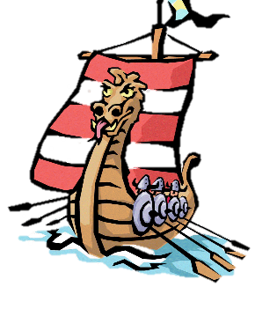
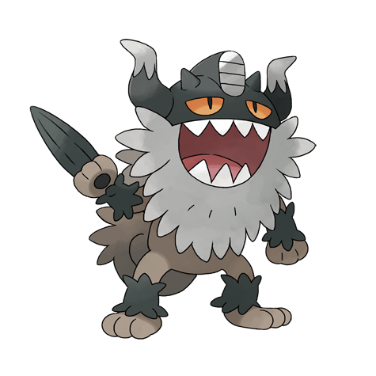
Key Questions
Introduction: What do I already know?
LC 1 | Who were the Anglo-Saxons and did they like the Vikings?
LC 2 | Which region of Britain would you have come under during the Heptarchy?
LC 3 | Why did the Vikings come to Britain and how did they make the journey?
LC 4 | What did the Brits learn from the Vikings?
LC 5 | What was life like for a 11 year old (boy/ girl) Viking?
LC 6 | How did the Vikings live when they came to Britain?
LC 7 | How can you create a Viking long boat from a range of materials?
Fantastic Finish: Children to prepare a Viking day when they show others the crafts and skills that the Vikings had.

Slide 2




Tuesday 19th January
LC: Can I create a timeline?
Self Assessment
What have you learned today? What have you succeeded in doing?
I can
I understand how to
I am able to
I know that
Today you will be learning about the Vikings’ time in Britain to continue our work for LC1: Who were the Anglo Saxons and did they like the Vikings?
Consider what you have learned when doing timelines for previous topics
You will need to consider:
How many years will your timeline span?
How will you divide your timeline to show this?
What does it mean to be in chronological order?
Further learning: For each key event, you can research what happened and add more detail to your timeline
Support: The timeline activity sheet summarises each evet for you.
Ext: Consider what it would have been like to be a Viking or a Saxon - how would you opinion change when discussing the other?

Slide 3
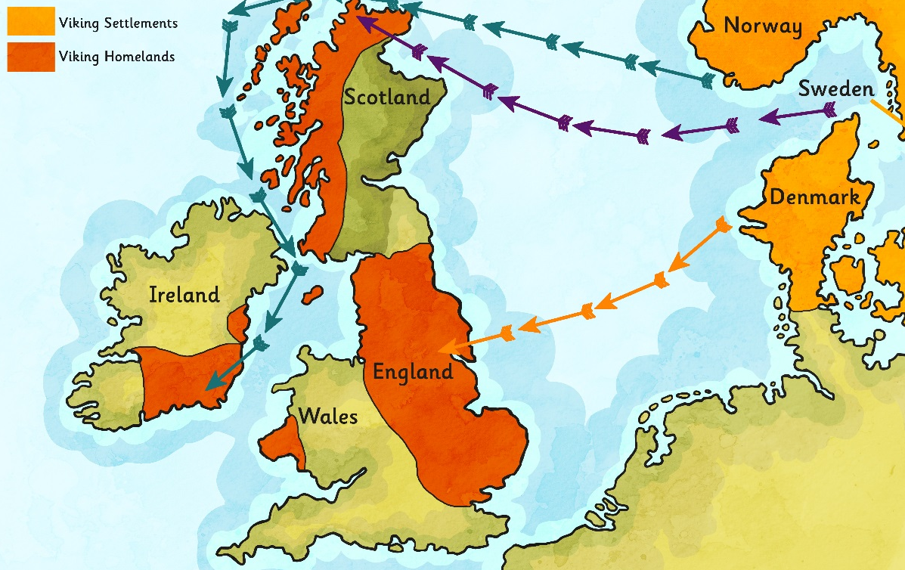
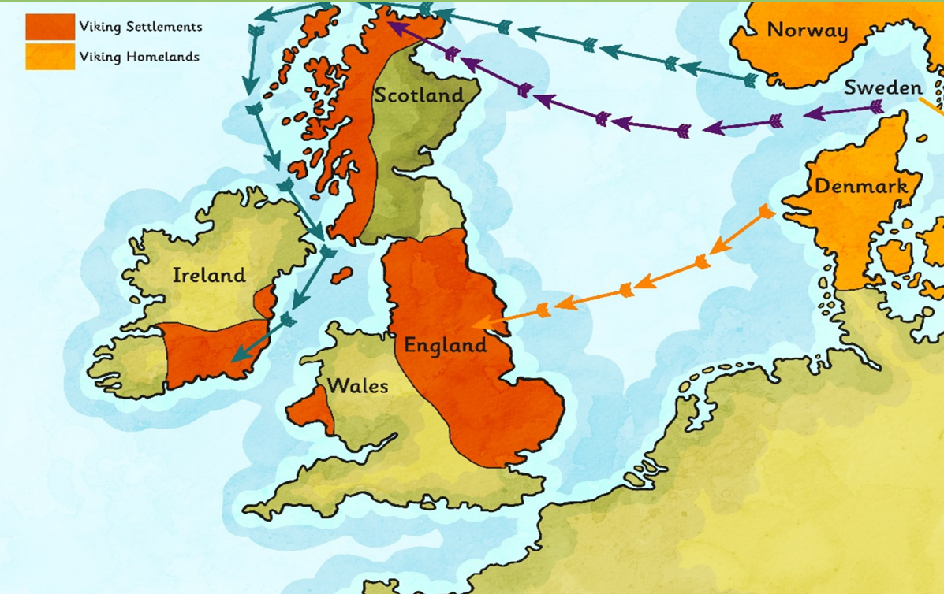
The Vikings Arrive
The Vikings came from the area of the modern Scandinavian countries (Denmark, Norway and Sweden).
They set out in boats called longships to ‘go Viking’ (which means to go travelling around looking for resources and land to claim as their own).
The Vikings first arrived in Britain around AD 787 and in AD 793 they raided and pillaged the monastery at Lindisfarne in Northumbria.
Glossary
Longship – a long, wooden, narrow boat used by the Vikings.
Pillage – to steal goods using violent tactics.
Raid – to suddenly attack a place.

Slide 4
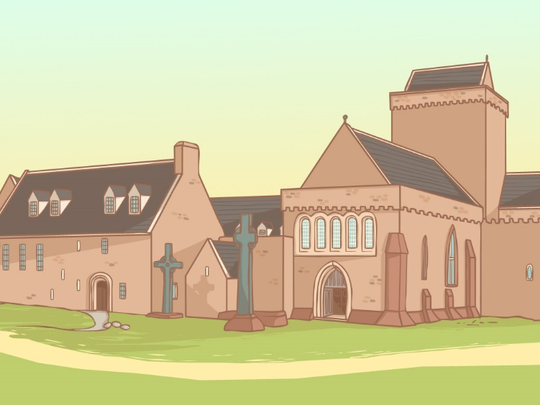
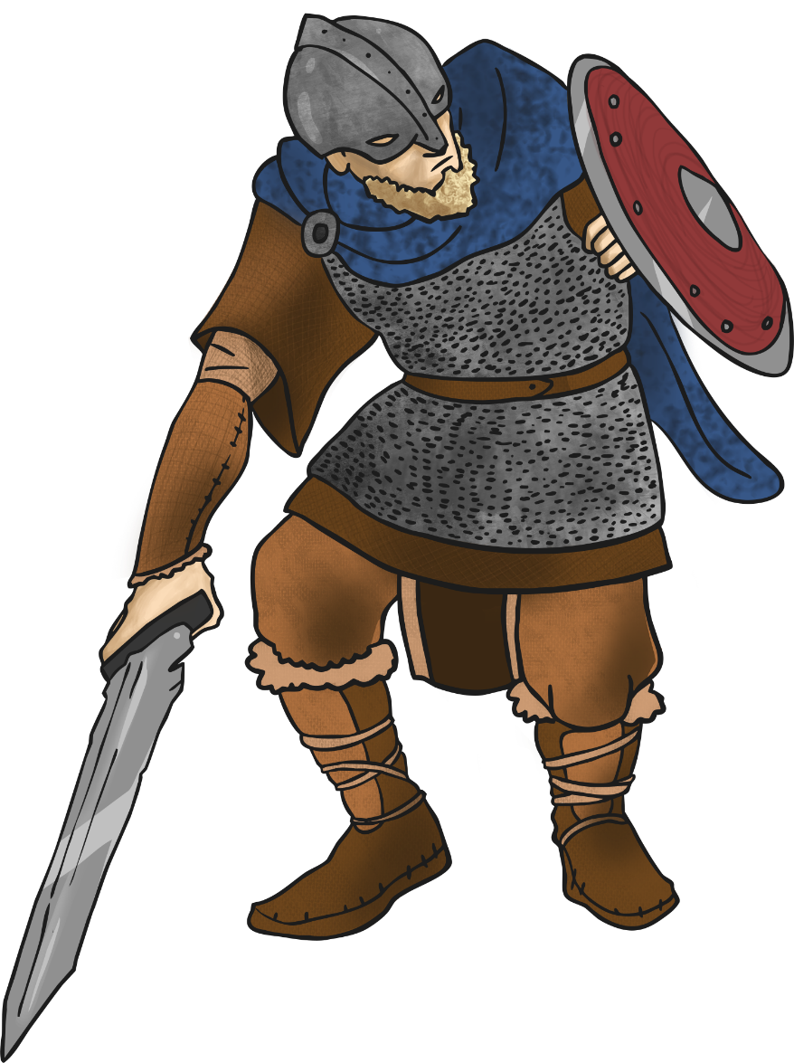

Raiders
The Vikings came to Britain looking for lucrative new items to steal and trade. In addition they wanted land that they could take and claim as their own.
They particularly liked to raid monasteries, like the one at Lindisfarne. The monasteries were not very well protected and contained valuable goods like gold and jewels, imported foods and other useful materials.
The Vikings also stole manuscripts and bibles. These were sold back to the religious leaders who could not bear to see them lost or damaged.

Slide 5
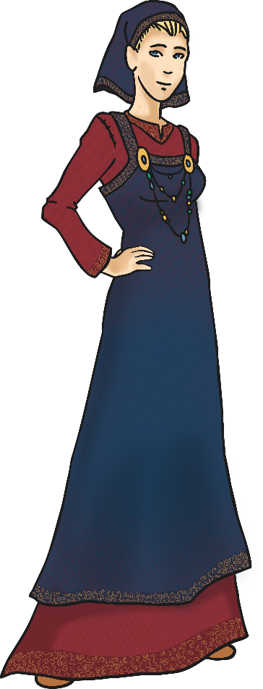
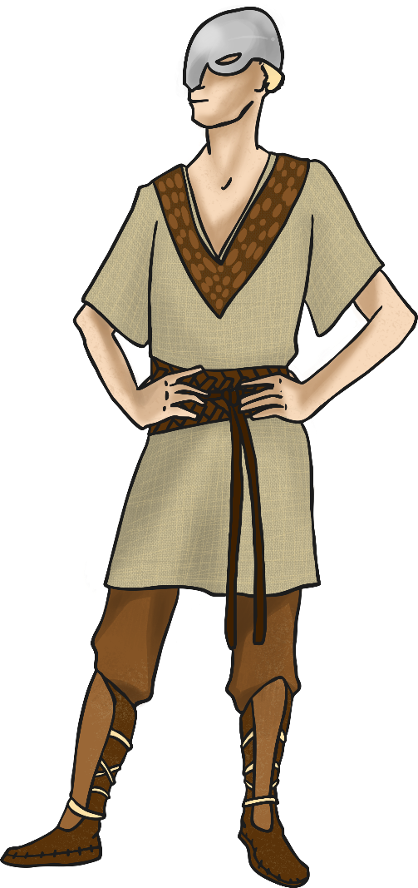
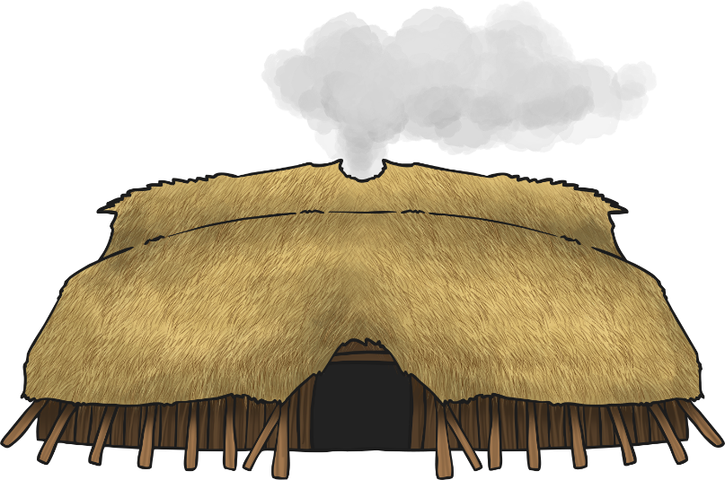
Invaders and Settlers
The Vikings went on to invade Scotland and in time they began to settle and stay there.
They were able to build up an army and in AD 866 they captured the city of York.
The Anglo-Saxon King Alfred the Great, who became King of Wessex in AD 871, managed to force the Vikings out of the South of England but this was short-lived.
By AD 878 the Vikings had settled permanently in England, overran Wessex and forced King Alfred into hiding. The Vikings were here to stay!

Slide 6
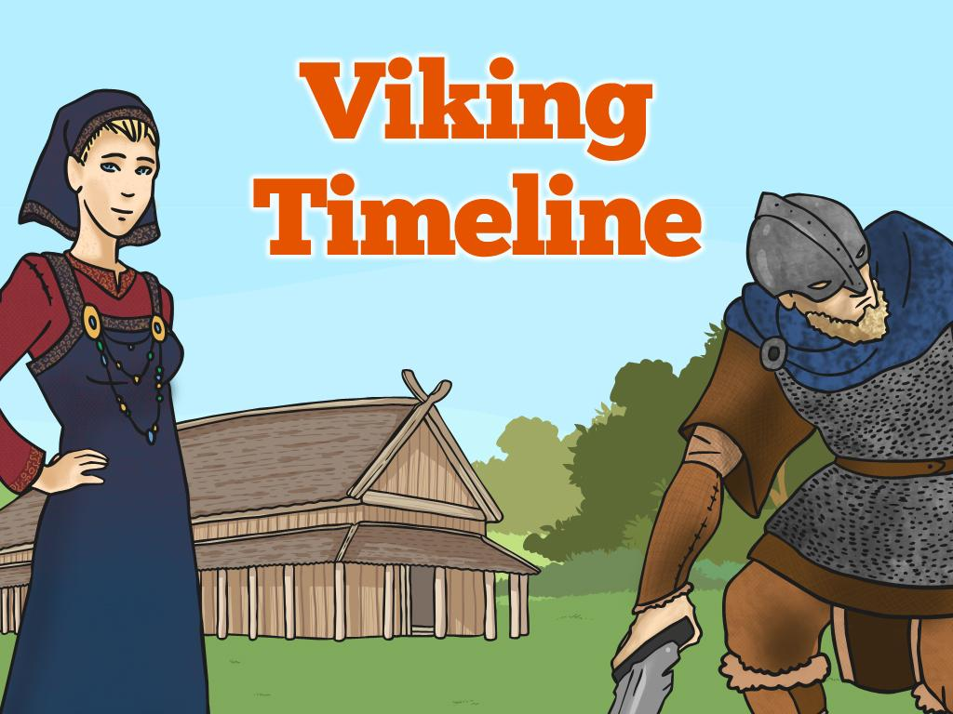
Throughout the PowerPoint, you will learn about the reasons for the Viking invasion and key events during their period of time in England. There seems to be one thing missing - the dates!
Research the events and note down information about them and the date it happened.
You must use these events to create a timeline in your pink book.

Slide 7
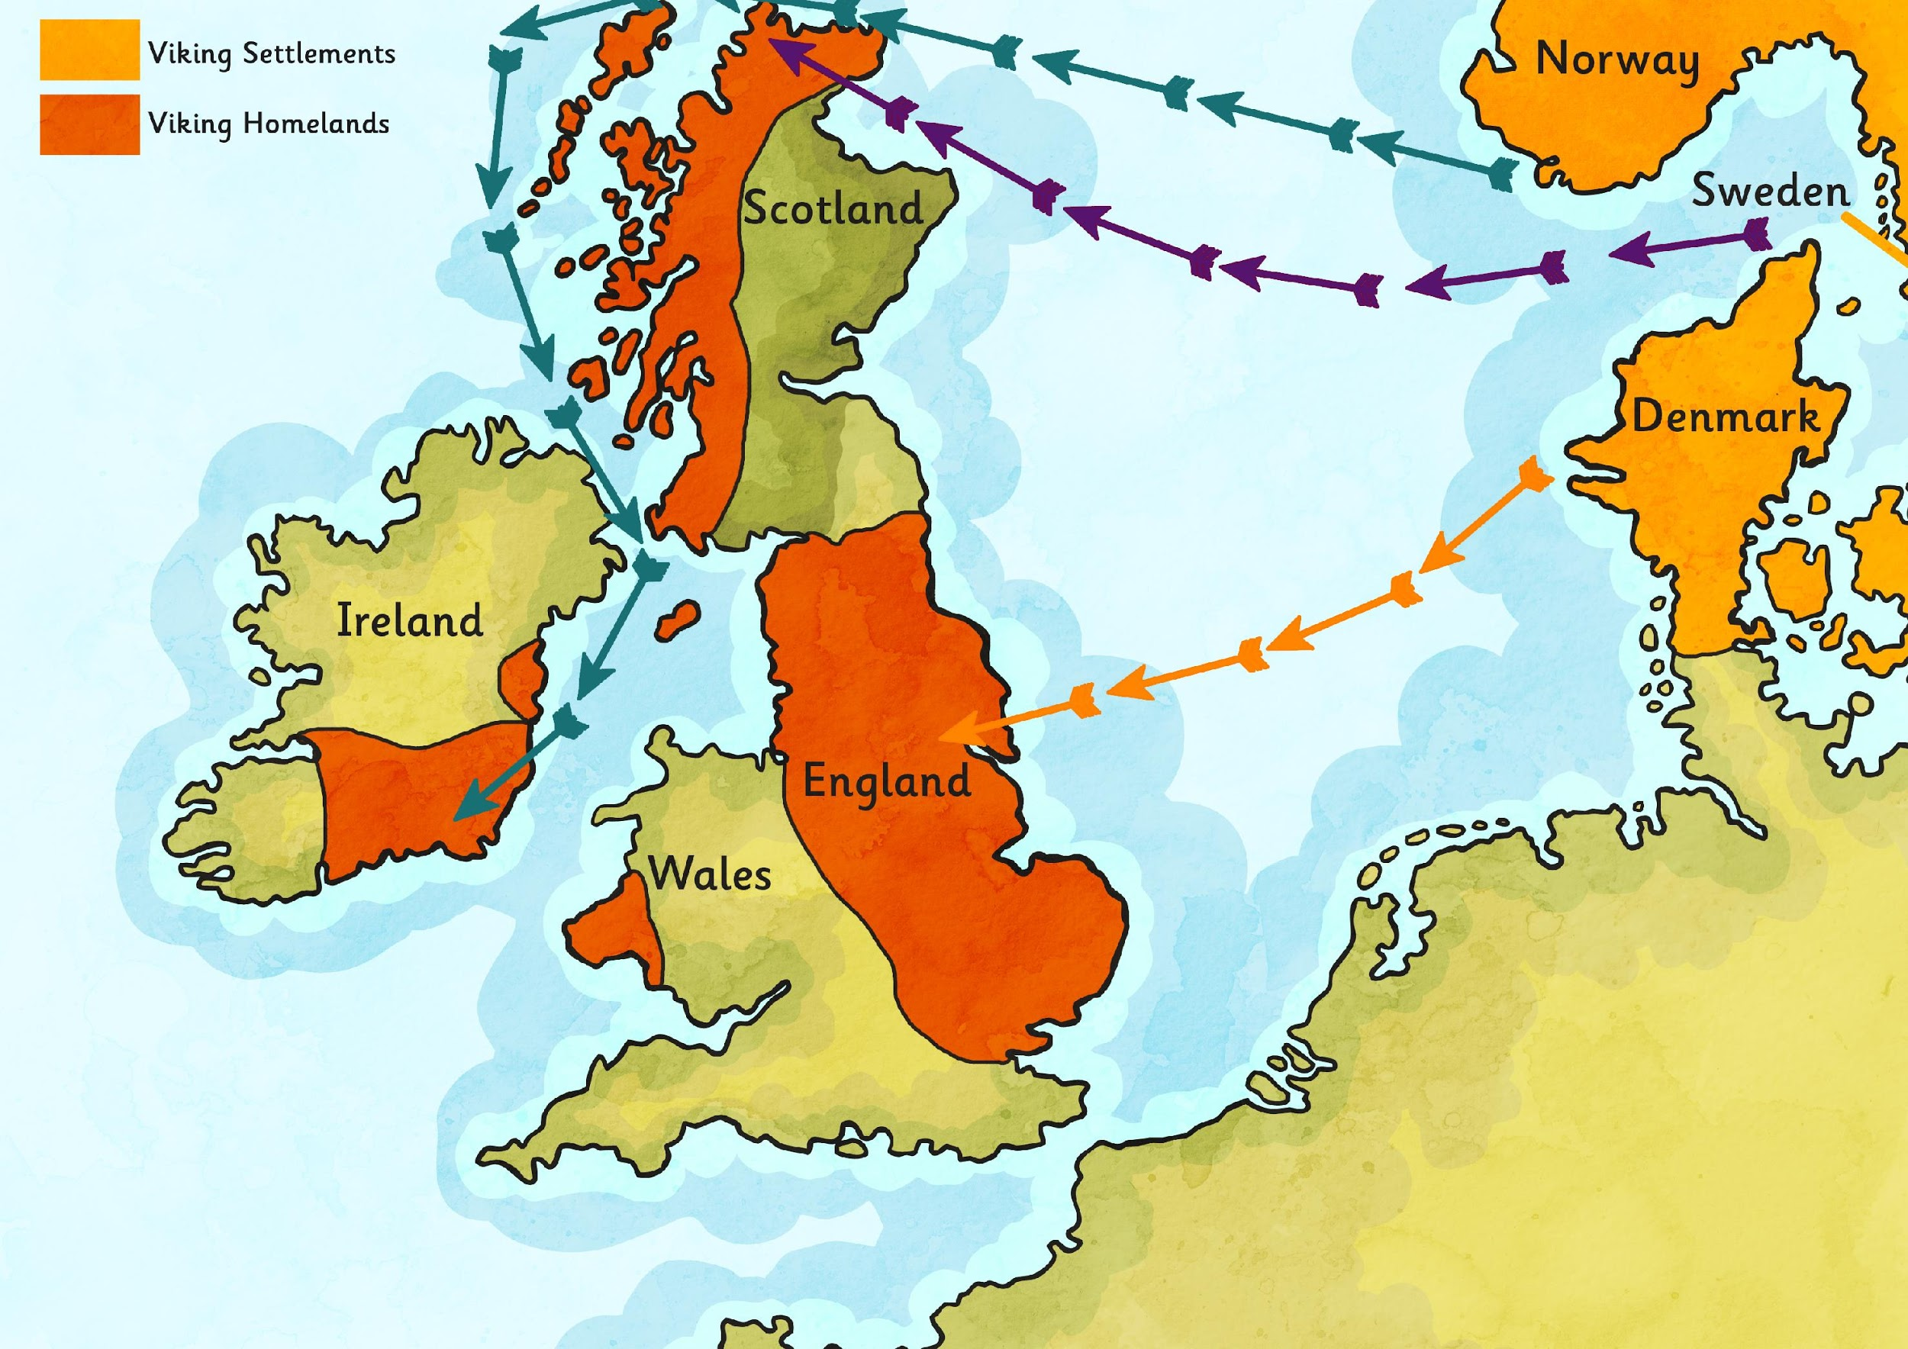
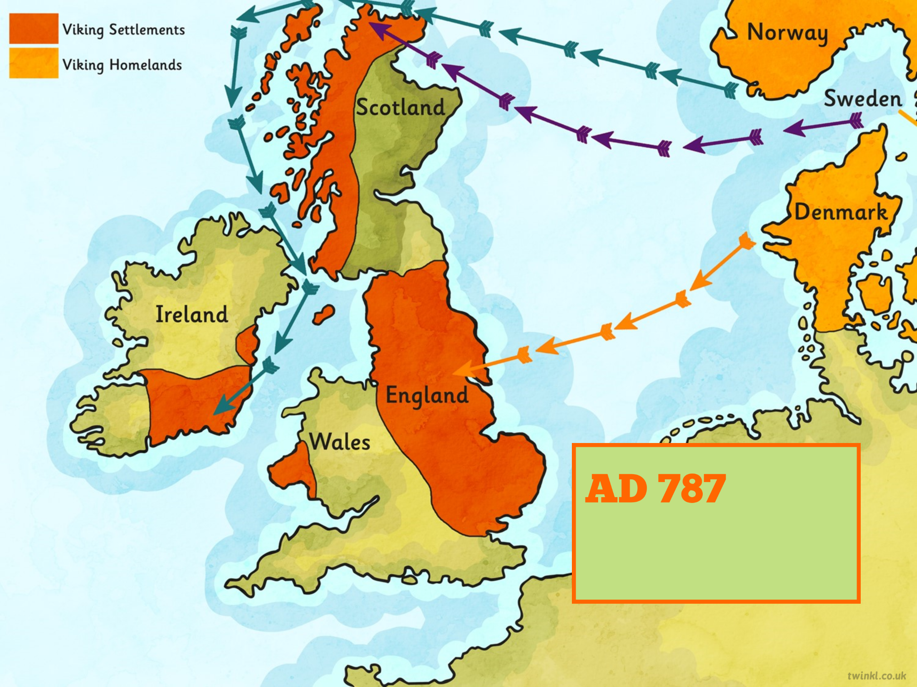
First Viking raid in England occurred.

Slide 8
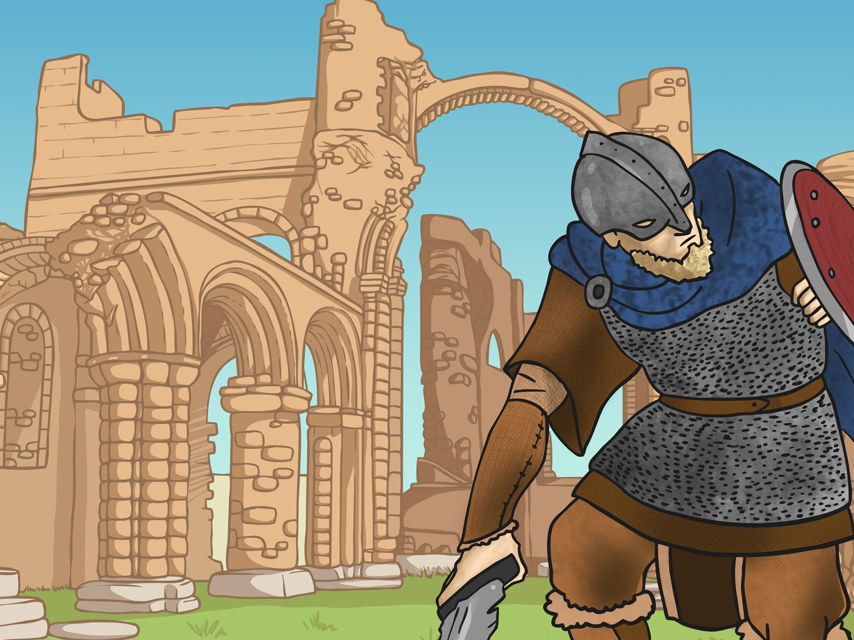
The Vikings attack from Norway. They attack the Monastery of Lindisfarne in Northumbria. The following year they attack northern Britain, in what we now call Scotland.

Slide 9
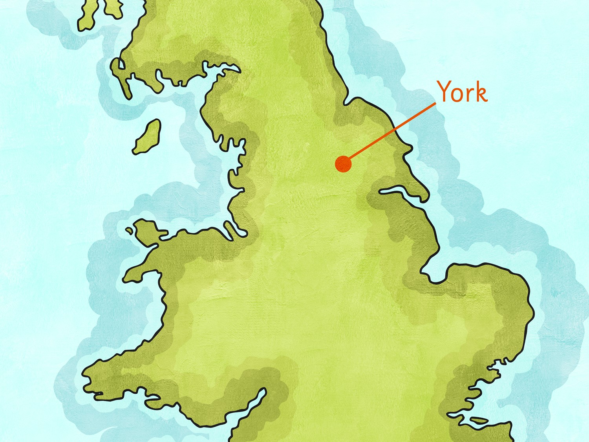

The Vikings capture the city of York.

Slide 10
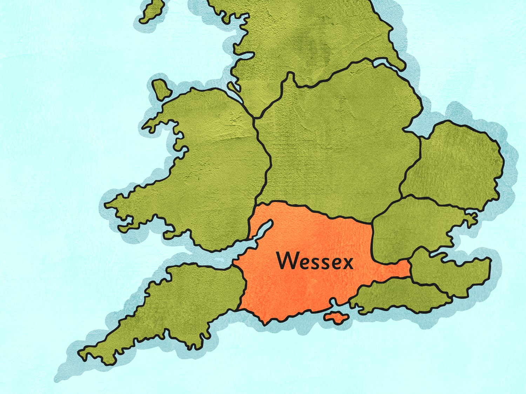

Wessex is the last Anglo-Saxon kingdom.

Slide 11
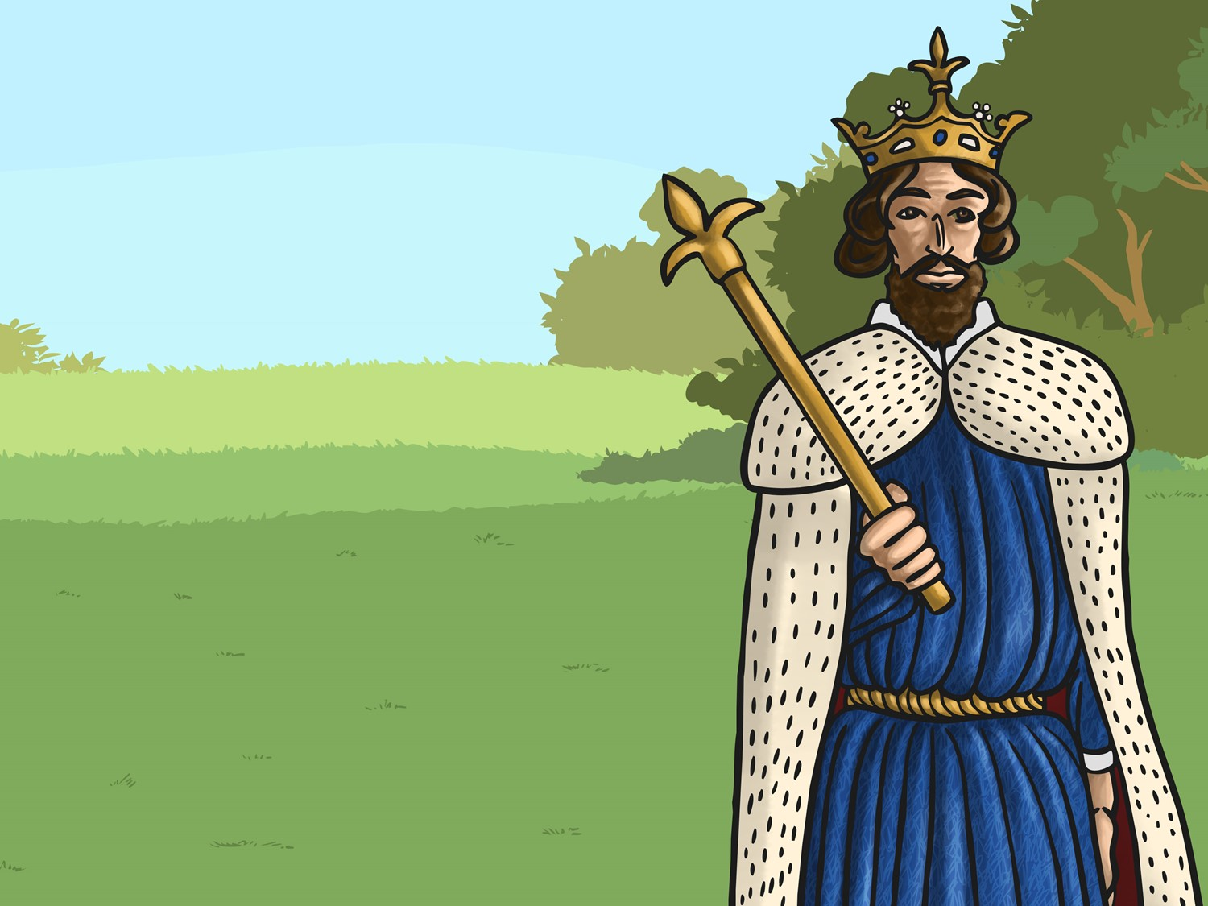
Alfred the Great becomes King of Wessex. He drives the invading Vikings from the south but they stay in the north and the east.

Slide 12
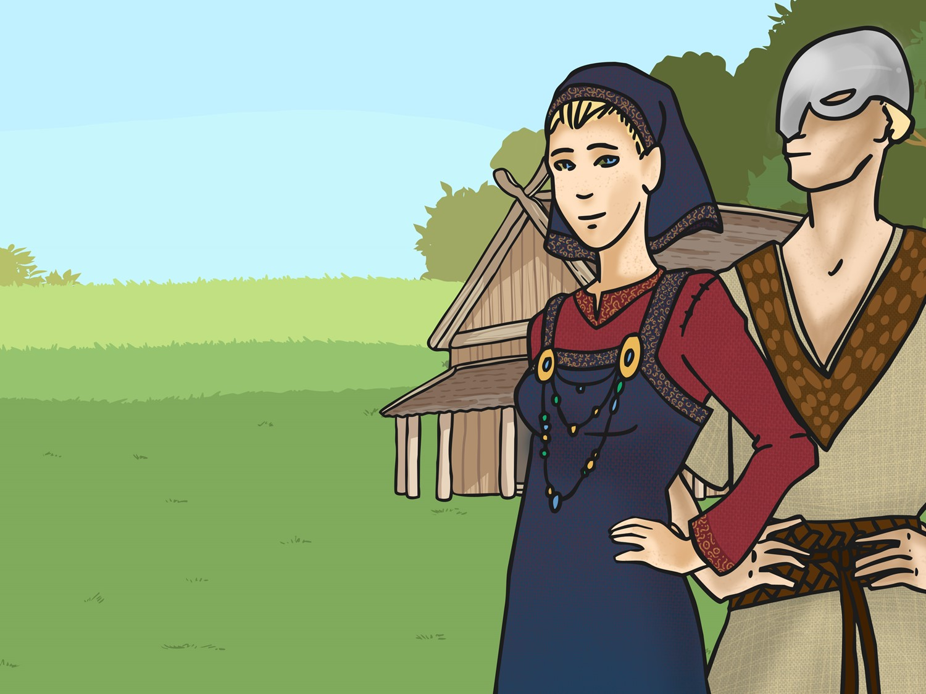
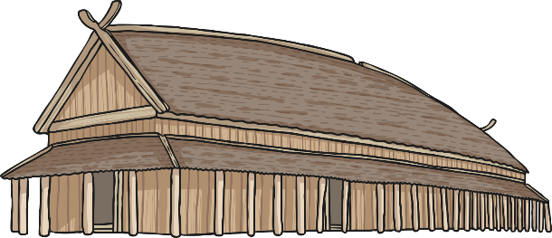
By this time, the Vikings had settled permanently in England, overran Wessex and forced King Alfred into hiding.

Slide 13
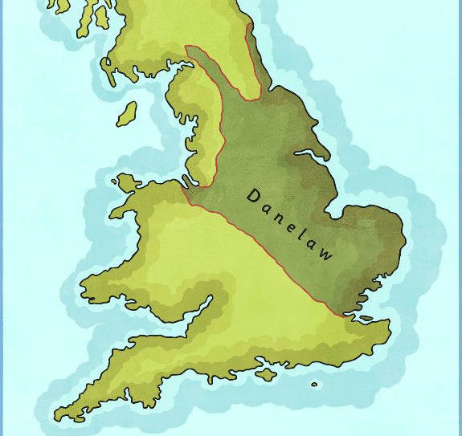
King Alfred agrees to a treaty with the Vikings. Alfred keeps the west and the Vikings are given the east which is later known as ‘Danelaw’.

Slide 14
The Vikings establish rule over northern Scotland

Slide 15
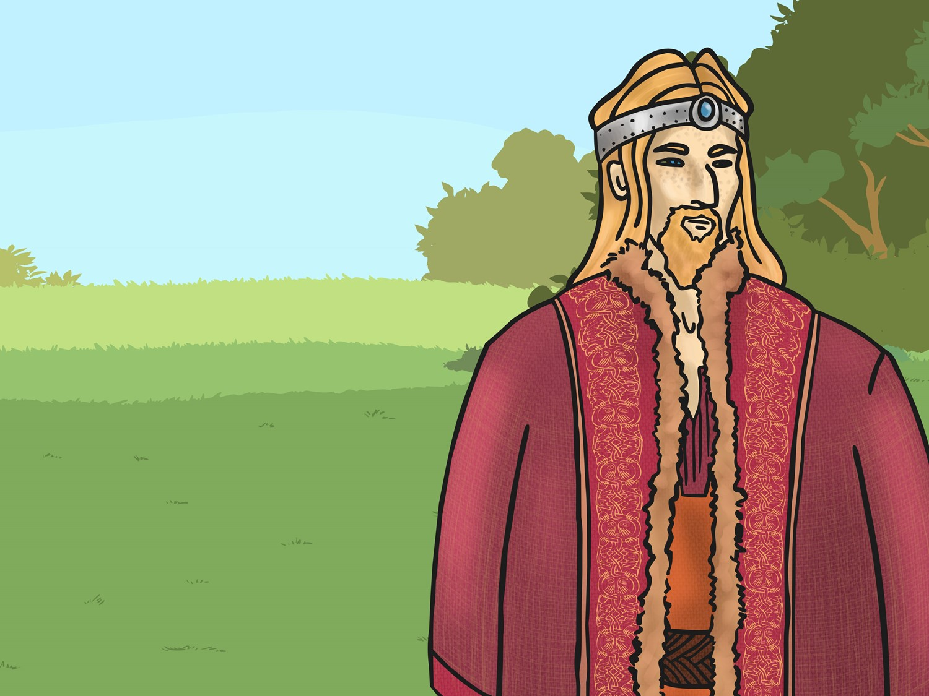
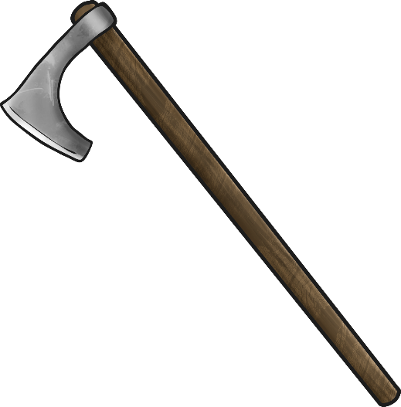
The last Viking King of Jorvick (York), Eric Bloodaxe, is forced out of York.

Slide 16
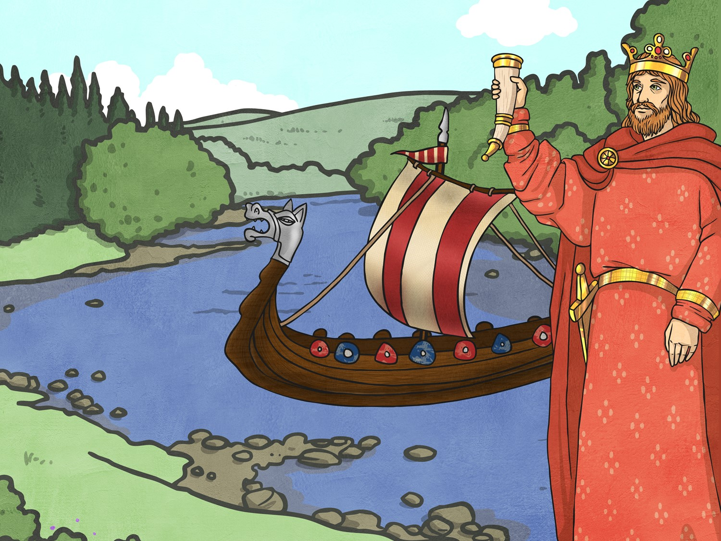
King Sven of Denmark and his son Cnut sail up the rivers Humber and Trent to claim the throne in Danelaw and Ethelred, the Saxon King, flees abroad.

Slide 17
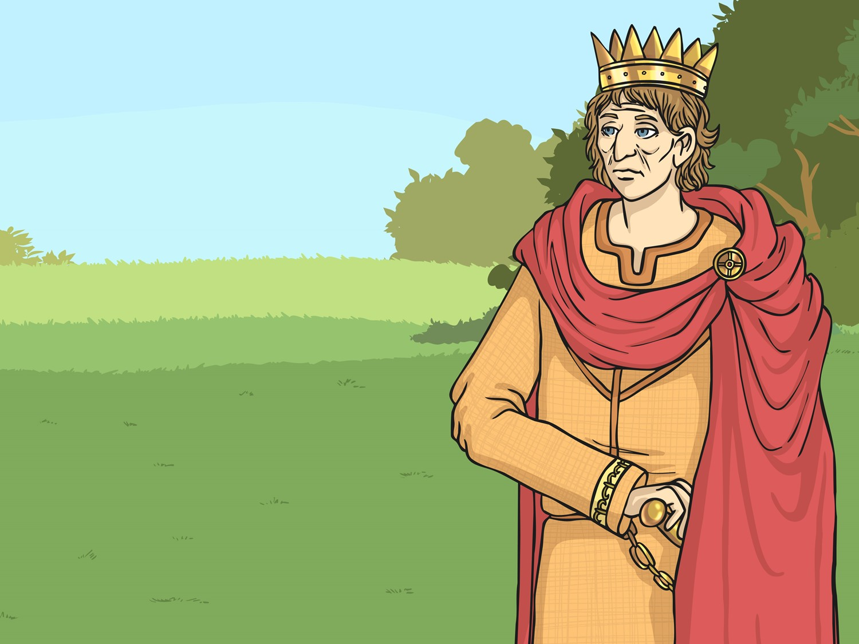
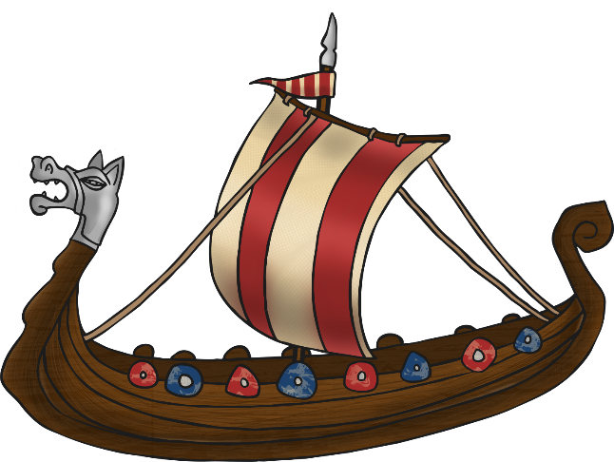
King Sven dies and Ethelred returns to rule England again.

Slide 18
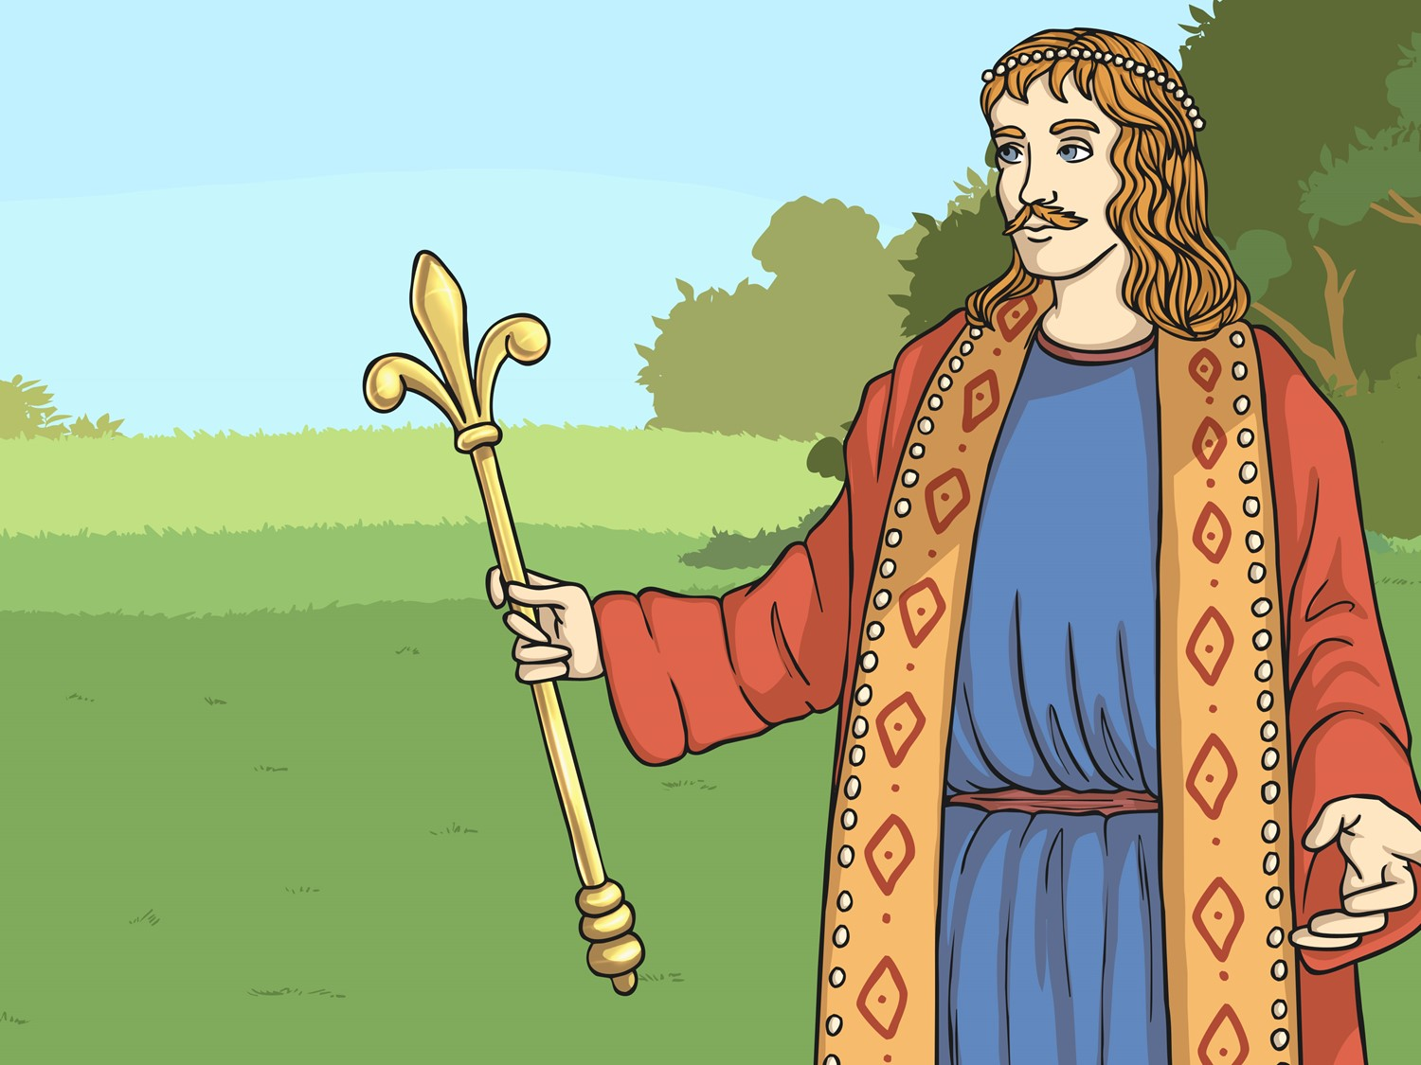
King Ethelred dies. His son, Edmund Ironside, becomes king for a few months until he also dies.
Cnut becomes King of the Danes and King of England.

Slide 19
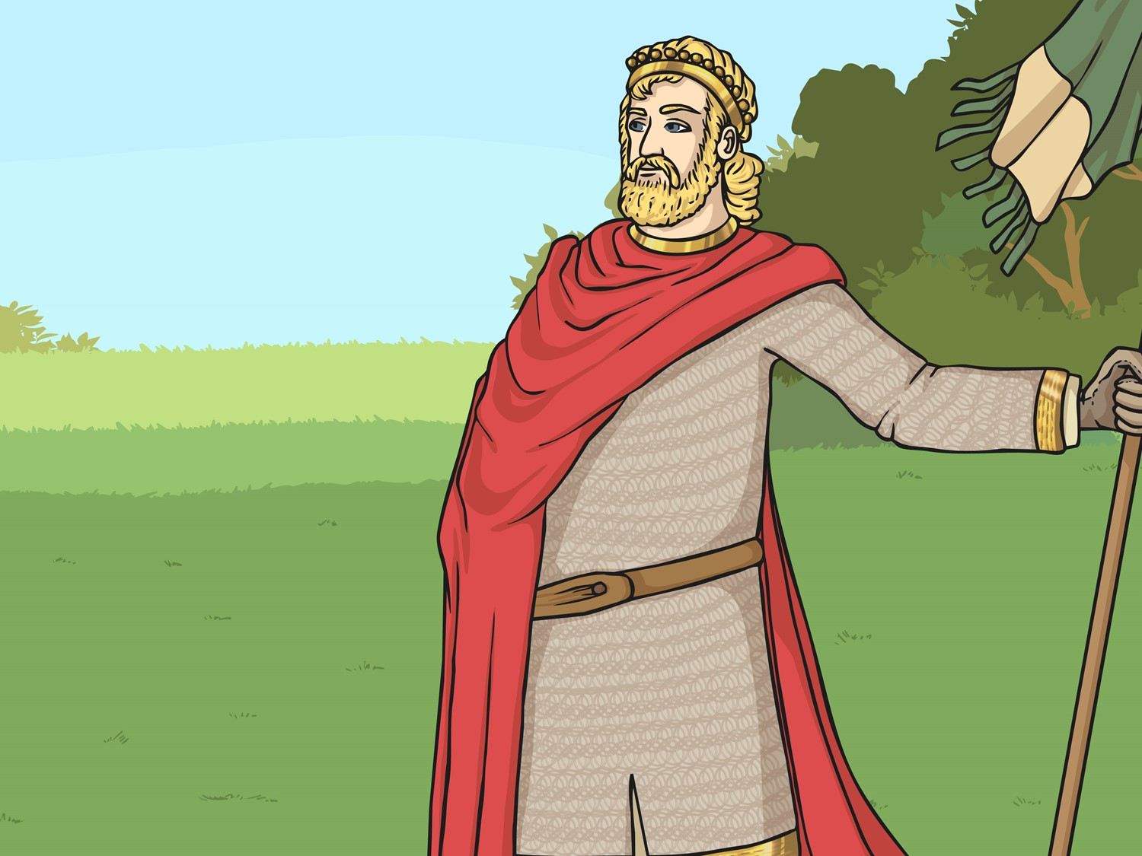
King Cnut dies. His sons Harold Harefoot and Hardicanute share the ruling of England. Harold dies in 1040 and Hardicanute becomes the sole ruler of England.

Slide 20
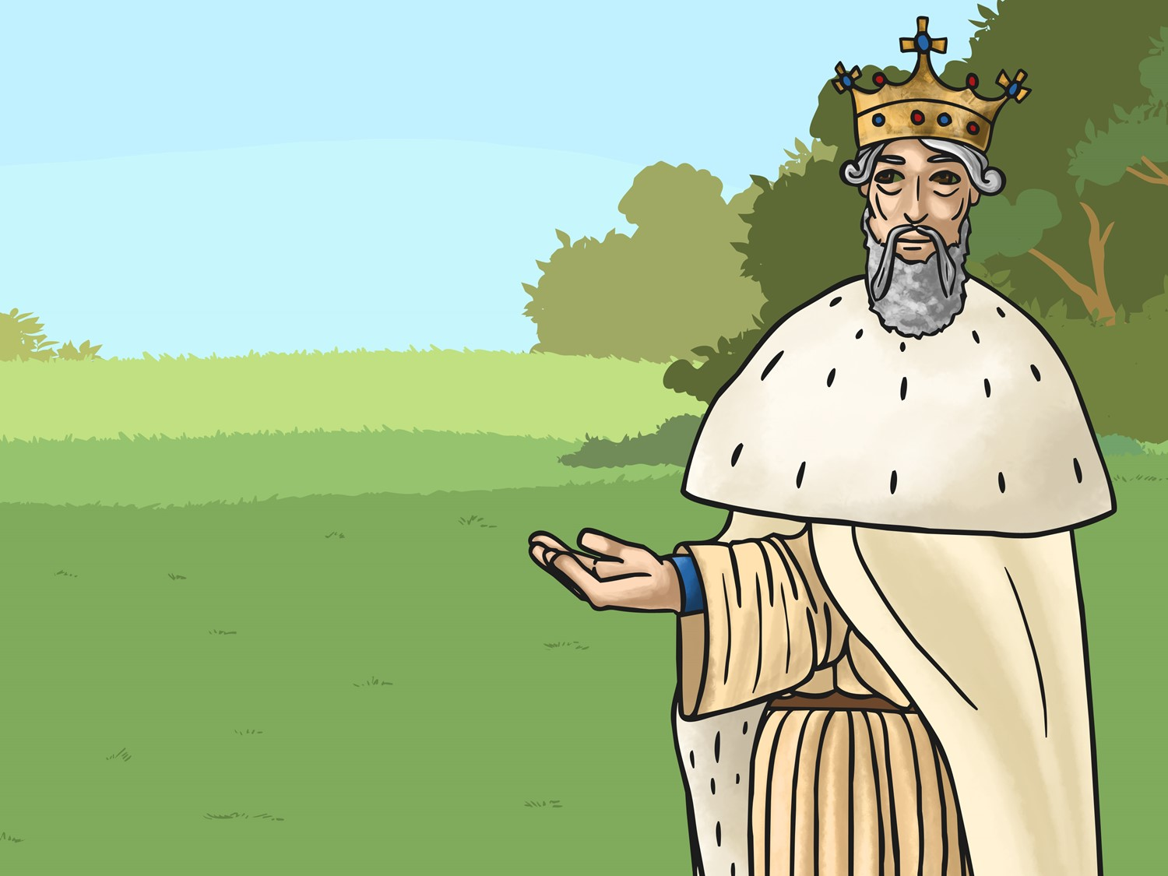
Ethelred’s second son, Edward is invited to return from Normandy to become the King of England. Edward was better known as ‘Edward the Confessor’ due to his extreme piety.

Slide 21
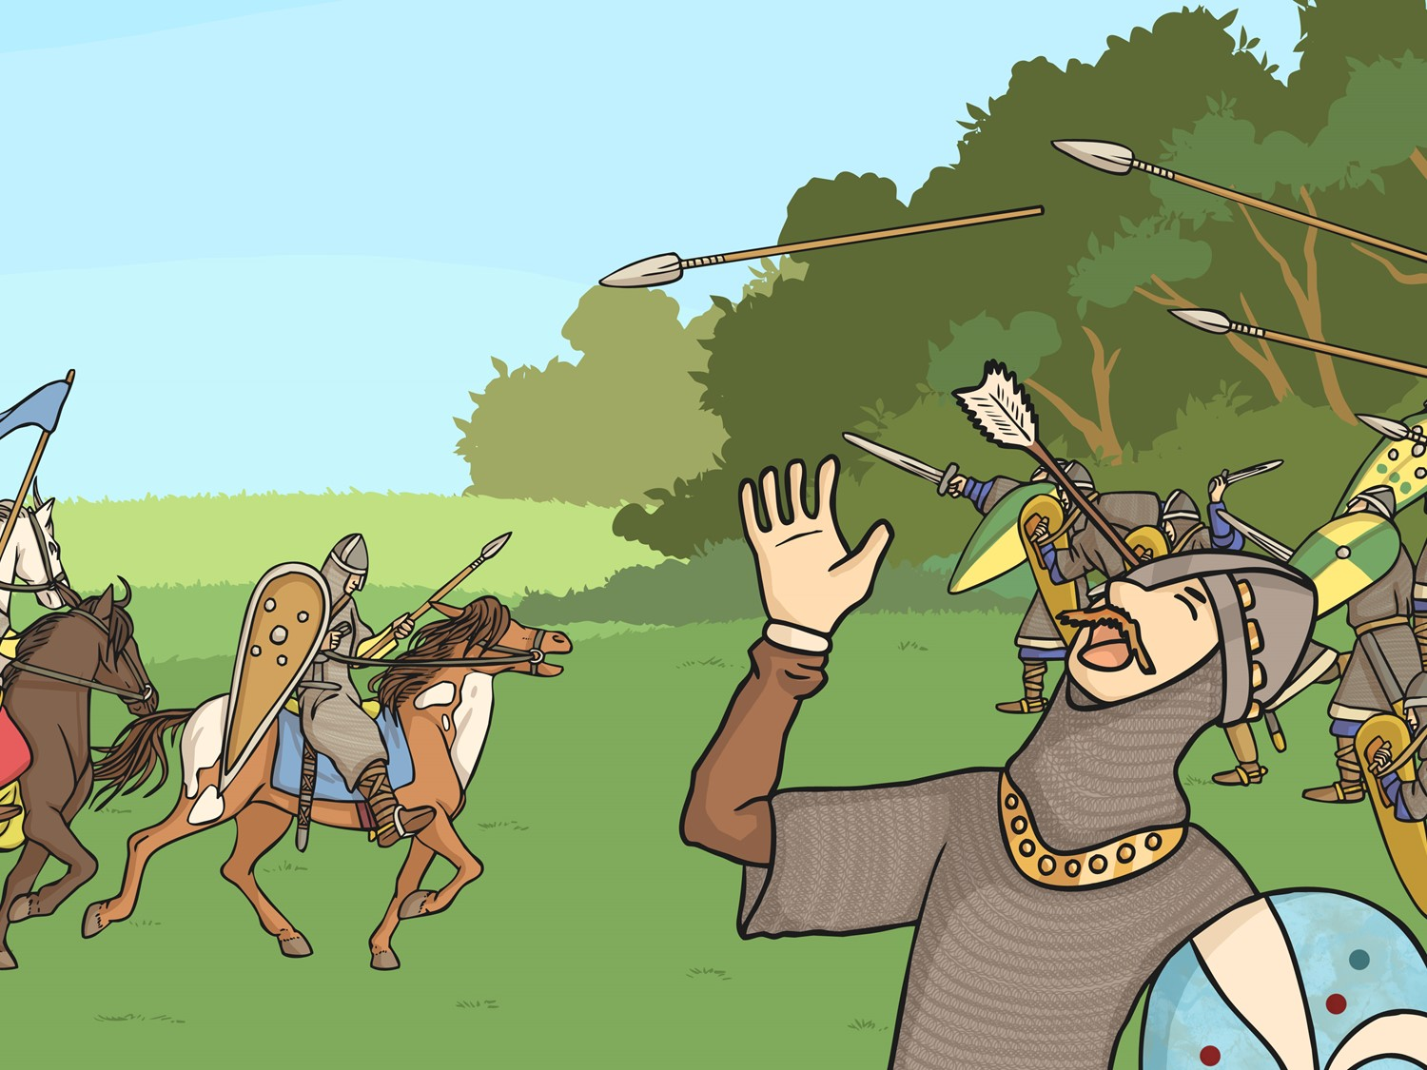
The last Anglo-Saxon king, King Harold, is defeated by William the Conqueror at the Battle of Hastings and Norman Britain begins.

Slide 22
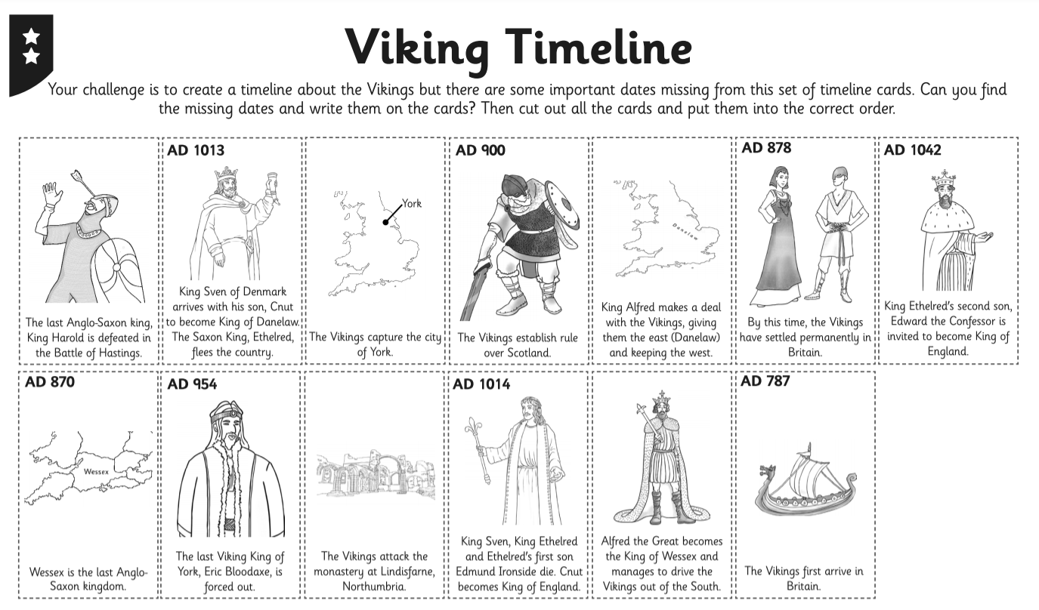
Viking Timeline Activity
Your challenge is to create your own Viking Timeline to help you remember and order the important facts about the Vikings.

Slide 23
Vikings and Kings Extension
Who thinks they can act in role as a Viking warrior or an Anglo-Saxon king to answer the questions?
Questions for a
Viking Warrior
Questions for an
Anglo-Saxon King
Who are the Vikings?
Where do you come from?
When did you come to Britain and why?
Or can you think of a question of your own?
Where have these Vikings come from?
How have you and your people been affected?
What have the Vikings done?
Or can you think of a question of your own?

