Slide 2

What Does Inference Iggy Do?
Inference Iggy helps with content domain 2d:
Make inferences from the text/explain and justify inferences with evidence from the text.
This means that he is there to help you to pick up ideas from the text that are not always written in the text itself.
He helps you to do this by getting you to read the text as if you are a detective. You’re not looking for what is there – you’re looking for what is meant by it. For example, if the text says ‘Jenni’s face was red – she wrinkled her brow and began to shout’, what could you infer about how Jenni feels?

Slide 3

What Might Inference Iggy Ask?
Back
Inference Iggy might ask questions like these:
What makes you think…? Give evidence to support your answer.
What impression are we given about…? Why?
Why did the character behave like this?
How does this character feel about the situation? How do you know?
Why is… important? Explain your answer.
Which character would you most like to meet? Explain why.

Slide 4

Summing Up Inference Iggy
Prove your understanding of what Inference Iggy does by answering the following questions:
What does Inference Iggy help you to do?
What sort of question might Inference Iggy ask?
How can you make sure you get full marks on
Inference Iggy questions?

Slide 6
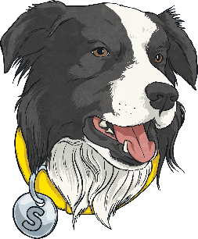
What Does Summarising Sheba Do?
Summarising Sheba helps with content domain 2c:
Summarise main ideas from more than one paragraph..
This means that she is there to help you to sum up what you’ve read.
She helps you to do this by reading the text, picking out the key points that are really important and giving a quick run down of the text’s main ideas.
Imagine that you’ve read a book and have to text your friend about the plot – which key messages would you tell them and which would you leave out?

Slide 7
What Might Summarising Sheba Ask?
Back
Summarising Sheba might ask questions like these:
What is the main theme, argument or message of this paragraph?
Can you describe what happened in this chapter?
Write a new blurb for this story using 20 words or less.
Can you describe what happened in three short sentences?
How would you sum up…?
What is the most important message in this book?

Slide 8

Summing Up Summarising Sheba
Prove your understanding of what Summarising Sheba does by answering the following questions:
What does Summarising Sheba help you to do?
What sort of question might Summarising Sheba ask?
How can you make sure you get full marks
on Summarising Sheba questions?

