Slide 2
What Does Arlo the Author Do?
Arlo the Author helps with content domain 2g:
Identify/explain how meaning is enhanced through choice of words and phrases.
This means that he is there to help you to spot examples of ambitious vocabulary and figurative language within the text.
When you find them, Arlo helps you to think about why the author made those vocabulary choices and how they give a certain meaning to the text.
For example, an author could say that the water in a lake was still and reflective. However, for effect, they could describe the water as ‘like a sheet of glass’.

Slide 3
What Might Arlo the Author Ask?
Arlo the Author might ask questions like these:
What does this word tell us about the character/setting/atmosphere?
Look at that phrase which implies that the character/setting/atmosphere is…
Look for a simile/metaphor in the text. How does this add meaning?
Find and copy an example of personification from the text. Why is it used?
How has the author’s choice of words created a feeling of…?
Why did the author choose this particular verb/adjective/adverb?

Slide 5
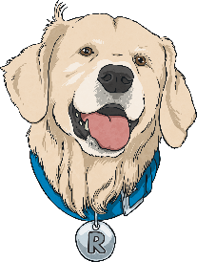
What Does Rex Retriever Do?
Rex Retriever helps with content domain 2b:
Retrieve and record information/identify key details
from fiction and non-fiction.
This means that he is there to help you to find
key pieces of information within the text you are reading.
He helps you to do this by looking through the text for a specific answer. With Rex Retriever questions, the answer you are looking for is always
in the text somewhere… you just have to find and retrieve it!

Slide 6
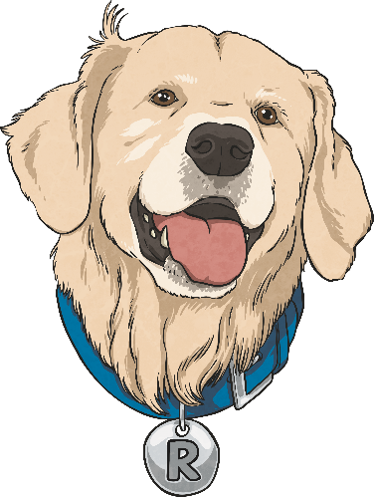
Summing Up Rex Retriever
Prove your understanding of what Rex Retriever does by answering the following questions:
What does Rex Retriever help you to do?
What sort of question might Rex Retriever ask?
How can you make sure you get full marks on
Rex Retriever questions?

