Slide 1
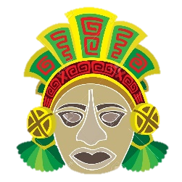
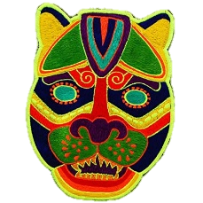
Our Art unit for this half term will link with both our Topic and Science units. We will be exploring South and Central American art to link with our topic on the Maya. We will use this style of art to develop our portrait skills, linking with our Science unit on the body and key question, ‘Can you create a picture of your face using collage?
Week 1 | Can I research an artist?
Week 2 | Can I develop my portrait drawing skills?
Week 3 | Can I create a self-portrait in the style of an artist?
Week 4 | Can I create research Maya masks and design my own?
Week 5 | Can I use different materials to make a collage of my face?
Week 6 | Can I evaluate my work?

Slide 2
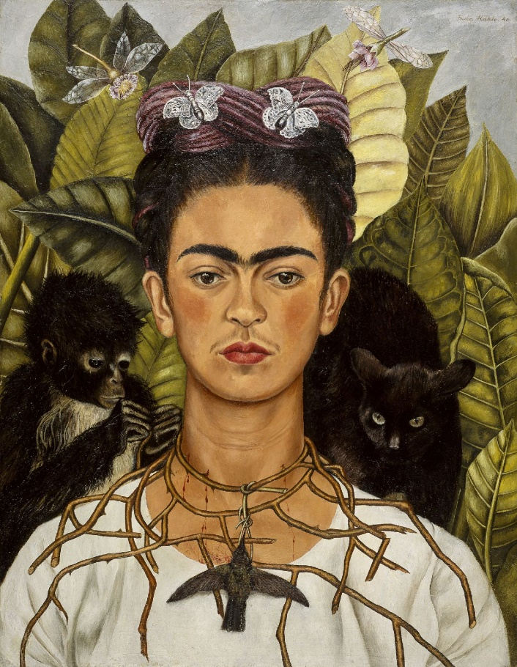
Friday Xth November
LC: Can I create a self portrait in the style of an artist?
What does the picture consist of?
What references are there to her home country?
What colours are used and why?
What does her expression tell you about her?

Slide 3
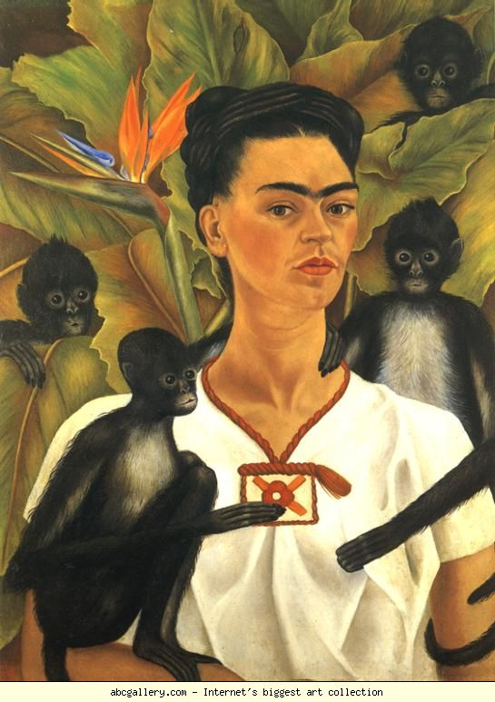


Slide 4
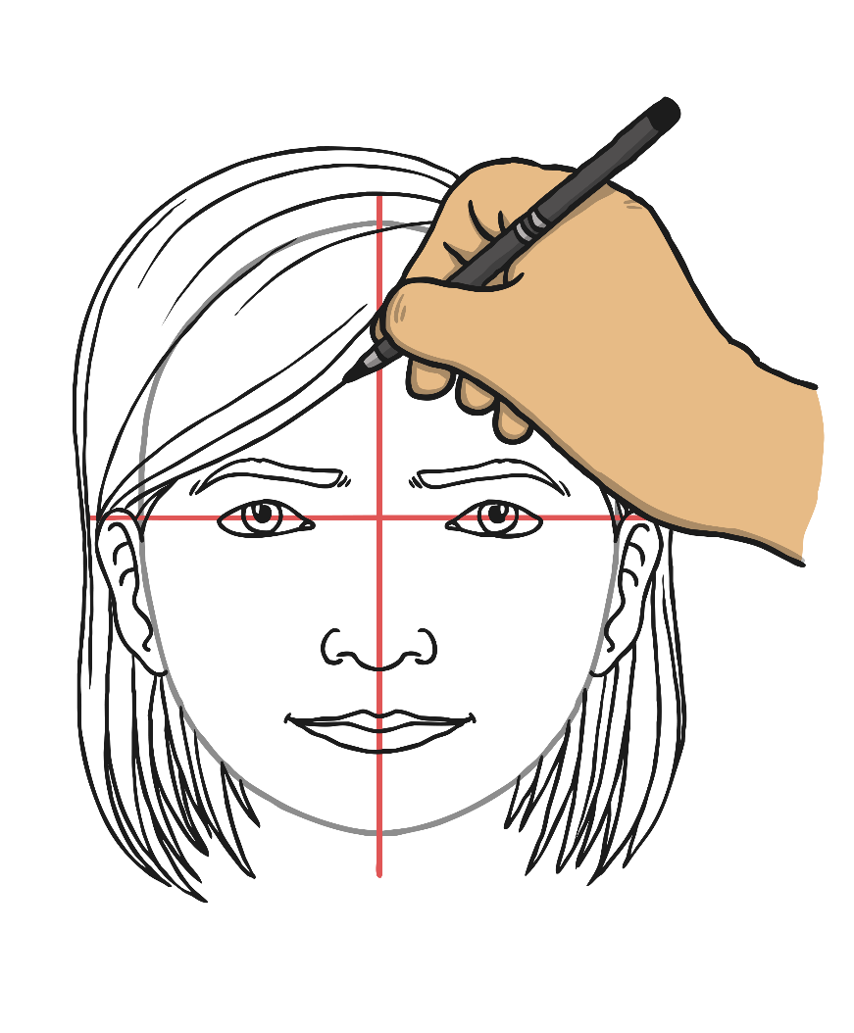
Using the same techniques developed in the last session, draw your self portrait.
Consider your expression and what this reveals about you as a person.
Unlike last week, consider what you will surround yourself with.
What plants and animals represent you and where you are from?
What colours are associated with your culture? Can you represent this through your portrait.

