Slide 1
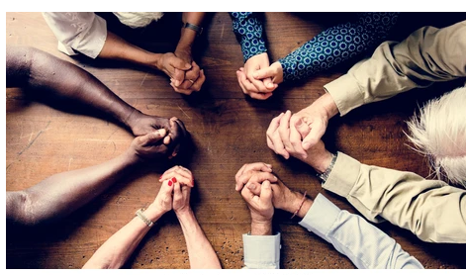
Monday 5th July
LC: Can I explain what religions teach about temptation?

Slide 2
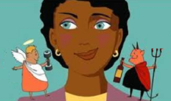
What is temptation?
Temptation is when we feel that we want something or want to do something even though we know we shouldn’t.
For example: I was tempted to eat my friend’s cake even though I knew it was greedy.

Slide 3

There are lots of ancient stories about temptation. Which Greek one, that you learnt about in Year 5, can you remember?

Slide 4
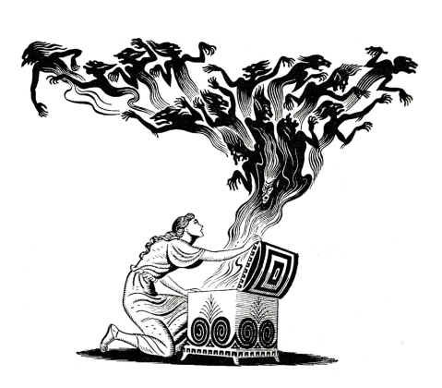
In Greek mythology, the god Zeus gave Pandora a box and told her not to open it. She could not resist the temptation and opened it, letting evil into the world.

Slide 5
Temptation in religions
Stories of temptation are found many religions, including of Judaism, Christianity and Islam. Today we are going to look at two of these
In fact the story that involves the first people in the Bible and Quran is a story of temptation:
the story of Adam and Eve.

Slide 6
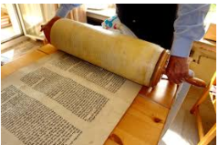
Where is this story from?
The story of Adam and Eve is found in Genesis, the first book of the Jewish holy scripture (The Torah). This is also the first book of the Christian Bible. In the Quran, details of this story are also mentioned, mainly in Surah (chapter) 7.
A Torah Scroll

Slide 7
The story of Adam and Eve from Genesis (adapted)
Narrator God made the whole world and everything in it. He breathed life into the first man (Adam) and woman (Eve). The humans lived in the perfect Garden of Eden. God told them they could eat any fruit there, except the fruit from one tree. One day, Eve was walking near this tree when a snake appeared.
Snake: Why don't you try this tasty fruit?
Eve: God told us not to eat from that tree.
This fruit is so tasty. Even better, if you eat it, you will become wise like God.
Really?
Yes, go on!

Slide 8
The story of Adam and Eve from Genesis (adapted)
Narrator: Eve wanted the fruit so started to eat it.
Adam: Hello Eve, what are you doing?
Eve: Here, try this tasty fruit and you’ll be wise like God.
Adam: Sounds good to me!
Narrator: Obviously God found out that the humans had disobeyed him
Adam: It wasn’t my fault, blame Eve!
Eve: The snake tricked me
Narrator: As a result of disobeying God, the humans had to leave the perfect Garden of Eden and live in a world where there would be pain and suffering.

Slide 9
Questions
They were tempted by the fruit that would make them wise like God.
The snake is normally seen as representing the devil tempting people. This is view of the Quran too.
Temptation is very strong. People are not good at doing what God tells them to do. Temptation separates us from God.
What were Adam and Eve tempted by?
Who does the snake in the story represent?
What does this show us about temptation?

Slide 10
Right from the start of these religions, we see that humans are not good at resisting temptation. There are many more stories in the Bible where people face temptations to do what they want, not what is the right thing.
You are going to look at a story and decide what message it teaches.
Read the story.
Write down in your home learning book what message it give about temptation. For example:
The story of ___ is about ____. ______ is tempted to ________
The message of this story is that ___________.

Slide 11
Choose either this story or the one in dark green writing, two slides ahead. Then answer the questions on the previous slide.
The story of Jonah. (There is a book in the Bible about him and a version if this story is also part of Islam)
Narrator: God wanted the people in a city called Nineveh to stop doing wrong things, so he chose the Prophet Jonah to go and teach them.
Jonah: That sounds like hard and dangerous work. I’m getting out of here!
Narrator: Jonah did not want to do this, so he went to the sea.
Jonah: Excuse me captain, let me come on your ship please.
Ship’s captain: OK.
Narrator: That night there was a storm.
Sailors: We’re going to drown. Why is God punishing us?
Jonah: It’s because I ran away from God. Throw me overboard and the storm will stop.
Sailors: If you say so. God, don’t punish us if he dies. We’re doing what he asked.
Narrator: Jonah did not drown but was swallowed by a huge fish. Inside it, he prayed…
Jonah: Forgive me God! Let me live and I will do what you asked.

Slide 12
The Jonah story (continued)
Narrator: So God sent Noah to Nineveh.
Jonah: People of Nineveh, stop doing what is wrong and God will not punish you.
Ruler of Ninevah: Everyone, you heard what God is telling you. Stop doing what is wrong! Put ashes on your head to show that you have made mistakes and need to do better.
Narrator: Seeing that the city had changed, God forgave them.
Jonah: God, I thought you were going to punish these evil people. It’s not fair
Narrator: God reminded Jonah that the people of Nineveh were God’s not Jonah’s and that he was there to care for them.

Slide 13
This story of Jesus facing temptation is found in the Gospels of the Bible. Read it and answer the questions on slide 9.
To prepare for his life as a prophet, Jesus went to the desert to fast and pray. While he was there the devil came and tempted him.
First the devil tempted him with food saying, that Jesus should use his powers to turn stones into bread. Jesus replied with words from the Bible “You do not live by bread alone but by the words of God.”
Then the devil took Jesus to the top of the temple and told him that he should prove his powers by jumping off and having angels save him. Jesus responded that God’s holy book told people not to set challenges for God.
Finally, the devil took Jesus to a high mountain, from where many kingdoms could be seen. The devil told Jesus that all he had to do to rule them was to worship him. Angrily, Jesus told Satan to leave because only God should be worshipped.
The devil left and angels came to look after Jesus.

Slide 14
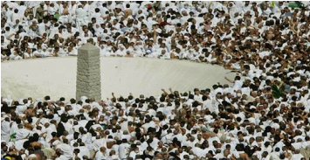
Final Activity
When Muslims go to Mecca on Hajj (pilgrimage) they throw stones at three pillars outside the city. This reminds them of when the prophet Ibrahim resisted the devil by throwing stones at him.
On a piece of scrap paper, write down a temptation that you want to stop. Then place it in the bin, to show that you want to be free from it. Keep it private!

