Slide 2
Learning Outcome
To find out about the Maya Civilisation
Develop knowledge and understanding of world history.

Slide 3
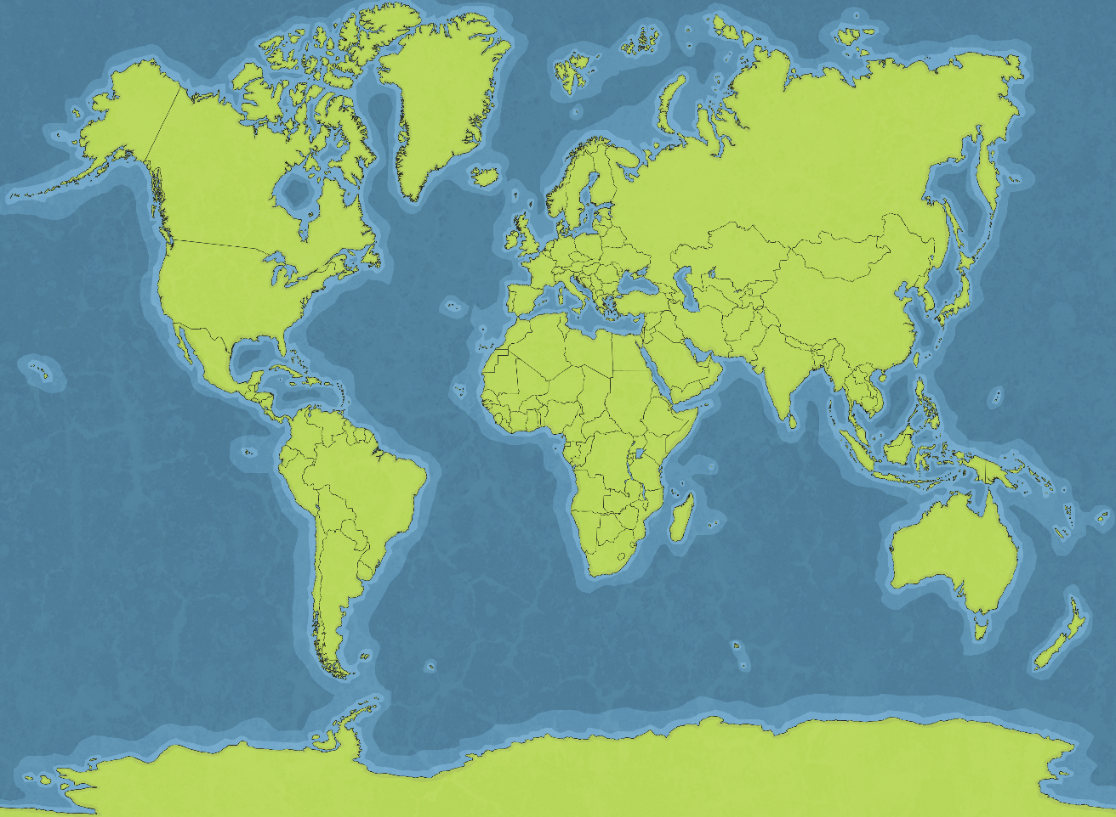
Where did they live?
Mexico & Central America

Slide 4
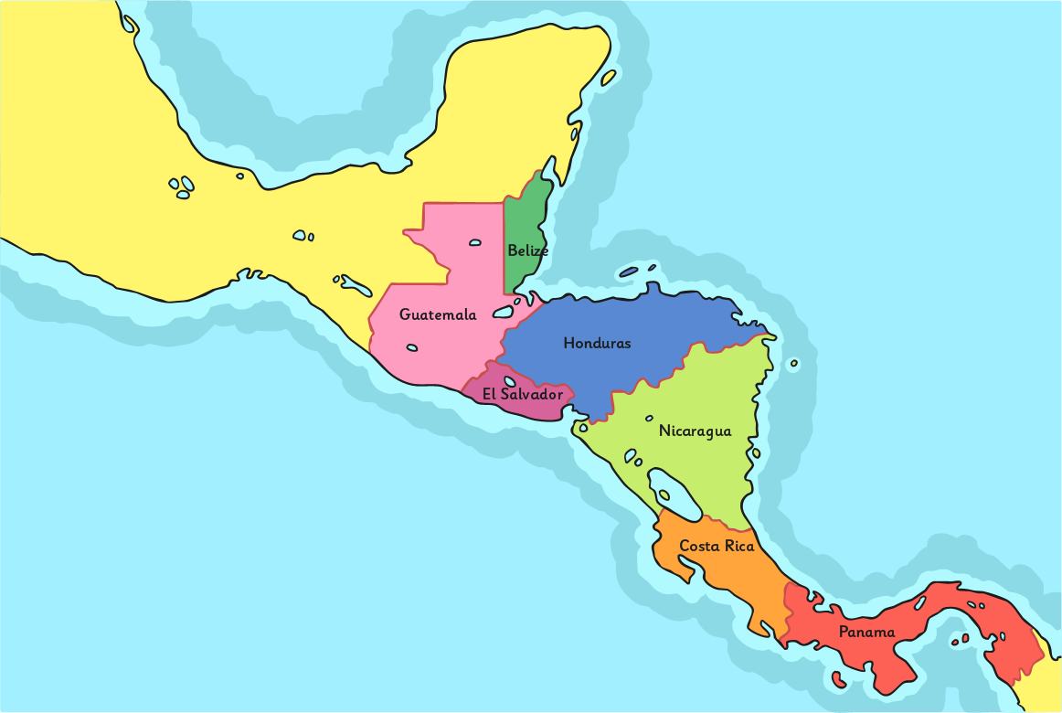
Where did they live?
Yucatán Peninsula of Mexico

Slide 5
Maya or Mayan?
Although it’s possible to find mention of the ‘Mayan’ Civilisation, academics use ‘Maya’ to describe all aspects of the civilisation and people, ‘Mayan’ is used only to describe the language. ‘Maya’ is both singular and plural.

Slide 6
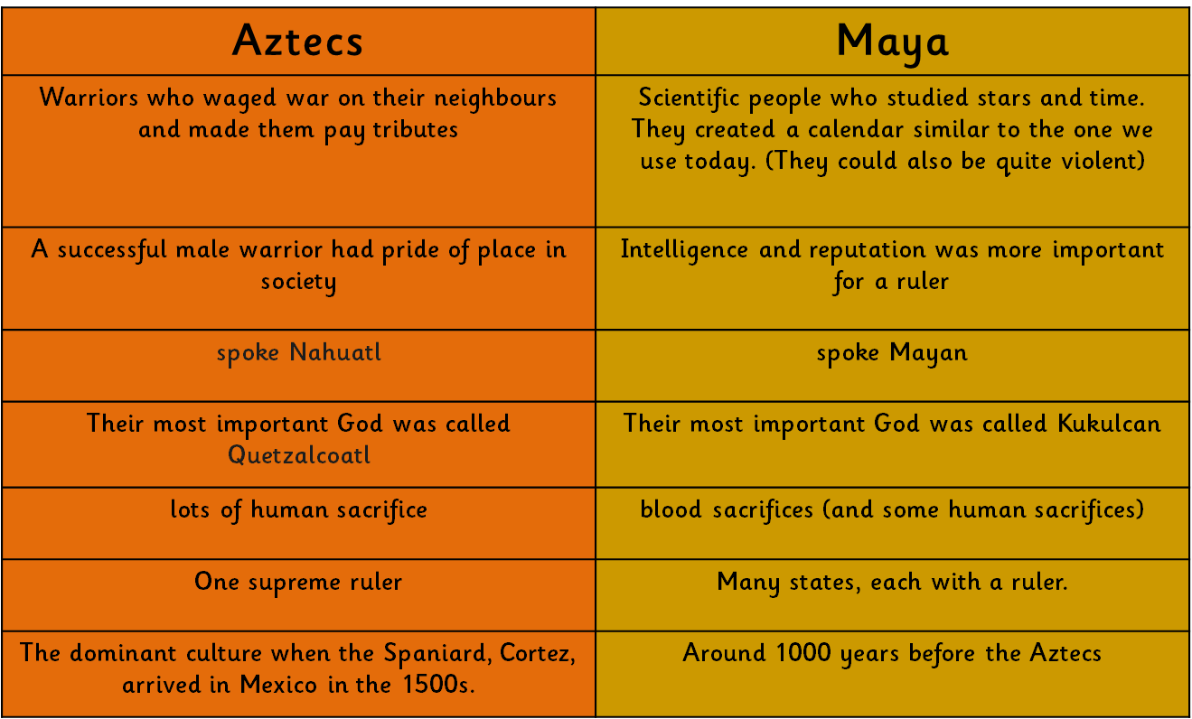
What were the differences between Aztecs and Maya?
Aztecs and Maya are both ancient American civilisations, but there are important differences between them.

Slide 7
When was the Maya Civilisation?
The Maya civilisation came into being around 2000 BC but the Classic Period from around AD 200 onwards was when their cities became large and powerful.
By AD 900 the major cities of Palanque, Tikal and Copan had been mysteriously abandoned. No one knows for sure why. Perhaps they stretched the farming too far, perhaps the climate changed and affected food production, maybe there was an illness that swept through the population.
By AD 1500 the Maya were a long way past their prime and the cities had fallen to ruin.

Slide 8
How do we know about the Maya?
The first Maya ‘lost city in the jungle’ was visited by an American explorer, John Lloyd Stevens, in 1839.
Photography was not established at this time so he travelled with a British artist, Frederick Catherwood, who drew pictures of what they found.

Slide 9
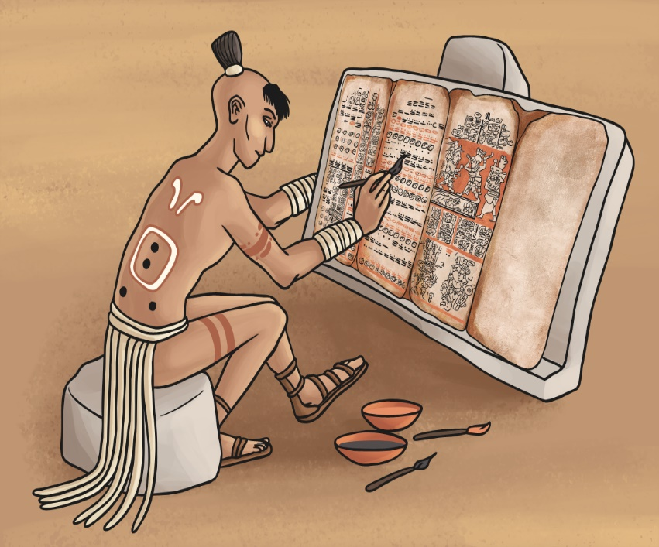
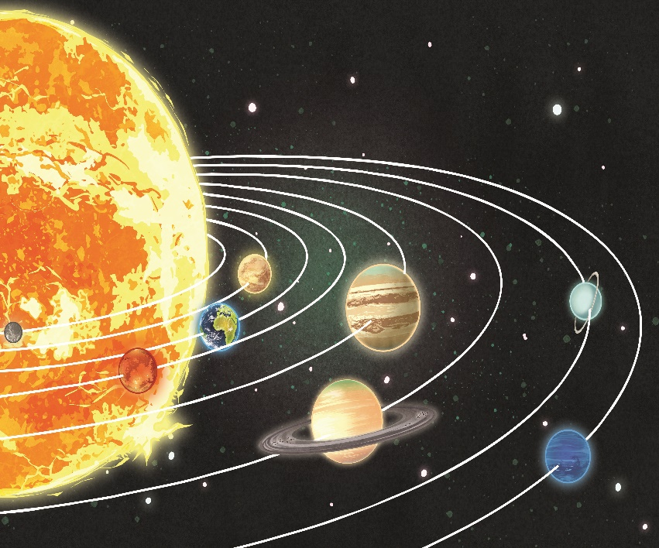
Who were they?
The Mayas were scholars who invented their own system of writing and were skilled astronomers and mathematicians.

Slide 10
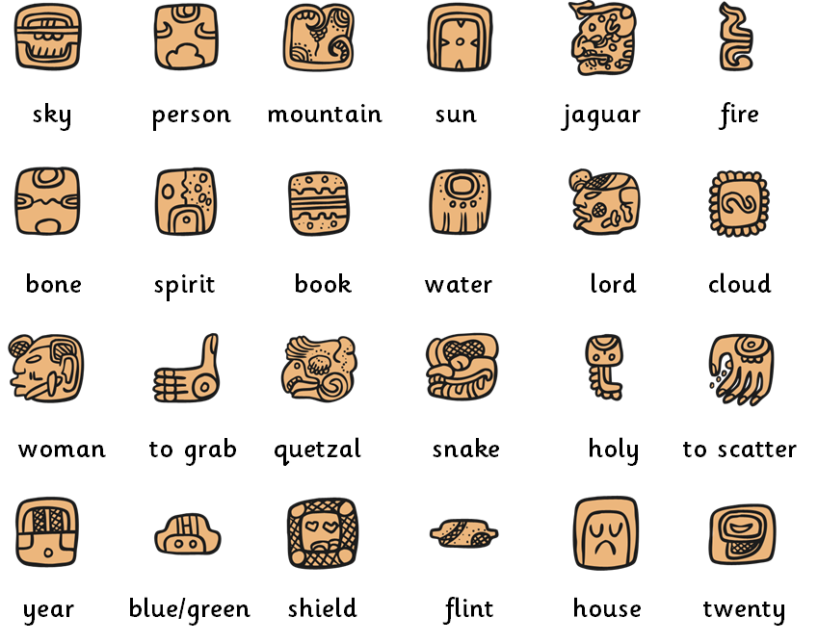
Did they have written communication?
The Maya developed a writing system using a hieroglyphic text, which is a set of picture symbols. They carved on stone or ceramics as well as writing on paper made from the inner bark of certain trees, cloth or animal skin.
The glyphs represent whole words like place names and names of gods, or syllables.
Many syllables could be represented by more than one glyph.
The script was read left to right, top to bottom, like in English, but it was usually written in columns, with a pair of glyphs on each row.

Slide 11
What did their books look like?
A codex was a book made from paper folded concertina style.
There are three important codices that survived which give us important clues about Maya beliefs and their astronomical observations.

Slide 12
Did they follow a calendar?
The Maya were very scientifically minded. They studied the stars and planets and were able to track Venus and Mars with impressive accuracy. They understood the phases of the moon and predicted lunar and solar eclipses. Some of their buildings included observatories and their dramatics temples were aligned specifically in accordance with dramatic features of the heavens at certain times of the year.
They developed a system of counting and recording time that included the concept of zero. They devised a solar calendar that is similar to the one we use today. Aspects of their calendar can also be found in their buildings, for example there are 365 steps on the pyramid temple at Chichen Itza to match the number of days in the year. They had a second calendar with a year of 200 days that was used for religious ceremonies.
Mayan Calendar

Slide 13

How did they count?
The numbers 1-19 are formed in a similar way to Roman Numerals.
= 0
= 1
= 5
Different numbers are made by stacking the lines and lining up the circles on top.
5 circles = a new line.
Can you work out what these numbers would be?
6
13

Slide 14
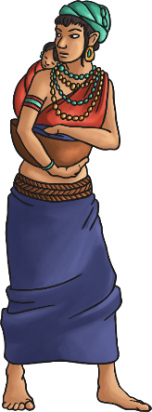
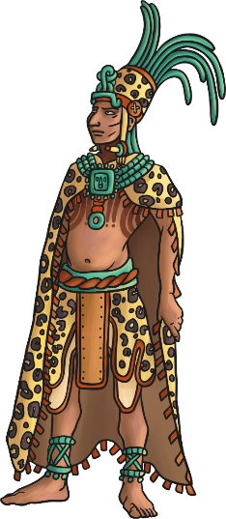
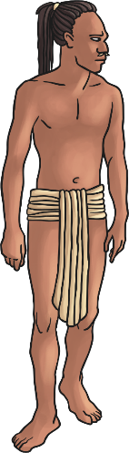
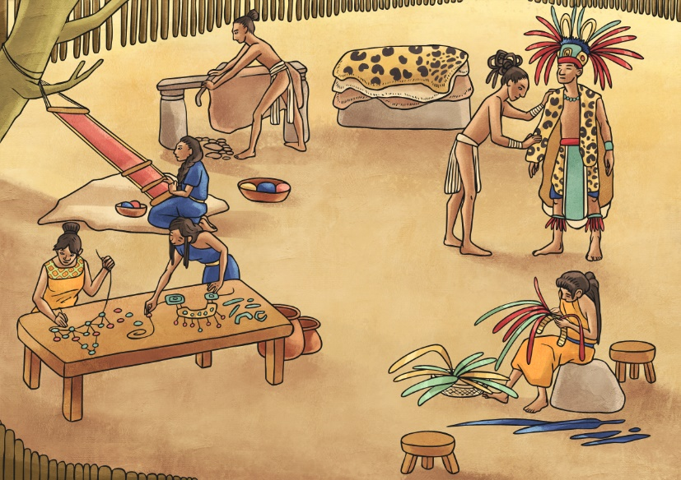
What did they wear?
Men wore a simple loin cloth. If it was cold they also wore a cloak called a ‘manta’.
Women wore simple dresses with little shape. The cloth was made from plant fibres like cotton. Plants were used to make colourful dyes.
A wealthy Maya might wear animal skins and a distinctive headdress decorated with quetzal or macaw feathers. The more important he was, the bigger the headdress!
They made jewellery from jade, a precious stone.
Both men and women grew their hair long and had tattoos.

Slide 15



Was there a ranking system?
the King
the King’s family/ other leaders
There were different levels in society (the size of their headdress was a good clue as to how important someone was).
farmers
slaves

Slide 16
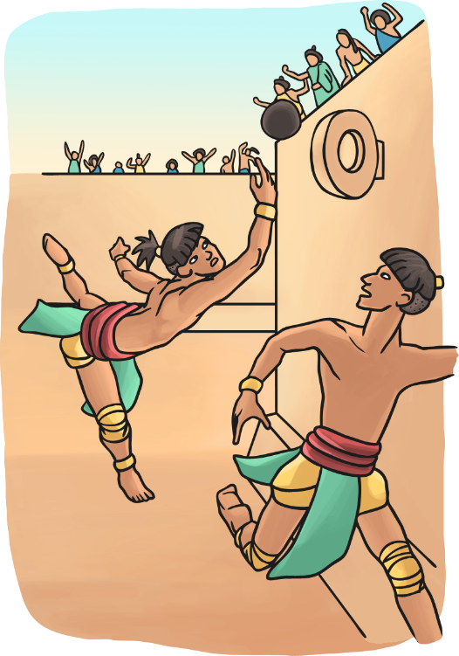
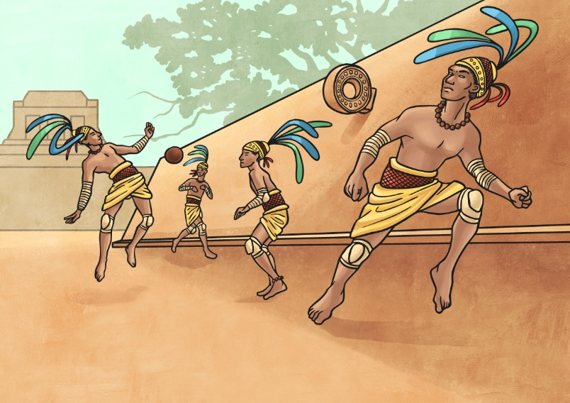
Did they play team games?
The ball game ‘pok a tok’ was played in front of huge crowds.
Players on each team would use their hips, knees and elbows to try and keep the heavy rubber ball in the air and pass it through their stone hoop. They would wear thick padding around their waists and pads on their knees and elbows.
There were thirteen ball courts in Chichen Itza, the largest was almost 150 metres long and the walls were 8 metres high!
Stone carvings show that the game was played to the death!
Teams could be anything from just one player to eleven. The losing person/team was decapitated and sometimes used for human sacrifice.

Slide 17
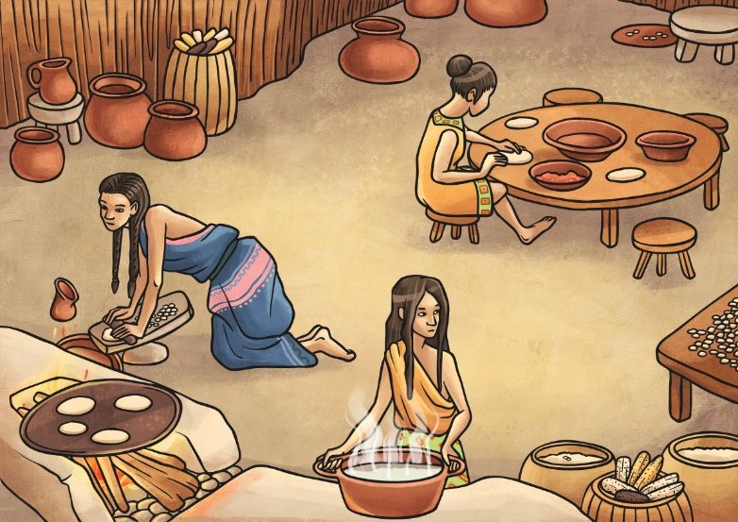
What did they eat?
The Maya developed efficient farming techniques and grew crops like maize, squash, beans and root vegetables.
Maize was a very important crop, it made up 80% of their diet.
The corn from maize was soaked to bring out the grain, rolled into a dough and used to make tortillas, the bread that is still eaten widely today. It could be eaten on its own or used to wrap beans or vegetables.
The maize dough could also be mixed with water and boiled to make a loose porridge called pozole.
It could even be a drink, mixed with water and sweetened with honey.

Slide 18
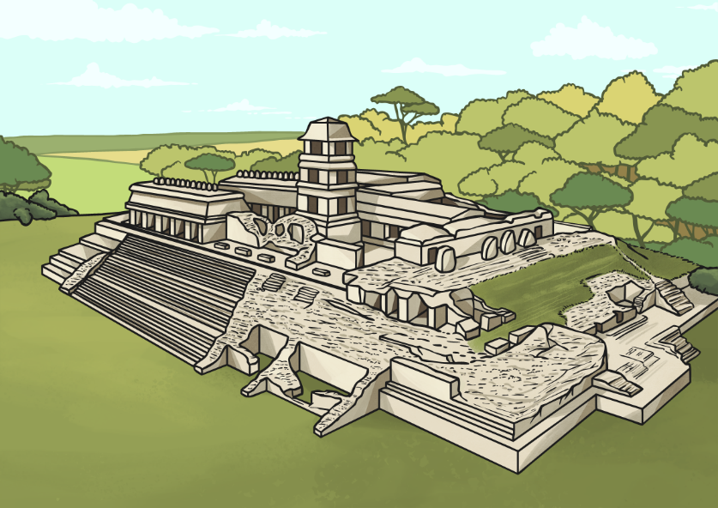
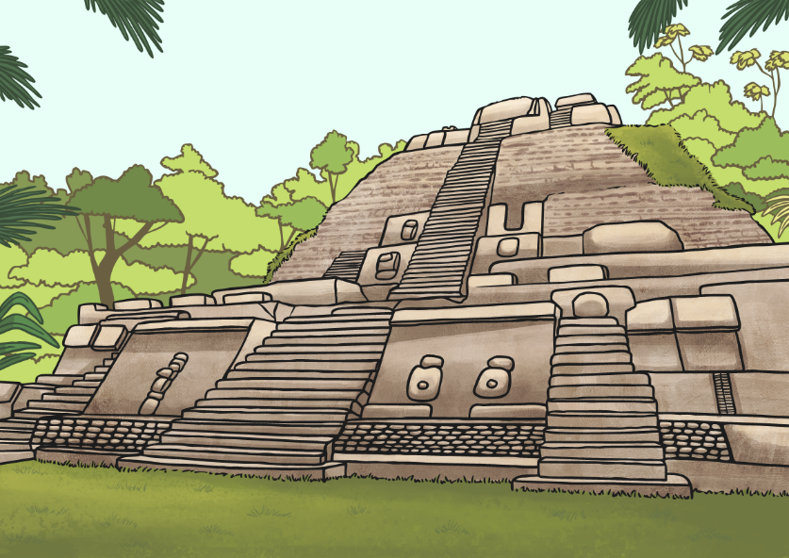
What did their cities look like?
The Maya were the first people to build large cities in America. They included temples, palaces, pyramids. The walls were plastered and sometimes painted red, an important colour to the Maya that had religious significance. Other walls might be decorated with hieroglyphs or paintings of gods.
The main cities discovered include Chichen Itza, Copan, Palenque and Tikal. Each of these cities had the distinctive pyramid shaped temples at the centre with stairs up each face of the pyramid. Shrines were built at the top of these temples. Other temples contained bodies of dead rulers. Each city also had at least one ball court for the very popular game of pok a tok.

Slide 19
What were their homes like?
They lived in simple mud brick houses with thatched roofs, around the outside of the cities.
A typical house would have just one or two rooms and very little furniture. Reed mats were used to sit on and slighter thicker mats would be used to sleep on.
The houses were built on platforms of mud or stone to protect them from floods.

Slide 20
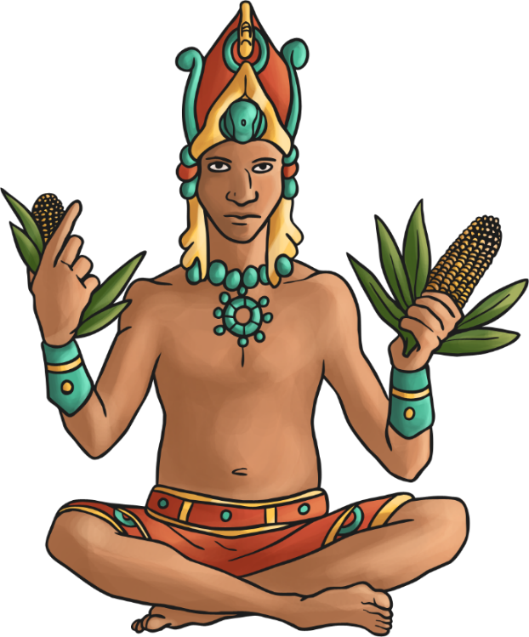
Did they worship gods?
The Maya had over 150 gods. They were mainly gods of nature. Many sacrifices of crops, animals, blood, and even humans (usually prisoners, or men who lost the ball game) were offered to the gods to bring good fortune.
The most important god was the sun god. He went down to the underworld at sunset and became a jaguar god.
The maize god was highly respected as the Maya believed he had the power to control whether crops grew or not.

