Slide 1
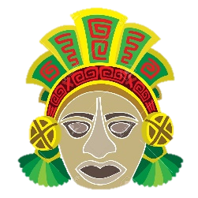
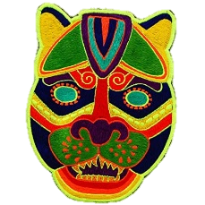
Our Art unit for this half term will link with both our Topic and Science units. We will be exploring South and Central American art to link with our topic on the Maya. We will use this style of art to develop our portrait skills, linking with our Science unit on the body and key question, ‘Can you create a picture of your face using collage?
Week 1 | Can I research an artist?
Week 2 | Can I develop my portrait drawing skills?
Week 3 | Can I create a self-portrait in the style of an artist?
Week 4 | Can I create research Maya masks and design my own?
Week 5 | Can I use different materials to make a collage of my face?
Week 6 | Can I evaluate my work?

Slide 2
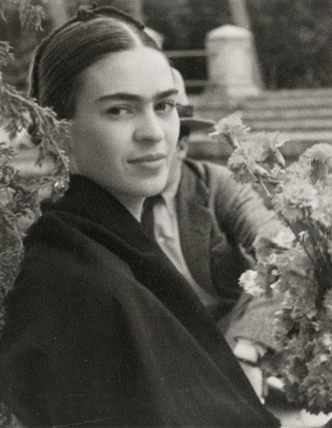
Friday Xth November
LC: Can I develop my portrait drawing skills?
Who is this artist? What do you know about her?
Due to her many injuries and years spent recovering, Frida was able to develop her portrait drawing skills.

Slide 3
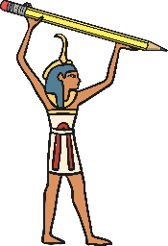
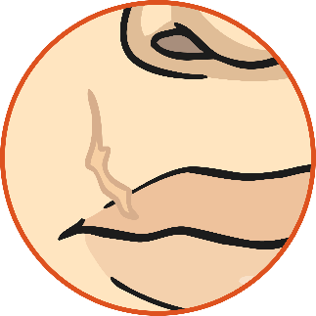
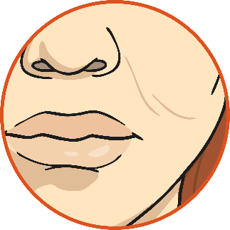
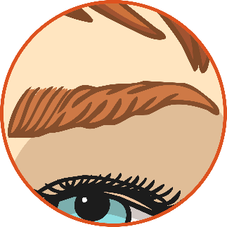
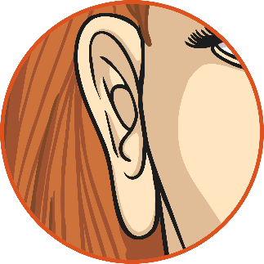
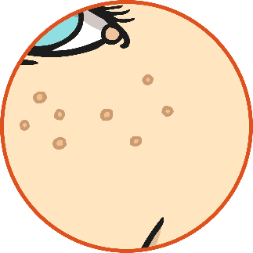
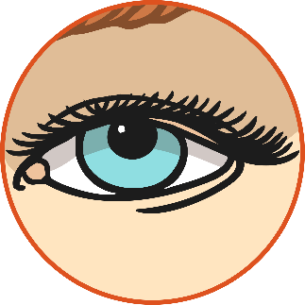
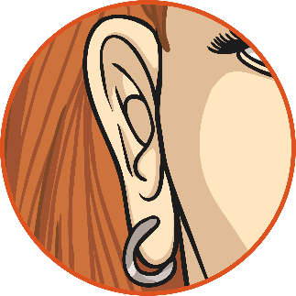
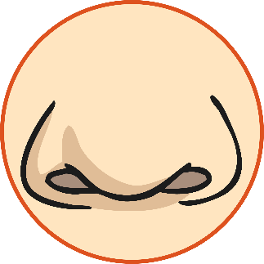
Looking at Faces
Use your mirror to look carefully.
Jot down as many nouns as you can on your whiteboard,
based on what you can see in the mirror e.g. nose…
What can you see in the mirror?

Slide 4
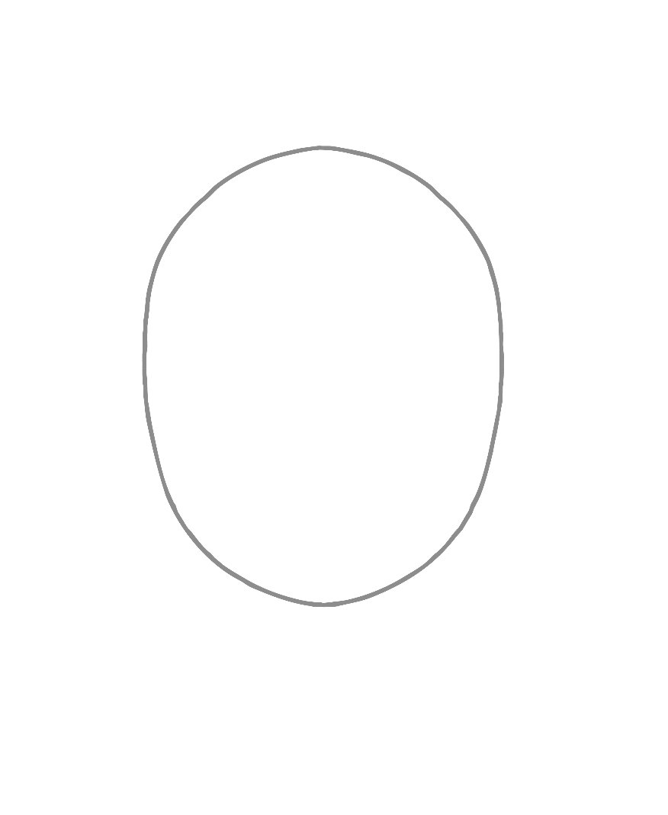
Step 1
Draw a faint oval. You will go back over this later after you have drawn the hair.

Slide 5
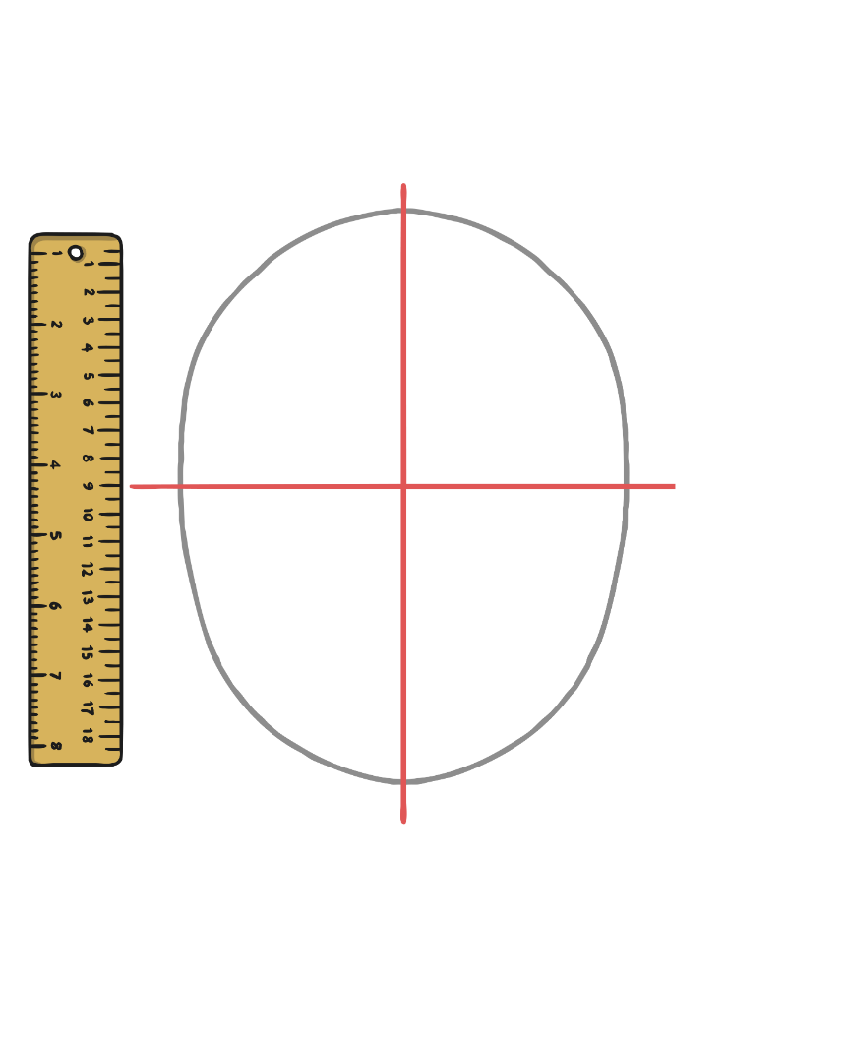
Step 2
Mark some very faint guide lines with a pencil and ruler.

Slide 6
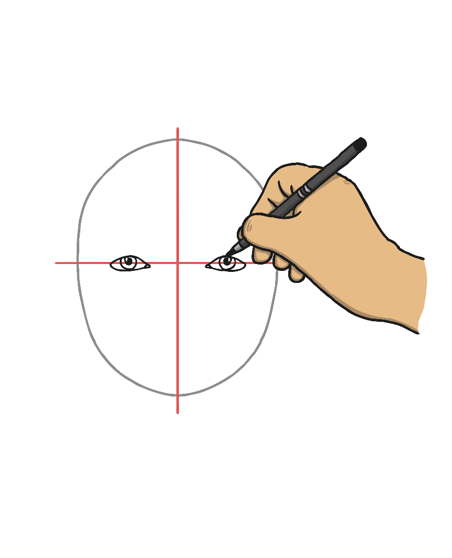
Step 3
Draw the eyes.

Slide 7
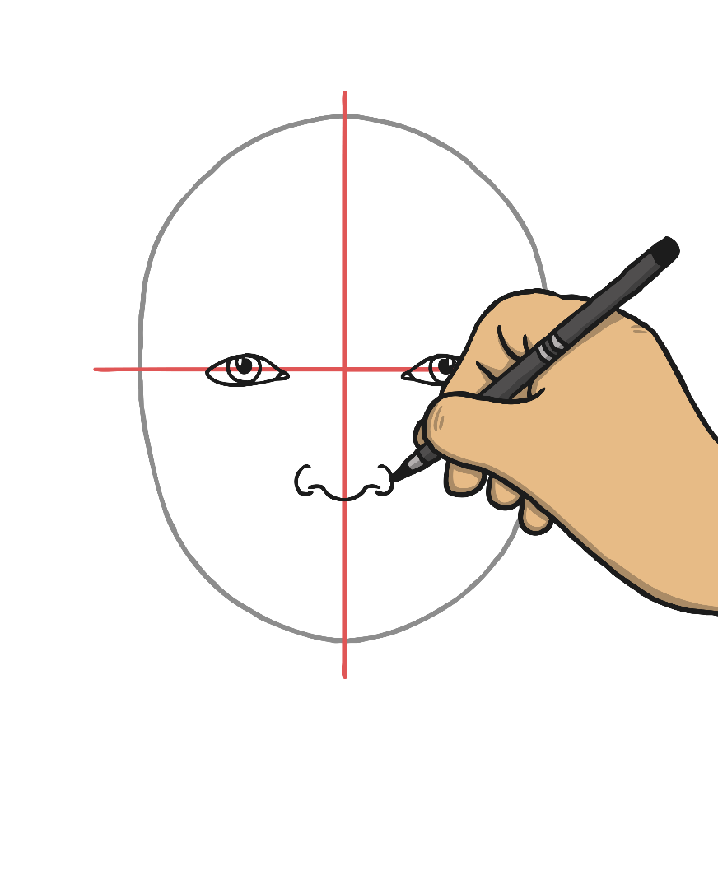
Step 4
Draw the nose.

Slide 8
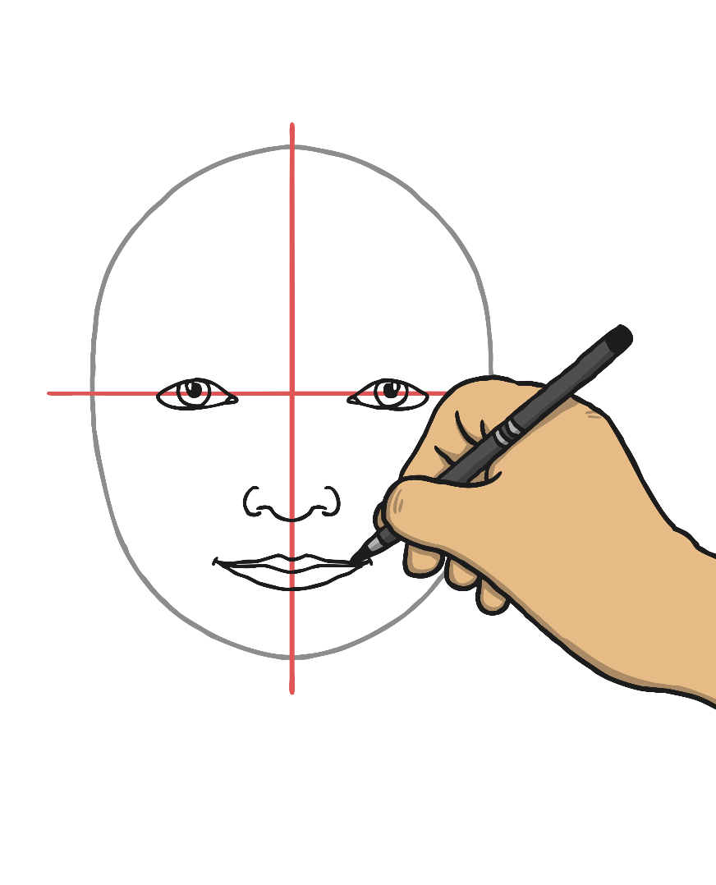
Step 5
Draw the mouth.

Slide 9
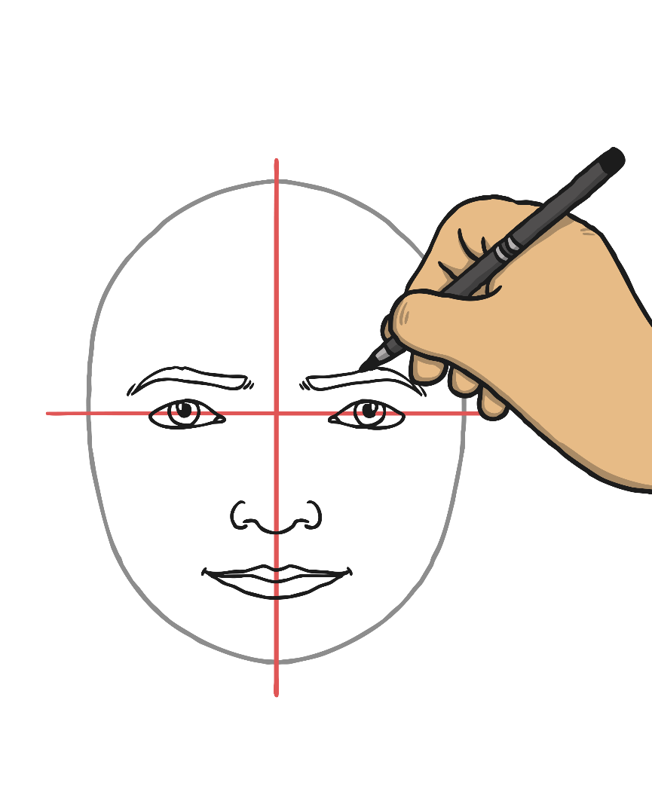
Step 6
Draw the eyebrows.

Slide 10
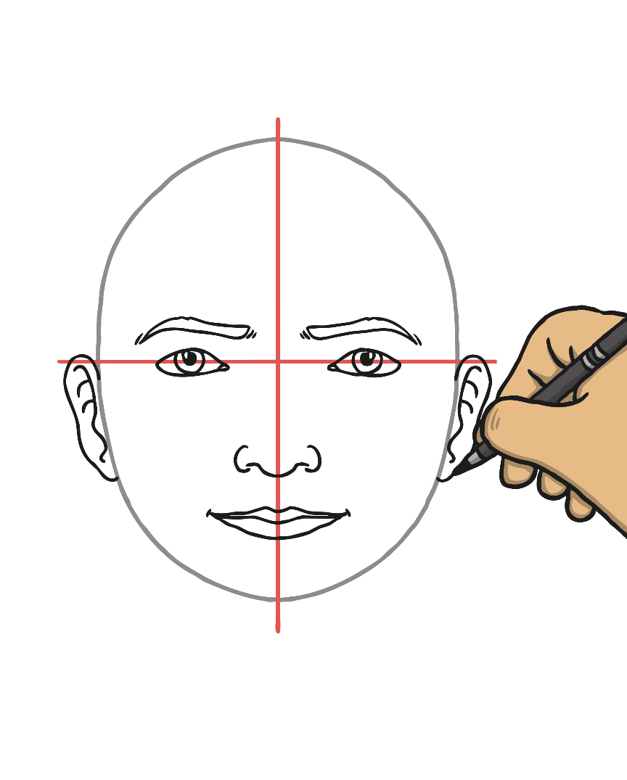
Step 7
Draw the ears.

Slide 11
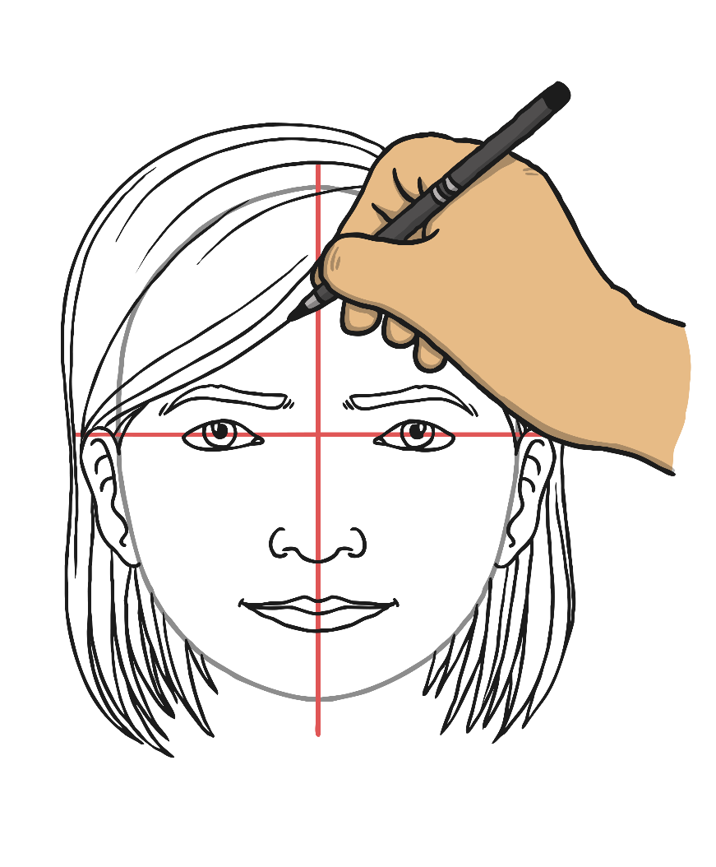
Step 8
Draw the hair.

Slide 12
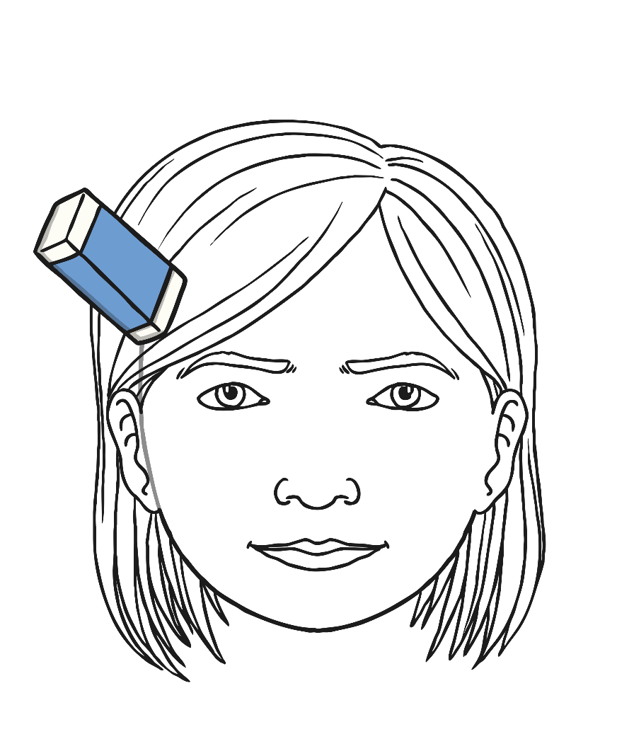
Step 9
Go over the lines of the oval that isn't covered by hair. Erase the faint guide lines and the oval lines that are covered by hair.

