Slide 1
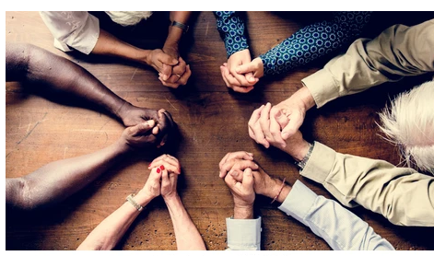
Monday 14th June
LC: Can I compare how different religions use art and objects to help them pray?

Slide 2


TTYP: What do you find most distracting?
I find ____ and _______ most distracting because ___________

Slide 3
Prayer and distractions
When people pray, they want to stay focused on prayer and not be distracted. There are different ways that they do this and different objects that they may use to help them.
We are going to look at some of those objects today.

Slide 4
Objects to help with prayer
Study the objects and discuss how you think they are used.

Slide 5
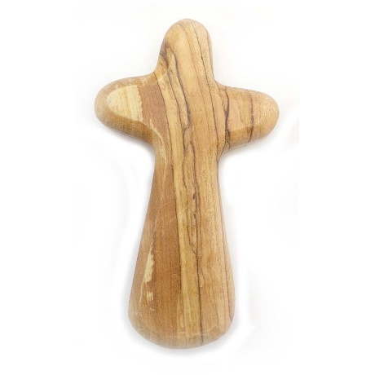
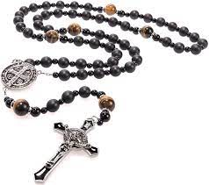
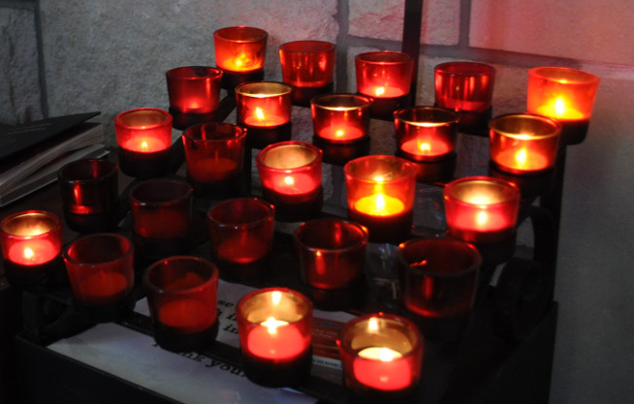
Objects used by some Christians in prayer
Our Father…..
The Lord’s Prayer is a prayer that Jesus taught people to use.
Many Christians focus on a cross to help them to pray. This one made of olive wood is designed to be held in your hands
The rosary is used by Catholic Christians. As well as the cross it has beads. For each bead, you say a different prayer or statement of faith.
Many Christians light a candle and focus on the light as they pray.

Slide 6
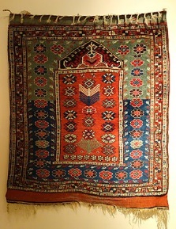
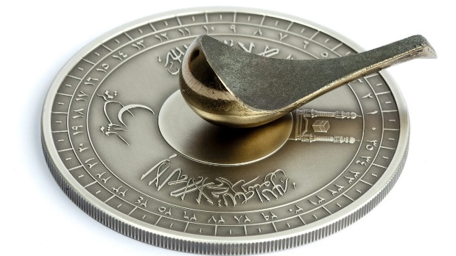
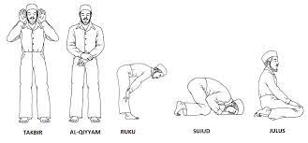
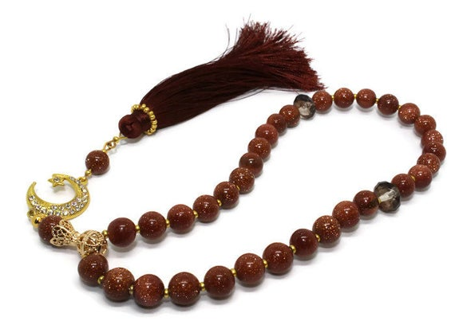
Objects used by some Muslims in prayer
A prayer mat gives Muslims a comfortable space to pray on
Muslims pray facing Mecca. This compass can help you know which direction to face. In England, you need to face south east.
Muslims have movements that they perform during prayer to show respect.
Some Muslims use prayer beads to help them to focus.

Slide 7
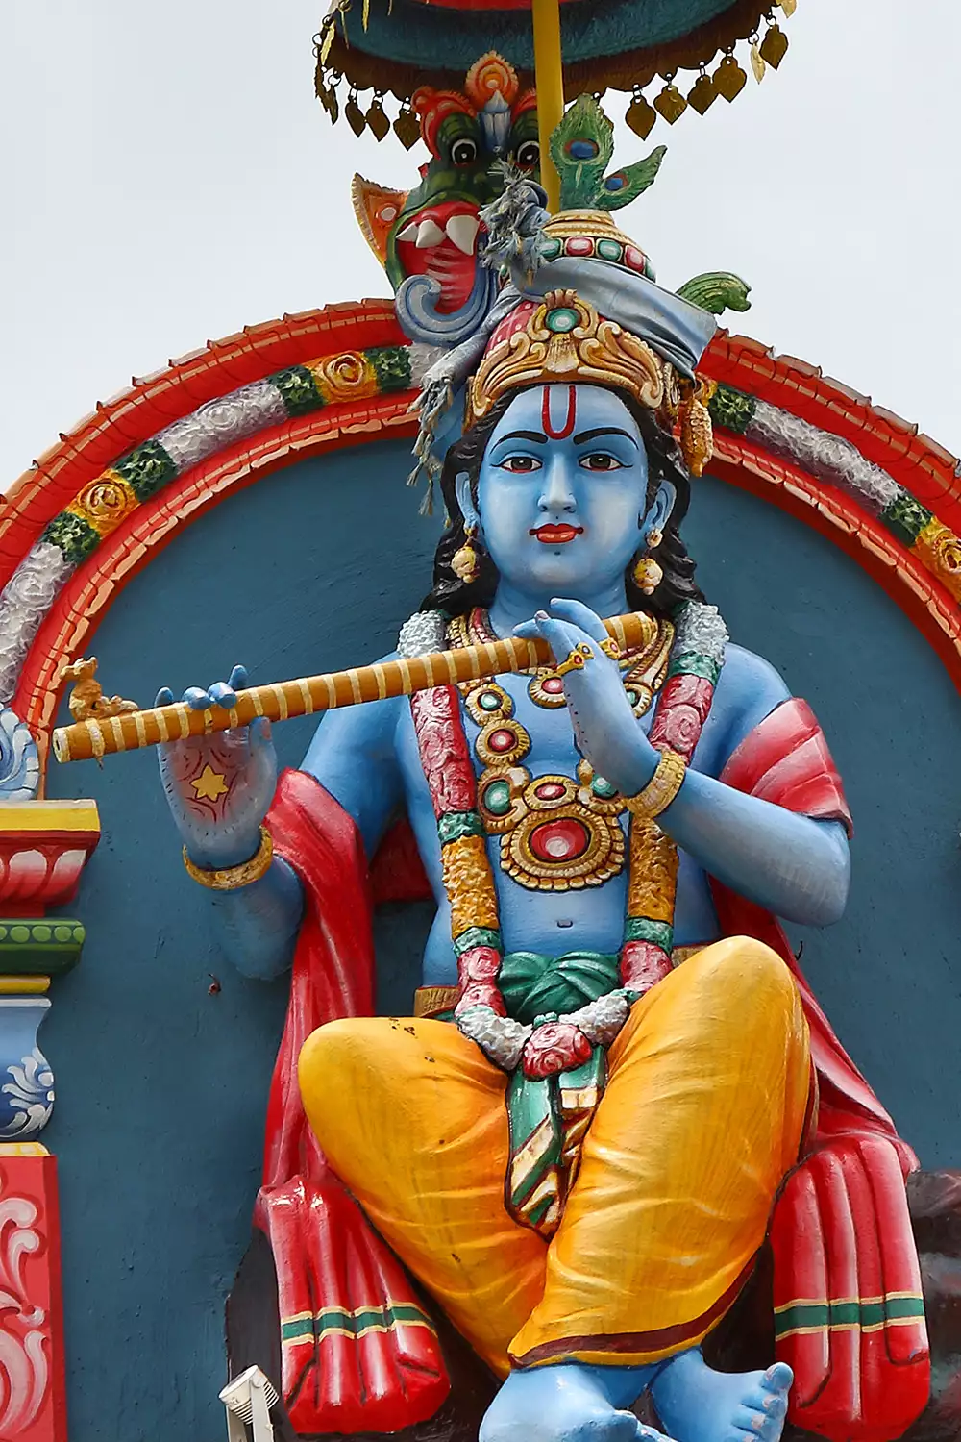
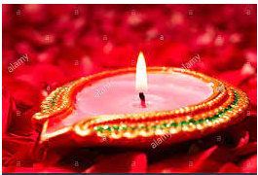
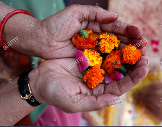
Objects used by some Hindus in prayer
This picture of the god Krishna is used by Hindus to focus when praying.
A diya lamp is used by Hindus, especially at Diwali.
Hindus offer flowers at the temple as part of their prayers.

Slide 8
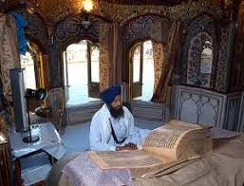
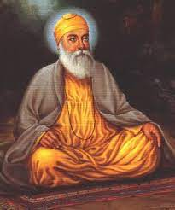
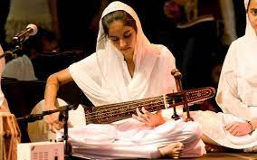
Objects used by some Sikhs in prayer
The Sikh holy book the Guru Granth Sahib contains prayers.
Sikhs do not worship the Gurus. However, they use their images as inspiration for how they should live and pray.
Sikhs pray at home and together in the Gurdwara. When they are at the Gurdwara, music can accompany the prayers.

Slide 9
Writing Task
Write a paragraph to explain the similarities and the differences between the objects. For example:
Both ______ and ________ use these objects.
A ___________ might use a __________ to help them pray but a _____ would not because _______
Muslim Christian Jew Hindu Sikh Buddhist

Slide 10
Plenary
Look at quote by Jesus from the Gospel of Matthew, Chapter 6
“And when you pray, do not be like the hypocrites, for they love to pray standing in the synagogues and on the street corners to be seen by others. Truly I tell you, they have received their reward in full. But when you pray, go into your room, close the door and pray to your Father, who is unseen. Then your Father, who sees what is done in secret, will reward you”.
Do you think it is easier to concentrate on prayer when you are by yourself or when you are in a group of people?
I think it is easier to pray when you are ______ because _____________

